Slide 1
FirePOWER
Replacing your ASA/FTD with Firepower services
Kaustubh Vajarkar
Cisco FirePOWER TAC Engineer

Slide 2
STEPS
Collect important information from existing device
Download installer files for required version
Re-image new device to the required version
Restore configuration
Re-host licenses
Replace device

Slide 3
Collect important information from existing device Download installer files for required version Re-image new device to the required version Restore configuration Re-host licenses Replace device
Collect version information
show module
show version
show asdm image
Collect ASA license information
show activation-key detail
Configuration > ASA FirePOWER Configuration > Licenses and clicking Add New License. (To locate old license key if on-box managed)
Create backup from ASDM
ASA configuration backup
http://www.cisco.com/c/en/us/td/docs/security/asa/asa83/asdm63/configuration_guide/config/admin_swconfig.html#wp1243681

Slide 4
Collect important information from existing device Download installer files for required version Re-image new device to the required version Restore configuration Re-host licenses Replace device
Collect version information
show version
FTD license information
The FTD uses smart license and a token will be required to be downloaded from Cisco Smart Software Manager
Create backup from FTD
Firepower configuration backup if using on-box management
http://www.cisco.com/c/en/us/support/docs/security/asa-5500-x-firepower-services/200448-Configure-Backup-Restore-of-Configurati.html

Slide 5
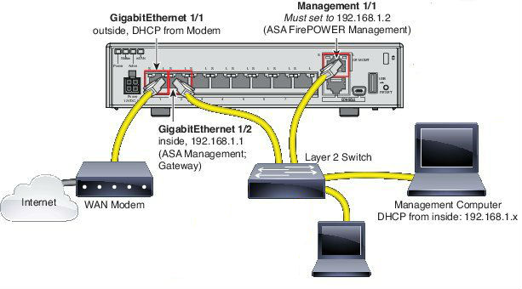
Collect important information from existing device Download installer files for required version Re-image new device to the required version Restore configuration Re-host licenses Replace device
Device cabling

Slide 6
Collect important information from existing device Download installer files for required version Re-image new device to the required version Restore configuration Re-host licenses Replace device
Download link
http://www.cisco.com/go/asa-firepower-sw
Compatibility matrix
http://www.cisco.com/c/en/us/td/docs/security/asa/compatibility/asamatrx.html
ASA
asa953-lfbff-k8.SPA
ASDM
asdm-771.bin
FirePOWER Boot Image
asasfr-5500x-boot-6.1.0-330.img
Firepower Package Installer
asasfr-sys-6.1.0-330.pkg
FTD boot image
ftd-boot-9.6.2.0.lfbff
System software install package
ftd-6.1.0-330.pkg

Slide 7
Collect important information from existing device Download installer files for required version Re-image new device to the required version Restore configuration Re-host licenses Replace device
Install and Configure a FirePOWER Services Module on an ASA Platform
http://www.cisco.com/c/en/us/support/docs/security/asa-firepower-services/118644-configure-firepower-00.html
Reimage the Cisco ASA or Firepower Threat Defense Device
http://www.cisco.com/c/en/us/td/docs/security/firepower/quick_start/reimage/asa-ftd-reimage.html

Slide 8
Collect important information from existing device Download installer files for required version Re-image new device to the required version Restore configuration Re-host licenses Replace device
Install basic configuration on ASA and connect via ASDM
Cisco ASA 5506-X Series Quick Start Guide
http://www.cisco.com/c/en/us/td/docs/security/asa/quick_start/5506X/5506x-quick-start.html
Cisco ASA 5508-X and ASA 5516-X Quick Start Guide
http://www.cisco.com/c/en/us/td/docs/security/asa/quick_start/5508X/5508x-quick-start.html
Restore backup for ASA using ASDM
Restoring Configurations
http://www.cisco.com/c/en/us/td/docs/security/asa/asa83/asdm63/configuration_guide/config/admin_swconfig.html#wp1244402
Restore Firepower module if on-box managed
Provision network settings to Firepower module
ciscoasa# session sfr console
> configure network ipv4 manual ipaddr netmask gw

Slide 9
Collect important information from existing device Download installer files for required version Re-image new device to the required version Restore configuration Re-host licenses Replace device
Assign management IP address on the new FTD
Restore the previously taken backup

Slide 10
Collect important information from existing device Download installer files for required version Re-image new device to the required version Restore configuration Re-host licenses Replace device
Product License Registration
http://www.cisco.com/go/license
FTD uses smart licenses and a token will be required to be downloaded from Cisco Smart Software Manager

Slide 11
Collect important information from existing device Download installer files for required version Re-image new device to the required version Restore configuration Re-host licenses Replace device
Connect cables according to the network diagram
Delete old FirePOWER module/FTD from FirePOWER Management Center GUI
Device > Device management > Delete device.
Add the FirePOWER module/FTD in the new device to the Management Center
> configure manager add fmcIP regkey
Deploy policies to the device
Verify connection events indicating correct functionality of the FirePOWER module.

Slide 12
FirePOWER Kaustubh Vajarkar Cisco FirePOWER TAC Engineer
THANK YOU

