Slide 1
Web Security Service
Secure Anywhere, Anytime Access for Your Users
Clive Gladwin
24.03.2020
Notes:
This presentation covers the key capabilities of WSS, CASB, and Secure Access Cloud, discussing them as a solution to meet our enterprises cloud and web security needs

Slide 2
Terminology
What is a proxy?
More Terminology
Background
Capabilities
Pricing
Q & A

Slide 3
Terminology
  SWG – Secure Web Gateway. This is an industry term.
  ProxySG – Symantec’s Secure Web Gateway
    On Premise
    Public / Private clouds (Google, AWS, Microsoft)
  Proxy – A key component in a Secure Web Gateway
  WSS – Symantec Web Security Service
    A SaaS service based on ProxySG code
“Secure Web gateway solutions protect Web-surfing PCs from infection and enforce company policies. A secure Web gateway is a solution that filters unwanted software/malware from user-initiated Web/Internet traffic and enforces corporate and regulatory policy compliance. These gateways must, at a minimum, include URL filtering, malicious-code detection and filtering, and application controls for popular Web-based applications, such as instant messaging (IM) and Skype. Native or integrated data leak prevention is also increasingly included.” [Gartner]
Notes:
BREAKING NEWS!

Slide 4
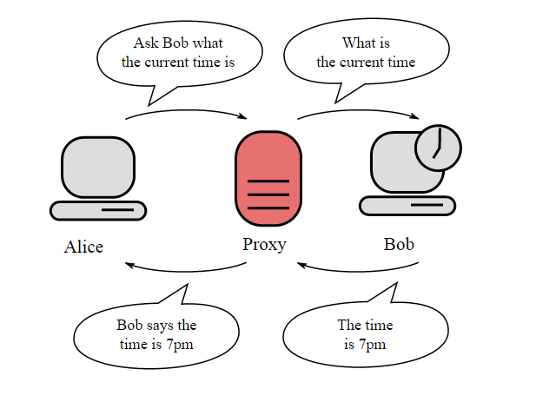




What Is a Proxy?
Key component of a Secure Web Gateway. Symantec products : ProxySG & WSS
Ask Bob what the current time is
PROXY
INSPECT
The time is 7pm
Notes:
Let’s make sure our definitions of what a proxy is and can do align.
Real quickly let’s get a reminder on what a proxy is and what makes it so special in the security space. Here’s the very basic level definition of a proxy, It handles all the communication between two parties.
When you put a proxy between two users (or a user and a server on the internet), you are terminating the connection at the proxy, between the proxy and the user. So in this example, Alice is the user, and asks Bob (who could be a server) for the current time. The request from Alice ends at the proxy. A completely new session is started by the proxy to ask Bob for the current time.
This is what makes a proxy so secure. It doesn’t allow a connection to tunnel or make it through the proxy. It terminates the connections, and waits for entire objects to be assembled at the proxy for inspection. These features allow the proxy to guarantee all objects are inspected, and no evasive techniques can be used to bypass the proxy.

Slide 5
Terminology
  CAS - Content Analysis System
    Blocks known threats, sources and signatures and centrally analyses unknown content. Content Analysis is a sophisticated, multi-layer inspection platform that combines reputation services, white and blacklisting, static code file analysis, machine learning, dual anti-malware signature inspection engines and on-box or cloud sandboxing to protect against known and unknown threats.
  FI – File Inspection. Licence for malware scanning
  ASG - Advanced Security Gateway
    A physical appliance that combines ProxySG with Symantec Content Analysis. With Content Analysis now on the new hardware platform, customers can achieve the same functionality as the ASG Appliances.
  IS/ IS Advanced /BCIS – Intelligence Services
Notes:
BREAKING NEWS!

Slide 6

Traditional Architecture
Security Stack
Headquarters Data Center
Firewall
Secure Web Gateway
Anti-malware
Sandbox
Regional
Office

Slide 7


Evolving Data Attack Surface
Security Stack
Headquarters Data Center
Firewall
Secure Web Gateway
Anti-malware
Sandbox
Regional
Office
Roaming
Users
Personal Devices

Slide 8
Innovation for the Cloud Generation:
Ensuring Safe Cloud Usage
Firewall
Secure Web Gateway
Anti-malware
Sandbox
Headquarters Data Center
Policy
WSS
Regional
Office
Roaming
Users
Personal Devices
IOT Devices

Slide 9
Symantec Web Security Service
PRODUCTS
Enterprise Class Access Security
Headquarters Data Center
Threat Protection, Information Security, & Access Governance
For Remote Sites, Mobile Users, & Data Centers
Regional
Office
Take Remote Sites Safely
“Direct to Net”
Assure a Safe & Responsible Migration to Cloud
Symantec
Web Security
Service (WSS)
Roaming
Users
Extend Web & Cloud
Governance to Mobile

Slide 10




Symantec Web Security Service
Malware Scanning & Analysis
Information
Protection
Cloud delivered ProxySG Secure Web Gateway
Set granular policies to control web usage
Unified policy enforcement (cloud & premise)
Symantec Web Security Service
Market-leading enterprise-class feature set
Deployment
Flexibility
CASB

Slide 11

Symantec Cloud Security
Access
Security
Cloud Apps
(CASB)
SaaS Security
Access
Governance
Information
Security
Threat
Protection
Endpoint
Security
Cloud-Powered & Managed
Public Cloud
Infrastructure
IaaS & PaaS
Notes:
Protect information
Protect users
Compliance
Threat protection
What 3 questions do you they need to ask the competitors…
These cloud vendors have built to a 2014 model – the focused model; we’re building to a 2020 model

Slide 12




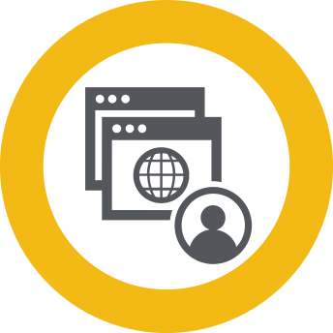










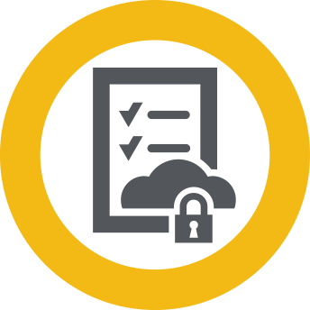
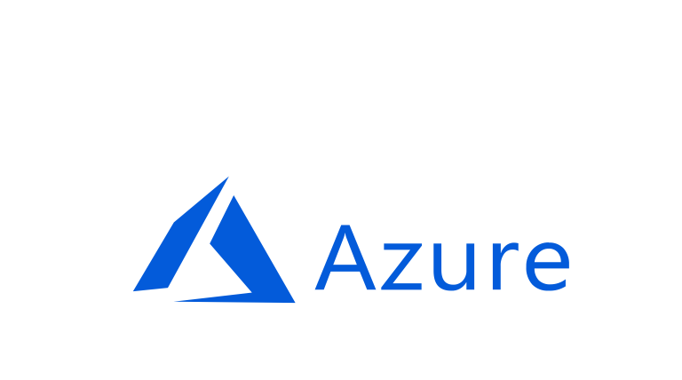
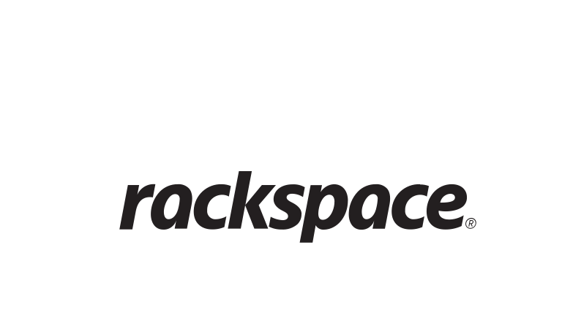



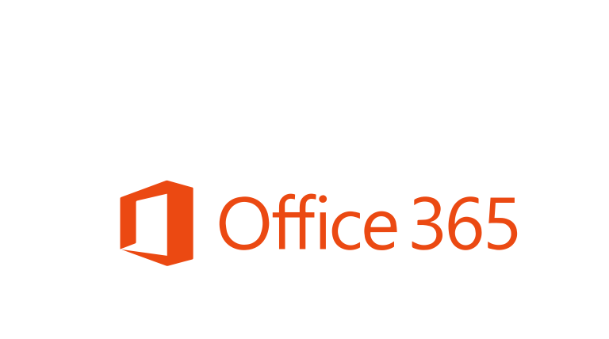


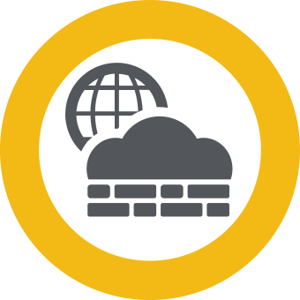
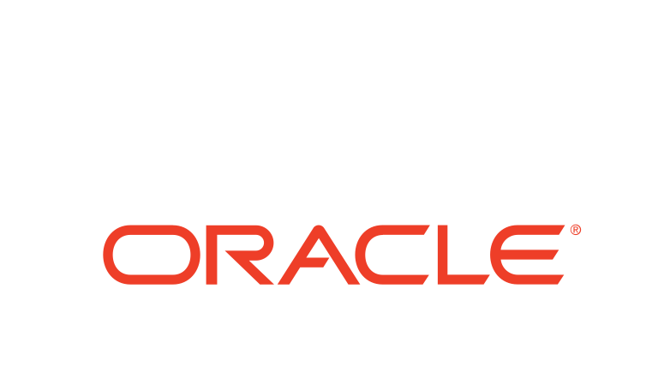
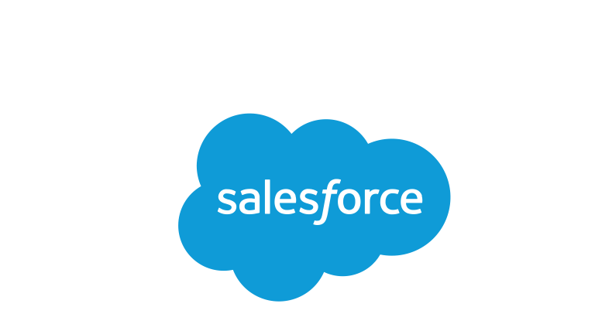

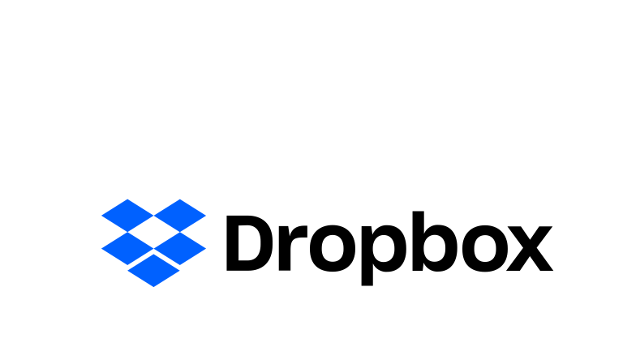




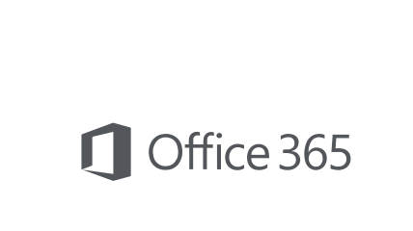




The Symantec SASE Framework
De-Risk Your Secure Access and Reduce Costs
ProxySG
Headquarters
w/ Data Center
Internet
Remote Browser Isolation
Explicit or Proxy Fwd
File Extraction
& Inspection
DLP Inspect & Enforce
NGFW
Cloud Visibility
& Control (CASB)
Private Data Center
Regional
Offices
SD-WAN Connect
Secure SSL Decrypt
URL / Content / Application Categorization
IPSec or B/W
Advanced Malware
Analysis Service (Sandbox)
SEP/Agent
Authentication
Cloud Firewall Service
Roaming
Users
SEP
Connection
Services
WSS Inspect Before Delivery
Advanced Security Services
Accelerated
Cloud Backbone
Telco POP
Backbone
Bandwidth Enforcement
Automate Policy &
Content Acceleration
Elastic Cloud
SVC Structure
Content Peering &
Connection Scaling
3rd Party
Monitoring
WSS Agent
Secure Access Cloud (ZTNA)
Notes:
I have talked about our Web Security Service, so lets spend a moment on it
It is our cloud network security backbone - at the edge – for a distributed workforce
Since most customers send all of their user traffic through it – I consider this solution to be an ISP coupled with advanced Security stack for the traffic
ISP - All of the network requirements - low latency, in-country experience, global POPs, auto-scale, SLA, uptime
- And the security stack requirements – efficacy, policy management, visibility, thread detection and prevention
And that distinction is important – as I will discuss later in the presentation
SWG proxy at the core…authenticates, terminates traffic for inspection, applies fine-grained policy for acceptable use and security including SSL/TLS inspection
Web Isolation to prevent malware targeting your user’s emails and web browsing (% of web traffic increases, so will the importance of Web Isolation)
Integrated Data Loss Protection (DLP) for information security policy enforcement
Cloud Access Security Broker (CASB) controls to ensure your use of cloud apps is secure and compliant, Report Shadow IT
This platform also includes our industry leading URL and Content categorization and risk data feeds
Advanced Malware analysis w/ Sandboxing to secure file downloads
Our Cloud Firewall Service allows you to control and secure non-web traffic.
End users can use SEP and SEP mobile, with their endpoint protection, to access WSS
End users can also use the WSS Agent, which provides all-ports/all-protocols to WSS and thus is a great combination for the CFS
On a side note – we do have plans to consolidate our agents
Certification with SD-WAN partners who can simplify your branch connectivity into the cloud.
In the SASE model, Gartner recommends partnering with multiple SD-WAN vendors, as each customer will choose to use their preferred SD-WAN
.
Couple of points
Customer transformation - PRoxySG on-Prem, then proxy forward to WSS, unify policy, then connect BO to WSS Direct to NET, a…
BRCM – Google partnership
Migrating our WSS cloud operations from co-lo to GCP
Very positive impact - site installation, onboard WFH, sets the state for our next gen service

Slide 13











WSS: Effective File Inspection for Threat Protection
Stops malware targeting your users
Extract files and inspect before delivery
Pre-filter to improve detection and reduce sandbox load
Add sandboxing (Malware Analysis Service)
Update to GIN to inform other devices
ADVANCED
MACHINE LEARNING
WHITELIST
BLACKLIST
AV1
AV2
SANDBOX
WSS Proxy
Content
Analysis
Endpoints
Web Security Service
GIN
SEP
Notes:
Lets look at content scanning – inspecting files being downloaded for threats
Proxy fully terminates the traffic, extracts files and inspects prior to delivery; this is different than a firewall, which passively scans traffic as it flows by
Files are extracted and inspected before delivery
Pre-filtering through white-list/lack-list, Symantec Advanced Machine Learning with dual AV to improve detection and pre-filter anything before traffic would be sent to our cloud sandbox for detonation/analysis to prevent zero day threats
Finally, as part of out ICD story, anything the we find is updated to the GIN. If customers are using us on the endpoint, SEP Manager will be made aware of the new malware just discovered in the network, Orchestrate to remediate on the endpoint

Slide 14


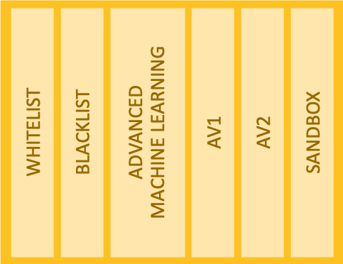



















Isolate the Web to Stop Threats
Isolate uncategorized/risky sites
Secure browsing of privileged users
Embedded Email URLs (phishing)
Evaluate and pilot a remote browser solution…as one of the most significant ways an enterprise can reduce the ability of web-based attacks on users to cause damage.
Web Security Service
CONTENT
ANALYSIS
DOWNLOAD
EXECUTE
RENDER
101010011010
100101001010110100110010101
011110
100% SAFE
RENDERING
INFORMATION
Secure Disposable Container
PROXY
WEB ISOLATION
Notes:
The only way to truly stop this class of threats is through Web Isolation
With Proxy, you can set policies to isolate web traffic; typical scenarios we see are
Selective Isolation - Isolate uncategorized/risky sites
Full Isolation of a Subset of users - Secure web browsing of privileged users like C-Level Execs, System Admins, Etc.
Isolating URL’s launched from Emails (which may be used in a phishing attack)
Web Isolation eliminates all threats of malware infections by executing web content remotely, away from endpoint devices, and sending only safe rendering information to users’ browsers. It solves the challenges that IT Security teams face from uncategorized and risky websites. It enables them to stop over-blocking the web and avoid operational overhead from support tickets requesting access to blocked sites. With Web Isolation employees enjoy secure broad web access and along with a seamless and transparent user experience.
As I’ll show you in a demo in a little while, you can also isolate and view documents in a browser, and hand to Content Analysis for threat scanning of a document if it needs to be downloaded.

Slide 15







Cloud Firewall Service
Securing All Internet Traffic
Secure all internet traffic for internet breakouts in remote offices & branches
  Proxy Service: Web/Cloud App traffic gets deep proxy-based inspection & controls across all ports
  Cloud Firewall Service: Access and use controls for remaining internet
Web Traffic
Proxy
Regional
Office
Cloud Firewall
Mobile
Workers
Non-Web Traffic
Non-Web
Symantec Web Security Service
Improved Security & Performance
  Uniform policies follow your users
  No backhaul to corporate datacenters
Reduced Cost & Complexity
  Enables a secure “direct-to-internet” approach for branch offices
Full Visibility
  Centralized logging & reporting

Slide 16
Licensing
WSS base service is licenced per user per year on a subscription basis. SKU : CLD-WEB-SUB
Add-ons
Cloud Firewall Service | Meter | Term | Note
CLD-CFSS-SUB | Subscription : Per user | 1 year | Cannot be purchased without WSS
CLD-CFSA-SUB | Subscription : Per user | 1 year | Cannot be purchased without WSS
DLP Connector
DLP-CDS-WSS-SUB | Subscription : Per user | 1 year | Cannot be purchased without WSS. Need DLP too.
REFER to the speaker notes for details about the Cloud Firewall Service Standard and Advanced editions.
Notes:
What are the differences between CFS Standard and Advanced?
Cloud Firewall Service Standard license includes policy based on:
• Source - Deployment type, IPsec location, and/or internal IP subnets
• User/Group from identification or authentication to WSS
• Destination - IP address or domain/hostname
• Services - defined TCP/UDP ports
As well as logging and reporting on any traffic flows blocked by the CFS policy.
CFS Advanced includes the full Standard feature set, logging of all flows, and Deep-Packet-Inspection based
application/protocol policy.

Slide 17
Add-ons
Full Web Isolation | Meter | Term | Notes
CLD-NEW-FWI-1-99-1Y | Per user/per year | 1 Year | Still using old style SKUS
Selective Web Isolation | Meter | Term | Notes
CLD-NEW-SWI-1-99-1Y | Per user/per year | 1 Year | Still using old style SKUS
Notes:
What are the differences between CFS Standard and Advanced?
Cloud Firewall Service Standard license includes policy based on:
• Source - Deployment type, IPsec location, and/or internal IP subnets
• User/Group from identification or authentication to WSS
• Destination - IP address or domain/hostname
• Services - defined TCP/UDP ports
As well as logging and reporting on any traffic flows blocked by the CFS policy.
CFS Advanced includes the full Standard feature set, logging of all flows, and Deep-Packet-Inspection based
application/protocol policy.

