Slide 1
Splunk Remote Work Insights

Slide 2
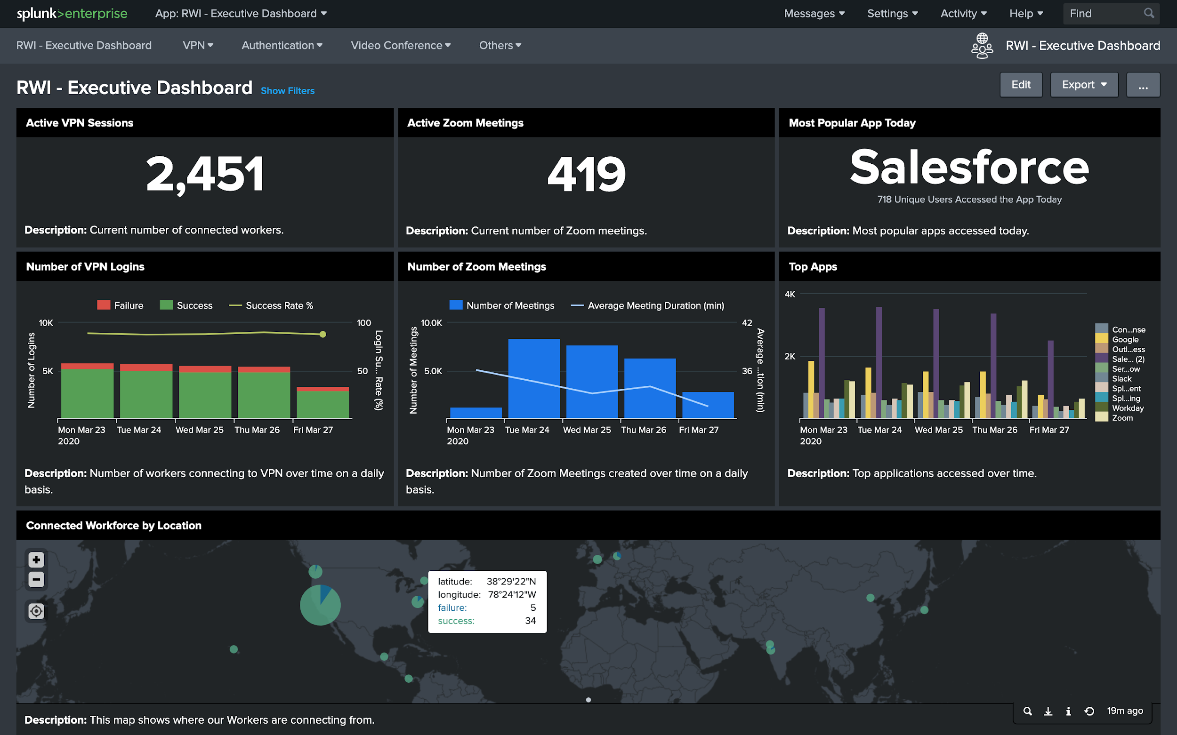
Splunk Remote Work Insights Support for Your Remote Workforce
For customers responding to COVID-19 by moving employees to remote work, Splunk has introduced Remote Work Insights
Empowers IT and Security teams to manage applications and monitor critical business performance from remote locations
Executive dashboard provides views into business operations and employee productivity
Notes:
For customers responding to the current COVID-19 crisis by moving their employees to remote work, we are making available a solution to support you called Remote Work Insights (RWI) to help monitor and secure their remote workforce.
RWI provides real-time visibility across multiple disparate systems, such as VPN, Microsoft 365 and Cloud-based collaboration platforms.
Empowers IT and Security teams to manage application and monitor business performance from remote locations while providing Executive stakeholders views into critical business operations and employee productivity.
This will be available to Splunk customers starting March 31st and will be posted to internal enablement sites as well as the COVID-19 response site on splunk.com.
RWI is available for 90 days (free trial).

Slide 3
Splunk Remote Work Insights
© 2020 SPLUNK INC.
Real-Time Visibility
Across disparate remote systems including VPN, Microsoft 365, and cloud-based collaboration platforms
Available March 31
COVID-19 Response Page on Splunk.com
Frequent Updates
Support for additional remote work systems coming soon
Notes:
This will be available to Splunk customers starting March 31st
And posted to internal enablement sites as well as the COVID-19 response site on splunk.com
RWI is available for 90 days (free trial)
We are planning for OKTA and Zoom support with the next 2-4 weeks.

Slide 4
COVID-19 Response on Splunk.com
Curated collection of apps
TAs
Blogs
Sample Searches
Best Practices
For On-Premises Customers
New RWI Autobahn lane
Curated collection of apps
TAs
Blogs
Sample Searches
Best Practices
For Cloud Customers
Notes:
RWI includes dashboards, TAs and an Autobahn program for the foundation to deploy and deliver meaningful insights in a rapid, scalable way across the entire organization.
For on-premises customers, there is a curated collection of apps (listed on the COVID-19 response page on Splunk.com)
For Cloud customers, there is a new RWI Autobahn lane which includes support for VPN and Microsoft 365 data sources. Additional data sources will be added

Slide 5
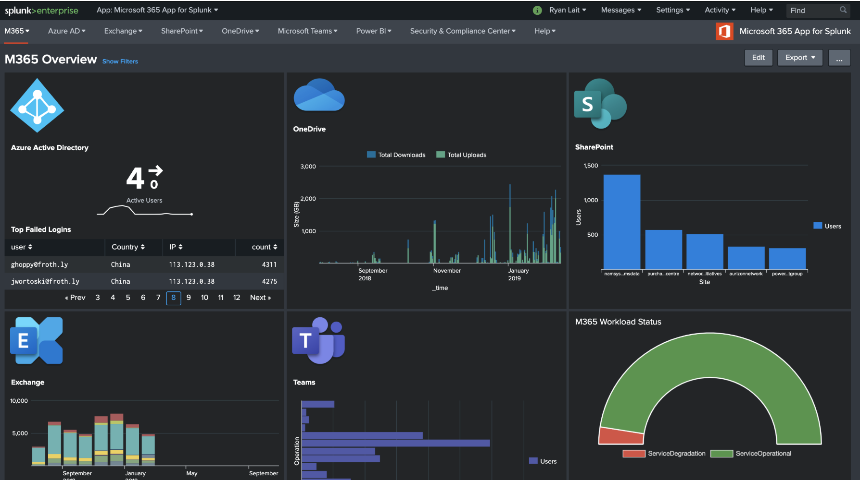
Remote Work Insights Autobahn Cloud-based solution for rapid insights into remote work environments
Receive a free Splunk Cloud instance with RWI capabilities for 90 days
Onboard your data and implement best practices on select use cases
Includes VPN and Microsoft 365 with new use cases added on a regular basis
Contact your Splunk account team to get started
Notes:
Customers receive a free Splunk Cloud instance for a defined period (90 days).
Together we onboard the customers data and implement best practices on select use cases.
Splunk will enable customers to monitor key performance indicators, identify emerging issues and perform deep root cause analysis across a representative subset of the customer’s full environment
RWI Autobahn includes VPN and Microsoft 365 at launch, additional data sources will be added frequently
More information on starting an Autobahn for your customer is located on the FEP, Autobahn page

Slide 6
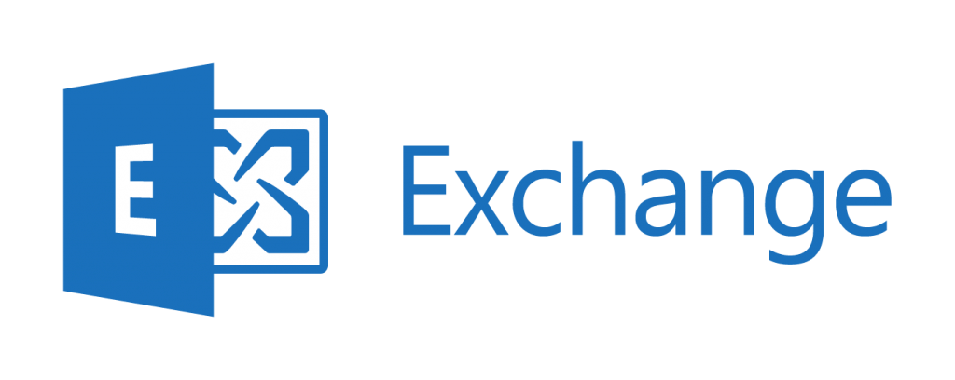
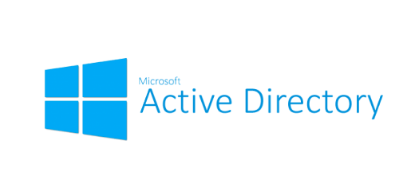
Splunk Remote Work Insights
Solutions Suite
RWI Autobahn
Network Security / VPN’s / Malware Protection
Collaboration with Office 365
Unified Comms / Collaboration (inc VOIP)
Virtualization Containers
MFA / Password managers / SSO
Cloud
Services
Remote Work Insights
Operations and Service Desks
App Performance Monitoring
Productivity Tools
HR Capital Mgmt Systems
Payroll / Finance
Notes:
A range of plugins, templates and full-fledged apps are available to help you collect, analyze and harness data from every layer of your technology stack. Even if you’re using a product that’s not listed here, Splunk still doesn’t limit you – you can still index data from that technology.
Backbone Technologies
VPN
VoIP
Data Backup/Recovery
Network Security
Malware Protection
Unified communications
Supporting Technologies
Cloud computing
Public Networks
Mobile apps
Home Office - laptops, tablets, and printers, BYOD
Management—feedback and communication tools. Project management tools
Productivity— Wellness Connectivity / KPI’s / Timecard?
MFA, Password Managers, SSO
Teams Impacted
IT Operations
Security
Department Heads
HR
Finance
App Dev

Slide 7
Appendix
Includes supported TAs and screenshots
For internal use only

Slide 8
Security RWI Apps/TAs (1 of 2)
https://www.splunk.com/en_us/solutions/covid19-response-overview/covid-19-solutions.htmAl
VPN Session Status, Stats, Client Info
Cisco CESA
App for Cisco ASA
App for Palo Alto Networks and TA
Add-on for Checkpoint Opsec LEA
App for Cisco ISE and TA
Cisco NVM App and TA
FortiGate TA and app
Zscaler TA and app
F5 Access Visibility
TA-Tomato
Data Loss Detection
TA for Symantec DLP
TA for Fidelis and app
TA for Digital Guardian and app
TA for Microsoft Windows
TA for Osquery
Day-Zero Malware & Threat Hunting
TA for Carbon Black and Response app
TA for Crowdstrike Falcon Endpoint and app
TA for Microsoft Windows
TA for Microsoft Sysmon
TA for cmdReporter
TA for Osquery
SA-Investigator
InfoSec App
Zero-Trust Monitoring
TA for Carbon Black and Response app
TA for Crowdstrike Falcon Endpoint and app
TA for Microsoft Windows
TA for Microsoft Sysmon
TA for cmdReporter
TA for Osquery
TA for Okta
Duo Connector
TA for Azure
TA for Salesforce
TA for ServiceNow
InfoSec App

Slide 9
Security RWI Apps/TAs (2 of 2)
https://www.splunk.com/en_us/solutions/covid19-response-overview/covid-19-solutions.htmAl
Unapproved Apps and SaaS Visibility
TA for Carbon Black and Response app
TA for Crowdstrike Falcon Endpoint and app
TA for Microsoft Windows
TA for Microsoft Sysmon
TA for cmdReporter
TA for Osquery
TA for Okta
Duo Connector
TA for Azure
TA for Salesforce
TA for ServiceNow
TA for Proofpoint Email and app
TA for Cisco ESA
TA for Office365
TA for STOQ
TA for Infoblox
InfoSec App
Security Evasion / User Attribution
TA for Carbon Black and Response app
TA for Crowdstrike Falcon Endpoint and app
TA for Microsoft Windows
TA for Microsoft Sysmon
TA for cmdReporter
TA for Osquery
TA for UNIX
Cisco NVM App and TA
TA for Salesforce
TA for ServiceNow
InfoSec App
Asset Inventory
TA for ServiceNow
SA-LDAPsearch
TA for Microsoft Windows
TA for UNIX
Cisco NVM App and TA
App for Palo Alto Networks and TA
Protect Against COVID-19 Risks
TA for Proofpoint Email and app
TA for Cisco ESA
TA for Office365
TA for STOQ
InfoSec App

Slide 10
Virtualized Infrastructure Availability
App for VMware
Add-on for Amazon Web Services
App for VMware NSX-T
Add-on for Citrix NetScaler
Add-on for Cisco UCS
Add-on for VMware
Add-on for Amazon Kinesis Firehose
App for AWS
Add-on for Microsoft Windows
App for Windows Infrastructure
Microsoft 365 App
Microsoft Azure Add-on
Add-on for Microsoft Office 365
Microsoft Cloud Services
Shared Resource Availability and Usage
Microsoft 365 App for Splunk
App for Microsoft Exchange
Add-on for Active Directory
App for Slack
App for Google Suite
Add-On for Microsoft Office 365
Add-on for Microsoft Exchange
Supporting Infrastructure
Splunk App for Infrastructure
Splunk App for AWS
Splunk App for Unix and Linux
Splunk App for Windows Infrastructure
Palo Alto Networks App for Splunk
Splunk Add-on for Amazon Web Services
Splunk Add-on for Amazon Kinesis Firehose
EMC Isilon Add-on for Splunk Enterprise
Dell EMC VMAX Add-on for Splunk
Dell EMC ECS Add-on for Splunk
EMC Isilon App for Splunk Enterprise
Splunk Add-on for Cisco ASA
Splunk Add-on for Cisco Identity Services
Palo Alto Networks Add-on for Splunk
Splunk Add-on for Cisco UCS
Splunk Add-on for F5 BIG-IP
Splunk Add-on for Unix and Linux
Splunk Add-on for Microsoft Windows
Splunk Add-on for Microsoft Systems Ctr
Operations Manager
Splunk DB Connect
Splunk Stream
VPN Infrastructure Monitoring
Cisco CESA
Palo Alto Networks App for Splunk
Splunk App for Okta
Splunk App for Sailpoint
Splunk App for RSA
TA for Cisco ASA
App for Palo Alto Networks and TA
Splunk Add-on for Checkpoint Opsec LEA
App for Cisco ISE and TA
Cisco NVM App and TA
FortiGate TA and app
Zscaler TA and app
F5 Access Visibility
TA-Tomato
IT RWI Apps/TAs
https://www.splunk.com/en_us/solutions/covid19-response-overview/covid-19-solutions.htmAl

Slide 11
Notes:
RWI - Exec dashboard view

Slide 12
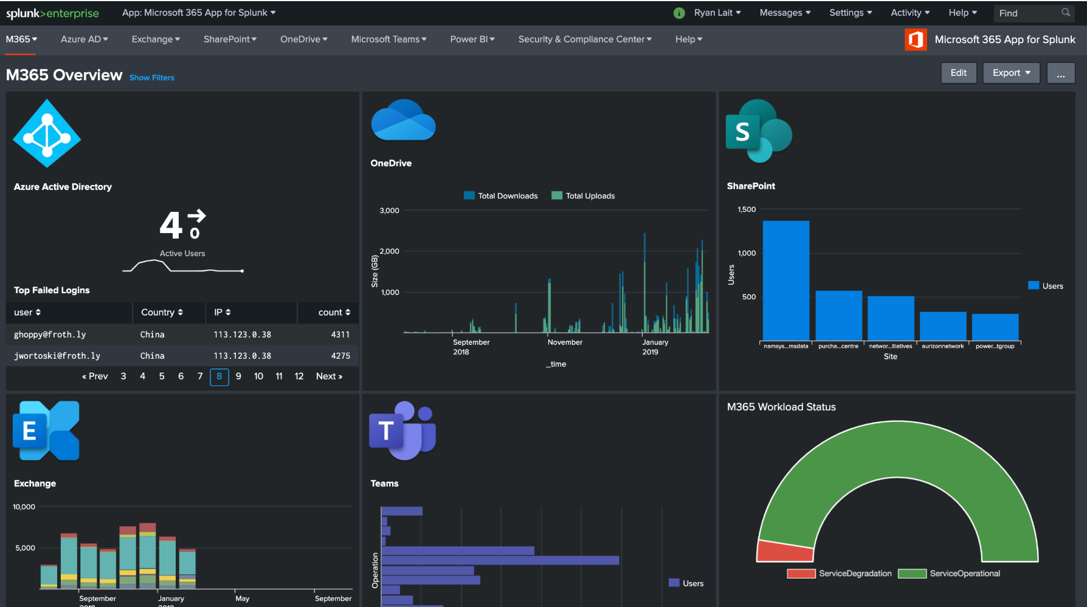
Notes:
RWI - Microsoft 365 Dashboard

Slide 13
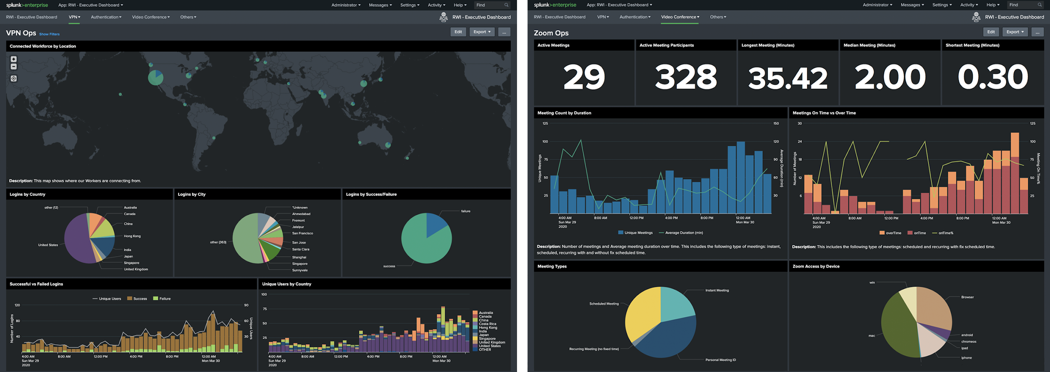
Remote Work Insights - VPN and Zoom

Slide 14
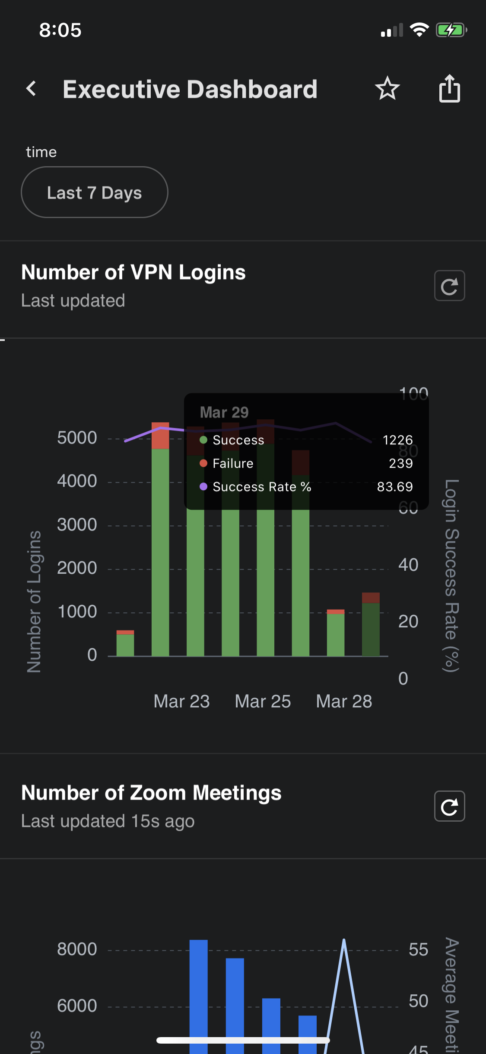
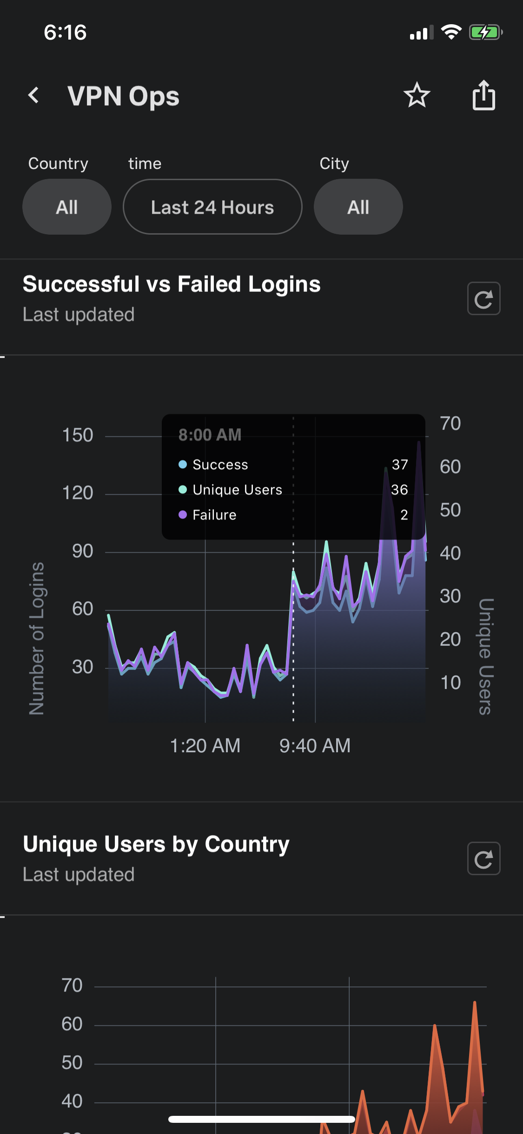
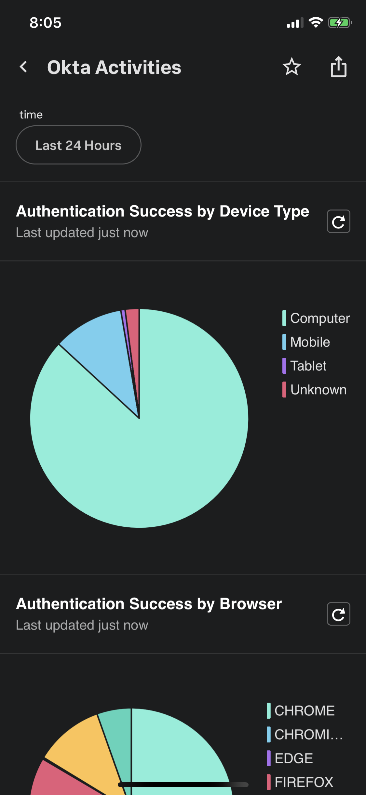
Remote Work Insights - mobile

