Slide 1
Windows® Deployment Services
Infrastructure Planning and Design
Published: February 2008
Updated: July 2010
Notes:
Copyright © 2010 Microsoft Corporation. This documentation is licensed to you under the Creative Commons Attribution License. To view a copy of this license, visit http://creativecommons.org/licenses/by/3.0/us/ or send a letter to Creative Commons, 543 Howard Street, 5th Floor, San Francisco, California, 94105, USA. When using this documentation, provide the following attribution: Infrastructure Planning and Design is provided with permission from Microsoft Corporation.
This documentation is provided to you for informational purposes only, and is provided to you entirely "AS IS". Your use of the documentation cannot be understood as substituting for customized service and information that might be developed by Microsoft Corporation for a particular user based upon that user’s particular environment. To the extent permitted by law, MICROSOFT MAKES NO WARRANTY OF ANY KIND, DISCLAIMS ALL EXPRESS, IMPLIED AND STATUTORY WARRANTIES, AND ASSUMES NO LIABILITY TO YOU FOR ANY DAMAGES OF ANY TYPE IN CONNECTION WITH THESE MATERIALS OR ANY INTELLECTUAL PROPERTY IN THEM.
Microsoft may have patents, patent applications, trademarks, or other intellectual property rights covering subject matter within this documentation. Except as provided in a separate agreement from Microsoft, your use of this document does not give you any license to these patents, trademarks or other intellectual property.
Information in this document, including URL and other Internet website references, is subject to change without notice. Unless otherwise noted, the example companies, organizations, products, domain names, email addresses, logos, people, places and events depicted herein are fictitious.
Microsoft, Active Directory, Hyper-V, SQL Server, Windows, Windows Server, and Windows Vista are either registered trademarks or trademarks of Microsoft Corporation in the United States and/or other countries and regions.
The names of actual companies and products mentioned herein may be the trademarks of their respective owners.
You have no obligation to give Microsoft any suggestions, comments or other feedback (“Feedback”) relating to the documentation. However, if you do provide any Feedback to Microsoft then you provide to Microsoft, without charge, the right to use, share and commercialize your Feedback in any way and for any purpose. You also give to third parties, without charge, any patent rights needed for their products, technologies and services to use or interface with any specific parts of a Microsoft software or service that includes the Feedback. You will not give Feedback that is subject to a license that requires Microsoft to license its software or documentation to third parties because we include your Feedback in them.

Slide 2
What Is IPD? Guidance that clarifies and streamlines the planning and design process for Microsoft® infrastructure technologies
IPD:
Defines decision flow
Describes decisions to be made
Relates decisions and options for the business
Frames additional questions for business understanding
IPD guides are available at www.microsoft.com/ipd
Notes:
Infrastructure Planning and Design (IPD) is a series of planning and design guides created to clarify and streamline the planning and design process for Microsoft® infrastructure technologies.
Each guide in the series addresses a unique infrastructure technology or scenario.
These guides include the following topics:
Defining the technical decision flow (flow chart) through the planning process.
Describing the decisions to be made and the commonly available options to consider in making the decisions.
Relating the decisions and options for the business in terms of cost, complexity, and other characteristics.
Framing the decisions in terms of additional questions for the business to ensure a comprehensive understanding of the appropriate business landscape.
The guides in this series are intended to complement and augment Microsoft product documentation.

Slide 3
Getting Started
Windows Deployment Services
Notes:
This guide was created to enable infrastructure planners to design virtualization infrastructure solutions. This guide includes specific design information, including activities that encourage sound planning.
Each activity includes:
Prerequisites and background on the activity
Tasks that will be performed to complete the activity
Reference information regarding the activity's impact on characteristics such as cost, complexity, and capacity of the solution
Questions to ensure business needs are captured and reflected in the solution
This guide is written for information technology (IT) infrastructure specialists who are responsible for planning and designing a virtualized server infrastructure.

Slide 4
Purpose and Overview
Purpose
To provide design guidance for Windows Deployment Services
Overview
Windows Deployment Services overview
Windows Deployment Services architecture design process
Notes:
This guide focuses on the elements that organizations must consider when designing a Windows Deployment Services infrastructure.
Windows Deployment Services is utilized in the Microsoft Deployment Toolkit (MDT) that, like the IPD guides, is available from the Solution Accelerators team. This Windows Deployment Services guide can be used for planning the architecture of Windows Deployment Services and be used within MDT. However, MDT itself is out of the scope of this guide. MDT unifies the tools and processes required for desktop and server deployment into a common deployment console and collection of guidance. MDT and the included end-to-end guidance reduce deployment time, standardize desktop and server images, limit service disruptions, and reduce post-deployment help desk costs. MDT is available at http://www.microsoft.com/downloads/details.aspx?familyid=3bd8561f-77ac-4400-a0c1-fe871c461a89&displaylang=en&tm.

Slide 5
What’s New in Windows Server® 2008 R2
Windows Server 2008 R2 introduces new functionality and enhancements to Windows Deployment Services, including the following:
Dynamic driver provisioning
Virtual hard disk (VHD) deployment
Additional multicasting functionality
Pre-Boot Execution Environment (PXE) provider for Transport Server
Additional Extensible Firmware Interface (EFI) functionality
Notes:
What’s New in Windows Server 2008 R2
This guide’s design process is valid for both Windows Server 2008 and Windows Server 2008 R2 environments.
Windows Server 2008 R2 introduces new functionality and enhancements to Windows Deployment Services, including the following:
Dynamic driver provisioning
Virtual hard disk deployment
Additional multicasting functionality
Pre-Boot Execution Environment (PXE) provider for Transport Server
Additional Extensible Firmware Interface (EFI) functionality
For more details on the changes, see http://technet.microsoft.com/en-us/library/dd391932(WS.10).aspx.

Slide 6
Windows Deployment Services Overview
Rapid deployment of Windows operating systems
Easy to administer
Image-based deployment solution
Notes:
Windows Deployment Services is the updated and redesigned version of Remote Installation Services (RIS). Windows Deployment Services assists with the rapid adoption and deployment of Windows operating systems. It can be used to set up new computers through a network-based installation without IT pros having to be physically present at each computer and without having to install directly from CD or DVD media.

Slide 7
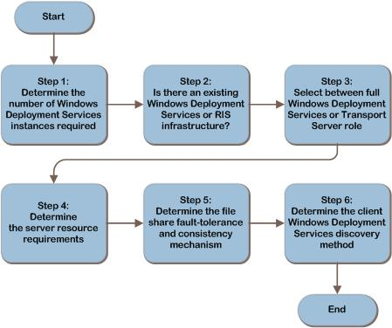
Windows Deployment Services Decision Flow
Notes:
The Windows Deployment Services design flow provides a graphical overview of the steps in designing a Windows Deployment Services infrastructure.

Slide 8
Step 1: Determine the Number of Windows Deployment Services Instances Required
Identify locations requiring access to a Windows Deployment Services instance:
The Windows Deployment Services server should be located close to the client computers to which it will deploy the instances
Locations should have sufficient bandwidth and a low-latency connection between the Windows Deployment Services server and client computers
Determine the need for multiple Windows Deployment Services installations in a single location:
Isolated networks
Low bandwidth
Notes:
When considering the overall design of Active Directory Domain Services (AD DS), a single forest implementation is always desired. Administration of a single forest is easier and more efficient than multiple forests.
Multiple Schemas. Everything in the forest shares a common schema. If there are any conflicts with applications or administration of the schema, this can introduce the need for an additional forest.
Resource forests. Some organizations may require multiple forests for isolation reasons, but need to share a common resource, for example Microsoft Exchange Server 2000 and later. A separate forest can be created to host the shared resources, and forest-level trusts can be used to provide the authentication and authorization paths. A test environment could be created as a resource forest.
Forest Administrator Distrust. There are instances where a company or entity that is considering AD DS has an internal structure where there is more than one IT staff. If each IT staff wants to control the forest, while denying the other IT staff from controlling the forest, multiple forests are the only way to provide the solution. This is a common scenario when companies merge, government agencies, and Universities.
Legal Regulations for Application or Data Access. Due to the fact that all domains in a single forest have automatic, two-way, Kerberos trusts, data and applications can be accessible very easily. When working with some foreign countries, the legal requirements can dictate that data and applications need to be separated. Multiple forests provide this separation.

Slide 9
Step 2: Is There an Existing Windows Deployment Services or RIS Infrastructure?
New Windows Deployment Services 2008 installation:
Ideal for a new installation
Can also be used to perform a parallel upgrade (Deploy Windows Deployment Services 2008, decommission the old infrastructure)
Upgrade an existing Windows Deployment Services 2003 or RIS infrastructure:
Set Windows Deployment Services 2003 to native mode
Convert RIS-based images to Windows Imaging Format (WIM) images
First upgrade RIS to Windows Deployment Services native mode
Notes:
<Explain that there are two paths for deploying Windows Deployment Services 2008. In the event that no deployment infrastructure exists, you can deploy a fresh deployment of the Windows Deployment Services server role. If you are upgrading hardware to 2008, upgrade the deployment software to Windows Deployment Services 2003 Native mode before upgrading the entire server.>

Slide 10
Step 3: Select Between Full Windows Deployment Services or the Transport Server Role
Full Windows Deployment Services:
PXE boot services
Microsoft Management Console (MMC) tools
The ability for administrators to select which image to install from a presented list
Both unicast and multicast deployments
Transport Server only:
Used when the Active Directory Domain Services (AD DS), Domain Name System (DNS), and Dynamic Host Configuration Protocol (DHCP) are not available
Windows Server 2008 R2: PXE boot available
Windows Server 2008: No PXE boot available
Notes:
<Emphasize that the transport server is used in very specific cases—for example, when an isolated server room should not have DHCP requests being broadcast on its network.>
Note The Transport Server can be used to multicast any type of data, not just image data. For example, it can be used as a platform for delivering data through a multicast for line-of-business (LOB) applications.
Tasks and Considerations
The Windows Image (WIM) format is supported by Windows Deployment Services 2003 in mixed or native mode as well as Windows Deployment Services 2008. As new Windows Deployment Services 2008 servers are put into production, the WIM format-based images used on existing Windows Deployment Services 2003 can be used with Windows Deployment Services 2008. The new Windows Deployment Services 2008 server can use an existing remote image store containing the existing WIM- and VHD-based images.
If Windows Deployment Services 2003 is using RIS-based images (RIPREP or RISETUP) or if Windows Server 2003 or Windows 2000 Server RIS is being used, ensure that an equivalent image is offered in WIM format for Windows Deployment Services 2008. Otherwise, clients will get inconsistent offers for images.

Slide 11
Step 4: Determine the Server Resource Requirements
Identify deployment requirements for each Windows Deployment Services instance:
Total number of computers
Image deployment speed
Size and number of images
Determine whether virtualization will be used:
Hyper-V™ will allow a 64-bit deployment environment
Determine the WIM storage location:
Low-latency access is required
Scale the servers:
Determine the baseline
Scale the server’s CPU, memory, network, and disk
Determine the number of servers for the location
Notes:
<Server resource requirements will be based on key criteria. The total number of computers, image deployment speed, and the size of the image.
Windows Deployment Services servers can also be virtualized. Discuss the various impacts that using a computer running Microsoft Virtual PC can have on Windows Deployment Services. Discuss how Hyper-V will be a better virtual environment for deploying Windows Deployment Services because it supports 64-bit virtual machines (VMs) and requires less overhead.
Discuss the WIM storage options: either local storage or on a storage area network (SAN) or network-attached storage (NAS) devices. It is important to discuss the need for all Windows Deployment Services servers to have rapid, low-latency access to the WIM images on any form of shared storage. New for Windows Server 2008 R2, VHD-based images can be used to deploy images of Windows Server 2008 R2 to a physical (not virtual) computer using Windows Deployment Services.>
Scale servers by first creating a baseline with an in-place or initial Windows Deployment Services deployment. If scaling is required, do so by upgrading server subsystems.
The last task is to determine the number of servers that will suit the location. This number can be affected by the need to run faster deployments. One way to speed up deployment is by spreading the client request across more than one server. Adding servers is another method for achieving a limited form of fault tolerance. If one Windows Deployment Services server fails, a second server can provide access to images.
Note If a server fails while it is transferring the image, the image cannot be resumed from the second server. The computer receiving the image must reinitiate the deployment process.
Tasks and Considerations
With Windows Server 2008 R2, there is the capability for multiple stream transfer, meaning there can be multiple bands to broadcast images to clients. This optimizes the transfer rate per connected client, but does require a Windows 7 boot image. The second significant capability introduced is Client Auto Removal, where slower clients can be dropped back to unicast, or even dropped completely, allowing the remaining clients to complete the image transfer more reliably. This is supported with Windows 7 or Windows Vista SP1 or above boot images.

Slide 12
Step 5: Determine the File Share Fault-Tolerance and Consistency Mechanism
Determine image storage system fault tolerance:
Distributed File System (DFS)
Server clustering
WIM-based image consistency:
Manual copy/manage image locally
DFS with replication
Third-party replication
Notes:
<The Windows Deployment Services image file storage location can either be replicated using DFS, or the storage array can be clustered to provide fault tolerance.>
WIM-based or VHD-based image consistency is important for keeping images up to date. The files can be manually copied, but a solution such as DFS replication is recommended.
Note Server clustering cannot be used to provide fault tolerance when the content is locally stored with the Windows Deployment Services system because Windows Deployment Services is not cluster-aware. Server clustering, therefore, is not supported.

Slide 13
Step 6: Determine the Client Windows Deployment Services Discovery Method
Using network boot referrals—uses DHCP boot referrals:
66 = Boot server host name (Set to the Windows Deployment Services server name)
67 = Boot file name (Set to the boot file name that the client computers attempt to download and execute)
Using IP helpers:
Configure routers and switches to forward UPD port 67 broadcasts from client computers to DHCP/Windows Deployment Services servers in other subnets
Notes:
Explain that there are some drawbacks to using network boot referrals:
Using DHCP options is not as reliable as updating the IP helper tables. In testing, Microsoft has observed some issues (mainly with older PXE ROMs) whereby client computers do not correctly parse the DHCP options returned from the DHCP server. The result is that booting client computers see the “TFTP Failed” error message. Generally, this problem occurs when the PXE ROM ignores the boot server host name value and instead attempts to download the Name Binding Protocol (NBP) directly from the DHCP server (which likely does not have the file in question).
If multiple network boot servers are available to service client computer requests, specifying the explicit network boot server’s name as part of the DHCP scope may prevent load balancing from occurring.
Clients may be directed to a network boot server that is not available. Because the client computer does not have to contact a network boot server directly to determine the appropriate network boot file to download, the DHCP server may direct client computers to download a nonexistent boot file or to a server that is not available on the network.
Client computers may bypass the network boot server’s answer settings. Many network boot servers on the market have an on/off mechanism that controls whether certain (or any) client computer requests are answered. Following the PXE standard, client computers contact the network boot server directly to obtain the path and file name of the NBP. Using DHCP options 66 and 67 may cause the client computer to bypass this communication with the network boot server completely and therefore circumvent or ignore the network boot server’s settings regarding answering clients.

Slide 14
Summary and Conclusion
Carefully consider infrastructure requirements for Windows Deployment Services
Planning is key
Provide feedback to satfdbk@microsoft.com
Notes:
Summary and Conclusion
This guide offers major architectural guidance. Refer to product documentation for additional details.

Slide 15
Find More Information
Download the full document and other IPD guides:
www.microsoft.com/ipd
Contact the IPD team:
satfdbk@microsoft.com
Access the Microsoft Solution Accelerators website:
http://www.microsoft.com/technet/SolutionAccelerators

Slide 16
Questions?

Slide 17
Addenda:
Benefits for Consultants or Partners
IPD in Microsoft Operations Framework 4.0
Windows Deployment Services in Microsoft Infrastructure Optimization

Slide 18
Benefits of Using the Windows Deployment Services Guide
Benefits for Business Stakeholders/Decision Makers
Most cost-effective design solution for implementation
Alignment between the business and IT from the beginning of the design process to the end
Benefits for Infrastructure Stakeholders/ Decision Makers
Authoritative guidance
Business validation questions ensuring solution meets requirements of business and infrastructure stakeholders
High integrity design criteria that includes product limitations
Fault-tolerant infrastructure
Infrastructure that’s sized appropriately for business requirements
Notes:
Benefits of Using the Windows Deployment Services Guide
Benefits for Business Stakeholders/Decision Makers:
Most cost-effective design solution for an implementation. IPD eliminates over-architecting and over-spending by precisely matching the technology solution to the business needs.
Alignment between the business and IT from the beginning of the design process to the end.
Benefits for Infrastructure Stakeholders/Decision Makers:
Authoritative guidance. Microsoft is the best source for guidance about the design of Microsoft products.
Business validation questions to ensure the solution meets the requirements of both business and infrastructure stakeholders.
High integrity design criteria that includes product limitations.
Fault-tolerant infrastructure, where necessary.
Proportionate system and network availability to meet business requirements. Infrastructure that is sized appropriately to meet business requirements.

Slide 19
Benefits of Using the Windows Deployment Services Guide (Continued)
Benefits for Consultants or Partners
Rapid readiness for consulting engagements
Planning and design template to standardize design and peer reviews
A “leave-behind” for pre- and post-sales visits to customer sites
General classroom instruction/preparation
Benefits for the Entire Organization
Using the guide should result in a design that will be sized, configured, and appropriately placed to deliver a solution for achieving stated business requirements
Notes:
Benefits of Using the Windows Deployment Services Guide (continued)
Benefits for Consultants or Partners:
Rapid readiness for consulting engagements.
Planning and design template to standardize design and peer reviews.
A “leave-behind” for pre- and post-sales visits to customer sites.
General classroom instruction/preparation.
Benefits for the Entire Organization:
Using the guide should result in a design that will be sized, configured, and appropriately placed to deliver a solution for stated business requirements, while considering the performance, capacity, manageability, and fault tolerance of the system.

Slide 20
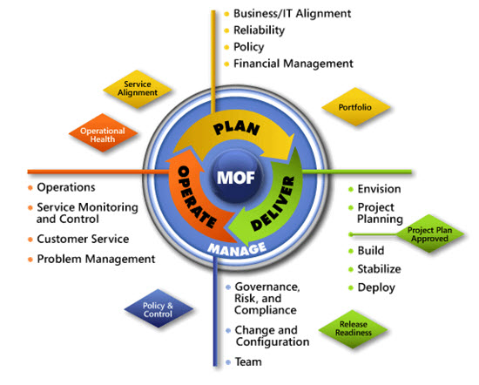
IPD in Microsoft Operations Framework 4.0
Use MOF with IPD guides to ensure that people and process considerations are addressed when changes to an organization’s IT services are being planned.
Notes:
For more information about Microsoft Operations Framework 4.0, go to www.microsoft.com/mof.

Slide 21
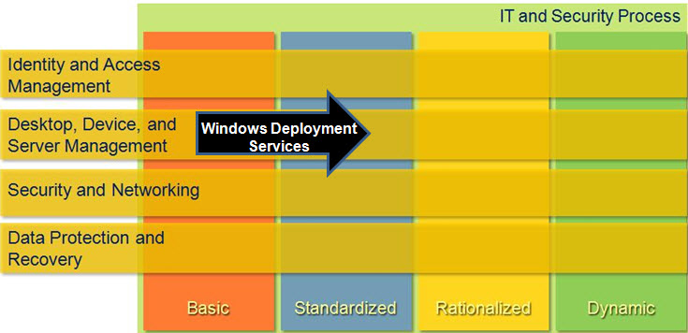
Windows Deployment Services in Microsoft Infrastructure Optimization
Notes:
<This slide shows the effect that Windows Deployment Services has on infrastructure maturity as reflected in the Core Infrastructure Optimization Model.>
The Infrastructure Optimization (IO) Model at Microsoft groups IT processes and technologies across a continuum of organizational maturity. (For more information, see http://www.microsoft.com/infrastructure.) The model was developed by industry analysts, the Massachusetts Institute of Technology (MIT) Center for Information Systems Research (CISR), and Microsoft's own experiences with its enterprise customers. A key goal for Microsoft in creating the Infrastructure Optimization Model was to develop a simple way to use a maturity framework that is flexible and can easily be applied as the benchmark for technical capability and business value.
IO is structured around three information technology models: Core Infrastructure Optimization, Application Platform Optimization, and Business Productivity Infrastructure Optimization. According to the Core Infrastructure Optimization Model, having administrator-controlled automated physical or virtual application distribution helps move an organization to the Standardized maturity level. Windows Deployment Services gives the administrator control over operating system deployment by providing a mechanism to deploy operating systems with an increased level of customization while using a common base image for all installation scenarios. On the path to the Standardized level, organizations can use Windows Deployment Services to enable Zero Touch Installation (ZTI) for operating system deployments, making it possible to manage operating system refreshes and new installations from a central location.

