Slide 1
Microsoft® System Center Virtual Machine Manager 2008 R2
Infrastructure Planning and Design Series
Published: June 2008
Updated: September 2009
Notes:
Copyright © 2009 Microsoft Corporation. This documentation is licensed to you under the Creative Commons Attribution License. To view a copy of this license, visit http://creativecommons.org/licenses/by/3.0/us/ or send a letter to Creative Commons, 543 Howard Street, 5th Floor, San Francisco, California, 94105, USA. When using this documentation, provide the following attribution: Infrastructure Planning and Design is provided with permission from Microsoft Corporation.
This documentation is provided to you for informational purposes only and is provided to you entirely “AS IS”. Your use of the documentation cannot be understood as substituting for customized service and information that might be developed by Microsoft Corporation for a particular user based upon that user’s particular environment. To the extent permitted by law, MICROSOFT MAKES NO WARRANTY OF ANY KIND, DISCLAIMS ALL EXPRESS, IMPLIED AND STATUTORY WARRANTIES, AND ASSUMES NO LIABILITY TO YOU FOR ANY DAMAGES OF ANY TYPE IN CONNECTION WITH THESE MATERIALS OR ANY INTELLECTUAL PROPERTY IN THEM.
Microsoft may have patents, patent applications, trademarks, or other intellectual property rights covering subject matter within this documentation. Except as provided in a separate agreement from Microsoft, your use of this document does not give you any license to these patents, trademarks or other intellectual property.
Information in this document, including URL and other Internet Web site references, is subject to change without notice. Unless otherwise noted, the example companies, organizations, products, domain names, e-mail addresses, logos, people, places and events depicted herein are fictitious.
Microsoft, Hyper-V, SQL Server, and Windows Server are either registered trademarks or trademarks of Microsoft Corporation in the United States and/or other countries.
The names of actual companies and products mentioned herein may be the trademarks of their respective owners.
You have no obligation to give Microsoft any suggestions, comments or other feedback (“Feedback”) relating to the documentation. However, if you do provide any Feedback to Microsoft then you provide to Microsoft, without charge, the right to use, share and commercialize your Feedback in any way and for any purpose. You also give to third parties, without charge, any patent rights needed for their products, technologies and services to use or interface with any specific parts of a Microsoft software or service that includes the Feedback. You will not give Feedback that is subject to a license that requires Microsoft to license its software or documentation to third parties because we include your Feedback in them.

Slide 2
What Is IPD?
Guidance that clarifies and streamlines the planning and design process for Microsoft® infrastructure technologies
IPD:
Defines decision flow
Describes decisions to be made
Relates decisions and options for the business
Frames additional questions for business understanding
IPD guides are available at www.microsoft.com/ipd
Notes:
Infrastructure Planning and Design (IPD) is a series of planning and design guides created to clarify and streamline the planning and design process for Microsoft® infrastructure technologies.
Each guide in the series addresses a unique infrastructure technology or scenario.
These guides include the following topics:
Defining the technical decision flow (flow chart) through the planning process
Describing the decisions to be made and the commonly available options to consider in making the decisions
Relating the decisions and options for the business in terms of cost, complexity, and other characteristics
Framing the decisions in terms of additional questions for the business to ensure a comprehensive understanding of the appropriate business landscape
The guides in this series are intended to complement and augment Microsoft product documentation.

Slide 3
Microsoft® System Center Virtual Machine Manager 2008 R2
Getting Started
Notes:
This guide was created to enable infrastructure planners to design virtualization-management infrastructure solutions. This guide includes specific design information, including activities that encourage sound planning.
Each activity includes:
Prerequisites and background on the activity.
Tasks that will be performed to complete the activity.
Reference information regarding the activity's impact on characteristics such as cost, complexity, and capacity of the solution.
Questions to ensure business needs are captured and reflected in the solution.
This guide is written for information technology (IT) infrastructure specialists who are responsible for planning and designing a Virtual Machine Manager infrastructure.

Slide 4
Benefits of Using the VMM Guide
Benefits for Business Stakeholders/Decision Makers
Most cost-effective design solution for implementation
Alignment between the business and IT from the beginning of the design process to the end
Benefits for Infrastructure Stakeholders/ Decision Makers
Authoritative guidance
Business validation questions ensuring that solution meets requirements of business and infrastructure stakeholders
High integrity design criteria that includes product limitations
Fault-tolerant infrastructure
Infrastructure that’s sized appropriately for business requirements
Notes:
Benefits of Using the Virtual Machine Manager Guide
Benefits for Business Stakeholders/Decision Makers:
Most cost-effective design solution for an implementation. IPD eliminates over-architecting and over-spending by precisely matching the technology solution to the business needs.
Alignment between the business and IT from the beginning of the design process to the end.
Benefits for Infrastructure Stakeholders/Decision Makers:
Authoritative guidance. Microsoft is the best source for guidance about the design of Microsoft products.
Business validation questions to ensure the solution meets the requirements of both business and infrastructure stakeholders.
High integrity design criteria that includes product limitations.
Fault-tolerant infrastructure, where necessary.
Proportionate system and network availability to meet business requirements. Infrastructure that is sized appropriately to meet business requirements.

Slide 5
Benefits of Using the VMM Guide (Cont’d)
Benefits for Consultants or Partners
Rapid readiness for consulting engagements
Planning and design template to standardize design and peer reviews
A “leave-behind” for pre- and post-sales visits to customer sites
General classroom instruction/preparation
Benefits for the Entire Organization
Using the guide should result in a design that will be sized, configured, and appropriately placed to deliver a solution for achieving stated business requirements
Notes:
Benefits of Using the VMM Guide (continued)
Benefits for Consultants or Partners:
Rapid readiness for consulting engagements.
Planning and design template to standardize design and peer reviews.
A “leave-behind” for pre- and post-sales visits to customer sites.
General classroom instruction/preparation.
Benefits for the Entire Organization:
Using the guide should result in a design that will be sized, configured, and appropriately placed to deliver a solution for achieving stated business requirements, while considering the performance, capacity, manageability, and fault tolerance of the system.

Slide 6
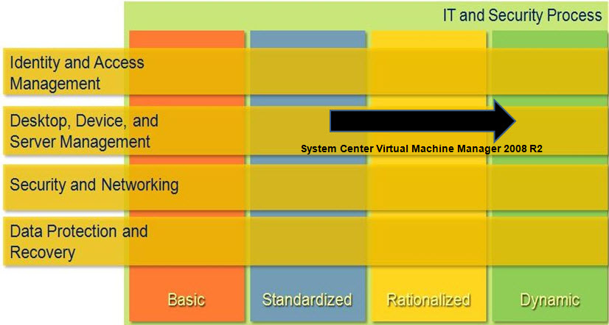
The Role of VMM in Infrastructure Optimization
Notes:
<This slide shows the effect Virtual Machine Manager has on infrastructure maturity as reflected on the Infrastructure Optimization Model>
According to the Core Infrastructure Optimization Model (Core IO), organizations that are actively pursuing virtualization management are meeting one of the requirements to move to the Dynamic level. This guide will assist in planning and designing the infrastructure for virtualization management infrastructure.

Slide 7
Purpose and Overview
Purpose
To provide design guidance for Virtual Machine Manager (VMM)
Agenda
What is VMM?
What’s new in VMM 2008 R2
VMM architecture design process
Notes:
The purpose of the guide is to focus on the considerations that organizations should take into account when designing a virtualization-management infrastructure.
This will be accomplished by enabling planners to determine virtualization-management requirements and, using those requirements, design a Virtual Machine Manager infrastructure.
Details about disaster recovery, server support, and server hosting are outside the scope of the guide.

Slide 8
Virtualization Management Challenges
Lack of agility
Self-service provisioning
Speed of provisioning
Lack of virtualization management (VM) organization
Optimizing use of host resources
Managing decentralized VMs
Notes:
Challenges:
Organizations are slow to provision new virtual machines, and self-service provisioning is difficult to provide.
Organizations lack a global view of the VMs in their environment, making it difficult to organize VMs.
Organizations lack insight to the resource requirements of the VMs in their environment or the ability to place VMs intelligently.
Organizations can’t centrally manage all of the VMs in their environments.

Slide 9
Solution: VMM
Increases operational agility
Speeds provisioning of new VMs
Reduces IT burden by enabling self-service provisioning
Keeps virtual assets organized
Optimizes resource usage
Provides insight to how workloads perform
Takes the guesswork out of VM placement
Facilitates P2V conversion
Helps fine-tune the virtual and physical infrastructure
Ensures VMs are built to standard specifications
Organizes VMs in the environment
Notes:
Virtual Machine Manager makes data center management more efficient by simplifying several important tasks. With Virtual Machine Manager, IT administrators can easily consolidate underutilized physical servers, provision new virtual machines, centrally manage virtual assets, and optimize virtual infrastructure—all while taking advantage of existing investments and expertise.

Slide 10
What’s New in VMM 2008 R2
VMM 2008 R2 RC now manages many of the new features of Windows Server® 2008 R2 RC Hyper-V® including:
Live migration ― for moving virtual machines between hosts with no downtime
Automating the evacuation of VMs off Hyper-V host machines
Multiple virtual machines are supported on a single logical unit number using Clustered Share Volumes
Notes:
VMM 2008 R2 manages many of the new capabilities of Windows Server 2008 R2 Hyper-V including:
Live migration for moving virtual machines between hosts with no downtime. VMM performs host compatibility checks and can then initiate and control the migration. This enables users to check on whether a VM is compatible with the destination host instead of doing the migration and then finding out that the VM cannot start on the host.
VMM can automate the evacuation of VMs off Hyper-V host machines – for example, to implement maintenance mode. A Hyper-V host can participate in only one live migration at any given time, both as source and destination. This means that the user has to wait for the live migration to complete before attempting another one. VMM R2 can detect the condition where live migration fails due to another live migration in progress, queue up the request in the background, and then retry the request after a period of time. This feature enables users to perform multiple live migrations without needing to keep track of other live migrations that are happening within the cluster; VMM R2 will automatically do the queuing and retries in the background.
Multiple virtual machines are supported on a single LUN using Clustered Share Volumes. Quick Storage Migration enables migration of a VM’s storage both within the same host and across hosts while the VM is running, with a minimum of downtime. The downtime depends on the amount of activity going on in the VM at the time of migration; product group tests have shown typical downtimes to be less than 2 minutes.

Slide 11
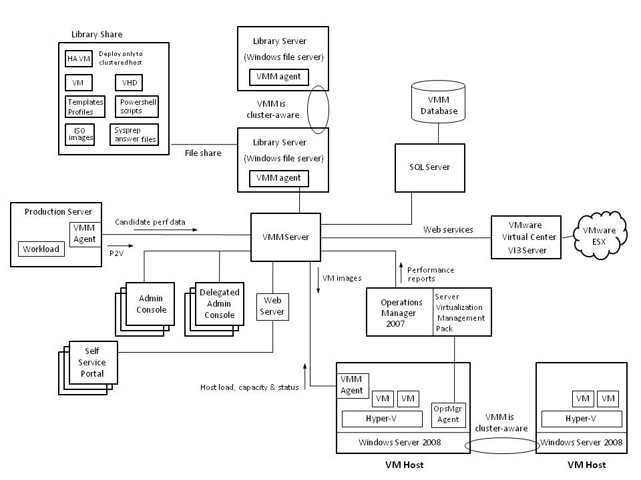
VMM Architecture
Notes:
The components of a typical VMM infrastructure are shown in this slide.
Project teams should consider having Microsoft Customer Service and Support review their architecture prior to implementation, as that is the organization that can best comment on the supportability of a particular design.

Slide 12
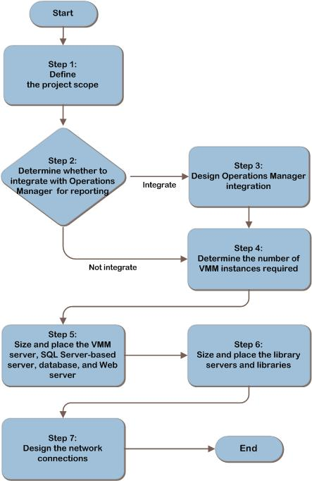
VMM Design Flow
Notes:
The seven steps on this slide represent the most critical design elements in a well-planned Virtual Machine Manager design. Some of these items represent decisions that should be made. Where this is the case, a corresponding list of common response options will be presented. Other items in this list represent tasks that should be carried out. These types of items are addressed because their presence is significant in order to complete the infrastructure design.

Slide 13
Step 1: Define the Project Scope
Identify locations to manage
Assess each host location
Virtualization technology
VM management technology
Number of hosts at location
Determine if self-service provisioning is a business requirement
Identify management requirements
1
2
3
4
5
6
7
Notes:
In this step, the project team should determine which parts of the organization to include in the design.
Identify locations to manage – choose which locations in the organization to manage using SCVMM.
Assess each host location:
Virtualization technology – Identify the virtualization technologies each location uses.
VM management technology – Identify the VM management technologies, if any, that each location uses to manage hosts.
Number of hosts at location – Record the number of existing and planned hosts.
Determine if self-service provisioning is a business requirement.
Identify management requirements:
Identify the organization’s management model for virtualization.
Identify whether there are plans to use server virtualization as a disaster recovery solution.

Slide 14
Step 2: Determine Whether to Integrate with Operations Manager for Reporting
Integrate
Console integration
Seamless reporting drill-down
Not integrate
Can still use Operations Manager data
Must use the Operations Manager console
1
2
3
4
5
6
7
Notes:
If the Operations Manager data is integrated into the VMM console, the VMM console user can seamlessly drill down from performance views of the VM host machine to examine performance data for each VM guest that is running on the host. They can then drill down further in order to view performance counters for the operating system and applications running in the VM guest.
This step’s goal is to determine whether to integrate historical reporting from Operations Manager into the VMM console. The step should be repeated for each VM host that will be managed by VMM. The project team should make this decision early, because if this integration will be done, it may affect the number of Virtual Machine Manager instances the team defines in step 4.
Integrate:
More easily leverage Operations Manager’s historical reporting data to complement VM placement recommendations.
Not Integrate:
Users can still take advantage of the performance data that Operations Manager provides.

Slide 15
Step 3: Design Operations Manager Integration
Multiple VMM instances
Works within organization of existing management groups
Dedicated management group for VMM
Simplifies deployment by using fewer VMM servers
Simplifies placing and sizing of VMM servers
Enables the organization to consolidate VM management
1
2
3
4
5
6
7
Notes:
In order to deliver integrated reporting, Virtual Machine Manager uses the Operations Manager Connector Framework to connect to a management group. The scope of the reporting data available from that connection is limited to VM hosts within that management group. Therefore, if more than one management group contains a VM host, the project team has two options to deliver integrated reporting on those VM hosts:
Multiple VMM Instances
Benefits
Works within organization of existing Management Groups.
Challenges
Must deploy additional Virtual Machine Manager instances, each with a server, database, and library server.
Makes placing and sizing of Virtual Machine Manager servers more complex.
Prevents the organization from consolidating management of VMs.
Dedicated Management Group for VMM
Benefits
Simplifies deployment by using fewer Virtual Machine Manager servers.
Simplifies placing and sizing of Virtual Machine Manager servers.
Enables the organization to consolidate VM management.
Challenges
Requires the addition of a new Operations Manager Management Group and its associated infrastructure.
The Operations Manager product currently supports a maximum of 10 multi-homing agents in a Management Group.

Slide 16
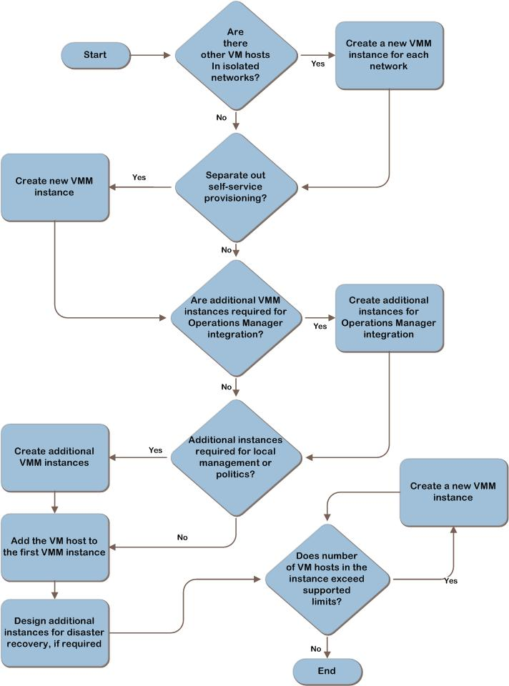
Step 4: Determine the Number of VMM Instances Required
1
2
3
4
5
6
7
Notes:
This step’s goal is to determine the number of Virtual Machine Manager instances the organization requires. Both business and technical requirements drive this determination.
Determine required instances
(Instances might be required for the following):
Isolated networks
Self-service provisioning
Number of Operations Manager management groups
Management model: local or centralized
Political considerations
Disaster recovery
Number of VM hosts in the project’s scope

Slide 17
Step 5: Size and Place the VMM Server, SQL Server®-Based Server, Database, and Web Server
Servers
VMM server
Database server and database
Web server
Design considerations
Capacity requirements
Integration
Performance characteristics
Unit sizing and volume expectations
1
2
3
4
5
6
7
Notes:
This step’s goal is to design the servers for each VMM instance that the project team identified in Step 4. Design characteristics include each server’s form factor, size, physical placement and, where necessary, the fault-tolerance strategy.
Determining appropriate size, placement, and distribution of server roles is an important element in delivery of required monitoring functionality at a level of performance and fault tolerance that the organization expects.
Design the Virtual Machine Manager Server
Physical Placement
Fault Tolerance
Design the Database Server and Database
Physical Placement
Fault Tolerance
Design the Web Server

Slide 18
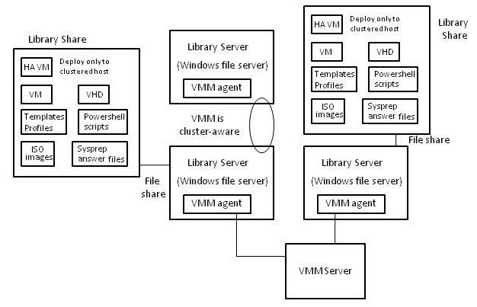
Step 6: Size and Place the Library Servers and Libraries
1
2
3
4
5
6
7
Notes:
The Virtual Machine Manager library is a set of resources that can be used to create and configure VMs. Libraries can include the following:
Virtual Hard Drive (VHD) and Virtual Machine Configuration (VMC) files
VM templates and guest operating system profiles
Scripts and Sysprep answer files
ISO image files
Virtual floppy disks
Design and Place the Virtual Machine Manager library server
Placement: library server on the same LAN segment as the VM hosts it will service
Decision: Design Fault Tolerance
Distributed File System
Server Clustering

Slide 19
Step 7: Design the Network Connections
Determine where additional bandwidth is required
Determine network port requirements
1
2
3
4
5
6
7
Notes:
In this step, the project team uses the following information to determine network bandwidth and network port requirements:
Determine Where Additional Bandwidth Is Required
Map Connections
Measure Available Bandwidth
Determine TCP/IP Port Requirements

Slide 20
Conclusion
Carefully consider infrastructure requirements for virtualization management
Planning is key
This guide offers major architectural guidance. Refer to product documentation for additional details
Provide feedback to satfdbk@microsoft.com
Notes:
This guide summarized the critical design decisions, activities, and tasks required to successfully design a Virtual Machine Manager infrastructure.
Identification of the business and technical requirements
Virtual Machine Manager and Operations Manager integration
Number of VMM servers
After planning and designing the architecture, the project team should conduct limited pilot tests before beginning a major rollout.

Slide 21
Find More Information
Download the full document and other IPD guides:
www.microsoft.com/ipd
Contact the IPD team:
satfdbk@microsoft.com
Visit the Microsoft Solution Accelerators Web site:
www.microsoft.com/technet/SolutionAccelerators

Slide 22
Questions?

