Slide 1
Microsoft® System Center Data Protection Manager 2007 with Service Pack 1
Infrastructure Planning and Design
Published: January 2009
Updated: July 2010
Notes:
Copyright © 2010 Microsoft Corporation. This documentation is licensed to you under the Creative Commons Attribution License. To view a copy of this license, visit http://creativecommons.org/licenses/by/3.0/us/ or send a letter to Creative Commons, 543 Howard Street, 5th Floor, San Francisco, California, 94105, USA. When using this documentation, provide the following attribution: Infrastructure Planning and Design is provided with permission from Microsoft Corporation.
This documentation is provided to you for informational purposes only, and is provided to you entirely "AS IS". Your use of the documentation cannot be understood as substituting for customized service and information that might be developed by Microsoft Corporation for a particular user based upon that user’s particular environment. To the extent permitted by law, MICROSOFT MAKES NO WARRANTY OF ANY KIND, DISCLAIMS ALL EXPRESS, IMPLIED AND STATUTORY WARRANTIES, AND ASSUMES NO LIABILITY TO YOU FOR ANY DAMAGES OF ANY TYPE IN CONNECTION WITH THESE MATERIALS OR ANY INTELLECTUAL PROPERTY IN THEM.
Microsoft may have patents, patent applications, trademarks, or other intellectual property rights covering subject matter within this documentation. Except as provided in a separate agreement from Microsoft, your use of this document does not give you any license to these patents, trademarks or other intellectual property.
Information in this document, including URL and other Internet website references, is subject to change without notice. Unless otherwise noted, the example companies, organizations, products, domain names, email addresses, logos, people, places and events depicted herein are fictitious.
Microsoft, Active Directory, Hyper-V, SharePoint, Windows, Windows Server, and Windows Vista are either registered trademarks or trademarks of Microsoft Corporation in the United States and/or other countries and regions.
The names of actual companies and products mentioned herein may be the trademarks of their respective owners.
You have no obligation to give Microsoft any suggestions, comments or other feedback ("Feedback") relating to the documentation. However, if you do provide any Feedback to Microsoft then you provide to Microsoft, without charge, the right to use, share and commercialize your Feedback in any way and for any purpose. You also give to third parties, without charge, any patent rights needed for their products, technologies and services to use or interface with any specific parts of a Microsoft software or service that includes the Feedback. You will not give Feedback that is subject to a license that requires Microsoft to license its software or documentation to third parties because we include your Feedback in them.

Slide 2
What Is IPD? Guidance that clarifies and streamlines the planning and design process for Microsoft® infrastructure technologies
IPD:
Defines decision flow
Describes decisions to be made
Relates decisions and options for the business
Frames additional questions for business understanding
IPD guides are available at www.microsoft.com/ipd
Notes:
Infrastructure Planning and Design (IPD) is a series of planning and design guides created to clarify and streamline the planning and design process for Microsoft® infrastructure technologies.
Each guide in the series addresses a unique infrastructure technology or scenario.
These guides include the following topics:
Defining the technical decision flow (flow chart) through the planning process.
Describing the decisions to be made and the commonly available options to consider in making the decisions.
Relating the decisions and options for the business in terms of cost, complexity, and other characteristics.
Framing the decisions in terms of additional questions for the business to ensure a comprehensive understanding of the appropriate business landscape.
The guides in this series are intended to complement and augment Microsoft product documentation.

Slide 3
Getting Started
Microsoft ® System Center Data Protection Manager 2007 with Service Pack 1
Notes:
The Microsoft System Center Data Protection Manager (DPM) 2007 with Service Pack 1 guide is designed to provide a consistent structure for addressing the decisions and activities that are most critical to the successful implementation of a data protection manager infrastructure.
Each decision or activity is subdivided into four elements:
Background on the decision or activity, including context setting and general considerations.
Typical options or tasks to perform the activity.
A reference section that evaluates the tasks in terms of cost, complexity, and manageability.
Questions for the business that may have a significant impact on decisions to be made.
This document is written for use by information technology (IT) specialists, generalists, consultants, value-added resellers (VARs), or anyone who needs to design a Data Protection Manager implementation.

Slide 4
Purpose and Overview
Purpose
To assist in the decision-making process to plan a successful Microsoft System Center Data Protection Manager with SP1 implementation
Overview
Define the project scope
Determine what data will be protected
Create the logical design for protection
Design the storage
Design the DPM server
Notes:
The purpose of this presentation is to address the decisions and/or activities that need to occur in planning a Microsoft System Center Data Protection Manager 2007 with SP 1 implementation. The following slides will take an IT pro through the most critical design elements in a well-planned Data Protection Manager design.

Slide 5
What Is Microsoft System Center Data Protection Manager 2007 with SP1?
DPM 2007 provides protection for core Windows Server-based workloads by backing up critical files to a DPM server or appliance, which provides disk-based recovery and tape-based, long-term archival storage as well as disaster recovery from offsite repositories.
Protect and recover:
Microsoft SQL Server®
Exchange Server
SharePoint® data
Windows® file servers
Notes:
The purpose of this guide is to focus on the considerations that organizations should take into account when designing a Microsoft System Center Data Protection Manager 2007 with SP1 infrastructure.
Microsoft Data Protection Manager (DPM) 2007 is a member of the Microsoft System Center family of management products, which are designed to help IT pros manage their Windows Server infrastructures.
First released in September 2007 and now including Service Pack 1 (SP1), DPM 2007 delivers data protection for Microsoft application and file servers to a disk and tape solution attached to the DPM server.
Microsoft designed DPM 2007 to protect and recover Microsoft SQL Server, Exchange Server, SharePoint products and technologies, and Windows Virtualization hosts (Microsoft Virtual Server and Hyper-V™), as well as Windows file services.

Slide 6
Applicable Scenarios
The guide addresses the needs of organizations that plan to:
Replace an existing data protection solution
Use DPM to provide protection for the Windows environment and possibly integrate DPM with an existing backup solution for third-party platforms
Notes:
The DPM guide addresses the following scenarios when planning and designing the necessary components for a successful implementation of Data Protection Manager:
DPM is being used to replace an existing data protection solution.
DPM will be implemented to provide protection for the Windows environment and may be integrated with an existing backup solution for third-party platforms.
Out of Scope
The guide does not address the following:
Designing synchronization frequency and recovery point schedule. However, these configuration decisions need to be made prior to implementing DPM and will be used as input to the DPM infrastructure design.
Storage technology recommendations.
Virtual machine operating systems that are not VSS-aware.
Using the DPM OEM appliance on Windows Storage Server, in place of DPM on Windows Server® 2008 or Windows Server 2003.

Slide 7
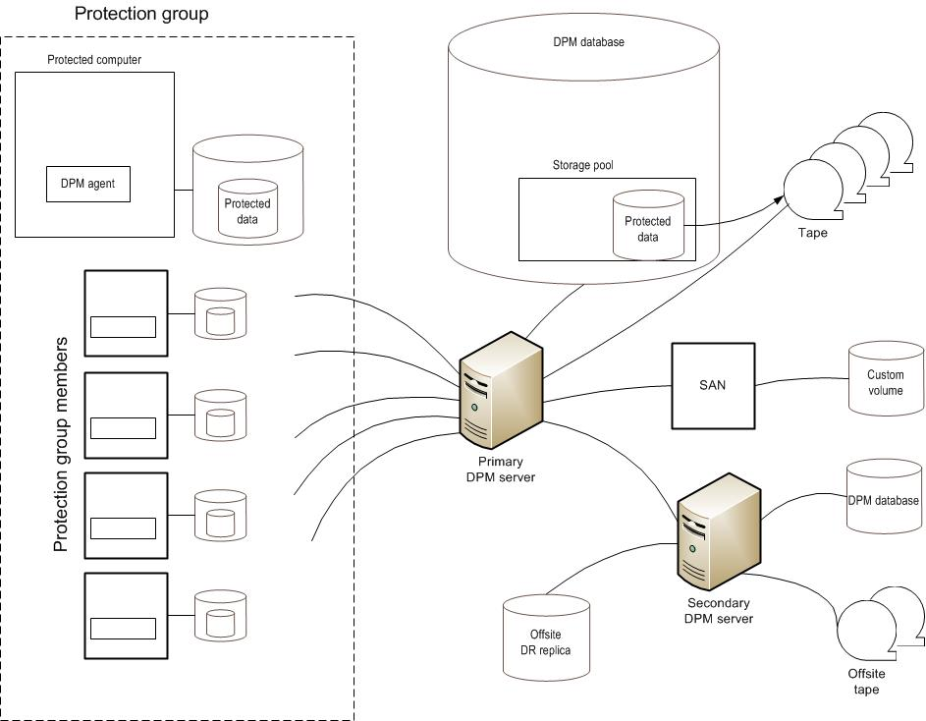
Example of DPM Architecture
SCM
ITA
Notes:
The diagram illustrates the relationship between the components that can work together to deliver a data protection management solution with DPM.
This diagram is one example of a DPM architecture.

Slide 8
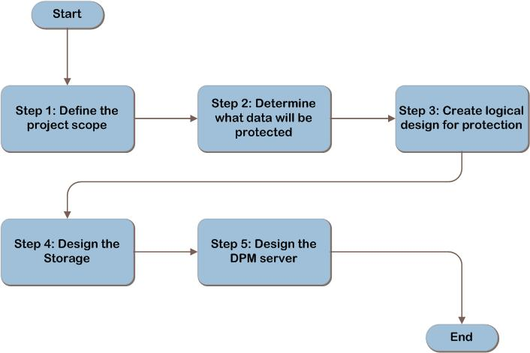
Data Protection Manager Decision Flow
MAP w/ CAL Tracker
SCM
ITA
Notes:
This is the DPM design flow. The details of the design will be discussed in the following slides.

Slide 9
Step 1: Define Project Scope
Answer the following questions to align goals with business motivation:
What are the business requirements for protecting data?
How is data currently being protected?
Notes:
Step 1. Define the Project Scope
Task 1: What are the business requirements for protecting data?
First, determine which business applications are in scope for data protection and who owns and manages those applications and their data. For each application decide:
Determine the recovery point objective (RPO), which is the acceptable amount of data loss that can be tolerated, measured in time. DPM can back up changed data as frequently as every 15 minutes, or as infrequently as once a week. More frequent backups will increase the cost and complexity of the implementation.
How long must protected data be kept available for recovery? This will be used to determine how long the protected data will be stored.
Regulatory requirements such as: SOX or HIPAA, or PCI DSS may determine data storage length and location. The data retention period could be years. Data may also need to be protected long enough for the help desk to retrieve data a user may have deleted.
Determine the recovery time objective (RTO), which is the time within which a business process must be restored to a serviceable state after a problem occurs. The business service may be restored & made available to users prior to the recovery of protected data, which may occur over time as a background operation.
Data can be protected as a VM, which can enable recovery of an entire system to a newly provisioned machine. The decision whether to protect data as a VM will be determined in Step 5.
Is the purpose for data protection part of a business continuity plan (BCP) or disaster recovery plan (DRP)? The BCP/DRP determines how quickly the organization must be operational again after a data loss event. Ask the business for the assigned BCP/DRP priority of each application’s data based on:
Scope of the user base that would be affected by an outage.
Categorization of how an outage of that service would affect work (work stoppage, work impairment, sustainable workaround available, no impact).
Validate with the Business:
Are any changes planned for the future that may affect the portfolio of applications requiring data protection?
Business acquisitions or divestitures.
Applications that require data protection that may be retired or replaced.
Files that may grow or reduce in size.
New applications that require protection.
Are current business policies up to date with today’s internal and external governance requirements? If not, they should be updated prior to the DPM data protection project so that the technology design can accurately reflect the business requirements.
The answers to these questions may affect the protection requirements and, therefore, the size or design of the infrastructure.
Task 2: How is data currently being protected?
Determine if there is already a data protection infrastructure in place.

Slide 10
Step 2: Determine What Data Will Be Protected
The data that DPM will protect for each application needs to be determined so that the DPM agent placement can be designed
Does the application run in a virtual machine?
Are Microsoft Exchange Server mailboxes in use?
Are SharePoint servers in use?
Are SQL Server databases in use?
Protect files?
Protect system state?
Notes:
Step 2. Determine What Data Will Be Protected
Task 1: DPM Agent Placement
For each business application that was determined to be in scope in Step 1, determine where the DPM agents will be placed. Start by mapping the components of the application to data that can be protected by DPM. For each business application, record the data that can be protected, & then the server on which the DPM agent will be placed, to provide that protection.
Decision 1: Does the Application Run in a Virtual Machine?
There are two options when backing up virtual machines:
The entire guest can be protected as a VM, using the VSS Writer in the virtualization host. Place the DPM agent on the Host.
Data within the guest can be separately protected, using each application’s VSS Writer. Place the DPM agent on the Host and the Guest.
Decision 2: Are Microsoft Exchange Server Mailboxes in Use? Place the DPM agent on the Exchange Server.
Decision 3: Are SharePoint Servers In Use?
Determine which MOSS farms should be protected, plan to install a DPM agent on each farm server. Then, for each farm, determine which SQL Server databases DPM will protect; this determination will be used to design the storage in Step 4. SQL Server databases that are part of the farm do not need to be separately protected using the DPM SQL Server protection, so do not plan for these in the next decision.
Decision 4: Are SQL Server Databases In Use?
Record which databases will be protected and which servers they run on. To provide high availability, SQL Server can be implemented in the following ways:
Database mirroring. Plan to install the DPM agent on both servers running SQL Server.
Log shipping. Plan to install the DPM agent on both the primary and standby servers.
SQL Server cluster. DPM detects the cluster when protection is set up and installs the agent on both servers.
Decision 5: Protect Files?
Record all the files, folders, and shares that must be separately protected, along with the name of the servers on which they are stored. Plan to install the DPM agent on those servers.
Validate with the Business
To maximize the opportunity to use standard DPM protection for the application’s components, ask business stakeholders the following questions:
Will any servers or components of the application be virtualized in the near future? If yes, the systems or applications that require protection could be protected as virtual machines, so it may be most effective to plan to protect them in this way.
Could servers be moved from another virtualization platform to Windows Server 2008 Hyper-V? These systems could be additional candidates for protection using VMs.

Slide 11
Step 3: Create Logical Design for Protection
Determine recovery goals for each data source
Determine protection media
Determine how replicas will be created
Organize data sources into protection groups
Notes:
Step 3. Create Logical Design for Protection
Task 1: Determine the Recovery Goals for Each Data Source
In DPM, recovery goals are defined by synchronization frequency, retention range, and recovery point schedule.
Task 2: Determine the Protection Media
DPM 2007 offers the following data protection media: disk-based (D2D), tape-based (D2T), or a combination of disk-based and tape-based protection (D2D2T), in which data is backed up from the disk-based replica to tape.
The selection of disk or tape should be made using the following criteria:
Whether the media type is suitable for a protection configuration that meets the recovery goals. For example, disk-based protection cannot protect data for longer than 512 days, whereas tape-based protection can retain the data for up to 99 years. And while disk-based protection can synchronize the replica as frequently as every 15 minutes, tape-based protection cannot back up data more frequently than once a day.
File data can be recovered by end users only if it is on disk. End-user recovery is not available for data that is stored on tape. Refer to the protection business requirements that were determined in Step 1. If end users must be able to recover workstation files themselves, then protection must be to disk.
How well the media meets the recovery goals. The advantages and disadvantages of each media type are covered at http://technet.microsoft.com/en-us/library/bb808739.aspx.
Fill out the Media column in Table C-1 in Appendix C in the guide.
Task 3: Determine How Replicas Will Be Created
If initial replica creation will be done automatically by DPM across the network, that will affect network sizing, especially if new members are added to the protection group on a frequent basis.
Task 4: Organize Data Sources into Protection Groups
To organize data sources into protection groups, in the order shown in the guide.

Slide 12
Step 4: Design the Storage
To design the storage for DPM, follow these steps:
Calculate the storage requirements on the file protection data sources
Calculate the storage requirements for DPM
Determine whether custom volumes are required
Design the storage pool
Design the disk subsystem
Design the tape storage
Place the disk and tape storage
Notes:
Step 4. Design the storage
Task 1: Calculate the Storage Requirements on the File Protection Data Sources
Determine the storage space that must be allocated on protected file servers or workstations for the change journal.
Task 2: Calculate the Storage Requirements for DPM
The DPM product group provides storage calculators that can be used to determine the storage required for each protection group. The calculation of required space can be complex if attempted manually, so use these calculators to ensure a supported configuration.
Task 3: Determine Whether Custom Volumes Are Required
Select a custom volume for protection, rather than the DPM storage pool, for the following reasons:
For critical data that must be manually separated onto a high performance Logical Unit Number (LUN). If the data were instead backed into the DPM storage pool, there would be no way to guarantee that it would be stored on that specific LUN, since DPM would make the data placement decisions.
To meet regulatory requirements for separation. The DPM server will place all the data wherever within a pool, a separate DPM server would be required with another storage pool for separation.
To separate IO-intensive workloads across multiple spindles. DPM protects a data source by applying changes to a single volume in the storage pool where the replica is stored. It also creates many dynamic volumes on the same physical disk for different data sources.
Task 4: Design the Disk Subsystem - DPM can use any non-removable disks for the storage pool and custom volumes.
Task 5: Design the Tape Storage
DPM provides a list of tape libraries that have been tested and found compliant at http://technet.microsoft.com/en-us/dpm/cc678583.aspx. The tape library (or stand-alone tape drive) must be storage network-attached or SCSI-attached to the DPM server.
As with the disk configuration, the tape storage must be designed to deliver sufficient performance to support the required number of IOps. Two factors apply to each protection group:
Peak IOps during backup. All members of a protection group will send data to the DPM server at the same time, this will create a spike in the write load on the storage, the tape subsystem throughput must be sufficient to write all the data to storage before the next timed backup begins.
Peak IOps during restore. The DPM restore technology may require the restoration of an entire volume in order to recover a single Microsoft Exchange mailbox. The read IO performance of the tape subsystem must be sufficient to enable the business to meet the RTO for the business application.
Task 6: Place the Disk and Tape Storage
Refer to Step 3 where the design of the protection groups was completed, and data sources were grouped into protection groups. Plan to place the custom disks, the DPM storage pool, and the tape storage in close network proximity to the data sources in order to optimize the performance of backup and recovery operations. This decision will likely affect the placement of DPM servers in Step 5.

Slide 13
Step 5: Design the DPM Server
To design the DPM Server, follow these steps:
Determine the number of DPM servers required
Map protection groups to servers and storage
Design and place the servers
Design the DPM database
Design the reporting components
Determine whether to use a dedicated backup network
Design fault tolerance and protection for DPM
Notes:
Step 5. Design the DPM server
Task 1: Determine the Number of DPM Servers Required
To determine the number of DPM servers required, use the DPM sizing calculator provided by the product group, available at http://blogs.technet.com/dpm/archive/2007/10/31/data-protection-manager-2007-storage-calculator.aspx.
That calculator provides a starting point for Exchange Server, but it does not take into account all of the limits to which the DPM server is subject. Start the design with one DPM server; then apply the supported scale limits that are explained in the guide, in turn, to determine whether additional servers will be required.
Task 2: Map Protection Groups to Servers and Storage
Determine which protection groups will be protected by which DPM servers. Refer to the protection group design that was created in Step 3 and recorded in Table C-1 in Appendix C in the DPM guide.
Task 3: Design and Place the Servers
For each DPM server that will be designed, start by referring to the minimum and recommended hardware sizing provided in “Hardware Requirements” at http://technet.microsoft.com/en-us/library/bb808861.aspx. Use these as a base configuration; then for each of the components of the form factor listed in the guide, add resources to the configuration as required.
Task 4: Design the DPM Database
Each DPM server requires a separate SQL Server instance. The SQL Server instance can be on the DPM server or on a remote server.
Task 5: Design the Reporting Components
DPM uses an instance of IIS to deliver reports to a web browser. If the SQL Server instance is remote from the DPM server, IIS is required on the server running SQL Server.
Determine the IIS server that will be used, and record that.
Task 6: Determine Whether to Use a Dedicated Backup Network
When DPM backs up a production server, it has to compete for resources with application and user traffic traversing the same network adapter. This can be avoided by dedicating a backup network for workloads with a high rate of change.
Determine whether a dedicated backup network will be used and record that.
Task 7: Design Fault Tolerance and Protection for DPM
Two components can be made fault tolerant: the DPM server and the DPM database. In addition, the DPM server environment can be protected by a secondary DPM server.

Slide 14
Summary and Conclusion
The guide summarized the critical design decisions, activities, and tasks required to enable a successful design of Data Protection Manager. It focused on decisions involving:
What data will be protected
The logical design for protection, storage, and the DPM server
The primary reason and expected timeline for implementing DPM and the expectations for growth or contraction
Provide feedback to satfdbk@microsoft.com
Notes:
Summary and Conclusion
This guide has summarized the critical design decisions, activities, and tasks required to enable a successful design of Data Protection Manager. It focused on decisions involving:
What data will be protected.
The logical design for protection, storage, and the DPM server.
The five steps in the decision flow required to develop a successful design were described in detail. Where appropriate, the decisions and tasks have been illustrated with typical usage scenarios.

Slide 15
Find More Information
Download the full document and other IPD guides:
www.microsoft.com/ipd
Contact the IPD team:
satfdbk@microsoft.com
Access the Microsoft Solution Accelerators website:
http://www.microsoft.com/technet/SolutionAccelerators

Slide 16
Questions?

Slide 17
Addenda:
Benefits for Consultants or Partners
IPD in Microsoft Operations Framework 4.0
DPM in Microsoft Infrastructure Optimization

Slide 18
Benefits of Using the DPM Guide
Benefits for Business Stakeholders/Decision Makers
Most cost-effective design solution for implementation
Alignment between the business and IT from the beginning of the design process to the end
Benefits for Infrastructure Stakeholders/ Decision Makers
Authoritative guidance
Business validation questions ensuring solution meets requirements of business and infrastructure stakeholders
High integrity design criteria that includes product limitations
Fault-tolerant infrastructure
Infrastructure that’s sized appropriately for business requirements
Notes:
Benefits of Using the DPM Guide
Benefits for Business Stakeholders/Decision Makers:
Most cost-effective design solution for an implementation. IPD eliminates over-architecting and over-spending by precisely matching the technology solution to the business needs.
Alignment between the business and IT from the beginning of the design process to the end.
Benefits for Infrastructure Stakeholders/Decision Makers:
Authoritative guidance. Microsoft is the best source for guidance about the design of Microsoft products.
Business validation questions to ensure the solution meets the requirements of both business and infrastructure stakeholders.
High integrity design criteria that includes product limitations.
Fault-tolerant infrastructure, where necessary.
Proportionate system and network availability to meet business requirements. Infrastructure that is sized appropriately to meet business requirements.

Slide 19
Benefits of Using the DPM Guide (Continued)
Benefits for Consultants or Partners
Rapid readiness for consulting engagements
Planning and design template to standardize design and peer reviews
A “leave-behind” for pre- and post-sales visits to customer sites
General classroom instruction/preparation
Benefits for the Entire Organization
Using the guide should result in a design that will be sized, configured, and appropriately placed to deliver a solution for achieving stated business requirements
Notes:
Benefits of Using the DPM guide (continued)
Benefits for Consultants or Partners:
Rapid readiness for consulting engagements.
Planning and design template to standardize design and peer reviews.
A “leave-behind” for pre- and post-sales visits to customer sites.
General classroom instruction/preparation.
Benefits for the Entire Organization:
Using the guide should result in a design that will be sized, configured, and appropriately placed to deliver a solution for stated business requirements, while considering the performance, capacity, manageability, and fault tolerance of the system.

Slide 20
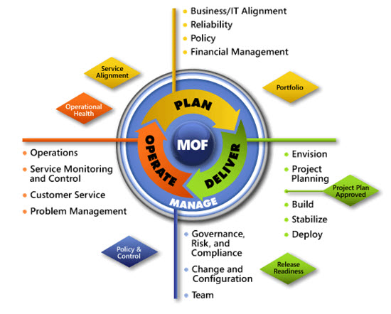
IPD in Microsoft Operations Framework 4.0
Use MOF with IPD guides to ensure that people and process considerations are addressed when changes to an organization’s IT services are being planned.
Notes:
For more information about Microsoft Operations Framework 4.0, go to www.microsoft.com/mof.

Slide 21
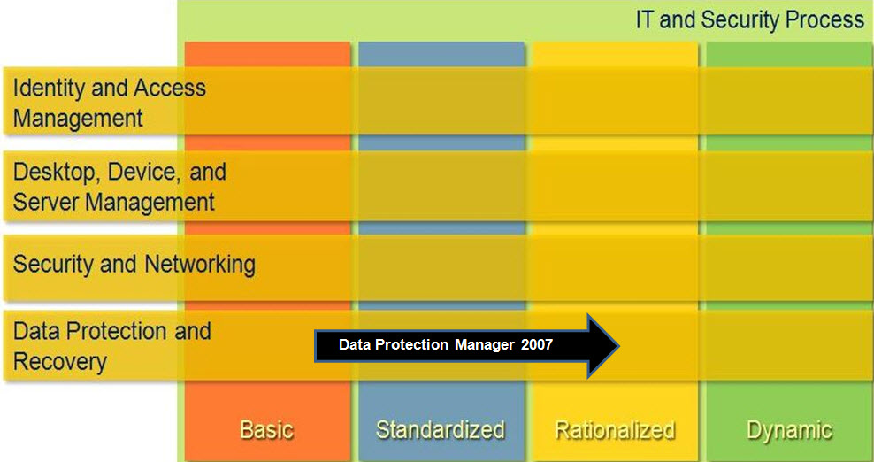
DPM in Microsoft Infrastructure Optimization
Notes:
<This slide shows the effect that DPM has on infrastructure maturity as reflected in the Core Infrastructure Optimization Model.>
The Infrastructure Optimization (IO) Model at Microsoft groups IT processes and technologies across a continuum of organizational maturity. (For more information, see http://www.microsoft.com/infrastructure.) The model was developed by industry analysts, the Massachusetts Institute of Technology (MIT) Center for Information Systems Research (CISR), and Microsoft's own experiences with its enterprise customers. A key goal for Microsoft in creating the Infrastructure Optimization Model was to develop a simple way to use a maturity framework that is flexible and can easily be applied as the benchmark for technical capability and business value.
IO is structured around three information technology models: Core Infrastructure Optimization, Application Platform Optimization, and Business Productivity Infrastructure Optimization. According to the Core Infrastructure Optimization Model, protecting critical business data and applications will help move an organization to the Rationalized level.

