Slide 1
Microsoft® SharePoint® Server 2010
Infrastructure Planning and Design
Published: July 2011
Notes:
Copyright © 2011 Microsoft Corporation. All rights reserved. Complying with the applicable copyright laws is your responsibility. By using or providing feedback on this documentation, you agree to the license agreement below.
If you are using this documentation solely for non-commercial purposes internally within YOUR company or organization, then this documentation is licensed to you under the Creative Commons Attribution-NonCommercial License. To view a copy of this license, visit http://creativecommons.org/licenses/by-nc/2.5/ or send a letter to Creative Commons, 543 Howard Street, 5th Floor, San Francisco, California, 94105, USA.
This documentation is provided to you for informational purposes only, and is provided to you entirely "AS IS". Your use of the documentation cannot be understood as substituting for customized service and information that might be developed by Microsoft Corporation for a particular user based upon that user’s particular environment. To the extent permitted by law, MICROSOFT MAKES NO WARRANTY OF ANY KIND, DISCLAIMS ALL EXPRESS, IMPLIED AND STATUTORY WARRANTIES, AND ASSUMES NO LIABILITY TO YOU FOR ANY DAMAGES OF ANY TYPE IN CONNECTION WITH THESE MATERIALS OR ANY INTELLECTUAL PROPERTY IN THEM.
Microsoft may have patents, patent applications, trademarks, or other intellectual property rights covering subject matter within this documentation. Except as provided in a separate agreement from Microsoft, your use of this document does not give you any license to these patents, trademarks or other intellectual property.
Information in this document, including URL and other Internet Web site references, is subject to change without notice. Unless otherwise noted, the example companies, organizations, products, domain names, e-mail addresses, logos, people, places and events depicted herein are fictitious.
Microsoft, Access, Active Directory, Excel, InfoPath, OneNote, SharePoint, SQL Server, and Visio are either registered trademarks or trademarks of Microsoft Corporation in the United States and/or other countries and regions.
The names of actual companies and products mentioned herein may be the trademarks of their respective owners.
You have no obligation to give Microsoft any suggestions, comments or other feedback ("Feedback") relating to the documentation. However, if you do provide any Feedback to Microsoft then you provide to Microsoft, without charge, the right to use, share and commercialize your Feedback in any way and for any purpose. You also give to third parties, without charge, any patent rights needed for their products, technologies and services to use or interface with any specific parts of a Microsoft software or service that includes the Feedback. You will not give Feedback that is subject to a license that requires Microsoft to license its software or documentation to third parties because we include your Feedback in them.

Slide 2
What is IPD? Guidance that clarifies and streamlines the planning and design process for Microsoft infrastructure technologies
IPD:
Defines decision flow
Describes decisions to be made
Relates decisions and options for the business
Frames additional questions for business understanding
IPD guides are available at www.microsoft.com/ipd
Notes:
Infrastructure Planning and Design (IPD) is a series of planning and design guides created to clarify and streamline the planning and design process for Microsoft® infrastructure technologies.
Each guide in the series addresses a unique infrastructure technology or scenario.
These guides include the following topics:
Defining the technical decision flow (flow chart) through the planning process.
Describing the decisions to be made and the commonly available options to consider in making the decisions.
Relating the decisions and options for the business in terms of cost, complexity, and other characteristics.
Framing the decisions in terms of additional questions for the business to ensure a comprehensive understanding of the appropriate business landscape.
The guides in this series are intended to complement and augment Microsoft product documentation.

Slide 3
Getting Started
Microsoft SharePoint Server 2010
Notes:
The guide was created to enable infrastructure planners to design a Microsoft SharePoint Server 2010 infrastructure. The guide includes specific design information and activities that encourage sound planning.
Each activity includes:
Prerequisites and background on the activity.
Tasks that will be performed to complete the activity.
Reference information regarding the activity’s impact on characteristics such as the cost, complexity, and capacity of the solution.
Questions to ensure that business needs are captured and reflected in the solution.
The guide is written for information technology (IT) infrastructure specialists who are responsible for planning and designing the infrastructure for SharePoint Server 2010.

Slide 4
Purpose and Overview
Purpose
To provide guidance for designing a SharePoint Server 2010 infrastructure
Overview
SharePoint Server 2010 architecture
SharePoint Server 2010 infrastructure design process
Notes:
SharePoint Server 2010 is an integrated platform that allows users to share information effectively. It facilitates collaboration, provides content management, and can assist the organization in implementing business processes.
The guide leads the reader through the design process to create a SharePoint Server 2010 infrastructure design that is appropriately placed, sized, and designed to deliver the stated business benefits while also considering the performance, capacity, and fault tolerance of the system. It addresses the scenarios most likely to be encountered by someone designing a SharePoint Server 2010 infrastructure. Customers with specific questions should consider having their architecture reviewed by Microsoft Customer Service and Support prior to implementation to ensure the supportability of a particular design.
When used in conjunction with product documentation, the guide helps organizations confidently plan a SharePoint Server 2010 implementation. Appendix A in the guide includes sample job aids for recording the decisions made during the design process.

Slide 5
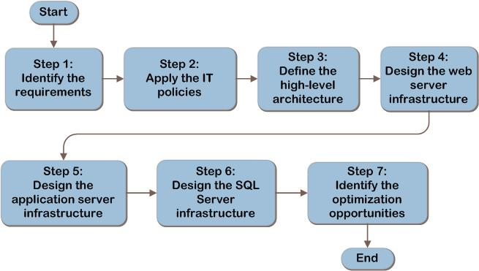
SharePoint Server 2010 Decision Flow
Notes:
The goal of the guide is to assist the reader through the process of planning a SharePoint Server 2010 infrastructure by addressing the following:
Step 1: Identify the Requirements
Step 2: Apply the IT Policies
Step 3: Define the High-Level Architecture
Step 4: Design the Web Server Infrastructure
Step 5: Design the Application Server Infrastructure
Step 6: Design the SQL Server® Infrastructure
Step 7: Identify the Optimization Opportunities
The figure on this slide provides a graphical overview of these steps.

Slide 6
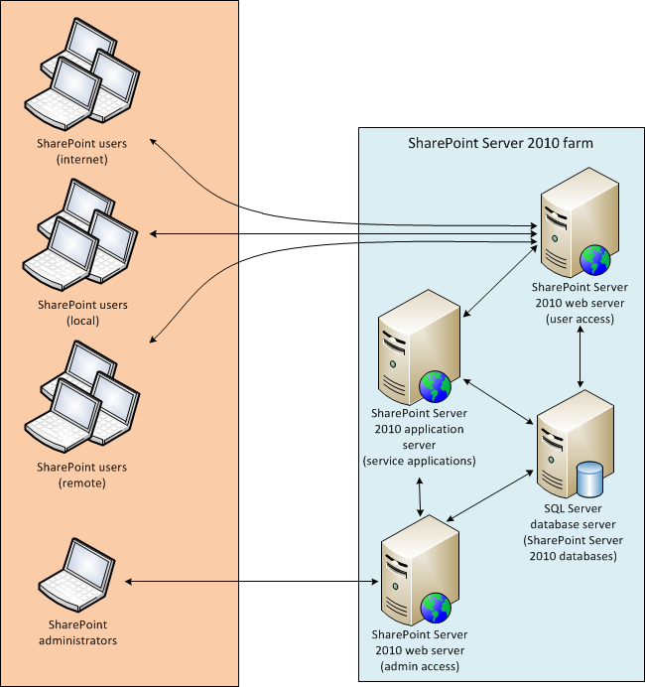
SharePoint Server 2010 Architecture Example
Notes:
The figure on this slide is a graphical representation of one SharePoint Server 2010 implementation. Note that the figure does not provide a comprehensive view of all possible options; rather, it is a single representation that shows the architectural items that must be considered for each SharePoint Server 2010 design.

Slide 7
Step 1: Identify the Requirements
Task 1: Determine the Business Requirements
What is the name of the website?
Which physical locations have users who will require access to the website?
Does the website require operational autonomy in any of the locations in which it will be used?
Must the website be accessed independently of the availability of the wide area network (WAN)?
How many users will access the website from each physical location?
Will the website require high availability?
Will the website require isolation?
Notes:
Step 1: Identify the Requirements
Task 1: Determine the Business Requirements
Determine the business requirements by identifying the SharePoint Server 2010 websites that will be created, where geographically and by whom they will be accessed, and other characteristics about the functionality the business needs the websites to be capable of providing.
Ask the business representative the following:
What is the name of the website?
Which physical locations have users who will require access to the website?
Does the website require operational autonomy in any of the locations in which it will be used?
Must the website be accessed independently of the availability of the wide area network (WAN)?
How many users will access the website from each physical location?
Will the website require high availability?
Will the website require isolation?

Slide 8
Step 1: Identify the Requirements (Continued)
Task 2: Determine the Functionality Requirements
Identify what types of functionality each website requires in the following three areas:
User functionality
Developer functionality
Administrative functionality
Notes:
Step 1: Identify the Requirements (Continued)
Task 2: Determine the Functionality Requirements
The next task is to identify what types of functionality each website requires. For each website identified in Task 1, determine the specific SharePoint Server 2010 functionality required by interviewing the business representative.
User Functionality
Does the website need to:
Centrally manage Microsoft InfoPath® forms that will be available for editing online in a web browser?
Provide web-based project scheduling functionality?
Interact with Microsoft Access® 2010 databases in a web browser?
Allow users to edit worksheets without having Microsoft Office installed on each client computer?
Allow users to edit presentations without having Microsoft Office installed on each client computer?
Allow users to edit documents without having Microsoft Office installed on each client computer?
Allow users to edit diagrams without having Microsoft Visio® installed on each client computer?
Allow users to edit Microsoft OneNote® notebooks without having Microsoft Office installed on each client computer?
Allow users to access shared Microsoft PowerPivot for Excel® 2010 workbooks that are stored in SharePoint Server 2010?
Provide a “My Sites” social networking platform for users to share personal information?
Developer Functionality
Does the website need to:
Access line-of-business (LOB) system data?
Use managed taxonomy hierarchies, keywords, and a social tagging infrastructure?
Use custom dashboards, scorecards, key performance indicators (KPIs), or reports?
Collect, report, and analyze the use and effectiveness of the SharePoint Server 2010 deployment?
Automatically convert documents between formats that Microsoft Word recognizes—for example, saving a Word document as a PDF?
Administrative Functionality
Does the website need to:
Allow users to search documents stored in SharePoint Server 2010?
Provide enhanced search services such as contextual or linguistic search?
Allow users to use data from external sources without having to log on to those external sources?
Allow the temporary storage of user data (session state)?
Provide system health reports, web analysis reports, or administrative reports?
Have an end-to-end secure/encrypted environment?

Slide 9
Step 2: Apply the IT Policies
Task 1: Determine the IT Policy Requirements
For each website identified in Step 1, are there any IT policies that:
Specify where servers must be located?
Affect where data can be stored?
Require the use of an existing enterprise database or web server infrastructure?
Add to the availability requirements identified in Step 1?
Notes:
Step 2: Apply the IT Policies
Task 1: Determine the IT Policy Requirements
In this task, the IT policy representative, such as a systems architect, should be interviewed or written policies reviewed to ensure that the SharePoint Server 2010 design is aligned and compliant with current policy.
For each website identified in Step 1, answer the following questions about system implementation information.
For this website, are there any IT policies that:
Specify where servers must be located? This answer will affect the server placement decisions in Step 3. If the answer is yes, make a note of how this policy affects this website.
Affect where data can be stored? For example, data may be required to stay within the organization’s country, facility, or other boundaries. If the answer is yes, make a note of how this policy affects this website.
Require the use of an existing enterprise database or web server infrastructure? This answer will affect the SharePoint Server 2010 application placement decisions in Step 3. If the answer is yes, make a note of how this policy affects this website.
Add to the availability requirements identified in Step 1? If the answer is yes, then for each website that will require additional availability requirements, update the availability item in Table A-1 in Appendix A in the guide.

Slide 10
Step 3: Define the High-Level Architecture
Task 1: Design the SharePoint Server 2010 Farms
Apply Network Constraints
Adequate bandwidth, speed, and reliability
Site autonomy needs
Apply Isolation Requirements
Map Website User Locations to Farms
Notes:
Step 3: Define the High-level Architecture
Task 1: Design the SharePoint Server 2010 Farms
This task designs the total number of farms needed to match the system requirements previously defined. Start with one farm and identify geographically where it will be placed—a location nearest the majority of the users in the scope of the project.
Apply Network Constraints
For each physical user location, answer the following questions: Does this connection have sufficient bandwidth to service all of the user connections, sufficient speed (low latency) to service all the user connections, and sufficient reliability?
If the answer to any of these questions is no, then either the network must be upgraded or an additional farm needs to be placed at the user side of this connection.
Does the user location require site autonomy? In the event of a WAN failure, must this location’s users still be able to access their websites?
Apply Isolation Requirements
If physical isolation was defined as a requirement in Step 1, either add a new isolated farm at the first farm location and associate only this website with the new farm or add new farms as appropriate based on the network constraints in each location where the websites’ users exist.
Map Website User Locations to Farms
For every SharePoint Server 2010 website identified, compare that sites’ user locations and map each website with one of the farm names previously defined so that every user population for the website is associated with a single farm name.

Slide 11
Additional Considerations (Step 3)
The items below may need to be addressed based on other organizational requirements. Such work is outside of the scope of this guide.
Domain name uniqueness
Data consistency among farms
Encrypted client-to-server communications
Active Directory® Domain Services (AD DS)
Notes:
Additional Considerations (Step 3)
Below is a list of items that may need to be addressed based on other organizational requirements. Such work is outside of the scope of this guide.
Domain name uniqueness. It is possible that any given website could be logically associated with more than one SharePoint Server 2010 farm. If this is the case, then a unique website fully qualified domain name will be needed for each website so that each site has a globally unambiguous name in the organization’s Domain Name System (DNS). This is necessary to ensure that users can connect to the proper website for their location.
Data consistency among farms. SharePoint Server 2010 does not replicate the data or configuration information from a given website in one farm to its corresponding website in other farms. A separate process will be needed to accomplish this replication, if desired.
Encrypted client-to-server communications. Any website that requires an end-to-end secure/encrypted environment must have additional architectural components designed—for example, certificate servers that support HTTPS.
Active Directory Domain Services (AD DS). SharePoint Server 2010 requires AD DS for authenticating users and services in a farm. Ensure that both the SharePoint Server 2010 website and users who consume its resources are able to authenticate with the organization’s AD DS infrastructure.

Slide 12
Step 4: Design the Web Server Infrastructure
Task 1: Design the Web Servers
Determine Server Capacity Requirements
Calculate the total amount of storage required for all web servers in the farm. If total local capacity amount exceeds the amount of storage of the web server footprint, add servers until the capacity limits of each server are within tolerance levels
Determine Server Performance Requirements
The amount of physical resources needed to meet business requirements (processor, memory, disk, and network) per server based on estimated peak user loads
Notes:
Step 4: Design the Web Server Infrastructure
Task 1: Design the Web Servers
The initial base number of SharePoint Server 2010 web servers required for each farm is established by combining the total website capacity information for the farm, the total website performance requirements for the farm, and the fault tolerance requirements for the farm. Start with a single web server for the farm, and add servers based on the impacts of the following information. It may be necessary to repeat this process more than once to achieve the right balance of capacity and performance for a given hardware and/or virtual platform.
Determine Server Capacity Requirements
Capacity is defined in this guide as the amount of storage needed to hold all data that the server generates. SharePoint Server 2010 itself stores all of the content information in SQL Server. It is possible, however, that some custom applications running on SharePoint Server 2010 could choose to store data on the web server. Calculate the total amount of storage required for all web servers in the farm. If total local capacity amount exceeds the amount of storage of the web server footprint, add servers until the capacity limits of each server are within tolerance levels.
Determine Server Performance Requirements
System performance is defined as the amount of physical resources needed to meet business requirements (processor, memory, disk, and network) per server based on estimated peak user loads. The SharePoint Server 2010 product group has no specific guidance on individual website performance metrics; however, the group has identified processes on web servers that can be particularly hardware-intensive.

Slide 13
Step 4: Design the Web Server Infrastructure (Continued)
Task 2: Apply the Fault Tolerance Requirements
SharePoint Server web servers achieve high availability via load balancing
Can be hardware or software load balancers
Notes:
Step 4: Design the Web Server Infrastructure (Continued)
Task 2: Apply the Fault Tolerance Requirements
Fault tolerance through load balancing is the mechanism by which SharePoint Server 2010 web servers achieve high availability. For each web server identified in Task 1, review the list of websites on the server. If any of the websites on the server required high availability as identified in Step 1, add at least one more web server to the farm. This additional server will need to contain duplicate configurations (mirror image) of the first web server.
It is possible to optimize the number of fault-tolerant servers through additional manipulation of which websites are placed on the fault-tolerant servers rather than making an entire mirror image of the first server. However, the details of this work are beyond the scope of this guide.
If any fault-tolerant servers are added to the farm, either a hardware or software load balancer will need to be added to the environment to automatically redirect network traffic to the fault-tolerant (backup) server in the event of a failure on the primary web server.

Slide 14
Step 5: Design the Application Server Infrastructure
Task 1: Design the Application Servers
Determine Server Capacity Requirements
See Table 3 in the guide for capacity recommendations
Determine Server Performance Requirements
Certain processes can be hardware-intensive (see Table 4 in the guide)
Recommended minimum hardware for small and large deployments is in Table 5 in the guide
Task 2: Apply the Fault Tolerance Requirements
High availability is achieved by implementing multiple servers
Notes:
Step 5: Design the Application Server Infrastructure
Task 1: Design the Application Servers
The base number of SharePoint Server 2010 application servers required for each farm is established by combining the total application server capacity information for the farm, the total application server performance requirements for the farm, and the fault tolerance requirements for the farm. One server can host as many service applications as the platform allows.
Determine Server Capacity Requirements
Service applications typically store a limited amount of data that is used during the processing of information stored in SharePoint Server 2010 databases for rendering to user clients (application state and session information). The SharePoint Server 2010 product group has established the capacity recommendations shown in Table 3 in the guide. Start with these recommendations, and monitor the server to determine when additional disk space will be needed.
Determine Server Performance Requirements
The SharePoint Server 2010 product group has no specific guidance on performance metrics; however, the group has identified processes on application servers that can be particularly hardware-intensive. These processes are listed in Table 4 in the guide. Table 5 in the guide lists the product group’s recommended minimum hardware for small and large deployments. Even though small and large deployments are not defined, the product group does give a relative bracket or range for consideration.
Task 2: Apply the Fault Tolerance Requirements
Fault tolerance through the implementation of multiple servers is the mechanism by which SharePoint Server 2010 application servers achieve high availability. If a website requires high availability, so do all service applications the website uses to provide continuous operation. If any of the websites in the farm require high availability and a service application (identified in Step 1), add at least one more application server to the farm. This additional server will need to contain duplicate configurations (mirror image) of each service application that requires high availability.

Slide 15
Additional Considerations (Step 5)
Application servers and service applications have additional flexibility whose design is outside the scope of this guide:
Isolation of service applications
Cross-farm sharing of service applications
Server consolidation
Notes:
Additional Considerations (Step 5)
Application servers and service applications have additional flexibility whose design is outside of the scope of this guide:
Isolation of service applications. It is possible to segregate service applications so that, for example, one instance of a Microsoft Excel® service application is used by some websites and another instance of the Excel service application is used by others to isolate these functions for security or administrative purposes.
Cross-farm sharing of service applications. It is also possible for service applications in one farm to be used by websites in a different farm, assuming that they are within the 1-millisecond (ms) range that the product requires.
Server consolidation. After reviewing the capacity and performance information of the service applications for each farm, it may be possible to collapse the application server tier into the SharePoint Server 2010 web server tier if there is sufficient capacity, performance, and fault tolerance on the web servers to host the service applications, as well.

Slide 16
Step 6: Design the SQL Server Infrastructure
Task 1: Determine SQL Server Capacity and Performance Requirements
SharePoint Server 2010 uses SQL Server databases at three different levels within a farm:
Farm-level databases
Content-level databases
Service application–level databases
See Appendix C in the guide for capacity and performance information
Notes:
Step 6: Design the SQL Server Infrastructure
Task 1: Determine SQL Server Capacity and Performance Requirements
SharePoint Server 2010 stores the majority of its data within SQL Server databases. This means that proper capacity and performance planning is critical to the long-term health of the SharePoint Server 2010 environment. Capacity is defined as the total amount of disk space required by the SQL Server instance. Performance is defined as the amount of throughput (expressed in IOPS) needed to meet business requirements at peak user load as well as the memory, processing, and network needed.
To determine how many servers are needed in each farm, the requirements for all of the databases in the farm must first be identified. SharePoint Server 2010 uses SQL Server databases at three different levels within a farm:
Farm-level databases. Used to hold the farm configuration information as well as administration and other functions.
Content-level databases. Used to hold the user content of all the websites. These databases exist once for every farm and may optionally be split into multiple databases by deploying multiple site collections.
Service application-level databases. Used to hold the information for individual SharePoint Server 2010 service applications. These databases differ based on the need for each service application being used in the farm.
There is no prescriptive guidance from the product group on capacity and performance planning for the SQL Server instance design for a farm. There is a limited amount of planning information available, which can be found in Appendix C in the guide, along with a complete listing of all known SharePoint Server 2010 databases. Create a SQL Server instance design that supports the capacity and performance requirements for the farm by iterating through the farm, user content, and application service-level database requirements and summing the total amount of capacity and performance capabilities needed. If necessary, SQL Server databases can be distributed over several SQL Server instances.

Slide 17
Step 6: Design the SQL Server Infrastructure (Continued)
Task 2: Apply the Fault Tolerance Requirements
SharePoint Server 2010 relies on SQL Server’s fault-tolerance mechanisms to provide high availability for SharePoint Server 2010 databases
Use either:
SQL Server failover clustering
SQL Server high-availability database mirroring
Notes:
Step 6: Design the SQL Server Infrastructure (Continued)
Task 2: Apply the Fault Tolerance Requirements
SharePoint Server 2010 relies on SQL Server’s fault tolerance mechanisms to provide high availability for SharePoint Server 2010 databases. Review each SQL Server instance defined in the preceding task. If any SharePoint Server 2010 website associated with the SQL Server instance (because of its user content database or service application dependencies) requires high availability (identified and recorded in Step 1), this SQL Server instance and the SQL Server instance containing the farm-level databases must be configured to be fault tolerant to allow the website to meet its requirement for continuous availability.
SharePoint Server 2010 only supports two SQL Server database fault tolerance mechanisms: SQL Server failover clustering and high-availability database mirroring. See Step 3, Task 4 of the Infrastructure Planning and Design Guide for SQL Server 2008 and SQL Server 2008 R2 for help in determining the right fault tolerance mechanism. If SQL Server failover clustering is used to provide fault tolerance, a SQL Server cluster instance is required for each SQL Server instance containing databases that require fault tolerance. If SQL Server high-availability database mirroring is used to provide fault tolerance, a mirror is required for each individual SQL Server database that requires fault tolerance.

Slide 18
Step 7: Identify the Optimization Opportunities
There is potential for consolidation of individual SharePoint Server 2010 server roles, with considerations given to isolation, capacity, performance, and fault tolerance
Review design as a whole for application consolidation opportunities
Notes:
Step 7: Identify the Optimization Opportunities
This step focuses on the server optimization opportunities of the SharePoint Server 2010 infrastructure. The potential for consolidation of individual SharePoint Server 2010 server roles will be discussed, with considerations given to isolation, capacity, performance, and fault tolerance.
Steps 4-6 were used to design each of the different infrastructure parts of a SharePoint Server 2010 farm: the web servers, application servers, and SQL Server instances independent of one another. The final step in the design process is to review all three of these designs collectively to see whether the design within each farm can be optimized.
Review each tier of applications, overlaying one over the next to determine whether some capabilities can be combined. For example, in a design with just a few websites, it may be feasible to combine the SharePoint Server 2010 web servers and application servers on a single set of servers, reducing the amount of hardware needed. The same could be true for a review of the application server and the SQL Server instances.
In this review, it is important to ensure that IT policies, system capacity, system performance, and system fault tolerance are all aligned before consolidating any platforms.

Slide 19
Summary and Conclusion
This guide has focused on summarizing the critical design decisions, activities, and tasks required to enable a successful design of SharePoint Server 2010
See the IPD guide appendix for job aids to assist in recording decisions
Provide feedback to ipdfdbk@microsoft.com

Slide 20
Find More Information
Download the full document and other IPD guides:
www.microsoft.com/ipd
Contact the IPD team:
ipdfdbk@microsoft.com
Access the Microsoft Solution Accelerators website:
www.microsoft.com/technet/SolutionAccelerators

Slide 21
Questions?

Slide 22
Addenda
Benefits for Consultants or Partners
IPD in Microsoft Operations Framework 4.0

Slide 23
Benefits of Using the SharePoint Server 2010 Guide
Benefits for Business Stakeholders/Decision Makers
Most cost-effective design solution for implementation
Alignment between the business and IT from the beginning of the design process to the end
Benefits for Infrastructure Stakeholders/Decision Makers
Authoritative guidance
Business validation questions ensuring solution meets requirements of business and infrastructure stakeholders
High-integrity design criteria that includes product limitations
Fault-tolerant infrastructure
Infrastructure that’s sized appropriately for business requirements
Notes:
Benefits of Using the SharePoint Server 2010 guide
Benefits for Business Stakeholders/Decision Makers:
Most cost-effective design solution for an implementation. IPD eliminates over-architecting and over-spending by precisely matching the technology solution to the business needs.
Alignment between the business and IT from the beginning of the design process to the end.
Benefits for Infrastructure Stakeholders/Decision Makers:
Authoritative guidance. Microsoft is the best source for guidance about the design of Microsoft products.
Business validation questions to ensure the solution meets the requirements of both business and infrastructure stakeholders.
High-integrity design criteria that includes product limitations.
Fault-tolerant infrastructure, where necessary.
Proportionate system and network availability to meet business requirements.
Infrastructure that is sized appropriately to meet business requirements.

Slide 24
Benefits of Using the SharePoint Server 2010 Guide (Continued)
Benefits for Consultants or Partners
Rapid readiness for consulting engagements
Planning and design template to standardize design and peer reviews
A “leave-behind” for pre- and post-sales visits to customer sites
General classroom instruction/preparation
Benefits for the Entire Organization
Using the guide should result in a design that will be sized, configured, and appropriately placed to deliver a solution for achieving stated business requirements
Notes:
Benefits of Using the SharePoint Server 2010 guide (Continued)
Benefits for Consultants or Partners:
Rapid readiness for consulting engagements.
Planning and design template to standardize design and peer reviews.
A “leave-behind” for pre- and post-sales visits to customer sites.
General classroom instruction/preparation.
Benefits for the Entire Organization:
Using the guide should result in a design that will be sized, configured, and appropriately placed to deliver a solution for stated business requirements, while considering the performance, capacity, manageability, and fault tolerance of the system.

Slide 25
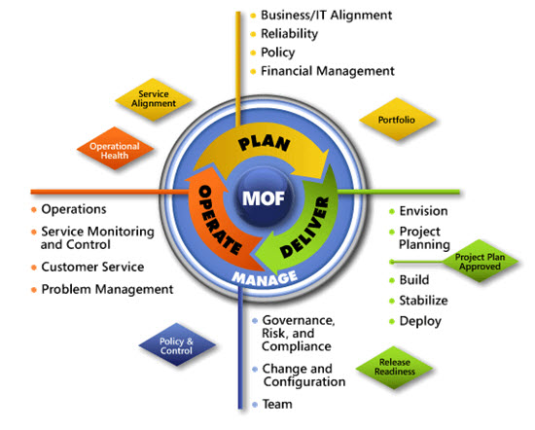
IPD in Microsoft Operations Framework 4.0
Use MOF with IPD guides to ensure that people and process considerations are addressed when changes to an organization’s IT services are being planned
Notes:
For more information about Microsoft Operations Framework 4.0, go to www.microsoft.com/mof.

