Slide 1
Selecting the Right Virtualization Technology
Infrastructure Planning and Design
Published: November 2007
Updated: November 2011
Notes:
Copyright © 2011 Microsoft Corporation. This documentation is licensed to you under the Creative Commons Attribution License. To view a copy of this license, visit http://creativecommons.org/licenses/by/3.0/us/ or send a letter to Creative Commons, 543 Howard Street, 5th Floor, San Francisco, California, 94105, USA. When using this documentation, provide the following attribution: Infrastructure Planning and Design is provided with permission from Microsoft Corporation.
This documentation is provided to you for informational purposes only, and is provided to you entirely "AS IS". Your use of the documentation cannot be understood as substituting for customized service and information that might be developed by Microsoft Corporation for a particular user based upon that user’s particular environment. To the extent permitted by law, MICROSOFT MAKES NO WARRANTY OF ANY KIND, DISCLAIMS ALL EXPRESS, IMPLIED AND STATUTORY WARRANTIES, AND ASSUMES NO LIABILITY TO YOU FOR ANY DAMAGES OF ANY TYPE IN CONNECTION WITH THESE MATERIALS OR ANY INTELLECTUAL PROPERTY IN THEM.
Microsoft may have patents, patent applications, trademarks, or other intellectual property rights covering subject matter within this documentation. Except as provided in a separate agreement from Microsoft, your use of this document does not give you any license to these patents, trademarks or other intellectual property.
Information in this document, including URL and other Internet website references, is subject to change without notice. Unless otherwise noted, the example companies, organizations, products, domain names, email addresses, logos, people, places and events depicted herein are fictitious.
Microsoft, Hyper-V, Windows, Windows Server, and Windows Vista are either registered trademarks or trademarks of Microsoft Corporation in the United States and/or other countries and regions.
The names of actual companies and products mentioned herein may be the trademarks of their respective owners.
You have no obligation to give Microsoft any suggestions, comments or other feedback ("Feedback") relating to the documentation. However, if you do provide any Feedback to Microsoft then you provide to Microsoft, without charge, the right to use, share and commercialize your Feedback in any way and for any purpose. You also give to third parties, without charge, any patent rights needed for their products, technologies and services to use or interface with any specific parts of a Microsoft software or service that includes the Feedback. You will not give Feedback that is subject to a license that requires Microsoft to license its software or documentation to third parties because we include your Feedback in them.

Slide 2
What Is IPD? Guidance that clarifies and streamlines the planning and design process for Microsoft® infrastructure technologies
IPD:
Defines decision flow
Describes decisions to be made
Relates decisions and options for the business
Frames additional questions for business understanding
IPD guides are available at www.microsoft.com/ipd
Notes:
Microsoft® Infrastructure Planning and Design (IPD) is a series of planning and design guides created to clarify and streamline the planning and design process for Microsoft infrastructure technologies.
Each guide in the series addresses a unique infrastructure technology or scenario.
These guides include the following topics:
Defining the technical decision flow (flow chart) through the planning process
Describing the decisions to be made and the commonly available options to consider in making the decisions
Relating the decisions and options for the business in terms of cost, complexity, and other characteristics
Framing the decisions in terms of additional questions for the business to ensure a comprehensive understanding of the appropriate business landscape
The guides in this series are intended to complement and augment Microsoft product documentation.

Slide 3
Getting Started
Selecting the Right Virtualization Technology
Notes:
The guide was created to enable infrastructure planners to determine the best Microsoft virtualization technology to use in their environment.

Slide 4
Why Use Virtualization?
Scenarios driving virtualization:
Server consolidation—lower data center costs
Application migration
Increased IT agility—reduced deployment and provisioning time
Software development and training
Notes:
<Use this slide to discuss broad justifications for choosing virtualization.>
Most organizations explore virtualization for one of the following reasons:
Server consolidation. By consolidating multiple server instances on one set of hardware, efficiency is gained by more fully using the hardware.
Application migration. Some applications do not run on newer server operating systems, creating a need for the ability to host virtual instances of legacy operating systems to run these applications.
Increased IT agility. Provide the ability to rapidly add and move servers to respond to changing business needs.
Software development. By saving and restoring a set of template virtual hard disks, developers can rapidly cycle through test scenarios during software development processes.

Slide 5
Purpose and Overview
Purpose
To assist in the decision process regarding which technology to use to meet business and technical requirements
Overview
Determine a virtualization technology
Locate the appropriate IPD guide to use to plan and design the infrastructure for the technology
Notes:
The purpose of this presentation is to focus on the considerations that organizations should take into account when determining what virtualization technology to use to meet their business and technical requirements.
Once that determination has been made, the planner is referred to the appropriate IPD guide for the technology, where available.

Slide 6
Virtualization Technologies
Server hardware virtualization
Server software virtualization
Session virtualization
Application virtualization
Virtualization on the desktop
Notes:
There are several different forms of virtualization that need to be understood as a basis for making the right technology choice:
Server hardware virtualization
Server software virtualization
Session virtualization
Application virtualization
Virtualization on the desktop

Slide 7
Microsoft Virtualization Technologies
Virtualization technology | Microsoft implementation
Server hardware virtualization | Windows Server® 2008 R2 Hyper-V® technology
Server software virtualization | Microsoft Virtual Server 2005 R2 with Service Pack 1 (SP1)
Session virtualization | Remote Desktop Services (formerly Terminal Services)
Application virtualization | Microsoft Application Virtualization (App-V)
Virtualization on the desktop | Windows® Virtual PC (and Windows XP Mode)
Desktop virtualization | Virtual Desktop Infrastructure (VDI)
Virtualization management on the server | Microsoft System Center Virtual Machine Manager 2008
Virtualization management on the desktop | Microsoft Enterprise Desktop Virtualization (MED-V)
Notes:
Server hardware virtualization. Also known as a hypervisor, server hardware virtualization runs a very lightweight core operating system. The hypervisor can host independent virtual machines. This form of virtualization requires hardware that has embedded virtualization awareness capabilities. Because the hypervisor is lightweight, there is little overhead in the system, which allows for more scalability in the virtual machines.
Server software virtualization. An operating system, such as Windows Server® 2003 or Windows Server 2008, runs an application that is able to host virtual machines. Each virtual machine runs a completely separate operating system and application set.
Session virtualization. Centralized systems host multiple user workloads, and all processing is done on those host systems. The user sessions are isolated from each other. Only the presentation information (such as keyboard and mouse inputs, and video updates) is sent between the client and the host system. The client can be a full Windows®-based client computer or a Windows-based terminal device.
Application virtualization. An application is isolated from the underlying operating system by means of wrapper software that encapsulates it. This allows multiple applications that may have conflicting dynamic link libraries or other incompatibilities to run on the same machine without affecting each other.
Virtualization on the desktop. This is similar to server software virtualization, but it runs on client systems such as Windows 7 and Windows Vista®. The client operating system runs a virtualization application that hosts virtual machines. This is often used when a specific person needs to run one or a limited number of legacy applications on a legacy operating system.

Slide 8
Microsoft Virtualization Technologies (Continued)
Virtualization technology | Microsoft implementation
Server hardware virtualization | Windows Server 2008 R2 Hyper-V
Server software virtualization | Virtual Server 2005 R2 with SP1
Session virtualization | Remote Desktop Services
Application virtualization | App-V
Virtualization on the desktop | Windows Virtual PC (and Windows XP Mode)
Desktop virtualization | VDI
Virtualization management on the server | System Center Virtual Machine Manager
Virtualization management on the desktop | MED-V
Notes:
<The Virtualization Technologies in black font should be discussed on this slide (continued from slide 8)>
Windows Virtual PC. Windows Virtual PC is a desktop virtualization technology designed to create virtual machine environments on Windows 7 and Windows Vista client computers. For more information, see the Windows Virtual PC website at www.microsoft.com/windows/products/winfamily/virtualpc/default.mspx.
VDI. VDI provides desktop virtualization for enterprise customers who want to host desktops as virtual machines in central locations. Organizations can choose to create a dedicated virtual machine for each user or to allow a user to access a virtual desktop virtual machine from a pool of identically configured virtual machines that are temporarily assigned to users. Users can connect to these virtual machines either from traditional Windows-based client machines or using a thinner, stateless Windows-based terminal device. Keyboard and mouse input is sent to the server, and video output is sent to the client using a network connection. For more information on VDI, see “Virtual Desktop Infrastructure” at www.microsoft.com/virtualization/products/desktop/default.mspx and “Microsoft VDI—Overview” at http://blogs.msdn.com/rds/archive/2009/08/19/microsoft-vdi-overview.aspx.
Microsoft System Center Virtual Machine Manager 2008. System Center Virtual Machine Manager is a stand-alone application that provides centralized management of virtual machines that run on Windows Server 2008 Hyper-V® technology, Microsoft Virtual Server 2005 R2 with Service Pack 1 (SP1) and VMware ESX through VMware Virtual Center. As part of the Microsoft System Center family, System Center Virtual Machine Manager integrates with the other System Center products to provide end-to-end physical and virtual infrastructure management.
Microsoft Enterprise Desktop Virtualization (MED-V). MED-V enhances deployment and management of Windows Virtual PC images on a Windows desktop while providing a seamless user experience of a Windows Virtual PC environment. MED-V is an integral component of the Microsoft Desktop Optimization Package (MDOP).

Slide 9
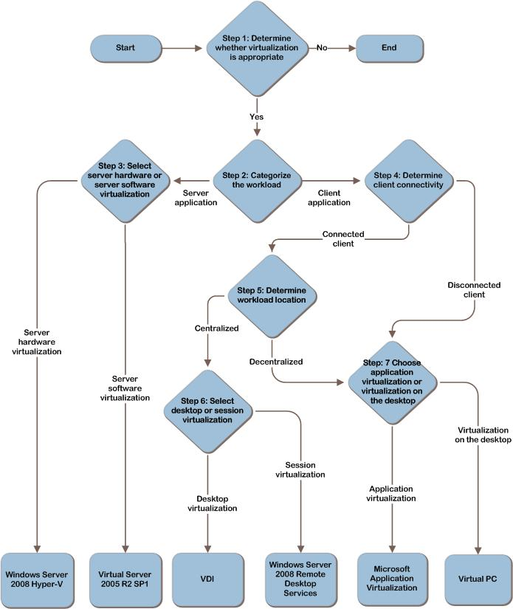
Decision Flow
Walk through the scenario for each workload
Arrive at a decision
Repeat for each scenario
Notes:
This slide depicts the decision flow that can be used to determine the appropriate virtualization technology for each workload.

Slide 10
Step 1: Determine Whether Virtualization Is Appropriate
Areas to consider when determining whether virtualization is appropriate:
Compatibility
Supportability
Licensing
Business benefits
Notes:
Step 1: Determine Whether Virtualization Is Appropriate
The purpose of the step is to determine whether virtualization is appropriate for a specific situation. Areas to consider when determining whether virtualization is appropriate include:
Compatibility. Determine whether the workload can run in a virtualized environment.
Supportability. Determine whether the workload is supported in a virtualized environment. It might be necessary to verify non-Microsoft vendors’ policies for deployment of the workload on all the virtualization technologies that will be used.
Licensing. Determine whether the workload can be licensed for use in a virtualized environment.
Business benefits. Determine the business reasons for virtualizing the workload and the related benefits. Potential benefits include cost savings, reduced deployment time, and reduced administration costs.

Slide 11
Step 2: Categorize the Workload
Is the workload designed to run on:
A server operating system?
Proceed to “Select Server Hardware or Server Software Virtualization”
A client operating system?
Proceed to “Determine Client Connectivity”
Notes:
Step 2: Categorize the Workload
Workloads designed for server operating systems typically have different resource requirements and different levels of interactivity than those designed for client workloads.
The decision flow branches here, so proceed down the appropriate path based on this decision.

Slide 12
Step 3: Select Server Hardware or Server Software Virtualization
Use the table below to select between:
Windows Server 2008 R2 Hyper-V technology
Virtual Server 2005 R2 with SP1
Criteria | Windows Server 2008 R2 Hyper-V | Virtual Server 2005 R2 with SP1
32-bit host
64-bit host
Multiple CPU support for guest operating system
Enhanced management tools
Type 1 hypervisor (server hardware virtualization)
Server software virtualization
Notes:
Step 3: Select Server Hardware or Server Software Virtualization
Microsoft offers two server virtualization products:
Windows Server 2008 R2 Hyper-V, which provides server hardware virtualization.
Virtual Server 2005 R2 with SP1, which provides server software virtualization.
This step involves determining which product will deliver the most appropriate platform for virtualization based on the technical needs of the environment. The table compares the capabilities of the server virtualization products.
Option 1: Use Windows Server 2008 R2 Hyper-V
Windows Server 2008 R2 Hyper-V offers the advantage of being a hypervisor-based solution. The thin hypervisor implementation dramatically reduces the overhead of virtualization. Windows Server 2008 R2 Hyper-V is available as part of the Windows Server 2008 R2 platform. It requires hardware-assisted virtualization (Intel VT or AMD-V processor).
For detailed design planning information on Windows Server 2008 R2 Hyper-V, refer to the Infrastructure Planning and Design Guide for Windows Server Virtualization at http://go.microsoft.com/fwlink/?LinkID=147617.
Option 2: Use Virtual Server 2005 R2 with SP1
If the hardware on which the virtualization platform will be installed does not support hardware-based virtualization extensions (Intel VT or AMD-V processor), then server software virtualization is the only choice. For detailed design planning information on Virtual Server 2005 R2 with SP1, refer to the Infrastructure Planning and Design Guide for Windows Server Virtualization at http://go.microsoft.com/fwlink/?LinkID=147617.

Slide 13
Step 4: Determine Client Connectivity
Option 1: Connected Client
Client computers that will have reliable network connections
Client computers that will not need to run the workload when disconnected from the network
Proceed to “Determine Workload Location”
Option 2: Disconnected Client
Client computers that will run the workload while disconnected from the network
Proceed to “Choose Application Virtualization or Virtualization on the Desktop”
Notes:
Step 4: Determine Client Connectivity
This step focuses on narrowing the options for virtualization based on the network requirements of client machines. Computers that are always connected to the network will be able to rely on server-based technologies, whereas those that are not always connected must have locally accessible applications.
Option 1: Connected Client
Client computers that will always be connected to the network when running a particular workload can rely upon the network in order to access their applications and data. Typical scenarios include corporate desktop computers and kiosks as well as some computers used in remote offices and home offices. This option should be selected when client computers will have reliable network connections and do not need to run applications when not connected to the network. If the client will always be connected, proceed to Step 5: “Determine Workload Location.”
Option 2: Disconnected Client
Client computers that must have the ability to run virtualized applications while disconnected from the network will require versions of the applications that are resident on the disconnected computer. These options are most useful for situations in which users need only occasional access to applications while traveling or when network connections are unreliable. If the client may run disconnected, proceed to Step 7: “Choose Application Virtualization or Virtualization on the Desktop.”

Slide 14
Step 5: Determine Workload Location
Option 1: Centralized Workload
The workload can be run and managed on a server
Tight control is required, and workload resources are in a central location
Easier to deploy and manage
If the workload will be run centralized, proceed to “Select Desktop or Presentation Virtualization”
Option 2: Decentralized Workload
The workload cannot run on a server
Individualized configurations are required by different users
Access to local resources is required
If the workload will be run decentralized, proceed to “Choose Application Virtualization or Virtualization on the Desktop”
Notes:
Step 5: Determine Workload Location
The next decision for connected client systems is to determine where the workload should be run. Depending on the technology choices that have been made previously, the virtualized workload can either run as a centralized workload or a decentralized workload.
Option 1: Centralized Workload
If the workload can be centrally managed and efficiently run from a server, consider a centralized approach to application virtualization. This is beneficial when the workload configuration needs to be tightly controlled or when resources must be centrally managed. It allows for easier deployment and management of workloads. Proceed to Step 6: “Select Desktop or Session Virtualization.”
Option 2: Decentralized Workload
Some workloads cannot be run from a central server or they require individualized configuration or access to local system resources to run efficiently. These workloads should be deployed using a virtualization method that can be distributed to desktop systems. Proceed to Step 7: “Choose Application Virtualization or Virtualization on the Desktop.”

Slide 15
Step 6: Select Session or Desktop Virtualization
Option 1: Session Virtualization
One or more applications must be virtualized
The applications can support multiple users
Use Windows Server 2008
Option 2: Desktop Virtualization
VDI provides virtualized desktops that can run a wide variety of client or server operating systems, because they are hosted in virtual machines on the Windows Server 2008 operating system
Notes:
Step 6: Select Session or Desktop Virtualization
Now that the decision has been made to centralize, the next decision involves choosing between session virtualization and desktop virtualization. In both cases, users access centralized workloads through a Remote Desktop Protocol (RDP) connection. The client computers can run a full operating system such as Windows 7, or they can run any other operating system that has an available RDP client. They may also be diskless and boot from the network so that no data or applications are stored locally.
Option 1: Session Virtualization
The client’s applications are run directly on the Windows Server 2008 operating system. There will normally be many connected clients that share the operating system and the applications, so clients cannot be granted administrative rights. All applications that are installed on the server must be able to run on the same Windows Server 2008 operating system. Any incompatibilities should be managed by using another application virtualization technology, such as Microsoft Application Virtualization (App-V).
Option 2: Desktop Virtualization
VDI provides virtualized desktops that can run a wide variety of client or server operating systems, because they are hosted in virtual machines on the Windows Server 2008 operating system. Because there will normally be only one user on the client’s operating system, he or she may be granted administrative rights.

Slide 16
Step 7: Choose Application Virtualization or Virtualization on the Desktop
Option 1: Application Virtualization
One or more applications must be virtualized
The client’s operating system supports the application
Use App-V
Option 2: Virtualization on the Desktop
The entire desktop must be virtualized— both the operating system and the applications
The client operating system is Windows XP or Windows Vista®
Use Windows Virtual PC
Notes:
Step 7: Choose Application Virtualization or Virtualization on the Desktop
This decision step determines whether the application being considered is better implemented in application virtualization or virtualization on the desktop.
Option 1: Application Virtualization
App-V provides a method for installing applications into a virtualized environment via MSI or streaming them on demand. Application processing will occur on client computers. App-V requires that client computers have a complete client operating system that supports the virtualized applications as well as meeting the hardware requirements for applications that will be deployed and executed on that computer. Sufficient network bandwidth for deploying applications must also be available. See the Infrastructure Planning and Design Guide for Microsoft Application Virtualization 4.6 at http://go.microsoft.com/fwlink/?LinkId=160978.
Option 2: Virtualization on the Desktop
Windows Virtual PC allows users to run entire client operating systems on their local computers. To support this configuration, the client computer must have sufficient CPU, memory, disk, and network resources to support the base Windows operating system as well as resources for each virtual machine that will be supported. Windows Virtual PC provides support for running legacy applications and operating systems. Windows XP Mode provides a tailored Windows XP virtual machine that runs on Windows Virtual PC in Windows 7. Users can create a wide variety of different virtual machines and can start and stop them as needed. This solution is particularly helpful for software developers and testers who often require access to multiple different platforms.

Slide 17
Additional Considerations
Managing the Virtualization Environment
Microsoft provides two products to assist with the challenges of managing a virtualized environment:
System Center Virtual Machine Manager
MED-V
Microsoft virtualization management products can be used to manage the organization’s virtualized environment—for example, to quickly provision new virtual machines
Notes:
Additional Considerations
After selecting the most appropriate virtualization technology for each requirement, decide how the virtualized environment will be managed, and determine whether virtualization technologies should be used separately or together in combination.
Managing the Virtualization Environment
Microsoft provides two products—System Center Virtual Machine Manager and MED-V—to assist with the challenges of managing a virtualized environment. Some of the benefits that can be realized by using Microsoft virtualization management products to manage the organization’s virtualized environment include:
Optimal consolidation of underutilized physical servers.
Rapid provisioning of new virtual machines.
Maximization of data center resources.
Integration with Microsoft System Center Operations Manager 2007 reporting.
System Center Virtual Machine Manager
System Center Virtual Machine Manager is a stand-alone application that provides centralized, enterprise-class management of virtual machines that run on Windows Server 2008 Hyper-V, Virtual Server 2005 R2 with SP1, and VMware ESX (through VMware Virtual Center). As part of the System Center family, System Center Virtual Machine Manager integrates with the other System Center products to provide end-to-end physical and virtual infrastructure management.
MED-V
MED-V enhances deployment and management of Windows Virtual PC images on a Windows desktop while also providing a seamless user experience of a Windows Virtual PC environment, independent of the local desktop configuration and operating system. MED-V utilizes Windows Virtual PC to provide an enterprise solution for desktop virtualization and is an integral component of the MDOP.

Slide 18
Summary and Conclusion
Microsoft provides a family of virtualization solutions
Select which solution is most appropriate for each workload:
Workload location
User characteristics
Management requirements
Characteristics of the workload
Provide feedback to ipdfdbk@microsoft.com

Slide 19
Find More Information
Download the full document and other IPD guides:
www.microsoft.com/ipd
Contact the IPD team:
ipdfdbk@microsoft.com
Access the Microsoft Solution Accelerators website:
www.microsoft.com/technet/SolutionAccelerators

Slide 20
Questions?

Slide 21
Addenda
Benefits of using the Selecting the Right Virtualization Technology guide
IPD in Microsoft Operations Framework 4.0

Slide 22
Benefits of Using the Selecting the Right Virtualization Technology Guide
Benefits for Business Stakeholders/Decision Makers
Most cost-effective design solution for implementation
Alignment between the business and IT from the beginning of the design process to the end
Benefits for Infrastructure Stakeholders/Decision Makers
Authoritative guidance
Business validation questions ensuring solution meets requirements of business and infrastructure stakeholders
High-integrity design criteria that includes product limitations
Fault-tolerant infrastructure
Proportionate system and network availability to meet business requirements
Infrastructure that’s sized appropriately for business requirements
Notes:
Benefits of Using the Selecting the Right Virtualization Technology Guide
Benefits for Business Stakeholders/Decision Makers:
Most cost-effective design solution for an implementation. IPD eliminates over-architecting and over-spending by precisely matching the technology solution to the business needs.
Alignment between the business and IT from the beginning of the design process to the end.
Benefits for Infrastructure Stakeholders/Decision Makers:
Authoritative guidance. Microsoft is the best source for guidance about the design of Microsoft products.
Business validation questions to ensure the solution meets the requirements of both business and infrastructure stakeholders.
High-integrity design criteria that includes product limitations.
Fault-tolerant infrastructure, where necessary.
Proportionate system and network availability to meet business requirements.
Infrastructure that is sized appropriately to meet business requirements.

Slide 23
Benefits of Using the Selecting the Right Virtualization Technology Guide (Continued)
Benefits for Consultants or Partners
Rapid readiness for consulting engagements
Planning and design template to standardize design and peer reviews
A “leave-behind” for pre- and post-sales visits to customer sites
General classroom instruction/preparation
Benefits for the Entire Organization
Using the guide should result in a design that will be sized, configured, and appropriately placed to deliver a solution for achieving stated business requirements
Notes:
Benefits of Using the Selecting the Right Virtualization Technology Guide (Continued)
Benefits for Consultants or Partners:
Rapid readiness for consulting engagements.
Planning and design template to standardize design and peer reviews.
A “leave-behind” for pre- and post-sales visits to customer sites.
General classroom instruction/preparation.
Benefits for the Entire Organization:
Using the guide should result in a design that will be sized, configured, and appropriately placed to deliver a solution for achieving stated business requirements, while considering the performance, capacity, manageability, and fault tolerance of the system.

Slide 24
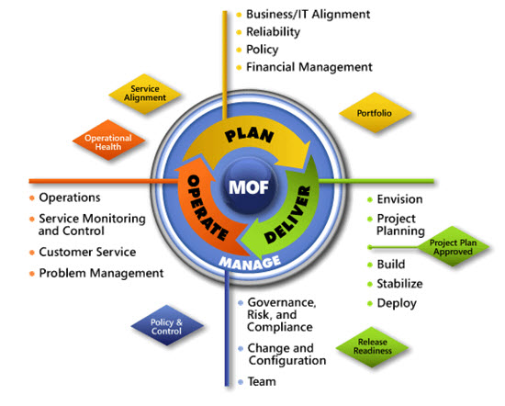
IPD in Microsoft Operations Framework 4.0
Use MOF with IPD guides to ensure that people and process considerations are addressed when changes to an organization’s IT services are being planned.
Notes:
For more information about Microsoft Operations Framework 4.0, go to www.microsoft.com/mof.

