Slide 1
Selecting the Right Network Access Protection (NAP) Architecture
Infrastructure Planning and Design
Published: June 2008
Updated: November 2011
Notes:
Copyright © 2011 Microsoft Corporation. All rights reserved. Complying with the applicable copyright laws is your responsibility. By using or providing feedback on this documentation, you agree to the license agreement below.
If you are using this documentation solely for non-commercial purposes internally within YOUR company or organization, then this documentation is licensed to you under the Creative Commons Attribution-NonCommercial License. To view a copy of this license, visit http://creativecommons.org/licenses/by-nc/2.5/ or send a letter to Creative Commons, 543 Howard Street, 5th Floor, San Francisco, California, 94105, USA.
This documentation is provided to you for informational purposes only, and is provided to you entirely "AS IS". Your use of the documentation cannot be understood as substituting for customized service and information that might be developed by Microsoft Corporation for a particular user based upon that user’s particular environment. To the extent permitted by law, MICROSOFT MAKES NO WARRANTY OF ANY KIND, DISCLAIMS ALL EXPRESS, IMPLIED AND STATUTORY WARRANTIES, AND ASSUMES NO LIABILITY TO YOU FOR ANY DAMAGES OF ANY TYPE IN CONNECTION WITH THESE MATERIALS OR ANY INTELLECTUAL PROPERTY IN THEM.
Microsoft may have patents, patent applications, trademarks, or other intellectual property rights covering subject matter within this documentation. Except as provided in a separate agreement from Microsoft, your use of this document does not give you any license to these patents, trademarks or other intellectual property.
Information in this document, including URL and other Internet Web site references, is subject to change without notice. Unless otherwise noted, the example companies, organizations, products, domain names, e-mail addresses, logos, people, places and events depicted herein are fictitious.
Microsoft, Active Directory, Microsoft Press, Windows, Windows Server, and Windows Vista are either registered trademarks or trademarks of Microsoft Corporation in the United States and/or other countries and regions.
The names of actual companies and products mentioned herein may be the trademarks of their respective owners.
You have no obligation to give Microsoft any suggestions, comments or other feedback ("Feedback") relating to the documentation. However, if you do provide any Feedback to Microsoft then you provide to Microsoft, without charge, the right to use, share and commercialize your Feedback in any way and for any purpose. You also give to third parties, without charge, any patent rights needed for their products, technologies and services to use or interface with any specific parts of a Microsoft software or service that includes the Feedback. You will not give Feedback that is subject to a license that requires Microsoft to license its software or documentation to third parties because we include your Feedback in them.

Slide 2
What Is IPD? Guidance that clarifies and streamlines the planning and design process for Microsoft® infrastructure technologies
IPD:
Defines decision flow
Describes decisions to be made
Relates decisions and options for the business
Frames additional questions for business understanding
IPD guides are available at www.microsoft.com/ipd
Notes:
Infrastructure Planning and Design (IPD) is a series of planning and design guides created to clarify and streamline the planning and design process for Microsoft® infrastructure technologies.
Each guide in the series addresses a unique infrastructure technology or scenario.
These guides include the following topics:
Defining the technical decision flow (flow chart) through the planning process.
Describing the decisions to be made and the commonly available options to consider in making the decisions.
Relating the decisions and options for the business in terms of cost, complexity, and other characteristics.
Framing the decisions in terms of additional questions for the business to ensure a comprehensive understanding of the appropriate business landscape.
The guides in this series are intended to complement and augment Microsoft product documentation. It is assumed that the reader has a basic understanding of the technologies discussed in these guides. It is the intent of these guides to define business requirements, then align those business requirements to product capabilities, and design the appropriate infrastructure.

Slide 3
Getting Started
Selecting the Right NAP Architecture
Notes:
The Selecting the Right NAP Architecture guide was created to enable infrastructure planners to make the appropriate component decisions used in conjunction with a NAP deployment.

Slide 4
Purpose and Overview
Purpose
To provide design guidance for a NAP infrastructure
Overview
Selecting the Right NAP architecture
Selecting the Right NAP infrastructure design process
Notes:
The guide focuses on the elements that organizations must consider when designing a NAP infrastructure.

Slide 5
What Is NAP?
Network Access Protection is a policy-based solution that:
Validates whether computers meet health policies
Can limit access for noncompliant computers
Automatically remediates noncompliant computers
Continuously updates compliant computers to maintain health state
Offers administrators a wide range of choice and deployment flexibility to better secure their Windows® networks
Notes:
Network Access Protection (NAP) is a policy enforcement platform that allows better protection of network assets by enforcing compliance with system health requirements.
With Network Access Protection, administrators can create customized health policies to validate computer health before allowing access or communication, automatically update compliant computers to ensure ongoing compliance, or limit the access of noncompliant computers to a restricted network until they become compliant.
Network Access Protection functions on four levels. It:
Validates compliance to health and security policy.
Restricts access to the network resources based on that compliance.
Automatically remediates clients to a compliant health state.
Ensures the client’s ongoing compliance to policy.

Slide 6
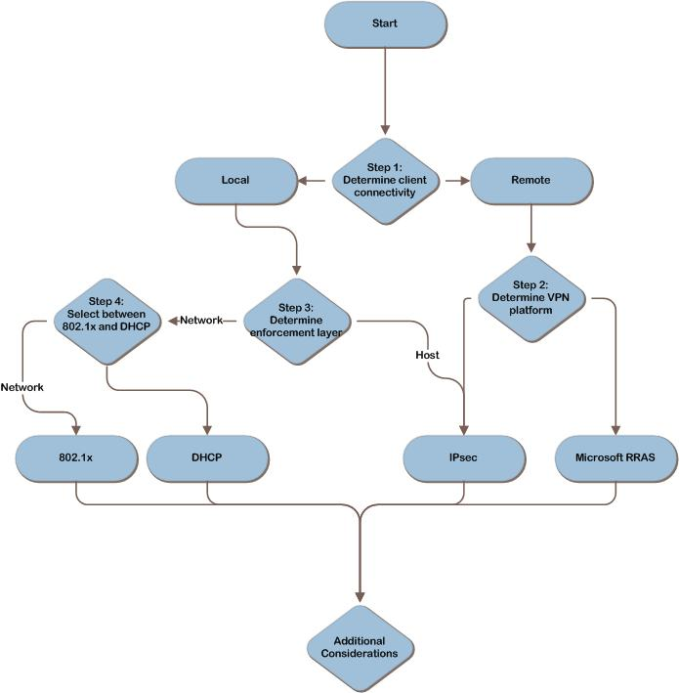
NAP Decision Flow
MAP w/ CAL Tracker
Notes:
The NAP design flow provides a graphical overview of the steps in designing a NAP infrastructure.
These steps are:
Determine Client Connectivity
Determine the VPN Platform
Determine the Enforcement Layer
Select Between 802.1X and DHCP
Each of these steps will be discussed in the following slides.

Slide 7
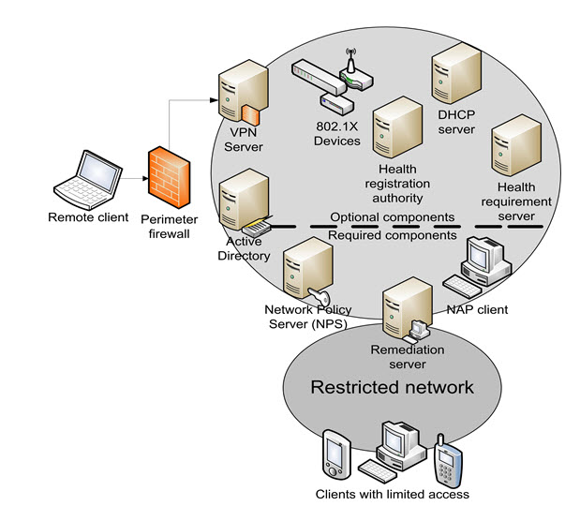
Example NAP Architecture
ITA
Notes:
This slide illustrates all of the possible components of the NAP infrastructure.

Slide 8
Why Implement NAP?
Controlled access for guests, vendors, partners
Improved resilience to malware as network health increases
More robust update infrastructure
Managed compliance
Notes:
Why implement NAP?
NAP provides investment protection, interoperability, and reduced deployment costs.
Controlled access for guests, vendors, and partners.
NAP allows IT to enforce organizational policies when client computers attempt to connect to the corporate network. These policies are referred to as health policies. When a client device meets the health policy requirements, it is considered compliant.
NAP uses a restricted network.
This logically or physically separate network includes remediation servers. These servers—such as those hosting software updates and antivirus signature updates—can update NAP client devices to help them become compliant with the organization’s health policies.
Client computers and servers that are not NAP-capable can be exempted from the NAP restrictions so that they can continue to use the network. They can be placed on the restricted network or granted exemptions that allow them to access the internal network.
Improved resilience to malware as network health increases.
NAP uses Network Policy Servers. These servers run Windows Server 2008 and the Network Policy Server (NPS) service. NPS is the Windows Server 2008 implementation of Remote Authentication Dial-In User Service (RADIUS). NPS replaces Internet Authentication Service (IAS), the version of RADIUS included in Windows Server 2003. In a NAP deployment, NPS acts as the health policy server regardless of enforcement method; it also provides authentication, authorization, and accounting services when 802.1X is the enforcement method.
NAP uses health requirement servers. These computers define the current compliance state for health policy servers—for example, an antivirus server that tracks the latest version of the software’s antivirus signature file. Some examples of health requirement servers are Microsoft System Center Configuration Manager, Microsoft Windows Server Update Services, and Microsoft System Center Operations Manager.
More robust update infrastructure and managed compliance.
NAP continuously updates compliant computers to maintain health state.

Slide 9
Key Messages for NAP
The NAP client can be Windows Server® 2008, Windows Vista®, Windows XP SP3, or third party (Linux + Macintosh)
NAP is built into Windows that is enabled via GP/script
NAP requires a minimum of one Windows Server 2008 machine to get started
Notes:
Key Messages for NAP
Microsoft built the Network Access Protection platform with client and server components.
The client side is built into Windows Vista and will be included in Windows XP SP 3.
The server components are being shipped with Windows Server 2008.

Slide 10
NAP Enforcement Options
Enforcement options | Capabilities
IPsec – implemented at host layer | Restricts client device communication to a limited number of servers until compliance is demonstrated
802.1X – implemented at network layer | Client device’s access is restricted by network infrastructure devices. Client access is restricted until device has demonstrated compliance
VPN – Microsoft VPN | VPN server restricts client device’s access by using IP filters until client device has demonstrated compliance
DHCP – implemented at network layer | DHCP client is restricted by providing a 32-bit netmask and removing the default gateway
Notes:
NAP Enforcement Options
NAP allows IT to enforce organizational policies, called health policies, when client computers attempt to connect to the corporate network. When a client device meets the health policy requirements, it is considered compliant.
Four methods are available for restricting client devices until they have demonstrated that they meet the policy requirements. IT pros can implement a single method or combine several methods to increase the robustness of the solution.
IPsec Enforcement:
The client device is able to communicate with only a limited number of servers until it has demonstrated its compliance. Other managed systems will ignore network traffic from these client devices unless they prove their compliance or are exempted from compliance checks. When compliance has been confirmed, the client device achieves unrestricted access because the managed systems are able to recognize that its compliance status has been established.
Can be complex to deploy because it relies on IPsec and certificates issued from a public key infrastructure (PKI).
Is robust and does not involve upgrading infrastructure components such as Ethernet switches or DHCP servers.
802.1X Enforcement:
Either wired or wireless networks—the client device’s access is restricted by network infrastructure devices such as wireless connection points and switches. Until the device has demonstrated its compliance, client access is restricted.
Restriction is enforced on the network access device using an access control list (ACL) or by placing the client device on restricted virtual local area networks (VLANs).
More complex to deploy than DHCP, but provides a high degree of protection.
VPN Enforcement:
The VPN server restricts the client device’s access by using IP filters until the client device has demonstrated its compliance. When compliance has been proven, the VPN server lifts the restrictions and grants the client device full access.
Less complex than either IPsec or 802.1X, but can restrict only remote client devices.
Not appropriate for controlling access to client devices that connect locally.
RRAS service in Windows Server 2008 and the Microsoft VPN client included with Windows XP with SP3, Windows Server 2008, and Windows Vista.
DHCP Enforcement:
Simplest to deploy, it is the easiest for malicious users to bypass if they have administrative privileges on their computers because they can manually configure their computers with a static IP address, which avoids all DHCP enforcement capabilities.

Slide 11
Step 1: Determine Client Connectivity
Task 1: Select the Scope of NAP Clients
Type of network connectivity dictates appropriate enforcement methods. Client devices connect two ways:
Locally—via wired or wireless
Remotely—such as VPN
Notes:
Step 1: Determine Client Connectivity
Task 1: Select the Scope of NAP Clients
Client devices connect to a corporate network in either of two ways: locally, through a wired or wireless interface; or using a remote connection such as a VPN. The type of network connectivity dictates which enforcement methods are appropriate for consideration.
An organization could initially deploy NAP to enforce compliance requirements for managed VPN clients. IT may need to grant exemptions if staff members are allowed to connect to the VPN using unmanaged systems (for example, their own personal computers). When the IT team has become more familiar and the system health policies have been tuned appropriately, local enforcement can be put into effect.
Some organizations will initially deploy NAP for managing locally connected computers; others will use NAP for both local and remote clients.

Slide 12
Step 2: Determine VPN Platform
Option 1: Microsoft VPN
If IT selects RRAS to provide remote access, VPN server must run Windows Server 2008
Low level of complexity and cost to implement
Option 2: Third-Party VPN
If IT selects a third-party VPN, IPsec can be used to restrict client device access
High level of complexity and medium cost to implement
Notes:
Step 2: Determine VPN Platform
There are two options for defining the organization’s VPN platform: Microsoft or third-party.
If IT uses RRAS to provide remote access to the corporate network, packet filtering can be used at the VPN server to control client device access until devices have proven that they meet the organization’s compliance requirement policies. If another technology is used for the VPN, IPsec must be used as the enforcement method.
Option 1: Microsoft VPN
If RRAS provides remote clients with VPN access to the corporate network, NAP enforcement can be implemented using packet filters on the VPN server—a simple process.
To support NAP with VPN enforcement, IT pros must update the VPN server to run Windows Server 2008.
Option 2: Third-Party VPN
If a third-party VPN solution is used, IPsec must be used to restrict access for client devices that have not proven that they meet the organization’s health policies.
Procedures for implementing IPsec are well documented, and the Windows operating system includes tools for managing IPsec.

Slide 13
Step 3: Determine the Enforcement Layer
Option 1: Enforce Restrictions at the Host
Using IPsec provides robust security
High level of complexity and medium cost to implement
Option 2: Enforce Restrictions on the Network
Depending on specific network-based enforcement method, security level less robust than IPsec
Medium level of complexity and high cost to implement
Notes:
Step 3: Determine the Enforcement Layer
For clients connecting to the network locally, there are two options:
Option 1: Enforce Restrictions at the Hosts
With IPsec enforcement, hosts on the network ignore traffic from client devices that haven’t proven they meet the organization’s health policies. Its benefits include:
Powerful method of protecting compliant computers from other computers.
Can be combined with server and domain isolation ensuring that when a system has demonstrated compliance, it will still be restricted to communicating only with authorized hosts.
Network packets are digitally signed, reducing the risk of man-in-the-middle and replay attacks.
Traffic can be encrypted with IPsec, providing a high degree of protection from eavesdropping attacks.
Windows Server 2008 includes tools for managing and monitoring IPsec, eliminating much of the associated complexity. However, IPsec enforcement is more complex than DHCP enforcement.
The cost of acquiring IPsec technology is low because support for it is built into all versions of the Windows operating system that support NAP.
Option 2: Enforce Restrictions on the Network
Enforcing restrictions on the network means that either 802.1X or DHCP will be used to prevent clients that do not meet the organization’s health policies from accessing the network.
One advantage both have over IPsec is that noncompliant devices are able to communicate only with hosts on the remediation network because they are unable to send traffic to any other segments of the network.

Slide 14
Step 4: Select Between 802.1X and DHCP
Option 1: 802.1X Enforcement
Can be more complex and expensive
Switches and wireless access points must support the 802.1X authentication protocol – meaning possible hardware upgrades
Robust choice that offers a high degree of protection. Until a client device has demonstrated that it meets the organization’s compliance requirements, the network switches and wireless access points will restrict its access to the network. These restrictions will be difficult to bypass, even by a determined malicious user
Option 2: DHCP Enforcement
Simplest and least-expensive enforcement option. Until a computer has been proven to meet the organization’s health policies, the DHCP server assigns it an IPv4 address configuration that restricts its access to a portion of the network
Requires Windows Server 2008. Many organizations begin their testing and pilot deployments of NAP using DHCP enforcement because it can be deployed quickly
One significant drawback: DHCP is easily bypassed by users who have administrative privileges on their computers. This means it is trivial for a malicious user and relatively easy for a technically savvy one
Notes:
Step 4: Select Between 802.1X and DHCP
Selecting Between 802.1X and DHCP
If IT decides to enforce NAP restrictions at the network layer, the organization must choose between two methods: 802.1X and DHCP.
Option 1: 802.1X Enforcement:
Can be more complex and expensive.
Switches and wireless access points must support the 802.1X authentication protocol – meaning possible hardware upgrades.
Robust choice that offers a high degree of protection. Until a client device has demonstrated that it meets the organization’s compliance requirements, the network switches and wireless access points will restrict its access to the network. These restrictions will be difficult to bypass, even by a determined malicious user.
Option 2: DHCP Enforcement:
Simplest and least-expensive enforcement option. Until a computer has been proven to meet the organization’s health policies, the DHCP server assigns it an IPv4 address configuration that restricts its access to a portion of the network.
Requires Windows Server 2008. Many organizations begin their testing and pilot deployments of NAP using DHCP enforcement because it can be deployed quickly.
One significant drawback: DHCP is easily bypassed by a user who has administrative privileges on his or her computer. This means that it is trivial for a malicious user and relatively easy for a technically savvy one.

Slide 15
NAP Restrictions – Host vs. Network Enforcement
Use the table below to select between:
IPsec – host-based
802.1X – network-based
DHCP – network-based
Method | Security Level | Complexity | Cost
IPsec | High | High | Medium
8021.1X | High | Medium | High
DHCP | Low | Low | Low
Notes:
NAP Restrictions – Host vs. Network Enforcement
Selecting IPsec
With IPsec enforcement, hosts on the network will ignore traffic from client devices that have not proven that they meet the organization’s health policies. This is a powerful method of protecting compliant computers from other computers. Additionally, it can be combined with server and domain isolation to ensure that when a system has demonstrated its compliance, it will still be restricted to communicating only with authorized hosts. IPsec provides other benefits, as well. For example, network packets are digitally signed, which reduces the risk of man-in-the-middle and replay attacks. Also, traffic can be encrypted with IPsec, which provides a high degree of protection from eavesdropping attacks.
Windows Server 2008 includes tools for managing and monitoring IPsec that eliminate much of the associated complexity. Nevertheless, IPsec enforcement is more complex than DHCP enforcement. The cost of acquiring IPsec technology is low, however, because support for it is built into all versions of Windows operating systems that support NAP.
Choosing Between 802.1X and DHCP
If IT decides to enforce NAP restrictions at the network layer, the organization must choose between two methods: 802.1X and DHCP. See the previous slide for details about choosing between 802.1X and DHCP.

Slide 16
Additional Considerations
Determining system compliance requirements
Combining NAP technologies
Dependencies
Notes:
Additional Considerations
Determining system compliance requirements:
The organization must consider which characteristics will be checked on the client devices for them to be considered compliant. It may decide to use only what is already present on the client devices; conversely, it may find merit in the idea of rolling out additional technologies for system health checks and remediation in conjunction with the NAP deployment. The NAP client is able to verify the following range of items when conducting the system compliance check:
Are malware-prevention technologies, such as antivirus and antispyware software, enabled and up to date?
Are automatic updates for Windows-based computers enabled?
Are all current security updates installed?
Is a host-based firewall enabled and configured correctly?
Combining NAP technologies:
The steps presented in the guide may imply that each enforcement technology will be implemented alone, but it is possible to use multiple enforcement methods simultaneously. An organization might invest additional resources into combining these enforcement technologies because they have complementary strengths and weaknesses:
RRAS can be used to enforce organizational compliance policies on remote client devices.
IPsec could be used for local client devices.
The 802.1X protocol and IPsec offer a particularly robust combination because together they can restrict network connectivity at multiple layers of the network protocol stack.
Keep in mind that the complexity of the NAP deployment can increase when combining enforcement methods.
Dependencies:
All NAP enforcement methods rely on NPS in Windows Server 2008 to validate the compliance status of NAP clients. Using DHCP enforcement requires the DHCP service in Windows Server 2008. Using IPsec enforcement requires HRA service in Windows Server 2008. When 802.1X is used, the network devices must be capable of supporting NAP and 802.1X. Using VPN enforcement requires RRAS in Windows Server 2008.

Slide 17
Summary and Conclusion
This guide has focused on summarizing the critical design decisions, activities, and tasks required to enable a successful design of Network Access Protection
Provide feedback to ipdfdbk@microsoft.com
Notes:
Summary and Conclusion
All NAP enforcement methods rely on Network Policy Server service in Windows Server 2008 to validate the compliance status of NAP clients.
These requirements include:
Using DHCP enforcement requires the DHCP service in Windows Server 2008.
Using IPsec enforcement requires HRA service in Windows Server 2008.
When 802.1X is used, the network devices must be capable of supporting NAP and 802.1X.
Using VPN enforcement requires RRAS in Windows Server 2008.

Slide 18
Find More Information
Download the full document and other IPD guides:
www.microsoft.com/ipd
Contact the IPD team:
ipdfdbk@microsoft.com
Access the Microsoft Solution Accelerators website:
www.microsoft.com/technet/SolutionAccelerators

Slide 19
Questions?

Slide 20
Addenda
Benefits of using the Selecting the Right NAP Architecture guide
IPD in Microsoft Operations Framework 4.0
Selecting the Right NAP Architecture in Microsoft Infrastructure Optimization

Slide 21
Benefits of Using the Selecting the Right NAP Architecture Guide
Benefits for Business Stakeholders/Decision Makers
Most cost-effective design solution for implementation
Alignment between the business and IT from the beginning of the design process to the end
Benefits for Infrastructure Stakeholders/Decision Makers
Authoritative guidance
Business validation questions ensuring solution meets requirements of business and infrastructure stakeholders
High-integrity design criteria that includes product limitations
Fault-tolerant infrastructure
Proportionate system and network availability to meet business requirements
Infrastructure that is sized appropriately for business requirements
Notes:
Benefits of Using the Selecting the Right NAP Architecture Guide
Benefits for Business Stakeholders/Decision Makers:
Most cost-effective design solution for an implementation. IPD eliminates over-architecting and over-spending by precisely matching the technology solution to the business needs.
Alignment between the business and IT from the beginning of the design process to the end.
Benefits for Infrastructure Stakeholders/Decision Makers:
Authoritative guidance. Microsoft is the best source for guidance about the design of Microsoft products.
Business validation questions to ensure the solution meets the requirements of both business and infrastructure stakeholders.
High-integrity design criteria that includes product limitations.
Fault-tolerant infrastructure, where necessary.
Proportionate system and network availability to meet business requirements.
Infrastructure that is sized appropriately to meet business requirements.

Slide 22
Benefits of Using the Selecting the Right NAP Architecture Guide (Continued)
Benefits for consultants or partners
Rapid readiness for consulting engagements
Planning and design template to standardize design and peer reviews
A “leave-behind” for pre- and post-sales visits to customer sites
General classroom instruction/preparation
Benefits for the entire organization
Using the guide should result in a design that will be sized, configured, and appropriately placed to deliver a solution for achieving stated business requirements
Notes:
Benefits of Using the Selecting the Right NAP Architecture Guide (Continued)
Benefits for Consultants or Partners:
Rapid readiness for consulting engagements.
Planning and design template to standardize design and peer reviews.
A “leave-behind” for pre- and post-sales visits to customer sites.
General classroom instruction/preparation.
Benefits for the Entire Organization:
Using the guide should result in a design that will be sized, configured, and appropriately placed to deliver a solution for stated business requirements, while considering the performance, capacity, manageability, and fault tolerance of the system.

Slide 23
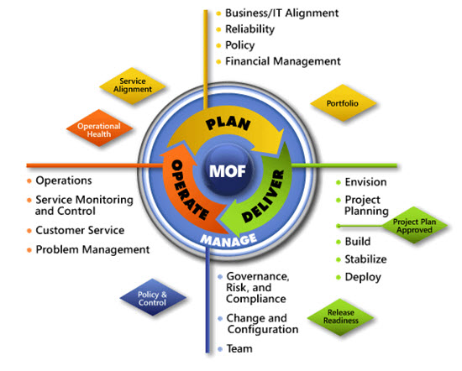
IPD in Microsoft Operations Framework 4.0
Use MOF with IPD guides to ensure that people and process considerations are addressed when changes to an organization’s IT services are being planned
Notes:
For more information about Microsoft Operations Framework 4.0, go to www.microsoft.com/mof.

Slide 24
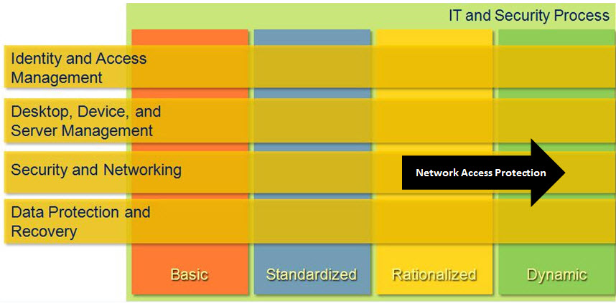
Selecting the Right NAP Architecture in Microsoft Infrastructure Optimization
Notes:
<This slide shows the effect that Selecting the Right NAP Architecture has on infrastructure maturity as reflected in the Core Infrastructure Optimization Model.>
The Infrastructure Optimization (IO) Model at Microsoft groups IT processes and technologies across a continuum of organizational maturity. (For more information, see http://go.microsoft.com/fwlink/?LinkId=229236.) The model was developed by industry analysts, the Massachusetts Institute of Technology (MIT) Center for Information Systems Research and Microsoft's own experiences with its enterprise customers. A key goal for Microsoft in creating the Infrastructure Optimization Model was to develop a simple way to use a maturity framework that is flexible and can easily be applied as the benchmark for technical capability and business value.
IO is structured around three IO models: the Core IO Model, the Application Platform IO Model, and the Business Productivity IO Model. According to the Core IO Model, controlling which client computers can access network resources based on their current compliance status helps move an organization toward the Dynamic level. NAP gives administrators control over which client computers are allowed full access to the internal network by enforcing organizational policies such as required patch levels or the use of antivirus software. This guide assists IT pros in planning and designing the infrastructure for a NAP implementation.

