Slide 1
Microsoft® SQL Server® 2008 and SQL Server 2008 R2
Infrastructure Planning and Design
Published: February 2009
Updated: May 2010
Notes:
Copyright © 2010 Microsoft Corporation. This documentation is licensed to you under the Creative Commons Attribution License. To view a copy of this license, visit http://creativecommons.org/licenses/by/3.0/us/ or send a letter to Creative Commons, 543 Howard Street, 5th Floor, San Francisco, California, 94105, USA. When using this documentation, provide the following attribution: Infrastructure Planning and Design is provided with permission from Microsoft Corporation.
This documentation is provided to you for informational purposes only, and is provided to you entirely "AS IS". Your use of the documentation cannot be understood as substituting for customized service and information that might be developed by Microsoft Corporation for a particular user based upon that user’s particular environment. To the extent permitted by law, MICROSOFT MAKES NO WARRANTY OF ANY KIND, DISCLAIMS ALL EXPRESS, IMPLIED AND STATUTORY WARRANTIES, AND ASSUMES NO LIABILITY TO YOU FOR ANY DAMAGES OF ANY TYPE IN CONNECTION WITH THESE MATERIALS OR ANY INTELLECTUAL PROPERTY IN THEM.
Microsoft may have patents, patent applications, trademarks, or other intellectual property rights covering subject matter within this documentation. Except as provided in a separate agreement from Microsoft, your use of this document does not give you any license to these patents, trademarks or other intellectual property.
Information in this document, including URL and other Internet Web site references, is subject to change without notice. Unless otherwise noted, the example companies, organizations, products, domain names, e-mail addresses, logos, people, places and events depicted herein are fictitious.
Microsoft, Excel, Hyper-V, SharePoint, SQL Azure, SQL Server, Windows, and Windows Server are either registered trademarks or trademarks of Microsoft Corporation in the United States and/or other countries.
The names of actual companies and products mentioned herein may be the trademarks of their respective owners.
You have no obligation to give Microsoft any suggestions, comments or other feedback (“Feedback”) relating to the documentation. However, if you do provide any Feedback to Microsoft then you provide to Microsoft, without charge, the right to use share and commercialize your Feedback in any way and for any purpose. You also give to third parties, without charge, any patent rights needed for their products, technologies and services to use or interface with any specific parts of a Microsoft software or service that includes the Feedback. You will not give Feedback that is subject to a license that requires Microsoft to license its software or documentation to third parties because we include your Feedback in them.

Slide 2
What is IPD? Guidance that clarifies and streamlines the planning and design process for Microsoft® infrastructure technologies
IPD:
Defines decision flow
Describes decisions to be made
Relates decisions and options for the business
Frames additional questions for business understanding
IPD guides are available at www.microsoft.com/ipd
Notes:
Infrastructure Planning and Design (IPD) is a series of planning and design guides created to clarify and streamline the planning and design process for Microsoft® infrastructure technologies.
Each guide in the series addresses a unique infrastructure technology or scenario.
These guides include the following topics:
Defining the technical decision flow (flow chart) through the planning process.
Describing the decisions to be made and the commonly available options to consider in making the decisions.
Relating the decisions and options for the business in terms of cost, complexity, and other characteristics.
Framing the decisions in terms of additional questions for the business to ensure a comprehensive understanding of the appropriate business landscape.
The guides in this series are intended to complement and augment Microsoft product documentation.

Slide 3
Getting Started
Microsoft® SQL Server® 2008 and SQL Server 2008 R2
Notes:
The guide is designed to provide a consistent structure for addressing the decisions and activities that are most critical to the successful implementation of Microsoft® SQL Server® 2008 and SQL Server 2008 R2 data management software.
Each decision or activity is subdivided into four elements:
Background on the decision or activity, including context setting and general considerations.
Typical options or tasks to perform for the activity.
Reference section evaluating the tasks in terms of cost, complexity, and manageability.
Questions for the business that may have a significant impact on the decisions to be made.

Slide 4
Purpose and Overview
Purpose
To provide guidance for designing a Microsoft SQL Server 2008 infrastructure, or where applicable, a Microsoft SQL Server 2008 R2 infrastructure
Overview
Microsoft SQL Server 2008 architecture
Microsoft SQL Server 2008 infrastructure design process
Notes:
The purpose of this presentation is to address the decisions and/or activities that need to occur in planning a Microsoft SQL Server 2008 implementation, or where applicable, a Microsoft SQL Server 2008 R2 implementation. The following slides will take an IT pro through the most critical design elements in a well-planned SQL Server 2008 design.

Slide 5
What Is Microsoft SQL Server 2008?
Microsoft SQL Server 2008 is a database solution that includes four primary components:
Database Engine
Integration Services
Analysis Services
Reporting Services
Microsoft SQL Server 2008 R2 includes a fifth component:
Master Data Services
Notes:
SQL Server 2008 includes four primary components:
Database Engine. The Database Engine is the core service for storing, processing, and securing data.
Integration Services. Microsoft SQL Server Integration Services (SSIS) is a platform for building data integration solutions from heterogeneous sources, including packages that provide extract, transform, and load (ETL) processing for data warehousing.
Analysis Services. Microsoft SQL Server Analysis Services (SSAS) supports OLAP (online analytical processing) and data mining functionalities. This allows a database administrator to design and create multidimensional structures that contain data aggregated from other data sources, such as relational databases.
Reporting Services. Microsoft SQL Server Reporting Services (SSRS) delivers enterprise reporting functionality for creating reports that gather content from a variety of data sources, publishing the reports in various formats, and centrally managing their security and subscriptions.
Additionally, SQL Server 2008 R2 introduces a fifth component:
Master Data Services. Master Data Services is a master data management (MDM) application built from platform components that may be deployed as an application or extended by use of the platform components to consistently define and manage the critical data entities of an organization. Master Data Services is an any-domain hub that supports but is not limited to domains such as product, customer, location, cost center, equipment, employee, and vendor.

Slide 6
Microsoft SQL Server 2008 - Out of Scope
Microsoft SQL Server 2008 does not address the following items:
In-place upgrades
Side-by-side upgrades
Developer, Express, Compact, Evaluation, and Parallel Data Warehouse editions of SQL Server
SharePoint integration
Database design
Notes:
Out of Scope. This guide does not address the following:
In-place upgrades, where an older instance of SQL Server is upgraded to SQL Server 2008 R2 on the existing server; therefore, no infrastructure changes occur.
Side-by-side upgrades, where a new instance of SQL Server 2008 R2 is installed on the same server as an instance of SQL Server 2005, and then the data is moved, with no infrastructure changes occurring.
Developer, Express, Compact, Evaluation, and Parallel Data Warehouse editions of SQL Server. The Developer edition has all the capabilities of the Enterprise edition but is not licensed for any form of production use. The Express edition is an entry level database for learning and ISV redistribution. The Compact edition is an embedded database for developing desktop and mobile applications. The Evaluation edition is used for evaluating SQL Server. The Parallel Data Warehouse solution comes preassembled from certified hardware vendors.
Reporting Services can integrate with Microsoft Office SharePoint® Server 2007 to provide a user interface (UI) to administer, secure, manage, view, and deliver reports. SharePoint integration will not be covered in this guide.
Database design as it addresses the structure of the actual database.

Slide 7
What’s New in Microsoft SQL Server 2008 R2
Microsoft SQL Server 2008 R2 has expanded reporting and analytics and two new premium editions:
SQL Server 2008 R2 Datacenter
SQL Server 2008 R2 Parallel Data Warehouse
In addition:
Master Data Services
Improved application and multi-server management
Notes:
Built on SQL Server 2008, SQL Server 2008 R2 has expanded reporting and analytics through self-service business intelligence.
Master Data Services. With Master Data Services, IT organizations can centrally manage critical data assets companywide and across diverse systems, enable more people to securely manage master data directly, and ensure the integrity of information over time.
Improved application and multi-server management capabilities.
The SQL Server Utility allows DBAs to centrally manage and view instances of SQL Server, data-tier applications, database files, and volumes.
The Utility Control Point (UCP) collects configuration and performance information from managed instances of SQL Server every 15 minutes, and provides dashboard views of health summary of SQL Server resources.
Data-tier applications (DAC), which contain all of the database’s schema, dependent objects, and deployment requirements used by an application to improve the deployment of data applications and the collaboration between data-tier developers and DBAs.
Utility Explorer dashboards to monitor resource utilization and health states.
Two new premium editions. SQL Server 2008 R2 introduces two new premium editions to meet the needs of large-scale datacenters and data warehouses: Datacenter and Parallel Data Warehouse.
Integration with Microsoft SQL Azure. The client tools included with Microsoft SQL Server 2008 R2 allows DBAs to connect to SQL Azure, a cloud-based service that offers a flexible and fully relational database solution in the cloud.
Integration of SQL Server with Sysprep. Allows DBAs to automate the deployment of SQL Server.
Analysis Services integration with SharePoint. SQL Server PowerPivot for SharePoint is a new role-based installation option in which PowerPivot for SharePoint will be installed on a new or an existing SharePoint 2010 server to support PowerPivot data access in the farm.
See http://msdn.microsoft.com/en-us/library/cc645993.aspx for more detailed information on features in specific versions of SQL Server 2008 and http://msdn.microsoft.com/en-us/library/cc645993(SQL.105).aspx for SQL Server 2008 R2.

Slide 8
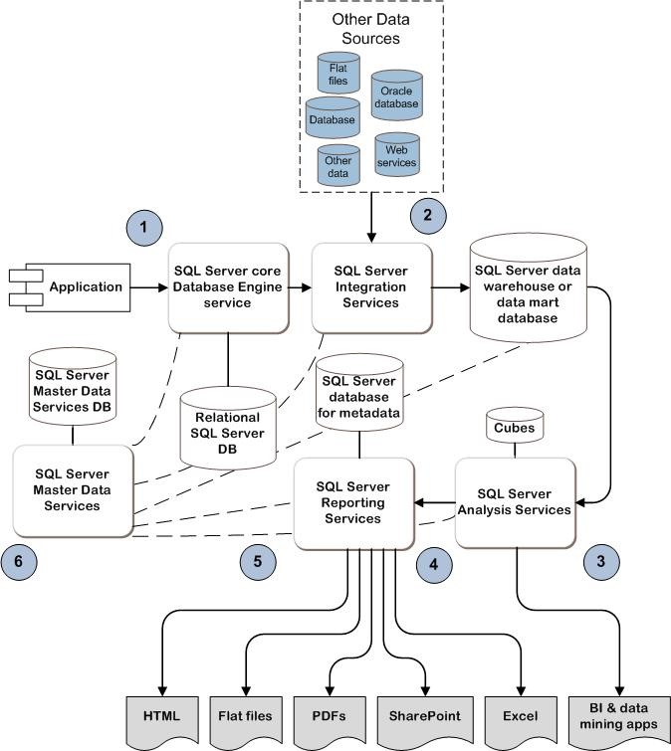
Example of SQL Server Architecture
MDT
SCM
ITA
Notes:
This diagram is one possible example of a SQL Server 2008 architecture for illustrative purposes only.
To provide a perspective on how the different SQL Server components complement each other, a possible scenario (steps 1–6) is pictured in this figure and described below:
An application takes input from users and writes entries to an OLTP database as it occurs.
Periodically, SQL Server Integration Services (SSIS) extracts the data from the OLTP database, combines it with other data existing in the organization: perhaps another database system or some flat file exports from legacy systems. SSIS then transforms the data, standardizes the formats of the data—for example, state names versus abbreviations—and then loads the data into another database, in this case, a SQL Server data warehouse.
SQL Server Analysis Services (SSAS) is then used to extract data from the data warehouse and place it into OLAP cubes. Cubes allow for complex analytical and as-needed queries with a rapid execution time.
Managerial decision makers can use Microsoft Excel® spreadsheet software or other applications to perform data mining to detect and predict trends in the business.
SQL Server Reporting Services (SSRS) is used to publish reports to other users in the organization, for example, salespeople who need to know current production levels. These reports are generated either on-demand or on a scheduled basis.
Master Data Services is a master data management application used to consistently define and manage the critical data entities of an organization.

Slide 9
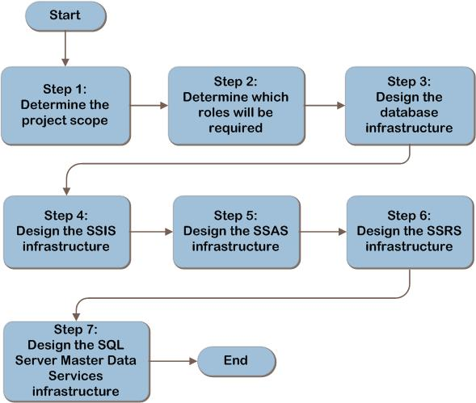
SQL Server 2008 Decision Flow
MDT
SCM
ITA
Notes:
This is the SQL Server 2008 design flow. The details of the design will be discussed in the following slides.

Slide 10
Step 1. Determine Project Scope
The project scope will be determined in order to align the goals of the project with the business motivation:
Task 1: Determine applications in scope
The results of this step will be used to determine which SQL Server roles will be required.
Notes:
Step 1. Determine Project Scope
The project scope will be determined in order to align the goals of the project with the business motivation.
Task 1: Determine applications in scope
The project scope will be determined in order to align the project goals with the business motivation. The results of this step will be used to determine which SQL Server roles will be required. Understanding the needs of the business provides a design that meets the business requirements. The database administrator (DBA) can serve as a major influence for the design team given the DBA’s working knowledge of the SQL Server features.
There are two primary architecture approaches—application-specific or as a service—for designing a SQL Server implementation.
In the application-specific approach, the infrastructure is designed to support a specific application. This requires application requirements gathering, determining required SQL Server roles, and specific application server design optimization. This is the approach used in the guide.
In the second approach, consider the SQL Server needs of many applications across the enterprise and design SQL Server as a service. The SQL Server as a service approach can be made available as a general platform for the business units to deliver standardization and economies of scale. The IT department can determine the SQL Server needs of specific applications based on data throughput, storage, memory, fault tolerance, security, and availability requirements. Then standardized hardware is purchased, and the IT department can balance incoming requests against existing capacity and performance and allocate the appropriate resources. This guide is not written for this approach; however, all of the tasks will be applicable so it may provide a starting point. With this approach, several steps in this guide may need to be repeated as each role is designed.

Slide 11
Step 2. Determine Which Roles Will Be Required
The product roles required to deliver the business requirements and desired functionality will be identified to:
Task 1: Determine if Database Engine will be required
Task 2: Determine if Integration Services will be required
Task 3: Determine if Analysis Services will be required
Notes:
Step 2. Determine Which Roles Will Be Required
In this step, the product roles required will be identified.
Task 1: Determine if Database Engine will be required
The Database Engine is the core service for storing, processing, and securing data. It supports OLTP databases. If the application being implemented requires one or more OLTP databases, record the database names in Table A-1 in the Appendix in the guide. Other services that may be selected in later tasks might also need databases.
Task 2: Determine if Integration Services will be required
SQL Server Integration Services (SSIS) can connect to a variety of data sources to extract data, transform data to compatible formats, merge it into one dataset, and load it into one or more destinations, including flat files, raw files, and relational databases. See Appendix A in this presentation deck for one SSIS configuration.
Task 3: Determine if Analysis Services will be required
SQL Server Analysis Services (SSAS) supports OLAP (online analytical processing) and data mining functionalities. This allows a DBA to design and create multidimensional structures that contain data aggregated from other data sources, such as relational databases. SSAS may be needed if reports need to be accessed rapidly with varying degrees of granularity (for example, yearly totals, monthly totals, quarterly totals, and individual transactions). See the Appendices in this presentation deck for one SSAS configuration.

Slide 12
Step 2. Determine Which Roles Will Be Required (Continued)
The product roles required to deliver the business requirements and desired functionality will be identified to:
Task 4: Determine if Reporting Services will be required
Task 5: Determine if SQL Server Master Data Services will be required
Notes:
Step 2. Determine Which Roles Will Be Required (Continued)
In this step, the product roles required will be identified.
Task 4: Determine if Reporting Services will be required
SQL Server Reporting Services (SSRS) delivers enterprise reporting functionality for creating reports that gather content from a variety of data sources, publishing the reports in various formats, and centrally managing their security and subscriptions. See the Appendices in this deck for one SSRS configuration.
Task 5: Determine if SQL Server Master Data Services will be required
SQL Server Master Data Services provides a master data hub to centrally organize, maintain, and manage master data within the organization. By integrating disparate operational and analytic systems with Master Data Services, all applications across the organization will rely on a central, accurate source of information. Using Master Data Services, a single source of master data is created and an auditable record of that data is maintained as it changes over time.

Slide 13
Step 3. Design the SQL Server Database Engine Infrastructure
The database requirements will be gathered and the database infrastructure will be designed from those requirements to:
Task 1: Determine capacity and performance requirements:
Storage needs should be calculated for the database, transaction log, indexes, and tempdb database.
After estimating the database size with the formula provided in the guide, add about 5 percent for database overhead.
Estimate IOPS and throughput as accurately as possible since
both of these can cause performance degradation if not
properly calculated.
Notes:
Step 3. Design the SQL Server Database Engine Infrastructure
In this step, the database requirements will be gathered and the database infrastructure will be designed from those requirements.
Task 1: Determine capacity and performance requirements:
Disk storage required. For databases that don’t yet exist, an estimate will need to be made of the disk storage required. Storage needs should be calculated for the database, transaction log, indexes, and tempdb database.
IOPS and throughput required. Since the main function of SQL Server is to manipulate data, and that data resides either in memory or on the I/O subsystem, any I/O performance problems will result in performance degradation of SQL Server. Although it may not be possible to calculate the required IOPS in advance, benchmarks for some workloads may be available from SAN and disk vendors that may provide a baseline for estimating the required performance and the disk storage configuration required to deliver that performance level.

Slide 14
Step 3. Design the SQL Server Database Engine Infrastructure (Continued)
The database requirements will be gathered and the database infrastructure will be designed from those requirements to:
Task 2: Determine whether to place the database in an existing instance
A separate instance might be required because of memory isolation needs; different fault tolerance, authentication, or security concerns; or regulatory or support requirements.
Task 3: Determine whether to place the instance on an existing server running SQL Server or a new server
However, each additional instance adds overhead.
Notes:
Step 3. Design the SQL Server Database Engine Infrastructure (continued)
Task 2: Determine whether to place the database in an existing instance
Regulatory requirements, memory isolation, fault tolerance, authentication, security concerns, and support requirements might be potential reasons why a database might not be able to be located within an existing instance.
Task 3: Determine whether to place the instance on an existing server running SQL Server or new server
Running multiple instances on a server is ideal to support multiple test and dev environments, to support multiple applications on a server but have each application in its own instance, or to securely isolate databases, but each additional instance adds overhead.

Slide 15
Step 3. Design the SQL Server Database Engine Infrastructure (Continued)
The database requirements will be gathered and the database infrastructure will be designed from those requirements to:
Task 4: Determine the number of servers after addressing scaling-out and fault-tolerance needs
Task 5: Determine placement of each new instance
Task 6: Select the server hardware
Notes:
Step 3. Design the SQL Server Database Engine Infrastructure (continued)
Task 4: Determine the number of servers
Several factors may change the number of SQL Server-based servers: whether scaling out will be implemented, and whether fault tolerance will be implemented at the database-level or instance level.
Task 5: Determine placement of each new instance
For each instance identified in Task 1, determine location of instance, whether instance will be on a physical or virtual server, and whether instance will be on existing or new hardware.
Task 6: Select the server hardware
Little specific architectural information is available to determine hardware for servers. Hardware vendors provide sizing calculators to help design server hardware. See “Additional Reading” section for links to these tools. In addition to using a calculator, considerations for the hardware are given below.
CPU. Many variables can affect CPU utilization. The following are guidelines when selecting new hardware:
Use 64-bit processors.
Multi-core and multiple processors. Doubling the number of CPUs is preferred, but it does not guarantee twice the performance.
L2 or L3 cache. Larger L2 or L3 processor caches generally provide better performance and often play a bigger role than raw CPU frequency.
Memory. For OLTP applications, the product group recommends 2–4 GB of memory per processor core, and for data warehouses, 4–8 GB of memory per processor core.
Disk subsystem. Design the disk subsystem to provide the required storage space, deliver the performance to support the required number of IOPS, and provide protection against hardware failures. If a SAN is used, this may include redundant HBAs and switches.
Network adapters. Some hardware manufacturers provide network adapters and drivers providing fault tolerance or network port teaming for increased throughput.

Slide 16
Step 4. Design the SQL Server Integration Services Infrastructure
If it was determined that SQL Server Integration Services (SSIS) is required in the organization, the SSIS infrastructure will be designed in this step to:
Task 1: Determine resource requirements
Task 2: Decide where the Integration Services packages will be stored
Task 3: Determine number of SSIS servers required
Task 4: Determine placement
Notes:
Step 4. Design the SQL Server Integration Services Infrastructure
The SSIS infrastructure will be designed in this step. If it was determined that SSIS is not required, go to the next step.
Task 1: Determine resource requirements
Data cannot be transformed faster than it can be read or written, and since there isn’t a calculator available to determine capacity and performance for the SSIS role, this task presents several items for consideration:
SSIS takes data from one source and moves it to another, so the areas to consider include the data source, the network from data source to the SSIS server, the SSIS server, the network to the destination, and the destination server.
Task 2: Determine where the Integration Services packages will be stored
An Integration Services package is the set of instructions that is retrieved and executed against the data. Packages can be stored in the SQL Server msdb database or on the file system.
Task 3: Determine number of SSIS servers required
SSIS does not support clustering or provide for scaling out to automatically load balance. If the load exceeds the capacity of the server to meet the business’s requirements, add additional servers to perform parallel loads or processing and manually split up the SSIS tasks among the servers.
Task 4: Determine placement
Network throughput is important with the SSIS role as it is moving data from one system to another. Factors such as politics, policy, network constraints, proximity to data sources, and geography may affect the decision of where to place the SSIS. SSIS can be run in a virtualized environment and the SSIS role can be installed on an existing server.
See the Appendices in this deck for one SSIS configuration.

Slide 17
Step 5. Design the SQL Server Analysis Services Infrastructure
If it was determined that SQL Server Analysis Services (SSAS) is required in the organization, the SSAS infrastructure will be designed in this step to:
Task 1: Determine resource requirements:
SSAS uses OLAP databases, or cubes, stored on the file system.
Processing of OLAP databases is read and write-intensive.
Product group recommends 4–8 GB of memory per processor core.
Notes:
Step 5. Design the SQL Server Analysis Services Infrastructure
If it was determined that SQL Server Analysis Services (SSAS) is required in the organization, the SSAS infrastructure will be designed in this step. If it was determined that SSAS is not required, go to the next step.
Task 1: Determine resource requirements
SSAS uses online analytical processing (OLAP) multi-dimensional databases, also called cubes, which are stored in a folder on the file system.
Disk Storage Required
Cube sizes depend on the size of the fact tables and dimension members. If no other data is available, a good starting point may be to plan to allocate approximately 20–30 percent of the amount of space required for the same data stored in the underlying relational database, if that’s where the data is originating.
Aggregations are typically less than 10 percent of the size of the data stored in the underlying relational database, but they can vary based on the number of aggregations.
During processing, SSAS stores copies of the objects in the processing transaction on disk until it is finished, and then the processed copies of the objects replace the original objects. Therefore, sufficient additional disk space must be provided for a second copy of each object.
Memory and Processor
It is recommended to have 4–8 GB of memory per processor core.

Slide 18
Step 5. Design the SQL Server Analysis Services Infrastructure (Continued)
If it was determined that SQL Server Analysis Services (SSAS) is required in the organization, the SSAS infrastructure will be designed in this step to:
Task 2: Determine SQL Server version
Task 3: Decide whether scalable shared databases will be used
Task 4: Determine scaling needs
Task 5: Decide whether to cluster
Task 6: Determine placement
Notes:
Step 5. Design the SQL Server Analysis Services Infrastructure (continued)
Task 2: Determine SQL Server version
SQL Server comes in 32-bit and 64-bit versions. Depending on the ODBC drivers available for the source and destination, a particular version may be required.
Task 3: Decide whether scalable shared databases will be used
Scalable shared database can be used to scale out querying or reporting loads.
Task 4: Determine scaling needs
If cube processing affects query performance or if processing can’t occur during times of reduced query load, consider moving processing tasks to a staging server and then performing an online synchronization of the production server and the staging server. Processing can also be distributed across multiple instances of Analysis Services by using remote partitions. Processing remote partitions uses the processor and memory resources on the remote server instead of the resources on the local computer
Task 5: Decide whether to cluster
SSAS natively supports failover clusters (formerly known as server clusters or as MSCS) in Windows Server to maximize availability.
Task 6: Determine placement
Factors such as politics, policy, network constraints, proximity to data sources, and geography, can determine where to place the SSAS servers.
SSAS can be run in a virtualized environment if the memory, disk, and network requirements do not exceed the throughput capabilities of the virtual machine.
SQL Server roles can coexist with other SQL Server roles on the same server.
See the Appendices in this deck for one SSAS configuration.

Slide 19
Step 6. Design the SQL Server Reporting Services Infrastructure
If it was determined that SQL Server Reporting Services (SSRS) is required in the organization, the SSRS infrastructure will be designed in this step to:
Task 1: Determine resource requirements. Depends on:
Disk storage needed for SSRS databases
Memory: 2–4 per processor core
Task 2: Determine placement of the report server databases:
Databases can be hosted either on the Reporting Services server or on a remote database server.
Notes:
Step 6. Design the SQL Server Reporting Services Infrastructure
If it was determined that SQL Server Reporting Services (SSRS) is required in the organization, the SSRS infrastructure will be designed in this step. If it was determined that SSRS is not required, the SQL Server infrastructure planning is complete.
Task 1: Determine resource requirements
In this task, the performance requirements will be assessed. No hard guidance is available for determining the processor, disk performance, or networking requirements for a typical scenario as they are all different, but there are a few factors that can be taken into consideration:
Size and complexity of report definitions.
Data source. Whether reports are executed from cached or snapshot data or from live data.
Format requested when rendering a report. Formats such as PDF or Excel are more resource-intensive than HTML.
Disk Storage. A report server database, or catalog, provides internal storage to one or more report servers. Each SSRS server must connect to two databases, named ReportServer and ReportServerTempDB by default. The ReportServer database stores the report definitions, resources, and configurations, while the ReportServerTempDB database stores all of the temporary snapshots while reports are running. See the guide for more information about the database sizes.
Memory Requirements. The product group recommends 2–4 GB of memory per processor core.
Task 2: Determine placement of the report server databases
The report server databases can be hosted either on the Reporting Services server or on a remote database server.

Slide 20
Step 6. Design the SQL Server Reporting Services Infrastructure (Continued)
If it was determined that SQL Server Reporting Services (SSRS) is required in the organization, the SSRS infrastructure will be designed in this step to:
Task 3: Determine scaling and fault-tolerance approach:
Load balancing for both scale out and fault tolerance
Clustering for report server databases
Task 4: Determine placement of the SSRS server
Notes:
Step 6. Design the SQL Server Reporting Services Infrastructure (continued)
Task 3: Determine scaling and fault-tolerance approach
Scale-out deployments are used to provide fault tolerance and increase scalability of report servers in order to handle additional concurrent users and larger report execution loads. It can also be used to dedicate specific servers to process interactive or scheduled reports. Although moving to a scale-out configuration requires a move to the Enterprise edition of Reporting Services, doing so has a number of advantages in addition to raw capacity. These include the following:
Multiple report servers offer better availability; if a single server fails, the overall system continues to answer queries.
Additional machines can take advantage of dedicated memory address space, without having to move to 64-bit hardware.
While SSRS is not supported in an MSCS cluster configuration, the server hosting the report server database can be set up in a failover cluster configuration.
Task 4: Determine placement of the SSRS server
For smaller environments, the SSRS server can be implemented on the same system as other SQL Server services.
SSRS is supported in a virtualized environment if the memory, disk, and network requirements do not exceed the throughput capabilities of the virtual machine.
See the Appendices in this deck for one SSRS configuration.

Slide 21
Step 7. Design the SQL Server Master Data Services Infrastructure
If it was determined that SQL Server Master Data Services is required in the organization, the infrastructure will be designed in this step to:
Task 1: Determine Resource Requirements
Task 2: Determine Scaling and Fault-Tolerance Approach
Notes:
Step 7. Design the SQL Server Master Data Services Infrastructure
Task 1: Determine Resource Requirements
In this task, the performance requirements will be assessed. No hard guidance is available for determining the processor, disk performance, or networking requirements for a typical scenario as they are all different, but there are a few factors that can be taken into consideration:
The amount of Master Data Services data that will be tracked. Organizations will often implement master data management to solve the business problem in a single domain area, and expand the system from there. The SQL Server Master Data Services product group has tested the system up to 10 million unique members.
How often the data will be versioned. An accounting domain area may only need to be updated once per month, but a product domain area could need more frequent updates.
Master Data Services Database
Master Data Services requires a database to support the Master Data Manager web application and web services. The computer that hosts the Master Data Services database must run an instance of the SQL Server Database Engine. The disk space requirements for the database are not necessarily significant as Master Data Services is not transactional in nature. The product group reports that even a fairly large implementation only resulted in a database that was 2 GB in size.
Master Data Services Web Server
Master Data Services will have different categories of users, such as system administrators, data architects, data stewards, data editors, and data consumers. Depending on the implementation, the data consumers may not be directly interacting with the system so they would not count as concurrent users. A rough estimate provided by the product group is that a 10,000-employee company may have 50-100 Master Data Services users.
Task 2: Determine Scaling and Fault-Tolerance Approach
The Master Data Services web server can be placed in a load-balanced web farm to provide scaling and/or fault tolerance. The deployment is based on the feature provided by the underlying IIS, such as hardware load balancers, software load balancing via NLB, or Application Request Routing (ARR).
Multiple web servers in a load-balanced farm may be required:
For scale out.
For fault tolerance.

Slide 22
Step 7. Design the SQL Server Master Data Services Infrastructure (Continued)
If it was determined that SQL Server Master Data Services is required in the organization, the infrastructure will be designed in this step to:
Task 3: Determine Placement of the Master Data Services Database
Task 4: Determine Placement of the Master Data Services Web Server
Notes:
Step 7. Design the SQL Server Master Data Services Infrastructure (Continued)
Task 3: Determine Placement of the Master Data Services Database
The Master Data Services database can be hosted either on the Master Data Services web server or on a remote database server that runs a supported version and edition of SQL Server. If the Master Data Services database is hosted locally on the web server, adequate hardware resources should be allocated to support both database and web operations. It can also coexist with other databases and SQL Server services and is supported in a virtualized environment.
Reasons for hosting the Master Data Services database on a remote server include:
To conform with the organization’s IT or security policies. The Master Data Services web service and Master Data Services web application both run on top of IIS, so it may be that the organization’s policies dictate using a separate database server.
To support an implementation of the Master Data Services web server in a load-balanced web farm for fault tolerance (this was determined in Task 2).
Task 4: Determine Placement of the Master Data Services Web Server
For smaller environments, the Master Data Services web server can be implemented on the same system as other SQL Server services. The Master Data Services web server is supported in a virtualized environment if the memory, disk, and network requirements do not exceed the throughput capabilities of the virtual machine host.
For each Master Data Services web server, determine whether to have the server coexist with other SQL Server services or by itself. Also, determine whether the server will be in a physical environment or exist in a virtualized environment.
There are no requirements for physical placement of the web server as long as there is sufficient throughput to the database. There are also no hardware or software requirements specific to Master Data Services other than what is required for IIS, which is outlined here for Windows Server 2008 http://msdn.microsoft.com/en-us/windowsserver/cc196364.aspx and here for Windows Server 2008 R2: http://www.microsoft.com/windowsserver2008/en/us/system-requirements.aspx.
See the Appendices in this deck for one Master Data Services configuration.

Slide 23
Summary and Conclusion
The SQL Server 2008 guide has outlined the process for planning the SQL Server infrastructure:
Choices of roles needed
Server resources
Scaling
Fault tolerance
Provide feedback to satfdbk@microsoft.com
Notes:
Summary and Conclusion
The guide has outlined the step-by-step process for planning a SQL Server 2008 infrastructure. In each step, major decisions relative to the SQL Server infrastructure were determined and explained. The guide has explained how to record choices of roles needed, server resources, scaling, and fault tolerance, which can then be made available to the infrastructure planners.
Using the information recorded from the steps completed in this guide, organizations can help ensure that they meet business and technical requirements for a successful SQL Server 2008 deployment.

Slide 24
Find More Information
Download the full document and other IPD guides:
www.microsoft.com/ipd
Contact the IPD team:
satfdbk@microsoft.com
Access the Microsoft Solution Accelerators website:
http://www.microsoft.com/technet/SolutionAccelerators

Slide 25
Questions?

Slide 26
Appendices

Slide 27
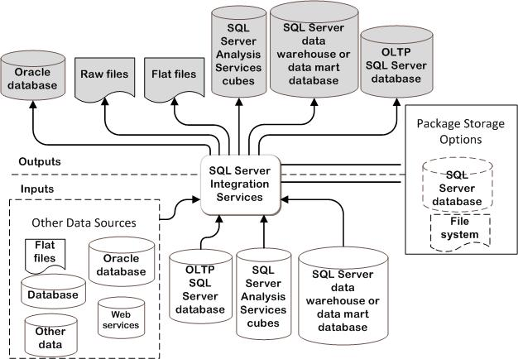
Appendix A: SSIS Configuration Example
Notes:
This figure provides a graphic overview of many of the possible inputs and outputs for SSIS in a SQL Server 2008 infrastructure.

Slide 28
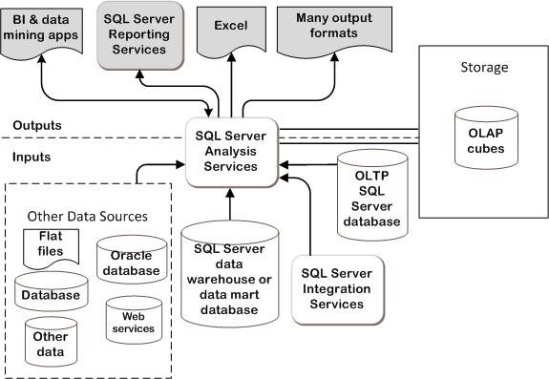
Appendix B: SSAS Configuration Example
Notes:
This figure provides a graphic overview of inputs and outputs for SSAS in a SQL Server 2008 infrastructure.

Slide 29
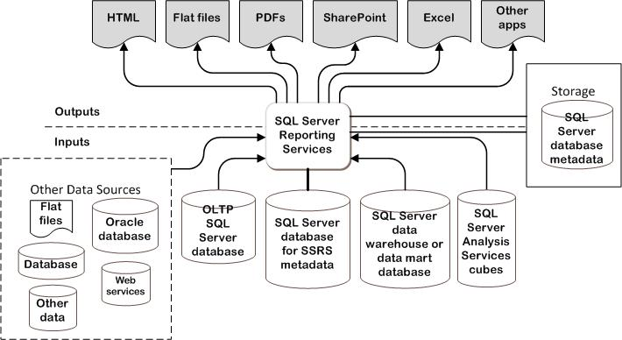
Appendix C: SSRS Configuration Example
Notes:
This figure provides a graphic overview of inputs and outputs for SSRS in a SQL Server 2008 infrastructure.

Slide 30
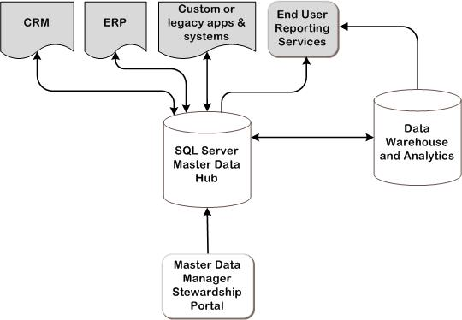
Appendix D: Master Data Services Configuration Example
Notes:
This figure provides a graphic overview of inputs and outputs for Master Data Services in a SQL Server 2008 R2 infrastructure.

Slide 31
Appendix E: Job Aids
Step 1. Use the table below to record business applications in the project scope.
Table A-1. Requirements Gathering
Requirement description | Requirement results
Name of business applications
Notes:
This table can be used to record business applications in the project scope.

Slide 32
Appendix E: Job Aids (Continued)
Step 2. Use the table below to record information relative to the required SQL Server roles.
Table A-2. SQL Server Roles Data Gathering
Requirement description | Requirement results
Names of relational or OLTP databases required
Names of data warehouse databases required
SSIS required?
SSAS required?
SSRS required? * requires Database Engine also
Master Data Services required? * requires Database Engine also
Notes:
This table can be used to record information relative to the required SQL Server roles.

Slide 33
Appendix E: Job Aids (Continued)
Step 3. Use the table below to record information relative to the SQL Server Database Engine.
Table A-3. SQL Server Database Engine Data Gathering
Requirement description | Requirement results
Disk storage requirements
IOPS and throughput requirements
Database in new or existing instance?
Will instance reside on existing server running SQL Server or new server?
Number of servers required to support scale-out options, if selected
Number of servers required to support fault-tolerance option, if selected
Failover clustering protection required?
In which office or geographical location will instance be placed?
Notes:
This table can be used to record information relative to the SQL Server Database Engine.

Slide 34
Appendix E: Job Aids (Continued)
Step 3. Use the table below to record information relative to the SQL Server Database Engine.
Table A-3. SQL Server Database Engine Data Gathering (Continued)
Requirement description | Requirement results
Will instance be on physical server or virtualized environment?
Number of CPUs required
Required architecture
Required processor speed
Amount of memory required
Disk subsystem configuration
Notes:
This table can be used to record information relative to the SQL Server Database Engine.

Slide 35
Appendix E: Job Aids (Continued)
Step 4. Use the table below to record information relative to the SSIS infrastructure.
Table A-4. SQL Server SSIS Infrastructure Data Gathering
Requirement description | Requirement results
Does each component of the system meet the capacity and performance requirements?
Source data type
Destination data type
SSIS server version
Name of SQL Server instance or file share where packages are stored
Database Engine required?
Number of SSIS servers
SSIS server: virtualized or physical environment?
SSIS - SQL Server role coexist with other SQL Server roles on same server?
Notes:
This table can be used to record information relative to the SSIS infrastructure.

Slide 36
Appendix E: Job Aids (Continued)
Step 5. Use the table below to record information relative to the SSAS infrastructure.
Table A-5. SQL Server SSAS Infrastructure Data Gathering
Requirement description | Requirement results
Disk storage space requirements
SSAS server version
Will scalable shared databases be used?
What are scaling needs? (scale up or scale out)
Will failover clustering be used?
SSAS server: virtualized or physical environment?
SSAS - SQL Server role coexist with other SQL Server roles on same server?
Notes:
This table can be used to record information relative to the SSAS infrastructure.

Slide 37
Appendix E: Job Aids (Continued)
Step 6. Use the table below to record information relative to the SSRS infrastructure.
Table A-6. SQL Server SSRS Infrastructure Data Gathering
Requirement description | Requirement results
Record database requirements (size of the ReportServer and ReportServerTempDB databases)
Databases hosted locally or on a remote database server?
Which databases are hosted locally or on a remote server?
Number of servers to support SSRS
SSRS – SQL Server coexist with other SQL Server roles on same server?
SSRS server: virtualized or physical environment?
Notes:
This table can be used to record information relative to the SSRS infrastructure.

Slide 38
Appendix E: Job Aids (Continued)
Step 7. Use the table below to record information relative to the Master Data Services infrastructure.
Table A-7. SQL Server Master Data Services Infrastructure Data Gathering
Requirement description | Requirement results
Estimated Master Data Services database size
Number of concurrent users
Number of servers to support fault tolerance and scaling requirements
Databases hosted locally or on a remote database server?
Which databases are hosted locally or on a remote server?
Master Data Services Web server coexist with other SQL Server roles on same server?
Master Data Services Web server: virtualized or physical environment?
Notes:
This table can be used to record information relative to the Master Data Services infrastructure.

Slide 39
Benefits of Using the SQL Server 2008 Guide
Benefits for Business Stakeholders/Decision Makers
Most cost-effective design solution for implementation
Alignment between the business and IT from the beginning of the design process to the end
Benefits for Infrastructure Stakeholders/ Decision Makers
Authoritative guidance
Business validation questions ensuring solution meets requirements of business and infrastructure stakeholders
High integrity design criteria that includes product limitations
Fault-tolerant infrastructure
Infrastructure that’s sized appropriately for business requirements
Notes:
Benefits of Using the SQL Server 2008 Guide
Benefits for Business Stakeholders/Decision Makers:
Most cost-effective design solution for an implementation. IPD eliminates over-architecting and over-spending by precisely matching the technology solution to the business needs.
Alignment between the business and IT from the beginning of the design process to the end.
Benefits for Infrastructure Stakeholders/Decision Makers:
Authoritative guidance. Microsoft is the best source for guidance about the design of Microsoft products.
Business validation questions to ensure the solution meets the requirements of both business and infrastructure stakeholders.
High integrity design criteria that includes product limitations.
Fault-tolerant infrastructure, where necessary.
Proportionate system and network availability to meet business requirements. Infrastructure that is sized appropriately to meet business requirements.

Slide 40
Benefits of Using the SQL Server 2008 Guide (Continued)
Benefits for Consultants or Partners
Rapid readiness for consulting engagements
Planning and design template to standardize design and peer reviews
A “leave-behind” for pre- and post-sales visits to customer sites
General classroom instruction/preparation
Benefits for the Entire Organization
Using the guide should result in a design that will be sized, configured, and appropriately placed to deliver a solution for achieving stated business requirements
Notes:
Benefits of Using the SQL Server 2008 guide (continued)
Benefits for Consultants or Partners:
Rapid readiness for consulting engagements.
Planning and design template to standardize design and peer reviews.
A “leave-behind” for pre- and post-sales visits to customer sites.
General classroom instruction/preparation.
Benefits for the Entire Organization:
Using the guide should result in a design that will be sized, configured, and appropriately placed to deliver a solution for stated business requirements, while considering the performance, capacity, manageability, and fault tolerance of the system.

Slide 41
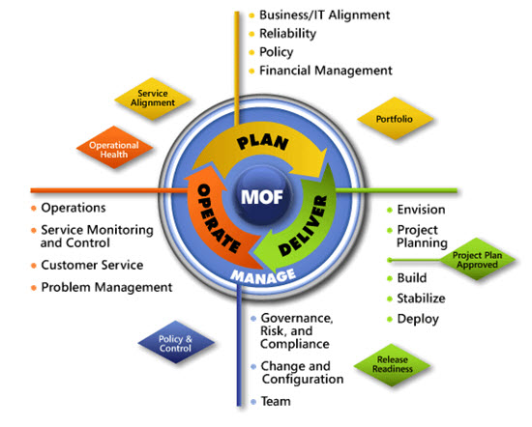
IPD in Microsoft Operations Framework 4.0
Use MOF with IPD guides to ensure that people and process considerations are addressed when changes to an organization’s IT services are being planned.
Notes:
For more information about Microsoft Operations Framework 4.0, go to www.microsoft.com/mof.

