Slide 1
Windows Server® 2008 and Windows Server 2008 R2
Print Services
Infrastructure Planning and Design
Published: June 2010
Updated: November 2011
Notes:
Copyright © 2011 Microsoft Corporation. All rights reserved. Complying with the applicable copyright laws is your responsibility. By using or providing feedback on this documentation, you agree to the license agreement below.
If you are using this documentation solely for non-commercial purposes internally within YOUR company or organization, then this documentation is licensed to you under the Creative Commons Attribution-NonCommercial License. To view a copy of this license, visit http://creativecommons.org/licenses/by-nc/2.5/ or send a letter to Creative Commons, 543 Howard Street, 5th Floor, San Francisco, California, 94105, USA.
This documentation is provided to you for informational purposes only, and is provided to you entirely "AS IS". Your use of the documentation cannot be understood as substituting for customized service and information that might be developed by Microsoft Corporation for a particular user based upon that user’s particular environment. To the extent permitted by law, MICROSOFT MAKES NO WARRANTY OF ANY KIND, DISCLAIMS ALL EXPRESS, IMPLIED AND STATUTORY WARRANTIES, AND ASSUMES NO LIABILITY TO YOU FOR ANY DAMAGES OF ANY TYPE IN CONNECTION WITH THESE MATERIALS OR ANY INTELLECTUAL PROPERTY IN THEM.
Microsoft may have patents, patent applications, trademarks, or other intellectual property rights covering subject matter within this documentation. Except as provided in a separate agreement from Microsoft, your use of this document does not give you any license to these patents, trademarks or other intellectual property.
Information in this document, including URL and other Internet Web site references, is subject to change without notice. Unless otherwise noted, the example companies, organizations, products, domain names, e-mail addresses, logos, people, places and events depicted herein are fictitious.
Microsoft and Windows Server are either registered trademarks or trademarks of Microsoft Corporation in the United States and/or other countries and regions.
The names of actual companies and products mentioned herein may be the trademarks of their respective owners.
You have no obligation to give Microsoft any suggestions, comments or other feedback ("Feedback") relating to the documentation. However, if you do provide any Feedback to Microsoft then you provide to Microsoft, without charge, the right to use, share and commercialize your Feedback in any way and for any purpose. You also give to third parties, without charge, any patent rights needed for their products, technologies and services to use or interface with any specific parts of a Microsoft software or service that includes the Feedback. You will not give Feedback that is subject to a license that requires Microsoft to license its software or documentation to third parties because we include your Feedback in them.

Slide 2
What Is IPD? Guidance that clarifies and streamlines the planning and design process for Microsoft® infrastructure technologies
IPD:
Defines decision flow
Describes decisions to be made
Relates decisions and options for the business
Frames additional questions for business understanding
IPD guides are available at www.microsoft.com/ipd
Notes:
Infrastructure Planning and Design (IPD) is a series of planning and design guides created to clarify and streamline the planning and design process for Microsoft® infrastructure technologies.
Each guide in the series addresses a unique infrastructure technology or scenario.
These guides include the following topics:
Defining the technical decision flow (flow chart) through the planning process.
Describing the decisions to be made and the commonly available options to consider in making the decisions.
Relating the decisions and options for the business in terms of cost, complexity, and other characteristics.
Framing the decisions in terms of additional questions for the business to ensure a comprehensive understanding of the appropriate business landscape.
The guides in this series are intended to complement and augment Microsoft product documentation.

Slide 3
Getting Started
Windows Server 2008 and Windows Server 2008 R2
Print Services
Notes:
The Infrastructure Planning and Design Print Services Guide was created to give infrastructure planners a step-by-step approach to design a Windows Server 2008 Print Services infrastructure. The guide includes specific design information and activities that encourage sound planning.
This guide is written for information technology (IT) infrastructure specialists who are responsible for planning and designing a Print Services infrastructure.

Slide 4
Purpose and Overview
Purpose
To provide design guidance for a Print Services infrastructure
Overview
Print Services architecture
Print Services infrastructure design process
Notes:
The guide focuses on the elements that organizations must consider when designing a Print Services infrastructure.

Slide 5
What’s New in Windows Server 2008 R2
Windows Server 2008 R2 introduces new functionality and enhancements to Windows print services that provide improved performance, increased reliability, and greater flexibility for users, including the following:
Print migration enhancements
Printer driver isolation
Print administrator delegation
Print Management snap-in improvements
Client-Side Rendering (CSR) performance improvements
XML Paper Specification (XPS) print path improvements
Location-aware printing
Distributed Scan Server role service
Improvements to the Add Printer Wizard
Notes:
What’s New in Windows Server 2008 R2
The guide’s design process is valid for both Windows Server 2008 and Windows Server 2008 R2 environments.
For more details on the changes, see http://technet.microsoft.com/en-us/library/dd878502.aspx.

Slide 6
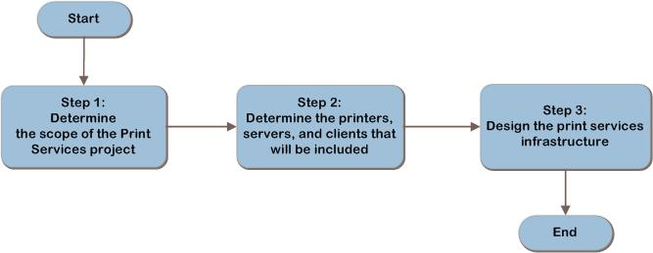
Print Services Decision Flow
MAP w/ CAL Tracker
SCM
ITA
Notes:
The three steps shown represent the most critical design elements required for achieving a well-planned Windows Server 2008 Print Services design:
Step 1: Determine the Scope of the Print Services Project
Step 2: Determine the Printers, Servers, and Clients That Will Be Included
Step 3: Design the Print Services Infrastructure
Other items in this list represent tasks that must be completed. These types of items are addressed because their presence is significant in order to complete the infrastructure design.

Slide 7
Step 1: Determine the Scope of the Print Services Project
Task 1: Determine the Scope of the Project
Which parts of the organization will be participating
Which geographic areas within the organization will be included
Whether the scope extends beyond the boundaries of the organization, affecting external organizations
Task 2: Assess Special Printing Needs
Requirements for secure printing
Requirements for fault tolerance
Requirements for encryption
Notes:
Step 1: Determine the Scope of the Print Services Project
Task 1: Determine the Scope of the Project
Understanding the full extent of the work to be performed enables the designer to begin visualizing the tasks and roles that will be needed to successfully implement the infrastructure plan.
Task 2: Assess Special Printing Needs
Special requirements may affect the architectural design in the following ways:
Requirements for secure printing may need to be met by local printers, rather than to the Print Services infrastructure.
Requirements for fault tolerance may necessitate the design of printer pools, or even duplicate print locations.
Requirements for encryption may limit the network segments over which print streams can flow.

Slide 8
Step 2: Determine the Printers, Servers, and Clients That Will Be Included
Task 1: Inventory Existing Print Servers
Server name
Server location
Server storage capacity (used and free)
Whether the server uses a separate spool drive to improve performance
Task 2: Inventory Existing Print Devices
Location
Printer
Make/model
Printer type
Server
Task 3: Inventory Clients
Number of Print Server clients
Client operating systems in use
Print job characteristics
Notes:
Step 2: Determine the Printers, Servers, and Clients That Will Be Included
Task 1: Inventory Existing Print Servers
Important information to collect:
Server name
Server location
Server storage capacity (used and free)
Whether the server uses a separate spool drive to improve performance
Task 2: Inventory Existing Print Devices
Important information to collect:
Location
Printer
Make/model
Printer type
Server
Task 3: Inventory Clients
Number of Print Server clients
Client operating systems in use
Print job characteristics

Slide 9
Step 3: Design the Print Services Infrastructure
Task 1: Determine How Many Print Servers Will Be Needed
Capacity and scalability are key factors in planning the deployment of print servers
Task 2: Determine Print Server Placement
Place client, print server, and print devices on the same local area network (LAN) for best printing performance
Task 3: Design Server Hardware
Can scale up or scale out
Notes:
Step 3: Design the Print Services Infrastructure
Task 1: Determine How Many Print Servers Will Be Needed
Start the design with a single server and then add more servers if any of the following requirements are necessary:
Scaling
Performance
Regulatory
Organizational requirements
Task 2: Determine Print Server Placement
For each print server, determine:
The location of the print server
Whether the instance will be on a physical or virtual server
Whether the instance will be on existing hardware or new hardware
Task 3: Design Server Hardware
Determine the most appropriate server hardware on which to deploy the print servers, including these characteristics:
Processor architecture (32-bit versus 64-bit)
Number of CPUs and their speed
Amount of memory installed
Disk storage capacity
Disk subsystem design
Number of network card ports configured

Slide 10
Step 3: Design the Print Services Infrastructure (Continued)
Task 4: Design Server Fault Tolerance
Server clustering
Fault-tolerant storage
Redundant network connections
Task 5: Determine Whether Printer Pools Will Be Used for Fault Tolerance
Printer pools can simplify administration and provide fault tolerance
Task 6: Design Printer Pools
There is no limit to the number of printers that can be in a pool
Notes:
Step 3: Design the Print Services Infrastructure (Continued)
Task 4: Design Server Fault Tolerance
Where fault tolerance is required, it can be implemented by providing redundancy in each of the layers of the print server infrastructure:
Server clustering. For physical print servers, server clustering provides fault tolerance when one server in a cluster is lost.
Fault-tolerant storage. Fault-tolerant storage systems such as those using a redundant array of independent disks (RAID) can protect data by maintaining the ability to operate even when one disk fails. Most storage arrays provide some hardware RAID capabilities.
Redundant network connections. Having more than one adapter improves throughput during normal operation and maintains connectivity during loss of one adapter, thus offering fault tolerance.
Task 5: Determine Whether Printer Pools Will Be Used for Fault Tolerance
Benefits
Printer pools can simplify administration, and provide fault tolerance in the following ways:
Providing an opportunity to consolidate identical print devices as one.
Print capacity can be increased gradually as demand increases, or large demand can be met without investing in a single high-capacity printer. Increasing print capacity without use of printer pools will result in the need to acquire higher capacity printers, which tend to be more expensive.
Printer pools increase scalability by allowing the addition of new printers to the pool at any time.
Increased fault tolerance by eliminating the print device as a single point of failure.
Limitations
Printer pools can increase complexity, both for administrators and for users in the following ways:
Can cause confusion. Users can experience difficulty locating printouts.
Increased expense. Additional print devices can raise maintenance costs.
Choosing to deploy printer pools will increase complexity due to the need to configure printer pools and administer a larger number of printers.
All printers in the pool must use the same driver.
Printers in a printer pool should be in close proximity to enable users to locate their printed documents.
Task 6: Design Printer Pools
Although creation of printer pools is mainly an operational task, certain aspects of printer pool design require planning for best results:
Use identical print devices. Print devices in a pool all use the same print driver. As a result, the printers must all be supported by the driver used.
Place print devices in close proximity to each other. Users cannot control which device in a printer pool will service their print job. It is important, therefore, to place the print devices close to each other to help users locate their documents.

Slide 11
Summary and Conclusion
This guide has outlined the step-by-step process for planning a Print Services infrastructure. In each step, major decisions relative to the Print Services infrastructure were determined and described.
The guide has explained how to define the goals and scope of the project, assess the current Print Services infrastructure, and design a new Print Services infrastructure, which can then be made available to the infrastructure planners.
Provide feedback to ipdfdbk@microsoft.com
Notes:
Summary and Conclusion
This guide presented readers with a decision regarding the use of printer pools, evaluating the possible choices against characteristics such as cost and complexity. This enabled readers to make informed decisions relative to the design of their infrastructure.
By following this guidance, an organization can create a robust, fault-tolerant Print Services infrastructure. This can lead to enhanced productivity through easier discovery of resources, reduced downtime, and lower costs through more effective administration and infrastructure management.

Slide 12
Find More Information
Download the full document and other IPD guides:
www.microsoft.com/ipd
Contact the IPD team:
ipdfdbk@microsoft.com
Access the Microsoft Solution Accelerators website:
www.microsoft.com/technet/SolutionAccelerators

Slide 13
Questions?

Slide 14
Addenda
Benefits of using the Print Services guide
IPD in Microsoft Operations Framework 4.0
Print Services in Microsoft Infrastructure Optimization

Slide 15
Benefits of Using the Print Services Guide
Benefits for Business Stakeholders/Decision Makers
Most cost-effective design solution for implementation
Alignment between the business and IT from the beginning of the design process to the end
Benefits for Infrastructure Stakeholders/Decision Makers
Authoritative guidance
Business validation questions ensuring solution meets requirements of business and infrastructure stakeholders
High integrity design criteria that includes product limitations
Fault-tolerant infrastructure
Proportionate system and network availability to meet business requirements
Infrastructure that’s sized appropriately for business requirements
Notes:
Benefits of Using the Print Services Guide
Benefits for Business Stakeholders/Decision Makers:
Most cost-effective design solution for an implementation. IPD eliminates over-architecting and over-spending by precisely matching the technology solution to the business needs.
Alignment between the business and IT from the beginning of the design process to the end.
Benefits for Infrastructure Stakeholders/Decision Makers:
Authoritative guidance. Microsoft is the best source for guidance about the design of Microsoft products.
Business validation questions to ensure the solution meets the requirements of both business and infrastructure stakeholders.
High integrity design criteria that includes product limitations.
Fault-tolerant infrastructure, where necessary.
Proportionate system and network availability to meet business requirements.
Infrastructure that is sized appropriately to meet business requirements.

Slide 16
Benefits of Using the Print Services Guide (Continued)
Benefits for Consultants or Partners
Rapid readiness for consulting engagements
Planning and design template to standardize design and peer reviews
A “leave-behind” for pre- and post-sales visits to customer sites
General classroom instruction/preparation
Benefits for the Entire Organization
Using the guide should result in a design that will be sized, configured, and appropriately placed to deliver a solution for achieving stated business requirements
Notes:
Benefits of Using the Print Services Guide (Continued)
Benefits for Consultants or Partners:
Rapid readiness for consulting engagements.
Planning and design template to standardize design and peer reviews.
A “leave-behind” for pre- and post-sales visits to customer sites.
General classroom instruction/preparation.
Benefits for the Entire Organization:
Using the guide should result in a design that will be sized, configured, and appropriately placed to deliver a solution for stated business requirements, while considering the performance, capacity, manageability, and fault tolerance of the system.

Slide 17
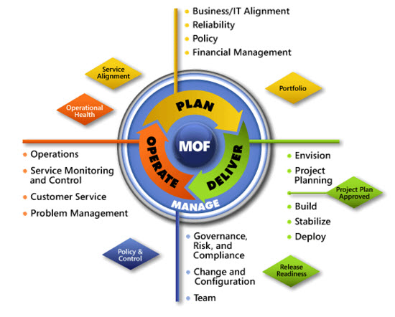
IPD in Microsoft Operations Framework 4.0
Use MOF with IPD guides to ensure that people and process considerations are addressed when changes to an organization’s IT services are being planned.
Notes:
For more information about Microsoft Operations Framework 4.0, go to www.microsoft.com/mof.

Slide 18
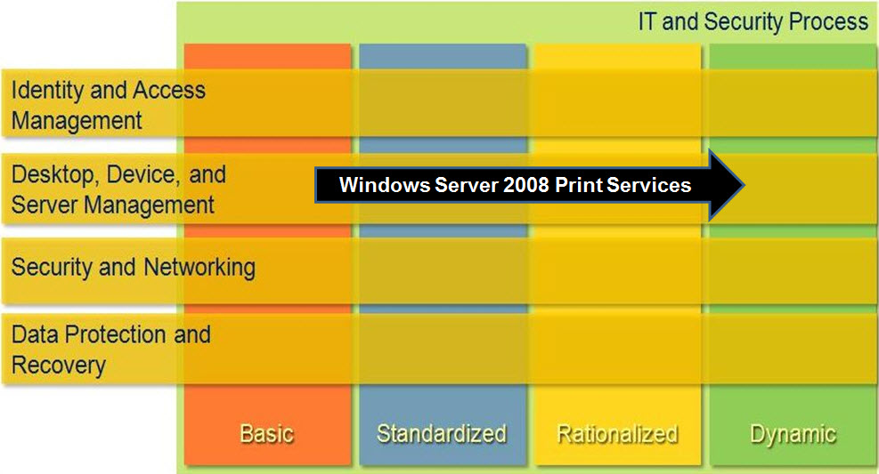
Print Services in Microsoft Infrastructure Optimization
Notes:
<This slide shows the effect that Print Services has on infrastructure maturity as reflected in the Core Infrastructure Optimization Model.>
The Infrastructure Optimization (IO) Model at Microsoft groups IT processes and technologies across a continuum of organizational maturity. (For more information, see http://go.microsoft.com/fwlink/?LinkId=229236.) The model was developed by industry analysts, the Massachusetts Institute of Technology (MIT) Center for Information Systems Research (CISR), and Microsoft's own experiences with its enterprise customers. A key goal for Microsoft in creating the Infrastructure Optimization Model was to develop a simple way to use a maturity framework that is flexible and can easily be applied as the benchmark for technical capability and business value.
IO is structured around three information technology models: Core Infrastructure Optimization, Application Platform Optimization, and Business Productivity Infrastructure Optimization. According to the Infrastructure Optimization Model, migrating Print Services to Windows Server 2003 or later can move an organization from a Basic to a Standardized maturity level. By implementing fault-tolerant print services and Group Policy-based automated printer assignment and provisioning, an organization can move significantly farther into the Dynamic level.

