Slide 1
Microsoft® Application Virtualization 4.6
Infrastructure Planning and Design
Published: September 2008
Updated: November 2011
Notes:
Copyright © 2011 Microsoft Corporation. This documentation is licensed to you under the Creative Commons Attribution License. To view a copy of this license, visit http://creativecommons.org/licenses/by/3.0/us/ or send a letter to Creative Commons, 543 Howard Street, 5th Floor, San Francisco, California, 94105, USA. When using this documentation, provide the following attribution: Infrastructure Planning and Design is provided with permission from Microsoft Corporation.
This documentation is provided to you for informational purposes only, and is provided to you entirely "AS IS". Your use of the documentation cannot be understood as substituting for customized service and information that might be developed by Microsoft Corporation for a particular user based upon that user’s particular environment. To the extent permitted by law, MICROSOFT MAKES NO WARRANTY OF ANY KIND, DISCLAIMS ALL EXPRESS, IMPLIED AND STATUTORY WARRANTIES, AND ASSUMES NO LIABILITY TO YOU FOR ANY DAMAGES OF ANY TYPE IN CONNECTION WITH THESE MATERIALS OR ANY INTELLECTUAL PROPERTY IN THEM.
Microsoft may have patents, patent applications, trademarks, or other intellectual property rights covering subject matter within this documentation. Except as provided in a separate agreement from Microsoft, your use of this document does not give you any license to these patents, trademarks or other intellectual property.
Information in this document, including URL and other Internet Web site references, is subject to change without notice. Unless otherwise noted, the example companies, organizations, products, domain names, e-mail addresses, logos, people, places and events depicted herein are fictitious.
Microsoft, Active Directory, AppLocker, BitLocker to Go, BranchCache, SQL Server, Windows, Windows Server, and Windows Vista are either registered trademarks or trademarks of Microsoft Corporation in the United States and/or other countries and regions.
The names of actual companies and products mentioned herein may be the trademarks of their respective owners.
You have no obligation to give Microsoft any suggestions, comments or other feedback (“Feedback”) relating to the documentation. However, if you do provide any Feedback to Microsoft then you provide to Microsoft, without charge, the right to use, share and commercialize your Feedback in any way and for any purpose. You also give to third parties, without charge, any patent rights needed for their products, technologies and services to use or interface with any specific parts of a Microsoft software or service that includes the Feedback. You will not give Feedback that is subject to a license that requires Microsoft to license its software or documentation to third parties because we include your Feedback in them.

Slide 2
What Is IPD? Guidance that clarifies and streamlines the planning and design process for Microsoft® infrastructure technologies
IPD:
Defines decision flow
Describes decisions to be made
Relates decisions and options for the business
Frames additional questions for business understanding
IPD guides are available at www.microsoft.com/ipd
Notes:
Infrastructure Planning and Design (IPD) is a series of planning and design guides created to clarify and streamline the planning and design process for Microsoft® infrastructure technologies.
Each guide in the series addresses a unique infrastructure technology or scenario.
These guides include the following topics:
Defining the technical decision flow (flow chart) through the planning process.
Describing the decisions to be made and the commonly available options to consider in making the decisions.
Relating the decisions and options for the business in terms of cost, complexity, and other characteristics.
Framing the decisions in terms of additional questions for the business to ensure a comprehensive understanding of the appropriate business landscape.
The guides in this series are intended to complement and augment Microsoft product documentation.

Slide 3
Getting Started
Microsoft Application Virtualization 4.6
Notes:
This guide was created to enable infrastructure planners to design virtualization infrastructure solutions. This guide includes specific design information, including activities that encourage sound planning. Each activity includes:
Prerequisites and background on the activity.
Tasks that will be performed to complete the activity.
Reference information regarding the activity’s impact on characteristics such as cost, complexity, and capacity of the solution.
Questions to ensure business needs are captured and reflected in the solution.
This guide is written for information technology (IT) infrastructure specialists who are responsible for planning and designing a Microsoft Application Virtualization infrastructure.

Slide 4
Purpose and Overview
Purpose
To provide guidance for designing an application virtualization infrastructure
Overview
Determine models needed
Determine instances needed
Assess client and sequencer considerations
Design the streaming infrastructure
Design the full infrastructure
Notes:
The purpose of this presentation is to address the decisions and/or activities that need to occur in planning a Microsoft Application Virtualization (App-V) implementation. The following slides will take an IT pro through the most critical design elements in a well-planned App-V design.

Slide 5
Application Management Challenges
Application life-cycle management
Deployment
Update
Support
Termination
Deploying applications to multiple environments
Windows® 7
Windows Vista®
Windows XP
Windows Server® 2008 Terminal Server
Windows Server 2008 R2 Remote Desktop Services
Notes:
Software management is one of the most time-consuming aspects of managing an enterprise network environment. Most enterprises use hundreds of different software applications across their organizations.
Organizations today are beginning to implement more structured management systems to reduce the work of managing numerous software applications and suites. A significant new tool to help with this challenge is application virtualization. Microsoft’s application virtualization offering is built on the Microsoft Application Virtualization (App-V) platform.
App-V offers several new technologies to reduce the complexity of managing applications in enterprise environments. To effectively implement the App-V platform, organizations will want to align it with business goals and needs. There are several additional considerations to examine, as the following slides will show.

Slide 6
What Is Microsoft Application Virtualization?
Microsoft Application Virtualization is a virtualization solution that:
Enables organizations to respond to the management challenge by providing the capability to make applications available to end-user computers without having to install the applications directly on those computers
Notes:
The purpose of this guide is to focus on the considerations that organizations should take into account when designing a virtualization infrastructure.
This will be accomplished by enabling planners to determine applications’ requirements and, using those requirements, design a Microsoft Application Virtualization infrastructure.

Slide 7
What’s New in App-V 4.6?
Delivers support for 64-bit operating systems
Provides support for Windows 7 and Windows Server 2008 R2, and support for Windows 7 features such as Windows Taskbar, Jump List, AppLocker®, BranchCache®, and BitLocker to Go®
Expands globalization and localization
Adds support for Virtual Desktop Infrastructure (VDI) systems: provides capability for read-only shared cache to help optimize server disk storage in VDI scenarios
Offers improved sequencing experience: provides improvements to the sequencing wizard and support for sequencing 32-bit and 64-bit applications
Notes:
The App-V 4.6 product provides the following enhancements and new features:
Delivers support for 64-bit operating systems. Provides the ability to sequence and run 32-bit and 64-bit applications on 64-bit Windows 7, Windows Vista, Windows XP, and Windows Server 2008 R2.
Provides support for Windows 7 and Windows Server 2008 R2. Provides support for Windows 7 and Windows Server 2008 R2, including support for Windows 7 features such as Windows Taskbar, Jump List, AppLocker®, BranchCache®, and BitLocker to Go®.
Expands globalization and localization. Provides 12 additional languages to support both virtualizing non-English applications and running the App-V user interface in additional non-English languages.
Adds support for Virtual Desktop Infrastructure (VDI) systems. Provides capability for read-only shared cache to help optimize server disk storage in VDI scenarios.
Offers improved sequencing experience. Provides improvements to the sequencing wizard and support for sequencing 32-bit and 64-bit applications.

Slide 8
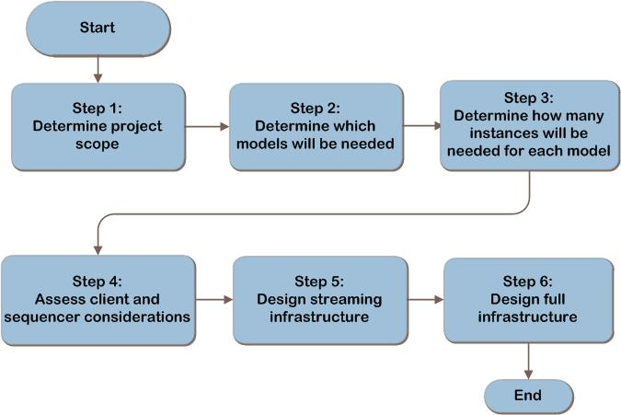
App-V Decision Flow
Notes:
This is the App-V design flow. The details of the design will be described in the following slides.

Slide 9
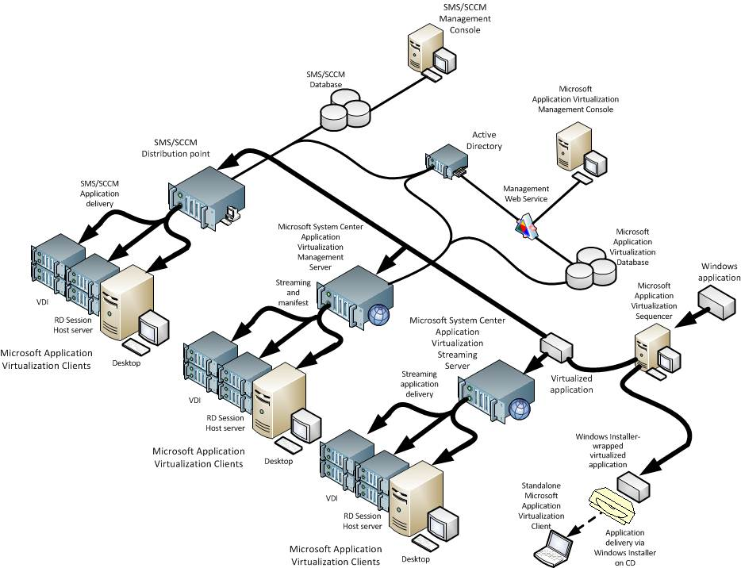
Example App-V Architecture
Notes:
The process of delivering virtualized applications to users is composed of two steps:
The first step involves publishing the application, consisting of delivering the shortcuts and file type associations, package definition information, and content source location to each computer with the App-V client installed.
In the second part, the packaged virtual applications are deployed to the workstation or terminal server. Alternatively, in a Windows Installer (MSI) deployment, the publishing information and deployment are combined in a single step.
This diagram is one example of an App-V Architecture.

Slide 10
Step 1: Determine the Project Scope
Task 1: Determine Application Scope
Define what applications the business needs virtualized
Task 2: Determine Location Scope
For example, enterprisewide or a specific geographic location
Record:
Location
Number of users at location
Connection paths and available bandwidth to each location
Notes:
Step 1: Determine the Project Scope
Task 1: Determine Application Scope
Depending on the applications to be virtualized, the App-V infrastructure may be set up in different ways. The first task is to define what applications the business needs virtualized.
Task 2: Determine Location Scope
Location scope refers to the places (for example, enterprise-wide or a specific geographic location) where the virtualized applications will be used. It can also refer to the user population (for example, a single department) who will use them. Obtain a network map that includes the connection paths as well as available bandwidth to each location.

Slide 11
Validating with the Business (Step 1)
It is important to clarify these items with the business:
Is each application to be virtualized supported by the vendor?
Does the licensing agreement allow each application to be virtualized?
Notes:
Validating with the Business (Step 1)
It is important to clarify several items with the business:
Is each application to be virtualized supported by the vendor? There may be additional risks to the business if the vendor does not support an application once it is virtualized. If a problem with a virtualized application arises, it may be necessary to reproduce the problem with the application installed locally in order to receive support.
Does the licensing agreement allow each application to be virtualized? Not all applications can be legally used in a virtualized environment.

Slide 12
Step 2: Determine Which Models Will Be Needed
App-V provides three methods for deploying application virtualization:
Option 1: Standalone Model via sequencing and client
Option 2: Streaming Model using the native streaming capabilities of App-V
Option 3: Full Infrastructure Model provides software distribution, management, and reporting capabilities (includes application streaming)
Notes:
Step 2: Determine Which Models Will Be Needed
The three models for deploying application virtualization are:
Standalone Model. Allows virtual applications to be Windows Installer-enabled for distribution without streaming and is interoperable with electronic software delivery (ESD) systems.
Streaming Model. Offers application streaming without requiring Active Directory or a database, and enables administrators to stream from existing servers or via System Center Configuration Manager 2007 SP1 with R2 distribution points.
Full Infrastructure Model. Provides for built-in software distribution, management, and reporting capabilities; it also includes application streaming.

Slide 13
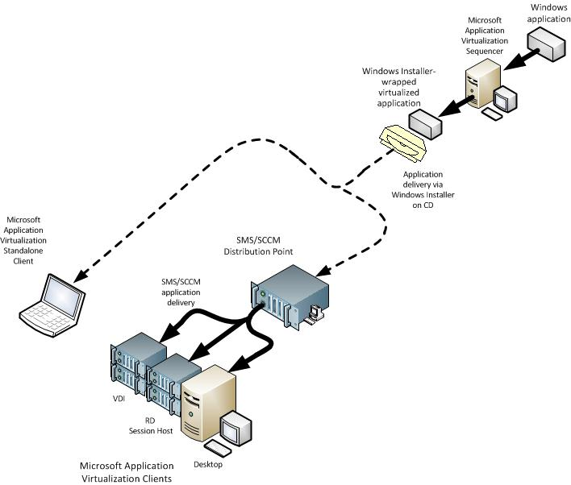
Option 1: Example Standalone Model Architecture (Step 2)
Notes:
Option 1: Example Standalone Model Architecture (Step 2)
Standalone delivery enables the business to realize the benefits of application virtualization in situations where no servers are available to support other methods of deploying virtual apps, such as disconnected remote users.
This diagram is one example of a Standalone Model architecture.

Slide 14
Option 1: Standalone Model (Step 2)
Creates a Windows Installer package as part of application sequencing
The sequencer creates a Windows Installer package, which contains the publication information, shortcuts, and installer routines
Use the Standalone Model:
With disconnected remote users who cannot connect to App-V infrastructure
Where software management systems, such as System Center Configuration Manager 2007 and Systems Management Server (SMS) 2003, are already in place
Where network bandwidth limitations prevent electronic software distribution
Notes:
Option 1: Standalone Model (Step 2)
App-V in Standalone Model consists of the sequencer and the Microsoft Application Virtualization client; no additional App-V infrastructure is required. Applications are prepared for virtualization in a process called sequencing. The sequencer packages the publication information, shortcuts, and the install routines into a Windows Installer file (MSI), and the virtualized application into an SFT file. The application can then be distributed using existing installation methods, such as:
Active Directory publishing through Group Policy objects (GPOs).
Media distribution via USB key or CD.
Run from a file share or Web server.
Software management systems such as System Center Configuration Manager 2007 or Microsoft Systems Management Server (SMS) 2003.
Cost and complexity for the Standalone Model is low as it uses existing infrastructure and deployment methods.

Slide 15
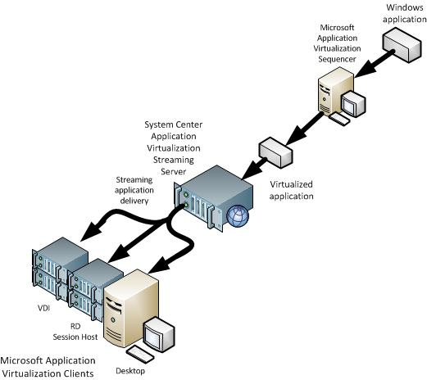
Option 2: Example Streaming Model Architecture (Step 2)
Notes:
Option 2: Example Streaming Model Architecture (Step 2)
App-V in Streaming Model consists of one or more streaming servers, the sequencer, and the App-V client. The App-V-enabled apps are placed on a streaming server that streams applications to client computers. Streaming is a term used to describe the process of obtaining content from a sequenced application package, starting with Feature Block 1, and obtaining additional blocks as needed, which allows the applications to be launched quickly.
This diagram is one example of a Streaming Model architecture.

Slide 16
Option 2: Streaming Model (Step 2)
Applications are streamed in feature blocks
Allows a quick application start; needs only Feature Block 1 (FB1) to load application
Uses existing server infrastructure
Use the Streaming Model:
Where Configuration Manager 2007 SP1 with R2 is already in place and the organization will use it for managing virtual application publishing and delivery
Where Active Directory® or SQL Server®-based servers are not in place, but the organization wants to take advantage of streaming virtual applications
Notes:
Option 2: Streaming Model (Step 2)
The App-V Streaming Model consists of one or more streaming servers, the sequencer, and the App-V client. The App-V client will need to be installed on the workstations or terminal server.
Cost and complexity for the Streaming Model are slightly higher as it may need new infrastructure.

Slide 17
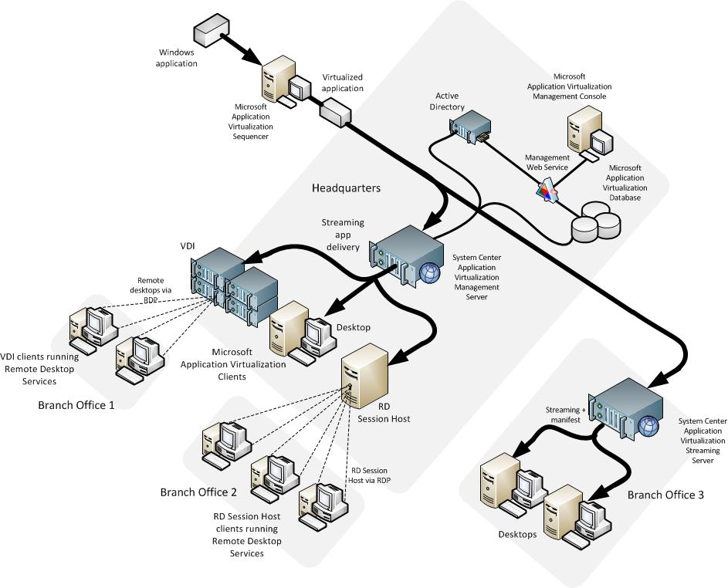
Option 3: Example Full Infrastructure Model Architecture (Step 2)
Notes:
Option 3: Example Full Infrastructure Model Architecture (Step 2)
An App-V Full Infrastructure Model consists of one or more System Center Application Virtualization Management Servers as the core of the App-V system architecture.
This diagram is one example of Full Infrastructure Model architecture.

Slide 18
Option 3: Full Infrastructure Model (Step 2)
Requires significant additional infrastructure
Consists of one or more System Center Application Virtualization Management Servers
Requires Microsoft SQL Server database
Application Virtualization Management Console required on a Management Server or a designated management workstation
Use Full Infrastructure Model:
Where the organization wants to use the Management Server to publish the application shortcuts to the clients
Where the additional reporting capabilities of the Management Server are desired
When group-based application publishing is required
When license enforcement is required
For rapid provisioning of applications to clients
Notes:
Option 3: Full Infrastructure Model (Step 2)
The App-V Full Infrastructure Model consists of one or more Microsoft System Center Application Virtualization Management Servers as the core of the App-V system architecture. The App-V client will need to be installed on the workstations or terminal server.
Cost and complexity for the Full Infrastructure Model are higher as it requires additional infrastructure to be deployed to support application deployment and management.
The business should ask this question:
Do the benefits provided by the App-V Full Infrastructure Model warrant the costs? Although the App-V Full Infrastructure Model provides some enticing features, the costs associated with implementing this model are greater than using the existing infrastructure.

Slide 19
Step 3: Determine How Many Instances Will Be Needed for Each Model
Task 1: Determine the Number of Streaming Model Instances
Full Infrastructure Model instance anchored by single SQL Server database. Separate databases define separate instances.
Streaming Model instance is defined by Streaming Server that provides virtualized applications to a location. Each location requires a Streaming Server deployed locally.
Task 2: Determine the Number of Full Infrastructure Model Instances
Technical
Political
Regulatory requirements
Isolation
Notes:
Step 3: Determine How Many Instances Will Be Needed for Each Model
Task 1: Determine the Number of Streaming Model Instances
A Streaming Model instance is defined as any type of Streaming Server that provides virtualized applications to a given location.
Each location that requires application virtualization should have a Streaming Server deployed locally.
Internet-based clients may realize the benefits of application virtualization in a streaming environment by the use of an ISA server or by placing a Streaming Server in a perimeter network (also known as DMZ, demilitarized zone, and screened subnet).
Task 2: Determine the Number of Full Infrastructure Model Instances
Examples of business requirements that may require separation of App-V onto more than one instance include:
Technical. If the organization expects more than 12,000 publishing refresh operations per minute, a separate instance may be required. A publishing refresh is a call to the Management Server to determine which virtual application shortcuts are sent to the client for use by the end user, and by default occurs at logon and then once per day.
Political. Different groups within the organization might each require their own installations.
Regulatory requirements. Can require total separation of an environment from other environments.
Isolation. A separate instance my be required for testing applications before release.

Slide 20
Step 4: Assess Client and Sequencer Considerations
Task 1: Client Considerations
Ensure cache is large enough for App-V desktop clients
Ensure clients are pre-cached on RD Session Host servers for performance reasons for remote desktop services
App-V clients must be pre-installed for all models
Task 2: Sequencer Considerations
Sequencer should be placed in an isolated environment
No agents or background applications
Virtual machine or physical CPU
Must have a second drive with a letter that matches the virtual drive used by the client
Default is drive Q
Deploying to a staging environment is recommended
Notes:
Step 4: Assess Client and Sequencer Considerations
Task 1: Client Considerations
The App-V Client is the component that runs the virtual applications and enables users to interact with icons and to double-click file types to start a virtual application. It also handles streaming of the application content from a streaming server and caches it before starting the application.
Task 2: Sequencer Considerations
The application sequencer needs to be kept in an isolated environment. The sequencer box itself cannot have any agents installed. This is so that when applications are being sequenced, they do not get sequenced with an errant dynamic-link library (DLL) or to a library specific to the agent because it happened to perform an operation while the application was being sequenced. This includes antivirus software.
It is important that the sequence environment remain isolated from the production environment. Also, applications that are sequenced should be tested in an environment that contains all of the normal agents and programs installed before being widely deployed. A physical or virtual hard drive should be defined in the sequencer to represent the virtual drive in the App-V client. By default, this is drive Q.

Slide 21
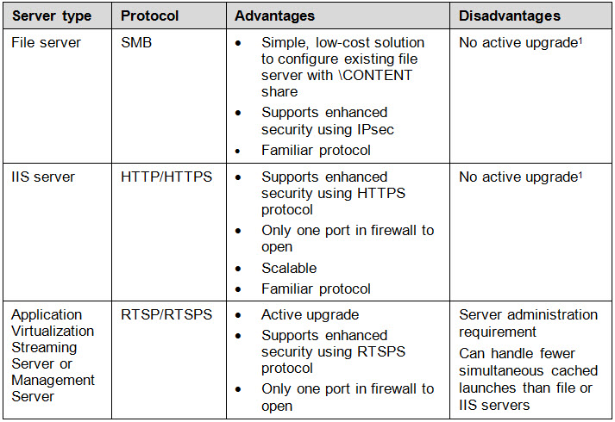
Step 5: Design the Streaming Infrastructure
Task 1: Determine the Streaming Server Types
The following options are available:
Notes:
Step 5: Design the Streaming Infrastructure
Task 1: Determine the Streaming Server Types
The purpose of this step is to select a Streaming Server type for each location defined in the scope. It’s important for the clients to be on the same high-speed LAN as the server due to the amount of content that will be transferred, so there should be at least one streaming server for each location.
New with R2, Configuration Manager 2007 distribution points can be enabled for streaming and provide the further benefit of automating the redirection to the “closest” server for clients that roam. Configuration Manager 2007 would be used to publish and deploy streaming applications and keep the content on the streaming servers in sync. Configuration Manager 2007 SP1 with R2 uses Internet Information Services (IIS) on standard distribution points and file server Server Message Block (SMB) streaming on branch distribution points.
Note Configuration Manager 2007 SP1 with R2 uses IIS on standard distribution points and file server SMB streaming on branch distribution points.
¹Note An alternative transparent way of providing new versions of applications to users for IIS or SMB streaming servers is to revise the OSD file to specify a new SFT file name (for example, *_2.sft) and send those with the next publishing refresh. When a user’s computer is started, the client searches for the new file name, differentially streams the blocks down, and starts the new application automatically. This may mitigate the need for Active Upgrade functionality.

Slide 22
Step 5: Design the Streaming Infrastructure (Continued)
Task 2: Determine the Streaming Server Scaling
Streaming Server size is highly dependent on environment in which it is placed
Start with one streaming server (or two if required for fault tolerance)
Task 3: Determine Fault-Tolerance Approach
Fault tolerance for Streaming Servers using RTSP/RTSPS achieved by load balancing the servers
Task 4: Maintaining Application Packages Across Multiple Streaming Servers
Consider an automated approach to keeping these applications and shares consistent
Notes:
Step 5: Design the Streaming Infrastructure (Continued)
Task 2: Determine the Streaming Server Scaling
The key point here is that the sizing of the server will be linked to the total number of users and the maximum number of potential streams. This will be a high watermark. It will also reflect typical server usage. However, it is important to note that when planning for server capacity and performance, it will be important to plan for the highest level of possible streams to ensure that performance is maintained at acceptable levels.
Task 3: Determine Fault-Tolerance Approach
Fault tolerance for Microsoft System Center Application Virtualization Streaming Servers using RTSP/RTSPS protocol is achieved by load balancing streaming servers. If Microsoft System Center Application Virtualization Streaming Servers are to stream different applications, assign the servers to separate load-balanced groups.
Task 4: Maintaining Application Packages Across Multiple Streaming Servers
With potentially multiple virtualized application packages stored on potentially many systems, it may be beneficial to consider an automated approach to keeping these applications and shares consistent. Distributed File System (DFS) Replication and DRS namespaces can be used to provide fault tolerance and synchronization.

Slide 23
Validating with the Business (Step 5)
Consider the effect these items could have on the business:
Are there any regulatory or policy requirements governing the need for encryption?
Is there sufficient cost justification to warrant fault tolerance for the streaming infrastructure?
Notes:
Validating with the Business (Step 5)
In this step, decisions must not only be evaluated against IT-related criteria; their effect on the business should also be considered:
Are there any regulatory or policy requirements governing the need for encryption? Many companies have compliance and privacy laws that affect applications. It is important to make sure that applications that interact with sensitive business information and data be kept in compliance with legal and security policies.
Is there sufficient cost justification to warrant fault tolerance for the streaming infrastructure? Given that the streaming server is only accessed to load the application for first use, the organization may want to weigh whether the costs of implementing fault tolerance are justified.

Slide 24
Step 6: Design the Full Infrastructure
Task 1: Server Resource Considerations
Decisions to make:
Management Server Service: Service can be placed on its own server or on the Management Server
SQL Server: App-V data store can be located on a dedicated SQL Server instance or in a shared database server
Management Server Scaling: To scale out, use load balancing
Notes:
Step 6: Design the Full Infrastructure
Task 1: Server Resource Considerations
Scaling and some capacity planning needs to be done once the environment is instantiated through creating a baseline of the system and looking at the growth trends.
Determining the resource requirements for each App-V role is accomplished by using the performance monitoring tools in Windows Server to measure the impact of the running system against key performance indicators.
App-V Full Infrastructure Model instance includes these server roles:
App-V Management Server
Streaming Server
Server running App-V Management Web Service
SQL Server
Active Directory
App-V Management Console
Sequencer for creating virtualized application packages
App-V client installed on systems requiring application virtualization (desktops, virtual machines, or RD Session Host servers)
Decisions to make:
Management Server Service. If placed on a Management Server, service can have a performance impact if performing report generation. Decide if service should be placed on its own server.
SQL Server. Running built-in reporting capabilities can add significant CPU load on App-V SQL Server. It’s recommended to replicate reporting data to a new database on a different server running SQL Server. Database growth can be calculated for proper capacity planning.
Management Server Scaling. To scale out, use load balancing.

Slide 25
Step 6: Design the Full Infrastructure (Continued)
Task 2: Determine Fault Tolerance for Each Role
Decisions to make:
Management Server Service: Service can be on same server with Management Console unless Management Server is load-balanced
Microsoft SQL Server: Several SQL Server versions available to provide fault tolerance, as well as possibility of clustering
Management Server: Two load balancing options for Management Server—software-based and hardware load balancing
Combining server roles:
Compatible fault-tolerant role combinations
Notes:
Step 6: Design the Full Infrastructure (Continued)
Task 2: Determine Fault Tolerance for Each Role
A number of services are important to the functionality of the App-V infrastructure. To increase the reliability and availability of these services, additional technology can be used to increase each component system’s fault tolerance.
Decisions to make
Management Server service: Management Console can be placed on same Management Server with service. If service fails, App-V system continues to function normally with the exception of App-V management changes and reporting. Decide whether to install service on the same server with Management Console or on an administrator’s workstation.
Microsoft SQL Server: App-V requires SQL Server 2000 (SP3a or SP4), SQL Server 2005 (SP1 or SP2), or SQL Server 2008. In locations where fault tolerance is not required, the SQL Server-based server can be installed on the same server as the Management Server service and Management Server.
If the App-V database is unavailable, no configuration changes can be made to the App-V system. Streaming Servers that are currently running will continue to service clients. However, the Management Server service will fail to run if the database is unavailable during startup.
The only supported fault-tolerance method for App-V today is SQL Server clustering. Server clusters are made up of two or more servers that can assume the load of the other servers in the cluster in the event of a failure. Creating a new cluster using failover clusters will require additional servers with the appropriate hardware to support the cluster service. Failover clusters will also require a shared storage device that can be locally attached to the servers running SQL Server, thus increasing the costs of deploying App-V.
Management Server: Fault tolerance is achieved by load balancing Management Servers; there are two Network Load Balancing options available—software-based NLB and hardware load balancer.
Combining server roles
Discounting scaling and fault-tolerance requirements, the minimum number of servers needed for a location with connectivity to Active Directory is one. This server will host the Management Server, Streaming Server, Management Server service, and SQL Server roles. Server roles, therefore, can be arranged in any desired combination since they do not conflict with one another.
Although there are a number of fault-tolerance strategies and technologies available, not all are applicable to a given service. Additionally, if App-V roles are combined, certain fault-tolerance options may no longer apply due to incompatibilities.

Slide 26
Validating with the Business (Step 6)
Review the decisions made for each server role with the affected business units:
Is there sufficient cost justification to warrant fault tolerance?
Notes:
Validating with the Business (Step 6)
Review the decisions made for each server role with the affected business units:
Is there sufficient cost justification to warrant fault tolerance? If applications must be available, implementing a load-balanced and redundant solution may be a requirement of the deployment. It is important to understand which applications are critical to the enterprise and how virtualization and streaming may affect their availability to the parties that rely on them. Ensure that the business agrees that there is an appropriate balance between the costs and fault-tolerance capabilities.

Slide 27
Summary and Conclusion
A combination of models may be required to deliver virtual applications within the organization
Carefully consider requirements for streaming infrastructure
Planning is key
Provide feedback to ipdfdbk@microsoft.com
Notes:
Summary and Conclusion
Carefully consider requirements for streaming infrastructure.
A combination of models may be required to deliver virtual applications within the organization.
Planning is key.

Slide 28
Find More Information
Download the full document and other IPD guides:
www.microsoft.com/ipd
Contact the IPD team:
ipdfdbk@microsoft.com
Access the Microsoft Solution Accelerators website:
www.microsoft.com/technet/SolutionAccelerators

Slide 29
Questions?

Slide 30
Addenda
Benefits of using the App-V guide
IPD in Microsoft Operations Framework 4.0
Application Virtualization in Microsoft Infrastructure Optimization

Slide 31
Benefits of Using the App-V Guide
Benefits for Business Stakeholders/Decision Makers
Most cost-effective design solution for implementation
Alignment between the business and IT from the beginning of the design process to the end
Benefits for Infrastructure Stakeholders/Decision Makers
Authoritative guidance
Business validation questions ensuring solution meets requirements of business and infrastructure stakeholders
High integrity design criteria that includes product limitations
Fault-tolerant infrastructure
Proportionate system and network availability to meet business requirements
Infrastructure that’s sized appropriately for business requirements
Notes:
Benefits of Using the App-V Guide
Benefits for Business Stakeholders/Decision Makers:
Most cost-effective design solution for an implementation. IPD eliminates over-architecting and over-spending by precisely matching the technology solution to the business needs.
Alignment between the business and IT from the beginning of the design process to the end.
Benefits for Infrastructure Stakeholders/Decision Makers:
Authoritative guidance. Microsoft is the best source for guidance about the design of Microsoft products.
Business validation questions to ensure the solution meets the requirements of both business and infrastructure stakeholders.
High integrity design criteria that includes product limitations.
Fault-tolerant infrastructure, where necessary.
Proportionate system and network availability to meet business requirements.
Infrastructure that is sized appropriately to meet business requirements.

Slide 32
Benefits of Using the App-V Guide (Continued)
Benefits for Consultants or Partners
Rapid readiness for consulting engagements
Planning and design template to standardize design and peer reviews
A “leave-behind” for pre- and post-sales visits to customer sites
General classroom instruction/preparation
Benefits for the Entire Organization
Using the guide should result in a design that will be sized, configured, and appropriately placed to deliver a solution for achieving stated business requirements
Notes:
Benefits of Using the App-V Guide (Continued)
Benefits for Consultants or Partners:
Rapid readiness for consulting engagements.
Planning and design template to standardize design and peer reviews.
A “leave-behind” for pre- and post-sales visits to customer sites.
General classroom instruction/preparation.
Benefits for the Entire Organization:
Using the guide should result in a design that will be sized, configured, and appropriately placed to deliver a solution for stated business requirements, while considering the performance, capacity, manageability, and fault tolerance of the system.

Slide 33
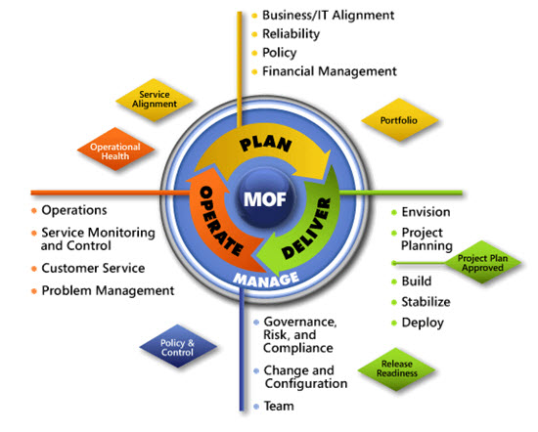
IPD in Microsoft Operations Framework 4.0
Use MOF with IPD guides to ensure that people and process considerations are addressed when changes to an organization’s IT services are being planned.
Notes:
For more information about Microsoft Operations Framework 4.0, go to www.microsoft.com/mof.

Slide 34
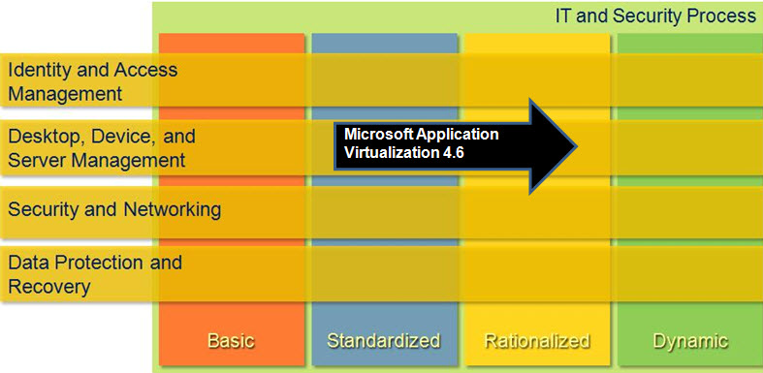
Application Virtualization in Microsoft Infrastructure Optimization
Notes:
<This slide shows the effect that Application Virtualization has on infrastructure maturity as reflected in the Core Infrastructure Optimization Model.>
The Infrastructure Optimization (IO) Model at Microsoft groups IT processes and technologies across a continuum of organizational maturity. (For more information, see www.microsoft.com/infrastructure.) The model was developed by industry analysts, the Massachusetts Institute of Technology (MIT) Center for Information Systems Research (CISR), and Microsoft's own experiences with its enterprise customers. A key goal for Microsoft in creating the Infrastructure Optimization Model was to develop a simple way to use a maturity framework that is flexible and can easily be applied as the benchmark for technical capability and business value.
IO is structured around three information technology models: Core Infrastructure Optimization, Application Platform Optimization, and Business Productivity Infrastructure Optimization. According to the Core Infrastructure Optimization Model, having administrator-controlled automated physical or virtual application distribution will help move an organization to the Rationalized level. App-V gives the administrator control over application distribution by delivering applications that are never installed, yet securely follow users anywhere, on demand. On the path to the Dynamic level, organizations can use App-V to enable dynamic application access and recovery for desktop applications.

