Slide 1
Microsoft® Enterprise Desktop Virtualization
Infrastructure Planning and Design
Published: March 2009
Updated: November 2011
Notes:
Copyright © 2011 Microsoft Corporation. All rights reserved. Complying with the applicable copyright laws is your responsibility. By using or providing feedback on this documentation, you agree to the license agreement below.
If you are using this documentation solely for non-commercial purposes internally within YOUR company or organization, then this documentation is licensed to you under the Creative Commons Attribution-NonCommercial License. To view a copy of this license, visit http://creativecommons.org/licenses/by-nc/2.5/ or send a letter to Creative Commons, 543 Howard Street, 5th Floor, San Francisco, California, 94105, USA.
This documentation is provided to you for informational purposes only, and is provided to you entirely "AS IS". Your use of the documentation cannot be understood as substituting for customized service and information that might be developed by Microsoft Corporation for a particular user based upon that user’s particular environment. To the extent permitted by law, MICROSOFT MAKES NO WARRANTY OF ANY KIND, DISCLAIMS ALL EXPRESS, IMPLIED AND STATUTORY WARRANTIES, AND ASSUMES NO LIABILITY TO YOU FOR ANY DAMAGES OF ANY TYPE IN CONNECTION WITH THESE MATERIALS OR ANY INTELLECTUAL PROPERTY IN THEM.
Microsoft may have patents, patent applications, trademarks, or other intellectual property rights covering subject matter within this documentation. Except as provided in a separate agreement from Microsoft, your use of this document does not give you any license to these patents, trademarks or other intellectual property.
Information in this document, including URL and other Internet Web site references, is subject to change without notice. Unless otherwise noted, the example companies, organizations, products, domain names, e-mail addresses, logos, people, places and events depicted herein are fictitious.
Microsoft, Active Directory, Hyper-V, SQL Server, Windows, and Windows Server are either registered trademarks or trademarks of Microsoft Corporation in the United States and/or other countries and regions.
The names of actual companies and products mentioned herein may be the trademarks of their respective owners.
You have no obligation to give Microsoft any suggestions, comments or other feedback ("Feedback") relating to the documentation. However, if you do provide any Feedback to Microsoft then you provide to Microsoft, without charge, the right to use, share and commercialize your Feedback in any way and for any purpose. You also give to third parties, without charge, any patent rights needed for their products, technologies and services to use or interface with any specific parts of a Microsoft software or service that includes the Feedback. You will not give Feedback that is subject to a license that requires Microsoft to license its software or documentation to third parties because we include your Feedback in them.

Slide 2
What Is IPD? Guidance that clarifies and streamlines the planning and design process for Microsoft® infrastructure technologies
IPD:
Defines decision flow
Describes decisions to be made
Relates decisions and options for the business
Frames additional questions for business understanding
IPD guides are available at www.microsoft.com/ipd
Notes:
Infrastructure Planning and Design (IPD) is a series of planning and design guides created to clarify and streamline the planning and design process for Microsoft® infrastructure technologies.
Each guide in the series addresses a unique infrastructure technology or scenario.
These guides include the following topics:
Defining the technical decision flow (flow chart) through the planning process.
Describing the decisions to be made and the commonly available options to consider in making the decisions.
Relating the decisions and options for the business in terms of cost, complexity, and other characteristics.
Framing the decisions in terms of additional questions for the business to ensure a comprehensive understanding of the appropriate business landscape.
The guides in this series are intended to complement and augment Microsoft product documentation.

Slide 3
Getting Started
Microsoft® Enterprise Desktop Virtualization
Notes:
The guide is designed to provide a consistent structure for addressing the decisions and activities that are most critical to the successful implementation of Microsoft Enterprise Desktop Virtualization (MED-V) software.
Each decision or activity is subdivided into four elements:
Background on the decision or activity, including context setting and general considerations.
Typical options or tasks to perform for the activity.
Where there is a decision to be made, a reference section evaluating the options in terms of cost, complexity, and manageability.
Questions for the business that may have a significant impact on the decisions to be made.

Slide 4
Purpose and Overview
Purpose
To assist in the decision process to plan a successful Microsoft Enterprise Desktop Virtualization (MED-V) implementation
Overview
What is MED-V?
Review the design flow
Define the project scope
Determine the number of MED-V instances required
Design the server infrastructure
Design the image repositories
Notes:
The purpose of this presentation is to address the decisions and/or activities that need to occur in planning a Microsoft Enterprise Desktop Virtualization (MED-V) implementation. The following slides will take an IT pro through the most critical design elements in a well-planned MED-V design.

Slide 5
What Is Microsoft Enterprise Desktop Virtualization (MED-V)?
Administrator-controlled, automated virtual machine image distribution and management for Windows desktops
Note that MED-V is dependent on Virtual PC; however, virtual PC design is out of scope for this IPD guide as well as design of images for Virtual PC 2007

Slide 6
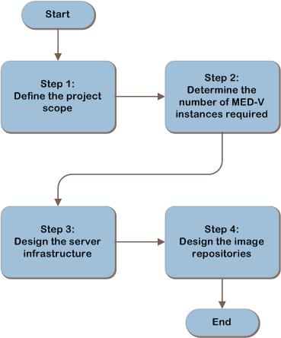
MED-V Decision Flow
MAP w/ CAL Tracker
SCM
ITA
Notes:
This is the MED-V decision flow. The details of the design will be discussed in the following slides.

Slide 7
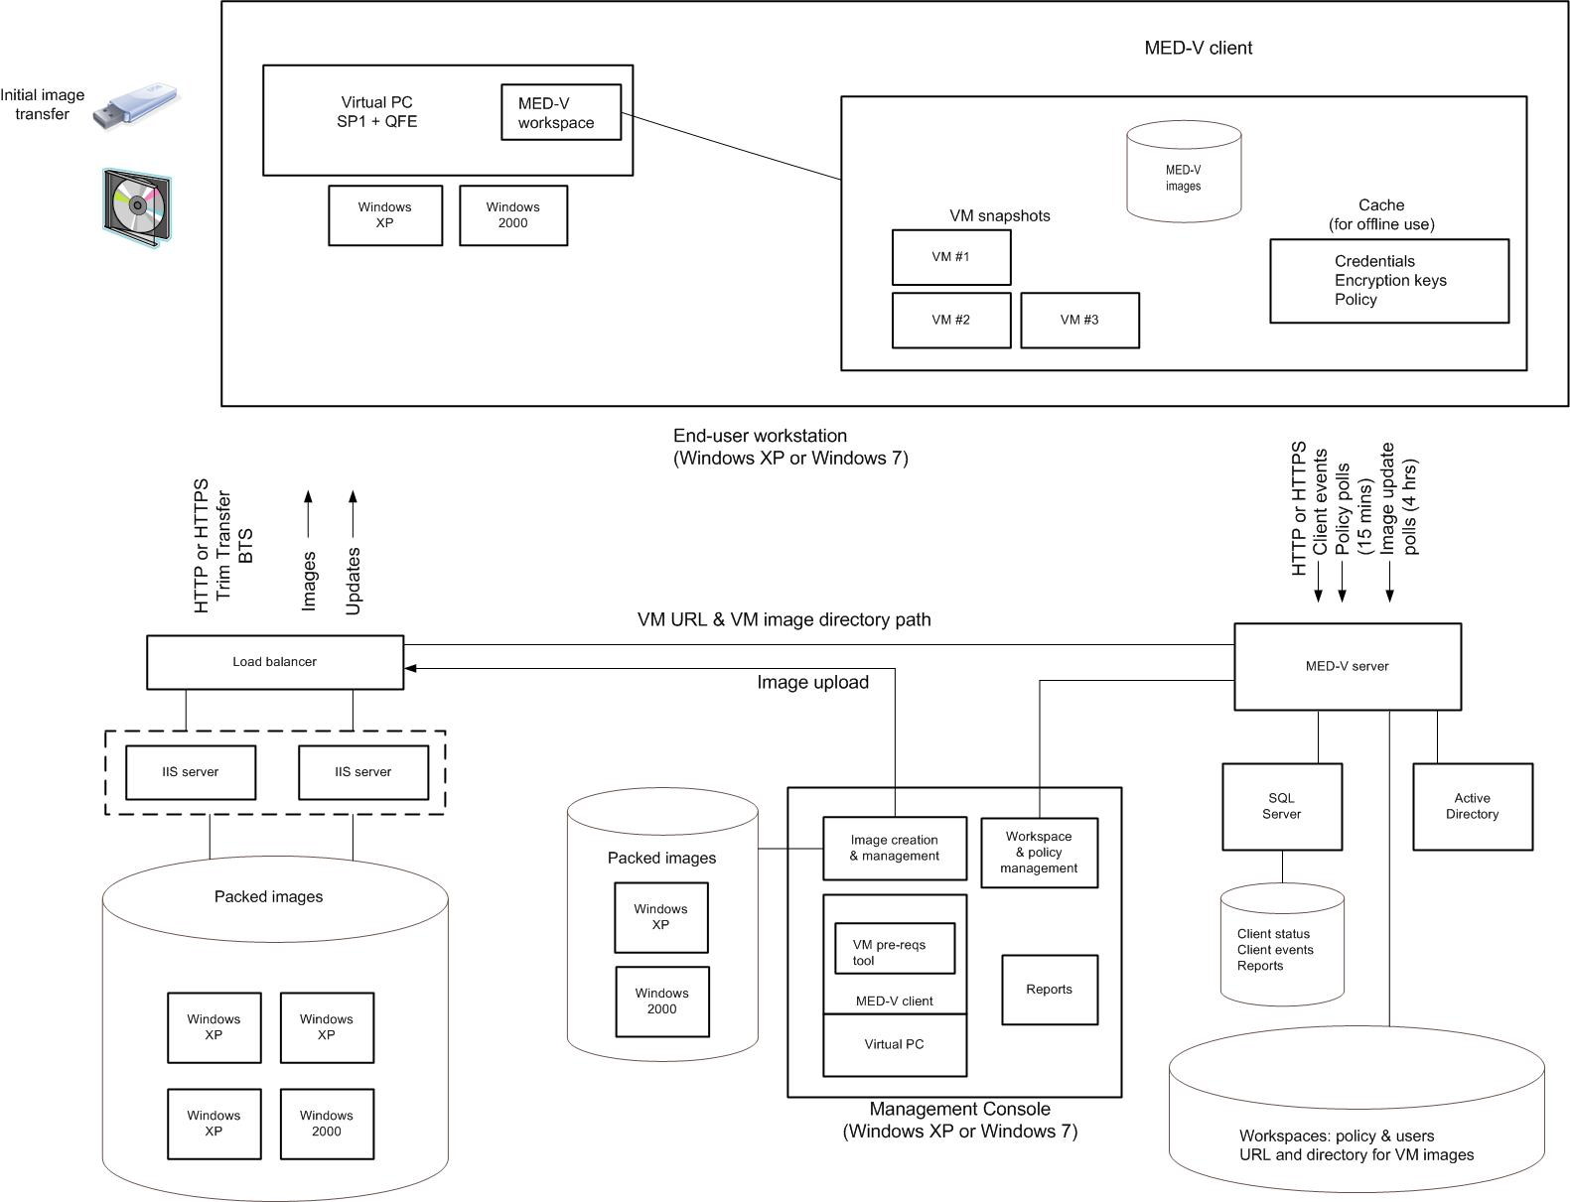
Example MED-V Architecture
SCM
ITA
Notes:
This diagram illustrates the relationship between the components that work together to provide an architecture for MED-V. They are shown together in one possible implementation for illustration purposes, but other configurations are possible.

Slide 8
Step 1: Define the Project Scope
The project scope will be determined in order to align the goals of the project with the business motivation:
Task 1: Define the User Population to Be Managed
Task 2: Determine Which Virtual Machines Will Be Managed by MED-V
Task 3: Determine the Organization’s Service Level Expectations
Notes:
Step 1. Define Project Scope
In this step, the project scope will be determined in order to align the goals of the project with the business motivation.
Task 1: Define the User Population to Be Managed
Identification of the population of end users provided with virtual machine images managed by MED-V will determine the location of the MED-V Client installations, the number of MED-V instances in Step 2, and the number and placement of MED-V repositories in Step 4.
Where are the users located? Used to determine the method of distributing images and placement of repositories in Step 4.
How are the user locations connected? Obtain a network infrastructure diagram showing user locations and available bandwidth to those locations. Used to determine the location of repositories in Step 4.
Will users travel between locations? If yes, this may require the design of additional capacity in the server infrastructure in Step 3 and repositories in Step 4. Also may increase the required bandwidth to these locations. Note that traveling users may appear in multiple locations.
Task 2: Determine Which Virtual Machines Will Be Managed by MED-V
Determine which virtual machines will be provided to users in each location. Used to design method of distributing images and placement of repositories in Step 4. Document whether users are permitted to work in the virtual machine images while in offline mode. Implications of offline mode are explained in Appendix B in the guide. MED-V doesn’t include standard capability for fault-tolerant MED-V server configuration. If users aren’t allowed to work offline, they’ll be unable to work in the event of a MED-V server failure, even if the MED-V workspace has already been started on the client. Used in Step 3 to determine if a backup server should be manually configured. If virtual machines are already stored in a centralized library, determine location of library so it may be evaluated in Step 4 as a MED-V repository.
Task 3: Determine the Organization’s Service Level Expectations
Document the acceptable time for a new image to load when a client requires it and the window for critical updates. Used to determine the performance and fault-tolerance requirements for the MED-V server and database in Step 3 and the image repository in Step 4. This information will be used in Step 3 to design the server infrastructure.

Slide 9
Step 2: Determine the Number of MED-V Instances Required
The number of MED-V instances will be determined and the scope of each instance defined so that the design of the server infrastructure for each instance can be completed in the next step:
Task 1: Determine the Number of MED-V Instances Required
Notes:
Step 2. Determine the Number of MED-V Instances Required
In this step, the number of MED-V instances will be determined and the scope of each instance defined so that the design of the server infrastructure for each instance can be completed in the next step.
Task 1: Determine the Number of MED-V Instances Required
The Database Engine is the core service for storing, processing, and securing data. It supports OLTP databases.
Begin the planning process with one MED-V instance, and scale out by adding more instances if any of the following conditions apply:
Number of supported users. Each MED-V instance can support up to 5,000 concurrently active clients. If there will be more than 5,000 active users, add one instance to the design for each 5,000 users.
Users in untrusted domains. The MED-V server associates workspace permissions with Active Directory® Domain Services users and/or groups. This requires MED-V users to be within the trust boundary of the MED-V server. Add one MED-V instance to the design for each group of MED-V users in a separate, untrusted domain.
Clients in isolated networks. Determine if any clients reside in networks that are isolated and therefore require a separate MED-V instance. For example, organizations often isolate lab networks from production networks. Add a MED-V instance to the design for each isolated network that will contain MED-V Clients.
Organizational requirements. The organization may require that a group of clients be managed by a separate MED-V instance for security reasons, such as when sensitive applications are delivered only to a restricted set of users within a domain. If the organization uses a distributed management model, a separate MED-V instance will be required for each business group that will have MED-V Clients to enable the group to manage its own virtualized environment. Add one MED-V instance to the design for each separate organizational requirement.
Legal considerations. National security or privacy issues and fiduciary laws could require the separation of certain data or prevent other data from crossing national borders. Design additional MED-V instances to address this need, if necessary.
Record a name for each MED-V instance, and the reason for designing it, in Table A-2 in Appendix A in the guide. This information will be used in Step 3 to determine the scope of each instance and to determine the design of the server infrastructure for that instance.

Slide 10
Step 3: Design the Server Infrastructure
In this step, the server infrastructure will be designed for each MED-V instance:
Task 1: Design and Place the Server for Each MED-V Instance
Notes:
Step 3. Design the Server Infrastructure
Task 1: Design and Place the Server for Each MED-V Instance
The MED-V server implements policy and stores state and history data about its clients. It performs the following functions:
Stores workspace policy when created or changed in MED-V Management Console.
Receives authentication request from each MED-V Client when MED-V Client starts a workspace.
Queries AD DS to authenticate the client for the workspace.
Receives policy update polls from clients and may deliver changed workspaces to clients.
Receives image update polls from clients, by default every 4 hours, and redirects them to the image download location.
Receives events from clients and stores them in the database. Events do not flow immediately; they are queued on the client, and then sent each minute.
Generates reports on demand for the MED-V Management Console.
Form Factor
MED-V PG recommends using at least a 2.8-GHz dual core CPU server with 2 GB of RAM, assuming the MED-V server runs on a dedicated machine. MED-V server should be lightly loaded. Design the server with memory matching the organization’s standard form factor. The MED-V server can be run in a virtual machine on Windows Server® 2008 Hyper-V®. If a virtual machine is used, ensure it has access to CPU and memory resources equal to those specified for a physical machine. Disk capacity required by MED-V server must be sufficient to store workspace configuration files. These XML files are around 30 KB. Multiply 30 KB by number of workspaces MED-V server will store to determine required disk capacity. The MED-V server’s most important network connections are links to clients, so place server in location providing most available bandwidth and robust links to clients.
Fault Tolerance
There can be only one active MED-V server in a MED-V instance, and MED-V doesn’t include standard capabilities to place server in an MSCS cluster. If users aren’t allowed to work offline, they’ll be unable to work if a MED-V server fails, even if MED-V workspace has been started on client. Policy polls and events will be held on the client until server can be contacted. If offline work is permitted, determine how long client is allowed to work offline before authenticating. This is the maximum time that server can be unavailable. Server is stateless, so a backup server can be configured to take over if MED-V server fails.

Slide 11
Step 3: Design the Server Infrastructure (Continued)
In this step, the server infrastructure will be designed for each MED-V instance:
Task 2: Design and Place the SQL Server® Database
Task 3: Design the Management Console
Notes:
Step 3. Design the Server Infrastructure (Continued)
Task 2: Design and Place the SQL Server Database
SQL Server® database is used by MED-V server to store client status and events. SQL Server database can be on same machine as MED-V server, or on separate remote server running SQL Server. Database can be shared with other instances; events and alerts from instances are stored in same database, and reports will include events and alerts from all instances. Database can be installed in existing SQL Server instance, and other MED-V server databases can reside in same instance. If database server is remote from MED-V server, across network links with insufficient bandwidth, reports may be slow to load in console and may not display latest data from clients.
Form Factor – If SQL Server will run on same server as MED-V, and if SQL Server will store data for server, start with product group recommendation for MED-V server, and add resources for SQL Server load. No guidance available from MED-V product group to select SQL Server form factor. If SQL Server stores events and alerts from more than one MED-V instance, refer to the IPD guide on Microsoft SQL Server 2008 for how to scale up server. Size of database depends on number of client events database is required to store. Events are created by normal operation of client. Default interval which events are sent by client = 1 minute. To estimate database size, determine: # of clients in MED-V instance (max is 5,000), typical event arrival rate (depends on client usage, approximately 15-20 events/day), event size (typically, around 200 bytes), and storage amount (how many days’ events will be stored in database before events cleared by MED-V admin). Multiply values to calculate size of required data storage in bytes, and then add safety factor to account for errors, which could create large number of events from client in a short time, and database table and organizational space.
Fault Tolerance – If server running SQL Server is unavailable, events will become backed up on clients, and reports won’t be available in Management Console. Refer to organization service level expectations to decide if design of fault-tolerant SQL Server infrastructure is necessary. MED-V doesn’t provide support to run SQL Server in MSCS clusters. If necessary to design fault-tolerant SQL Server infrastructure, refer to the IPD guide on Microsoft SQL Server 2008 for information on other fault-tolerance options, and how to select and design a solution.
Task 3: Design the Management Console
MED-V Management Console (MC) should be designed with form factor resembling typical MED-V Client machine. MC used to test virtual machines before packed for distribution to MED-V Clients. MC is a stand-alone application and performs 3 functions: prepares/tests virtual machines, creates/configures workspaces, and displays reports. MC application is installed with MED-V Client, uses Microsoft Virtual PC 2007 SP1 with KB958162 to prepare/test virtual machines, so must be installed on client O/S; can’t run on same system as MED-V server. MC can’t be shared between MED-V server instances. Address of MED-V server is specified during install of MC’s MED-V Client and can be changed after install, but MC can only work with single MED-V server. More than one MC can be used with a MED-V server. A mechanism is available to notify other console users when one console has made changes to a workspace, so conflicts can be avoided. For each MED-V instance, determine how many MCs are needed and where they’ll be placed.

Slide 12
Step 4: Design the Image Repositories
In this step, the image repositories will be designed:
Task 1: Determine How Images Will Be Distributed
Task 2: Determine the Number of Image Repositories
Notes:
Step 4. Design the Image Repositories
Task 1: Determine How Images Will Be Distributed
This decision must be made for each workspace client may run. Used to decide how many repositories will be used to store packed virtual machines, where those repositories will be placed, and to design those repositories. A packed virtual machine can be distributed in the following ways: 1) Pre-staged to an image store directory on client machine, using a corporate software distribution tool such as Service Center Configuration Manager. This is supported only for initial distribution of image; can’t be used to distribute updates; 2) Downloaded over network from image distribution server, comprising a file server and Internet Information Services (IIS) server. MED-V uses TrimTransfer technology to reduce amount of data flowing over network from file server to client. Uses BITS to throttle distribution to minimize competition for bandwidth. May be long delays before client can work in virtual machine; 3) On removable media, such as a USB drive or DVD (not supported to run image from removable media; it must be copied to image location on client machine). The client should be able to work immediately when a workspace using virtual machine is loaded; 4) A combination of the above.
Task 2: Determine the Number of Image Repositories
Use output from previous task to design minimum number of repositories that will service clients’ needs for all MED-V instances. Add repositories if any of the following criteria apply: 1) Organizational or regulatory reasons to separate the virtual machines, 2) Clients in isolated networks, or 3) Clients in remote networks. Used in the next task to design each repository.

Slide 13
Step 4: Design the Image Repositories (Continued)
In this step, the image repositories will be designed:
Task 3: Design and Place the Image Repositories
Task 4: Design and Place the IIS Servers
Notes:
Step 4. Design the Image Repositories (Continued)
Task 3: Design and Place the Image Repositories
Repeat this task for each repository. Maximum load on repository occurs when new versions of images made available to clients and clients are notified by policy change. Multiple clients start to download image, possibly at same time, so image repository (IR) must be designed to meet demand. Determine how much data repository will store. Sum sizes of images to be stored in repository and number of clients that download virtual machines from repository. Will be maximum number of concurrent downloads that can occur when new virtual machine loaded in repository. File share (FS) must be designed with disk subsystem to meet IO demand this creates. Refer to the IPD guide on Windows Server 2008 File Services to design FS and disk subsystem. Use service level expectations to plan bandwidth for repository. IR can reside on same system as MED-V server and server running SQL Server, or can be on remote FS. Refer to network location of clients IR services; place repository where it will have sufficient bandwidth to meet service level expectations of clients.
Fault Tolerance – If IR is unavailable, clients won’t be able to download new or updated virtual machine images. The IR is a Windows Server 2008 FS, and could be placed in a cluster (not supported by MED-V). Refer to the IPD guide on Windows Server 2008 File Services to design other fault-tolerance options for FS and fault-tolerant disks.
Task 4: Design and Place the IIS Servers
Perform task for each IR. If clients will download image files over network using HTTP/HTTPS, proceed with task to design IIS server infrastructure; otherwise, skip to Step Summary. IIS server can coexist with MED-V server and server running SQL Server and can run in a Windows Server 2008 Hyper-V virtual machine. IIS server infrastructure must have sufficient throughput to deliver images to clients within service level expectations of organization. Must be designed with disk subsystem to meet IO demand this creates. Sum number of clients that may download virtual machines using IIS infrastructure. This is maximum number of concurrent downloads that can occur when new virtual machine is loaded in repository. Use throughput sum and service level expectations to design the IIS server infrastructure and to determine appropriate amount of bandwidth for repository. Refer to the IPD guide for IIS 7.0 and IIS 7.5 to design IIS server infrastructure.
Fault Tolerance – If IIS server infrastructure is unavailable, clients won’t be able to download new or updated virtual machine images. IIS server is a Windows Server 2008-based server and can be placed in failover cluster, for a fault-tolerant configuration. Refer to the IPD guide for IIS 7.0 and IIS 7.5 to design fault tolerance for IIS server infrastructure.

Slide 14
Summary and Conclusion
The guide has outlined the step-by-step process for planning a Microsoft Enterprise Desktop Virtualization infrastructure. In each step, major decisions relative to the MED-V infrastructure were determined and explained.
It focused on how to:
Define the project scope
Determine the number of MED-V instances required
Design the server infrastructure and image repositories
Provide feedback to ipdfdbk@microsoft.com
Notes:
Summary and Conclusion
The guide has outlined the step-by-step process for planning a Microsoft Enterprise Desktop Virtualization infrastructure. In each step, major decisions relative to the MED-V infrastructure were determined and explained.
Also, the guide explained how to define the project scope, how to determine the number of MED-V instances required, how to design the server infrastructure, and how to design the image repositories. Information was provided relative to scaling and fault tolerance, and job aids were provided to record all of the information necessary to plan the MED-V infrastructure.
Using the information recorded from the steps completed in the guide, the organization can help ensure that it meets business and technical requirements for a successful MED-V deployment.

Slide 15
Find More Information
Download the full document and other IPD guides:
www.microsoft.com/ipd
Contact the IPD team:
ipdfdbk@microsoft.com
Access the Microsoft Solution Accelerators website:
www.microsoft.com/technet/SolutionAccelerators

Slide 16
Questions?

Slide 17
Addenda
Benefits of Using the Microsoft Enterprise Desktop Virtualization Guide
IPD in Microsoft Operations Framework 4.0
MED-V in Microsoft Infrastructure Optimization

Slide 18
Benefits of Using the Microsoft Enterprise Desktop Virtualization Guide
Benefits for Business Stakeholders/Decision Makers
Most cost-effective design solution for implementation
Alignment between the business and IT from the beginning of the design process to the end
Benefits for Infrastructure Stakeholders/Decision Makers
Authoritative guidance
Business validation questions ensuring solution meets requirements of business and infrastructure stakeholders
High integrity design criteria that includes product limitations
Fault-tolerant infrastructure
Proportionate system and network availability to meet business requirements
Infrastructure that’s sized appropriately for business requirements
Notes:
Benefits of Using the Microsoft Enterprise Desktop Virtualization Guide
Benefits for Business Stakeholders/Decision Makers:
Most cost-effective design solution for an implementation. IPD eliminates over-architecting and over-spending by precisely matching the technology solution to the business needs.
Alignment between the business and IT from the beginning of the design process to the end.
Benefits for Infrastructure Stakeholders/Decision Makers:
Authoritative guidance. Microsoft is the best source for guidance about the design of Microsoft products.
Business validation questions to ensure the solution meets the requirements of both business and infrastructure stakeholders.
High integrity design criteria that includes product limitations.
Fault-tolerant infrastructure, where necessary.
Proportionate system and network availability to meet business requirements.
Infrastructure that is sized appropriately to meet business requirements.

Slide 19
Benefits of Using the Microsoft Enterprise Desktop Virtualization Guide (Continued)
Benefits for Consultants or Partners
Rapid readiness for consulting engagements
Planning and design template to standardize design and peer reviews
A “leave-behind” for pre- and post-sales visits to customer sites
General classroom instruction/preparation
Benefits for the Entire Organization
Using the guide should result in a design that will be sized, configured, and appropriately placed to deliver a solution for achieving stated business requirements
Notes:
Benefits of Using the Microsoft Enterprise Desktop Virtualization Guide (Continued)
Benefits for Consultants or Partners:
Rapid readiness for consulting engagements.
Planning and design template to standardize design and peer reviews.
A “leave-behind” for pre- and post-sales visits to customer sites.
General classroom instruction/preparation.
Benefits for the Entire Organization:
Using the guide should result in a design that will be sized, configured, and appropriately placed to deliver a solution for stated business requirements, while considering the performance, capacity, manageability, and fault tolerance of the system.

Slide 20
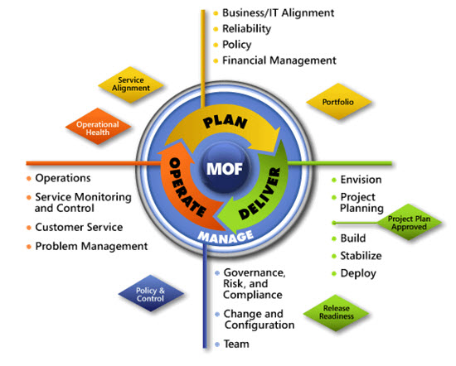
IPD in Microsoft Operations Framework 4.0
Use MOF with IPD guides to ensure that people and process considerations are addressed when changes to an organization’s IT services are being planned.
Notes:
For more information about Microsoft Operations Framework 4.0, go to www.microsoft.com/mof.

Slide 21
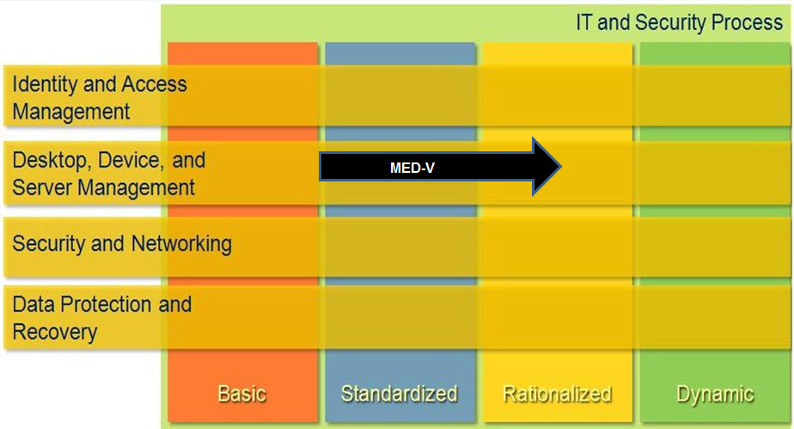
The Role of Microsoft Enterprise Desktop Virtualization in Infrastructure Optimization
Notes:
<This slide shows the effect Microsoft Enterprise Desktop Virtualization has on infrastructure maturity as reflected in the Infrastructure Optimization Model.>
IT infrastructure is a strategic asset and the critical foundation upon which software can deliver services and user applications that a business needs to operate effectively and succeed. For many organizations, growth and rapid developments in new technologies have resulted in data center and desktop infrastructures that are overly complex, inflexible, and difficult to manage and with built-in costs that are not only high but somewhat fixed regardless of changing business requirements.
The Infrastructure Optimization (IO) Model at Microsoft groups IT processes and technologies across a continuum of organizational maturity. (For more information, see www.microsoft.com/optimization/model/coreio.mspx.) The model was developed by industry analysts, the Massachusetts Institute of Technology (MIT) Center for Information Systems Research (CISR), and Microsoft's own experiences with its enterprise customers. A key goal for Microsoft in creating the Infrastructure Optimization Model was to develop a simple way to use a maturity framework that is flexible and can easily be applied as the benchmark for technical capability and business value.
IO is structured around three information technology models: Core Infrastructure Optimization, Application Platform Optimization, and Business Productivity Infrastructure Optimization. According to the Core Infrastructure Optimization Model, implementing administrator-controlled, automated virtual machine image distribution and management will help move an organization to the Rationalized level.

