Slide 1
Microsoft® Exchange Server 2010
with Service Pack 1
Infrastructure Planning and Design
Published: December 2010
Updated: July 2011
Notes:
Copyright © 2011 Microsoft Corporation. All rights reserved. Complying with the applicable copyright laws is your responsibility. By using or providing feedback on this documentation, you agree to the license agreement below.
If you are using this documentation solely for non-commercial purposes internally within YOUR company or organization, then this documentation is licensed to you under the Creative Commons Attribution-NonCommercial License. To view a copy of this license, visit http://creativecommons.org/licenses/by-nc/2.5/ or send a letter to Creative Commons, 543 Howard Street, 5th Floor, San Francisco, California, 94105, USA.
This documentation is provided to you for informational purposes only, and is provided to you entirely "AS IS". Your use of the documentation cannot be understood as substituting for customized service and information that might be developed by Microsoft Corporation for a particular user based upon that user’s particular environment. To the extent permitted by law, MICROSOFT MAKES NO WARRANTY OF ANY KIND, DISCLAIMS ALL EXPRESS, IMPLIED AND STATUTORY WARRANTIES, AND ASSUMES NO LIABILITY TO YOU FOR ANY DAMAGES OF ANY TYPE IN CONNECTION WITH THESE MATERIALS OR ANY INTELLECTUAL PROPERTY IN THEM.
Microsoft may have patents, patent applications, trademarks, or other intellectual property rights covering subject matter within this documentation. Except as provided in a separate agreement from Microsoft, your use of this document does not give you any license to these patents, trademarks or other intellectual property.
Information in this document, including URL and other Internet Web site references, is subject to change without notice. Unless otherwise noted, the example companies, organizations, products, domain names, e-mail addresses, logos, people, places and events depicted herein are fictitious.
Microsoft, Active Directory, Forefront, and Windows Server are either registered trademarks or trademarks of Microsoft Corporation in the United States and/or other countries and regions.
The names of actual companies and products mentioned herein may be the trademarks of their respective owners.
You have no obligation to give Microsoft any suggestions, comments or other feedback ("Feedback") relating to the documentation. However, if you do provide any Feedback to Microsoft then you provide to Microsoft, without charge, the right to use, share and commercialize your Feedback in any way and for any purpose. You also give to third parties, without charge, any patent rights needed for their products, technologies and services to use or interface with any specific parts of a Microsoft software or service that includes the Feedback. You will not give Feedback that is subject to a license that requires Microsoft to license its software or documentation to third parties because we include your Feedback in them.

Slide 2
What Is IPD? Guidance that clarifies and streamlines the planning and design process for Microsoft infrastructure technologies
IPD:
Defines decision flow
Describes decisions to be made
Relates decisions and options for the business
Frames additional questions for business understanding
IPD guides are available at www.microsoft.com/ipd
Notes:
Infrastructure Planning and Design (IPD) is a series of planning and design guides created to clarify and streamline the planning and design process for Microsoft® infrastructure technologies.
Each guide in the series addresses a unique infrastructure technology or scenario.
These guides include the following topics:
Defining the technical decision flow (flow chart) through the planning process.
Describing the decisions to be made and the commonly available options to consider in making the decisions.
Relating the decisions and options for the business in terms of cost, complexity, and other characteristics.
Framing the decisions in terms of additional questions for the business to ensure a comprehensive understanding of the appropriate business landscape.
The guides in this series are intended to complement and augment Microsoft product documentation. It is assumed that the reader has a basic understanding of the technologies discussed in these guides. It is the intent of these guides to define business requirements, then align those business requirements to product capabilities, and design the appropriate infrastructure.

Slide 3
Getting Started
Microsoft Exchange Server 2010
with Service Pack 1
Notes:
The guide was created to enable infrastructure planners to design a Microsoft Exchange Server 2010 infrastructure. The guide includes specific design information and activities that encourage sound planning.
Each activity includes:
Prerequisites and background on the activity.
Tasks that will be performed to complete the activity.
Reference information regarding the activity’s impact on characteristics such as the cost, complexity, and capacity of the solution.
Questions to ensure that business needs are captured and reflected in the solution.
The guide is written for information technology (IT) infrastructure specialists who are responsible for planning and designing the infrastructure for Microsoft Exchange Server 2010.

Slide 4
Purpose and Overview
Purpose
To provide design guidance for an Exchange Server 2010 infrastructure
Overview
Exchange Server 2010 architecture
Exchange Server 2010 infrastructure design process
Notes:
The guide focuses on the elements that organizations must consider when designing an Exchange Server 2010 infrastructure.

Slide 5
What Is Exchange Server 2010?
Exchange Server 2010 provides:
A complete end-to-end solution for electronic messaging both within and outside of an organization
A platform for users to exchange both traditional email messages, as well as non-traditional messages such as faxes and voice mail, in a fault-tolerant, distributed environment that is capable of communicating with other messaging systems across the world
Notes:
Exchange Server 2010 is an enterprise-class messaging system that provides a complete end-to-end solution for electronic messaging both within and outside of an organization. It provides a platform for users to exchange both traditional email messages, as well as non-traditional messages such as faxes and voice mail, in a fault-tolerant, distributed environment that is capable of communicating with other messaging systems across the world.
As with all enterprise-class solution deployments, Exchange Server 2010 requires proper planning around key critical areas: placement of individual servers and roles, capacity planning, performance planning, fault tolerance, and hardware configurations. To develop and implement a successful Exchange Server 2010 architecture, decisions must be made relative to each of these areas that weigh the value of implementing supporting services against the cost of managing and maintaining those services.

Slide 6
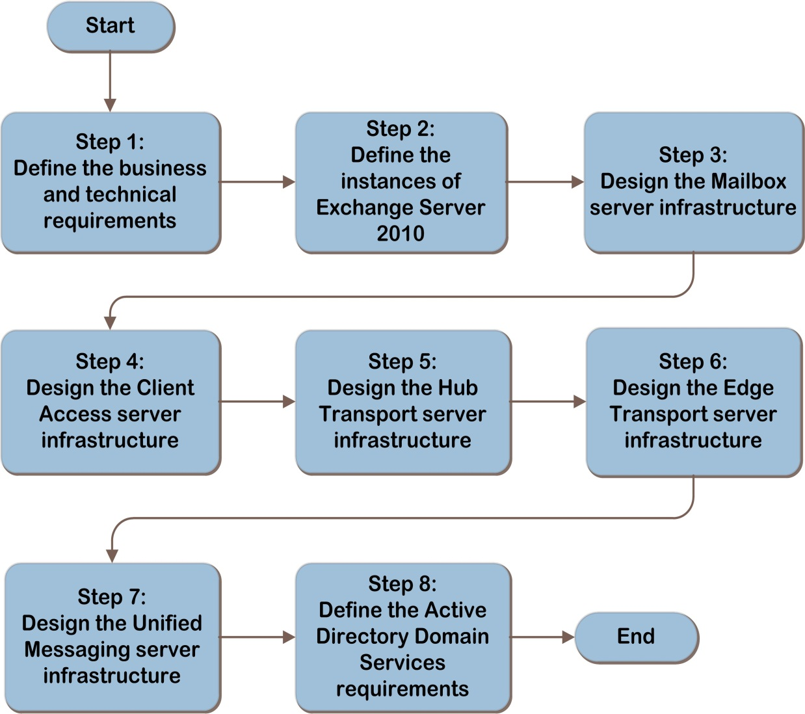
Exchange Server 2010 Decision Flow
SCM
ITA
Notes:
The Exchange Server 2010 design flow provides a graphical overview of the steps in designing an Exchange Server 2010 infrastructure.
These steps are:
Define the Business and Technical Requirements
Define the Instances of Exchange Server 2010
Design the Mailbox Server Infrastructure
Design the Client Access Server Infrastructure
Design the Hub Transport Server Infrastructure
Design the Edge Transport Server Infrastructure
Design the Unified Messaging Server Infrastructure
Define the Active Directory® Domain Services Requirements
Each of these steps will be discussed in greater detail in the following slides.

Slide 7
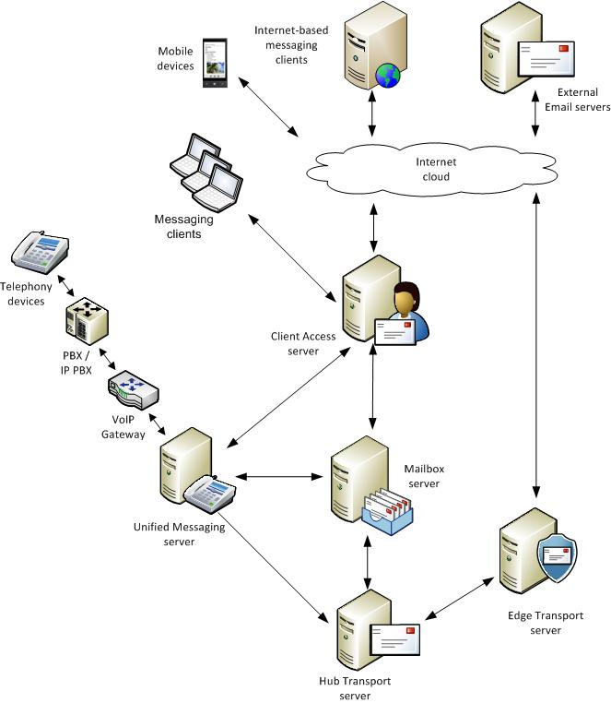
Exchange Server 2010 Architecture Example
ITA
Notes:
This diagram illustrates the relationship between the components that work together to provide an architecture for Exchange Server 2010. They are shown together in one possible implementation for illustration purposes, but other configurations are possible.

Slide 8
Step 1: Define the Business and Technical Requirements
Task 1: Identify Business Requirements
Questions will be asked of the business decision-makers in the organization to determine the scope and requirements of the Exchange Server implementation:
Which of the following capabilities are needed?
What portion of the organization is in scope?
For the parts of the organization that are in scope, do any business isolation requirements exist?
Does the organization require an operational consolidation?
Does the organization have a requirement for a unified global address list (GAL)?
Are there any business policies that impact messaging usage?
Does the organization require internal message hygiene services?
What are the availability requirements?
Notes:
Step 1: Define the Business and Technical Requirements
Task 1: Identify Business Requirements
The following questions should be asked of the business to determine the scope and the features that will be implemented:
Which of the following capabilities are needed?
Internal email services
External email services
Connectivity for external users
Public folders
Unified Communications (voice mail) services
What portion of the organization is in scope?
For the parts of the organization that are in scope, do any business isolation requirements exist?
Legal isolation
Political environment
Regulatory requirements
Business policy
Does the organization require an operational consolidation?
Does the organization have a requirement for a unified global address list (GAL)?
Are there any business policies that impact messaging usage?
Message size limits
Mailbox size limits
Employee differentiation
Does the organization require internal message hygiene services?
Availability Requirements
Determine if high availability (automated continuous service) is required for:
Mailbox access – access to an individual mailbox
Mailbox access for external users
Internal message flow – email within the organization
External message flow – email outside of the organization
Message hygiene – antimalware and antispam
Voice mail access

Slide 9
Step 1: Define the Business and Technical Requirements (Continued)
Task 2: Identify Technical Requirements
The technical requirements will need to be identified to align with the business requirements identified in Task 1
Which forests and domains will leverage messaging services?
What are the physical locations and requirements?
Message hygiene requirements for:
Mailbox servers
Transport servers
Client Access servers
Unified Messaging (UM) servers
Notes:
Step 1: Define the Business and Technical Requirements (Continued)
Task 2: Identify Technical Requirements
In this task, the technical requirements will need to be identified to align with the business requirements identified in Task 1.
Which forests and domains will leverage messaging services? In Task 1, the scope of the project for the organization was identified. Record which forests and domains will be impacted by this project. This will be used in the next step to help clearly define the number of Exchange Server instances that will be implemented, as well as any additional forest/domain requirements.
What are the physical locations and requirements? Based on the business requirements from Task 1, document all of the physical locations in the organization that are in scope, including:
Network connectivity
Mailbox counts
PBX and voice IP gateway locations
Message Hygiene Requirements
Message hygiene is an important part of an overall antivirus and antimalware solution. Hardware requirements for running hygiene on Exchange server roles must be addressed and are called out in each applicable section in the individual design steps below.
Mailbox servers
Transport servers
Client Access servers
Unified Messaging (UM) servers
This information will determine placement of services in later sections of this guide.

Slide 10
Step 2: Define the Instances of Exchange Server 2010
Task 1: Determine Messaging Service Instances
There can be only one instance of Exchange Server per Active Directory® Domain Services (AD DS) forest
Task 2: Determine the Active Directory host forest, site, and domain
Exchange Server has no specific requirements relative to forest, site, or domain locations
Notes:
Step 2: Define the Instances of Exchange Server 2010
Task 1: Determine Messaging Service Instances
The minimum number of Exchange Server instances for an organization to implement is one. It is sometimes necessary to add additional Exchange Server instances. If any of the following conditions are true, additional instances may be appropriate:
Mergers and acquisitions
Subsidiaries/business unit separation
Regulatory and/or legal requirements
Business requirements in Step 1
There can be only one instance of Exchange Server per Active Directory forest.
Complex Considerations
Some organizations have multiple Active Directory forests and/or external business relationships whose business requirements call for unified messaging and address list consolidation. If there are multiple forests, Exchange can be deployed either as a cross-forest topology with Exchange in each forest and recipients synchronized to present a unified GAL, or as a resource forest topology with an Exchange forest and one or more user account forests (see http://technet.microsoft.com/en-us/library/bb124734.aspx). In these cases Microsoft recommends that Microsoft Consulting Services or a certified Microsoft partner be contacted to consult on the design.
Task 2: Determine the Host Domain
Determine which Active Directory forest, site, and domain will be used to host this instance of Exchange Server. Exchange Server has no specific requirements relative to forest, site, or domain locations.

Slide 11
Step 3: Design the Mailbox Server Infrastructure
Task 1: Determine Role Placement
Items that affect the decision about where to locate Mailbox servers include:
Administrative and security requirements
Site autonomy
Fault-tolerance dependencies
Task 2: Plan for Capacity
See the Exchange Server 2010 IPD guide for details relative to calculating storage
Notes:
Step 3: Design the Mailbox Server Infrastructure
Task 1: Determine Role Placement
Based on the information gathered in Step 1 relative to mailboxes in the organization, determine where the Mailbox servers should be located, along with the corresponding Active Directory site in which the server will reside. Later sections of this guide address the question of how many servers should be placed in each location identified here. Items that affect the decision about where to locate Mailbox servers include:
Administrative and security requirements
Site autonomy
Fault-tolerance dependencies
Task 2: Plan for Capacity
This task will help to determine capacity planning, which is defined as the total number of mailboxes the server can handle at one time. This is different than performance planning, which focuses on ensuring the Mailbox server performs at a certain level given a set number of clients. The Exchange Server product group has developed a tool that helps with the sizing of Mailbox servers and goes into much more detail than is possible in this guide. The Mailbox Server Role Requirements Calculator can be found at http://msexchangeteam.com/archive/2009/11/09/453117.aspx.

Slide 12
Step 3: Design the Mailbox Server Infrastructure (Continued)
Task 3: Plan for Performance
Having the right number of processor cores is critical, and is based on the number of users and messaging traffic estimates
Memory is calculated based on the number of databases and messages sent/received
Disk subsystem must meet calculated IOPS requirements that are based on the number of users and messages sent/received
Task 4: Plan for Fault Tolerance
Using the information from Step 1 relative to fault-tolerance requirements, create a mapping of databases that require fault tolerance along with the locations that will host passive database copies
Notes:
Step 3: Design the Mailbox Server Infrastructure (Continued)
Task 3: Plan for Performance
Performance planning includes identifying what is required from the server to have the server perform at a certain minimum level. The following assumes that the Mailbox server role will be the only Exchange Server role on the server.
Performance planning centers around the number of processor megacycles required for the server. Determine the number of megacycles per user, based on the estimated user profile and message activity, and multiply by the number of users on the server at peak times. The user count should include the passive copy database users because the passive copy might become the active copy at any time. This will result in the total megacycles required for the server. See the Exchange Server 2010 guide for details relative to calculating performance requirements.
Virtualization
Microsoft supports running the Mailbox server role in hardware virtualized environments, as long as the virtual environment is approved by the Windows Server Virtualization Validation Program.
Task 4: Plan for Fault Tolerance
Create a mapping of databases that require fault tolerance along with the locations that will host passive database copies. Ideally, a passive copy will exist in the same physical location as the active database because that location best serves the active users. Additional copies may be placed in the same location or other locations as desired for additional resiliency or disaster recovery.
Now that the number of fault-tolerant passive database copies per location is known, the next activity is to determine which servers will host the database copies. Use the information derived in Task 2 relative to unallocated database space on each server to determine where passive databases can reside. In situations where there is not enough space on existing servers, it will be necessary to implement new servers of the same configuration to handle the additional databases.

Slide 13
Step 4: Design the Client Access Server Infrastructure
Task 1: Determine Role Placement
Each AD DS site that contains an Exchange Mailbox server must have at least one Client Access server
All Client Access servers that will host Internet users must be in an AD DS site configured as Internet facing
Task 2: Plan for Capacity
Client Access servers are stateless devices that connect users to their Mailbox servers
Client Access servers do not persist data on disk, minimizing the storage requirements
Notes:
Step 4: Design the Client Access Server Infrastructure
Task 1: Determine Role Placement
It is a product requirement that each AD DS site that contains an Exchange Mailbox server must have at least one Client Access server. Start with one Client Access server per AD DS site-hosting Mailbox servers. Additional Client Access servers may be required, based on the remaining tasks in this step.
Internet-Facing Client Access Server Placement
Add at least one Client Access server for each location that will service Internet-based messaging clients. Note that Microsoft does not support Client Access servers that are directly connected to the Internet. All Client Access servers that will host Internet users must be in an AD DS site configured as Internet facing. Typically, these servers are accessed using an intermediate device (a reverse proxy) such as Microsoft Forefront Unified Access Gateway server (See http://technet.microsoft.com/en-us/library/ee886315.aspx for more details.).
See http://technet.microsoft.com/en-us/library/bb310763.aspx for more information about how messaging clients connect and communicate with Client Access servers.
Task 2: Plan for Capacity
Client Access servers are stateless devices that connect users to their Mailbox servers. They do not persist user data on disk, therefore storage design is not a constraining factor. Product minimums are appropriate for disk sizing. See www.microsoft.com/exchange/2010/en/us/system-requirements.aspx for more information on Exchange Server 2010 system requirements.

Slide 14
Step 4: Design the Client Access Server Infrastructure (Continued)
Task 3: Plan for Performance
Client Access servers should have processor core counts that are proportional to the number of Mailbox server processor cores
The amount of physical memory is calculated as the number of processor cores times 2 GB
Task 4: Plan for Fault Tolerance
Wherever fault tolerance is needed, implement at least two Client Access servers in an array
A network load balancer must be used to provide a seamless client experience
Notes:
Step 4: Design the Client Access Server Infrastructure (Continued)
Task 3: Plan for Performance
Performance planning includes identifying what will be implemented in the server to have the server perform at a certain minimum level. The following assumes that the Client Access server role will be the only Exchange Server role on the server. The Client Access server role may also be deployed on servers with other Exchange Server roles (except for the Edge Transport server role), as long as the resource requirements for the additional loads are identified and addressed.
Virtualization
Microsoft supports running the Client Access server role in hardware virtualized environments, as long as the virtual environment is approved by the Windows Server Virtualization Validation Program.
Task 4: Plan for Fault Tolerance
Map the sites where additional servers need to be deployed along with the number of servers that will be required. A single Client Access server deployed in an AD DS site that contains a Mailbox server is considered a single point of failure for that site. Wherever fault tolerance is needed, implement at least two Client Access servers in an array. In sites that have more than one Client Access server for performance requirements, a single additional fault-tolerant server may not be sufficient in a scenario where two or more Client Access servers become unavailable at the same time. Determine the correct number of additional servers that meet the organization’s fault-tolerance requirements.
After the Client Access server array has been created, a network load balancer (dedicated hardware device or Network Load Balancing) must be implemented to route internal domain-joined Outlook client traffic to the Client Access server array instead of individual servers. If this is not done, those clients will connect to the first Client Access server implemented in the site. See http://technet.microsoft.com/en-us/library/ff625247.aspx for more information on the details and configuration of the Client Access server role design.

Slide 15
Step 5: Design the Hub Transport Server Infrastructure
Task 1: Determine Role Placement
Each AD DS site that contains a Mailbox server must have at least one Hub Transport server
Task 2: Plan for Capacity
There are space requirements around log files when using message tracking and other system logging functions
Database size must be considered when planning storage space
See the guide for details relative to calculating storage
Notes:
Step 5: Design the Hub Transport Server Infrastructure
Task 1: Determine Role Placement
It is a product requirement that each AD DS site that contains a Mailbox server must have at least one Hub Transport server. Start with one Hub Transport server per AD DS site containing Mailbox servers. Additional Hub Transport servers may be required, based on the remaining tasks in this step.
Task 2: Plan for Capacity
Hub Transport servers are responsible for holding messages while in transit to Mailbox servers. To determine the appropriate storage requirements for the Hub Transport server, see the guide for details.

Slide 16
Step 5: Design the Hub Transport Server Infrastructure (Continued)
Task 3: Plan for Performance
Hub Transport servers should have processor core counts that are proportional to the number of Mailbox server processor cores
The amount of physical memory is calculated as the number of processor cores times 1 GB
Task 4: Plan for Fault Tolerance
Wherever fault tolerance is needed within a site, implement at least two Hub Transport servers
Hub Transport servers are fault tolerant within a site by default when more than one Hub Transport server exists in the site
Notes:
Step 5: Design the Hub Transport Server Infrastructure
Task 3: Plan for Performance
Performance planning for Hub Transport servers involves four areas: CPU, memory, network, and disk storage performance.
The overall messaging traffic that a single Hub Transport server can handle before it becomes a potential bottleneck varies based on the organization’s particular messaging profiles and workloads. It is assumed that the Hub Transport server role will be the only Exchange Server role on the server.
Virtualization
Microsoft supports running the Hub Transport server role in virtualized environments, as long as the virtual environment is approved by the Windows Server Virtualization Validation Program.
Task 4: Plan for Fault Tolerance
Take the business fault-tolerance requirements from Step 1 and map sites where additional servers need to be deployed along with the number of servers that will be required.
A single Hub Transport server deployed in an AD DS site is considered a single point of failure. Wherever fault tolerance is needed within a site, implement at least one additional Hub Transport server to the calculated number required above. By default, multiple hub transport servers are automatically load balanced within sites on the Exchange Server infrastructure. See http://technet.microsoft.com/en-us/library/ff634392.aspx for more information.

Slide 17
Step 6: Design the Edge Transport Server Infrastructure
Task 1: Determine Role Placement
Edge Transport is an optional role and need not be deployed
Edge Transport provides the path for mail to flow into the organization in a secure manner
Each Edge Transport server must be subscribed to a single Active Directory site containing Hub Transport servers
Task 2: Plan for Capacity
Edge Transport has similar requirements as Hub Transport
See the guide for details relative to calculating storage
Notes:
Step 6: Design the Edge Transport Server Infrastructure
Task 1: Determine Role Placement
It is a product requirement that each Edge Transport server be subscribed to a single Active Directory site containing Hub Transport servers. When messages arrive from outside of the organization, the Edge Transport server passes them only to Hub Transport servers in the specific Active Directory site where the edge server is subscribed. Start with one Edge Transport server for the organization. Additional Edge Transport servers may be required, based on the remaining tasks in this step.
Consider the following when determining where to place Edge Transport servers:
Geographical location. Placing Edge Transport servers in physical sites that are widely separated by geography can help control wide area network utilization by allowing the routing of messages through servers that are closer to external users in that geography.
Network connectivity requirements. Select locations that have acceptable external network connectivity such as bandwidth and latency.
Task 2: Plan for Capacity
Ensure that the disks are properly sized for the expected loads. To determine the appropriate storage requirements for the Edge Transport server, see the guide for details.

Slide 18
Step 6: Design the Edge Transport Server Infrastructure (Continued)
Task 3: Plan for Performance
Hub Transport servers should have processor core counts that are proportional to the number of Mailbox server processor cores
The amount of physical memory is calculated as the number of processor cores times 1 GB
Task 4: Plan for Fault Tolerance
Fault tolerance for Edge Transport services requires attention to two areas:
Edge Transport server failure
Edge-connected Active Directory site availability
Notes:
Step 6: Design the Edge Transport Server Infrastructure (Continued)
Task 3: Plan for Performance
Performance planning for Edge Transport servers involves four areas: CPU, memory, network, and disk storage performance.
The overall messaging traffic that a single Edge Transport server can handle before it becomes a potential bottleneck varies based on the organization’s particular messaging profiles and workloads. The Edge Transport server role must be the only Exchange Server role on the server because this role cannot coexist with other Exchange Server roles.
Virtualization
Microsoft supports running the Edge Transport server role in hardware virtualized environments, as long as the virtual environment is approved by the Windows Server Virtualization Validation Program.
Task 4: Plan for Fault Tolerance
Use the business requirements for fault tolerance identified in Step 1, Task 1 to design perimeter fault tolerance. A single Edge Transport server in the organization is considered a single point of failure. Fault tolerance for Edge Transport services requires attention to two areas:
Edge server failure.
If the Edge-connected AD DS site becomes unavailable.

Slide 19
Step 7: Design the Unified Messaging Server Infrastructure
Task 1: Determine Role Placement
Items that affect the decision about where to locate Unified Messaging (UM) servers include:
Connectivity with telephony equipment and other messaging servers (<300ms round trip between UM and IP gateways)
Administrative and security requirements
Site autonomy
Fault-tolerance dependencies
Task 2: Plan for Capacity
Disk requirements are minimal, as the UM role is a process and forward system
Notes:
Step 7: Design the Unified Messaging Server Infrastructure
Task 1: Determine Role Placement
Based on the information gathered in Step 1 relative to users in the organization, determine where Unified Messaging (UM) servers should be located. Items that affect the decision about where to locate Mailbox servers include:
Connectivity
Administrative and security requirements
Site autonomy
Fault-tolerance dependencies
Task 2: Plan for Capacity
Because UM servers immediately forward all messages after they are processed to their destination mailboxes via Hub Transport servers, the disk requirements are minimal. When a UM server is unable to communicate with Hub Transport delivery servers, incoming voice messages are held on the UM server until communications with the Hub Transport servers become available. Ensure that there is enough storage to handle this scenario.

Slide 20
Step 7: Design the Unified Messaging Server Infrastructure (Continued)
Task 3: Plan for Performance
UM servers substantially leverage the processor cores in the server
The product group estimates each UM server can handle between 2,000 and 10,000 users
Each UM server can process 100 concurrent calls
Each UM server can process 200 concurrent voice mails
Task 4: Plan for Fault Tolerance
Fault tolerance for UM services requires attention to two areas: UM server failure and IP gateway failure
UM servers are automatically fault tolerant when multiple UM servers are deployed in the site
Notes:
Step 7: Design the Unified Messaging Server Infrastructure (Continued)
Task 3: Plan for Performance
UM servers substantially leverage the processor cores in the server, as transcoding of audio (inbound), as well as voice recognition (for voice mail previews) must be performed. Voice mail preview is particularly processor intensive; each incoming message requires approximately one minute of processor core time.
Virtualization
Microsoft supports running the UM role in virtualized environments.
Task 4: Plan for Fault Tolerance
Use the business requirements for fault tolerance identified in Step 1, Task 1 to design each site requiring fault tolerance. A single UM server for the organization is considered a single point of failure.
Fault tolerance for UM servers requires attention to two areas:
1. UM server failure
2. IP gateway failure

Slide 21
Step 8: Define the Active Directory Domain Services Requirements
Define AD DS Server Requirements
The location of the physical Exchange servers in the organization may drive the requirement of where to place AD DS servers
Forest must be Windows Server 2003 forest functionality mode at a minimum
AD DS schema master must be Windows Server 2003 with SP2 at a minimum
Each AD DS domain with Exchange servers must have at least one writable domain controller
Each AD DS site that hosts Exchange servers must have at least one global catalog server
Notes:
Step 8: Define the Active Directory Domain Services Requirements
The goal of this step is to determine any requirements for Active Directory Domain Services to support an Exchange Server 2010 deployment planned in the previous steps. Exchange Server 2010 has very specific requirements of Active Directory Domain Services that may require the organization to make adjustments to its currently deployed Active Directory Domain Services infrastructure. If these requirements are not met, Exchange Server 2010 cannot be deployed.
Define Active Directory Domain Services Server Requirements
The following server requirements must be met for Exchange Server to function properly in the environment:
Active Directory Forest. The Active Directory forest must be at Windows Server® 2003 forest functionality mode at a minimum.
Active Directory schema master. The domain controller that holds the Active Directory schema operations master role must be Windows Server 2003 with Service Pack 2 at a minimum.
Active Directory domain controllers. Each domain that hosts Exchange servers must have at least one domain controller that is writable. The server must run Windows Server 2003 with Service Pack 2 at a minimum.
Active Directory global catalog servers. Each site that will host Exchange servers will require at least one global catalog server; depending on the activity in the site and the fault tolerance desired, two or more global catalog servers may be required.
The Exchange Server product group recommends planning for the following:
32-bit platforms: 1 global catalog server processor core for every 4 Mailbox server processor cores.
64-bit platforms: 1 global catalog server processor core for every 8 Mailbox server processor cores.

Slide 22
Summary and Conclusion
This guide has focused on summarizing the critical design decisions, activities, and tasks required to enable a successful design of Microsoft Exchange Server 2010
See the IPD guide appendix for job aids to assist in recording decisions
Provide feedback to ipdfdbk@microsoft.com
Notes:
Summary and Conclusion
This guide has focused on summarizing the critical design decisions, activities, and tasks required to enable a successful design of Microsoft Exchange Server 2010. It has addressed the business requirements, technical aspects, and service characteristics to complete a comprehensive review of the decision-making process. When used in conjunction with product documentation, this guide can help organizations confidently plan a Microsoft Exchange Server 2010 implementation.

Slide 23
Find More Information
Download the full document and other IPD guides:
www.microsoft.com/ipd
Contact the IPD team:
ipdfdbk@microsoft.com
Access the Microsoft Solution Accelerators website:
www.microsoft.com/technet/SolutionAccelerators

Slide 24
Questions?

Slide 25
Addenda
Benefits for consultants or partners
IPD in Microsoft Operations Framework 4.0
Microsoft Exchange Server 2010 in Microsoft Infrastructure Optimization

Slide 26
Benefits of Using the Microsoft Exchange Server 2010 Guide
Benefits for Business Stakeholders/Decision Makers
Most cost-effective design solution for implementation
Alignment between the business and IT from the beginning of the design process to the end
Benefits for Infrastructure Stakeholders/Decision Makers
Authoritative guidance
Business validation questions ensuring solution meets requirements of business and infrastructure stakeholders
High-integrity design criteria that includes product limitations
Fault-tolerant infrastructure
Infrastructure that’s sized appropriately for business requirements
Notes:
Benefits of Using the Microsoft Exchange Server 2010 Guide
Benefits for Business Stakeholders/Decision Makers:
Most cost-effective design solution for an implementation. IPD eliminates over-architecting and over-spending by precisely matching the technology solution to the business needs.
Alignment between the business and IT from the beginning of the design process to the end.
Benefits for Infrastructure Stakeholders/Decision Makers:
Authoritative guidance. Microsoft is the best source for guidance about the design of Microsoft products.
Business validation questions to ensure the solution meets the requirements of both business and infrastructure stakeholders.
High-integrity design criteria that includes product limitations.
Fault-tolerant infrastructure, where necessary.
Proportionate system and network availability to meet business requirements. Infrastructure that is sized appropriately to meet business requirements.

Slide 27
Benefits of Using the Microsoft Exchange Server 2010 Guide (Continued)
Benefits for consultants or partners
Rapid readiness for consulting engagements
Planning and design template to standardize design and peer reviews
A “leave-behind” for pre- and post-sales visits to customer sites
General classroom instruction/preparation
Benefits for the entire organization
Using the guide should result in a design that will be sized, configured, and appropriately placed to deliver a solution for achieving stated business requirements
Notes:
Benefits of Using the Microsoft Exchange Server 2010 Guide (Continued)
Benefits for consultants or partners:
Rapid readiness for consulting engagements.
Planning and design template to standardize design and peer reviews.
A “leave-behind” for pre- and post-sales visits to customer sites.
General classroom instruction/preparation.
Benefits for the entire organization:
Using the guide should result in a design that will be sized, configured, and appropriately placed to deliver a solution for stated business requirements, while considering the performance, capacity, manageability, and fault tolerance of the system.

Slide 28
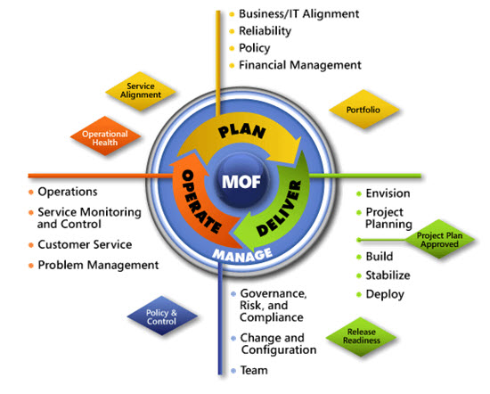
IPD in Microsoft Operations Framework 4.0
Use MOF with IPD guides to ensure that people and process considerations are addressed when changes to an organization’s IT services are being planned.
Notes:
For more information about Microsoft Operations Framework 4.0, go to www.microsoft.com/mof.

Slide 29
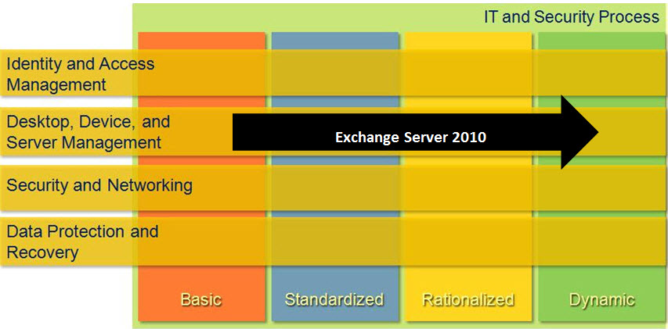
Microsoft Exchange Server 2010 in Microsoft Infrastructure Optimization
Notes:
<This slide shows the effect that Microsoft Exchange Server 2010 has on infrastructure maturity as reflected in the Core Infrastructure Optimization Model.>
The Infrastructure Optimization (IO) Model at Microsoft groups IT processes and technologies across a continuum of organizational maturity. (For more information, see www.microsoft.com/infrastructure.) The model was developed by industry analysts, the Massachusetts Institute of Technology (MIT) Center for Information Systems Research (CISR), and Microsoft's own experiences with its enterprise customers. A key goal for Microsoft in creating the Infrastructure Optimization Model was to develop a simple way to use a maturity framework that is flexible and can easily be applied as the benchmark for technical capability and business value.
IO is structured around three information technology models: Core Infrastructure Optimization, Application Platform Optimization, and Business Productivity Infrastructure Optimization. Microsoft Exchange Server 2010 gives users the power to access electronic communications securely from anywhere the end user is located from multiple devices. According to the Core Infrastructure Optimization Model, providing a properly designed messaging infrastructure will help move an organization to the Dynamic level.

