Slide 1
DirectAccess
Infrastructure Planning and Design
Published: October 2009
Updated: November 2011
Notes:
Copyright © 2011 Microsoft Corporation. All rights reserved. Complying with the applicable copyright laws is your responsibility. By using or providing feedback on this documentation, you agree to the license agreement below.
If you are using this documentation solely for non-commercial purposes internally within YOUR company or organization, then this documentation is licensed to you under the Creative Commons Attribution-NonCommercial License. To view a copy of this license, visit http://creativecommons.org/licenses/by-nc/2.5/ or send a letter to Creative Commons, 543 Howard Street, 5th Floor, San Francisco, California, 94105, USA.
This documentation is provided to you for informational purposes only, and is provided to you entirely "AS IS". Your use of the documentation cannot be understood as substituting for customized service and information that might be developed by Microsoft Corporation for a particular user based upon that user’s particular environment. To the extent permitted by law, MICROSOFT MAKES NO WARRANTY OF ANY KIND, DISCLAIMS ALL EXPRESS, IMPLIED AND STATUTORY WARRANTIES, AND ASSUMES NO LIABILITY TO YOU FOR ANY DAMAGES OF ANY TYPE IN CONNECTION WITH THESE MATERIALS OR ANY INTELLECTUAL PROPERTY IN THEM.
Microsoft may have patents, patent applications, trademarks, or other intellectual property rights covering subject matter within this documentation. Except as provided in a separate agreement from Microsoft, your use of this document does not give you any license to these patents, trademarks or other intellectual property.
Information in this document, including URL and other Internet Web site references, is subject to change without notice. Unless otherwise noted, the example companies, organizations, products, domain names, e-mail addresses, logos, people, places and events depicted herein are fictitious.
Microsoft, Active Directory, Forefront, Windows, and Windows Server are either registered trademarks or trademarks of Microsoft Corporation in the United States and/or other countries and regions.
The names of actual companies and products mentioned herein may be the trademarks of their respective owners.
You have no obligation to give Microsoft any suggestions, comments or other feedback ("Feedback") relating to the documentation. However, if you do provide any Feedback to Microsoft then you provide to Microsoft, without charge, the right to use, share and commercialize your Feedback in any way and for any purpose. You also give to third parties, without charge, any patent rights needed for their products, technologies and services to use or interface with any specific parts of a Microsoft software or service that includes the Feedback. You will not give Feedback that is subject to a license that requires Microsoft to license its software or documentation to third parties because we include your Feedback in them.

Slide 2
What Is IPD? Guidance that clarifies and streamlines the planning and design process for Microsoft® infrastructure technologies
IPD:
Defines decision flow
Describes decisions to be made
Relates decisions and options for the business
Frames additional questions for business understanding
IPD guides are available at www.microsoft.com/ipd
Notes:
Infrastructure Planning and Design (IPD) is a series of planning and design guides created to clarify and streamline the planning and design process for Microsoft infrastructure technologies. Each guide in the series addresses a unique infrastructure technology or scenario.
These guides include the following topics:
Defining the technical decision flow (flow chart) through the planning process.
Describing the decisions to be made and the commonly available options to consider in making the decisions.
Relating the decisions and options for the business in terms of cost, complexity, and other characteristics.
Framing the decisions in terms of additional questions for the business to ensure a comprehensive understanding of the appropriate business landscape.
The guides in this series are intended to complement and augment Microsoft product documentation.

Slide 3
Getting Started
DirectAccess
Notes:
The guide was created to enable infrastructure planners to design a DirectAccess infrastructure.
The guide includes specific design information and activities that encourage sound planning.
Each activity includes:
Prerequisites and background on the activity.
Tasks that will be performed to complete the activity.
Reference information regarding the activity’s impact on characteristics such as the cost, complexity, and capacity of the solution.
Questions to ensure that business needs are captured and reflected in the solution.
The guide is written for information technology (IT) infrastructure specialists who are responsible for planning and designing a DirectAccess infrastructure.

Slide 4
Purpose and Overview
Purpose
To provide design guidance for DirectAccess
Overview
DirectAccess overview
DirectAccess architecture design process
Notes:
The guide focuses on the elements that organizations must consider when designing a DirectAccess infrastructure.

Slide 5
What Is DirectAccess?
DirectAccess:
Can provide seamless connectivity experiences for mobile workers when connected to the Internet
Enables the mobile workforce to increase their productivity by providing them with the same connectivity experience—whether in or out of the office
Allows mobile computers to be managed any time the mobile computer has Internet connectivity, even if the user is not logged on
Notes:
The goal of the guide is to present common scenarios, decisions, and practices for implementing a DirectAccess infrastructure. DirectAccess can provide seamless connectivity experiences for mobile workers when connected to the Internet. DirectAccess enables the mobile workforce to increase their productivity by providing them with the same connectivity experience—whether in or out of the office. Mobile computers can be managed any time the mobile computer has Internet connectivity, even if the user is not logged on. Security is improved through the use of IPsec for authentication and encryption.
Using the guide, IT professionals can plan and design a DirectAccess infrastructure that ensures that critical phases are not left out of the plan and that a good foundation is established for future expansion.

Slide 6
DirectAccess Design Flow
Notes:
The DirectAccess design flow provides a graphical overview of the steps in designing a DirectAccess infrastructure.
These steps are:
Define the scope of the Direct Access project
Determine network requirements
Design DirectAccess server infrastructure
Design Web servers and certificate infrastructure
The primary components of a DirectAccess infrastructure are shown in the diagram on the next slide.

Slide 7
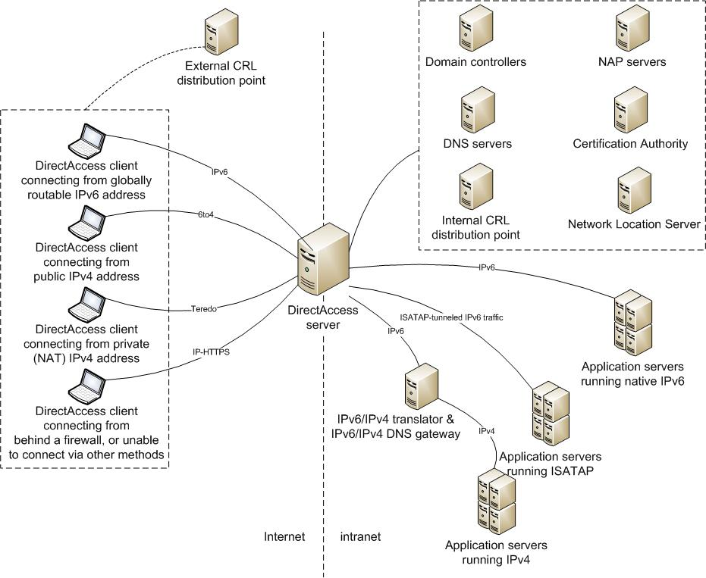
DirectAccess Architecture

Slide 8
Step 1: Define the Scope of the DirectAccess Project
Task 1: Determine the Scope of the Project
Which parts of the organization will be participating?
Which geographic areas will be included?
What are the number of users, access peak time, and maximum number of concurrent connections?
What internal resources will the users need to access?
What operating system is running on the domain controllers and DNS servers?
What operating system is running on each internal resource that will be accessible to DirectAccess clients?
Will DirectAccess be used to manage remote computers?
Notes:
Step 1: Define the Scope of the DirectAccess Project
Task 1: Determine the Scope of the Project
The business objectives should be prioritized at the start of the project so that they are clearly understood and agreed upon between IT and the business.
Understanding the full extent of the work to be performed enables the designer to begin visualizing the tasks and roles that will be needed to successfully implement the infrastructure plan. The following list provides questions to ask to assist in gathering data:
Which parts of the organization will be participating?
Which geographic areas will be included?
What are the number of users, access peak time, and maximum number of concurrent connections? A precise number is not needed, but an estimate will help define the hardware configuration needed to support the load.
What internal resources will the users need to access? Is the target to have a single application, all applications, or differing levels of access to internal resources available through DirectAccess?
What operating system is running on the domain controllers and DNS servers?
What operating system is running on each internal resource that will be accessible to DirectAccess clients?
Does the organization need to monitor all Web traffic of certain users or machines? If so, which ones?
Will DirectAccess be used to manage remote computers?
Record the information that defines the overall scope of the project in Table A-1 in Appendix A of the guide. These requirements will drive the scalability and the IPv6 infrastructure design in later steps.

Slide 9
Step 2: Determine Network Requirements
Task 1: Determine Connectivity Needs for DirectAccess Clients
The first task in this step is to record which external client connectivity methods will need to be designed
The following table shows a list of possible DirectAccess client networking configurations and the resulting primary IPv6 connectivity method.
Notes:
Step 2: Determine Network Requirements
Task 1: Determine Connectivity Needs for DirectAccess Clients
The first task in this step is to record which external client connectivity methods will need to be designed. See Table 1 “External Connectivity Methods” in the guide for a list of possible DirectAccess client networking configurations and the resulting primary IPv6 connectivity method. Record which external connectivity methods will be supported in the organization’s infrastructure in Table A-2 “External Connectivity Methods” in Appendix A in the guide.

Slide 10
Step 2: Determine Network Requirements (Continued)
Task 2: Determine Connectivity Needs for Internal Resources
This task focuses on determining how the DirectAccess server and remote clients will be provided access to internal resources
If an internal resource has IPv6 connectivity with the DirectAccess server, no further connectivity method is needed. Where IPv6 connectivity is not available, consult the following table for the appropriate alternative internal connection methods.
Notes:
Step 2: Determine Network Requirements (Continued)
Task 2: Determine Connectivity Needs for Internal Resources
This task focuses on determining how the DirectAccess server and remote clients will be provided access to internal resources. Refer to the list of internal resources the users will be accessing that was created in Step 1 in the guide to help determine if any of these connectivity methods will be required.
If an internal resource has IPv6 connectivity with the DirectAccess server, no further connectivity method is needed. Where IPv6 connectivity is not available, consult Table 2. “Internal Connectivity Methods for IPv4 Connections” in the guide for the appropriate alternative internal connection methods.
Record in Table A-3 “Internal Connectivity Methods” in Appendix A of the guide whether an ISATAP router and/or IPv6/IPv4 translator device will be implemented to achieve connectivity for intranet resources. The IPv6/IPv4 translator device will be placed on the corporate network and logically resides from a traffic standpoint between the DirectAccess server and the internal resource.
Additional Considerations:
IPsec policies in the form of Windows® Firewall with Advanced Security connection security rules. DirectAccess clients will access intranet resources over three tunnels.
Potential resources that might need to be accessible via the infrastructure tunnel include:
Active Directory® Domain Services (AD DS) domain controllers.
NAP servers, including Health Registration Authorities (HRAs) and Remediation servers.
DNS servers.
Microsoft System Center Configuration Manager 2007 servers.
Windows Update servers.
Help desk department computers that use remote desktop connections to connect to and troubleshoot remote DirectAccess clients.
Servers for antimalware updates, such as antivirus servers.
Corporate proxy servers to log and/or restrict Internet traffic.

Slide 11
Step 3: Design DirectAccess Server Infrastructure
Task 1: Determine the Server Configuration
The DirectAccess server can perform the following functions:
Teredo server and relay
6to4 relay
IP-HTTPS server
ISATAP router
Native Internet Protocol version 6 (IPv6) router
IPsec tunnel endpoint and gateway
Task 2: Determine Placement of Each Server
Note that the DirectAccess server must be a member of the Active Directory domain, but cannot be a domain controller
Notes:
Step 3: Design DirectAccess Server Infrastructure
Task 1: Determine the Server Configuration
The DirectAccess server can perform the following functions:
Teredo server and relay
6to4 relay
IP-HTTPS server
ISATAP router
Native Internet Protocol version 6 (IPv6) router
IPsec tunnel endpoint and gateway
DirectAccess can be installed in a virtual machine. It cannot be installed in a Microsoft failover cluster.
DirectAccess is designed to be installed and managed as a single unit. Any splitting of the functions will inherently introduce additional complexity and potential for configuration problems. Additionally, fault tolerance, scaling, sizing, and connectivity will need to be determined for each server.
Task 2: Determine Placement of Each Server
Because DirectAccess servers provide intranet connectivity to DirectAccess clients on the Internet, DirectAccess servers are installed in the perimeter network, typically between an Internet-facing connection and the intranet.
The DirectAccess server must be joined to an Active Directory domain, must be running Windows Server® 2008 R2, and must have at least two physical network adapters installed (one connected to the Internet side and the other connected to the intranet side).
The DirectAccess server must have at least two consecutive public IPv4 addresses assigned to the interface that is connected to the perimeter network or, in the absence of an Internet firewall, connected directly to the Internet.
Additional Considerations:
Active Directory Sites and Services and IPv6. Active Directory Sites and Services will need additional configuration with the introduction of native IPv6 or ISATAP in the organization. For each IPv4 subnet object, an equivalent IPv6 subnet object will need to be configured in which the IPv6 address prefix for the subnet expresses the assigned IPv6 prefix or the same range of ISATAP host addresses as the IPv4 subnet.
Active Directory domain controllers on the Internet. An Active Directory domain controller cannot be reachable from the Internet interface of the DirectAccess server. (The Internet interface cannot be in the domain profile of Windows Firewall.) If this is true, the DirectAccess Setup Wizard cannot be run.

Slide 12
Step 4: Design Web Servers and Certificate Infrastructure
Task 1: Design the Computer Certificates
Computer certificates required for IPsec can be autoenrolled or manual
Task 2: Design the Network Location Servers
A URL that is used by DirectAccess clients to detect correctly whether they are on the intranet
Notes:
Step 4: Design Web Servers and Certificates Infrastructure
Task 1: Design the Computer Certificates
Computer certificates are required for the authentication of IPsec protection. No additional infrastructure is required for DirectAccess; however, ensure that the organization’s PKI is configured to support autoenrollment of certificates or that the PKI administrator is prepared to issue certificates manually.
Task 2: Design the Network Location Servers
A network location server is an internal Web server that hosts an HTTPS-based uniform resource locator (URL). DirectAccess clients attempt to access the URL to determine whether they are located on the intranet; if the attempt fails, they conclude they are on the Internet and initiate the DirectAccess tunnels. Determine the placement of the network location server and record this in Table A-5 “Network Locations Servers” in Appendix A in the guide.

Slide 13
Step 4: Design Web Servers and Certificate Infrastructure (Continued)
Task 3: Design the Network Location Server Certificates
Internally accessible CRL distribution points to determine if network location server is using valid certificates
Task 4: Design the DirectAccess Server Certificates
A certificate is required for a connection between a DirectAccess client and the DirectAccess server. CRL distribution point must be externally accessible
Notes:
Step 4: Design Web Servers and Certificates Infrastructure (Continued)
Task 3: Design the Network Location Server Certificates
Certificate revocation list (CRL) distribution points provide access to the CRL that is published by the certification authority (CA) issuing certificates for DirectAccess and are published by Web servers. Without a reachable CRL distribution point on the intranet for the network location server HTTPS certificate, intranet detection fails, which can impair intranet connectivity for DirectAccess clients. Record the location of the intranet CRL distribution point in Table A-6 “CRL Distribution Points” in Appendix A in the guide.
Task 4: Design the DirectAccess Server Certificates
A separate certificate is required for IP-HTTPS connections between a DirectAccess client and the DirectAccess server. It is only used over IP-HTTPS connections, which will include clients that were unable to connect over native IPv6, Teredo, or 6to4.
Additional Considerations:
Smart cards for additional authorization. To use smart cards with IPsec tunnel mode authorization, the organization must first have a PKI deployment and a smart card infrastructure.
Network Access Protection (NAP). NAP enforces health requirements by monitoring and assessing the health of client computers when they attempt to connect or communicate on a network. No changes to the NAP infrastructure for the IPSec NAP enforcement method are required specifically for DirectAccess clients; however, the NAP servers should be listed in the infrastructure tunnel IPsec policy to properly validate and remediate the health of DirectAccess clients.

Slide 14
DirectAccess and Microsoft Forefront Unified Access Gateway
To provide fault tolerance, scalability, and increased management, Microsoft Forefront® Unified Access Gateway (Forefront UAG) can be used in conjunction with DirectAccess
Additional reading: Infrastructure Planning and Design guide for UAG is available at www.microsoft.com/ipd.
Additional reading: Microsoft Forefront Unified Access Gateway and DirectAccess at www.microsoft.com/forefront/edgesecurity/iag/en/us/UAG-DirectAccess.aspx
Notes:
To provide fault tolerance, scalability, and increased management, Microsoft Forefront Unified Access Gateway (Forefront UAG) can be used in conjunction with DirectAccess. This will allow multiple servers to be placed in a load-balanced array. For more information, see “Configuring NLB for a Forefront UAG DirectAccess array” at http://go.microsoft.com/fwlink/?LinkId=160075.

Slide 15
Summary and Conclusion
Carefully consider infrastructure requirements for DirectAccess
IPv6 is required, but IPv6 transition technologies can ease the pathway
This guide offers major architectural guidance. Refer to product documentation for additional details
All the IPD guides are available at www.microsoft.com/ipd

Slide 16
Find More Information
Download the full document and other IPD guides:
www.microsoft.com/ipd
Contact the IPD team:
ipdfdbk@microsoft.com
Access the Microsoft Solution Accelerators website:
www.microsoft.com/technet/SolutionAccelerators

Slide 17
Questions?

Slide 18
Addenda
Benefits of Using the DirectAccess Guide
IPD in Microsoft Operations Framework 4.0
DirectAccess in Microsoft Infrastructure Optimization

Slide 19
Benefits of Using the DirectAccess Guide
Benefits for Business Stakeholders/Decision Makers
Most cost-effective design solution for implementation
Alignment between the business and IT from the beginning of the design process to the end
Benefits for Infrastructure Stakeholders/Decision Makers
Authoritative guidance
Business validation questions ensuring solution meets requirements of business and infrastructure stakeholders
High integrity design criteria that includes product limitations
Fault-tolerant infrastructure
Proportionate system and network availability to meet business requirements
Infrastructure that’s sized appropriately for business requirements
Notes:
Benefits of Using the DirectAccess Guide
Benefits for Business Stakeholders/Decision Makers:
Most cost-effective design solution for an implementation. IPD eliminates over-architecting and overspending by precisely matching the technology solution to the business needs.
Alignment between the business and IT from the beginning of the design process to the end.
Benefits for Infrastructure Stakeholders/Decision Makers:
Authoritative guidance. Microsoft is the best source for guidance about the design of Microsoft products.
Business validation questions to ensure the solution meets the requirements of both business and infrastructure stakeholders.
High integrity design criteria that includes product limitations.
Fault-tolerant infrastructure, where necessary.
Proportionate system and network availability to meet business requirements.
Infrastructure that is sized appropriately to meet business requirements.

Slide 20
Benefits of Using the DirectAccess Guide (Continued)
Benefits for Consultants or Partners
Rapid readiness for consulting engagements
Planning and design template to standardize design and peer reviews
A “leave-behind” for pre- and post-sales visits to customer sites
General classroom instruction/preparation
Benefits for the Entire Organization
Using the guide should result in a design that will be sized, configured, and appropriately placed to deliver a solution for achieving stated business requirements
Notes:
Benefits of Using the DirectAccess Guide (Continued)
Benefits for Consultants or Partners:
Rapid readiness for consulting engagements.
Planning and design template to standardize design and peer reviews.
A “leave-behind” for pre- and post-sales visits to customer sites.
General classroom instruction/preparation.
Benefits for the Entire Organization:
Using the guide should result in a design that will be sized, configured, and appropriately placed to deliver a solution for stated business requirements, while considering the performance, capacity, manageability, and fault tolerance of the system.

Slide 21
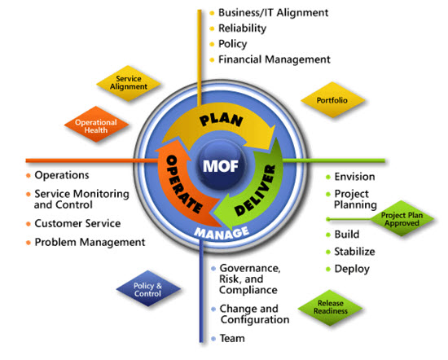
IPD in Microsoft Operations Framework 4.0
Use MOF with IPD guides to ensure that people and process considerations are addressed when changes to an organization’s IT services are being planned.
Notes:
For more information about Microsoft Operations Framework 4.0, go to www.microsoft.com/mof.

Slide 22
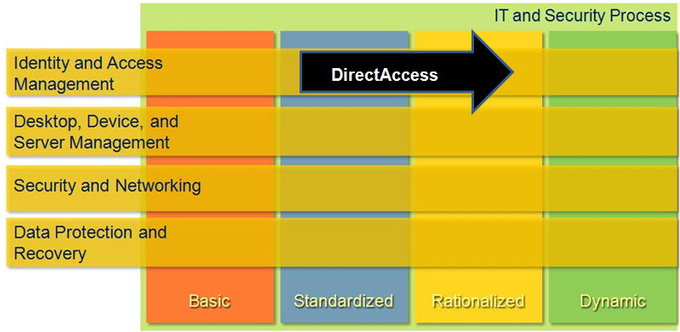
The Role of DirectAccess in Infrastructure Optimization
Notes:
<This slide shows the effect DirectAccess has on infrastructure maturity as reflected on the Infrastructure Optimization Model.>
The Infrastructure Optimization (IO) Model at Microsoft groups IT processes and technologies across a continuum of organizational maturity. (For more information, see www.microsoft.com/infrastructure.) The model was developed by industry analysts, the Massachusetts Institute of Technology (MIT) Center for Information Systems Research (CISR), and Microsoft's own experiences with its enterprise customers. A key goal for Microsoft in creating the Infrastructure Optimization Model was to develop a simple way to use a maturity framework that is flexible and can easily be applied as the benchmark for technical capability and business value.
IO is structured around three information technology models: Core Infrastructure Optimization, Application Platform Optimization, and Business Productivity Infrastructure Optimization. According to the Core Infrastructure Optimization Model, implementing DirectAccess will help move an organization to the Rationalized level and, in some cases, even to the Dynamic level. On the path to the Rationalized level, organizations can use DirectAccess to give mobile users seamless access to corporate networks without the need to use a virtual private network (VPN) and allow IT to manage mobile computers any time the mobile computers any time the mobile computer has Internet connectivity.

