Slide 1
HP Helion Managed Virtual Private Cloud for public sector (U.S.) v 6.2
Customer presentation
Speaker’s name/Day Month, 2014
Notes:
Opening slide
HP Helion Managed VPC for Public Sector-Client Presentation

Slide 2


Agenda
The new business landscape and its challenges
  The HP approach
  HP Managed VPC Cloud designed for critical business needs
  Why HP is the right choice for your business
  Next steps

Slide 3
The new business landscape and its challenges
Notes:
HP Helion Managed VPC for Public Sector-Client Presentation

Slide 4
Client or industry-specific challenges
This slide is to be customized for your specific sales presentation. You should modify the slide or select a new format that will highlight the specific challenges to your client.
Challenge #1
    Detail bullet
    Detail bullet
    Detail bullet
Challenge #2
    Detail bullet
    Detail bullet
    Detail bullet
Challenge #3
    Detail bullet
    Detail bullet
    Detail bullet
Challenge #4
    Detail bullet
    Detail bullet
    Detail bullet

Slide 5

Critical challenges regarding cloud computing
Which challenges are most important to you?
“The shift to cloud computing is disruptive, but it creates an opportunity to leverage the cloud to drive business innovation.”
“Very large enterprises are the fastest adopters of cloud services.”
“A majority of respondents rely on traditional IT suppliers—either vendors or integrators—for their cloud computing solutions rather than telecom companies or others.”
Gartner
Security
Open
50% of IT executives state that security is their biggest barrier to cloud adoption
71% of IT executives
believe open
standards are critical
Compliance
Increasing data sovereignty challenges are globally impacting customer cloud journeys
Vendor lock-in
$10+ trillion
Already invested in legacy IT
65% of IT executives are
concerned with vendor lock-in
Notes:
SECURITY
As nation-states and organized crime fixate on breaching your organizations – cloud security will be paramount.
And security is one of the single largest barriers for cloud adoption – 50% of IT executives have stated it’s their biggest barrier.
To put it in context, large companies like HP and it’s Fortune 500 peers suffer as many as 50,000 cyber intrusion attempts per day.
The Pentagon – an HP customer – reports 10 million attempts per day.
As a result, we’ve designed our hybrid cloud to integrate seamlessly with ArcSight, Fortify and TippingPoint – hands down the best security software assets in the industry.
OPEN
71% of IT executives believe that open standards are critical to their cloud strategy.
Last week, I was with a Fortune 25 customer – he mentioned a staggering statistic; his company has invested over 150 million man-hours in legacy code – that translates to around $11.3 billion dollars invested into traditional IT. And that’s just one company! Compare that to last year, this company invested 250,000 man-hours of code for “New Style of IT” solutions. As a result, customers need that bridge – they need a “bridge” to cloud-enable legacy applications.
And there is $2.2 trillion dollars in legacy IT that needs to be safely and securely “bridged” to the cloud.
Particularly for large enterprises, this transition will take time and a partner with a steady pair of hands – that’s why HP has built a cloud Professional Services organization unmatched in size and expertise to ensure you get the promise of the cloud without the pitfalls.
COMPLIANCE
And that takes us to compliance – since 2008, there have been 800 regulatory changes in the United States alone. And there are hundreds more in the queue moving through Washington and legislative bodies around the world.
The hybrid cloud allows for easy transition from public to private to managed clouds – ensuring your organization can easily adapt to changing regulatory environments.
VENDOR LOCK-IN
And finally, take advantage of the cloud for new applications – 71% of IT executives believe that open standards are critical to their cloud strategy.
In my conversations with customers, their excitement with open standards is deeply rooted in their concern with vendor lock-in – a staggering 65% are concerned with getting locked into a specific vendor – which erodes the long term economic value promised by the cloud.
And we’ve lived this storyline before – with IBM it was the mainframe, Microsoft dominated end-user computing with Windows, and Cisco locked you in enterprise networking.
If you want to ensure you continue to receive the cost savings from major IT innovations like the cloud, then you need to adopt an open IT architecture that is able to take advantage of future cloud innovations – we have to learn from the mistakes of our past, and avoid vendor lock-in as the cloud becomes the dominant delivery IT mechanism for your business critical applications.
###

Slide 6
HP approach

Slide 7


The HP Workload & Cloud strategy
We are in the workload business
We move, optimize and manage workloads
We are focused on optimizing enterprise business critical
legacy workloads onto the cloud
We have a “hub and spoke” strategy;
First, tackle business critical applications
Second, be in a position to assist on other follow-on workloads
FACT
HP ranked
#1 in Private Cloud
#2 in Virtual Private Cloud
Notes:
HP “leads the pack” for Private Cloud, according to Forrester Wave Private Cloud Solution study
Everest Group PEAK Matrix Leader for Enterprise Cloud Infrastructure Services 2013

Slide 8










Making the journey to a hybrid cloud
Business needs and workloads drive the platform choice
Traditional
Evolving current state
Future = hybrid
Build
On-premises cloud services
Consume
Off-premises cloud services
Private Cloud
Applications
Cloud broker services
Information
Applications
Infrastructure
Traditional IT
Converged Data Center
Traditional
Private
Managed
Public
Public Cloud
Applications
Interoperable Services, Unified Management via OpenStack
Dedicated, physical,
homogenous, managed
Disparate architectures,
fragmented management,
diverse security
Hybrid delivery
cloud OS OpenStack
architecture
Notes:
SLIDE PURPOSE AND USE
ADDITIONAL CONTEXT AND SPEAKER NOTES
This chart provides two things – a simplified picture of a journey to hybrid cloud – and a statement of fact, that the current state is already evolving for many firms – ‘the train is moving’ - but today there are disparate uses of clouds - in some cases w/o IT.
The end state is a form of managed hybrid cloud that should be attractive to large enterprise clients, showing a centrally managed converged architecture, inside of which are alternative workload optimized cloud delivery models.
That delivery could be private or public, on prem or in remote data center, owned by client or a service provider.
Be prepared to answer how the aspirational view achieves the 4 Goals in the previous chart:
Innovation – ‘first movers’ in services and software can get to market faster and more broadly with cloud delivery; upgrades/updates can be faster with cloud delivery; cloud best supports introductions to mobile end points
Agility – introducing auto-provisioning and capacity on demand makes the service portfolio much more agile in terms of supply meeting demand
Delivery Optimization – there is no one cloud delivery model for all apps – process, application, and operations all need to be analyzed; projected into a preferred future state; and THEN a cloud type that is best for that future state can be planned and implemented. In some cases, the choice between cloud delivery models will come down to be ‘pain versus gain’ – and will present as multiple viable alternatives. In general though, clouds with virtualized and pooled resources, delivered and managed by expert providers in house or externally, should provide the best financial results, and risks can be managed.
Security and Data – clouds can be best choice for data analytics and for security, depending on the client, the app, and the data. The level of security required may itself determine the cloud model that must be used (fully private cloud, for example – owned and operated by client). This is key criteria for evaluating delivery. Security in a way is why the aspiration is a ‘converged hybrid cloud with central management and oversight’. Security compliance must be achieved for each application service and data set.
To address the diverse needs, a hybrid delivery strategy is necessary.

Slide 9
Workloads are shifting to cloud
Cloud computing complements traditional IT
Private cloud
Public cloud
IT help desk
Collaborative apps
Data backup/archive svcs
Email
Personal productivity apps
Website creation and mgmt
Storage capacity on demand
Server capacity on demand
Business apps (CRM, ERP)
IT management
App dev. and test
Tech. computing apps
Data analysis and mining
Custom apps
Apps with sensitive data
Traditional IT
Based on the percent of customers indicated they would adopt cloud for a given workload in their organization, rated 4 or 5 on 1-5 scale,
IDC May 2010 Source: IDC, EB Strategy Analysis
Notes:
SLIDE PURPOSE AND USE
Select this slide or the next slide – its Option A or Option B – one chart only.
This chart shows specific applications and where they tend to be optimized, but this is meant to be illustrative and not a deep dive into specific applications.
ADDITIONAL CONTEXT AND SPEAKER NOTES
Business pressures are already prompting clients to shift their application workloads to cloud.
There are multiple forms of cloud:
Private cloud (dedicated single tenant, managed by client or provider)
On prem
client owned
third party owned
In a provider data center
client owned
third party owned
Usually does not use utility pricing, since all pooled resources are dedicated to one client. Customer portals support high levels of self service
Virtual private cloud (multi-tenant, but ‘virtual single tenant’ via secure partitioning, managed by provider)
In a provider data center
client owned
third party owned
Could use utility pricing or not - pooled resources are not dedicated to one client, but client may reserve or insure capacity levels. Customer portals support high levels of self service.
Public cloud (multi-tenant, but could be virtual single tenant via partitioning, or pure multi-tenant)
In a provider data center
third party owned
Usually use utility pricing, capacity on demand, self service.

Slide 10


Cloud delivery requires application decisions
What applications should I move to the cloud?
How do I make applications ready for the cloud?
How do I integrate applications in the cloud with my other apps?
How do I develop & test apps in
the cloud?
How do I integrate my business processes?
How do I manage applications in
the cloud?
CIO
How do I secure applications in
the cloud?
Notes:
SLIDE PURPOSE AND USE
This chart addresses ‘application/workload optimization’ for cloud delivery options.
ADDITIONAL CONTEXT AND SPEAKER NOTES
Typical application transformation questions for applications moving to new delivery models and being modernized:
-How do I develop and test applications in the cloud?
-How do I manage applications in the cloud?
-What applications should I move to the cloud?
-How do I make applications ready for the cloud?
-How do I integrate applications in the cloud with my other applications?
-How do I integrate my business processes with applications and workloads in the cloud?
-How do I secure applications in the cloud?
(more detailed notes and examples are needed in this section)
(more could be said on the need to look at the application and its workload, in a detailed assessment, in order to answer these questions)

Slide 11
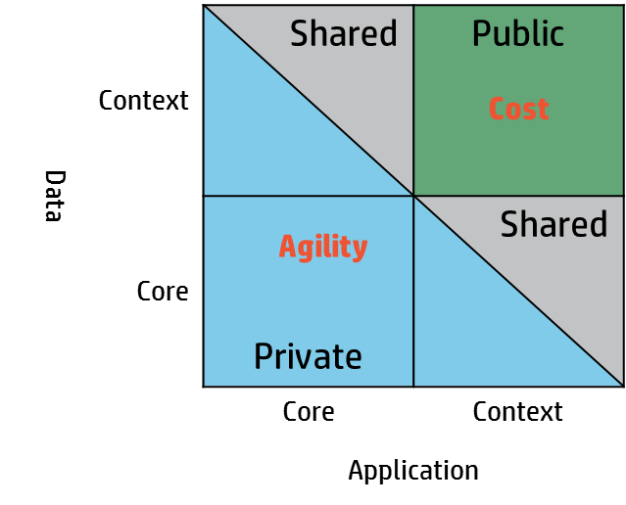
Deciding where workloads belong
Core versus context
    A core application is an application that fundamentally differentiates the enterprise within its market, that creates the identity of the business or agency
      Processes that create unique competitive differentiation
      Source of revenue/profit growth or service provided
    A context application is an application that does not differentiate the enterprise or agency from the consumer’s viewpoint.
      All other processes
      No differentiation for doing them well
      Penalties for doing them poorly
Business/agency
Geographic regulatory
requirements
High availability of apps
Compliance requirements
Service level requirements
Business continuity
Security policies
Technical
Network latency
External dependencies
Language of application
Physical hardware dependencies
Data encryption
Operating system requirements
Parallel processing
Geoffrey Moore – Dealing with Darwin – 2006 & Interviewing Geoffrey Moore: Core versus Context - 2011
Notes:
What are the application characteristics which must be evaluated? We have approximately 50 which we cover in our assessment, I am only calling out a subset on this slide.
Geographic or regulatory requirements – Is the application subject to regulatory requirements such as FISMA, HIPAA, or other such regulations or required to run on a government certified system image? Public cloud services may not provide a suitable environment for systems that are subject to regulatory rules. Applications that fall into this category may be better suited to a private cloud or dedicated environments.
Workload variability – this was covered in the prior page. If the workload pattern is not one of the four, does it make sense to run in the cloud?
Software licensing restrictions – can you run that application in a highly virtualized environment and still conform to your licensing model with the software vendor – if your scope includes packaged applications?
Vendor support – will the software vendor provide support for the applications in the new environment? Are they “certified” to run in the new environment on that specific operating system?
Obviously, there are many of the technical characteristics to consider as well:
Is the application considered context of core? Context are Applications that support the business, but don't bring down operations if they fail. Exchange, BI reporting applications, marketing and sales tools. Core are applications that the business depends upon to carry out its critical operations. May be obvious, but we suggest you start with context.
Are there any external dependencies or physical hardware dependencies? Physical hardware dependencies include software license dongles or legacy gear like token ring network cards, graphics cards and the like.
What is the language of the applications? Older technologies are less likely be to supported by sophisticated tools and cloud standards and programming styles. One consideration is the ability of the application, natively, or post-modernization to support parallel processing? Will the platform and infrastructure support this?
These are just a few of the considerations I have highlighted.
[next]

Slide 12
Addressing business needs
Value versus risk
How can IT support innovation agenda? (Re-factor or replace)
    Establish organization, application and infrastructure landscape responsive to evolving business needs
    Enable use of innovative technologies to create new business models and market offerings
    Support improved collaboration between business and eco-system partners (suppliers, citizens, etc.)
How to balance IT costs with business objectives? (Re-host)
    Consolidate and automate IT landscape to improve responsiveness while reducing cost
    Shift spend from CAPEX to OPEX, from operations to innovation,
    enabling business and IT transformation
How to reinvigorate legacy investments? (Re-architect)
    Exploit core business IP contained in legacy applications & data
    Remove dependency on scarce skills and legacy technologies
    Re-architect applications to exploit new technologies
    Reduce risk and improve security and regulatory compliance
Choose your transformation
strategy to balance value and risk
Replace
Re-architect
Appetite for value
Re-host
Re-factor
Appetite for risk

Slide 13





HP is making hybrid delivery real
Build and operate
Consume
Cloud broker services
Private cloud
Managed
private cloud
Managed virtual private cloud
Public cloud
and SaaS
HP Helion OpenStack common architecture
SLAs: Availability security performance compliance cost
Open
Secure
Agile
Portable, interoperable,
and heterogeneous
Based on open source to accelerate innovation
Deploy applications on multiple deployment models
Enterprise-grade security
Visibility, control, and governance for hybrid IT
Reliable, predictable services
Speed time to innovation
Scale with the right economics
Planning, building, and managing expertise
Notes:
Let me tell you more about HP Helion. HP Helion is a portfolio of products and services that make it easier for you to build, manage and consume workloads in a hybrid IT environment. It brings together all the benefits and agility of cloud computing, all the possibilities and interoperability of open source, and all the security and reliability enterprises need to move forward with confidence.
With our broad portfolio of products, solutions and services, from both HP and our partners, we can help you deploy a private cloud, managed private cloud, managed virtual private cloud and use public and SaaS services.
All based on a common technology, OpenStack, that makes it easier for you to deploy, manage and operate cloud applications.
It is open and secure and enables organizations to be more agile.
By open we mean it is based on open standards and built on open source to deliver fast innovation.. Openness enables the ability to move, integrate and deliver applications across IT environments. It means you can build your cloud, your way, without fear of proprietary systems or lock in.
By secure we mean you are safe in knowing that all products and services provide the visibility, control and governance you need across a hybrid IT environment. You can also be secure in knowing you are in a safe pair of hands with HP as your partner.
By agile we mean that HP provides the fastest time to business outcome through the best economics across all delivery models and solutions. IT and business can respond to the latest market challenges and use technology as a strategic advantage. You can pay as you go for as much or as little as you need.

Slide 14
The HP approach
Future = Hybrid
Advise
    Determine the best cloud choice for each workload
    Understand how to get best return on your current
    infrastructure and applications investment
    Build a business case and high-level plan
    Define a step-by-step plan for the journey
Transform
    Move from the current state to the future state
    Transform application workloads (design, build, and test)
    Design and implement cloud environments
    Transition workloads and infrastructure into production
Manage
    Provide monitoring and support for hybrid
    environments with the confidence it is all
    managed consistently and securely
Build
on-premises cloud services
Consume
off-premises cloud services
Cloud broker services
Traditional
Private
Managed
Public
Interoperable Services, Unified Management via OpenStack
Hybrid delivery
cloud OS OpenStack architecture
Notes:
And just as we’ve done through technology changes in the past, we listen to your concerns and collaborate with you on purposeful innovation that keeps you a step ahead.
Now—more than ever—you need a partner to advise, help you transform, and manage your processes so you can focus on your goals.
We’ll advise you on building a road map to get from where you are to where you want to be. And then we can design and deliver innovative new processes, applications, and infrastructure to enable your transformation. Finally, we can manage your processes to give you industry-leading service levels, help you manage risk, and work with you on the innovation you need to move forward.
Simply put, our goal is to help you meet yours.
In developing this broad portfolio of solutions across various delivery models, HP is laying a foundation that is the common architecture underpinning HP Cloud. This common architecture spans across all cloud delivery models (Private, Virtual Private and Public) providing a seamless foundation for workloads and applications, with a continuum of SLAs whether a customer is deploying in one or more of traditional model, private cloud model, managed cloud model, public cloud model.
Through this common architecture, HP provides a seamless experience for end users independent of infrastructure and delivery models. This common architecture is a key announcement we will be making at Discover.

Slide 15
Managed cloud offering overview

Slide 16
Workload & Cloud solutions built for your needs
We help clients move, optimize, and manage enterprise workloads securely within the cloud
Advise and transform
PaaS and Saas
A range of advisory and transformation
Enterprise-grade cloud solution that
services covering business consulting to
enables ISVs and Resellers to manage
application transformation running on the
and run complex application workloads
optimal infrastructures
and resell into the enterprise market
Cloud
Assess and
Application
Application
Assess &
Assess &
Application
Application
Application
DTaaS
ECS
iPaaS
ISVs
strategy
analyze
transformation
modernization
aPaaS
Analysis
Analysis
Transformation
Transformation
Modernization
aPaaS
Compute
Continuity
Provides a hosted cloud computing
Provides for recovery of work area,
infrastructure
-
as
-
a
-
Service that supports
telephony,
and data center services in the
important business workloads through high
event of an unforeseen calamitous event
levels of automation and availability
Traditional
Continuity
Data Center
Workplace
Advisory and
Traditional
Traditional
Private cloud
Virtual Private Cloud
Virtual Private Cloud
Virtual private cloud
Public Cloud
Public cloud
ECS
ECS
-
-
Continuity
Continuity
recovery
recovery
transformation
Notes:
Speaker Notes:
The Workload and Cloud solutions Global Practice provides clients with advisory and transformation services to optimize application workloads for the cloud based on what we see in the market:
Clients need advice in the journey to the cloud. Our Advisory and Transformation services enable clients choose from a phased cloud transformation approach (retire, replace, rehost or refactor) or rapid deployment approach where all applications are rapidly transformed to the cloud all at once (for example, Seadrill example of all apps moved to the cloud in <6 months).
We can satisfy the demand for hybrid environments to run the right app workloads on the right infrastructures through our Infrastructure-as-a-Service (IaaS) capabilities. With our IaaS offerings, based on workload optimization factors, we can run in a multitude of clouds including a public, private, or hybrid infrastructure, all managed by HP. We have a converged cloud architecture that provides APIs for open stack or traditional, as we see the industry demands a choice of both. In addition, compliance is a key part of our offerings including HIPPA, SOC2, PCI, and FedRAMP…to name just a few.
The industry is moving to an as-a-Service (aaS) market. HP provides Software-as-a-Service (think SAP, Oracle, and Microsoft), IaaS, Continuity-as-a-Service and we will be providing Storage-as-a-Service and Network-as-a-Service. We will continue to offer more aaS options.
We can also provide clients cloud continuity options contingent on app workloads ranging from simple backup and recovery to high availability (HA) of 99.999% uptime to cover a variety of application workloads
Let’s take a look at some cloud facts that differentiate us in the marketplace.

Slide 17





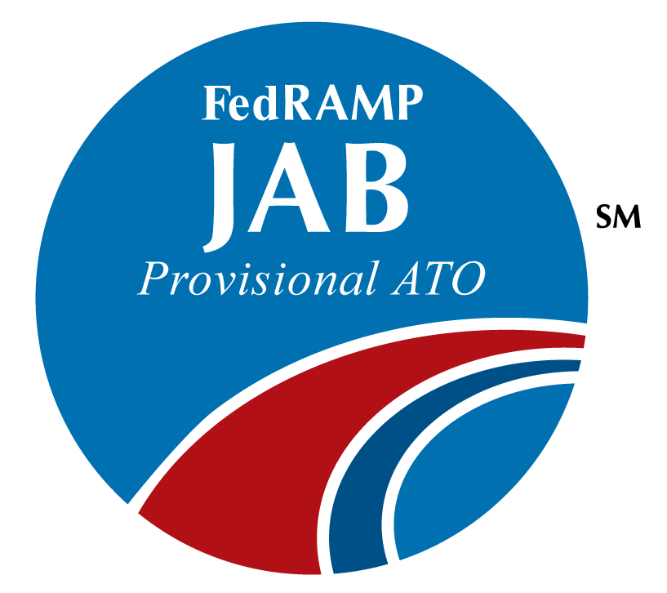





Helion Managed VPC for Public Sector (U.S.)
A highly secure, FedRAMP™-authorized managed hosted cloud computing infrastructure for critical business workloads. Designed to meet the needs of the U.S. public sector
Open platform to support workload migration across delivery models
Servers
Storage
Broad technology stack to better address today’s complex IT environments
Networking
Highly secure with industry relevant auditable compliance certifications
Security
In-country delivery capability for U.S. government related workloads
Management software
Enterprise-grade service management and robust SLAs
Portal, Automation
Advise
Transform
Manage
Notes:
For clients in any industry who needs to quickly react to dynamic market forces when business needs shift, HP provides Helion Managed Virtual Private Cloud to help them quickly and securely add infrastructure and capabilities without capital outlay, as well as upgrade business-critical applications to meet business and compliance requirements. This will give you a competitive advantage by freeing up capital to invest in new products and services as well reducing time-to-market while providing business assurance in meeting compliance reporting mandates.
Helion Managed Virtual Private Cloud is a flexible cloud computing infrastructure that enables the Enterprise to transform and embrace new economics, improved business agility and secure systems at high levels of availability and responsiveness.
Scalability—Scale the infrastructure up or down, within a chosen range.
Capital—No upfront outlay for infrastructure investments, leverage our economies of scale, and move to an OPEX model.
Security—Have peace-of-mind with our hardened security platform that includes dedicated network compartments, VLANS, certified OS builds, and proactive environment monitoring.
Audit reporting capabilities to easily comply with Sarbanes-Oxley, ISE, among other regulations.
Delivery: Orlando-based data center staffed with U.S. persons (employees authorized to work in the U.S.) or U.S. citizens if required
Reliable- disaster recovery options combined with server and data center configuration are utilized to provide a reliable and stable infrastructure at availability levels from 99.0%-99.95%

Slide 18


HP Managed VPC benefits
A single source of cloud coordination and accountability
Addresses
    Security and compliance concerns
    Under-utilized and decentralized IT resources
    Need to respond quickly to changing business conditions
    Lack of resources, experience, and time to deploy a cloud environment and create shared IT services
    Inability to view centralized visibility of IT consumption
    How you benefit
    Reduce operational risk by running within FedRAMP™ authorized cloud environment
    Lower total cost of ownership through increased IT utilization and adoption of consumption-based services
    Rapidly expand capacity and implement new services
    Overcome knowledge, skill, and resource gaps and enable internal/external IT service brokering
    Support multi-departmental usage requirements
Notes:
What are the main benefits?
Accelerates private cloud adoption & shared IT service model
Increases IT utilization and lowers costs via shared IT services
Supports multi-departmental usage requirements
Enables internal metering, billing, chargeback capability
Increases security, compliance, flexibility & scalability - e.g., network isolation, firewalls, database privacy and secure connectivity.
Provides system-level SLA supporting enterprise applications (99.95%)
Enables internal/external IT service brokering
Replaces legacy IT, enabling consolidation and virtualization
Provides self-service Private Cloud Customer Portal
Addresses knowledge, skill and resource gaps
Reduces operational risk

Slide 19
Proactive approach to security and compliance
Extend your current enterprise security on a proven and compliant platform built from the ground up, with security in mind.
  Granted FedRAMP℠ Provisional Authority to Operate (pATO), which provides the full National Institute of Standards and Technology (NIST) Risk Management Framework
  Assessed as compliant with HIPAA/HITECH and International Traffic in Arms Regulations (ITAR) by an independent Third Party Assessment Organization (3PAO)
  Complies with FISMA moderate security controls, FERPA, PCI-DSS,
  and CJIS
  Physically and virtually hardened to protect against threats
  and vulnerabilities
  Use as platform for agencies to achieve own FedRAMP authorization
Notes:
ADDITIONAL INFO:
FedRAMP
The primary goal of FedRAMP is to authorize cloud services, It does not provide subsequent government programs with Authority to Operate (ATO), but supports their getting that ATO in a consistent, reproducible, and expeditious manner. Helion Managed VPC has achieved a FedRAMP Provisional Authorization, which means that the offering has undergone a rigorous assessment by an independent third party assessment organization (3PAO) and has passed muster! HP is one of the very first companies to have a cloud offering that has this distinction!
It’s important to understand some of the different FedRAMP authorizations:
The level of authorization HP was granted represents the highest level and FedRAMP JAB authorizes a system on behalf of the entire federal government by issuing a pATO.
Individual agencies can also authorize a system on behalf of their agency by issuing an Agency ATO (example: Amazon Web Services received an agency FedRAMP authorization from the Department of Health and Human Services (HHS)).
Any agency can leverage HP’s pATO – at no additional cost – and grant their own ATO without conducting duplicative assessments, saving our customers time and money.
DISA ECSB
Our DISA ECSB provisional authorization for HP to be used by a DoD cloud customer as a container is pending. With this PA, HP demonstrates that we meet the requirements of managed cloud workloads for all DoD components. The DISA ECSB establishes the DoD security requirements for cloud service providers (CSPs) to host DoD content up to and including the Secret level.
HP Helion Managed VPC for Public Sector-Client Presentation

Slide 20

Cloud designed for enterprise-grade security
We take security, compliance, privacy seriously
Information security
    Protect your reputation,
    manage risk and achieve regulatory compliance
Data center security
    Use HP’s U.S. government-approved, highly secure, next-generation data center in Orlando, Florida
Multiple tenants
    Use dedicated network compartments
Endpoint security
    Protect your cloud with anti-
    virus, anti-malware, anti-spam
Network security
    Keep the cloud behind your firewall and use our security services with
    policy compliance management, vulnerability scanning and ID/access management
Notes:
While no service can guarantee absolute security, HP applies our extensive, global security expertise to keep your information and processes isolated and protect them from logical and physical threats. Working in tandem with our HP security experts, we cover your enterprise needs
HP Places Security and Privacy at the Forefront of the Solution
Both HP and many of our clients operate on a global scale where regional and sectorial legislation and regulation has an impact. Since Helion Managed Virtual Private Cloud is a managed private cloud service with 100% dedicated assets to each client, there’s physical and logical isolation of the infrastructure, applications and data, AND no sharing of resources with other clients.
Since the infrastructure is available behind the client’s corporate firewalls, they feel much more comfortable with meeting regulatory and industry requirements. Since clients already own and control the physical security of their data centers, they should be very comfortable with a dedicated private cloud that gets placed inside their walls. Optionally, clients can located the private cloud infrastructure in an HP data center.
The cloud’s standardized but configurable service items available in a service catalog ensure that little variability is introduced into the environment, thus giving more control to the IT staff in how workloads are deployed.
Some of our security precautions include standardized services from our security experts like:
Automated Identification and Access Management services. Two factor-authentication
End-Point-Threat Management services (Anti-virus, Anti-malware, etc.) based on McAfee agents and automated with HP Server Automation (HP-SA) software.
Security Policy Compliance Management services automated with Symantec agents (Symantec Enterprise Security Manager) and HP Virtual Security Manager (VirtualSM).
Vulnerability Scanning
------------
Additional detail if requested
Unlike many of the providers in the market, we take security, compliance and data privacy seriously
We focus on these security areas in a segregated operational environment:
Network- dedicated virtual LANS (VLANS), dedicated virtual firewall; two factor-digital certificate-based authentication; private network feature to segregate servers; client-managed VMs on dedicated hypervisors; network controls and ACLs to segregate server traffic
Hosting-automated patch deployment; security policy compliance management; encrypted login credentials
Security incident & event management; end-to-end ownership of security incidents on HP ES managed servers; ISO 27001-certified data center; ITIL process compliance/certification; ESIS standards compliance
Storage & Backup-client servers communicate only with allocated logical disk units; SAN port-based hard zoning
Customer Segregation—we use fiber channel zoning to logically isolate servers and storage devices
Applications-antivirus deployed on all servers; HP gold disks to build VMs, restricted admin access on HP Managed servers
Audit Compliance-customer audits allowed; General SAS70 Type II / ISA 3402
HP Helion Managed VPC for Public Sector-Client Presentation

Slide 21


HP Helion Managed VPC key characteristics
Enterprise
Cloud Services
Characteristics
Server types | Virtual and physical servers
Service levels | 99.0% to 99.9% (virtual); 99.0% to 99.95% (physicals)
Storage | Multiple tiers of SAN-based block storage
BUR | Onsite and offsite backup and archival options
Operating systems | Multiple OS options (Windows, RHEL, SuSE, HP-UX)
Virtualization | VMware, Hyper-V, Virtual Appliance (for nonstandard OS support)
System management | HP managed, customer managed
OS license | HP supplied, customer supplied options
Disaster recovery | Tape-based and host-based data replication
Network | Leveraged Internet, secured VPN, dedicated client circuits Load balancing
Database management | SQL and Oracle
Contract | One-month term and $1000 monthly minimum
Billing method | Daily pricing model for all services
Portal | Two-factor authenticated customer portal
Security | Anti-virus, vulnerability scanning, policy compliance management, SIEM
Compliance | FedRAMP, ITAR, and HIPAA compliant by means of third-party auditor
Self-Service Portal
Services catalog
Infrastructure
Platform
Applications
Industry
Orchestrate
Secure
Broker
Bridge
Bridge
Private cloud
Virtual private and
industry clouds
Public cloud
Notes:
Speaker Notes:
The real enterprise-class cloud
HP Helion Managed Virtual Private Cloud enables clients to gain high levels of automation and availability to run critical business applications with a highly secure, cost-effective managed cloud computing infrastructure.
Key Characteristics of the offering are on the right starting with Security and Compliance..
We maintain a range of industry certifications that are relevant to clients. Examples include:
Health Insurance Portability and Accountability Act (HIPAA)
Payment Card Industry Data Security Standard (PCI)
Service Organization Controls (SOC-2) Accounting Standards
Impact Level 3 (IL3) Regulatory Compliance
The Federal Risk and Authorization Management Program (FedRAMP)
International Organization for Standardization (ISO) 27001 audit reporting standards
Service Level Availability is next as it is a key differentiator for us relative to the competition. We offer SLA’s from 99.0% to 99.999% - the highest in the industry. Continuing on you’ll see the industry standard infrastructure building blocks of servers, operating systems and storage options available in our service catalog.
-----------------------------------------------------------------------------------------------------------------------------------------------
Technical detail below reflecting features as of Managed Virtual Private Cloud Release 6.2
-----------------------------------------------------------------------------------------------------------------------------------------------
Security and Compliance:
Health Insurance Portability and Accountability Act (HIPAA)
Payment Card Industry Data Security Standard (PCI)
Service Organization Controls (SOC-2) Accounting Standards
Impact Level 3 (IL3) Regulatory Compliance
The Federal Risk and Authorization Management Program (FedRAMP)
International Organization for Standardization (ISO) 27001 audit reporting standards
Data Centers:
HP Public Sector: U.S.-based data center staffed by U.S. persons or U.S. citizens if required. HP commercial: 18 data centers in five continents with 7 dual pairs for high availability and data sovereignty.
Customer Selectable
Indoor and Outdoor Video Surveillance
Biometric Palm Scanners and Key Card Access
On-Site Security Personnel 24 x 7
N+1 Data Links, Power, UPS, and Cooling
ISO27001 and ITIL framework and best practices
ISAE3401 (was SAS70)
Cloud Security Alliance (CSA-STAR)
Customer Audits Allowed
ECS–VPC Portal
Portal-based provisioning of Compute, Storage, and Network Services
Online help, provision resources, review service tickets, view reports
Document center includes portal User Guide, service descriptions, contracts and policy documents
Servers: Physical and Virtual servers
Virtual Machine Sizes Nine (9) Available:
VM 1x2: 1 vCPU 2 GB RAM
VM 1x16: 1 vCPU 16 GB RAM
VM 2x4: 2 vCPU 4 GB RAM
VM 2x16: 2 vCPU 16 GB RAM
VM 4x8: 4 vCPU 8 GB RAM
VM 4x32: 4 vCPU 32 GB RAM
VM 8x16: 8 vCPU 16 GB RAM
VM 8x32: 8 vCPU 32 GB RAM
VM 8x64: 8 vCPU 64 GB RAM
Physical server sizes Thirteen (13) available that provide high compute processing power of up to 3.3 GHz
Total # of CPU Cores x Memory (GB) options
PM 4x16
PM 8x24
PM 8x64
PM 8x144
PM 16x384
PM 48x512
HP-UX PM 8x48
HP-UX PM 16x96
HP-UX PM 32x192
HP-UX PM 8x128
HP-UX PM 16x192
HP-UX PM 16x256
HP-UX PM 32x512
SAN storage can be provisioned in blocks from 5 GB to 2 TB
High Performance (RAID 1/fiber channel): Ideal for SAP and Databases
Standard Performance (RAID 5/fiber channel: Ideal for business class applications. Note: Check with regional ECS Operations lead for availability.
Performance-EVA (RAID 5): Note: Check with regional ECS Operations lead for availability.
Backup and Business Continuity
30 day onsite with Virtual Library System for fast restore
30, 60, and 90 is off-site options
Encrypted backup
Selectable backup times
Server Operating System and File system backup
30, 60, or 90 day retention
Database backup (Oracle and SQL)
Daily, Twice Weekly, Weekly, 15, 30,60 or 90 day retention options
Helion -Continuity Services for Disaster Recovery
Tier 1 (Tape Based)
Tier 2 (Async to Continuity Data Center)
Tier 3 (Full Synchronous to Dual DC pair)
Operating Systems
Microsoft Windows Server Standard Edition 2008 R2 and 2012 R1
Red Hat Enterprise Linux 5.9
SUSE Linux Enterprise Server 11
HP-UX 11i v3
Operating system management
HP managed
Monitored
Systems Management, including Change, Incident, and Problem Management
Security Administration and Policy Compliance Management
Server Anti-Virus Protection (Windows only; not for Linux)
Anti-Malware Protection
HP retains Privileged / administrative (‘root’) access
Customer managed
Unmonitored
Customer or Account team provides monitoring, on-going patching, and server security
Privileged / Administrative (‘root’) access is provided
Point in time Operating System Versions (These OS versions are not patched during server provisioning)
OS license options
HP supplied
Customer supplied options
Computing Services: High Availability and Clustering Options
The following clustering services are available for customers with higher application performance and/or security requirements and include HP Managed Virtual Private Cloud clustering services. Customers who choose the dual data center service options via the ECS Portal will benefit from higher Service Levels. Refer to the Operation System Catalog and the Server Product Catalog for details on the OS versions and server platform sizes supported.
Customer Dedicated Virtual Host Cluster Single Data Center Service (VMWare only)
Enables customers with higher application performance and security needs to run their HP Managed Virtual Private Cloud standard virtual servers on dedicated physical hardware allocated just for them in a single data center. The dedicated Virtual “Hosts” Cluster can run an HP defined number of Physical Servers that are not shared with other Customers. Customers can select from HP defined virtual server sizes to run applications
Windows OS Cluster Single Data Center Service
Two or more HP Managed Physical Servers that are identically configured with clustering services running a Windows operating system with Active Directory.
Linux OS Cluster Single Data Center Service
Two or more HP Managed Physical Servers that are identically configured with clustering services running Red Hat Enterprise Linux Server or SUSE Linux Enterprise Server.
Windows OS Cluster Dual Data Center Service
In select data centers as indicated in the ECS Portal, and depending on the service level desired, the service provides HP Managed physical and HP or Customer Managed virtual server options with clustering services running a Windows operating system with Active Directory.
Linux OS Cluster - Dual Data Center Service
In select data centers as indicated in the ECS Portal, and depending on the service level desired, the service provides HP Managed physical and HP or Customer Managed virtual server options with clustering services running a Linux operating system.
Virtualization
Microsoft Hyper V and VMWare options. Hyper-V is supported on HP-Managed and Customer-Managed virtual servers only. Note: Customers do not have access to the hypervisor. Current Hyper-V Data Center Deployments in Brazil, Singapore, Alpharetta and Frankfurt: 90 day lead time no longer required for these HP Managed Virtual Private Cloud data centers.
Virtual server Resize option - Enables customers to change existing virtual machine sizes for both HP-Managed and Customer-Managed virtual servers.
Virtual appliance option - Enables customers to run non-standard VPC OS images on an HP Managed Virtual Private Cloud standard virtual machine. These virtual machines or “virtual appliances” can be managed by the customer or they may commission a third party (including HP ITO) to manage it.
Client Dedicated Virtual Host Cluster VMware option - Enables customers with higher application performance and security needs to run their HP Managed Virtual Private Cloud standard virtual servers on dedicated physical hardware allocated just for them in a single data center.
Snapshot Option for Client Dedicated Virtual Host Clusters - Enables customers to preserve the configuration of a virtual server while they are doing test/dev or maintenance and revert back to the original state of the virtual server if needed.
Other Service Options
Automated server Load Balancing – industry leading F5
Multiple VLANS (unlimited except with Load Balancer)
Customer configurable firewall rules
Dedicated hypervisor option
Network-dedicated Customer Compartments
Installation and set up - Customer Compartment set up within the ECS–Virtual Private Cloud environment.
Network-dedicated customer compartments with standard initial firewall rules (hardware, software, and with HP standard rules applied; customers can request modifications to ACLs and NATs through the ECS Portal)
Load balancer capability for both physical and virtual servers
VLANS – Up to 11 automatically configured; additional vLANs may be requested. First 6 vLANs have load balancing services available.
Firewall rules - The compartment will include a dedicated, virtual firewall with an HP ECS standard rule set. These can be modified through a service request by means of the ECS–Virtual Private Cloud Portal.
Internet protocol:
Internal IP addresses – Internal IP ranges are not routed outside of customer compartments
Public IP address – Assigned using Network Address Translation (NAT)
Host name changes
Network Switch as a Service – Customer-owned and provided devices that are not on the ECS–VPC standard list can be placed into their compartment. ECS–VPC will logically place the device into the customer’s compartment using an ECS–VPC managed dedicated switch. The customer can manage it or commission a third party (including HP ITO) to manage it. This is available for Customer-Managed compartments only.
Middleware , Database Management Services for SAP
Oracle and SQL single-instance database management services
Offers logical access to the application environment through private network connections or the public Internet.
It includes all infrastructure and DB management for the environment, including end–to-end operation of the LAN, operating system instance, database, and related utilities (that is, monitoring, backup, and reporting).
Oracle DBMS - available for HP-Managed physical servers
SQL DBMS – available for HP-Managed virtual servers.
License is supplied by HP or customer
Database clustering will be supported in a future release.
SAP Hosting Services
HP Helion Managed VPC for Public Sector-Client Presentation

Slide 22
Why HP?

Slide 23

Did you know:
Workload and Cloud Solutions
45,000
45,000 application resources with 12,000+ ERP professionals
private cloud provider
1,200+
81
HP Leveraged Data Centers
18 running Virtual Private Cloud
5 continents with 7 dual pairs
Expanding to 24 VPC cloud data centers in next 12 months
Private cloud clients
250+
#1
Managed cloud customers
27
40%
40% of Fortune 100
companies run HP Cloud
Total space = 27 US football fields
972,429 sqft used end of program
599,895 sqft available end of program
160 PB (Petabytes) online storage
700 PB of backed-up data
$Billions
largest single HP incremental investment in cloud
1000+
HP Cloud Journey workshops
with 5,600+ attendees
Americas
EMEA
Asia-Pacific
Montreal
Wynyard
Doxford
Roosendal, NL
(1Q14)
(UKPS TBD)
Toronto
(UKPS 2Q14)
Colorado
Springs
Belgium
(2Q14)
Shinsuna
Littleton
Reading
Frankfurt
Tulsa
Isle d’Abeau
Russelsheim
Bangalore
Alpharetta
Keppel DigiHub
Orlando
Grenoble
Milan
ECS-VPC Site
Spain
(secondary
2Q14)
Inverno
(2Q14)
VPC Public Sector
Sydney
Eastern Creek
Dual/HA DC
(4Q14)
ECS-Continuity
Alphaville, Brazil
Notes:
Call outs:
GLOBAL INFRASTRUCTURE INVESTMENTS THAT SUPPORT CLOUD MODELS NEEDING CLOSE PROXIMITY TO CLIENT (FOR DATA SOVERIGNTY, PRIVACY, SECURITY, LATENCY)
81 DATA CENTERS FOR WORKLOADS REQUIRING A PRIVATE CLOUD, NEEDED FOR LOCALIZED DATA SOVERIGNTY, PRIVACY, SECURITY AND LATENCY.
THE LARGEST NUMBER OF PRIVATE CLOUD CLIENTS (THIS IS ACCORDING TO FORRESTER). WE SPEND BILLIONS ON CLOUD.
HAVE THE EXPERIENCE IN IMPLEMENTING CLOUDS
INCREASED DEMAND FOR DEDICATED PRIVATE CLOUDS DUE TO SECURITY AND WORKLOAD OPTIMZITION REASONS
SOME APPLICATIONS RUN MORE EFFECTIVELY IN A DEDICATED ENVIRONMENT
OVER 45,000 APPLICATION RESOURCES
BENCH STRENGTH TO PERFORM COMPLEX WORKLOAD ADVISORY AND TRANSFORMATION WORK GLOBALLY
15,000 ERP PROFESSIONALS THAT UNDERSTAND THE APPLICATIONS
WE HAVE THE PEOPLE, TOOLS, PROCESSES AND IP TO MOVE BIG WORKLOADS TO THE CLOUD

Slide 24
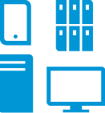



Built to meet your business needs
Best-in-class technology
Hybrid delivery
Open, extensible architecture
Experience
    Spans traditional IT, private, managed, and public cloud
    Supports infrastructure, applications, and information
    Converged infrastructure
    Converged management
    and security
    Converged information
    Enables service
    flexibility and portability
    Heterogeneous (hypervisor, deployment, development, infrastructure)
    Designed with public
    sector in mind
    1000+ customer engagements
    Knowledge running large-scale cloud environments
Notes:
HP creates new possibilities for clients by providing a comprehensive set of products and services combined with the right architecture and experience to power the migration, transformation and support for your most advanced applications and workloads
With the broadest global technology portfolio spanning printing, personal systems, software, services and IT infrastructure, HP delivers solutions for customers’ most complex challenges.
HP Helion Managed VPC for Public Sector-Client Presentation

Slide 25
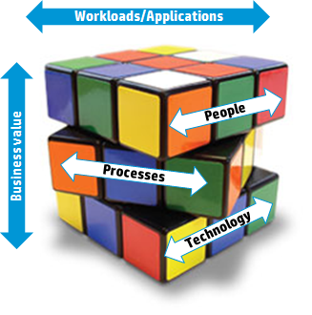







Why partner with HP
Putting your business first
Next steps?
Current state assessment
Hybrid cloud
delivery models
Knowledge of old style & New Style of IT
Safe pair of hands
Strategy/roadmap
Business case
High availability, compliance, security, localized clouds for data privacy and sovereignty
Advisory and transformation
Notes:
SLIDE PURPOSE AND USE
This is the closing chart that moves the discussion to next steps with HP:
- we have spoken about your business – and ES is able to help you, w/ proven expertise, services, and solutions
presenter can propose ES advisory services options (workshop, current state assessment, future state identification, strategy/roadmap)
the ideal next step might be to use the exec sponsorship just earned in this discussion to focus on this exec’s personal objectives and perform a service that engages HP ES with him or his direct reports one level down
depending on information provided by the client, highlight alternative solutions which ES could provide
At this point the client may have revealed numerous potential projects but they are not all well enough defined.
So you need to work here to create a prioritized list with the client, and a commitment to get back to this client with next steps.
ADDITIONAL CONTEXT AND SPEAKER NOTES

Slide 26
Thank you
Notes:
Speaker notes
HP Helion Managed VPC for Public Sector-Client Presentation

Slide 27
Optional slides

Slide 28
Customer challenges: Example
Lack of agility: Traditional systems are slow to change and repurpose to meet rapidly evolving business needs
Low asset utilization: Traditional system utilization rates average between 18% and 25%
Budgetary constraints: Increased pressure to cut spending inhibits ability to transform services and expand capacity
Security: Applications and processes demand significantly higher levels of security and transparency than is available from public cloud implementations
Experience gap: IT staff challenged to balance acquisition of new skills and technology while managing daily operations
Compliance: IT departments must be able to respond to rapid policy or regulatory changes to meet citizen needs
Government procurement lifecycle: Clients face lengthy and complex purchasing cycle for IT related infrastructure
Notes:
These are the common paint points that our customers are experiencing. Our offering is well positioned to address these issues….

Slide 29

What are your key challenges?
CFO/PM perspective
    Manage capital and cash flow
    Mitigate financial risk
    Drive return on assets
CIO perspective
    Respond to change
    Shift from maintain to innovate
    Deliver reliably and securely
    Manage rapid growth
Lines of business perspective
    Capitalize on new opportunities to drive growth
    Reduce operating and unit cost
    Deliver value to stakeholders
Notes:
Many analysts agree that moving to the cloud model can be disruptive to your current business model – and that creates many opportunities. Each executive level will have their own set of challenges and opportunities when analyzing the move to cloud.
For the CFO or Program Manager (PM) , most of the challenges relate to the financial model. How does the cloud impact my capital and my cash flow? How can I financially mitigate risk? How does moving to the cloud impact return on investment.
At the CIO level, the challenges and opportunities of cloud drive conversations around the tactical aspect of the business. Agility, innovation and managing growth are all significant drivers, but they must also maintain a reliable and secure delivery model.
For the Line of Business executives, the cloud opens up many opportunities to make direct impacts on the business's ability to drive growth reduce operating costs and deliver direct value.

Slide 30
Cloud computing fundamentally changes IT
Are you ready to take advantage of these changes?
By 2016, Enterprise IT delivery will be 39% in private cloud, 21% in managed cloud, and 15% in public cloud.
Leaving 25% in traditional IT.
Source: Coleman Parkes Research by HP, May 2013
Notes:
Cloud computing fundamentally changes IT
By 2016, Enterprise IT delivery will be 39% in private cloud, 21% in managed cloud, and 15% in public cloud.
Leaving 25% in traditional IT.
Businesses are under increasing pressures…to move faster; deliver products and services faster…to enable growth.
So what are the promises of the cloud? The cloud offers enterprises the ability to lower costs, accelerate and speed innovation, and be more agile in responding to customer needs and the marketplace…
Yet with the promises that the cloud offers, also comes some risks and challenges – how do I get started? Where should I deploy cloud resources and at what risk?

Slide 31








Disruptive innovation is accelerating
66% of IT decision makers spending less on traditional services as a result of moving to the cloud
Average cost of a security breach
$8.6M USD
Volume of data by 2020: 35 Zettabytes
Mainframe
Client/server
Internet
Mobile, social,
big data, cloud
And every 60 seconds:
98,000+ tweets
698,445 Google searches
168 million+ emails sent
217 new mobile web users
Notes:
SLIDE PURPOSE AND USE
Select this slide or the next slide – its Option A or Option B – one chart only.
Share HP’s perspective on what we see happening in the IT industry.
ADDITIONAL CONTEXT AND SPEAKER NOTES
A fourth wave of disruption is happening (Mobile, Social, Big Data, Cloud)
One can look at these waves using a “rubber band” analogy.
Wave #1 (Mainframes) was about large central pools of computing power that was slow to respond to the business’ needs. (the rubber band is contracted)
Wave #2 (Client/Server) was about distributing the computing power closer to the end users (the rubber band is expanded). While this solved some problems, it created new ones (e.g., how do I manage all these desktops?)
Wave #3 (Internet) was about centralizing data and access once again (the rubber band contracts again). This also solved some problems created by Client/Server but also created its own new problems (e.g., Data Security, Privacy, etc…)
Wave #4 (Mobile, Social, Big Data, Cloud) is about allowing users to generate and consume data when/how/where they want. (the rubber band expands again) Like the previous waves, it carries lots of promise and also lots of risk.
The stats on the far right serve to confirm that this wave is already upon us… and gaining strength… what does this mean to the Enterprise (and its IT organization)?
Speaker’s Notes from ES Marketing:
You and I are driving a big shift. We’ve incorporated technology so seamlessly into our lives that we often forget it’s there, moving digital options from cool trends to the new normal. And we’re addicted to data. We’ve become used to finding information anytime, anywhere. This need is pushing the expansion of technology. It’s also changing the boundaries of what’s possible.
But developments like cloud, security, Big Data, mobility, and social networking are not only causing disruptions in the consumer space, they are also affecting business models as well. Once innovative ideas, these drivers are changing the way things are bought and consumed, the way businesses connect to their customers, the way governments interact with their citizens, and even the way we collaborate on a daily basis. Today, organizations operate more like an ecosystem. They actively connect with customers, citizens, and communities as well as partners, suppliers and regulatory agencies.
Lots of change, but also lots of opportunity.
Organizations need to start thinking less about machines and more about how technology is delivered and consumed and how it helps solve business issues and interactions. It’s more about how end users engage with technology.

Slide 32





The result: a New Style of IT has emerged
Systems of record
(Legacy systems)
Systems of engagement
(Social and mobile)
Security
Mobile Apps Integration
Hybrid
cloud
Information optimization
  IT driven
  Host business processes
  Deeply entrenched, decades
  to build
  Modernizing and migrating,
  remain in new model
  End user driven
  Contacts and connections
  Digital (social/business, transactions, money)
  Cloud and analytics
Balancing
opportunity and risk
Notes:
SLIDE PURPOSE AND USE
Share HP’s POV on the “New Style of IT”.
See the ES Marketing notes below as well.
ADDITIONAL CONTEXT AND SPEAKER NOTES
In essence, the “New Style of IT” is using new technologies (Mobile, Big Data, Security, and Cloud) to re-think and re-create the relationship btw your Systems of Record (your accumulated IT core, where data and enterprise applications reside and the business is efficiently operated by IT staff)
and your Systems of Engagement (your systems and applications that bring you to end-users, build their loyalty, transact their business, and collaborate - as they consume your data and services when/how/where they want, much of the time on smart end devices that are mobile).
Studies have shown most enterprises have already extracted 80% of the potential business value from their Systems of Record, yet only 20% of the potential business value from their Systems of Engagement.
Focusing on realizing greater business value in the Systems of Engagement will (as a by-product) help companies unlock more business value from their Systems of Record.
Ask the customer for their thoughts on our POV. How well does this align with their thinking? What are they most concerned about?
Speaker’s Notes from ES Marketing:
The New Style of IT is where cloud, security, big data, and mobility all converge in comprehensive solutions to better connect customers, citizens, communities, partners, and suppliers to your organization. It’s the merging of legacy Systems of Record with the new Systems of Engagement. In other words, incorporating IT-driven systems with systems that are led by business drivers and innovation.
The New Style of IT supports organizational goals. It gives you choice as to how you consume IT, where you get it, and how you pay for it. It is efficient, open, flexible, scalable, and collaborative. It will predominantly be made up of as-a-service and consumption-based models. The bottom line is that the organization’s objectives will now drive IT.
Key Points:
A new paradigm and a new role for IT and the CIOs
Systems of record are deeply entrenched and responsible for key business processes
These assets will remain in the new model
However, systems of engagement are springing up all over as mobile device users demand access to the organization
The real success will be in the marriage of these two systems … allowing for the new systems of engagement, but ensuring that they are enterprise grade, scalable and secure.

Slide 33



Business demands: A New Style of IT
Business requirements of IT
Driven by the business
New IT delivery models
Bridge consumer
and enterprise
Enable business growth
User demands on IT
Speed
Simplicity
Innovation
Lower cost
Technology trends to leverage
Cloud
Social
Security
Big Data
Mobile
33
Notes:
There are significant business trends happening that are causing Enterprise IT organizations to fundamentally change what they do and the value they bring to the business. These big trends include cloud computing, security, big data and mobility. These trends are driving Enterprise IT to be more user-centric focused, providing faster access to applications and services, simplifying the IT environment, supporting innovation and driving down cost. Enterprise IT organizations are being driven to be closer to the business, supporting new business opportunities, leveraging new IT delivery models and bringing together consumer and enterprise experiences with the goal of enabling business growth.
[Key HP Messages]
The demand for “any time, any where” access to information from employees and consumers has initiated a transformational shift – which HP calls the “New Style of IT” and is powered by a convergence of four generation-defining trends: Security, Big Data, Mobility and Cloud
HP’s unique response to the way the world is changing is to provide “Solutions for the New Style of IT”.

Slide 34

Next, get started on your cloud journey
Define your cloud journey
HP Cloud Workshop
HP CloudSystem
Build your own cloud
Enterprise Cloud Services
HP Public Cloud Services
Consume cloud services
To learn more, visit hp.com/govcloud
Notes:
HP is here to help you get started and guide you through the journey every step of the way.
How can you get started?
To get started with your own cloud journey, sign up for a Cloud Workshop. Targeted at C-level and key business and technology decision makers, we help you achieve business and technology alignment, develop a cloud strategy, and help you build a high level tactical plan for your priority projects.
If you want to get started with building a private cloud, go with HP CloudSystem; the market leading, open, integrated solution that can get your private cloud up and running in a short period of time.
If you are interested in consuming external services and a pay-as-you-go consumption model, HP offers our Enterprise Cloud Services or HP public cloud services. The choice between the two will depend on the services you want to consume and the associated your Service Level Agreements (SLA) needed by your organization.
You can get more information from our website www.hp.com/govcloud
HP Helion Managed VPC for Public Sector-Client Presentation

Slide 35



Drive business outcomes for our clients
Increasing our relevance to clients’ agenda
Customer experience
Citizen engagement
Employee empowerment
IT-enabled transformation
Acquisitions, divestitures

Slide 36

Enhanced capabilities across services value-chain
Empowering clients' to realize their vision
Advise
Advise clients on how
best to deliver business
outcomes using our industry and technical expertise.
Transform
Develop and implement transformational roadmaps for the largest and most complex enterprise environments in the world.
Manage
Manage clients’ environment
while they transform
from the old style to
New Style of IT.
Innovative solutions
Global practices

Slide 37
Services across seven interconnected practices
Delivering innovation and client value
        Analytics &
        Data Management
        Mobility & Workplace
        Security Services
6
        Client
3
2
        HP
1
        Business
        Process
        Services
        Applications
4
5
        Industry
        outcomes
One HP
7
        Workload & Cloud

Slide 38
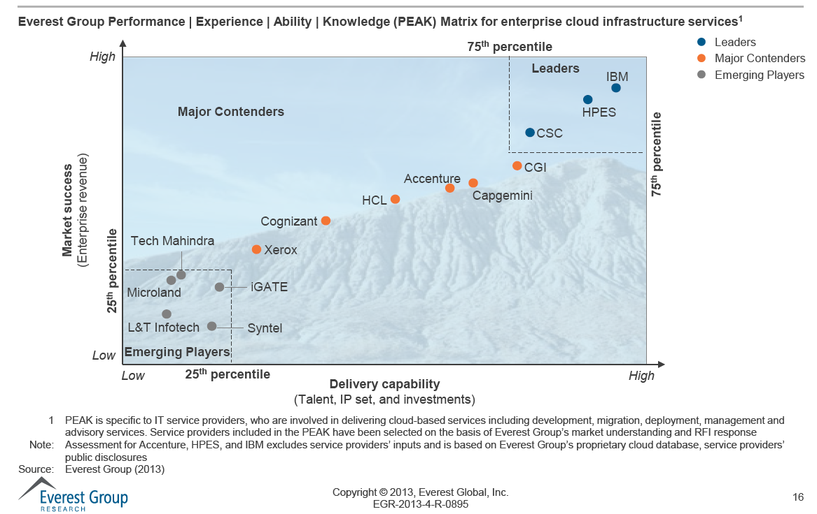
Helion Managed Virtual Private Cloud
Notes:
HP was ranked among the leaders for infrastructure services in a recent (July 2013) Everest Peak Matrix report. The report ranks vendors such as IBM, Accenture, and HP.
HP Helion Managed VPC for Public Sector-Client Presentation

Slide 39
Why HP for business critical workloads?
1
Physical footprint
Needed for running heavy workloads. 80+ data centers for workloads requiring a private cloud, which is ranked #1 by Forrester. 18 VPC sites for workloads requiring elasticity; of which (7) are dual pairs for High Availability.
6
Advisory
Services to drive a cloud strategy and roadmap based on client outcomes. This includes ROI analysis and workshops as part of our service offerings.
2
7
People footprint
Needed to deliver on the necessary cloud services including:
advising, transforming, and managing these workloads. We have over 45,000 application resources & 12,000+ ERP professionals.
Workload transformation
Depending on workloads, these options include: re-hosting, re-factoring, re-engineering, replacing with SaaS applications, and retiring applications.
3
8
High availability
Active/active cloud sites for up to 99.999% SLA uptime needed for mission critical workloads. This means extremely low RTO and RPOs.
Managed cloud services
Our clients have the choice of having HP managed some or all of the cloud stack including tasks like: server load balancing, backup and recovery, OS, firewall, network, etc.
4
9
Cloud OS OpenStack
Data sovereignty, data privacy
and low latency
We offer both traditional (Hyper V, VMware) and Cloud OS that enables our clients to run their business on an open platform. Our Cloud OS will enable our clients to move workloads amongst various IaaS platforms (e.g. Private, Virtual Private, Public).
Regionalized clouds (Private and Virtual Private Cloud ) that clients can chose from to run in-country applications for data sovereignty and data privacy with low latency.
5
10
SaaS for Tier-2 ISVs
Compliance
We enable ISVs to run their cloud business on HP’s cloud(s) including a Storefront and set of SaaS Accelerator services to move, optimize, and managed their workloads. These SaaS applications come into play when clients want to replace legacy applications with SaaS applications
Compliance is needed for most key business critical workloads and include: HIPPA, SOC2, IL3, PCI, FEDRamp, ISO27001.

Slide 40
Helion Managed Virtual Private Cloud
LOW Delivery standardization HIGH
Traditional outsourcing
Helion Managed Virtual Private Cloud
Public cloud
Strong SLA guarantees
Industry-leading
SLA guarantees
Minimum SLA guarantees
High security
levels
Auditable security compliance and
industry regulatory standards
Public Internet level security
0% Elasticity 100%
Fixed multi-year pricing
Monthly pricing
reservation and usage based
Instance, bandwidth etc. usage pricing
Contract length multi-year fixed
Contract length
one month to multi-year
Variable, short-term
Multi-tenancy with secure
network compartments
Single tenancy
Multi-tenancy
MONTHS Time to provision MINUTES
Notes:
Speaker Notes:
Looking across the continuum of Traditional Outsourcing to Public Cloud offerings, HP Managed Virtual Private Cloud provides the best of both worlds and offers unique differentiation.
Industry-leading SLAs
Security compliance and relevant industry certifications
Favorable commercial terms: Usage based consumption model
Cost-effective multi-tenant (shared) resources with secure network compartments
HP Helion Managed VPC for Public Sector-Client Presentation

Slide 41
Helion Managed Virtual Private Cloud features
Feature
Advisory | Analyze , optimize and move workloads to the cloud with clear value and positive business outcomes TCO, ROI, Y/Y productivity improvements and compliance
Enterprise Application Hosting | Industry leading service levels | Support of all leading mission-critical applications and databases
Database Management Services
Service Level Availability | 99.0% to 99.999% configuration options | Support of all leading backup software products Service based on successful backup metrics
Security and Industry Compliance | HIPAA, PCI, ISO27001, SOC2, FedRAMP, Sarbanes-Oxley, DISA (pending) | Auditable Continuous investment Platform for agencies to achieve own FedRAMP authorization
Technology and Reference Architectures | Broad technology stack Pre-integrated building blocks Optimized for application workloads | Chose optimal infrastructure Open standard support
Location | U.S.data center staffed by U.S. persons Enhanced DR in Colorado Springs | Close cloud proximity for data sovereignty and data privacy Reduced latency
Notes:
Expanding on the features from the last page and aligning the deliverables.
HP Helion Managed VPC for Public Sector-Client Presentation

Slide 42
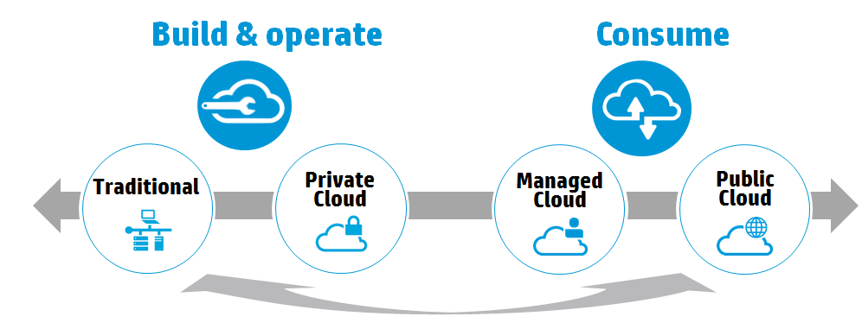
HP is making hybrid delivery real
Service Level Agreements (SLAs)
Availability, Security, Performance, Compliance, Cost
Build on a common architecture and create a common set of technologies that allow you to move from traditional infrastructures, to and around, the different cloud environments
Notes:
Enterprises will also have to consider service level agreements, security, compliance and data sovereignty issues.
A smooth transition of service responsibility is essential to achieve our customer's’ objectives. HP mitigates transition risk by bringing a proven and reliable transition process that leverages a successful track record of similar transitions.
HP understands the high complexity of enterprise’s current IT environment and our goal during this process is to help achieve a smooth transition with no disruption to the business.
HP also understands that working cooperatively with other solution providers is vital to the success of our customers. Companies have many reasons for wanting a multivendor approach: capability, content, best-of-breed skill sets, shared risk, continuous improvement, and competitiveness. In forming a relationship with our clients and other vendors, we believe there should be a set of common goals, understanding and beliefs agreed between all the Service Partners and our customer, and an operational structure that promotes communication.

Slide 43
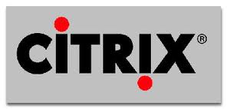
Many cloud solutions to solve business needs
Applications
Microsoft Dynamics CRM
SAP
Oracle
End-user/
workplace cloud
Messaging
Collaboration
Unified Communications
Mobility
Application
transformation
Infrastructure transformation
Application development
for cloud
IaaS
Private cloud
Virtual private cloud
Continuity
Enterprise-class, managed, highly secure cloud solutions
Notes:
With our Enterprise Cloud Services (ECS) ecosystem of Cloud Services, we offer a range of enterprise class, managed, highly secure cloud solutions:
Applications delivered via the cloud
End User/workplace cloud solutions
And IaaS delivered via private cloud, managed virtual private cloud , or utility/grid
Also our Continuity cloud solution provides recovery-as-a-service (also known as cloud disaster recovery or cloud DR)
We also provide a suite of consultative services that help our clients transform their enterprise and migrate to the cloud: From Applications Development for the cloud—that helps clients build or migrate apps to a cloud infrastructure while facilitating deployment of apps to the cloud—to Applications Transformation to the Cloud –that helps clients determine their suitability for cloud conversion, develops a transformation plan, and migrates and modernizes selected applications to the cloud .

