Slide 1
Email Security Service
Secure Anywhere, Anytime Access for Your Users

Slide 2
Terminology
More Terminology!
Capabilities
Pricing
Q & A

Slide 3
Terminology
    Email Security – we have many names !!
      Email Security.Service (ESS)
        Mostly used by Symantec ( it fits well with the naming of the Web Security Service)
      Email Security.Cloud
        The most used name and the one shown on the product brochure
      Email Cloud
        the Product Family shown in the price list
      .Cloud
        Sometimes used, but it is not valid! If someone asks for this then you must clarify what they mean. History: We used the ‘Dot’ Cloud suffix a few years ago, when the term ‘cloud’ was the new big thing. We had two product streams, Email Security.Cloud and Web Security.Cloud. Email Security.Cloud is still a valid product. Web Security.Cloud does not exist anymore – customers were migrated to WSS.
    Messagelabs
      Messagelabs was the name of the company that developed Email Security.Cloud. Symantec bought them in 2008 but people still use this name!
    SMG
      Symantec Messaging Gateway. This is deployed on premise. It is not a cloud based solution.
Notes:
BREAKING NEWS!

Slide 4
Email Security.Cloud – Four more terms..
      Safeguard or Email Safeguard
      Protect or Email Protect [Price list warning!!!]
      These represent service plans. Safeguard is the premium service whereas Protect was an entry level offering. Protect was discontinued some time ago.
    There is only one service plan today: Safeguard. [as there is only one plan, we don’t really need to talk about separately!]
    There is only one base thing to sell, it doesn’t matter if the partner calls it Email Security Service, Email cloud, Email Security.Cloud, Safeguard etc – they all mean the same thing!
If it was a mobile phone contract….
Safeguard
Protect
Discontinued
Just the name of the Service Plan
Email Security .Cloud
Also known as:
Email Security Service, ESS, Email Cloud, Safeguard, Protect
The name of the service

Slide 5


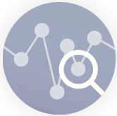
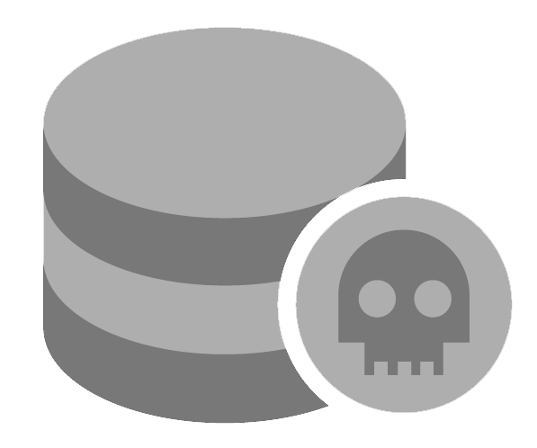


Email Represents A Major Threat Vector
Email is the #1
Delivery mechanism for malware and data loss
Social Engineering
Advanced Threats
Data Protection
65%
81%
$12B
81%
72%
90%+
  Targeted attacks use spear phishing campaigns
  Data breaches result from stolen or lost credentials
Exposed losses due to Business Email Compromise scams
All ransomware infections are in businesses
  Incident responders use security analytics to speed detection and response
Targeted threats identifying and stealing sensitive information
Sources: Symantec ISTR Report 2019, Verizon DBIR 2017, FBI PSA I-071218, 2016 SANS Incident Response Survey
Notes:
The reason why you have to deal with so many sophisticated email attacks is because email is the #1 delivery mechanism for malware and data loss. Email is the most used and critical cloud application, as the average user gets about 200 emails a day and spends about 3-5 hours day on email. Because of this, email is the top infection vector and entry point for attackers to get into your organization.
These attacks include socially engineered attacks such as spear phishing, credential theft, or Business Email Compromise that trick your users into clicking on a link (which can lead to account takeover) or performing an action such as sending a wire transfer or sensitive data over to criminals.
These attacks can also be advanced threats that get your users to download ransomware or some other malware and infect your endpoints. Responding to these attacks can be challenging as your security operations team needs deep visibility and automated remediation capabilities in order to quickly respond and contain an attack.
Finally, it’s important to protect your sensitive data in case an attack tries to exfiltrate data or an unknowing user emails the wrong individual.

Slide 6
Email Security.Cloud
(We will use the term ESS for today’s session – remember , it’s the same thing!)
Solution Overview
Notes:
Now that we’ve talked about the major issues you’re facing, let’s talk about the comprehensive Symantec solution

Slide 7
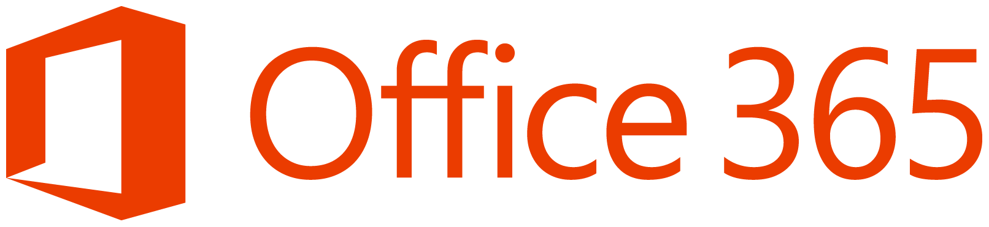


Symantec Email Security
Complete Solution Which Includes Threat Isolation and Fraud Protection
Cloud Service [or On-premises Appliance]
Solution Overview
Advanced Threat
Protection
Threat
Isolation
Email
Analytics
Fraud
Protection
Inbound/Outbound
Protects against ransomware, phishing and business email compromise
Insulates users from sophisticated email attacks such as credential theft and spear phishing
Automates sender authentication, which protects customer brands and helps ensure sender trust
Accelerates response with deep visibility and remediation for advanced attacks
Controls sensitive data and helps meet compliance & privacy requirements
?
Email
Security.cloud
Inbound/Outbound
Third-Party
Email Server
Inbound/Outbound
On-Premises
Email Server
Impersonation
Controls
Security
Awareness
Data Protection
Policy-Based Encryption
Anti-Spam
Anti-Malware
Notes:
The Symantec solution is available as both a cloud-based service or an on-premises appliance. Our cloud-based service is a multi-tenant, SaaS service with data centers around the world. Our on-premises appliance is either a physical or virtual appliance.
At a high-level, both of these solutions give you the same capabilities, as they both help you:
Stop malware & spam
Prevent sophisticated attacks such as spear phishing, credential theft, ransomware, or Business Email Compromise with advanced capabilities such as email threat isolation
Keep your sensitive data safe while helping you meet compliance & privacy requirements
Gain visibility into and remediate targeted attacks
Automate email authentication
Educate your users on the latest email attacks
Typical Use cases:
“I need to prevent ransomware threats from reaching my endpoints.” [MALWARE & SPAM PROTECTION]
“I need to protect specific executives or all users from attacks impersonating a user.” [MALWARE & SPAM PROTECTION]
“I want to eliminate spam and bulk mail, which hamper user productivity.” [MALWARE & SPAM PROTECTION]
“I need deep visibility into sophisticated attacks and prioritization of incidents to accelerate threat response.” [ETDR]
“I want to hunt threats in my email and correlate events across my security environment.” [ETDR]
“I want elevated levels of protection for my users against spear phishing and advanced attacks.” [THREAT ISOLATION]
“I want to prevent ransomware and other malware from infecting endpoints with weaponized attachments.” [THREAT ISOLATION]
“I want to stop users from submitting corporate passwords and sensitive information to malicious websites.” [THREAT ISOLATION]

Slide 8
Symantec Email Security
Complete Solution Which Includes Threat Isolation and Fraud Protection
[Cloud Service or] On-premises Appliance : Symantec Messaging Gateway
Solution Overview
Protects against ransomware, phishing and business email compromise
Insulates users from sophisticated email attacks such as credential theft and spear phishing
Automates sender authentication, which protects customer brands and helps ensure sender trust
Accelerates response with deep visibility and remediation for advanced attacks
Controls sensitive data and helps meet compliance & privacy requirements
Third-Party
Email Server
Advanced Threat
Protection
Threat
Isolation
Email
Analytics
Fraud
Protection
?
Messaging Gateway
Inbound/Outbound
On-Premises
Email Server
Impersonation
Controls
Security
Awareness
Data Protection
Policy-Based Encryption
Anti-Spam
Anti-Malware
Notes:
The Symantec solution is available as both a cloud-based service or an on-premises appliance. Our cloud-based service is a multi-tenant, SaaS service with data centers around the world. Our on-premises appliance is either a physical or virtual appliance.
At a high-level, both of these solutions give you the same capabilities, as they both help you:
Stop malware & spam
Prevent sophisticated attacks such as spear phishing, credential theft, ransomware, or Business Email Compromise with advanced capabilities such as email threat isolation
Keep your sensitive data safe while helping you meet compliance & privacy requirements
Gain visibility into and remediate targeted attacks
Automate email authentication
Educate your users on the latest email attacks
Typical Use cases:
“I need to prevent ransomware threats from reaching my endpoints.” [MALWARE & SPAM PROTECTION]
“I need to protect specific executives or all users from attacks impersonating a user.” [MALWARE & SPAM PROTECTION]
“I want to eliminate spam and bulk mail, which hamper user productivity.” [MALWARE & SPAM PROTECTION]
“I need deep visibility into sophisticated attacks and prioritization of incidents to accelerate threat response.” [ETDR]
“I want to hunt threats in my email and correlate events across my security environment.” [ETDR]
“I want elevated levels of protection for my users against spear phishing and advanced attacks.” [THREAT ISOLATION]
“I want to prevent ransomware and other malware from infecting endpoints with weaponized attachments.” [THREAT ISOLATION]
“I want to stop users from submitting corporate passwords and sensitive information to malicious websites.” [THREAT ISOLATION]

Slide 9


Email Security.cloud provides Multi-Layered Defenses
Incoming Mail
Connection analysis and IP based detection
Signature based spam and malware detection
Heuristic based spam and malware detection
SPF, DKIM and DMARC authentication
Cloud based sandboxing
Impersonation controls
Real time link following
Data protection
Image control
PROTECTS AGAINST
Malware
Advanced Threats
Spear Phishing
Business Email Compromise
Email Impersonation
Spam
Bulk Mail
Data Loss
Outbound Mail
Delivered Mail
Notes:
This slide and the next slide are an “either or” depending on preference. They tell the same story but use different graphics.

Slide 10



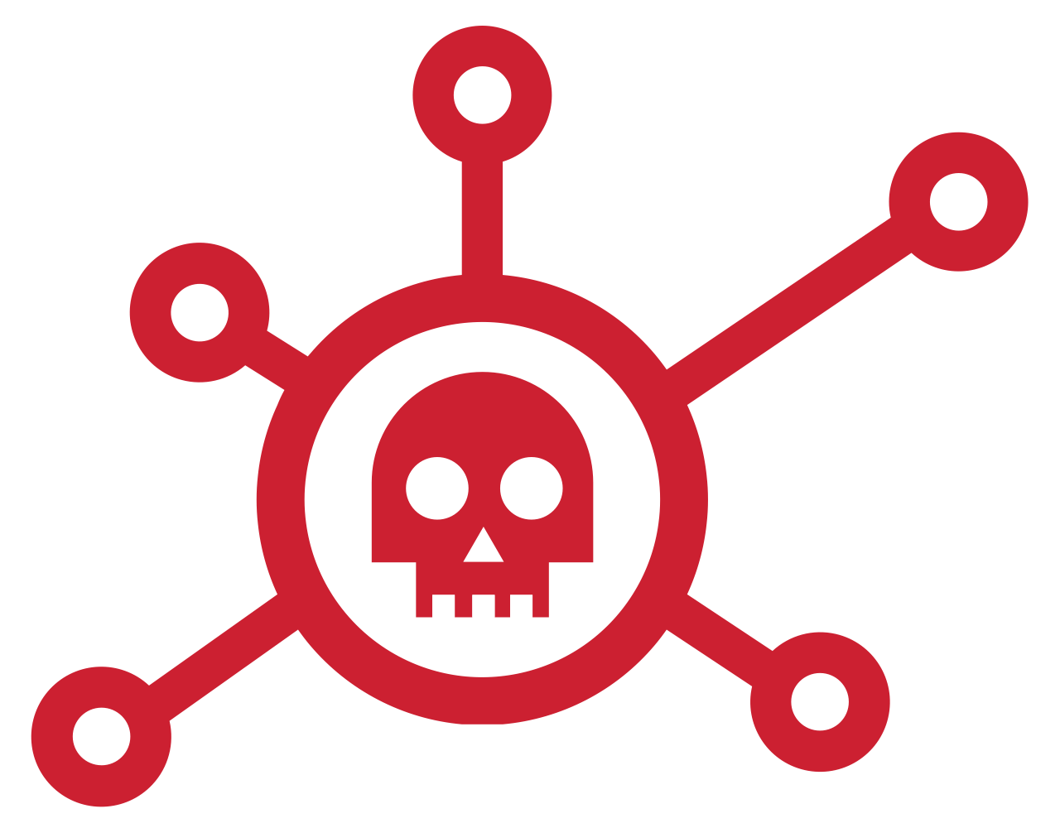



Broadcom: Most Complete Protection in the Industry
Global Intelligence Network
CONNECTION LEVEL
MALWARE & SPAM DEFENSE
LINK
PROTECTION
IMPERSONATION CONTROL
BEHAVIOR ANALYSIS
ADVANCED
MACHINE
LEARNING
SANDBOXING
SMTP firewall, sender reputation and authentication reduce risks and throttle bad connections
Heuristics, reputation, and signature-based engines evaluate files and URLs for email malware
& spam
Evaluates malicious links at email delivery and time of click with advanced phishing variant detection
Blocks Business Email Compromise and other spoofing attacks
Identifies new, crafted, and hidden malware by examining the behavior of suspicious email
Analyzes code
for malicious characteristics
Detonates only truly unknown files in both physical and virtual environments
MALWARE & SPAM PROTECTION
PHISHING DEFENSE
EMERGING THREAT PREVENTION
Notes:
The key here is that we are showing that the email security solution contains all of the key elements that a customer would expect from their email security service. We start with the core “table stakes” of email security malware and spam protection.
At the connection level we are talking about SMTP heuristics, a small handful of rules which identify spam and malware sending bots by the way they conduct an SMTP conversation. We use a number of DNS blocklists, both internal and from reputable 3rd parties such as spamhaus. Authentication technologies including SPF, DKIM and DMARC are key to prevent exact domain spoofing.
Our core threat defenses use both rules and signature based technologies with best of breed URL categorization.
In the next section we have technologies focused on the most recent changes in the threat landscape. Link protection covers both real time and click time scanning.
Real time scanning analyses each link before we deliver the email to it’s destination. We don’t just check it in a URL database but we also follow the link to it’s destination, parse javascript obfuscation and forwarding and scan the landing page with spam and malware detection technologies. Then, if required, we re-write the URL so each time the user clicks the link we carry out the same scanning and potentially route the user through our email threat isolation solution as a final layer of defense.
Impersonation control covers all aspects of spoofing. We’ve already mentioned SPF, DKIM and DMARC but we also carry out typo-squat checks, hunt for a customer’s domain name in every part of the email header and compare the display names being used with a customer provided list to make sure that VIP identities are not being abused.

Slide 11
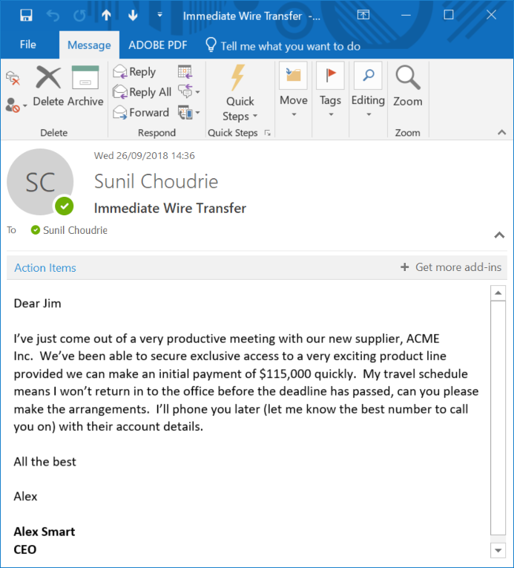
Issue: Business Email Compromise (Impersonation)
The Email Itself Isn’t Malicious, What You’re Being Asked to Do Is!
Types of Attacks:
You receive an email from your CEO asking you to make a wire transfer
You’re asked to provide tax data, which may be used to orchestrate future attacks or perform fraud
You’re involved in a real estate transaction and asked to change payment type to a fake account
Business Email Compromise scams cost = $12.5B, grew by 136% over 17 months
Source: FBI, July 2018
Notes:
Now, let’s talk about another type of attack that is socially engineered: Business Email Compromise, also known as email impersonation attacks, whaling, or CEO fraud.
Business Email Compromise is similar to phishing, but the difference is that there is no malicious link or attachment (no payload) and the attacker is typically impersonating high ranking executive within your organization (such as the CEO or CFO). They also ask the user to take an action such as perform a wire transfer, send over sensitive data, or change the payment type (for real estate transactions). They also usually target somebody within finance/accounting or human resources.
This scams are extremely dangerous, as they have been responsible for over $12.5 billion in damages and grew by 136% in just the past two years (according to statistics from the FBI). The reason why so many people are falling for these attacks is because they’re highly socially engineered (attackers typically perform research on the individual and/or organization ahead of time) and they seem to come from a place of authority (most people cannot say no to their CEO or CFO).

Slide 12
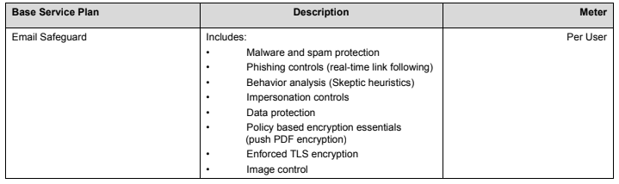
Base Service Plan

Slide 13
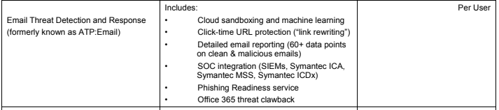
[Add on] Email Threat Detection and Response (ETDR)

Slide 14
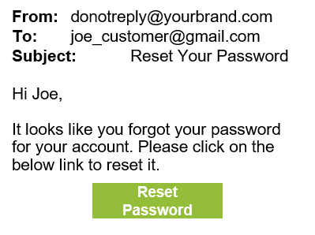
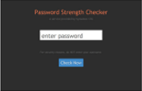
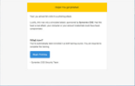
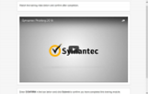
[Add on] Phishing Readiness ( this is part of Email Threat Detection & Response)
Assess your organization’s readiness; Educate end users about Phishing risk
Data exposure phishing email
Phishing domain landing page
Training content landing page
Training notice
Receive an email that prompts “click to comply” with an urgent request
A simulated form prompts targeted user to enter confidential data
Targeted users who fail phishing test are shown a training notice
Symantec default landing page appears when users click to get training
Multiple assessment types:
Open / Click; Attachment; Data Exposure
Customizable Templates
Notes:
Another important facet of protecting users against social engineering is to train them to spot phishing emails. The email security service provides customers with the ability to send fake phishing emails to users and to record their responses.
We can asses if they open emails, click links, open attachments, or even visit websites and try to enter information into forms. Customers with our outlook plugin submission button installed can even track if users report the email as suspicious.
Customers can create their own templates and route users who fail the assessment to online training. Reports can be generated compared over several tests to see if users are getting better at spotting and reporting phishing.

Slide 15
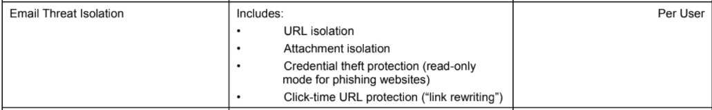
[Add on] Email Threat Isolation (ETI)

Slide 16


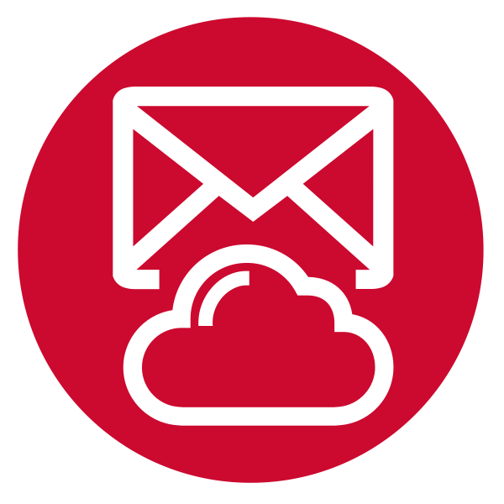
[Add on] URL isolation eliminates the window of vulnerability
Ransomware
Attack
Email Threat
Isolation
Isolate
Links and
Attachments
Isolate Attack
3
Trusted Websites
Allow Link &
Attachment
2
Block Attack
Users
Symantec Cloud
Email Security
Evaluate Links
At Click Time
1
Evaluate Links
At Delivery Time
Block Attack
Notes:
Firstly the email will be scanned by the standard phishing and spam controls contained within the service which will trigger if it has been sent from a known bad IP or matches rules, signatures from previously seen attacks. Then we will follow any links we find within the email, check their destinations again our URL database and scan the landing pages with phishing and malware detection tools. This will stop the vast majority of threat emails but in some cases we may not be able to convict the mail and the URL may be dead or unreachable.
Click time re-writing enables us to carry out the link following scanning each time the user clicks on the link within the email regardless of their location. Click time is browser and form factor independent and does not require a software agent on the endpoint.
Finally email threat isolation makes a decision based on the risk level of the website. The risk level is a scale of 1-10 and is based on a website's category (or lack of category if it is brand new) the traffic we have seen to the site and results of any analysis we have carried out. Should we not be able to completely convict and block a website but we are also unable to say that it is absolutely safe we will route the user through our isolation datacenter and provide them with a read only version of the site.
As a result, users cannot submit their corporate credentials or other sensitive information to potential credential phishing websites.
Note that isolation is a time bound control. If a user visits the same site an hour later, it may have been recategorized and they will either be blocked or allowed full access to the site.

Slide 17
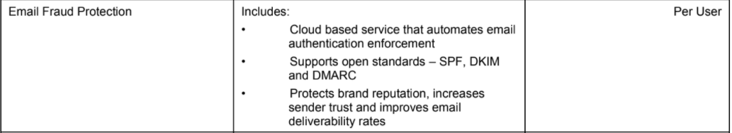
[Add on] Email Fraud Protection (EFP)

Slide 18
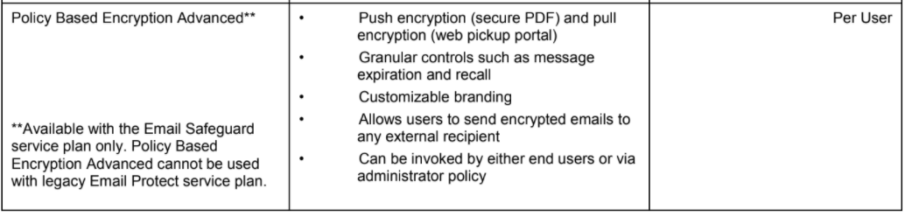
[Add on] Policy Based Encryption Advanced (PBE Advanced)

Slide 19

The Symantec Difference
 | Key Capabilities | Symantec
Prevent | Link Protection
 | Threat Protection Efficacy
Isolate | Comprehensive Malware Isolation (Email, Endpoint)
 | Credential Phishing Protection
Respond | Advanced Threat Analytics
 | Multi-Vector Correlation & Response (Email, Endpoint, Web)
Prepare | Security Awareness Training
Integrate | Strongest Office 365 Security (Email, CASB, DLP)
 | Holistic Messaging Security (Email, Slack, FB, etc.)

Slide 20
Email Security Differentiators
3. Insights and
Efficacy
Email Threat Isolation
Protects users from advanced phishing attacks by isolating suspicious links and rendering in read-only mode.
Email Fraud Protection
Provides fully automated DMARC implementation for sender authentication, protecting users and brand from email impersonation attacks.
Link Protection
Evaluates suspicious links both before an email is delivered and then again when the link is clicked.
Email Analytics
Allows integration with Symantec or 3rd party platforms, has 60+ data points on both clean & malicious emails, which can be streamed into any SIEM via a granular API.
Global Intelligence Network
Intelligence shared across web, email, endpoint and information protection constantly trains our machine learning platform to prevent new threats
Notes:
ETI - Protects users from spear phishing attacks by isolating suspicious links in emails and prevents users from entering sensitive information by rendering web pages in read-only mode.
EFP - Symantec Email Fraud Protection (EFP) provides fully automated DMARC implementation for sender authentication, protecting users and brand from email impersonation attacks. [SMTP was first defined in 1982]
Link Protection - Competitors rely on blacklists to analyze suspicious links within emails, which means they can only catch known malicious links.
Whereas,
MS does not have Isolation capabilities
MS does not have automated DMARC enforcement
MS relies on blacklisting URLs, Symantec uses real time link following
MS does not have extensive IOC capabilities

