Slide 1

Technical Overview of
Citrix Services

Slide 2
Citrix Cloud =
Citrix Services

Slide 3
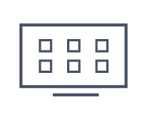
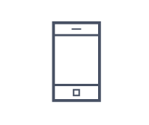





Unified Admin Experience
Citrix Virtual Apps and Desktops
Citrix Endpoint Management
Citrix Content Collaboration
Lifecycle Management
Service
Citrix architects & operates
Apps and Desktops
Mobile App & Device Mgmt
File Sync & Sharing
Design, Deploy, Manage
Citrix Cloud Platform
Cloud Connector
Cloud Connector
Cloud Connector
Customer / Partner architects & operates
Data Center
Public Cloud
Private Cloud

Slide 4
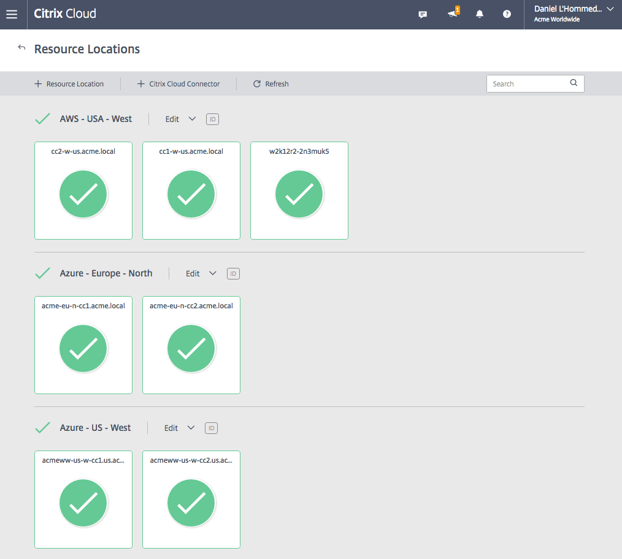
Resource Locations
Create multiple resource locations to manage many datacenters and clouds
Easily view health of connectors in each resource location; view any related alerts and messages
Add/Remove resource locations
Quickly download and deploy new connectors

Slide 5
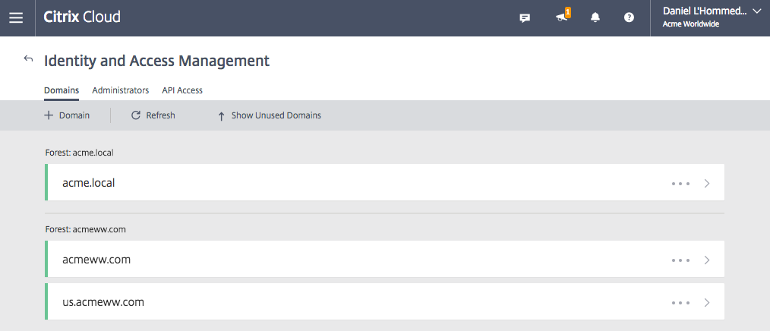
Domains (incl. Azure AD)
Manage one or more domains within each resource location
Cloud Connector discovers domains automatically during deployment
Manage across AD forests, user and resource domains

Slide 6
Citrix Virtual
Apps and Desktops
Service

Slide 7
Traditional Deployment
Studio
Director
License Server
StoreFront/
Receiver for Web
Delivery Controllers
SDaan Akkerman,
QL
SQL
Customer/Partner managed
NetScaler Gateway
Hypervisors
Active Directory
Server VDAs
Desktop VDAs
Server VDAs
Server VDAs
Server VDAs
Server VDAs
Notes:
With Workspace Cloud, the majority of components are now cloud services –customers/partners no longer need to install and maintain them. Citrix operates them at a global scale as part of the cloud control plane.
The customer/partner now only has to locate/install the VDAs and gateway in the Resource Location(s) of their choice – on-premises, in clouds, or any infrastructures . This approach greatly simplifies their effort – and guarantees that the Citrix-operated cloud-based components are always up-to-date.
The connection between the Resource Locations and workspace cloud are established with a “Cloud Connector” that’s deployed from Workspace Cloud itself. The Cloud Connector is a stateless HTTPS-based server that relays commands between Workspace Cloud and services in the Resource Location. No user data (such as desktop sessions) passes through Workspace Cloud – there is no bottleneck there.
Storefronts can be located in both workspace cloud (for cloud-based services) as well as in the Resource Location(s) to provide optimal connectivity and performance.

Slide 8

Citrix Virtual Apps and Desktops
Studio
Director
License Server
Citrix Cloud (operated by Citrix)
StoreFront/
Receiver for Web
Delivery Controllers
SQL
Connector
Customer/Partner managed
NetScaler Gateway
Hypervisors
Active Directory
Server VDAs
Desktop VDAs
Server VDAs
Server VDAs
Server VDAs
Server VDAs
Resource Location
Notes:
With Workspace Cloud, the majority of components are now cloud services –customers/partners no longer need to install and maintain them. Citrix operates them at a global scale as part of the cloud control plane.
The customer/partner now only has to locate/install the VDAs and gateway in the Resource Location(s) of their choice – on-premises, in clouds, or any infrastructures . This approach greatly simplifies their effort – and guarantees that the Citrix-operated cloud-based components are always up-to-date.
The connection between the Resource Locations and workspace cloud are established with a “Cloud Connector” that’s deployed from Workspace Cloud itself. The Cloud Connector is a stateless HTTPS-based server that relays commands between Workspace Cloud and services in the Resource Location. No user data (such as desktop sessions) passes through Workspace Cloud – there is no bottleneck there.
Storefronts can be located in both workspace cloud (for cloud-based services) as well as in the Resource Location(s) to provide optimal connectivity and performance.

Slide 9
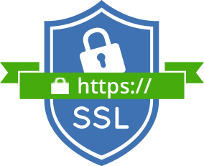
What is the cloud connector?
Bridge the gap between the cloud and the customer's resource location
Internet facing
Simply to deploy; cloud managed
Does not operate as a VPN
All connections are egress (port 443 only)
Supports enterprise web proxies
Secured by service key per-connector
Self updating, evergreen
Cloud Connector
Customer network
Notes:
Message: Designed to operate within your companies current security restrictions. Should not need difficult conversations with teams outside of the Citrix team, it should be install and go.
Key rotation is done on a periodic basis by Citrix. However if a customer needs to rotate keys for some other reason, they can contact Citrix Support and ask. An example would be, if the customer let a senior administrator go and were concerned that the keys may be compromised.
If the Workspace Cloud Connector is multi-homed, ensure that the company’s internal DNS is configured to resolve the connector’s internal address, and configure internal resources to use the DNS address. The external adapter IP does not need a DNS entry.

Slide 10
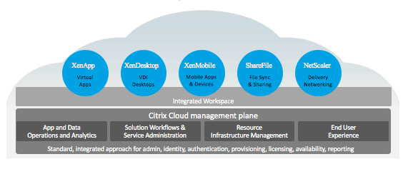
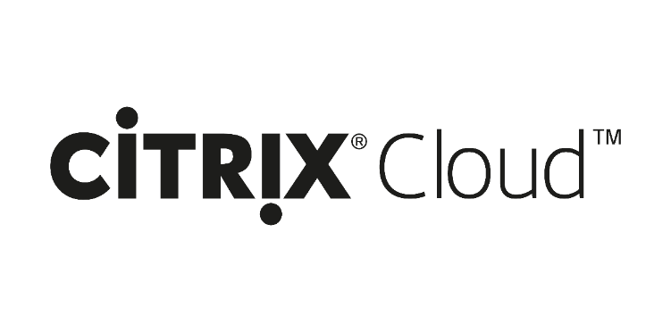

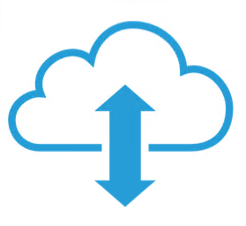
Connector Communication
Citrix
Citrix
Citrix
Citrix
Citrix
Connector to/from the cloud
Messages sent to the connector(s) rendezvous in the cloud at a special cloud service. Messages are then transferred via a Web Socket architecture
These messages are load balanced across connectors
Standard HTTPs Web requests
Inbound
HTTPS / API Calls
Binary Encoded Message Passing
Outbound
…

Slide 11
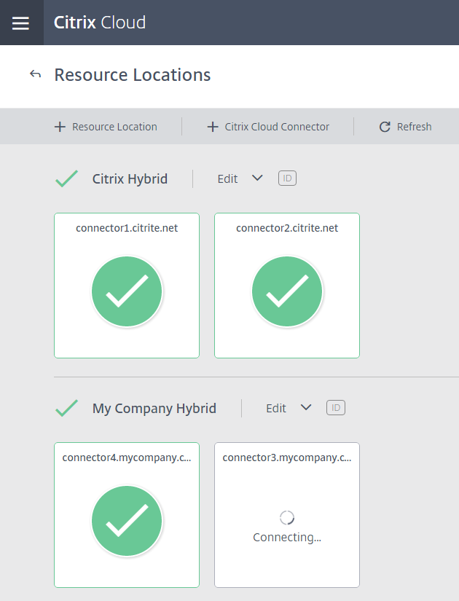
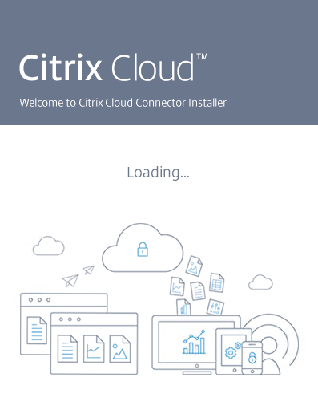
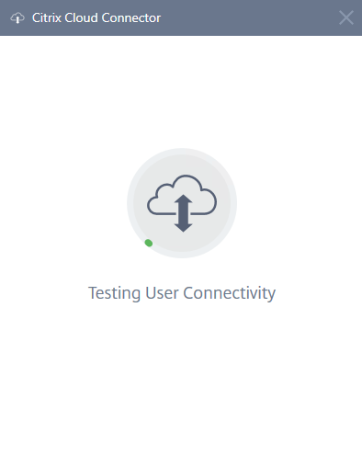
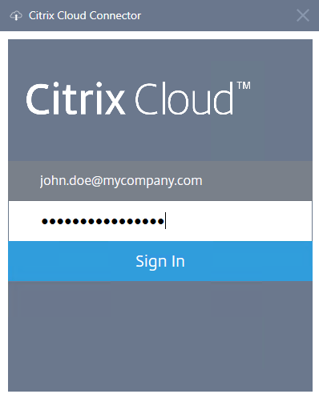
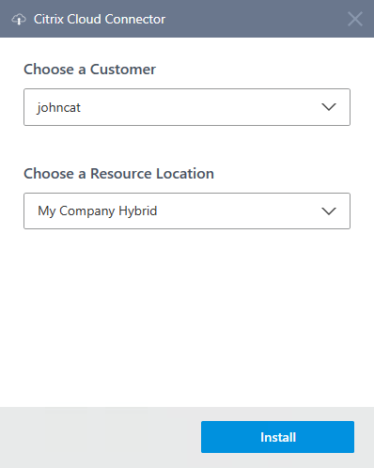
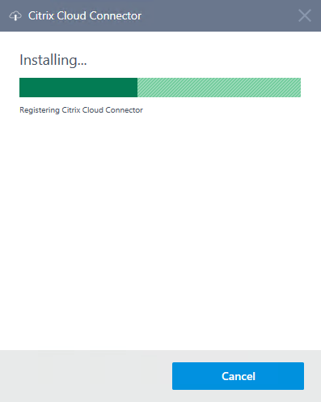
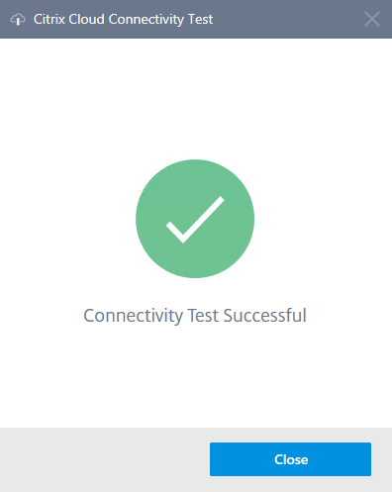
Cloud Connector Install Experience
Kept Simple, with customer experience in mind.

Slide 12

Hybrid Cloud Architecture
Citrix Virtual Apps and Desktops
License Server
StoreFront
Delivery Controller
SQL Database
Cloud Connector
Cloud Connector
Cloud Connector
Cloud Connector
Cloud Connector
Windows Apps
Windows Desktops
Windows
Server Desktops
Linux Desktop
App data
Windows Apps
Windows Desktops
Windows
Server Desktops
Linux Desktop
App data
Windows Apps
Windows Desktops
Windows Desktops
Linux Desktop
App data
Windows Apps
Windows Desktops
Windows Desktops
Linux Desktop
App data
Windows Apps
Windows Desktops
Windows Desktops
Linux Desktop
App data
Azure
NetScaler
ICA Proxy
AWS EC2
NetScaler
ICA Proxy
Microsoft Hyper-V
VMware vSphere
Citrix Hypervisor
NetScaler
ICA Proxy
Azure
NetScaler
ICA Proxy
NetScaler
ICA Proxy
Multiple Public Cloud Options
Multiple Data Center Infrastructure Options
Notes:
A better way to adopt any cloud - by being Inherently multi-cloud, hybrid cloud, multi-site. Unlike single cloud solutions, IT can chose to deploy on standard enterprise infrastructure, on-premises private clouds, a number of off-premises public clouds, or a true hybrid cloud combination
Additional cloud providers and co-located data center service providers not specifically mentioned in this slide can also be used as Citrix Cloud Resource Locations.

Slide 13
What makes it work?
Citrix virtual Apps and Desktops Service
Citrix Gateway Service
Citrix Unified Endpoint Mgmt. Service
Cloud Connector Services Architecture:
Provisioning for managing VM’s and templates on hypervisors or Provisioning Services (PVS)
Proxy for VDA registration and communication
Identity to support domain discovery and access
Authentication to enable user logon and app launch
HTTPS (port 443)
Cloud Connector
Authentication
Proxy
Provisioning
Identity
NetScaler Gateway
Hypervisors
Active Directory
Server VDAs
Desktop VDAs
Server VDAs
Server VDAs
Server VDAs
Server VDAs
Notes:
L:
What makes this service work is a new component called the Workspace Cloud Connector. As the name describes, the connector “connects” all of the components under the customer’s control to the Workspace Cloud service.
The connector eliminates the need for any VPN or IPsec by proxying only the few specific messages needed by the cloud service. As you can see from right to left, this includes:
Active Directory queries. The connector needs read-only access in order to broker users to VDAs. This eliminates the need for any of the components in the cloud to be domain-joined.
Provisioning. To provision VDAs to on-premises hypervisors, the cloud will relay all hypervisor calls through the connector.
VDAs. All brokering traffic between the VDAs and the cloud passes through the connector.
Finally, authentication. The connector acts as a STA, which allows NetScaler gateways to accept connections brokered by the cloud.
The connector is completely stateless, which makes it simple to install. In a few clicks, simply install it on any domain-joined Windows 2012 R2 machine. The connector only needs outbound Internet access and can be deployed behind a NAT. All traffic is sent over port 443, and the connector can even be configured to operate behind an HTTP proxy.
And once installed, the connector is low-touch. The connector includes an auto-update service managed by Workspace Cloud, which ensures it is always patched and up-to-date with the latest features.

Slide 14
Citrix SD-WAN
(fka Branch Repeater, WANScaler)

Slide 15
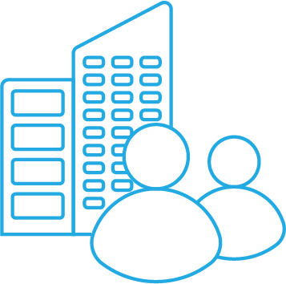
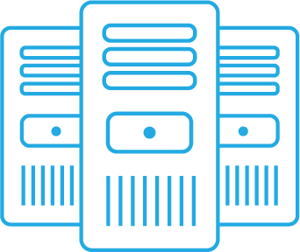

Citrix SD-WAN Creates a Software Defined Overlay …
Virtual logical path is created from diverse links
SD-WAN
Branch
MPLS
Internet
SD-WAN
LTE/Satellite
SD-WAN
Data Center
Branch
Azure
vWAN
Aggregates bandwidth
SD-WAN
Notes:
We start by building a single logical tunnel from diverse network links connecting offices to other offices, data centers or to clouds. While the WAN Optimization feature can bring value with only a single link, for the full SD-WAN functionality, a location should have 2 or more links. Up to 8 links simultaneously. Can be MPLS, Internet, LTE, Satellite, 4G. Single virtual software-defined link for applications.
All the diagrams in this presentation are simple, but the network created can of course be much larger than two sites. The virtual paths can be created from branch to data center, branch to branch or branch to cloud.

Slide 16
… with the understanding of line conditions
With every packet in each path and in both directions,
SD-WAN measures the latency, loss, jitter and congestion
SD-WAN
Branch
latency
loss
jitter
cong.
latency
loss
jitter
cong.
MPLS
Internet
latency
loss
jitter
cong.
latency
loss
jitter
cong.
SD-WAN
LTE/Satellite
SD-WAN
Data Center
Branch
latency
loss
jitter
cong.
latency
loss
jitter
cong.
Cloud
SD-WAN
We build a map of the network.
We measure with real traffic – not probe data.
Notes:
With each packet that passes through the network, we measure the latency, loss, congestion and jitter of every possible connection, in each direction. This intelligence is used for all network decisions and is key to our ability to provide always on branches and high application quality.
And unlike other companies we use all factors in assessing path quality and we measure with real traffic – not probe data.

Slide 17
…To Detect WAN Problems Quickly
Inspect packets to detect brownouts such as latency or loss spikes.
SD-WAN
Branch
MPLS
Internet
SD-WAN
LTE/Satellite
SD-WAN
Data Center
Branch
Cloud
SD-WAN
Detect link failures within just a couple packets
Retransmit and reorder packets
Notes:
If a link goes out, we detect that within just a couple of packets.
Even if there’s not a full outage, we can detect brownouts such as high latency or loss spikes.

Slide 18
…and directs traffic to the best path
Identify each application and direct it to the best path with priority given to critical applications.
SD-WAN
Branch
MPLS
Internet
SD-WAN
LTE/Satellite
SD-WAN
Data Center
Branch
Cloud
SD-WAN
Real-time data such as voice or HDX is put on a low loss, low latency path
File transfers need bandwidth, but don’t need a good connection
Notes:
When a session starts, the packets are directed along the best path, based on those measurements. For example, real time data such as voice or HDX is put on a low loss, low latency path.
Based on the company’s policies, high priority applications are given priority. And each application is assigned a share of the network, preventing low priority applications from chocking out critical data.
And unlike many of our competitors, we treat each MPLS class of service as a separate potential path, allowing us to make maximum use of all available bandwidth.

Slide 19
Ensure critical applications have bandwidth
SD-WAN
Branch
MPLS
Internet
SD-WAN
LTE/Satellite
SD-WAN
Data Center
Branch
Cloud
SD-WAN
How much bandwidth is each app using
Ensure high-priority apps always have bandwidth
Notes:
If the network is congested, the system will make sure that critical applications have adequate bandwidth using bi-directional QoS

Slide 20

Single-Ended QoS Has Pitfalls
10Mbps
Received
WAN
Site A
10Mbps
Site C
10Mbps
10Mbps
10Mbps
0Mbps
0Mbps
Received
Site B
0Mbps
Site D
10Mbps
5Mbps
Quality of service configuration is fairly static
No proactive or reactive actions taken to prevent far-end congestion
Lack of last-mile awareness (destination is a choke point, wasted potential utilization)

Slide 21
End-to-End QoS Ensures Delivery and Efficiency
10Mbps
Received
WAN
Site A
10Mbps
Site C
10Mbps
5Mbps
5Mbps
2.5Mbps
5Mbps
Received
Site B
2.5Mbps
Site D
10Mbps
5Mbps
Manages QoS and prioritization at the branch in addition to the data center, ensuring VoIP and HDX always receive top priority, regardless of where the applications originate
QoS configured globally from a single source, highly customizable
React to network conditions with retransmission and/or redirection
Last-mile awareness prevents oversubscription and wasted utilization

Slide 22

Optionally Duplicate Packets
Across multiple links
Packet Duplication
SD-WAN
Branch
MPLS
Internet
SD-WAN
LTE/Satellite
SD-WAN
Data Center
Branch
Cloud
Automatically turned on for VoIP!
SD-WAN
Notes:
For applications that don’t use a lot of bandwidth but are sensitive to loss (such as voice traffic or HDX thinwire) we can optionally duplicate packets across two different diverse links, ensuring no loss and that each packet takes the fastest possible path.

Slide 23
SD-WAN Makes All Links Active
Bond multiple links
SD-WAN
Branch
MPLS
Internet
Citrix SD-WAN
LTE/Satelliate
SD-WAN
Data Center
Cloud
SD-WAN
Notes:
Large flows such as file transfers or HDX print jobs can use more than one link or MPLS queue for a single session, allowing for better performance and better bandwidth utilization.

Slide 24
SD-WAN: The Best Solution for Virtualized Desktop Delivery
What Other Solutions See
What Citrix SD-WAN Sees
TCP
ICA
User
TCP
ICA
Screen Updates
Local Text Echo
Session Control
Higher
Priority
Lower
Priority
Video
Audio
Drive Mapping
Printing
Sub Channels
Deep visibility into HDX traffic to ensure end users are getting the level of service they require
SD-WAN has access to a proprietary “AppFlow” virtual channel and can peer into the ICA protocol itself
Granular awareness to the Virtual Desktop / Virtual Apps protocol allows for reliable, efficient, and effective delivery across the WAN
Notes:
Why Citrix SD-WAN is unique among WAN optimization solutions when it comes to optimizing Virtual Apps and Virtual Desktop? It is because it is HDX aware.
What does this mean? There are several elements to this…
First, Citrix SD-WAN announces to the Virtual Desktop/Virtual Apps server that it is present on the connection. This allows the Server to shut off its own compression features, thereby reducing server load.
Next, Citrix SD-WAN identifies the HDX traffic and parses it down to the individual sub-channels.
Citrix SD-WAN can de-duplicated even the smallest HDX commands via its nano-matcher algorithm.
And it also ensures proper prioritization is applied on the egress such that real time traffic has a higher priority than background functions.
Sounds simple, but the magic comes from having access to the HDX/ICA protocols and experts at Citrix. This is something that other WAN optimization solutions do not have.

Slide 25
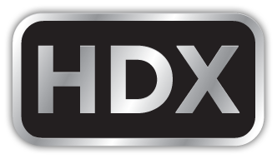



More Reliable HDX Delivery
Real-time
Video, high-res monitors, 3D graphics drive up bandwidth requirements
Smartcard
Interactive
Clipboard
Clipboard
Bulk
MPLS EF Queue
File Transfer
Mobile sensors
HDX
Background
MPLS Default Queue
Citrix SD-WAN
Internet
Citrix SD-WAN
Virtual Apps/Desktops
or VDAs in Azure
Client Host
Reliable connections for virtual apps/desktops, SaaS apps, Unified Communications apps, file sync, etc.
Brownout detection/failover
LTE standby failover
Cross-session tokenized compression (de-dup)
Notes:
Deep ICA classification/prioritizes with MSI enhancement
Time critical VCs use MPLS with DiffServ priority similar to Voice Admit (VA) or Assured Forwarding (AF) Tag
Non - time-sensitive VCs use the Internet and are similar to DiffServ Best Effort (BE) tag
Add points on why it’s better – no one else has it

Slide 26
Better HDX Delivery with Auto-QoS
Real-time
Smartcard
Interactive
Clipboard
Clipboard
Bulk
MPLS EF Queue
File Transfer
Mobile sensors
HDX
Background
MPLS Default Queue
Citrix SD-WAN 10.1
Internet
Citrix SD-WAN 10.1
head-end
Virtual Apps/Desktops
(7.17 or above)
User
Auto-QoS for each ICA stream
Multi-stream ICA
over single port
Moves file transfers and print jobs to slower links and screen refresh/mouse input to high priority links
Reserves bandwidth for HDX
Notes:
We continue to enhance the interoperability between SD-WAN and virtual apps/desktops. In SD-WAN 10.1, we are introducing “Auto-QoS for multi-stream ICA over single port”. This means that SD-WAN is able to not only automatically configure multi-stream ICA mode on XA/XD but also differentiate each stream even with a single-port configuration, thereby simplifying QoS. If the XA/XD server is at least at version 7.17 (March 2018 release), each of the four ICA streams will be classified as a separate “application”, each with its own default class for prioritization. The class is used to determine which packet is scheduled to leave first. SD-WAN’s traffic routing algorithm chooses the optimal path at that moment in time. Real-time and Interactive traffic is sent over the best path, with Bulk and Background traffic forced to other links when there isn’t enough bandwidth on the best path.
This feature supports both EDT (UDP-based HDX proprietary data transport technology with built-in flow control and congestion control) and TCP (alternative industry-standard reliable transport protocol recommended when using WANOP).
SD-WAN takes bulk traffic like file transfers and background activities like print jobs to slower links and keeps real-time and interactive elements like screen refresh/mouse input on high priority links.
SD-WAN also reserves bandwidth for HDX.
Real-time (priority 0) – web conferences, video
Interactive (priority 1) - screen, keyboard, and mouse
Bulk (priority 3) – file transfer
Background (priority 4) – printing

Slide 27
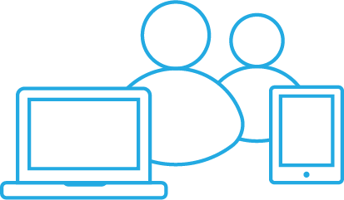
Fairness at the Session Level for HDX
Without Citrix SD-WAN
HDX Traffic
HDX Session 1
Other SD-WAN
Other SD-WAN
HDX Session 2
one user’s massive file transfer won’t impact other users’ sessions
HDX Session N
With Citrix SD-WAN
HDX Traffic
HDX Session 1
HDX Session 2
Citrix SD-WAN
HDX Session N
Citrix SD-WAN
Notes:
Citrix SD-WAN ensures that no single HDX user consumes more than a fair share of the available network bandwidth. HDX traffic flows falling in the Interactive class are governed by fair sharing. After Realtime traffic has been serviced, the remaining Sustained Share (%) bandwidth is available for traffic in the Interactive Class, on a fair share basis.
In Standard Edition, fair sharing divides bandwidth equally across all connections in the Realtime class. In WANOP Edition, fair sharing follows a hierarchical model and is achieved across every connection within the HDX service class.

Slide 28
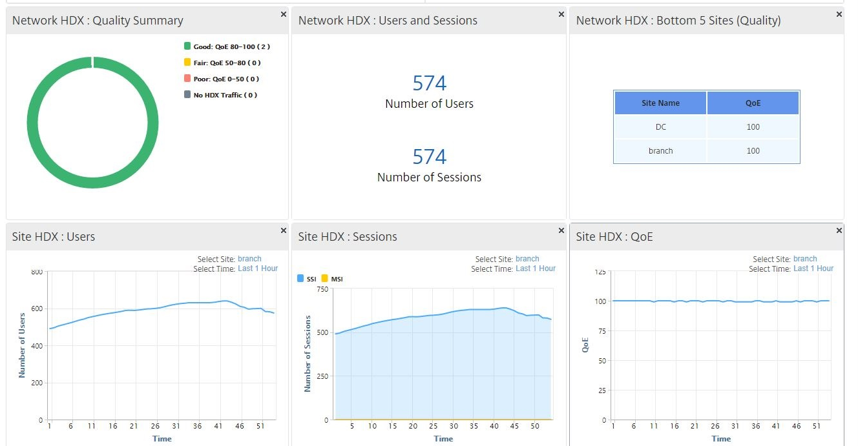
SD-WAN gives Insight into HDX Session Quality of Experience
Based on network conditions
QoE score of 98 and happy users!
Citrix is the only app and desktop virtualization vendor to also provide integrated networking solutions that strengthen the end-to-end digital workspace solution
Notes:
Emphasize troubleshooting
And tuning

Slide 29
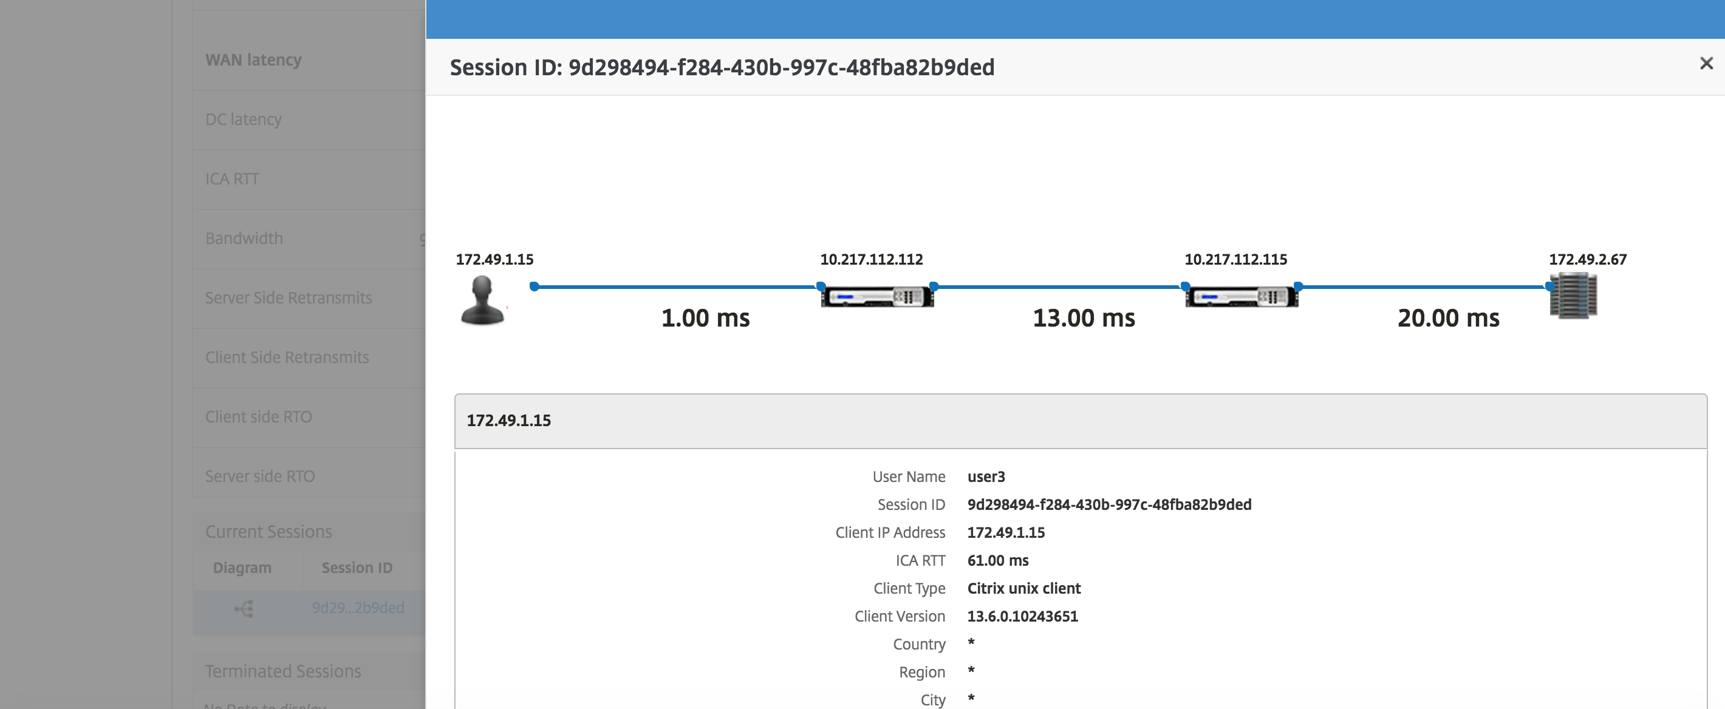
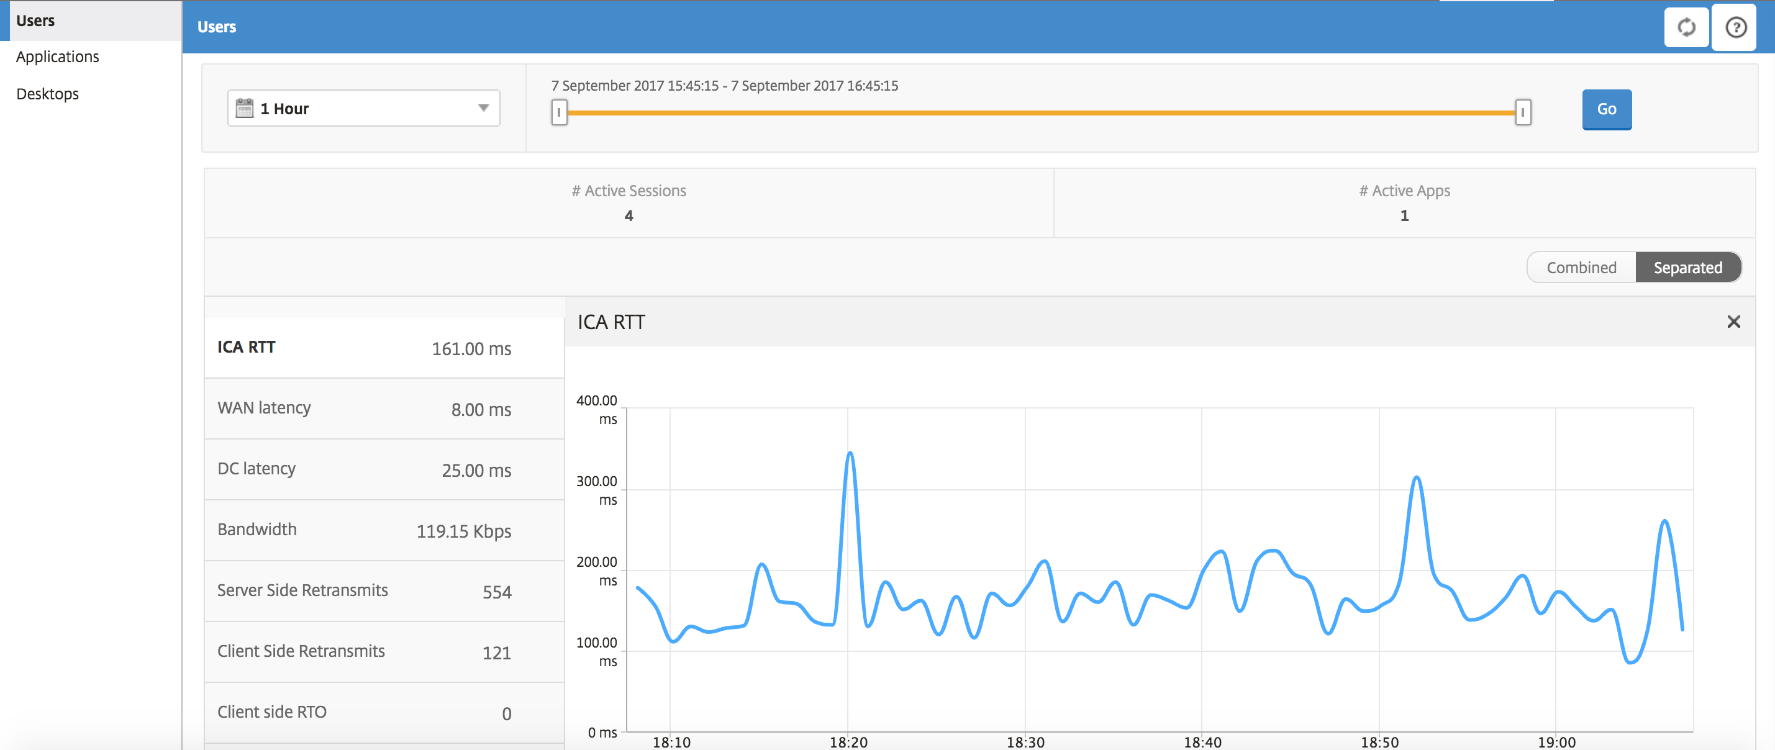
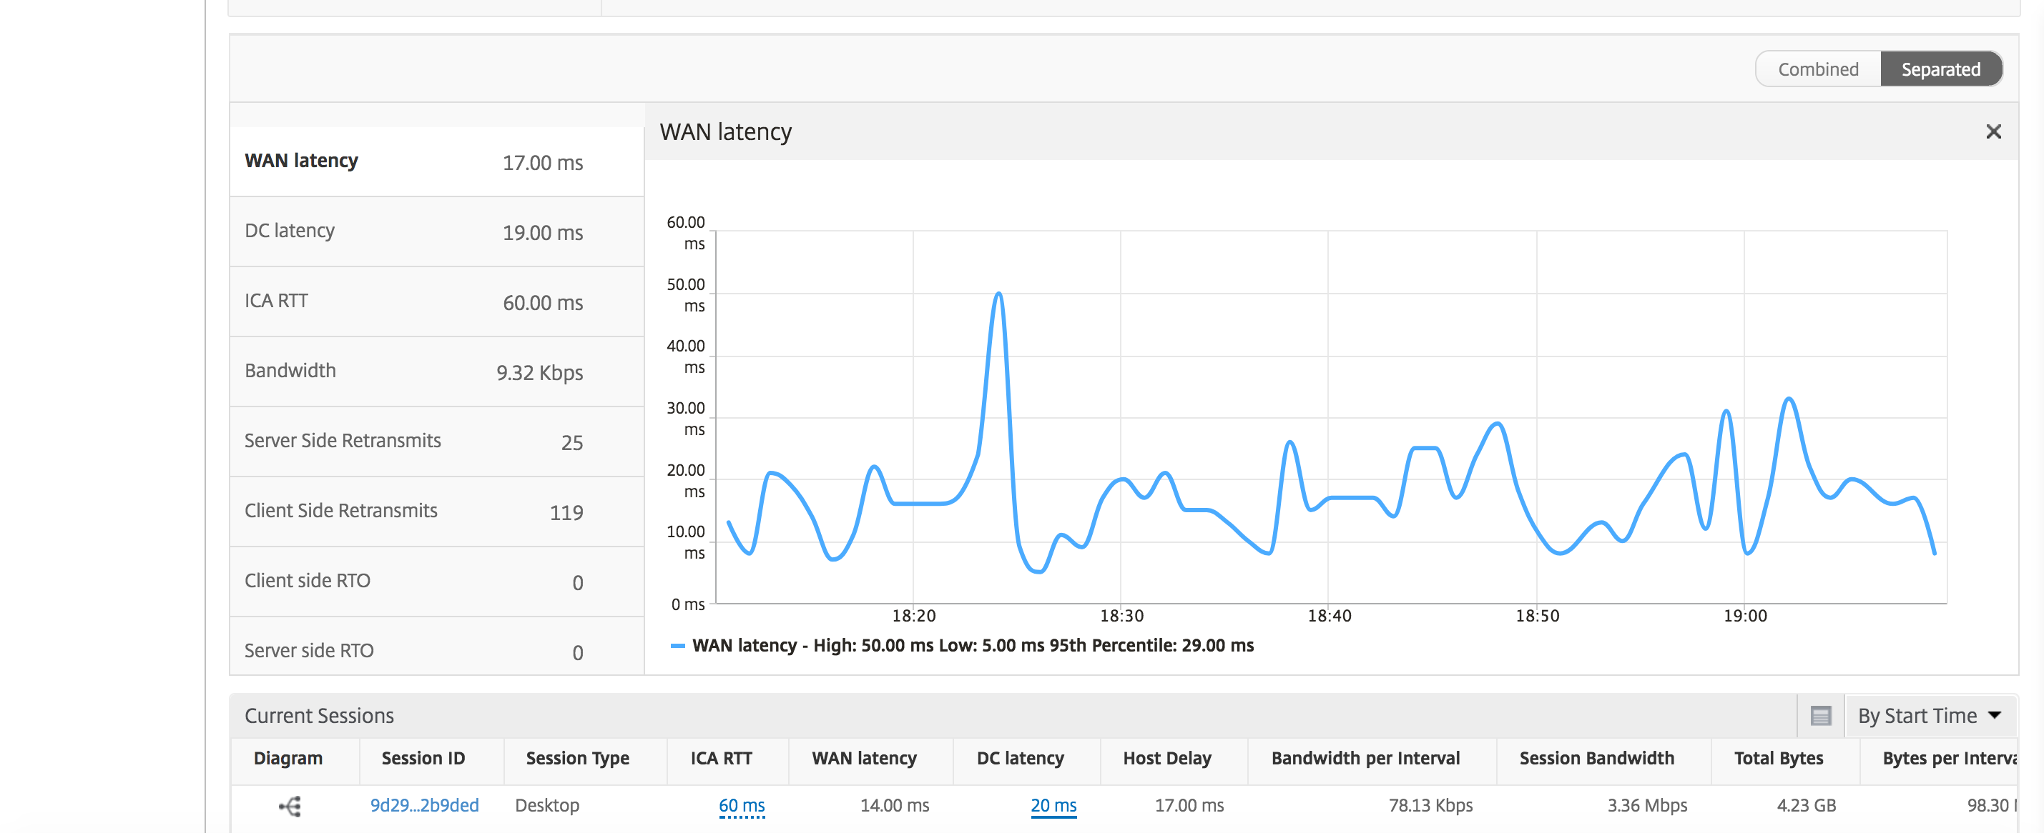
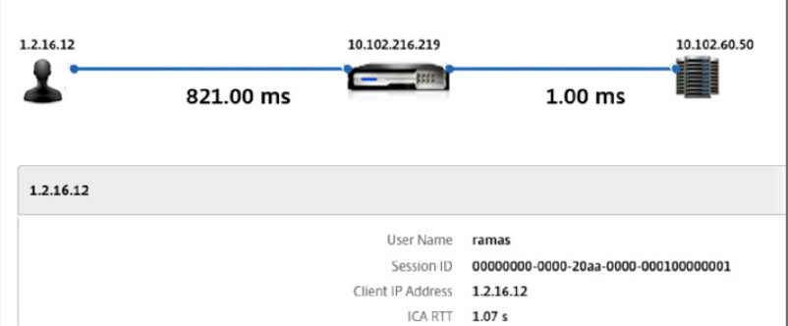
HDX Insight Via Desktop Director
High WAN latency
Notes:
This shows the deployment enhancement with Standard Edition + Application Delivery Management (formerly ADM).
The standard Edition performance impact (if any) is not confirmed yet – will know this around mid June.
The ICA information needs to come from a single device in the network while the L4 information is supplied by every device. The picture shows NS Gateway as the devices supplying this information.
For the HDX Insight support using Standard Edition, please note that we need a Citrix ADC or Gateway at the DC in the connection path (to provide the ICA template in AppFlow). So the license requirement for ADC/Gateway applies. The SD-WAN appliances provide the L4 template to enable the multi-hop HDX Insight. There is no specific license requirement for adding the SD-WAN.

Slide 30
Citrix SD-WAN and Azure Virtual WAN (preview)
MSFT global network:
130 edge sites
54 Azure regions
Fast and simple
  Bring Your Own Network
  Automated (API integration)
  Large-scale connectivity (cloning)
  Policy management and analytics
w
A
Azure vWAN controller
A
w
A
w
API
Citrix SD-WAN VPX
Always-on Connectivity
  Link ”brownout” detection
  Advanced QoS/QoE
  Audio Packet Duplication
  Link bonding
MPLS,
Internet, LTE
Citrix SD-WAN
Branch
Notes:
Azure Virtual WAN is like a self-driving flying car that goes directly from your house (branch) to your destination (Azure) without having to follow old roads. They can automatically space themselves out to allow maximum traffic flow. These flying cars can also speed up or down to reflect changing traffic conditions so everyone gets where they’re going faster.
BYON ((bring your own SD-WAN) setup shop anywhere without relying on carrier w/high-quality connectivity)
Microsoft Virtual WAN targets point of sales locations (ATM machines, convenience stores, mall stores) and small branch offices (warehouses, remote offices) that are reachable mostly by public internet.
SD-WAN is purpose-built for these types of deployments
In a nutshell, SD-WAN is a new access technology that takes advantage of the ubiquitous internet (both direct internet access and LTE) and enables direct connectivity to cloud-hosted applications. SD-WAN's high-performance comes from its dynamic and adaptive ability to route packets based on the application behavior; thereby, ensuring higher-quality of experience at all times.
By choosing SD-WAN as the on-ramp to the Azure cloud, Microsoft enables its massive customer base to connect securely and easily to its global hub of data centers.
Citrix has partnered with Microsoft to provide the Azure Virtual WAN service solution to quickly on-ramp to Azure. Azure vWAN automatically configures access for Citrix SD-WAN and the Azure network, quickly easing the access.
The combined solution simplifies and automates large-scale branch connectivity. It can be do-it-yourself or managed as a cloud service with built-in automation.
Cohesive network policy management with deep analytics; allows automatic information sharing between Azure head-end and the on-premises SD-WAN device. Scaling is much easier with support for template-based cloning.
Optimized routing using Microsoft’s global Network – Microsoft’s large private network within Azure accelerates content and application delivery through these optimized routes, resulting in significant user experience.
Simplified and automated large-scale branch connectivity
Citrix SD-WAN and Microsoft Azure Virtual WAN joint solution can be deployed as a complete SD-WAN service stack that simply works better together. It can be operated as a do-it-yourself SD-WAN or managed cloud service with built-in automation that simplifies small point-of-sale (POS) networks to large-scale branch-office network deployments.
Cohesive network policy management with deep analytics
The integration of Azure Resource Center and Citrix SD-WAN Center allows automatic information sharing between the Azure head-end and the on-premises SD-WAN device. It enables cohesive policy management with deep link-usage analytics. Additionally, Citrix SD-WAN makes network expansion at a massive scale much simpler by supporting template-based cloning.
Optimized routing using Microsoft’s global network
Microsoft’s large global private network within Azure accelerates content and application delivery through its optimized routes, resulting in significant improvements of the user experience and workspace productivity
Controller is an orchestrator (interface to user and translates to SDN/NFV language) – instructs network elements (VPN concentrator/IPsec concentrator or SD-WAN VPX)
ARC
API to interface with/talk to orchestrator.
On SD-WAN side, use VPX

Slide 31
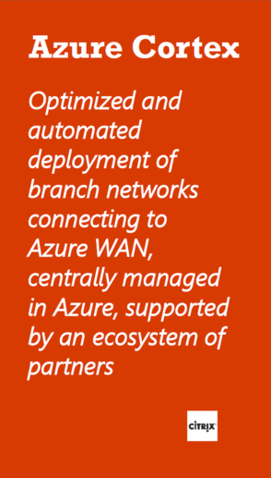
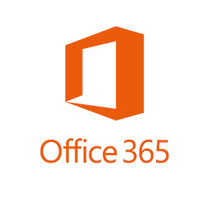
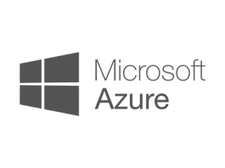

Citrix SD-WAN and Azure Virtual WAN (preview)
MS operates one of the world’s largest private network
Fastest growing cloud provider
2nd in market share
Hundreds of datacenters
Serving 54 regions
1+ Bilil Active Directory subs
vWAN addresses the last mile connectivity challenge
Azure
Virtual WAN
vNet
vNet
Internet
vWAN
vWAN
vWAN
Citrix SD-WAN
Notes:
Q: What is Azure Virtual WAN from Microsoft?
Azure Virtual WAN is a new service which provides optimized, automated and global-scale branch connectivity. This brings the ability to seamlessly connect to Azure using SD-WAN or IPSec VPN from branch locations, providing built-in ease of use and automated set-up.
Q: What has Microsoft announced?
Microsoft has announced the public preview of the Azure Virtual WAN Service
(https://azure.microsoft.com/en-us/blog/announcing-public-preview-of-azure-virtual-wan-and-azure-firewall/). Microsoft has announced two preferred SD-WAN partners: Citrix and Riverbed.
Q: Why do customers need this solution from Microsoft?
Azure Virtual WAN provides a better networking experience by taking advantage of Microsoft’s private global network. Traffic from branch office enters Microsoft’s network at the closest of 130 edge sites. Once customer traffic is in the Microsoft global network, it terminates in a virtual hub. An Azure Virtual WAN can be composed of multiple virtual hubs. Customers can create their own hubs in different Azure regions and take advantage of Microsoft backbone network to interconnect them.

Slide 32
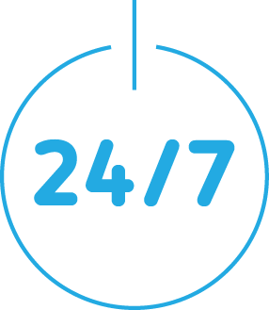



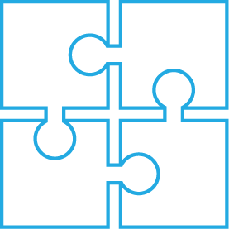

Citrix SD-WAN versus Traditional WANs
(Fractional Leased Line and MPLS)
Reliable Connectivity
Better User Experience
High Functional Integration
Full-Stack SD-WAN As-a-Service
Integrated Security
Cost Effective
With Citrix SD-WAN
Traditional Branch Office WAN
Cloud Managed
Zero touch provisioning
Stateful packet mirroring for high-availability
WAN optimization and ADC integration
Intelligent cloud path steering
Accelerated-SLA based on application-defined path
3rd party VNF hosting (Citrix SD-WAN 1100 in Q1 ‘19)
Dynamic security service insertion
Provider managed
Location dependent
Limited security features
No WAN optimization
Circuit-defined path
Site-to-PoP SLAs
Requires onsite reconfigure
High Priority
and Availability
Segmentation
DCI VPN
Firewall
Enhanced SaaS
Security

