Slide 1

Advanced Threat Protection with F5 and FireEye
Notes:
Welcome, today you nay have recently heard about the partnership between F5 and FE.
This partnership brings 2 leaders in app delivery and security together to help customers address the most daunting security challenges today. It goes beyond tech integration to provide a unified approach to engagements and solution delivery to deliver an overall great experience to customers.
Today we are going to cover the first step in our partnership, our betrter together advanced threat protection solution;

Slide 2
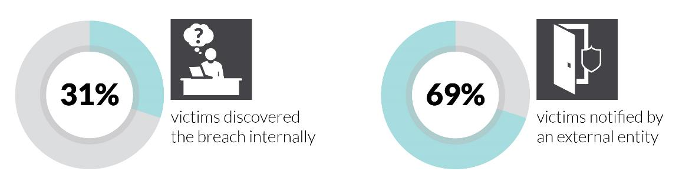
Only 3 in 10 Organizations Detected Breach on Their Own
How Organizations Detected They Were Compromised
This remains largely unchanged from the previous year, where 33% of victims discovered the breach on their own.
Source: Mandiant M-Trends 2015
Notes:
Mandiant, a fireeye company, provides an annual report called M-Trends Report.
In last years M-Trends report we noted that cyber security had gone from a niche IT issue to a boardroom priority. This year, cyber security (or perhaps more accurately, cyber insecurity) entered the mainstream.
Mandiant consultants’ role as the first responders to critical security incidents gives us a unique vantage point into how attackers’ motives and tactics are changing.
Sixty-nine percent learned of the breach from an outside entity such as law enforcement. That’s up from 67 percent in 2013 and 63 percent in 2012.
M-Trends report may be found here: https://www2.fireeye.com/WEB-2015-MNDT-RPT-M-Trends-2015_LP.html?src=f5_preso

Slide 3
While Organizations Are Detecting Attackers Sooner, the Typical Incident Saw Attackers Present for 6+ Months
The longest time we detected attackers had been present in the victim’s environment was 2,982 days (over 8 years).
Source: Mandiant M-Trends 2015
Notes:
Organizations made some gains, but attackers still had a free rein in breached environments far too long before being detected—a median of 205 days in 2014 vs. 229 days in 2013.
Taken together, these developments paint a threat landscape that is more complex than ever. The ability of security teams to prevent, detect, analyze, and respond to threat actors has never been harder—or more crucial.

Slide 4

Understanding the Attack
ATTACKERS UTILIZE MULTIPLE VECTORS
AND MULTIPLE FLOWS TO COMPLETE THEIR MISSION
Notes:
It’s like a game of cat and mouse: security teams put new defenses in place, and then attackers change their tactics. This continued in 2014. We saw more intrusions that used VPNs to maintain access to victims’ environments. We also saw clever new techniques to evade detection, and new tools and tactics to steal credentials and move laterally throughout a compromised environment
THE TAKEAWAY: Advanced threat actors continue to evolve their tools and tactics to reduce the forensic footprint of their activities and evade detection. Targeted organizations need to ensure that they maintain capabilities for both real-time monitoring and “look-back” forensics capabilities across endpoint systems, log sources, and network devices. Establishing a baseline of normal activity in an environment, and proactively hunting for deviations from this baseline, are essential to stay a step ahead of intruder’s efforts.

Slide 5
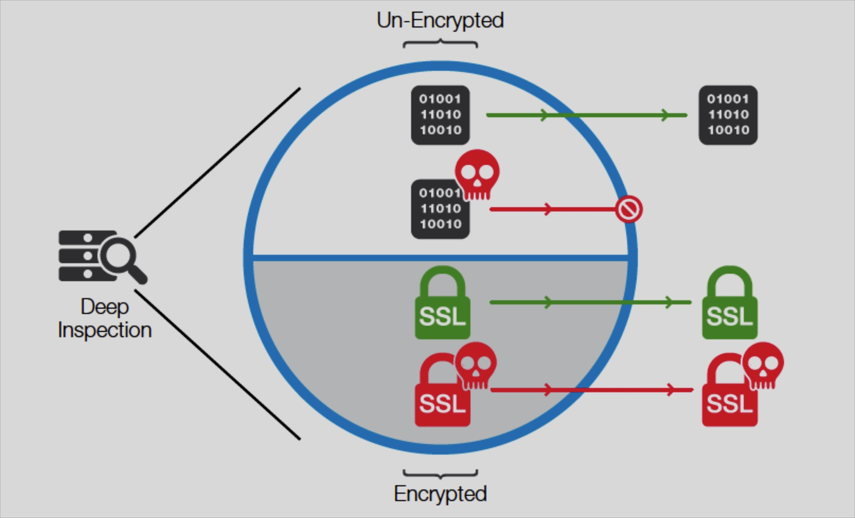
As Defenses Evolve, Attackers Adapt and Innovate
SSL the New Threat Vector
  Spotlight on the Game Changers
  Year over year growth in SSL traffic is not stopping
  New SSL protocols and ciphers can break security products
  80% performance degradation with SSL on NGFWs
  Stealthy Techniques
  Attackers continued to use novel techniques to deploy and hide web-based malware
  Shells planted on servers use SSL encryption to evade network monitoring
  Because the victims had not configured their network architectures to permit security tools to inspect SSL traffic, the attacker’s actions went undetected
“We expect this trend to continue, especially as more organizations adopt SSL encryption for all Internet-facing web services.”
Mandiant 2015 M-Trends Report
Notes:
SSL is growing due to data breaches, compliance and data privacy. SSL Growth presents a challenge for our customers. Compliance is complex and costly. Increasing frequency of ssl attacks and ssl encrypted payload attacks is stressing IT Ops. Enabling SSL on NG security products impacts performance.
SSL Provide security and privacy however it is a double edge sword as it can become a new threat vector for attacks.
SSL traffic is projected to reach 64% by 2016 which is up from 2014 which was 29%. That is more than double the encrypted traffic traversing the networks.
Source: 1 Sandvine, Global Internet Phenomena Spotlight: Encrypted Internet Traffic
In the M-Trends report Mandiant studied several cases in which attackers cleverly installed their webshells on servers that used secure-socket layer (SSL) encryption. As result, all requests to and from the backdoor were encrypted with the server’s own legitimately installed private key. Because the victims had not configured their network architectures to permit security tools to inspect SSL traffic, the attacker’s actions went undetected
We expect this trend to continue, especially as more organizations adopt SSL encryption for all Internet-facing web services.
Cyber criminals are growing more sophisticated and evasive in their attacks. As SSL becomes the de-facto standard for all Internet traffic, hidden threats such as malware pose a risk to uninspected SSL traffic. Attackers use novel techniques to deploy and hide web-based malware. Because traditional network architectures are built for little or no encryption, attackers plant SSL-encrypted malware on compromised servers to evade network monitoring. Without security tools to inspect SSL traffic, attacker actions can go undetected.
Other trends are spelled out in the M-Trends report. We encourage everyone to contact their local Fireeye rep or follow the link below to get the full report
M-Trends report may be found here: https://www2.fireeye.com/WEB-2015-MNDT-RPT-M-Trends-2015_LP.html?src=f5_preso

Slide 6
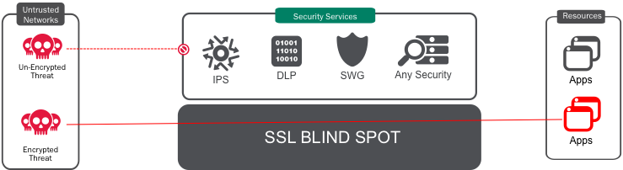
SSL Intercept
Typical Architecture – Built for little/no encryption
80%
Degraded
with SSL
SSL traffic is predicted to double this year
Impacts ability to identify behaviors or recognize exfiltration across all ports
80% performance degradation with SSL on NGFWs
Organizations do not want to move their certs to unknown platforms
Network
Blind
Security
Difficult to scale for
“Defense-in-Depth”
and more capacity
App Services &
Load Balancing
SSL
Applications
Difficult to scale
Capacity
Notes:
When we talk to customers they tend to agree that most network architectures are obsolete. They are not built for SSL encryption. Customers agree there is a trend on moving to %100 encryption and a new architecture is needed to overcome the challenges of security in an all encrypted world

Slide 7
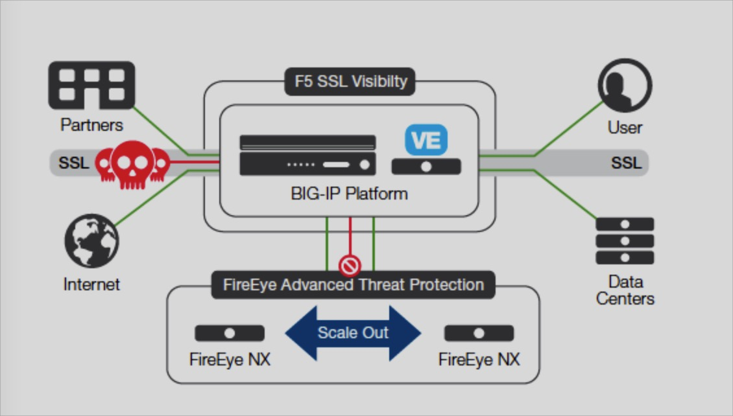
Advanced Threat Protection with F5 and FireEye
  The Transition to an All Encrypted World
  Un-inspected SSL traffic poses a risk to hidden threats like malware
  The traditional network architecture is built for little or no encryption
  SSL stresses the overall efficiency, security and performance of the infrastructure
  F5 Key Differentiators
  Hardware acceleration for high performance SSL visibility
  Provides firewall segmentation and key protection as an integral part of the design
  Decrypts SSL on any port. Many attacks use ports other than 443.
  Bypass URL categories dynamically and statically for flexible policy control
Key benefits
Find hidden threats with SSL visibility
Deliver advanced threat protection with greater scalability
Enhanced architecture for more efficient operations
Notes:
Accelerate your business growth without increasing the risk of cyber breaches. Comprehensive perimeter security solutions from F5 and FireEye provide threat protection, application delivery, and best-of-class products integration. These joint solutions offer the highest service availability and performance with the most effective technology, intelligence, and expertise to identify and stop malicious activity.
Finding hidden threats with SSL visibility
Leveraging the URL filtering and SSL inspection capabilities of the F5® BIG-IP® platform, select traffic can be decrypted, inspected by FireEye NX appliances, and then re-encrypted. This delivers enhanced visibility to potential threats traversing the network.
Performance, scale, and high availability in heavy network traffic environments
Enterprises with substantial traffic loads can optimize FireEye deployments by using the health monitoring, load-balancing, and SSL offload capabilities of the BIG-IP platform. This enables FireEye to scale and protect against Advanced Persistent Threats (APTs) in the most demanding application environments.
Enhanced security architecture
The F5 SSL inspection, URL filtering, and FireEye NX integration provide a foundation for enhanced security. For example, the SSL visibility and control, performance, and scale benefits can be extended to other offerings, including F5’s on-premises web application firewall, BIG-IP® Application Security Manager™ (ASM)—and FireEye’s intrusion prevention system, FireEye Multi-Vector Virtual Execution (MVX).

Slide 8
FireEye Advanced Threat Protection

Slide 9






FIREEYE ADAPTIVE DEFENSE
TECHNOLOGY
IDENTIFIES KNOWN, UNKNOWN, AND NON-MALWARE BASED THREATS
INTEGRATED TO PROTECT ACROSS ALL MAJOR ATTACK VECTORS
PATENTED VIRTUAL MACHINE TECHNOLOGY
INTELLIGENCE
DISCOVERED 20 OF THE LAST 30 ZERO-DAYS
LINE INTEL FROM INCIDENT RESPONSE
MILLIONS OF NETWORK & ENDPOINT SENSORS
HUNDREDS OF INTEL AND MALWARE EXPERTS
HUNDREDS OF THREAT ACTOR PROFILES
EXPERTISE
“GO-TO” RESPONDERS FOR SECURITY INCIDENTS
HUNDREDS OF CONSULTANTS AND ANALYSTS
UNMATCHED EXPERIENCE WITH ADVANCED
ATTACKERS

Slide 10
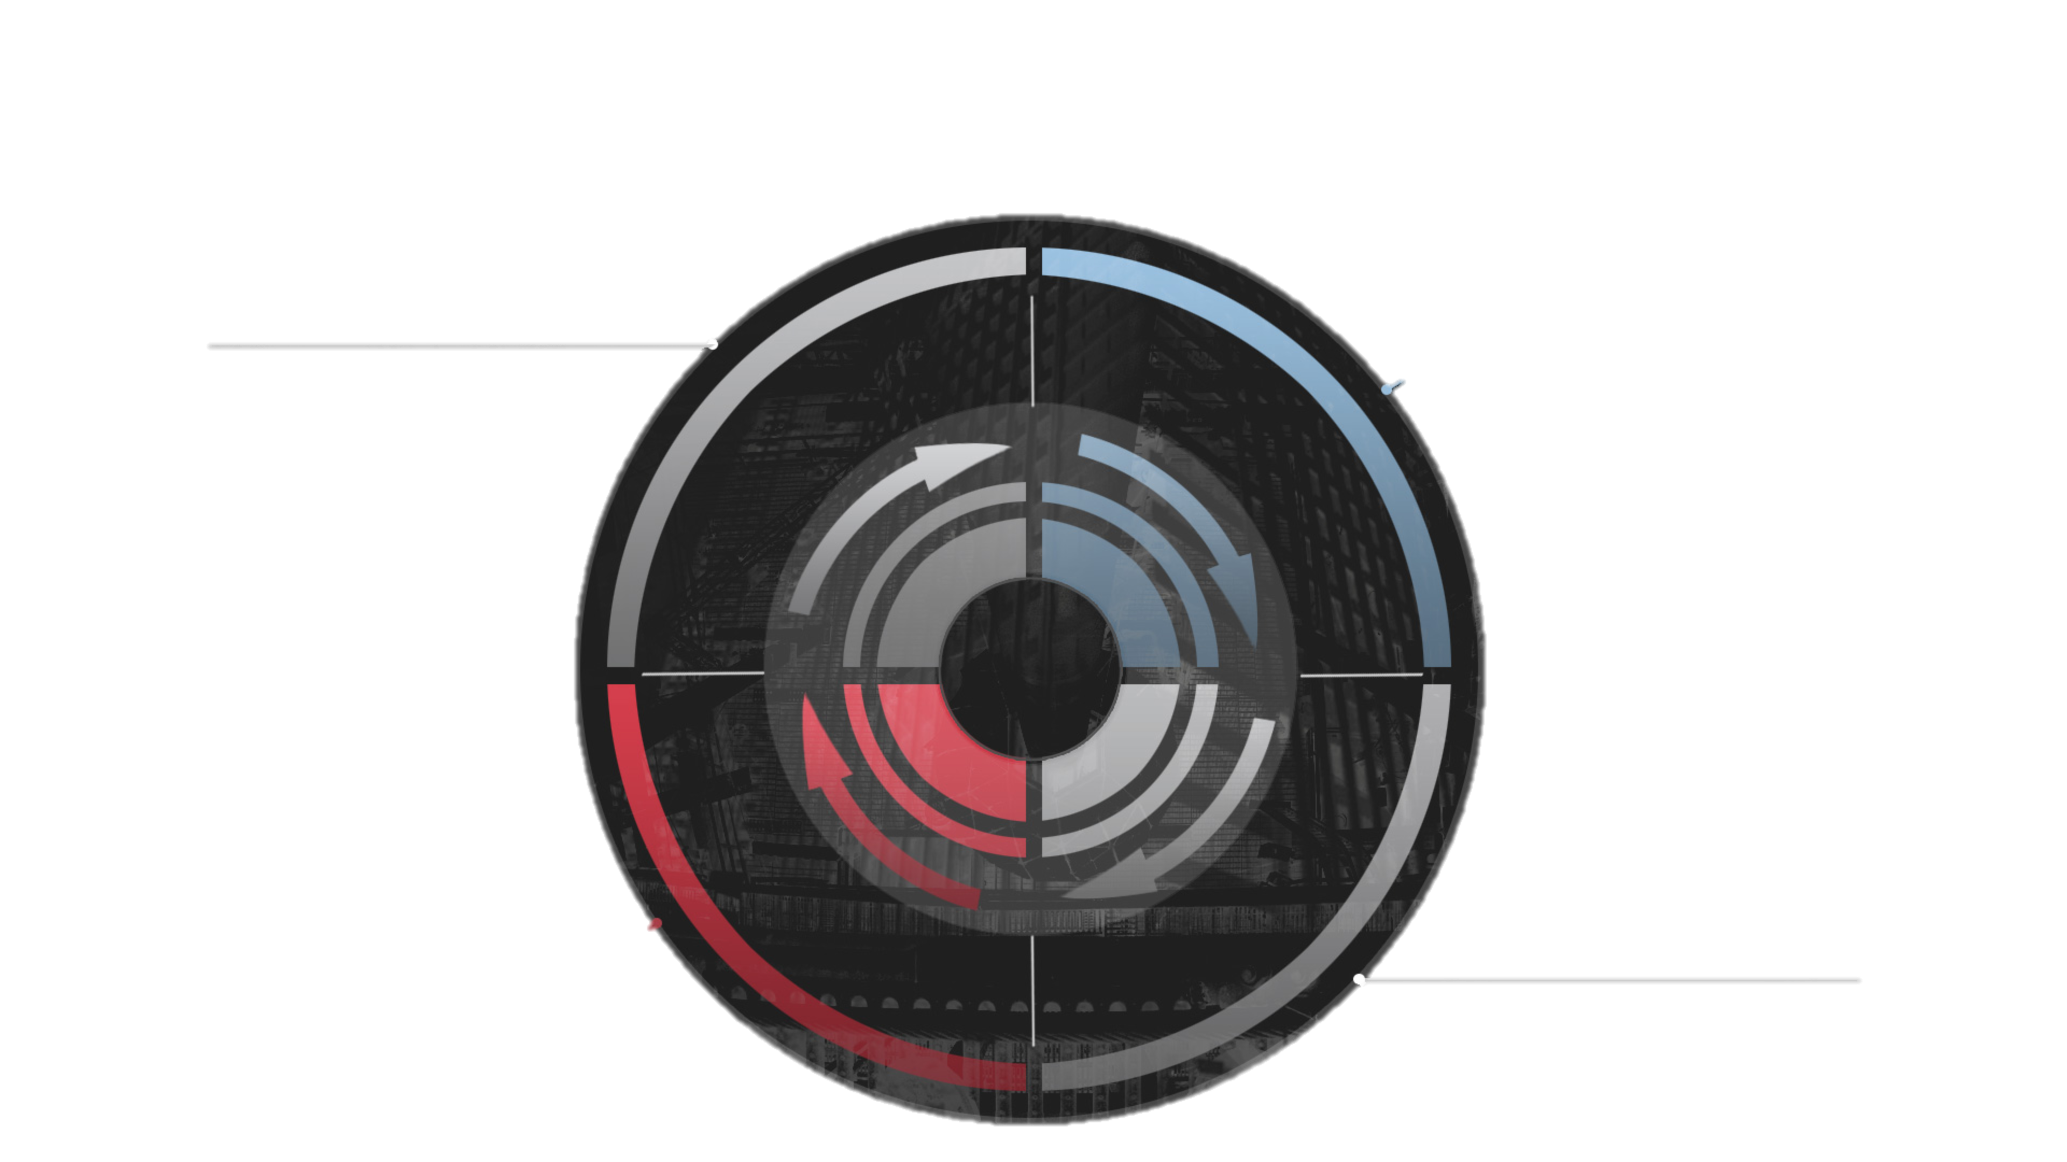

SIGNATURE-LESS AND MULTI-FLOW VIRTUAL MACHINE BASED APPROACH THAT LEVERAGES SUPERIOR THREAT INTELLIGENCE
FIREEYE CONTINUOUS THREAT PREVENTION PROCESS
RESPOND ANALYZE
DETECT PREVENT
DETECT
PREVENT
SIGNATURE-LESS AND MULTI-FLOW VIRTUAL MACHINE BASED APPROACH THAT LEVERAGES SUPERIOR THREAT INTELLIGENCE
MULTI-VECTOR INLINE KNOWN AND UNKNOWN THREAT PREVENTION
RESPOND
ANALYZE
REMEDIATION SUPPORT AND THREAT INTELLIGENCE TO RECOVER AND IMPROVE RISK POSTURE
CONTAINMENT, FORENSICS INVESTIGATION AND KILL CHAIN RECONSTRUCTION
Notes:
Of course “Detection to Response in Minutes” could sounds like just a slogan unless you put some substance to back it up. That’s what I will talk about next. First, as with most things you process is key – a continuous threat prevention process. It’s continuous because the attackers are always there. So if you were attacked today, and you manage to detect it and get the attacker out, there is no reason you will not be attacked tomorrow. This is a business process like everything else you do in your business. And it has to be continual to be effective. And that means it has to have the appropriate technology, the appropriate staff so it can operate like a regular part of your business and not some fire drill.
So what are the phases you need to care about?
Well, you definitely care about detection. Can you identify as early as possible that you’re being attacked? And we’re absolutely providing that in our solution. We’ll talk about that in just a minute.
You do want to have some prevention. When I say prevention, understand that you can’t prevent every attack outright. But there are many that you can. And if you can, and you’re slowing the attacker down because perhaps a piece of malicious software gets into the victim environment but it can’t communicate back to the bad guy, you prevented or blocked it, or contained it to the impacted system, fantastic. Now you’re reducing the attacker’s agility. That’s an important step in the process.
You have to be able to analyze. So if you see that attack, you can’t just say “oh, I probably prevented it.” You need to go and look and find out for sure. And if you don’t go and look and find out for sure, you’re contributing to the 205-day statistic. You need to analyze and investigate to find out for sure, and scope whether you have problem.
And if you do have a problem, you ultimately at the end of the day need to respond to it. You have to remediate. You need to contain the systems involved. You need to get the attacker off of your network. And you can only effectively do that when you understand the full scope of their activities. That’s why analysis is required before you can be effective at responding to the attack.
And then when you’re done, you’re right back into detection. And this is a forever cycle. The attacker doesn’t sleep. They’re not going away. You have to do the same thing. This is how FireEye is thinks about this problem. Our solutions then assist you in applying it in your environment as well as measuring it for effectiveness so you can improve it.

Slide 11









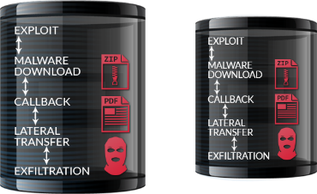
DETECTION AND PREVENTION – TECHNOLOGY
WITHIN VMs
ACROSS VMs
CROSS ENTERPRISE
© F5 Networks, Inc
11

Slide 12
F5 SSL Everywhere

Slide 13
The New Perimeter Is An App Perimeter
Apps Are The Gateway to Data!
Traditional
F5
APP
SSL
App
SSL
SSL
Traditional Network Perimeter
Per-APP / PER-user Perimeter
SSL-visible | ✖ | ✔
Location-independent | ✖ | ✔
Session-based | ✖ | ✔
Continuous trust verification | ✖ | ✔
Strategic control points | ✖ | ✔
App availability | ✖ | ✔
It’s time to rethink security architectures

Slide 14
F5 Architecture For The New Perimeter
Full Proxy defense against advanced security threats
Evaluate Context
  User, device, location, etc.
  Behavior
  Threat risk vs. app value
Chain Security Services
  SSL inspection
  Access & app protection
  Partner ecosystem
Execute Protection
  Performance & scalability
  Hybrid delivery
  Per-app defense
Inspection Zone
User Side
Evaluate Context
Risk
Reputation
Behavior
Application Protection
Application Access
App Side
Location
User/Device
Execute Protections
Chain Services
Firewall
Strong auth
WEB APP FIREWALL
URL FILTERING
1
2
3
Deployment Modes
Router
Clone / Mirror
ICAP / Proxy
L2 Bridge
NGFW
IDS
Data Loss Prevention
APT SCANNING
WEB APP FIREWALL
PACKET / FORENSICS
Antivirus
IPS
A foundation for More comprehensive security
Notes:
Need joel’s help

Slide 15
SSL Everywhere
Securing applications with SSL is what F5 excels at. By terminating all traffic at the strategic point of control in the network, organizations can use the scalability and agility of the F5 SSL reference architecture to transform their security service.
Data Protection
Visibility and Control
Key Lifecycle
Proactively protect data with a broad array of encryption options to reduce risk and support for the latest ciphers
Scale SSL across multiple security devices that are either blind or challenged with SSL performance to defend against encrypted threats
Protect high value authoritative keys in hardware to prevent MitM attacks and eavesdropping
Notes:
Securing applications with SSL is what F5 excels at. By terminating all traffic at the strategic point of control in the network, organizations can use the scalability and agility of the F5 SSL reference architecture to transform their security service.
Data Protection
Data protection is a large umbrella that protects multiple services. (More detail on the next slide)
Visibility and Programmatic Control
As described. (More detail in upcoming)
Key Lifecycle
As described. (More detail in upcoming)

Slide 16
Step 2: Highlight the challenges of today’s network
New SSL protocols can break infastructure
Growing SSL stresses performance
New ciphers address high profile vulnerabilities
Compatibility breaks many security products
F5 supports the broadest range of SSL protocols
Multiple decrypt and encrypt points adds overhead
SSL impacts performance by 80% on NGFWs
F5 offers industry leading SSL scale and performance
SSL
Notes:
Data Protection
Data protection is a large umbrella that protects multiple services. The three most significant today include transformational services, cipher agility, and the scalability challenges that will be introduced as the Internet of Things grows larger than the Internet of People. The protocol infrastructure of the Internet is showing its age. Companies like Google are tinkering with the HTTP to reduce round-trip times between the client and server as in the SPDY protocol. The global surveillance issue is also spurring designers to build security right into the protocol itself—for example, HTTP/2.0 will require end-to-end cryptography. These new protocols can be quickly implemented by leveraging an ADC or a similar strategic point of control within the network to speak an enhanced protocol like HTTP/2.0 with the end-user devices—while still speaking a legacy protocol with the back-end servers. New cryptographic protocols are being introduced and gaining popularity F5 has a broad range of supported encryption options allowing us to offer cypher agility.

Slide 17


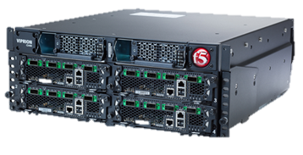
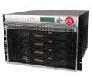
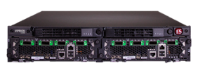





Industry Leading SSL Scale and Performance
BIG-IP 12250v
240K SSL TPS
40G Bulk Tput
VIPRION 4800
240K SSL TPS
160G Bulk Tput
VIPRION 2400
176K SSL TPS
144G Bulk Tput
VIPRION 4480
120K L7 RPS
80G Bulk Tput
VIPRION 2200
88K SSL TPS
72G Bulk Tput
BIG-IP 10200v-SSL
75K SSL TPS
33G Bulk Tput
BIG-IP 7200v-SSL
60K SSL TPS
19G Bulk Tput
BIG-IP 5250v
21K SSL TPS
12G Bulk Tput
BIG-IP 4200v
9K SSL TPS
8G Bulk Tput
BIG-IP 10G VE
3.4K SSL TPS
4G Bulk Tput
BIG-IP 2200s
4K SSL TPS
4G Bulk Tput

Slide 18


SSL Visibility and Control
Next- Gen
Firewall
Next-Gen
IPS
Malware
Protection
Secure Web Gateway
UX
Monitoring
Other…
BIG-IP Platform
Apps
User
Strategic point of control for policy enforcement
Notes:
Visibility
Policy-based traffic steering (IDS/IPS, web analytics, NGFW)
Policy-based traffic steering can be in-line with the web data or passive in the case of monitoring and reporting. Enhancing in-line security solution. An example of policy-based traffic steering made possible by a programmable SSL decryption device (like an ADC) is the built around the intrusion prevention systems (IPS).
A typical IPS excels at matching malicious traffic to thousands of signatures—but is not known for its SSL decryption performance. The goal is to keep the IPS CPU focused on matching signatures and not performing redundant decryption. An ADC can keep the IPS targeted on its strengths by offloading the SSL decrypting for the IPS. When the IPS determines that a particular data source is sending malicious data, it can signal to the ADC that the source is not to be trusted (for a period of time, perhaps 15 minutes). The ADC can then block that source address at the layer 3 firewall level, thereby saving the intrusion detection system (IDS) from having to
monitor more of that traffic and saving the SSL compute cycles on the ADC as well.
Programmatic Control
One of the benefits of the F5 SSL reference architecture is the level of programmability it offers. The granularity of attributes in the BIG-IP LTM SSL profiles and the depth of integration of the F5 iRules® scripting language let administrators write powerful scripts to patch or enhance even complex environments. When the Heartbleed vulnerability struck the SSL community, information security personnel were rushed to protect systems. For some, this meant scanning networks and preparing patches for hundreds or thousands of diverse virtual machines across multiple data centers and clouds. During those difficult initial days, administrators were aided by
many hastily-crafted tools such open-source IDS signatures, Metasploit modules, and nmap plugins.

Slide 19
Comprehensive Key Lifecycle Management
Secure Vault
Internal HSM
Network HSM
Cloud HSM
Software based encrypted storage system for securing cryptographic keys with the highest performance
Physical hardware designed to generate, store, and protect keys with high performance
Integration with leading network based hardware for use with all appliances, chassis, and Virtual Editions
Integration for high-assurance encryption services fit for the cloud.
Enterprise Key and
Certificate Management
Open APIs to automate management for the digital certificate and encryption key technologies used by today’s enterprises
Notes:
Key Lifecycle
Advanced key protection with hardware security modules F5 has offered integration with hardware security modules (HSMs) since the year 2000. These modules were developed specifically for ultra-high security environments where keys must not be compromised. High performance of these cryptographic modules was usually not the point. The devices were also quite expensive, often costing 10x the price of the host computer. The modules worked by allowing the hosting system to generate a key within the cryptographic device and then asking for information to be encrypted or decrypted with it. But the key itself could never pass through to the host in an unencrypted form. As business moved to the Internet, commercial demand for these HSM devices grew rapidly. They were initially deployed in web servers for financial and federal customers all across the world. When SSL decryption was absorbed as an ADC function, the HSM devices moved into the ADCs as well. This movement represented a significant fiscal savings as companies were able to buy fewer HSMs (since a proper ADC can manage thousands of servers). Today, HSMs are becoming network-attached devices. This enables best-of-all worlds for the high-security environment, as security teams have a single place to manage their keys
and organizations can rely and an even smaller number of HSM devices.

Slide 20
FireEye and F5
Comprehensive Solution

Slide 21
FireEye and F5 in a Typical Enterprise Environment
Cloud | Perimeter | Access | App | FireEye
F5 Silverline
Cloud based DDoS scrubbing
Volumetric DDoS mitigation
WaFaaS
Cloud | Perimeter | Access | App | FireEye
Network Firewall with ICSA and EAL4+
On Premises Network DDoS Mitigation
DNS Firewall
SSL Visibility
Cloud | Perimeter | Access | App | FireEye
Secure access from any device
SSL VPN
Context aware access and control
Federated platform
Cloud | Perimeter | Access | App | FireEye
Web Application Firewall
App Security and L7 DDoS Mitigation
Web Scraping and Brute Force Attack
Bot Detection (Human or Machine)
Cloud | Perimeter | Access | App | FireEye
Block Web Based Malicious Files
Block Malicious Web Communication
Advanced Malware Detection
Reduce False Positives
Advanced Threat Protection
Corporate Users
FireEye
NX
App Services
Perimeter Services
Tier 2
Network attacks:
ICMP flood,
UDP flood,
SYN flood
SSL attacks:
SSL renegotiation,
SSL flood
Financial
Services
Multiple ISP strategy
Legitimate
Users
E-Commerce
ISPa/b
Network and DNS
Application
DDoS
Attacker
DNS attacks:
DNS amplification,
query flood,
dictionary attack,
DNS poisoning
HTTP attacks:
Slowloris,
slow POST,
recursive POST/GET
Subscriber
Cloud
Scrubbing Service
Access
Threat Feed Intelligence
Strategic Point of Control
Scanner
Anonymous
Proxies
Anonymous
Requests
Botnet
Attackers
Access
Management
Directory
Services
Notes:
Typical enterprise environment comprises many areas for security as pictured above

Slide 22
Advanced Threat Protection With FireEye and F5
Scale FireEye for
demanding environments
Failover protection
for service availability
Find Hidden Threats in Encrypted Traffic
Protect keys for
data privacy
Lowest TCO and quickest ROI
All backed by world-class support and professional services

Slide 23
Resources
Solution Overview
F5.com FireEye Technology Alliance
FireEye.com Strategic Technology Partner
FireEye and F5 Solution Brief
Recommended Practices
F5 and FireEye Global Partnership Announcement
F5 SSL Everywhere
Reference Architecture
The Expectation of SSL Everywhere – White Paper
The F5 SSL Reference Architecture – White Paper
BIG-IP Hardware
BIG-IP Local Traffic Manager – Datasheet
FireEye
Network Security
Adaptive Defense
An Adaptive Approach to Cyber Threats – White Paper
Network Security – NX Series
Datasheet

Slide 24
Customer Conversation Flow
Close to home
FireEye inspection with mvx
Duration
Discovery
Limitations of existing tools
The “arms race”
Geographically focused
Ripped from the headlines
CISO Focused
SSL Traffic explosion
Cipher diversity
Speed
Signature failure
Time to disseminate detection
FireEye know how bad guys think
The solution is REAL!
Focus on Compliance
Relate to CISO
Pivot
Advanced threats
F5 ssl intercept
Close & next steps

Slide 25
Content and tools
Sales aide | Purpose
Advanced Threat Protection with F5 and FireEye | Sharing the threat landscape and solution details with partners and customers
F5 and FireEye Battle card | Bringing customers up to speed with F5 and FireEye, and each partners value proposition.
F5 and FireEye Deployment Guide | Detailed and comprehensive guide to making architectural decisions and deploying the solution. Use this with prospective customers to win them over
Solution Profile Whitepaper – 4 pages | Business focused discussion of the solution, suitable for inclusion in an email to a partner or customer. Handouts at events
F5 SSL everywhere reference architecture | F5 generated use case for why SSL growth matters
F5 and FireEye on the Web (F5) | Partnership launch details
F5 and FireEye on the Web (FireEye) | Partnership launch details
Using the F5 EBC | F5 and FireEye hardware for demo and making the solution real in the customers eyes. Most all booked sales pass through here.
Sale video (in development) | Video of the solution in action
Executive access, account connection, technical depth, pricing, etc. | The solution is nascent and most times customers need to hear from F5 and FireEye

