Slide 1
Closed Loop Remediation
Security & Shadow IT

Slide 2
Shadow
IT, 10%
5%
11%
5%
8%
Shadow IT
High-Risk and Med/Low-Risk Shadow contain the least sensitive data, at 10%
13%
16%
2%
2%
7%
31%

Slide 3
Negative Implications
15
number of cloud apps IT believes are used today
Shadow
IT
5%
11%
5%
8%
13%
the actual number of cloud apps in use by an average organization
1,935
16%
2%
2%
7%
9%
of shadow IT services in use are high risk
31%

Slide 4
The average organization now uses 1,935 cloud apps
an increase of 15% over last year
Source: McAfee Cloud Adoption Report, Nov 2018
Notes:
There are 1935 different cloud apps being used at your typical company.
That’s 15% more than last year and more than 3 times what we saw just 6 years ago.
If you find that hard to believe, you’re not alone, as I’ll show you in a bit.

Slide 5
Shadow IT Use Cases
1. Discover & Govern
Discover & Coach on use of high risk
Shadow
IT
5%
11%
5%
8%
13%
2. Conditional Access Control
Activity and Instance based access control
16%
2%
2%
7%
3. Data Loss Prevention
Prevent data exfiltration to medium risk services
31%

Slide 6
Secure Web Gateway and CASB convergence
Cloud Access Security Brokers
Secure Web Gateways
Synergic
Efficiency
Integrated Benefits
App Risk
API
Reverse Proxy
Identity
DLP
Malware
App Control
Forward Proxy/ Reverse Proxy
Identity
DLP
Malware

Slide 7
Web Hybrid Architectures
A Preferred Enterprise Solution
Customer Cloud Reasoning
Get out of the IT admin game (server management)
Scalability, Elasticity, Lower TCO…
Global Access
Limited Expertise and Resources
Customer On-prem Reasoning
Critical apps & home-grown apps
Data Protection – On-prem DLP & compliance requirements
100% control – Avoids Shared Responsibility Models
Selectively source from own IP addresses
Avoid cost around log data movement
Information Sharing (TIE & DXL)
McAfee Cloud
Web Gateway Cloud Service
MVISION Cloud
Sandboxing
Global Threat Intelligence
WAN Edge Infrastructure Players
Web Gateway
Sandboxing
VPN
Endpoints
Endpoints
Endpoints
Main Office
Remote Users (MCP, PAC, etc.)
Branch Office SD WAN Edge
Notes:
PS: Zscaler gets around the IP address issue by selling one (dedicated IP) which forces traffic on dedicated IP addresses to manage and unexpected costs, and then it can only go to one datacenter. Lear Sites that allow access from very specific IPs. By having unique IP addresses this helps security and multi-auth options. Having restricted IP addresses impacts global performance – creates a bottleneck… Looks good on paper but the devil is in the details. Added cost, lower performance, lower capability due to their on-prem capability, etc. Not forthcoming about the issues.
WAN Edge Infrastructure Players (1-3 are the MQ leaders, #4 is a visionary – we have customers using all of them)
1. Silver Peak
2. Velo Cloud = VMWare acquired them
3. Viptela = Cisco acquired them
4. Versa

Slide 8
Enhancements For An Enterprise Ready Web Gateway Cloud Service
Connectivity
MCP managed via MVISION ePO
Mobile MCP
Sophisticated connectivity setup for branch offices and networks
SD-Wan partnerships
Web/CASB Convergence
Zero Setup Closed Loop Remediation
Stronger Advanced Shadow controls when using SWG and CASB together in converged offering
Converged administrative experience starting from login to reporting and incident management
Policy
Flexible rules-based policy creation in context of an enterprise’s use cases
Predefined use cases available as online library within UI
Advanced configurations by exposing native policy language (MOWGLI)
McAfee Web Gateway Cloud Service
McAfee Common Architecture
IAM
GPS
MOWGLI
BPS

Slide 9
Web Gateway CASB Integration
Discover all cloud services in use and assess their risk against the comprehensive MVISION Cloud Registry
Enforce acceptable use cloud governance policies based on cloud service security risk
Upload and enforce security policies to McAfee Gateway
Gain granular visibility into user activity and block high risk activities
Detect and remediate policy enforcement gaps arising from proxy leakage
MVISION Cloud
Cloud Registry
Cloud Categorization
Logs
Cloud
Endpoint DLP
Web Gateway

Slide 10
MVISION Cloud (CASB) Integration
Shadow IT Architecture & Closed Loop Remediation (Hybrid Managed)
Remote Users
Web Gateway
Cloud Service
User Traffic
User Traffic
Log Collection
Service Groups
Endpoints
McAfee Client Proxy
Service Group Sync
Shadow IT
On-Premise
Web Gateway
Endpoints
McAfee Client Proxy
Explicit Proxy
Transparent Proxy
User Traffic
MVISION Cloud
Collected Raw Logs
Enterprise
Connector
Tokenized Cloud
Service Information
Published Service Groups

Slide 11
Value of Integrating Web to MVISION Cloud
MWG is able to:
Provide detailed (anonymized) web access log information to Skyhigh
Accept and use subscribed lists edited in MVISION Cloud console
Provides also Protection Level and not only visbility!
Support for gathering information on users utilizing shadow IT services
Perform risk assessment and scoring on Shadow IT service usage
Anonymization by Tokenization-Service (local in Enterprise Connector) – EMEA GDPR need!
Support for coaching and blocking for shadow IT service usage through MWG and WGCS

Slide 12
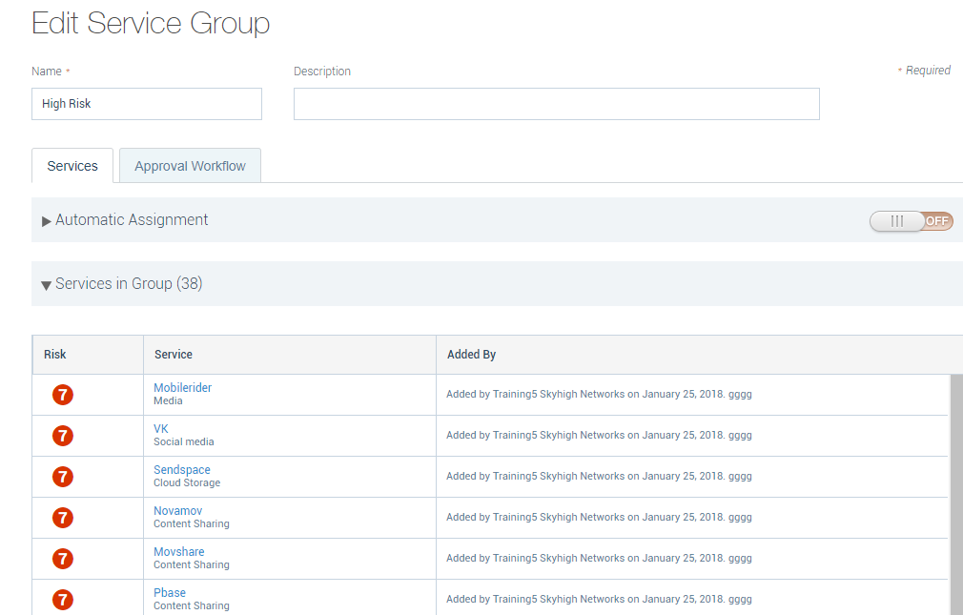
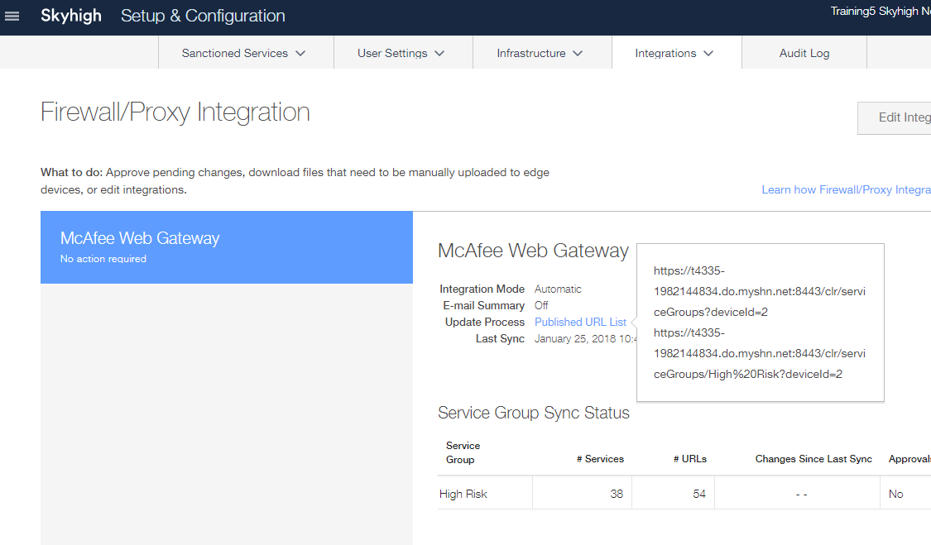
MVISION Cloud Integration
Syslog to EC (setup basically same as SIEM)
EC as subscribed list source
Add services to service group
Configure Integration for group
Use published URL (on EC) as subscribed list source
Notes:
In the SH console you can add Services to a Service Group, e.g. a list of High Risk Services, and then have Skyhigh create a MWG formatted Subscribed list (complete with the type=string header) and publish that on the on-premise Enterprise Connector/GroundLink.
The FQDN for the Subscribed list e.g. https://t4335-1982144834.do.myshn.net:8443/clr/serviceGroups?deviceId=2 resolves to the local Enterprise Connector IP.

