Slide 1
Increase your Collaboration with Azure Automation

Slide 2
Process automation that simplifies cloud management
Optimize and extend existing investments
  Integration
  Integrate into existing systems with PnP integration modules
  Build additional PS modules to enable integrating into other systems
Deliver flexible and reliable services
  Orchestration
  Accelerate time to value with flexible process workflows
Improve service reliability across multiple tools, systems, and department silos
Lower costs and improve predictability
  Automation
Enable service owners to focus on work that adds business value
Reduce error-prone manual activities while lowering costs

Slide 3
The “evolution” of application platforms

Slide 4
What is the right size of
servers for my business needs?
How do I deploy new
code to my server?
What media should I
use to keep backup?
What happens in case of
server hardware failure?
Which packages should
be on my server?
What size of servers
should I buy?
Who monitors
my App?
How often should I
backup my server?
How can I
scale my app?
How can I increase
server utilization?
Who has physical
access to my servers?
Which OS
should I use?
Do I need secondary
network connection?
Are my server in a
secure location?
What happens if the
power goes out?
Who monitors
my Servers?
Do I need
a UPS?
What storage I
need to use?
How many servers
do I need?
How can I dynamically
configure my app?
It takes how long to
provision a new server?
How often should
I patch my servers?
On-Premises
The “evolution” of application platforms

Slide 5
What is the right size of servers for my business needs?
How can I increase server utilization?
How many servers do I need?
How can I scale my app?
How often should I patch my servers?
How do I deploy new code to my server?
How often should I backup my server?
Which OS should I use?
Which packages should be on my server?
Who monitors my App?
On-Premises
IaaS
The “evolution” of application platforms

Slide 6
What is the right size of “servers” for my business needs?
How can I increase “server” utilization?
How many “servers” do I need?
How can I scale my app?
On-Premises
IaaS
PaaS
The “evolution” of application platforms

Slide 7
How do I architect my app?
Serverless, the platform for next gen apps
On-Premises
IaaS
PaaS
Serverless
The “evolution” of application platforms

Slide 8
What is Serverless?
$
Abstraction
of servers
Event-driven/ instant scale
Micro-billing

Slide 9
Benefits of Serverless
Manage apps
not servers
Reduced
DevOps
Faster time
to market

Slide 10
Serverless application platform components
Functions
Execute your code based on events you specify

Slide 11
Serverless application platform components
Logic Apps
Functions
Design workflows and orchestrate processes
Execute your code based on events you specify

Slide 12
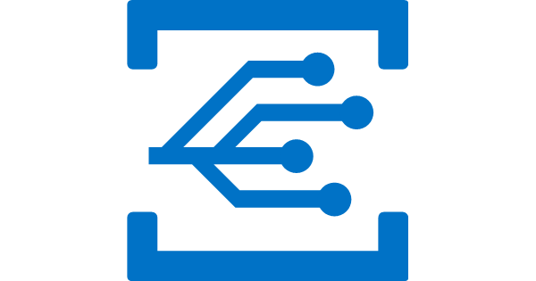
Serverless application platform components
Event Grid
Logic Apps
Functions
Manage all events that can trigger code or logic
Design workflows and orchestrate processes
Execute your code based on events you specify

Slide 13


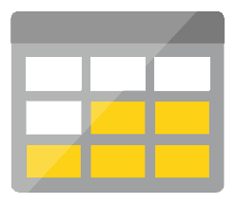
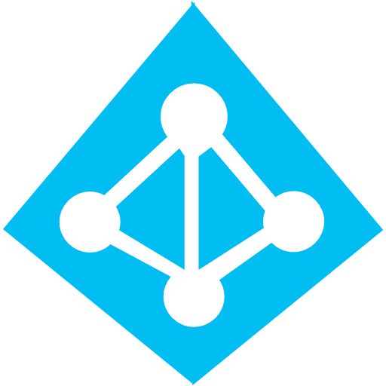
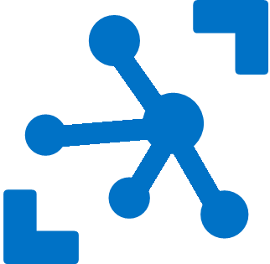

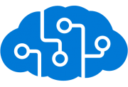
Serverless application platform components
Development
Platform
IDE support
Functions
Logic Apps
Event Grid
Developer productivity
Triggers and Bindings
Flexible deployment options
Visual designer
170+ connectors
Functions orchestration
Manage all events
in one place
Near real-time delivery
Broad coverage
Integrated DevOps
Local development
Monitoring
Database
Storage
Security
IoT
Analytics
Intelligence
Visual Debug History

Slide 14

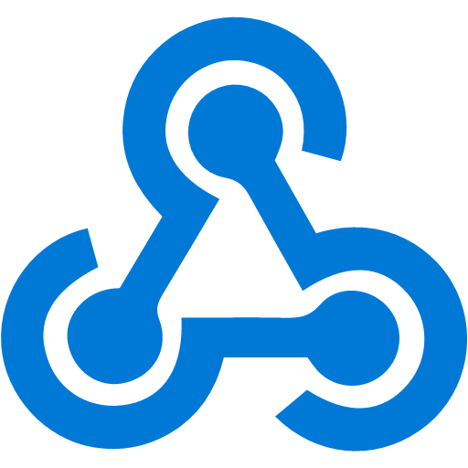
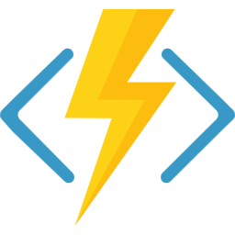
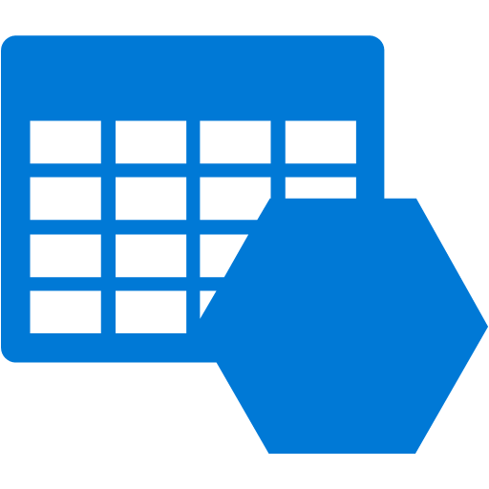


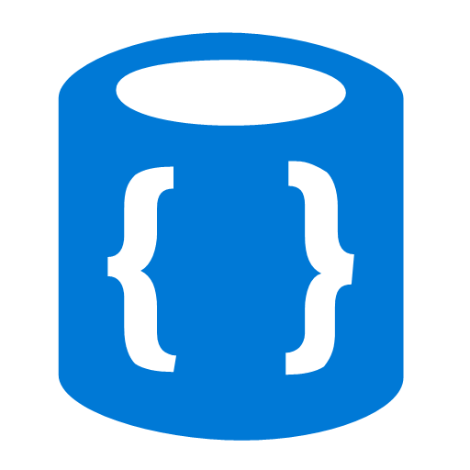

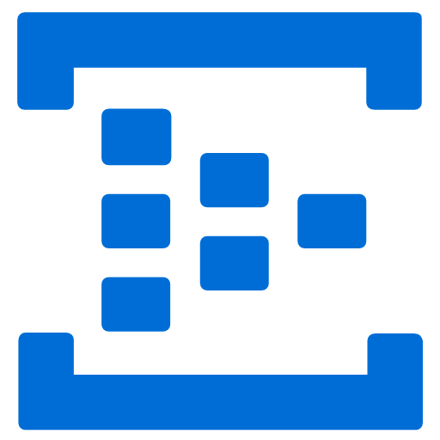
Events
Code
Outputs
React to timers, HTTP, or events from your favorite Azure services, with more on the way
Author functions in C#, F#, Node, Java, Python, Powershell, and more
Send results to an ever-growing collection of services

Slide 15
Logic Apps
SaaS
Protocols/native
appFigures
Asana
Azure API Management
Azure App Services
Azure Automation
Azure Cognitive Face API
Azure Cognitive LUIS
Azure Cognitive Text Analytics
Azure Cognitive Vision
Azure Data Lake Store
Azure Document DB
Azure Event Hub
Azure Functions
Azure Machine Learning
Azure Resource Manager
Azure Service Bus
Azure SQL
Azure Storage Blob
Azure Storage Queues
Basecamp
Bing Search
BitBucket
Bitly
Blogger
Box
Buffer
Campfire
Chatter
Common Data Service
Disqus
DocuSign
Dropbox
Dynamics AX Online
Dynamics CRM Online
Dynamics CRM Service Bus
Dynamics Financials
Dynamics Operations
Easy Redmine
Eventbrite
Facebook
FreshBooks
Freshdesk
GitHub
Gmail
Google Calendar
Google Contacts
Google Drive
Google Sheets
Google Tasks
GoTo Meeting
GoTo Training
GoTo Webinar
Harvest
HelloSign
Infusionsoft
JIRA
Insightly
Instagram
Instapaper
MailChimp
Mandrill
Medium
Microsoft Project Online
Microsoft Translator
MSN Weather
Muhimbi PDF
Office 365
Office 365 Users
Office 365 Video
OneDrive
OneDrive for Business
OneNote
Outlook.com
Outlook Tasks
PagerDuty
Pinterest
Pipedrive
Pivotal Tracker
Power BI
Project Online
Redmine
Salesforce
Salesforce Chatter
SendGrid
SharePoint Online
Slack
SmartSheet
SparkPost
Stripe
Survey Monkey
Todoist
Toodledo
Trello
Twilio
Twitter
Typeform
UserVoice
VS Team Services
Webmerge
Wordpress
Wunderlist
Yammer
YouTube
Zendesk
HTTP, HTTPS
HTTP Webhook
FTP, SFTP
SMTP
RSS
Compose, Query,
Parse JSON
Wait
Terminate
Workflow
Cloud APIs and
platform functionality
  Over 200 built-in connectors
  Hosted and managed
  within the platform
  Scales to meet your needs
  First class designer experience
  Rapid development
XML and EDI
XML Validation
Transform XML (+Mapper)
Flat File Encode
Flat File Decode
X12
EDIFACT
AS2
Integration Account Artifact Lookup
API connections
  Authenticate once and reuse
  Differentiate
  connection configuration
  Simple to deploy
  Portal experience
  for managing API Connections
Hybrid
BizTalk Server
File System
IBM DB2
Informix
Oracle DB
SharePoint Server
SQL Server
SAP
Websphere MQ
Notes:
Azure tools for building orchestration in the cloud
Orchestration is way to build a set of tasks, actions, and executing on them
A whole range of different thinks
Building apps, automating purchases
Run automation

Slide 16
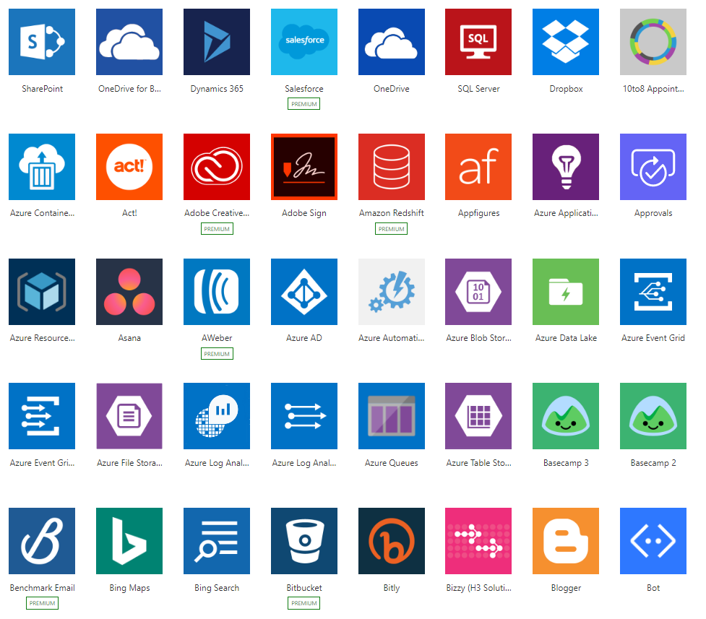
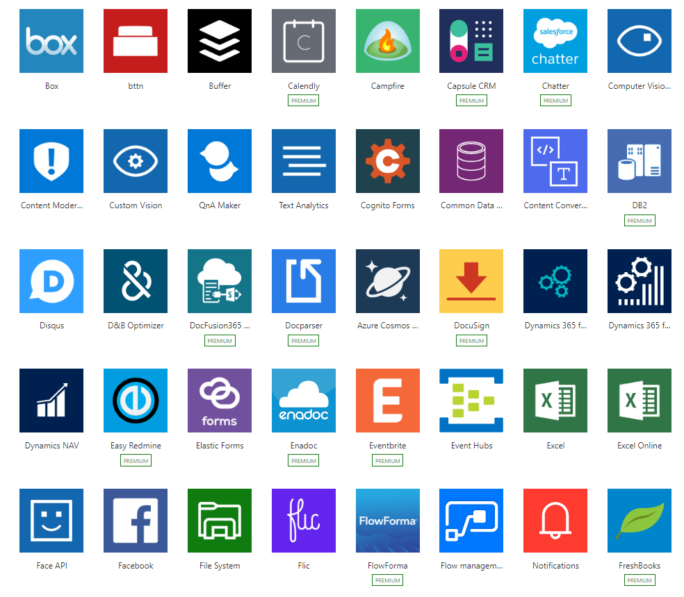
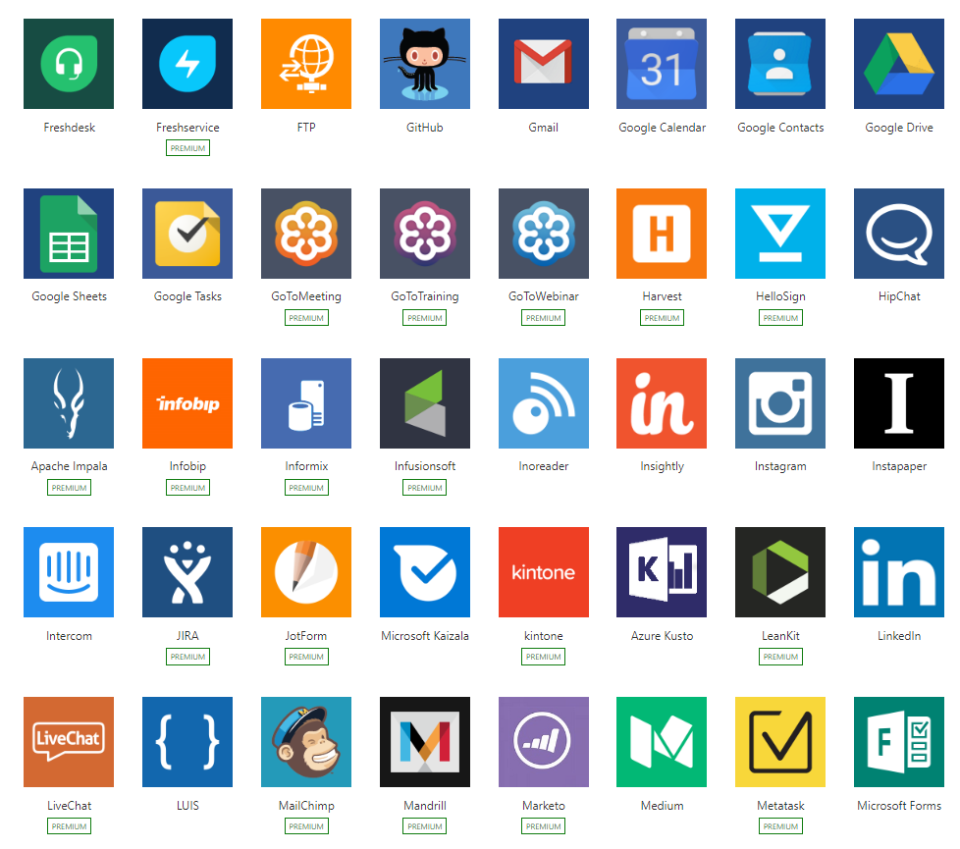
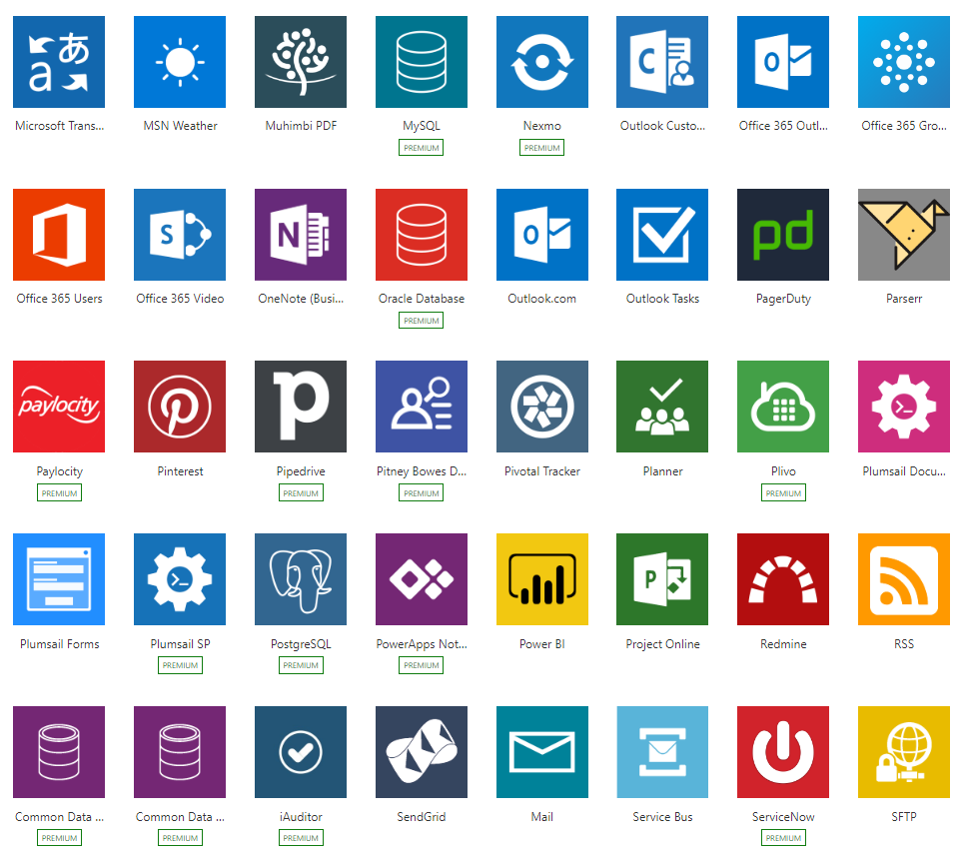
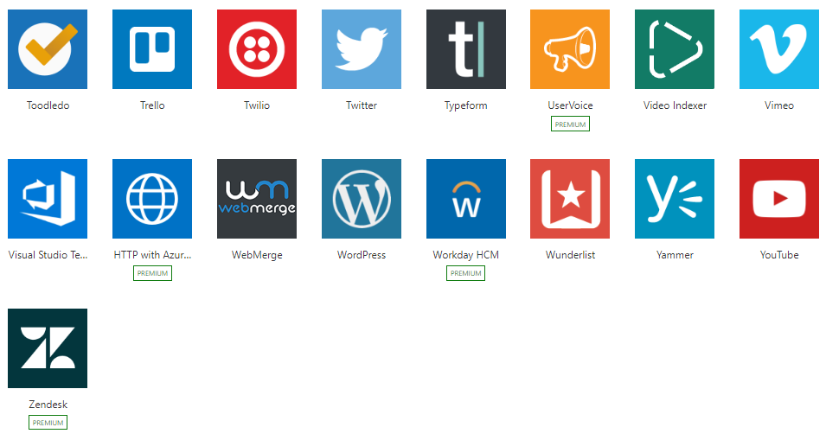
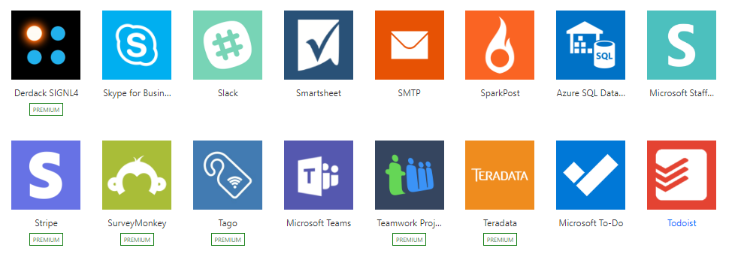
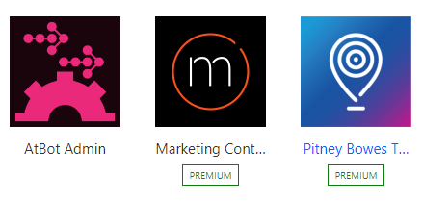
Connected
Built-in connectivity to 200+ SaaS cloud services, file providers, databases, web APIs, productivity apps, and more
Connect to on-premises systems via Data Gateway
Pluggable extensibility via Custom Connectors to integrate existing LOB systems into Logic Apps including SOAP support

Slide 17
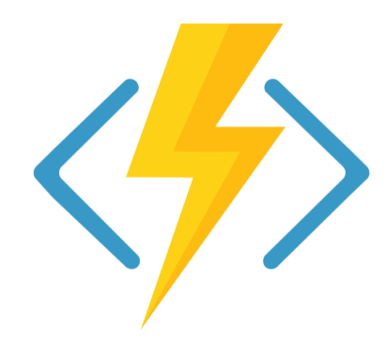
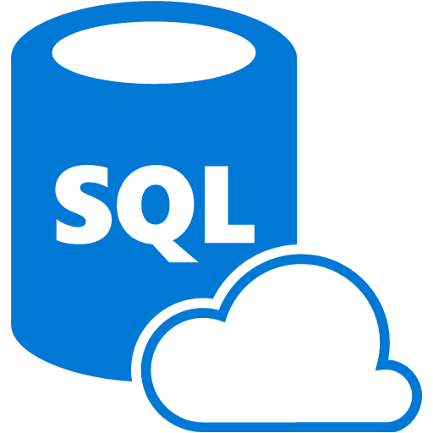

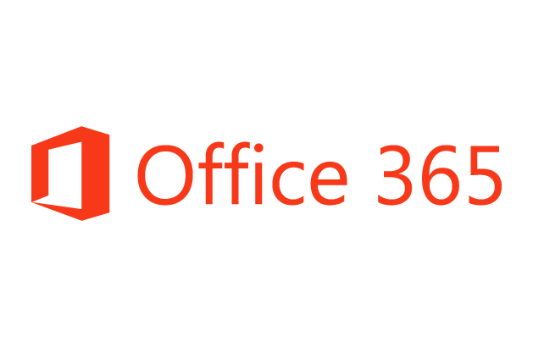
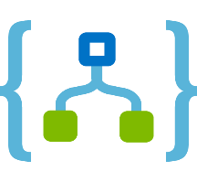
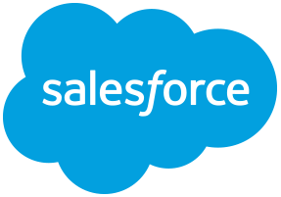
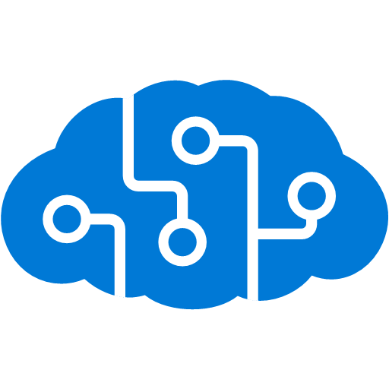

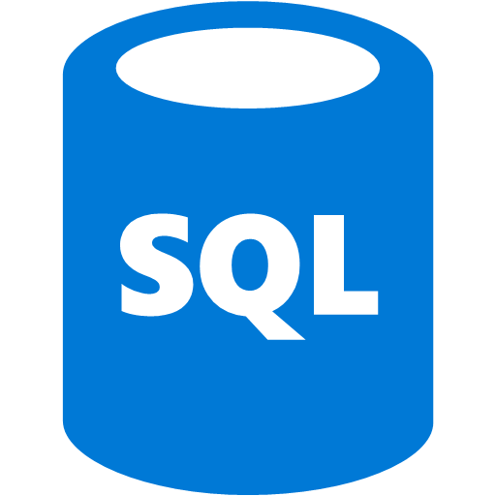
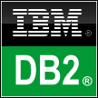
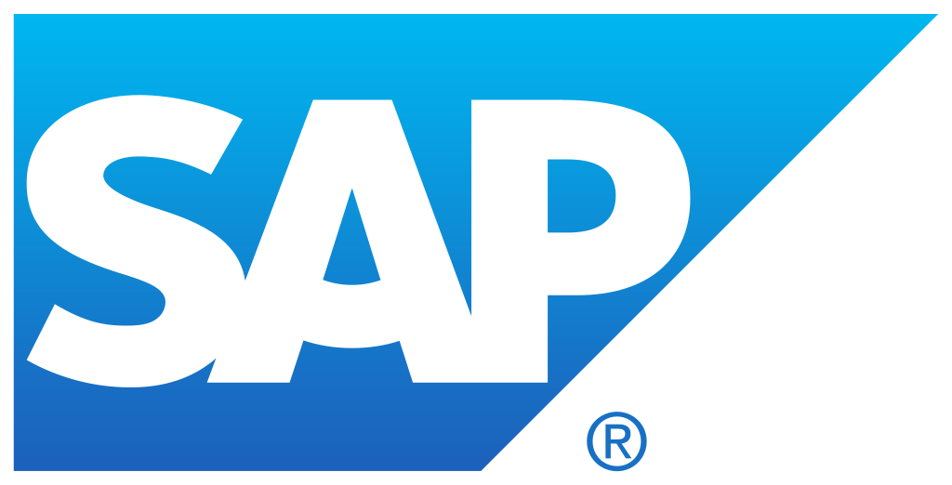


Logic Apps connects everything
Azure Functions
Service bus
Cognitive services
Logic Apps
Machine learning
On-premises
data gateway
BizTalk
server

Slide 18
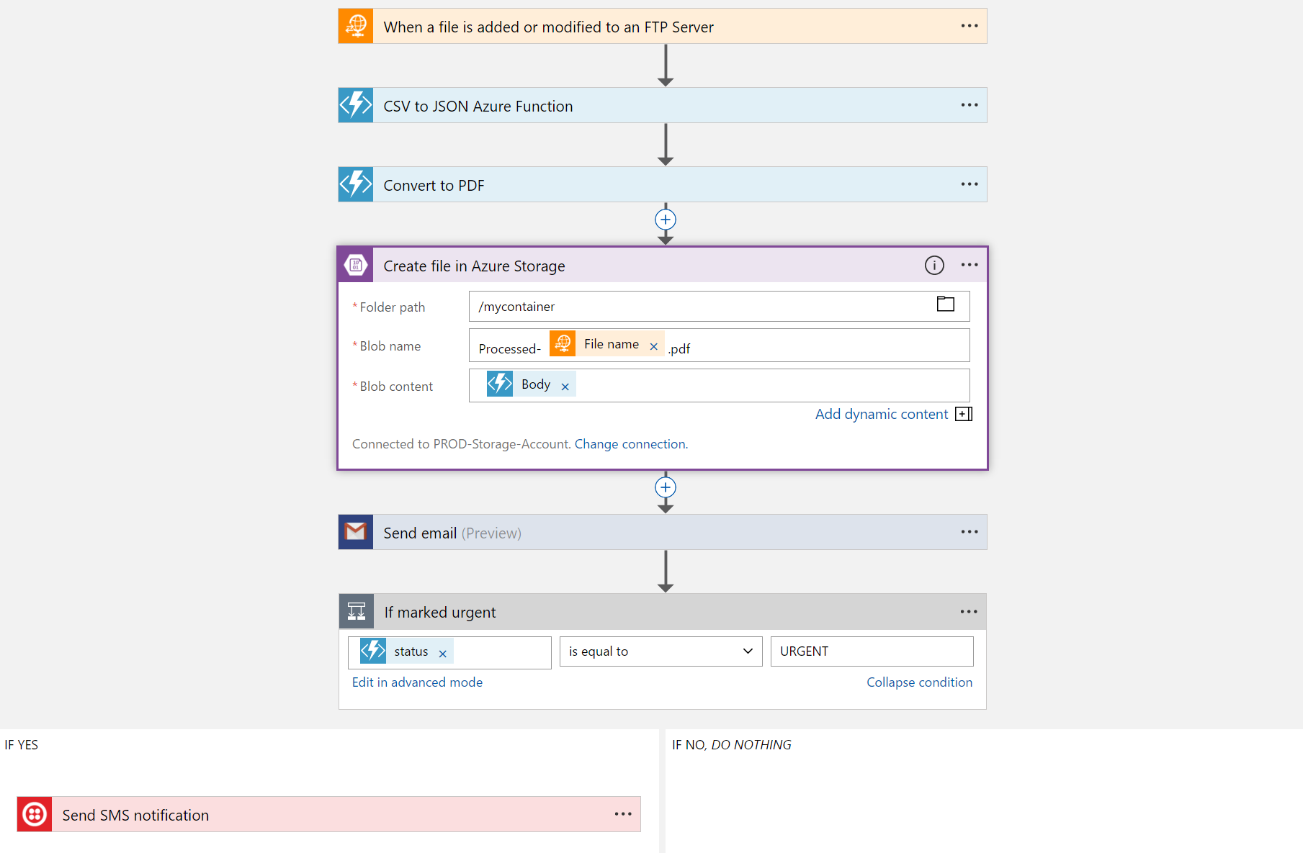
Logic Apps
  Visually design workflows in the cloud
  Express logic through powerful control flow
  Connect disparate functions and APIs
  Utilize declarative definition to work with CI/CD
Notes:
Differences between LogicApp and Flow. Very very similar; they are born from the same set of tools and services
The main differences are who they are targeted at
Flow →users; Power Users; automating sending an email or process
LogicApp building application or integration of different clouds and apps

Slide 19
Demo

Slide 20
Typical Azure Automation Scenarios
Patch Azure IaaS VMs without downtime, leveraging Traffic manager.
Enable regeneration of storage account keys while avoiding downtime in the application.
SQL Backup on a schedule.
Backup and restore IaaS VMs.
Patch / Update / Backup Orchestration
Alert on a VM then turn on tracing, collect logs, upload to Azure Storage and make available in Visual Studio for troubleshooting.
Monitor for when a new service gets created, and configure it for the right tracing / backup policy.
Notify users of a subscription who have underutilized VMs and perform remediation.
Deploy a VM on an Azure / On-Premise cloud and enable monitoring for the VM.
Deploy a new service to Azure and configure the end points for CPU and Memory alerts.
Deploy application from Git, run validation tests, and swap to production if tests pass.
Monitor SharePoint online for an approval to update a service and update the service once approved.
Monitoring & Remediation
Change Control & Provisioning

Slide 21
If you think you will do a task twice – automate it!

Slide 22
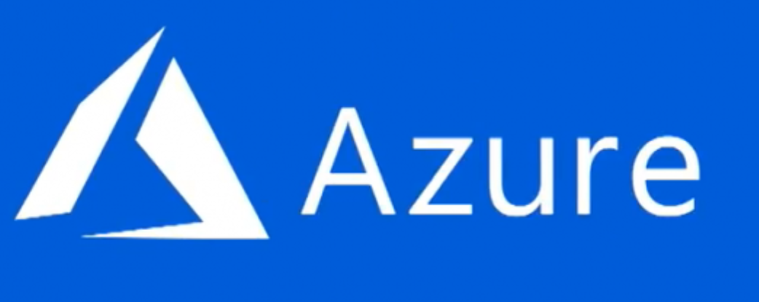
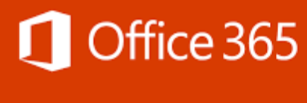
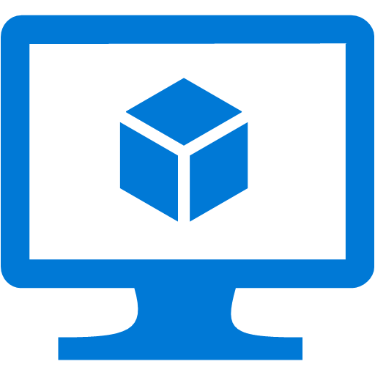

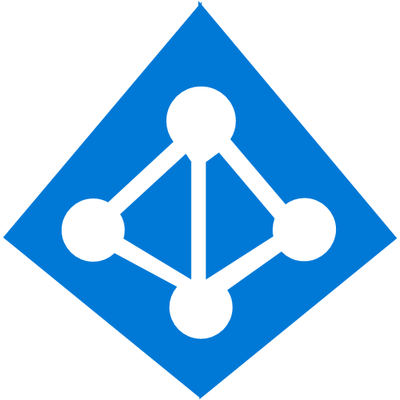
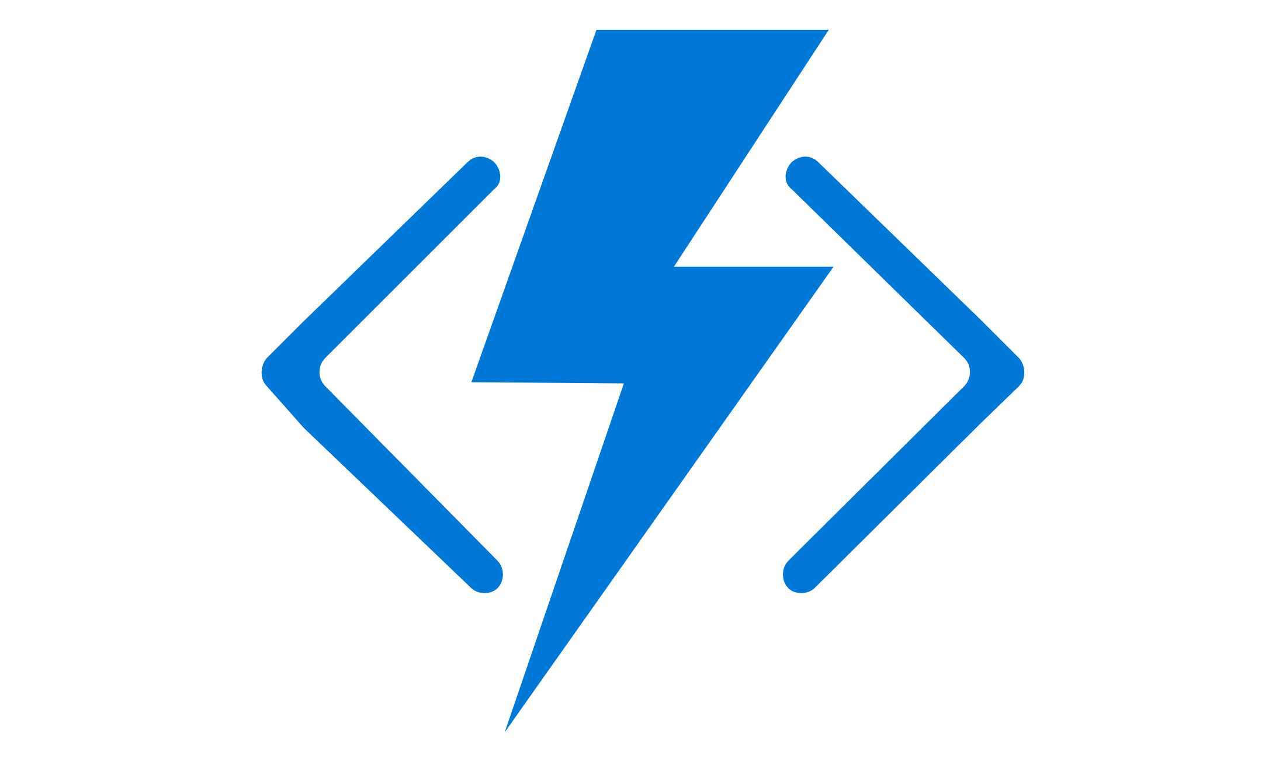
Collaboration | Mobility | Intelligence
Enterprise grade | Hyper Scale | Open & Flexible
Modern Business Application Dev Platform
Better Integration with one cloud provider
Higher Developer Productivity

Slide 23
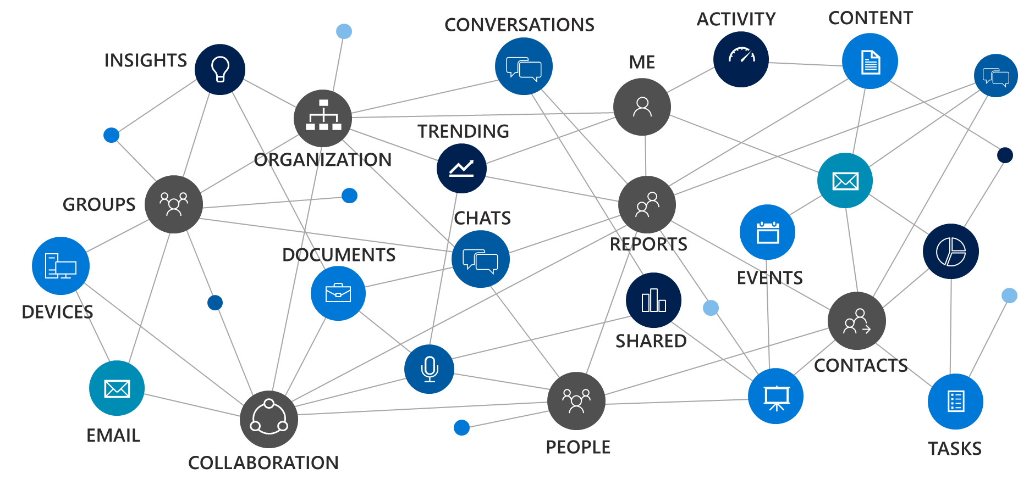

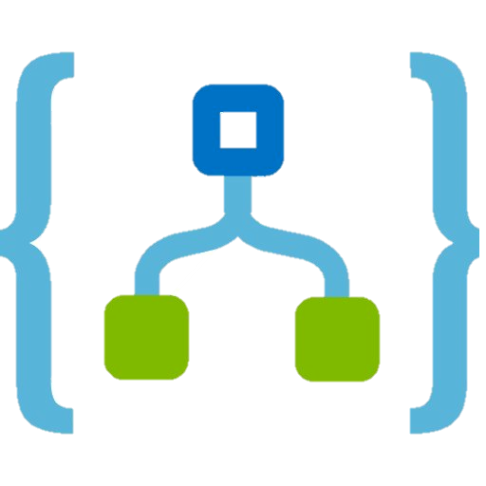
Office 365 and Azure for Cloud productivity
Access O365 Data
Process O365 Info
Host Canvases & Apps
Functions
Microsoft Graph
App service
Azure AD
Logic Apps
SQL DB

Slide 24
Salesforce Integration Use Case

Slide 25
Current Data Structure
Corporate Data
Structured
Unstructured Data
Data
NetSuite
HRIS
SF CRM
Pulse
StarLIMS
Web Sites
File Shares
SharePoint
Publishing
System
Data Warehouse
/
Data Curation
/
Data
Business
Mining
Intelligence

Slide 26
Salesforce Integration Method
IT Team
Create AD Groups
for Permissions
Active Dir
Request for new
Account or
Opportunity
Salesforce
Platform
O365
Files Connect
/Trove
Create Folder Structure
and Assign Permissions
Attach/Access Account and Opportunity Documents

Slide 27
Salesforce Integration Method
Azure Logic Apps Integration
Active Dir
Create AD Groups
for Permissions
Salesforce
Platform
O365
Azure Logic Apps
Trigger for new Account
or Opportunity Creation
Create Folder Structure
and Assign Permissions
Attach/Access Account and Opportunity Documents from SalefForce that reside in the ECM

Slide 28
Protection Outside ECM
Active Dir
Audit Logs
Azure Information Protection
Active Dir
Group Membership
Assignments
Group MembershipPermissions
Group MembershipPermissions
O365
ECM Folder
Permissions
Assignments
Azure Rights
Management
Assignments
Download File to Edit
Distribute File
to Colleagues
Download File
to Edit
File Shares
E-Mail
Local Drives

Slide 29
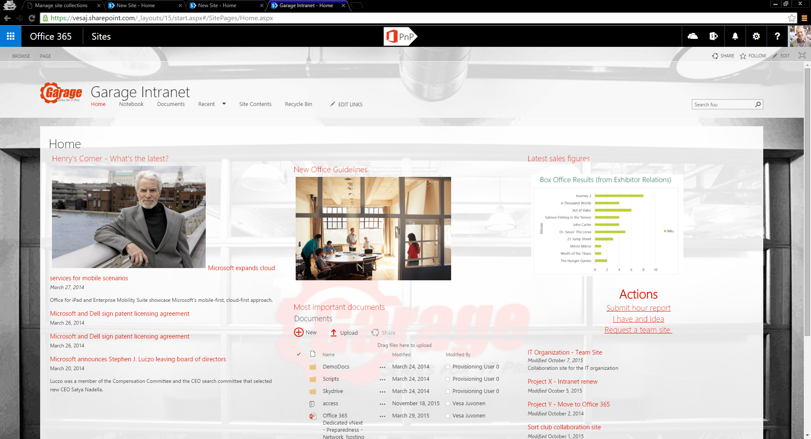
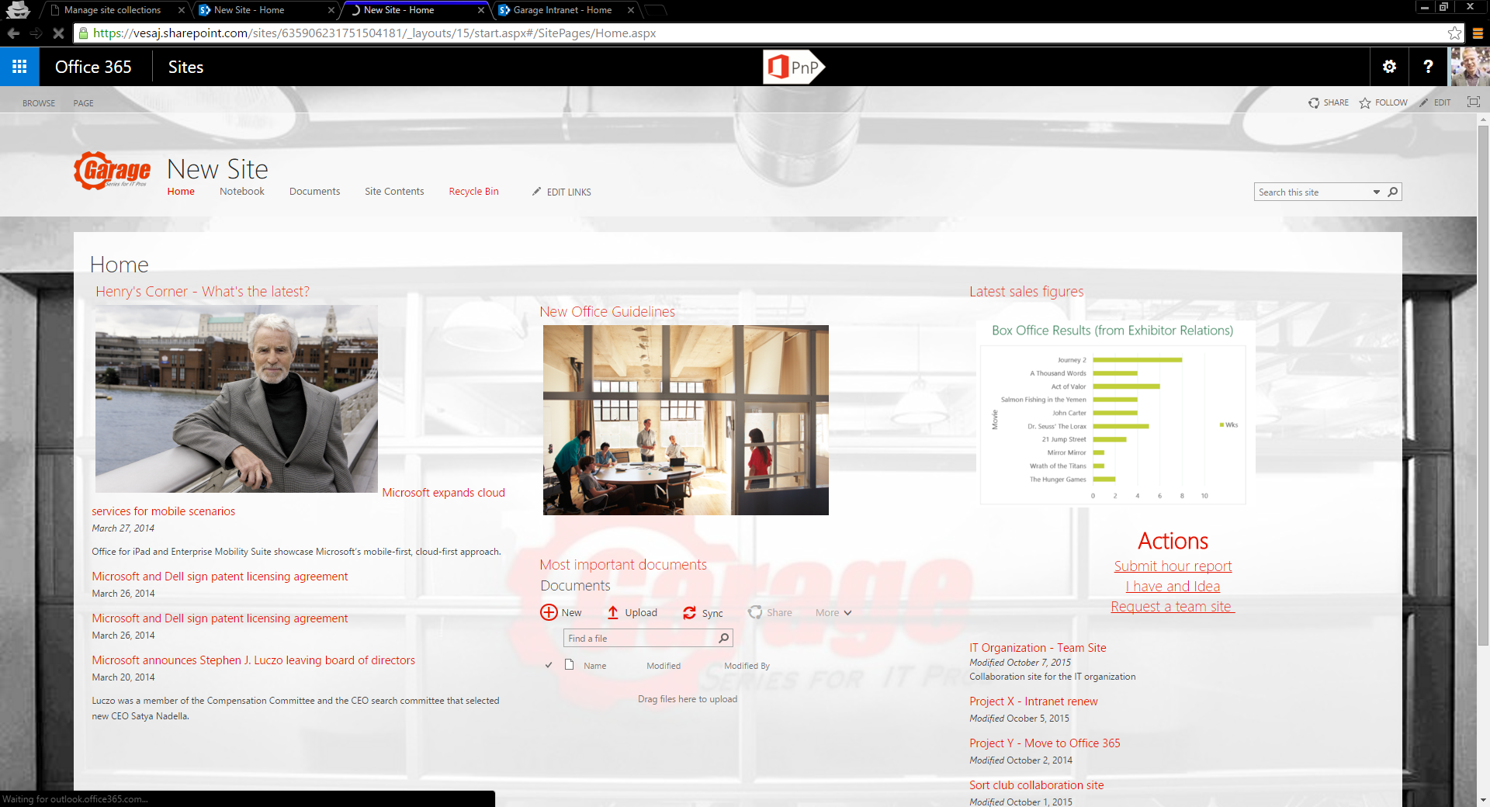
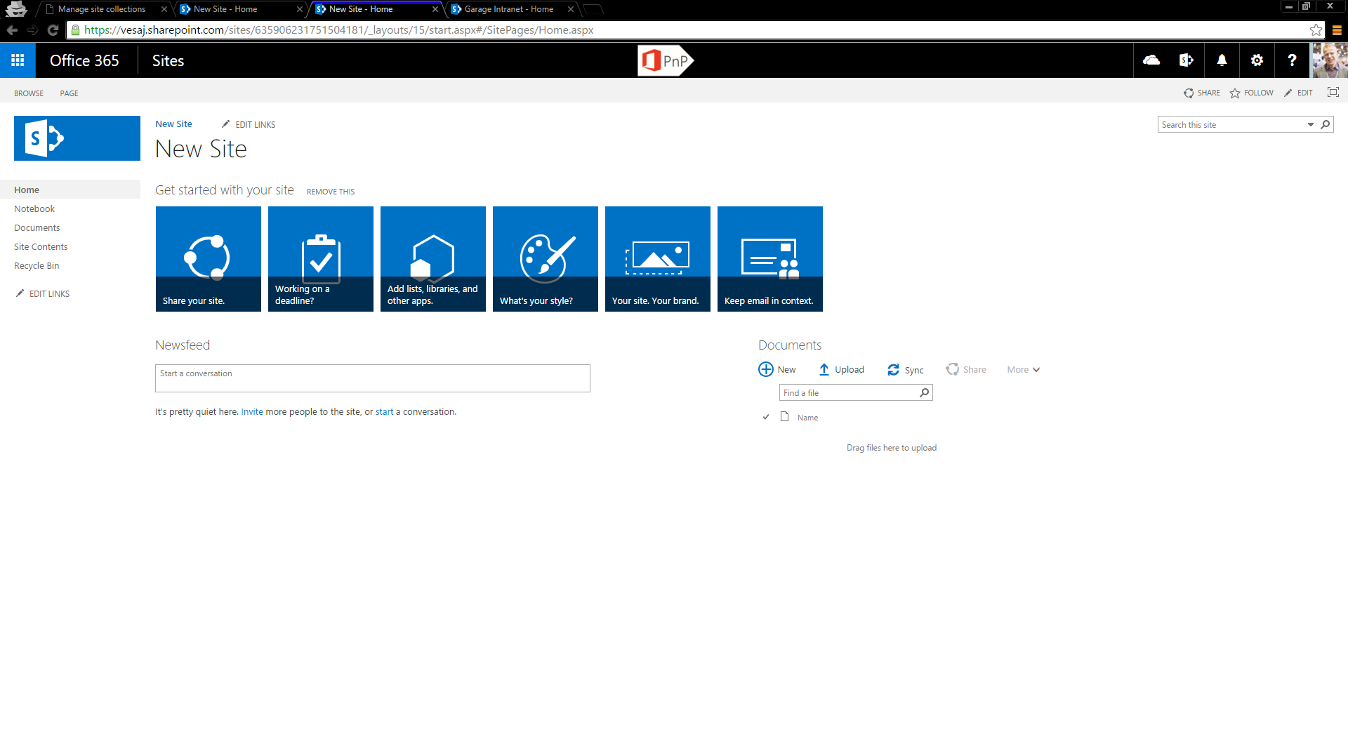
Provisioning Engine - Basics
Template site
OOB site with needed configuration
Empty OOB site

Slide 30
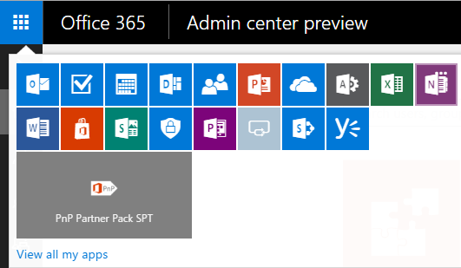
Architecture & Logic Flow – in the Cloud
https://github.com/OfficeDev/PnP-Partner-Pack
Azure
Active Directory
Web App
WebJobs
Storage
(
Azure
)

Slide 31
Demo

Slide 32
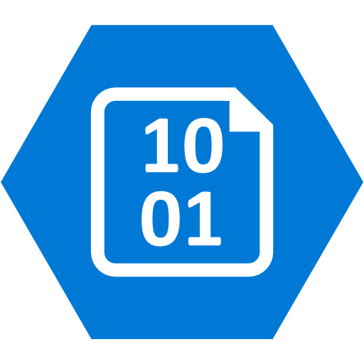

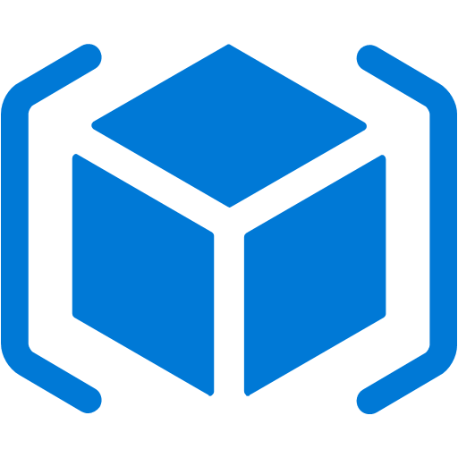

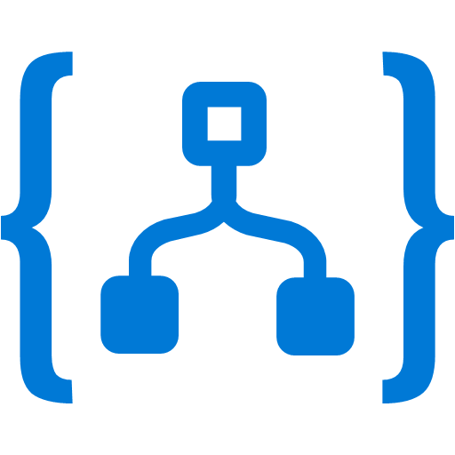
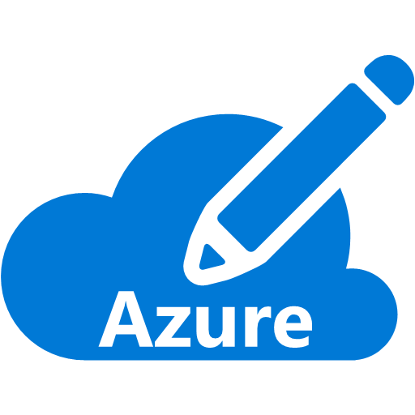


Event Grid: Manage all events in one place
Event publishers
Event handlers
Blob Storage
Azure Functions
Resource Groups
Logic Apps
Azure Subscriptions
Azure Automation
Event Hubs
WebHooks
Custom Events

Slide 33




Functions
Code
Azure Functions
Events & Data
  Develop locally using best of class developer tools
  Boost productivity through triggers and bindings
  Choose from a variety of programming languages
  Integrate with existing DevOps processes

Slide 34

General Availability of Functions 2.0

Slide 35
Functions 2.0 – What in this GA announcement?
New Functions Quickstarts by Language
Updated runtime built on .NET Core 2.1
.NET Functions loading changes
New extensibility model
  Decoupled from language providers and bindings
Run code from a package
Tooling updates: CLI, Visual Studio & VS Code
Durable Functions (GA)
Consumption mode SLA

Slide 36
Functions runtime 1.0 and 2.0 key differences
 | Functions 1.0 | Functions 2.0
.NET Support | .NET Framework 4.7.1 | .NET Core 2.1
Assembly isolation | No | Yes
Bindings versions | Runtime versions | User controlled
Language options | Limitations in languages and versions | Languages are external to the host
Node.js version | Node.js 6 only | Node.js 8 & 10 + future versions
Node.js native modules | Not supported | Supported
HTTP triggers | HTTP and specialized Webhooks | HTTP (supports Webhooks)
Language Runtime | Multiple languages per function app | Single language per function app
Functions Proxies | GA | GA
OpenAPI definition | Preview | Not yet available
Observability | Application Insights/WebJobs dashboard | App Insights

Slide 37
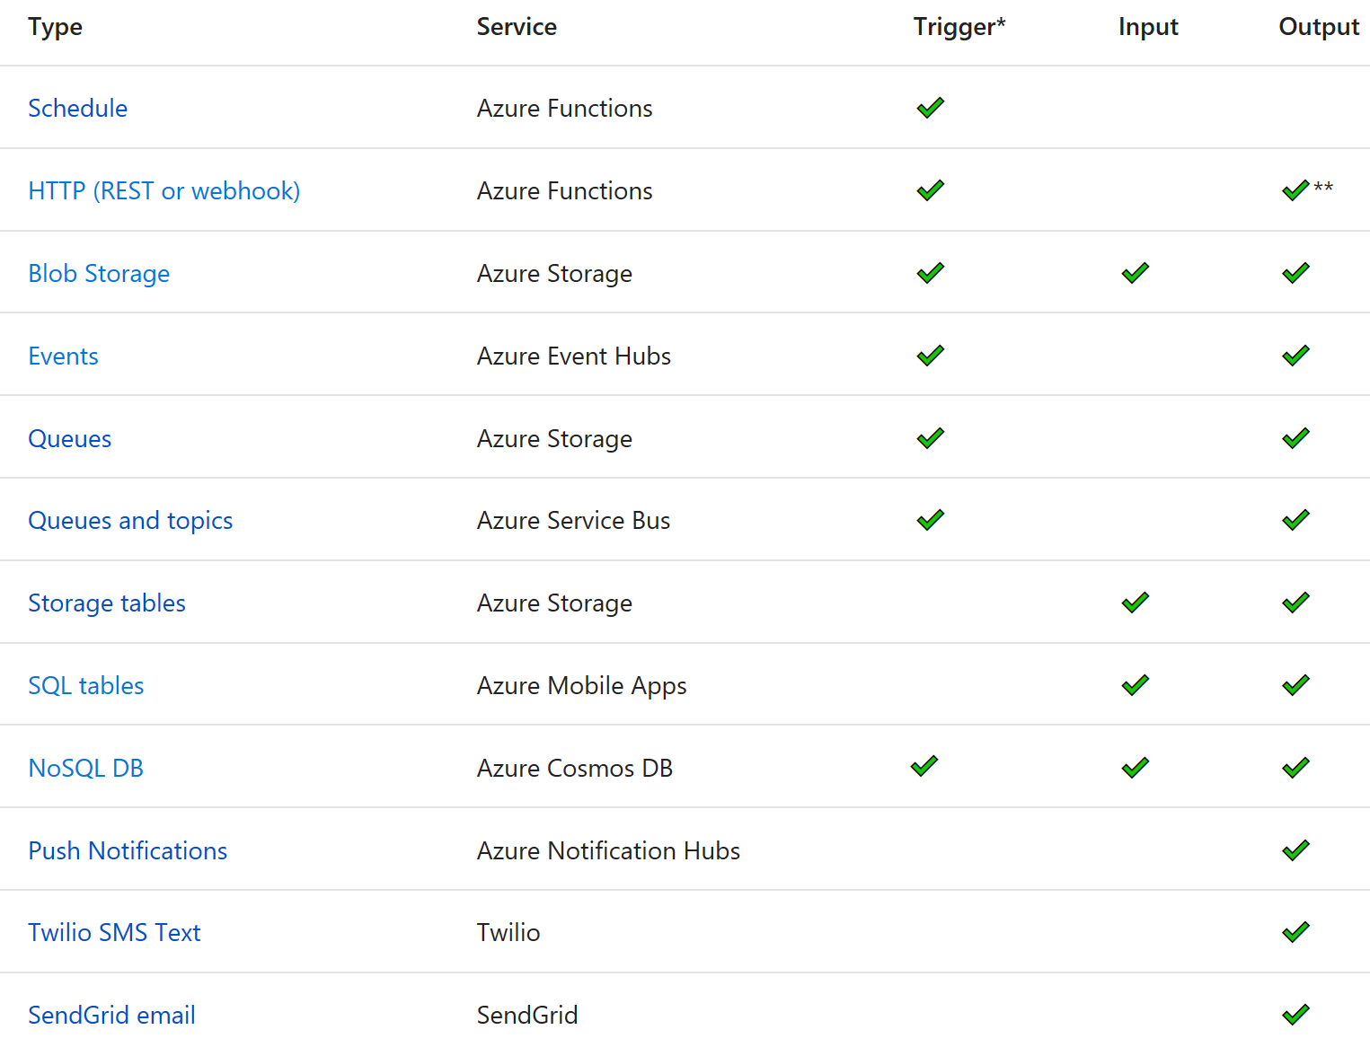
Functions triggers and bindings

Slide 38

What’s new in Azure Functions
Trigger a function based on changes in Cosmos DB
Database
Local Development
Develop functions locally on Linux, MacOS, Windows
Functions
Securely provide access to information in Microsoft Graph through a function
Security
Execute your code based on events you specify
Monitoring
Monitor serverless applications using Application Insights
Trigger a function from a real-time analytics pipeline in Stream Analytics
Analytics

Slide 39
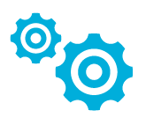
Automation & Configuration
Key Features
Manage any cloud & on premises
Windows & Linux
Configuration Management
Process Automation
Update Management
Configuration Management
DSC Configurations, Pull service
Node Management & Reporting
Change tracking & Inventory
Process Automation
Author runbooks - PowerShell, scripts PowerShell workflow, Graphical, Python2
Hybrid Runbook Workers with Proxy support
Update Management
Insights across your hydrid Environment
Orchestrated updates and troubleshooting
Easy Onboarding
Run As account for Azure management
Gallery of runbooks and modules from Microsoft and community
Shared capabilities across features
Role Based Access Control
Secure, global store for variables, credentials, certificates, connections
Schedules
Modules
Source control support
Auditing
Tags
Integration
Included with Azure SDK
Webhooks to start runbook remotely
Azure
Any Cloud
Automation & Config
Hybrid Worker
On-Premises
Hyper-V
VMWare
OpenStack
Reliable, highly available, scalable
Hybrid management Integrate existing systems

Slide 40
Demo

Slide 41
Take away
Azure Serverless technologies like Functions, Logic App and Event Grid enhances Business productivity by connecting different systems easily
Logic Apps you access contextual Office 365 data
Options to run Functions or Automation
Host Office Canvases, Mobile or Web app related to your Office data on Azure easily with App Service and SQL DB

Slide 42
References
https://azure.microsoft.com/en-us/services/logic-apps/
https://azure.microsoft.com/en-us/services/functions/
https://azure.microsoft.com/en-gb/services/event-grid/
https://azure.microsoft.com/en-us/services/automation/

