Slide 1
Windows® User State Virtualization
Infrastructure Planning and Design
Published: August 2010
Notes:
Copyright © 2010 Microsoft Corporation. All rights reserved. Complying with the applicable copyright laws is your responsibility. By using or providing feedback on this documentation, you agree to the license agreement below.
If you are using this documentation solely for non-commercial purposes internally within YOUR company or organization, then this documentation is licensed to you under the Creative Commons Attribution-NonCommercial License. To view a copy of this license, visit http://creativecommons.org/licenses/by-nc/2.5/ or send a letter to Creative Commons, 543 Howard Street, 5th Floor, San Francisco, California, 94105, USA.
This documentation is provided to you for informational purposes only, and is provided to you entirely "AS IS". Your use of the documentation cannot be understood as substituting for customized service and information that might be developed by Microsoft Corporation for a particular user based upon that user’s particular environment. To the extent permitted by law, MICROSOFT MAKES NO WARRANTY OF ANY KIND, DISCLAIMS ALL EXPRESS, IMPLIED AND STATUTORY WARRANTIES, AND ASSUMES NO LIABILITY TO YOU FOR ANY DAMAGES OF ANY TYPE IN CONNECTION WITH THESE MATERIALS OR ANY INTELLECTUAL PROPERTY IN THEM.
Microsoft may have patents, patent applications, trademarks, or other intellectual property rights covering subject matter within this documentation. Except as provided in a separate agreement from Microsoft, your use of this document does not give you any license to these patents, trademarks or other intellectual property.
Information in this document, including URL and other Internet Web site references, is subject to change without notice. Unless otherwise noted, the example companies, organizations, products, domain names, e-mail addresses, logos, people, places and events depicted herein are fictitious.
Microsoft, Active Directory, Outlook, and Windows, are either registered trademarks or trademarks of Microsoft Corporation in the United States and/or other countries and regions.
The names of actual companies and products mentioned herein may be the trademarks of their respective owners.
You have no obligation to give Microsoft any suggestions, comments or other feedback ("Feedback") relating to the documentation. However, if you do provide any Feedback to Microsoft then you provide to Microsoft, without charge, the right to use, share and commercialize your Feedback in any way and for any purpose. You also give to third parties, without charge, any patent rights needed for their products, technologies and services to use or interface with any specific parts of a Microsoft software or service that includes the Feedback. You will not give Feedback that is subject to a license that requires Microsoft to license its software or documentation to third parties because we include your Feedback in them.

Slide 2
What is IPD?
Guidance that clarifies and streamlines the planning and design process for Microsoft® infrastructure technologies
IPD:
Defines decision flow
Describes decisions to be made
Relates decisions and options for the business
Frames additional questions for business understanding
IPD guides are available at www.microsoft.com/ipd
Notes:
Infrastructure Planning and Design (IPD) is a series of planning and design guides created to clarify and streamline the planning and design process for Microsoft® infrastructure technologies.
Each guide in the series addresses a unique infrastructure technology or scenario.
These guides include the following topics:
Defining the technical decision flow (flow chart) through the planning process.
Describing the decisions to be made and the commonly available options to consider in making the decisions.
Relating the decisions and options for the business in terms of cost, complexity, and other characteristics.
Framing the decisions in terms of additional questions for the business to ensure a comprehensive understanding of the appropriate business landscape.
The guides in this series are intended to complement and augment Microsoft product documentation.

Slide 3
Getting Started
Windows® User State Virtualization
Notes:
Windows user state virtualization (USV) is a collection of Microsoft technologies that enables synchronization of user state information from individual computers to a central location. Centralized management and storage of user state is desirable because it provides users with mobility and flexibility while helping IT departments manage costs and compliance.

Slide 4
Purpose and Contents of the Guide
Purpose
Describes a scenario assessment process that helps IT professionals get started with planning a Windows User State Virtualization solution
Contents
About Windows User State Virtualization
User and IT requirements
Real-world scenario assessment and notes from the field
Comparison of USV technologies

Slide 5
What Is Windows User State Virtualization?
Windows user state virtualization (USV) is a collection of Microsoft Windows-based technologies that enable synchronization of user state information from individual computers to a central location
The Windows USV strategy is about finding the right balance between centralization/management of user state and flexibility of the desktop environment
Notes:
What are Windows USV Technologies?
Windows user state virtualization (USV) is a collection of Microsoft technologies that enables synchronization of user state information from individual computers to a central location. Centralized management and storage of user state is desirable because it provides users with mobility and flexibility while helping IT departments manage costs and compliance.
Developing a USV strategy requires consideration of numerous factors, including mixed environments of different operating system versions, different applications and platform architectures, security concerns, backup considerations, network bandwidth, and different user needs.

Slide 6
Core Windows USV technologies
Access user data on redirected folders over the network
Access locally cached copies of user data
Access user settings over the network
Notes:
This IPD guide describes a scenario assessment process that helps IT pros understand their USV requirements and map them to appropriate USV technologies. It also explains real-world caveats and considerations that might apply so IT pros can develop realistic strategies for their organizations.
This guide focuses on the following three Windows USV technologies:
Folder Redirection (FR)
Offline Files (OF)
Roaming User Profiles (RUP)

Slide 7
Benefits of Windows User State Virtualization
Ability to work from different computers
Ability to work when disconnected from the organization’s network
Faster and simpler user migration
Recovery from disaster scenarios and when hard disks fail or computers are lost or stolen
Notes:
Benefits of USV
By centralizing the storage of user state that typically resides on users’ computers, USV simplifies backup and management of business-critical data; when the central storage is backed up, the user state that was synchronized from users’ computers is also backed up.
Centralized management of user state also yields the following benefits:
The ability to work from different computers. Centralized data and settings can be synchronized and cached locally across different computers, thereby providing users with flexibility and mobility options that can help them be more productive.
The ability to work when disconnected from the organization’s network. USV technologies automatically and seamlessly cache local updates to user data and settings so as to synchronize them with the central store when network connectivity is reestablished.
Faster and simpler user migration. USV technologies enable the dynamic composition of user state on new computers over the network and thereby simplify migration.
Recovery from disaster scenarios and when hard disks fail or computers are lost or stolen. Centralized data and settings that are regularly backed up can be automatically restored to new hard disks when the user logs in, thereby reducing the time required for organizations and users to become productive again.

Slide 8
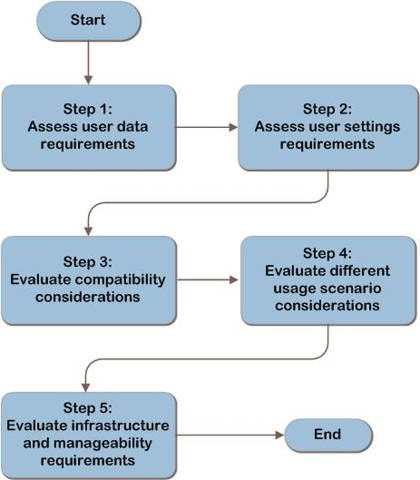
Windows USV Steps
Notes:
In planning for a Windows user state virtualization strategy, IT organizations should:
Assess user data requirements
Assess user settings requirements
Evaluate compatibility considerations
Evaluate different usage scenario considerations
Evaluate infrastructure and manageability requirements
The USV IPD guide contains descriptions and details on each step; it compares the capabilities of the various USV technologies in light of real-world scenarios that may be applicable to the organization.

Slide 9
Step 1: Assess User Data Requirements
Identify user data that is important to the business
Such as Desktop, My Documents, Contacts
Identify real-world considerations that apply to the organization
Such as concurrent logon, performance, and AppData\Roaming considerations
Compare Windows USV technologies to identify the best technology for the target environment
Notes:
Step 1: Assess User Data Requirements
This step addresses virtualization of the user data aspects of Windows user state. In this step the reader will identify which portions of user data are important to the business, discover technology limitations, and identify real-world considerations that apply to the organization.
User data pertains to files that are specific to users in the organization. Users may store data within or outside of their user profile, if they have access to do so. The core USV technologies Folder Redirection (FR) and Roaming User Profiles (RUP) only enable virtualization of user data that is stored within the user profile.

Slide 10
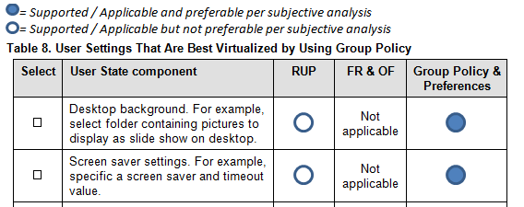
Step 2: Assess User Settings Requirements
Example: User settings virtualization
Identify user settings that are important to the business
Such as desktop, sound, keyboard, and mouse settings
Compare Windows USV technologies and Group Policy preferences to identify the best technology combination for the target environment
Notes:
Step 2: Assess User Settings Requirements
This step addresses virtualization of the user settings portion of Windows user state. In this step the reader will identify which components of user settings are relevant to the business, discover technology limitations, and identify real-world considerations that apply to the organization.

Slide 11
Step 3: Evaluate Compatibility Considerations
Example: Compatibility considerations
Identify real-world compatibility considerations for USV that apply to the organization
Such as operating system, platform, and application compatibility considerations
Compare Windows USV technology limitations with these compatibility considerations to identify the best technology combination for the target environment
Notes:
Step 3: Evaluate Compatibility Considerations
This step identifies common real-world compatibility considerations that might affect the planning and design of a Windows USV solution. Software and hardware infrastructures in mid- to large-sized organizations are seldom standardized. Therefore, planning a Windows USV solution often requires consideration of compatibility between different operating systems, platforms, and applications.

Slide 12
Step 4: Evaluate Different Usage Scenario Considerations
Understand common usage scenarios for USV and identify those that apply to the target organization
Such as Assigned Computer, Occasionally Roaming User, and Always Roaming User scenarios
Review subjective analysis, features, and limitations of Windows USV technologies to identify the best technology combination for the target environment
Review subjective analysis on using Outlook® and Exchange Server for these scenarios
Notes:
Step 4: Evaluate Different Usage Scenario Considerations
This step identifies and describes different common usage scenarios and considerations for each. Guidance from the field is also provided.

Slide 13
Step 5: Evaluate Infrastructure and Manageability Requirements
Example: Infrastructure and Manageability Requirements
Understand common Infrastructure and Manageability requirements for USV and identify those that apply to the target organization
Such as high latency, low bandwidth, availability, and redundancy
Review subjective analysis, features, and limitations of Windows USV technologies that are relevant to these requirements
Notes:
Step 5: Evaluate Infrastructure and Manageability Requirements
This step identifies common network infrastructure and manageability requirements.
Because Windows USV technologies can move considerable amounts of data, it is important that these technologies be optimally configured for each environment so that they provide optimal functionality and manageability. Although the requirements listed in this step are not comprehensive, they are based on subjective analysis of mid- to large-sized organizations, and may apply to organizations planning or designing a Windows USV solution.

Slide 14
Summary and Conclusion
Windows USV helps IT find the right balance between centralized management of business-critical data and a flexible work experience for users.
The Windows USV guide was designed to help IT pros get started with planning and designing effective Windows USV solutions.
Use the guide to provide a systematic approach to gathering user and IT requirements, comparing the suitability of the various Windows USV technologies, and planning for relevant real-world business scenarios.
Provide feedback to satfdbk@microsoft.com
Notes:
Summary and Conclusion
Windows USV helps IT find the right balance between centralized management of business-critical data and a flexible work experience for users. In order to design a suitable USV solution, user requirements and IT requirements need to be well understood.
Additionally, the best fitting combination of technologies should be employed to suit the organization’s business priorities.
The goal of this guide is to help IT pros get started with planning and designing effective Windows USV solutions. It was designed to provide a systematic approach to gathering user and IT requirements and comparing the suitability of the various Windows USV technologies from the perspectives of relevant business scenarios, and to provide guidance based on subjective analysis of real-world deployments in mid- to large-sized organizations.

Slide 15
Find More Information
What's New in Folder Redirection and User Profiles: technet.microsoft.com/en-gb/library/ff458273.aspx
What’s New in Offline Files: technet.microsoft.com/en-us/library/ff183315.aspx
“Choosing an Appropriate User State Virtualization Solution”: www.microsoft.com/downloads/details.aspx?displaylang=en&FamilyID=fd01ed7a-c603-4f7c-8a60-8e4872b58bdf
“Implementing an End-User Data Centralization Solution”: www.microsoft.com/downloads/details.aspx?displaylang=en&FamilyID=d8541618-5c63-4c4d-a0fd-d942cd3d2ec6
Managing Roaming User Data Deployment Guide: technet.microsoft.com/en-us/library/cc766489.aspx
Download the full document and other IPD guides: www.microsoft.com/ipd
Contact the IPD team: satfdbk@microsoft.com
Access the Microsoft Solution Accelerators website: www.microsoft.com/technet/SolutionAccelerators

Slide 16
Appendix

Slide 17
Benefits of Using IPD Guides
Benefits for Business Stakeholders/Decision Makers
Most cost-effective design solution for implementation
Alignment between the business and IT from the beginning of the design process to the end
Benefits for Infrastructure Stakeholders/ Decision Makers
Authoritative guidance
Business validation questions ensuring solution meets requirements of business and infrastructure stakeholders
High-integrity design criteria that includes product limitations
Fault-tolerant infrastructure
Infrastructure that is sized appropriately for business requirements
Notes:
Benefits of Using the Windows USV Guide
Benefits for Business Stakeholders/Decision Makers:
Most cost-effective design solution for an implementation. IPD eliminates over-architecting and over-spending by precisely matching the technology solution to the business needs.
Alignment between the business and IT from the beginning of the design process to the end.
Benefits for Infrastructure Stakeholders/Decision Makers:
Authoritative guidance. Microsoft is the best source for guidance about the design of Microsoft products.
Business validation questions to ensure the solution meets the requirements of both business and infrastructure stakeholders.
High-integrity design criteria that includes product limitations.
Fault-tolerant infrastructure, where necessary.
Proportionate system and network availability to meet business requirements.
Infrastructure that is sized appropriately to meet business requirements.

Slide 18
Benefits of Using IPD Guides (Continued)
Benefits for Consultants or Partners
Rapid readiness for consulting engagements
Planning and design template to standardize design and peer reviews
A “leave-behind” for pre- and post-sales visits to customer sites
General classroom instruction/preparation
Benefits for the Entire Organization
Using the guide should result in a design that will be sized, configured, and appropriately placed to deliver a solution for achieving stated business requirements
Notes:
Benefits of Using the Windows USV Guide (continued)
Benefits for Consultants or Partners:
Rapid readiness for consulting engagements.
Planning and design template to standardize design and peer reviews.
A “leave-behind” for pre- and post-sales visits to customer sites.
General classroom instruction/preparation.
Benefits for the Entire Organization:
Using the guide should result in a design that will be sized, configured, and appropriately placed to deliver a solution for stated business requirements, while considering the performance, capacity, manageability, and fault tolerance of the system.

Slide 19
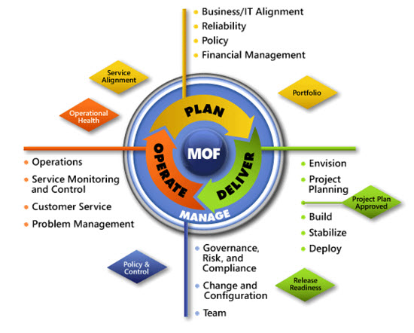
IPD in Microsoft Operations Framework 4.0
Use MOF with IPD guides to ensure that people and process considerations are addressed when changes to an organization’s IT services are being planned.
Notes:
For more information about Microsoft Operations Framework 4.0, go to www.microsoft.com/mof.

