Slide 1
Terminal Services in Windows Server® 2008
Infrastructure Planning and Design
Notes:
Copyright © 2009 Microsoft Corporation. This documentation is licensed to you under the Creative Commons Attribution License. To view a copy of this license, visit http://creativecommons.org/licenses/by/3.0/us/ or send a letter to Creative Commons, 543 Howard Street, 5th Floor, San Francisco, California, 94105, USA. When using this documentation, provide the following attribution: Infrastructure Planning and Design is provided with permission from Microsoft Corporation.
This documentation is provided to you for informational purposes only, and is provided to you entirely "AS IS". Your use of the documentation cannot be understood as substituting for customized service and information that might be developed by Microsoft Corporation for a particular user based upon that user’s particular environment. To the extent permitted by law, MICROSOFT MAKES NO WARRANTY OF ANY KIND, DISCLAIMS ALL EXPRESS, IMPLIED AND STATUTORY WARRANTIES, AND ASSUMES NO LIABILITY TO YOU FOR ANY DAMAGES OF ANY TYPE IN CONNECTION WITH THESE MATERIALS OR ANY INTELLECTUAL PROPERTY IN THEM.
Microsoft may have patents, patent applications, trademarks, or other intellectual property rights covering subject matter within this documentation. Except as provided in a separate agreement from Microsoft, your use of this document does not give you any license to these patents, trademarks or other intellectual property.
Information in this document, including URL and other Internet Web site references, is subject to change without notice. Unless otherwise noted, the example companies, organizations, products, domain names, e-mail addresses, logos, people, places and events depicted herein are fictitious.
Microsoft, Active Directory, Forefront, and Windows Server are either registered trademarks or trademarks of Microsoft Corporation in the United States and/or other countries.
The names of actual companies and products mentioned herein may be the trademarks of their respective owners.
You have no obligation to give Microsoft any suggestions, comments or other feedback (“Feedback”) relating to the documentation. However, if you do provide any Feedback to Microsoft then you provide to Microsoft, without charge, the right to use, share and commercialize your Feedback in any way and for any purpose. You also give to third parties, without charge, any patent rights needed for their products, technologies and services to use or interface with any specific parts of a Microsoft software or service that includes the Feedback. You will not give Feedback that is subject to a license that requires Microsoft to license its software or documentation to third parties because we include your Feedback in them.

Slide 2
What Is IPD?
Guidance that aims to clarify and streamline the planning and design process for Microsoft® infrastructure technologies.
IPD:
Defines decision flow
Describes decisions to be made
Relates decisions and options for the business
Frames additional questions for business understanding
IPD Guides are available at www.microsoft.com/ipd
Notes:
IPD is a series of planning and design guides created to clarify and streamline the planning and design process for Microsoft infrastructure technologies. Each guide in the series addresses a unique infrastructure technology or scenario.
These guides include the following topics:
Defining the technical decision flow (flowchart) through the planning process.
Describing the decisions to be made and the commonly available options to consider in making the decisions.
Relating the decisions and options for the business in terms of cost, complexity, and other characteristics.
Framing the decisions in terms of additional questions for the business to ensure a comprehensive understanding of the appropriate business landscape.
The guides in this series are intended to complement and augment Microsoft product documentation.

Slide 3
Terminal Services in Windows Server® 2008
Getting Started
Notes:
The Infrastructure Planning and Design Terminal Services Guide was created to give infrastructure planners a step-by-step approach to design a Terminal Services in Windows Server 2008 infrastructure. The guide includes specific design information and activities that encourage sound planning. Each activity includes:
Identifying which applications are to be delivered through Terminal Services and determining whether Terminal Services is the right approach to use.
Determining the resources needed to employ Terminal Services to serve the selected applications.
Designing the components, layout, security, and connectivity of the Terminal Services infrastructure.
This guide is written for information technology (IT) infrastructure specialists who are responsible for planning and designing a Terminal Services infrastructure.

Slide 4
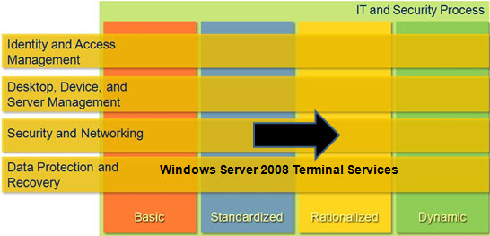
Terminal Services in Windows Server 2008 and the Core Infrastructure Optimization Model
Notes:
<This slide shows the effect that Terminal Services in Windows Server 2008 has on infrastructure maturity as reflected in the Core Infrastructure Optimization Model.>
IT infrastructure is a strategic asset and the critical foundation upon which software can deliver services and user applications that a business needs to operate effectively and to succeed. For many organizations, growth and rapid developments in new technologies have resulted in data center and desktop infrastructures that are overly complex, inflexible, and difficult to manage and that have built-in costs that are not only high but somewhat fixed, regardless of changing business requirements.
Most organizations recognize the importance of an optimized and cost-efficient IT infrastructure, and they have tried to rationalize their infrastructure and increase their operational efficiency through initiatives such as data center consolidation, desktop standardization, implementing IT operational best practices, and so on. Such initiatives undertaken by IT departments in isolation are not sufficient on their own to deliver the desired and long-lasting improvements that the business demands. To achieve a sustained improvement in their IT infrastructure, organizations must take a longer-term strategic view of IT infrastructure maturity and link these capability and maturity improvements to their business needs and overall business strategy.
The Core Infrastructure Optimization Model helps customers realize dramatic cost savings for their IT infrastructure by moving from an unmanaged environment toward a dynamic environment. Security improves from highly vulnerable in a basic infrastructure to dynamically proactive in a more mature infrastructure. IT infrastructure management changes from highly manual and reactive to highly automated and proactive. For more information, see “Microsoft Infrastructure Optimization Journey,” at http://technet.microsoft.com/en-ca/infrastructure/bb870589.aspx.
According to the Core Infrastructure Optimization Model (Core IO), organizations that are actively pursuing Terminal Services in Windows Server 2008 are meeting one of the requirements to move to the rationalized level.

Slide 5
Purpose and Overview
Purpose
To provide guidance for designing a Terminal Services infrastructure
Agenda
Terminal Services in Windows Server 2008 features
Terminal Services infrastructure design process
Notes:
This guide focuses on the elements that organizations must consider when designing a Terminal Services infrastructure.
Note Out of scope:
Remote Assistance, Remote Desktop for Administration
Remote- or multi-tenant hosting
Migration from prior Terminal Services editions
Non-Microsoft add-ons such as Citrix
Application virtualization

Slide 6
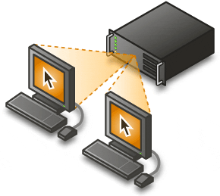
Terminal Services in Windows Server 2008 Overview
Presentation virtualization segment of Microsoft’s virtualization technologies
Enables centralized application management
Notes:
With presentation virtualization, processing happens on a server, while graphics and application interaction are handled remotely on the user’s computer.
Updates and upgrades can occur at the server rather than on each client computer.
Users can be local, at a branch office, at home, or anywhere there’s an Internet connection.
Note Slide graphic reprinted from http://www.microsoft.com/virtualization/solution-tech-presentation.mspx

Slide 7
New Features in Windows Server 2008
TS RemoteApp
Shortcuts on the Start menu
TS Web Access
Launch Terminal Services applications through a Web page
TS Gateway
Remote access without virtual private networks (VPNs)
TS Session Broker
Load balancing
TS Easy Print
No more printer driver confusion
Notes:
Some of the enhancements to Terminal Services in Windows Server 2008 include:
TS RemoteApp integrates Terminal Services application shortcuts with the desktop and Start menu:
No need to launch an application from the Remote Desktop Protocol (RDP) client.
TS Web Access presents the Terminal Services applications available to a user through a Web page.
TS Gateway provides a means for remote users to connect to Terminal Services through a firewall securely without a VPN client.
TS Session Broker directs a new connection to a terminal server farm to the server with the fewest sessions. TS Session Broker also ensures that a user with a disconnected session reconnects to the server from which he or she was disconnected.
TS Easy Print could be called virtual printing. When the user wants to print, the terminal server sends an .xml file to the client. It’s the client that actually sends the job to the printer. This behavior removes the need to have a driver for each printer loaded on the terminal server and solves many of the printer problems in earlier versions.

Slide 8
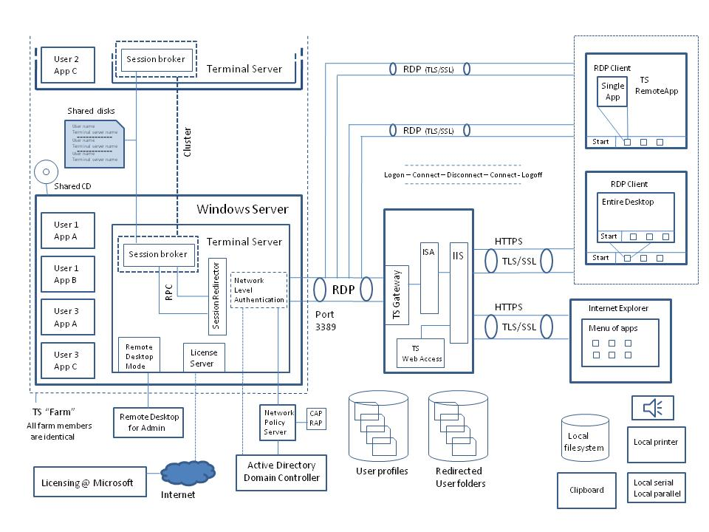
Terminal Services in Windows Server 2008 Architecture
Notes:
This diagram illustrates the relationship between the components that can work together to publish applications through Terminal Services. This is one possible configuration:
Three types of client connections are shown on the right: One inside the firewall, two outside.
The clients outside the firewall connect through TS Gateway and Microsoft® Internet Security and Acceleration (ISA) Server.
One client is using TS Web Access.
The secure, certificate-based connection transfers the client’s connection as RDP data on the corporate network:
From this point, the three clients, TS Web Access, the RDP client with a served desktop, and the RDP client using TS RemoteApp look the same to the Terminal Services infrastructure.
The client computer connects to the load-balanced terminal server farm, and a session redirector asks the TS Session Broker which terminal server to send the client to.
A session redirector is a terminal server that only accepts new connections from client computers, then authenticates and redirects the client computer to the TS Session Broker, offloading those tasks from the terminal servers.
TS Session Broker selects the terminal server with the fewest active sessions, then directs the client computer to connect there. A Terminal Services session is created between the client computer and the terminal server, and the application or desktop is displayed on the client computer’s terminal. The data sent through the TS Gateway is encrypted before being sent to the client computer.

Slide 9
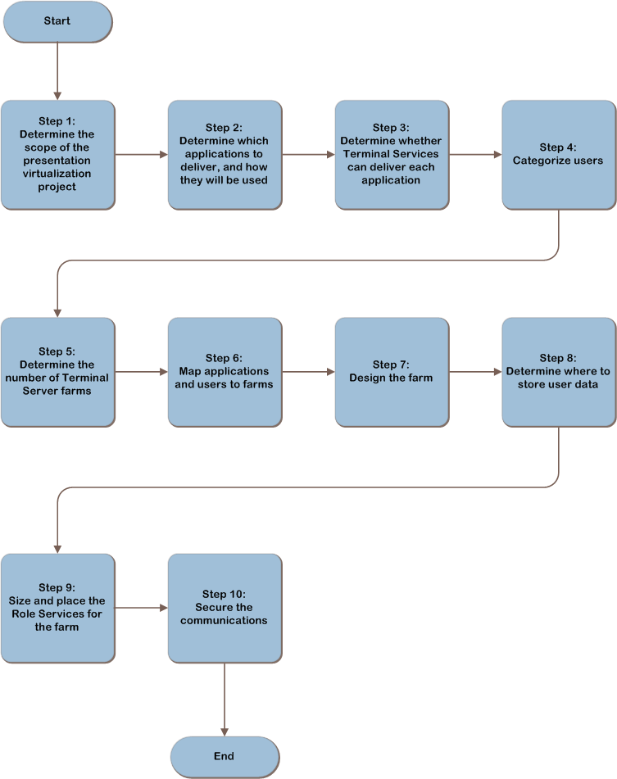
Terminal Services Decision Flow
Notes:
These are the steps we will follow to design a Terminal Services infrastructure.

Slide 10
Determine the Scope of the Presentation Virtualization Project
1
2
3
4
5
6
7
8
9
10
Determine the location scope
Which locations will be served by this implementation?
Determine the application scope
Define which applications Terminal Services will host
What benefits are desired from presentation virtualization?
Cost
Service levels
Remote access
Centralized management
Application compatibility fix
Platform independence
Notes:
<Communicate the value of determining and recording the scope of the project.>
Locations: Corporate network, branch office, home office, Internet café, hotel.
Each location presents different issues that must be considered during the design process.
What will be served by Terminal Services?
Applications: Which applications?
Full desktop: Treated as another application.
Be sure to record the business objectives and goals here to keep them in focus.

Slide 11
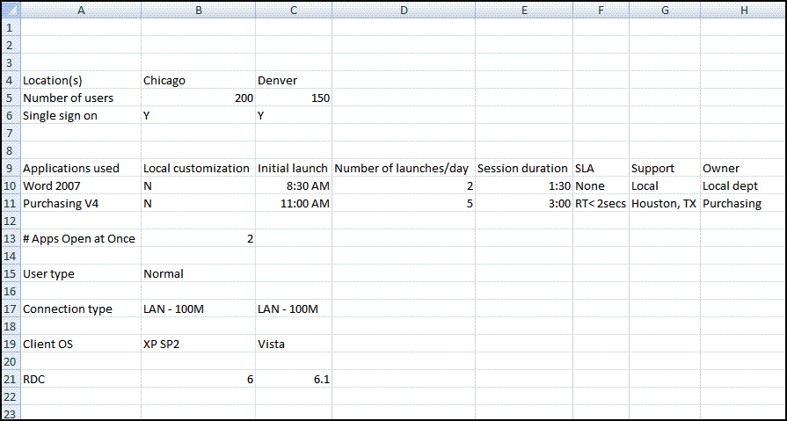
Determine Which Applications to Deliver and How They Will Be Used
1
2
3
4
5
6
7
8
9
10
Gather information about users and applications
Numbers of users
Applications they run
Customizations and requirements
Notes:
<This step’s goal is to look at the user populations that fall within the scope of the project and to determine which applications each person uses and how he or she uses them.>
Information collected on the job aid from Appendix A:
Number of users at each location.
Whether single sign-on (SSO) is required.
Applications, their use, and who supports them.
RDC client information.
Connection information.

Slide 12
Determine Whether Terminal Services Can Deliver Each Application
1
2
3
4
5
6
7
8
9
10
Examine each application’s capability to be served
Possible business issues
Licensing cost and issues
Legal
Potential technical issues
Operating system compatibility
Multi-user environment compatibility
Server resource use
Bandwidth use
Rank applications by suitability
Good candidate
Some issues
Not suitable for Terminal Services
Notes:
<Emphasize that while most applications will run on Terminal Services, there are a few cases in which an application is not suitable for a multi-user environment.>
Applications not yet ready for Terminal Services can often be made suitable using a different virtualization technology, such as Microsoft Application Virtualization 4.5.
<After viewing this slide and having a brief discussion of the bullet points, use the Appendix B Job Aid on the next slide to discuss the possible issues in this step.>

Slide 13
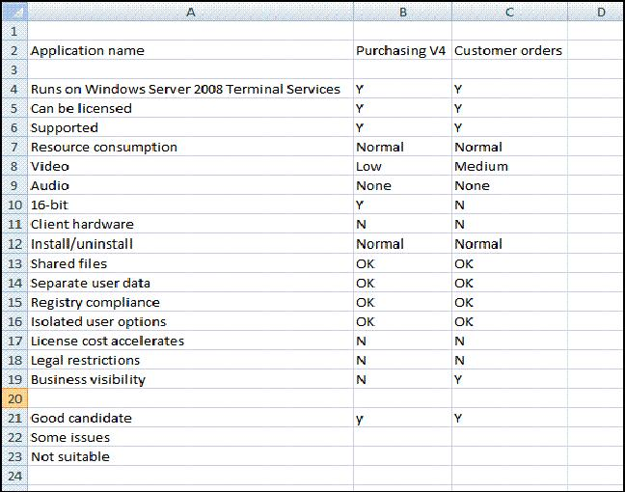
Appendix B Job Aid
1
2
3
4
5
6
7
8
9
10
Notes:
Can the application run on Windows Server 2008? Will the vendor license support the application in a multi-user environment? An application may still be a good candidate for inclusion without direct vendor support. Be sure to consider the risks.
Server resource usage: Processor, memory, disk input/output (i/o), etc., required to run the application.
Video/audio intensity pertains to bandwidth use.
Multi-user environment considerations:
Does the application alter shared files (for example, fonts, DLLs, drivers)?
Affects system stability as well as application integrity.
Does the application differentiate between each user and keep the data separate?
Can user A overwrite work saved by user B?
Does the application let Terminal Services redirect registry access?
Terminal Services typically redirects changes sent to HKEY Local Machine to HKEY Current User.
Does the application keep each user’s options separate?
When user A changes her application’s options, she inadvertently changes those options for everyone on that server.
Does the licensing model for the application make using it cost-prohibitive in a Terminal Services environment?
Check with the vendor.
Are there other legal restrictions?
National security or trade restrictions.
Confidential patient data.
Does excluding the application undermine the Terminal Services project goals set in step 1?
If so, would software virtualization over Terminal Services salvage the project?

Slide 14
Categorize Users
1
2
3
4
5
6
7
8
9
10
Categorize how users use their computers
Helps with factoring the number and size of the terminal servers
Heavy user
Has specialized applications, uses advanced application features, and spends most of the day at the computer
Graphic artist, engineer, developer
Normal user
Frequent computer use but runs mostly spreadsheets, e-mail client, and word-processing applications
Administrative assistant, salesperson, producer
Light user
Uses the computer infrequently to check e-mail or participate in a workflow
Hospital volunteer, baker, assembly line worker
Notes:
<Because applications execute in a shared environment on a remote server, sizing can be difficult to estimate. This exercise helps us get an idea of how much usage to assign to each user.>

Slide 15
Determine the Number of Terminal Server Farms
1
2
3
4
5
6
7
8
9
10
Each server in a farm
Same applications installed
Configured identically
Start with one farm and add more farms only as necessary
Conditions that may require the implementation of additional farms:
Large branch offices | Remote users
Software issues | Different roles
Encryption levels | Security considerations
Business | Legal
Notes:
< Emphasize that a load-balanced server farm must have the same applications with the same configurations because users may connect to any of the servers, and the requested application must be there.>
Branch office: A small office could connect to the corporate farm over the Internet, but if there’s a sufficient number of users at the remote site, a server farm located there may be necessary.
Remote users: Is there enough bandwidth to accommodate people connecting over the Internet? Would a farm located nearer the traveling user help deliver better performance?
Software: New and old versions of the same software or different levels of system files such as DLLs are required.
Different Terminal Services roles: The server farm for Accounting may need to be on a different farm than the kiosk system in the lobbies.
Encryption levels: A financial application needs 128-bit encryption. Some 56-bit client computers that don’t need to connect to the financial application still need to use a word-processing application.
Security: An application must be on a server that is inaccessible to all but a certain group of users, or certain data cannot travel on a shared line off-site.
Business: Similar to security, financial or executive staff members need their data separated from other users.
Legal: National security, privacy issues, and fiduciary laws could require the separation of certain data or prevent other data from crossing national borders.

Slide 16
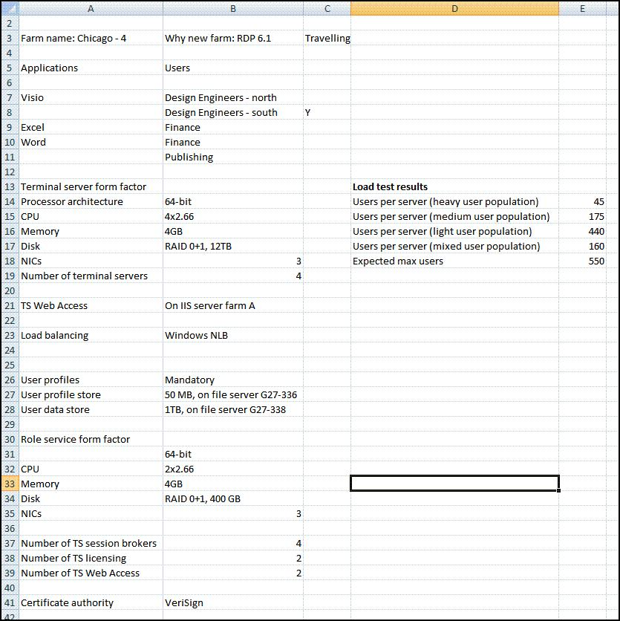
Map Applications and Users to Farms
1
2
3
4
5
6
7
8
9
10
Notes:
<Using the results of step 5, map users to their respective farms. Note that a user may be mapped to more than one farm if he or she needs access to applications on those farms.>
Record which applications each farm will carry.
Record which users will connect to those applications.
If mobile users connect to the farm, record that, as well.
Repeat this process for each application on each farm.

Slide 17
Design the Farm
1
2
3
4
5
6
7
8
9
10
Select a form factor for the server
CPU, memory, disks, disk capacity
Determine the number of terminal servers required in the farm
Number of users/maximum number of users per server = number of servers needed to handle a maximum load
Determine the number of additional servers required for fault tolerance
Extra servers for increased user capacity in case a server goes offline
Determine the number of servers required for TS Web Access
Cannot be shared between farms
Notes:
<Perform step 7 for each farm defined in step 5. Record the data on the Job Aid from Appendix C.>
We now know which applications will be on each farm and the number of users who will be using them. It is time to design the farms and the terminal servers in them:
Form factor: Although servers in a farm must have the same applications on them, the hardware can vary. Best practice is to have the same hardware for each server, because this aids in deciding the number of servers required.
Number of servers: Estimate how many typical user sessions each server can handle, then add enough servers to handle all the users.
Method 1: Build a terminal server, and run either a simulated or real load. Record how many concurrent users can be handled for calculating the number of servers needed.
Method 2: Extrapolate an estimate based on resources a typical user requires on a client computer. Determine how many users can be handled on a server given the typical user statistics, and then record the number.
Appendix D offers instructions for taking measurements.
Fault tolerance: Terminal servers cannot use Microsoft Cluster Service. Therefore, add extra capacity (that is, servers) to take up the load of a server going offline for repair or maintenance.
TS Web Access: The TS Web Access role cannot be shared between farms; each farm must have its own TS Web Access role. The role can be on a server performing other roles, such as Web server, file server, or print server. Add servers for TS Web Access if required.

Slide 18
Step 7 Job Aid
1
2
3
4
5
6
7
8
9
10
Notes:
<Reiterate that you repeat step 7 for each farm.>
Here is a farm with data entered through step 7.

Slide 19
Determine Where to Store User Data
1
2
3
4
5
6
7
8
9
10
Decide user profile policy/storage location
Mandatory versus Roaming
Storage size and location
Different profiles for different farms necessary?
\\fileserver\share\%FarmName%\%username%
Decide user data policy/storage locations
Space required
Storage location
Design storage for user profiles and data
Capacity required for all users
Performance
Fault tolerance
Notes:
<Point out that user profiles and data should never be stored on the terminal server because the user could connect to other servers or because the server storing the data may be unavailable.>
User profiles for Terminal Services can be stored in a different location from their Active Directory® directory service profile location:
Roaming profiles in Terminal Services are like any other roaming profile: Profile information and settings are saved somewhere on the network and downloaded to whichever server the user logs on to.
Mandatory profiles are the same for all users with that profile, and any changes are lost when the user logs off:
Much simpler to manage and requires very little storage.
Useful for multi-user client computers such as in call centers, on shop floors, and kiosk terminals.
Size and location: If roaming profiles are used, how large will each one be allow to grow?
The storage location should be on a high-speed link available to the terminal server (as opposed to the client computer).
Different profiles for different farms: The %FarmName% variable will be replaced with the name of the terminal server farm during logon.
Factor in user data storage space, as well.
When the size of a user’s profile and data is determined, design the storage, and record the information in the Appendix C Job Aid:
Capacity: The number of users * (profile storage + data storage)
Note Each mandatory profile requires only one copy. That copy is then used for each user assigned that profile.
Performance is key for smoother and faster logons. If it takes 60 seconds to download a 10 MB profile, the logon time is that much longer.
Fault tolerance: If losing any of this data could be a problem, the file storage should be fault tolerant and backed up.

Slide 20
Size and Place the Terminal Services Role Services for the Farm
1
2
3
4
5
6
7
8
9
10
Design and place the Terminal Services Session Brokers
Place at least one TS Session Broker anywhere there is a geographically separated farm, then add more to provide fault tolerance and handle load
Design and place the Terminal Services Licensing Servers
Start with one TS Licensing server, add another for fault tolerance, then add more as necessary to handle the load
Notes:
<These Terminal Services role servers can service more than one farm across multiple domains in a forest. Be sure to make them fault tolerant because they could present a single point of failure for the farms they service. Note, too, that these three roles can be hosted on virtual machines.>

Slide 21
Size and Place the Terminal Services Role Services for the Farm
1
2
3
4
5
6
7
8
9
10
Design and place the Terminal Services Gateway servers
Only needed if users without VPN access require access through a firewall
At least one fault-tolerant TS Gateway at each point of access through a firewall
Requires a certificate that is either self-signed or trusted certification authority (CA)
Can be combined with Microsoft Internet Security and Acceleration (ISA) Server or Microsoft Forefront™ Internet Application Gateway for increased security
If uncertain how many role servers are required, a load test can be performed to measure capacity
Notes:
<If non-VPN users are going to connect through the firewall, a TS Gateway can be employed to provide secure access.>
The TS Gateway role is a heavier load on the server than the TS Session Broker and TS Licensing roles.
Place at least one fault-tolerant TS Gateway at each firewall through which users need to connect.
Users can connect through an RDP client or Hypertext Transfer Protocol over Secure Sockets Layer (HTTPS): Either way, a certificate must be installed on the TS Gateway, and the client computer must trust that certificate.
Measure the load on a TS Gateway to determine how many certificates will be required at each entry.

Slide 22
Job Aid with Role Server Information Added
1
2
3
4
5
6
7
8
9
10
Notes:
<Design document with roles servers added.>

Slide 23
Secure the Communications
1
2
3
4
5
6
7
8
9
10
Determine the encryption level between client computers and the terminal server
56 bit, 128 bit, Federal Information Processing (FIPS) 140
Determine whether to seal the communications
Use Transport Layer Security (TLS)/Secure Sockets Layer (SSL) to prevent a man-in-the-middle attack
Determine the CA
Determine whether to encapsulate with Hypertext Transfer Protocol over SSL (HTTPS)
Require HTTPS Web access so port 3389 can be closed on the firewall.
Notes:
<Explain that the maximum security levels available are largely based on the RDP client version.>
The minimum encryption level required to connect is determined by the terminal server and set either locally or through Group Policy.
The maximum encryption level a client computer can use is determined by the RDP client version and which country or region the user is in.
If a client computer is configured to connect only after certificate authentication, the user can be assured that he or she is connecting to the right server and not to a “man-in-the-middle” posing as the destination server.
Self-signed: The certificate is issued by the TS Gateway and must be installed on every computer connecting through the TS Gateway.
Corporate CA: A server on the corporate network that issues certificates, this computer can easily install certificates on computers logged on to the network, but remote computers must still accept the certificate and install it.
Trusted third-party CA: Each client computer should already have this certificate installed and trusted. It is expensive but poses no distribution concerns.
The RDP client requires port access through port 3389. If port 3389 will be closed, users must connect over HTTPS port 443 or through a VPN tunnel.

Slide 24
Conclusion
If designed properly, Terminal Services in Windows Server 2008 can save the organization money while increasing security and application availability
Planning is key
This guide offers major architectural guidance.
Refer to product documentation for additional details.
All the IPD Guides are available at www.microsoft.com/ipd

Slide 25
Questions?

