Slide 1
Microsoft® System Center
Service Manager 2010
Infrastructure Planning and Design
Published: December 2010
Notes:
Copyright © 2010 Microsoft Corporation. All rights reserved. Complying with the applicable copyright laws is your responsibility. By using or providing feedback on this documentation, you agree to the license agreement below.
If you are using this documentation solely for non-commercial purposes internally within YOUR company or organization, then this documentation is licensed to you under the Creative Commons Attribution-NonCommercial License. To view a copy of this license, visit http://creativecommons.org/licenses/by-nc/2.5/ or send a letter to Creative Commons, 543 Howard Street, 5th Floor, San Francisco, California, 94105, USA.
This documentation is provided to you for informational purposes only, and is provided to you entirely "AS IS". Your use of the documentation cannot be understood as substituting for customized service and information that might be developed by Microsoft Corporation for a particular user based upon that user’s particular environment. To the extent permitted by law, MICROSOFT MAKES NO WARRANTY OF ANY KIND, DISCLAIMS ALL EXPRESS, IMPLIED AND STATUTORY WARRANTIES, AND ASSUMES NO LIABILITY TO YOU FOR ANY DAMAGES OF ANY TYPE IN CONNECTION WITH THESE MATERIALS OR ANY INTELLECTUAL PROPERTY IN THEM.
Microsoft may have patents, patent applications, trademarks, or other intellectual property rights covering subject matter within this documentation. Except as provided in a separate agreement from Microsoft, your use of this document does not give you any license to these patents, trademarks or other intellectual property.
Information in this document, including URL and other Internet Web site references, is subject to change without notice. Unless otherwise noted, the example companies, organizations, products, domain names, e-mail addresses, logos, people, places and events depicted herein are fictitious.
Microsoft, Active Directory, SharePoint, and Windows are either registered trademarks or trademarks of Microsoft Corporation in the United States and/or other countries and regions.
The names of actual companies and products mentioned herein may be the trademarks of their respective owners.
You have no obligation to give Microsoft any suggestions, comments or other feedback ("Feedback") relating to the documentation. However, if you do provide any Feedback to Microsoft then you provide to Microsoft, without charge, the right to use, share and commercialize your Feedback in any way and for any purpose. You also give to third parties, without charge, any patent rights needed for their products, technologies and services to use or interface with any specific parts of a Microsoft software or service that includes the Feedback. You will not give Feedback that is subject to a license that requires Microsoft to license its software or documentation to third parties because we include your Feedback in them.

Slide 2
What Is IPD? Guidance that clarifies and streamlines the planning and design process for Microsoft infrastructure technologies
IPD:
Defines decision flow
Describes decisions to be made
Relates decisions and options for the business
Frames additional questions for business understanding
IPD guides are available at www.microsoft.com/ipd
Notes:
Infrastructure Planning and Design (IPD) is a series of planning and design guides created to clarify and streamline the planning and design process for Microsoft® infrastructure technologies.
Each guide in the series addresses a unique infrastructure technology or scenario.
These guides include the following topics:
Defining the technical decision flow (flow chart) through the planning process.
Describing the decisions to be made and the commonly available options to consider in making the decisions.
Relating the decisions and options for the business in terms of cost, complexity, and other characteristics.
Framing the decisions in terms of additional questions for the business to ensure a comprehensive understanding of the appropriate business landscape.
The guides in this series are intended to complement and augment Microsoft product documentation. It is assumed that the reader has a basic understanding of the technologies discussed in these guides. It is the intent of these guides to define business requirements, then align those business requirements to product capabilities, and design the appropriate infrastructure.

Slide 3
Getting Started
Microsoft System Center
Service Manager 2010
Notes:
The guide was created to enable infrastructure planners to design a Microsoft System Center Service Manager 2010 infrastructure.
The guide includes specific design information and activities that encourage sound planning.
Each activity includes:
Prerequisites and background on the activity.
Tasks that will be performed to complete the activity.
Reference information regarding the activity’s impact on characteristics such as the cost, complexity, and capacity of the solution.
Questions to ensure that business needs are captured and reflected in the solution.
The guide is written for information technology (IT) infrastructure specialists who are responsible for planning and designing the infrastructure for System Center Service Manager 2010.

Slide 4
Purpose and Overview
Purpose
To provide design guidance for a Microsoft System Center Service Manager 2010 infrastructure
Overview
System Center Service Manager architecture
System Center Service Manager infrastructure design process
Notes:
The guide focuses on the elements that organizations must consider when designing a System Center Service Manager 2010 infrastructure.

Slide 5
What Is System Center Service Manager 2010?
Service Manager provides:
An integrated platform for automating and adapting an organization’s IT service management best practices
Built-in processes for incident and problem resolution, change control, and asset lifecycle management
Notes:
System Center Service Manager 2010 provides an integrated platform for automating and adapting an organization’s IT service management best practices, such as those found in Microsoft Operations Framework (MOF) and Information Technology Infrastructure Library (ITIL). It provides built-in processes for incident and problem resolution, change control, and asset lifecycle management. It is assumed that the reader has some knowledge of Service Manager.
To develop and implement a successful Service Manager design, many decisions must be made and strategies determined. Considerations for performance, security, manageability, scalability, and other criteria must be addressed if the design is to be successful.
The purpose of this guide is to assist infrastructure architects in the decision-making process by providing a clear and concise path for designing the Service Manager infrastructure. This guide relies on best practices and real-world experience to offer considerations and alternatives at each point in the design.
This guide, when used in conjunction with product documentation, will help organizations confidently plan a Service Manager implementation. The Appendix includes sample job aids for recording the decisions made during the design process.

Slide 6
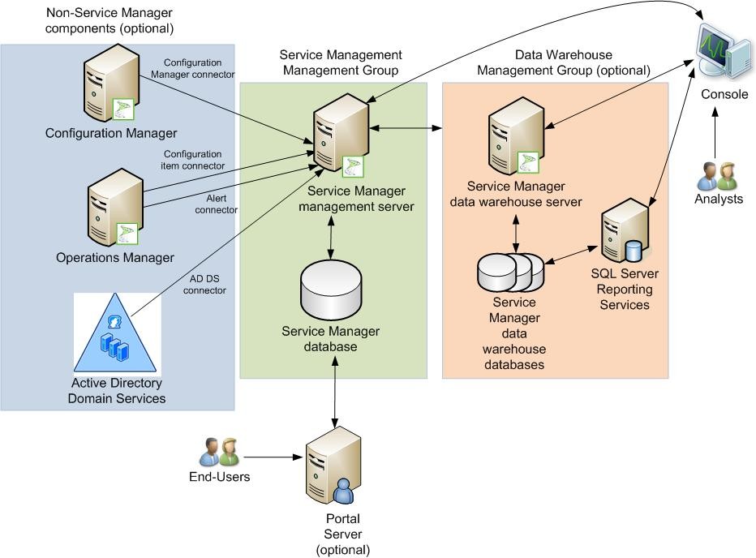
Service Manager Architecture Example
ITA
Notes:
This diagram illustrates the relationship between the components that work together to provide an architecture for Service Manager. They are shown together in one possible implementation for illustration purposes, but other configurations are possible.
The mandatory roles for a Service Manager implementation are:
Service Manager management server
Service Manager database
Service Manager console
The optional components of a Service Manager implementation are:
Additional Service Manager management servers
Service Manager Self-Service Portal servers
Data warehouse database
Data warehouse management server
Service Manager authoring console

Slide 7
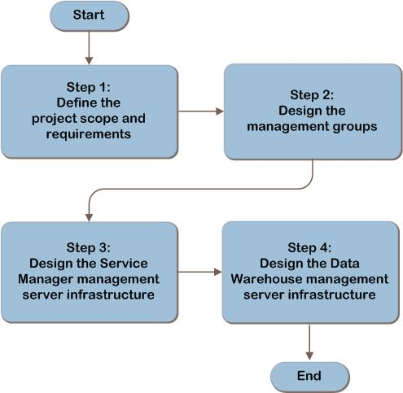
Service Manager Decision Flow
MAP w/ CAL Tracker
Notes:
The Service Manager design flow provides a graphical overview of the steps in designing a Service Manager infrastructure.
These steps are:
Define the Project Scope and Requirements
Design the Management Groups
Design the Service Manager Management Server Infrastructure
Design the Data Warehouse Management Server Infrastructure
Each of these steps will be discussed in greater detail in the following slides.

Slide 8
Step 1: Define the Project Scope and Requirements
Task 1: Determine the Business Requirements
What parts of organization included?
Applicable business or governance policies?
IT GRC Process Management Pack needed?
Relationship with other systems?
Any add-in management packs?
Historical retention?
Provide key info in graphical format without using console?
Portal needed?
Should end users be able to request software?
What are the availability requirements?
Notes:
Step 1: Define the Project Scope and Requirements
Task 1: Determine the Business Requirements
The following questions should be asked of the business to determine the scope and the features that will be implemented:
Which parts of the organization will be participating?
Would a business or governance policy impact the design of the system?
Does the business have a need to automate the enforcement and measurement of IT controls through the IT lifecycle?
What relationship will Service Manager have with other systems or information sources?
Does the business plan to implement any add-in management packs to extend the functionality of Service Manager?
Is historical retention of and reporting on change or incident information required?
Does the business want to provide management access to key information in a graphical format without using a console?
Does the business want end users to be able to interact directly with Service Manager via a portal?
Does the business want to provide the ability for end users to request software, which is deployed as a software package by System Center Configuration Manager?
Availability Requirements
Careful consideration should be given to the availability requirements for each functional area. The business should understand and rate the significance of the risk of possible data loss or interruption of business, and then the architect will use this information to select an appropriate fault-tolerance approach for the systems involved.

Slide 9
Step 1: Define the Project Scope and Requirements (Continued)
Task 2: Determine the Technical Requirements
Number of computers?
Expected usage?
Number of end users accessing portal?
Number of analysts in each location?
Integration with Active Directory® Domain Services?
Integration with System Center Operations Manager?
Integration with System Center Configuration Manager?
Any other custom connectors?
Any special management pack requirements?
Notes:
Step 1: Define the Project Scope and Requirements (Continued)
Task 2: Determine the Technical Requirements
In this task, information will be gathered from the technical decision-makers in the organization to determine the scope and requirements of the Service Manager implementation.
Capacity Requirements
Ask the following questions of the technical personnel in the organization:
What is the approximate number of computers that will be included?
What is the expected usage?
What is the approximate number of end users who may access the portal?
What is the approximate number of analysts in each location?
Connector Requirements
The following questions should be asked to determine the import and synchronization methods in scope:
Will Service Manager integrate with Active Directory Domain Services, and if so, which forests are in scope?
Will Service Manager integrate with System Center Operations Manager?
Will Service Manager integrate with System Center Configuration Manager, and if so, which site databases?
Are there any other custom connectors that will be used to integrate Service Manager with other systems?
Management Pack Requirements
Service Manager is a platform that is used to manage service management information using management packs. A management pack is a grouping of classes, workflows, views, forms, reports, and knowledge that extends Service Manager with the information necessary to implement all or part of a service management process. For example, the Incident Management pack provides the necessary information to enable Service Manager to implement the incident management process.

Slide 10
Step 2: Design the Management Groups
Task 1: Determine the Number of Service Manager Management Groups
Service Manager management groups are used to define an administrative boundary for managed devices
Task 2: Determine the Number of Data Warehouse Management Groups
The data warehouse components are optional and may be implemented to provide reporting, storage of data, and/or to assist with performance issues
Task 3: Align Service Manager Management Groups to Data Warehouse Management Groups
Complete this task if it was decided in Task 2 that data warehouse management groups were required
Notes:
Step 2: Design the Management Groups
Task 1: Determine the Number of Service Manager Management Groups
Service Manager management groups are used to define an administrative boundary for managed devices. The Service Manager database stores all the configuration information and configuration items for a management group. An organization can have one or more management groups to define different administrative boundaries for managed devices.
Start with a single Service Manager management group, and add additional only if needed for:
Larger scale deployments.
Security and administrative requirements.
Separate test environments.
Disaster recovery functionality.
Task 2: Determine the Number of Data Warehouse Management Groups
The data warehouse components are optional and may be implemented to provide reporting, storage of data, and/or to assist with performance issues. In this task, it will be determined whether the data warehouse is required, and if so, the number of data warehouse management groups will be determined.
Task 3: Align Service Manager Management Groups to Data Warehouse Management Groups
This task only needs to be completed if it was decided in Task 2 that data warehouse management groups were required.
Determine which Service Manager management groups will have their historical information extracted to each data warehouse management group. As indicated previously, there is a maximum of five Service Manager management groups that can have data archived to a given data warehouse management group.

Slide 11
Step 3: Design the Service Manager Management Server Infrastructure
Task 1: Determine the Placement of Each Component
The Service Manager management servers and databases should be well connected via LAN or very high-speed WAN (50 milliseconds or less latency)
Task 2: Determine the Number of Servers Required for Scaling
The constraints of the software will be applied to determine the number of Service Manager management servers and Service Manager Self-Service Portals required for scaling
Add additional management servers for every 40-60 consoles
Notes:
Step 3: Design the Service Manager Management Server Infrastructure
Task 1: Determine the Placement of Each Component
The Service Manager management servers and databases should be well-connected via local area network (LAN) or very high-speed wide area network (WAN) with less than 50 milliseconds (ms) latency between them. While the database can be located on the same computer as the management server, the most common reason for deploying the database on a separate server is performance gain from role specialization. Deploying them separately isolates them for potentially easier recovery from disaster-type scenarios because they have different fault tolerance options. (The database can be clustered, but the management server cannot. This will be discussed further in Task 3.) The Service Manager management server cannot coexist on the same computer with the data warehouse management server.
Task 2: Determine the Number of Servers Required for Scaling
In this task, the constraints of the software will be applied to determine the number of Service Manager Self-Service Portals and Service Manager management servers required for scaling.
Service Manager Management Servers - Multiple Service Manager management servers may be required for:
Scaling of console connections.
Dedicating a management server to running workflows.
Warm standby for quicker recovery of workflow management server.
Service Manager Self-Service Portal - This runs on an Internet Information Services (IIS) server. It may be installed separately or in combination with the Service Manager database or data warehouse databases in production, or the management server in non-production environments. The database and management server components typically use more resources than the portal, although this is partially determined by what custom workflows are in place and how many user transactions are expected. If it’s expected that the Self-Service Portal will be heavily burdened, the first step is to move it to a dedicated server, then to deploy multiple portal servers in a load-balanced configuration if required for scaling.

Slide 12
Step 3: Design the Service Manager Management Server Infrastructure (Continued)
Task 3: Apply Fault-Tolerance Requirements
Use fault tolerance for all services that have an impact on user-facing or business-essential scenarios
Use load balancing for fault tolerance of management server console connections
Use clustering, log shipping, or mirroring for SQL Server® database
Use load balancing for Service Manager Self-Service Portal
Notes:
Step 3: Design the Service Manager Management Server Infrastructure (Continued)
Task 3: Apply Fault-Tolerance Requirements
Service Manager Management Servers - The Service Manager management server is not cluster-aware.
Server running the workflows. The workflow management server is a single point of failure. There are no fault-tolerance options such as clustering or load-balancing that are workflow-aware. If this server fails, the workflows and connectors will fail to run, and manual administrator intervention will be required to restore it to service.
Additional management servers. For console connections, additional servers may be deployed in a hardware or software load-balanced configuration to provide fault tolerance. Each management server must be configured to communicate with the same Service Manager database. The Service Manager clients should communicate with the Service Manager management servers via the load-balanced IP or host name and not the actual hosts in order to automatically adjust if one of the nodes in the load-balanced management servers fails
Service Manager Database - Clustering, log shipping, and mirroring are the only supported SQL Server fault-tolerance options in Service Manager; however, the management servers must be installed on separate servers if SQL Server clustering is used since the Service Manager management service is incompatible with clustering (not only is it not cluster-aware, but the management service will not function if installed on the SQL Server cluster). For off-site redundancy, log shipping is the method currently supported by the product group.
Self-Service Portal - The Self-Service Portal is not cluster-aware. Multiple servers may be deployed in a hardware or software load-balancing configuration to provide fault tolerance. Note that the Self-Service Portal should not be coupled with the management server since it does not need it. If it was decided in Task 2 to implement the Self-Service Portal in a load-balanced configuration for scale-out, then fault tolerance is also provided by this configuration, as long as an adequate number of servers are deployed to accommodate the users in case of actual failure of a node in the load-balanced farm.

Slide 13
Step 3: Design the Service Manager Management Server Infrastructure (Continued)
Task 4: Determine the Hardware Configuration
Virtualization supported
See table on next slide for details on which roles can be co-located
Product group minimums:
Service Manager management server:
Dual quad-core 2.66-GHz CPU
8 gigabytes (GB) of RAM
10 GB of available disk space
Service Manager database server:
Dual quad-core 2.66-GHz CPU
8 GB of RAM
80 GB of available disk space
Service Manager Self-Service Portal servers:
Dual quad-core 2.66-GHz CPU
8 GB of RAM
10 GB of available disk space
Notes:
Step 3: Design the Service Manager Management Server Infrastructure (Continued)
Task 4: Determine the Hardware Configuration
Service Manager supports a variety of deployment topologies. Each of the main components of Service Manager may be installed either separately or in some combination as described below. The Service Manager components can be run in a virtualized environment or in a physical server environment.
Service Manager Management Servers - Factors that influence the load on the Service Manager management server include the following: number of computers being managed, rate of instance space changes, and number of consoles, portals, and other System Center Data Access service clients running simultaneously.
Service Manager Databases - The database can be co-located on a Service Manager management server if there are no conflicts between the fault-tolerance configurations selected. It can share a server or participate in a cluster with the data warehouse databases. Another possible driver for placing the Service Manager database on a separate server is if the organization’s policies dictate that a separate team manages the database infrastructure.
Service Manager Self-Service Portal Servers - Performance testing by the product group for the Service Manager Self-Service Portal was focused on typical “Monday morning” scenarios. Specifically, that means ensuring that on Monday morning hundreds of users can log in within the span of 5-10 minutes and open incidents with acceptable (less than 4-5 seconds) response times. The product group recommends deploying the Service Manager Self-Service Portal on a stand-alone server, separate from other Service Manager components. It is possible but not recommended by the product group to install the Service Manager Self-Service Portal on the same server as the Service Manager management server for non-production environments.

Slide 14
Step 3: Design the Service Manager Management Server Infrastructure (Continued)
Component | Description
Management server | Minimum number required: 1 per management group Maximum number possible: No limits Fault tolerance option: Load balancing available for console connections (The management server running workflows cannot be made fault tolerant.) Dependent on: Service Manager database Can co-exist with: Service Manager Self-Service portal, Service Manager database, Data Warehouse databases Cannot be combined with the Data Warehouse management server
Service Manager database | Minimum number required: 1 per management group Maximum number possible: 1 per management group Fault tolerance options: SQL Server clustering, log shipping, and mirroring Dependent on: Service Manager management server Can co-exist with: Any other role
Service Manager management group | Minimum number required: 1 per organization Maximum number possible: 5 per Data Warehouse management group
Service Manager Self-Service portal | Minimum number required: None Maximum number possible: No limits Fault tolerance option: Load balancing Dependent on: Service Manager management server and Service Manager database Can co-exist with: Service Manager database, Data Warehouse databases Not recommended to install on the Service Manager management server in production environments Not supported to install on the Data Warehouse management server
Notes:
Step 3: Design the Service Manager Management Server Infrastructure (Continued)
Component: Management server
Description:
Minimum number required: 1 per Service Manager management group
Maximum number possible: No limits
Fault-tolerance option: Load balancing available for console connections (The management server running workflows cannot be made fault tolerant)
Dependent on: Service Manager database
Can coexist with: Service Manager Self-Service Portal, Service Manager database, data warehouse databases
Cannot be combined with the data warehouse management server
Component: Service Manager database
Description:
Minimum number required: 1 per Service Manager management group
Maximum number possible: 1 per management group
Fault-tolerance options: SQL Server clustering, log shipping, and mirroring
Dependent on: Service Manager management server
Can coexist with: Any other role
Component: Service Manager management group
Description:
Minimum number required: 1 per organization
Maximum number possible: 5 per data warehouse management group
Component: Service Manager Self-Service Portal
Description:
Minimum number required: None
Maximum number possible: No limits
Fault-tolerance option: Load balancing
Dependent on: Service Manager management server and Service Manager database
Can coexist with: Service Manager database, data warehouse databases
Not recommended to install on the Service Manager management server in production environments
Not supported to install on the data warehouse management server

Slide 15
Additional Considerations (Step 3)
SMTP server access required for notification feature and incident creation through email
After deployment, back up encryption keys and develop disaster recovery plan for management servers and database
Notes:
Additional Considerations (Step 3)
The items listed below are generally outside the scope of an infrastructure design; however, they are included here as additional considerations that the architect may need to take into account:
SMTP servers. Service Manager requires access to a Simple Mail Transfer Protocol (SMTP) server to use the notification feature and for incident creation through email.
Disaster recovery planning. After Service Manager is implemented, the architect should prepare for recovering from a disaster by backing up the encryption keys and developing the plan for recovering the management servers and database. For more information about Service Manager disaster recovery, see the System Center Service Manager 2010 SP1 Disaster Recovery Guide at http://technet.microsoft.com/en-us/library/ff625768.aspx.

Slide 16
Step 4: Design the Data Warehouse Management Server Infrastructure
Task 1: Determine the Placement of Each Component
The data warehouse management server and database should be well-connected via LAN or very high-speed WAN (50 milliseconds or less latency)
Can co-locate data warehouse database with Service Manager database
Reporting for Service Manager is installed on any valid configuration of SQL Server Reporting Services
Be aware of incompatible fault-tolerance options if co-locating roles
Notes:
Step 4: Design the Data Warehouse Management Server Infrastructure
Task 1: Determine the Placement of Each Component
The product group recommends placing the data warehouse management server and database in a location with LAN or high-speed WAN connectivity with 50 milliseconds or less round trip latency to the Service Manager management server and database.
The data warehouse management server cannot coexist on the same computer with the Service Manager management server. Additionally, it is not supported to install the Self-Service Portal on a computer hosting the data warehouse management server.
The data warehouse databases can be located on the same computer as the data warehouse management server or with the Service Manager management server; however, given that they have different fault-tolerance options, deploying them separately isolates them for potentially easier recovery from disaster-type scenarios.
The data warehouse databases could share a server or cluster with the Service Manager database. This would reduce the SQL Server® licenses required, but if the data warehouse is large, separate servers are advised by the product group. If the databases are hosted on the same server or cluster, ensure that adequate resources are allocated for the combined load.
Reporting for Service Manager is installed on SQL Server Reporting Services, and any valid configuration of SQL Server Reporting Services will support Service Manager Reporting. For optimum performance, especially in a large environment where the number of CIs increase, the product group recommends that the data warehouse databases be installed on a different server than the Service Manager reporting server.
If a dashboard view is required, the Service Manager Dashboard should be installed on an existing or a new Windows® SharePoint® Services 3.0 SP2 server or Microsoft Office SharePoint Server 2007 SP2. This role can coexist with other roles including the Service Manager Self-Service Portal.

Slide 17
Step 4: Design the Data Warehouse Management Server Infrastructure (Continued)
Task 2: Apply Fault-Tolerance Requirements for SQL Server Databases
Clustering, log shipping, and mirroring are the only supported SQL Server fault-tolerance options
No fault tolerance for data warehouse management server itself
Task 3: Determine the Hardware Configuration
Product group minimums:
Dual quad-core 2.66-GHz CPU
8 GB of RAM
10 GB of available disk space for data warehouse management server
400 GB of available disk space for data warehouse database
Notes:
Step 4: Design the Data Warehouse Management Server Infrastructure (Continued)
Task 2: Apply Fault-Tolerance Requirements for SQL Server Databases
Clustering, log shipping, and mirroring are the only supported SQL Server fault-tolerance options for the data warehouse databases and reporting services; however, the management servers must be installed on separate servers if SQL Server clustering is used because the data warehouse management service is not cluster-aware.
For off-site redundancy, log shipping is the method currently supported by the product group.
Task 3: Determine the Hardware Configuration
Data Warehouse Management Servers
The minimum product group-recommended hardware requirements for the data warehouse management server are:
Dual quad-core 2.66-GHz CPU
8 GB of RAM
10 GB of available disk space
Data Warehouse Databases
The minimum product group-recommended hardware requirements for the data warehouse database server are:
Dual quad-core 2.66-GHz CPU
8 GB of RAM (if less than 4,000 computers, 4 GB is sufficient)
400 GB of available disk space

Slide 18
Step 4: Design the Data Warehouse Management Server Infrastructure (Continued)
Component | Description
Data Warehouse management server | Minimum number required: 1 per Data Warehouse management group Maximum number possible: 1 per Data Warehouse management group Fault tolerance option: Not applicable Dependent on: Data Warehouse database Connections to the Service Manager management groups will require the Service Manager management server and Service Manager database. Can co-exist with: Service Manager database, Data Warehouse database Cannot be combined with a Service Manager management server or Service Manager Self-Service portal.
Data Warehouse database | Minimum number required: 1 per Data Warehouse management group Maximum number possible: 1 per Data Warehouse management group Fault tolerance option: SQL Server clustering, log shipping, and mirroring Dependent on: Data Warehouse management server Can co-exist with: Any other role
Data Warehouse management group | Minimum number required: 0 if not implementing data warehousing, 1 per organization if implementing data warehousing Maximum number possible: Unlimited, but no communication or links between management groups
System Center Service Manager 2010 Dashboard | Minimum number required: 0 if not implementing dashboard, 1 per Data Warehouse management group if implementing the dashboard Fault tolerance option: Windows SharePoint Services 3.0 with SP2 farms and SQL Server clustering Dependent on: Data Warehouse database Can co-exist with: Any other role
Notes:
Step 4: Design the Data Warehouse Management Server Infrastructure (Continued)
Component: Data warehouse management server
Description:
Minimum number required: 1 per data warehouse management group
Maximum number possible: 1 per data warehouse management group
Fault-tolerance option: Not applicable
Dependent on: Data warehouse database
Connections to the Service Manager management groups will require the Service Manager management server and Service Manager database.
Can coexist with: Service Manager database, data warehouse database
Cannot be combined with a Service Manager management server or Service Manager Self-Service Portal.
Component: Data warehouse database
Description:
Minimum number required: 1 per data warehouse management group
Maximum number possible: 1 per data warehouse management group
Fault-tolerance option: SQL Server clustering, log shipping, and mirroring
Dependent on: Data warehouse management server
Can coexist with: Any other role
Component: Data warehouse management group
Description:
Minimum number required: 0 if not implementing data warehousing, 1 per organization if implementing data warehousing
Maximum number possible: Unlimited, but no communication or links between management groups
Component: System Center Service Manager 2010 Dashboard
Description:
Minimum number required: 0 if not implementing dashboard, 1 per data warehouse management group if implementing the dashboard
Fault-tolerance option: Windows SharePoint Services 3.0 with SP2 or Microsoft Office SharePoint Server 2007 SP2 farms and SQL Server clustering
Dependent on: Data warehouse database
Can coexist with: Any other role

Slide 19
Additional Considerations (Step 4)
System Center Service Manager 2010 Dashboard can be installed on a new or existing implementation of Windows SharePoint Services 3.0 SP2 and can be co-located with other roles
Notes:
Additional Considerations (Step 4)
The item listed below is outside the scope of the primary data warehouse infrastructure design; however, it’s included here as an additional consideration that the architect may need to take into account:
System Center Service Manager 2010 Dashboard. The System Center Service Manager 2010 Dashboard queries the data warehouse database and uses the resulting data set to present key infrastructure metrics in a graphical format.
The dashboard integrates with an already functioning deployment of System Center Service Manager 2010 and has no additional infrastructure requirements. The Dashboard can be installed on a new or existing implementation of Windows SharePoint Services 3.0 SP2 or Microsoft Office SharePoint Server 2007 SP2 and can be co-located with other roles. Fault tolerance is provided by the underlying SharePoint and SQL Server technology.

Slide 20
Summary and Conclusion
This guide has focused on summarizing the critical design decisions, activities, and tasks required to enable a successful design of System Center Service Manager 2010
See the IPD guide appendix for job aids to assist in recording decisions
Provide feedback to ipdfdbk@microsoft.com
Notes:
Summary and Conclusion
This guide has focused on summarizing the critical design decisions, activities, and tasks required to enable a successful design of System Center Service Manager 2010. It has addressed the business requirements, technical aspects, and service characteristics to complete a comprehensive review of the decision-making process. When used in conjunction with product documentation, this guide can help organizations confidently plan a Service Manager implementation.

Slide 21
Find More Information
Download the full document and other IPD guides:
www.microsoft.com/ipd
Contact the IPD team:
ipdfdbk@microsoft.com
Access the Microsoft Solution Accelerators website:
www.microsoft.com/technet/SolutionAccelerators

Slide 22
Questions?

Slide 23
Addenda
Benefits for consultants or partners
IPD in Microsoft Operations Framework 4.0
System Center Service Manager 2010 in Microsoft Infrastructure Optimization

Slide 24
Benefits of Using the System Center Service Manager 2010 Guide
Benefits for Business Stakeholders/Decision Makers
Most cost-effective design solution for implementation
Alignment between the business and IT from the beginning of the design process to the end
Benefits for Infrastructure Stakeholders/Decision Makers
Authoritative guidance
Business validation questions ensuring solution meets requirements of business and infrastructure stakeholders
High-integrity design criteria that includes product limitations
Fault-tolerant infrastructure
Infrastructure that is sized appropriately for business requirements
Notes:
Benefits of Using the System Center Service Manager 2010 Guide
Benefits for Business Stakeholders/Decision Makers:
Most cost-effective design solution for an implementation. IPD eliminates over-architecting and over-spending by precisely matching the technology solution to the business needs.
Alignment between the business and IT from the beginning of the design process to the end.
Benefits for Infrastructure Stakeholders/Decision Makers:
Authoritative guidance. Microsoft is the best source for guidance about the design of Microsoft products.
Business validation questions to ensure the solution meets the requirements of both business and infrastructure stakeholders.
High-integrity design criteria that includes product limitations.
Fault-tolerant infrastructure, where necessary.
Proportionate system and network availability to meet business requirements. Infrastructure that is sized appropriately to meet business requirements.

Slide 25
Benefits of Using System Center Service Manager 2010 Guide (Continued)
Benefits for consultants or partners
Rapid readiness for consulting engagements
Planning and design template to standardize design and peer reviews
A “leave-behind” for pre- and post-sales visits to customer sites
General classroom instruction/preparation
Benefits for the entire organization
Using the guide should result in a design that will be sized, configured, and appropriately placed to deliver a solution for achieving stated business requirements
Notes:
Benefits of Using the System Center Service Manager 2010 guide (continued)
Benefits for Consultants or Partners:
Rapid readiness for consulting engagements.
Planning and design template to standardize design and peer reviews.
A “leave-behind” for pre- and post-sales visits to customer sites.
General classroom instruction/preparation.
Benefits for the Entire Organization:
Using the guide should result in a design that will be sized, configured, and appropriately placed to deliver a solution for stated business requirements, while considering the performance, capacity, manageability, and fault tolerance of the system.

Slide 26
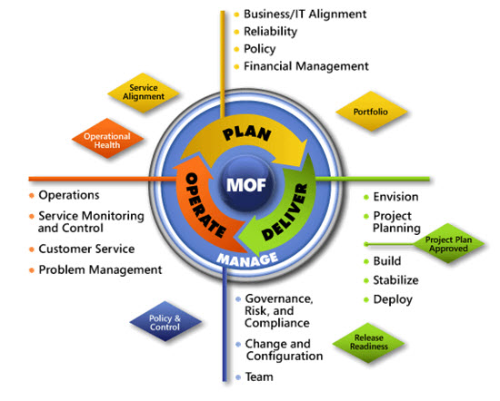
IPD in Microsoft Operations Framework 4.0
Use MOF with IPD guides to ensure that people and process considerations are addressed when changes to an organization’s IT services are being planned
Notes:
For more information about Microsoft Operations Framework 4.0, go to www.microsoft.com/mof.

Slide 27
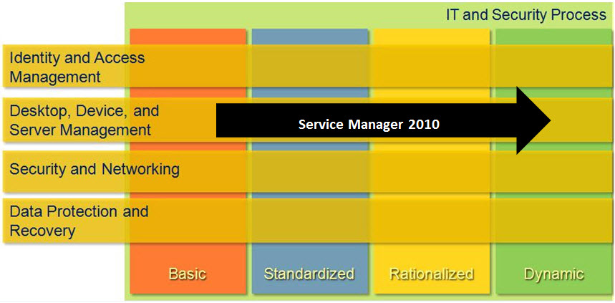
System Center Service Manager 2010 in Microsoft Infrastructure Optimization
Notes:
<This slide shows the effect that System Center Service Manager 2010 has on infrastructure maturity as reflected in the Core Infrastructure Optimization Model.>
The Infrastructure Optimization (IO) Model at Microsoft groups IT processes and technologies across a continuum of organizational maturity. (For more information, see www.microsoft.com/infrastructure.) The model was developed by industry analysts, the Massachusetts Institute of Technology (MIT) Center for Information Systems Research (CISR), and Microsoft's own experiences with its enterprise customers. A key goal for Microsoft in creating the Infrastructure Optimization Model was to develop a simple way to use a maturity framework that is flexible and can easily be applied as the benchmark for technical capability and business value.
IO is structured around three information technology models: Core Infrastructure Optimization, Application Platform Optimization, and Business Productivity Infrastructure Optimization. According to the Core Infrastructure Optimization Model, having near real-time policy enforcement based on company and industry-standard polices that allow for immediate quarantine of non-compliant systems, and consistent compliance reporting and standards exist across all data center services, and a configuration management database such as that provided by Service Manager 2010 will help move an organization to the Rationalized level. Then to move to the Dynamic level, organizations can use Service Manager 2010 to enable real-time policy enforcement with automated non-compliance resolution for all data center services and remediation.

