Slide 1
Microsoft® System Center Operations Manager 2007
Infrastructure Planning and Design
Published: June 2008
Updated: July 2010
Notes:
Copyright © 2010 Microsoft Corporation. This documentation is licensed to you under the Creative Commons Attribution License. To view a copy of this license, visit http://creativecommons.org/licenses/by/3.0/us/ or send a letter to Creative Commons, 543 Howard Street, 5th Floor, San Francisco, California, 94105, USA. When using this documentation, provide the following attribution: Infrastructure Planning and Design is provided with permission from Microsoft Corporation.
This documentation is provided to you for informational purposes only, and is provided to you entirely "AS IS". Your use of the documentation cannot be understood as substituting for customized service and information that might be developed by Microsoft Corporation for a particular user based upon that user’s particular environment. To the extent permitted by law, MICROSOFT MAKES NO WARRANTY OF ANY KIND, DISCLAIMS ALL EXPRESS, IMPLIED AND STATUTORY WARRANTIES, AND ASSUMES NO LIABILITY TO YOU FOR ANY DAMAGES OF ANY TYPE IN CONNECTION WITH THESE MATERIALS OR ANY INTELLECTUAL PROPERTY IN THEM.
Microsoft may have patents, patent applications, trademarks, or other intellectual property rights covering subject matter within this documentation. Except as provided in a separate agreement from Microsoft, your use of this document does not give you any license to these patents, trademarks or other intellectual property.
Information in this document, including URL and other Internet website references, is subject to change without notice. Unless otherwise noted, the example companies, organizations, products, domain names, email addresses, logos, people, places and events depicted herein are fictitious.
Microsoft, Active Directory, SharePoint, SQL Server, Visio, Windows, and Windows Server are either registered trademarks or trademarks of Microsoft Corporation in the United States and/or other countries and regions.
The names of actual companies and products mentioned herein may be the trademarks of their respective owners.
You have no obligation to give Microsoft any suggestions, comments or other feedback (“Feedback”) relating to the documentation. However, if you do provide any Feedback to Microsoft then you provide to Microsoft, without charge, the right to use, share and commercialize your Feedback in any way and for any purpose. You also give to third parties, without charge, any patent rights needed for their products, technologies and services to use or interface with any specific parts of a Microsoft software or service that includes the Feedback. You will not give Feedback that is subject to a license that requires Microsoft to license its software or documentation to third parties because we include your Feedback in them.

Slide 2
What Is IPD? Guidance that clarifies and streamlines the planning and design process for Microsoft® infrastructure technologies
IPD:
Defines decision flow
Describes decisions to be made
Relates decisions and options for the business
Frames additional questions for business understanding
IPD guides are available at www.microsoft.com/ipd
Notes:
Infrastructure Planning and Design (IPD) is a series of planning and design guides created to clarify and streamline the planning and design process for Microsoft® infrastructure technologies.
Each guide in the series addresses a unique infrastructure technology or scenario.
These guides include the following topics:
Defining the technical decision flow (flow chart) through the planning process.
Describing the decisions to be made and the commonly available options to consider in making the decisions.
Relating the decisions and options for the business in terms of cost, complexity, and other characteristics.
Framing the decisions in terms of additional questions for the business to ensure a comprehensive understanding of the appropriate business landscape.
The guides in this series are intended to complement and augment Microsoft product documentation.

Slide 3
Getting Started
System Center Operations Manager 2007
Notes:
This guide was created to enable infrastructure planners to design System Center Operations Manager 2007 infrastructure solutions. The guide includes specific design information and activities that encourage sound planning. Each activity includes:
Prerequisites and background on the activity.
Tasks that will be performed to complete the activity.
Reference information regarding the activity’s impact on characteristics such as the cost, complexity, and capacity of the solution.
Questions to ensure that business needs are captured and reflected in the solution.
The guide is written for information technology (IT) infrastructure specialists who are responsible for planning and designing a System Center Operations Manager 2007 infrastructure. The process in the guide applies to both Operations Manager 2007 and Operations Manager 2007 R2, except where content that is new in R2 is explicitly indicated.

Slide 4
Purpose and Overview
Purpose
To provide design guidance for Operations Manager 2007
Overview
Operations Manager 2007 overview
Operations Manager 2007 architecture design process
Notes:
This guide focuses on the elements that organizations must consider when designing a Operations Manager 2007 infrastructure.
Note Details about disaster recovery, server support, and server hosting are outside the scope of this guide.

Slide 5
What’s New in System Center Operations Manager 2007 R2
Operations Manager 2007 R2 introduces new functionality and enhancements, include the following:
UNIX and Linux monitoring
Integrated and customizable service level tracking
Enhanced synthetic monitoring
Process monitoring
Notifications
Run As capability
Import Management Packs Wizard
Update to Visio export
Maintenance mode
UI performance and usability
Notes:
The guide’s design process is valid for both Windows Server® 2008 and Windows Server 2008 R2 environments.
The guide has been revised to include these new enhancements in System Center Operations Manager 2007 that may, or may not, affect the infrastructure choices and design:
UNIX and Linux monitoring. Agents are now available to discover, monitor, and manage a number of UNIX and Linux platforms.
Integrated and customizable service level tracking. The Operations Manager 2007 Data Warehouse database includes all of the customization required for service level tracking and is ready to provide data to the Service Level Dashboard (available as a Solution Accelerator).
Enhanced synthetic monitoring. The scale of the existing URL monitoring has been increased and is easier to set up. Management packs are available for monitoring Microsoft Exchange Server and SQL Server® transaction performance and availability.
Process monitoring. This detects whether desired or undesired processes are running and, if they are, how many are running. In addition, it provides monitoring of the CPU and memory being consumed by processes.
Notifications. This provides a mechanism to set up Simple Mail Transfer Protocol (SMTP) more easily and to subscribe to notifications to events.
Run As capability. Provides improved granularity and control of security settings.
Import Management Packs Wizard. This wizard can be used to import management packs and updates to them, either from a local or network disk or directly from the management pack catalog on the Internet.
Update to Visio export. The Microsoft Visio® exports that are obtained from Operations Manager 2007 R2 now include the metadata that is necessary for future versions of Microsoft SharePoint® and Visio to query the OperationsManager database and update the status of exported objects in the diagram.
Maintenance mode. The process of placing a computer and all its related objects into maintenance mode has been streamlined.
UI performance and usability. The Operations console performance has been greatly improved.

Slide 6
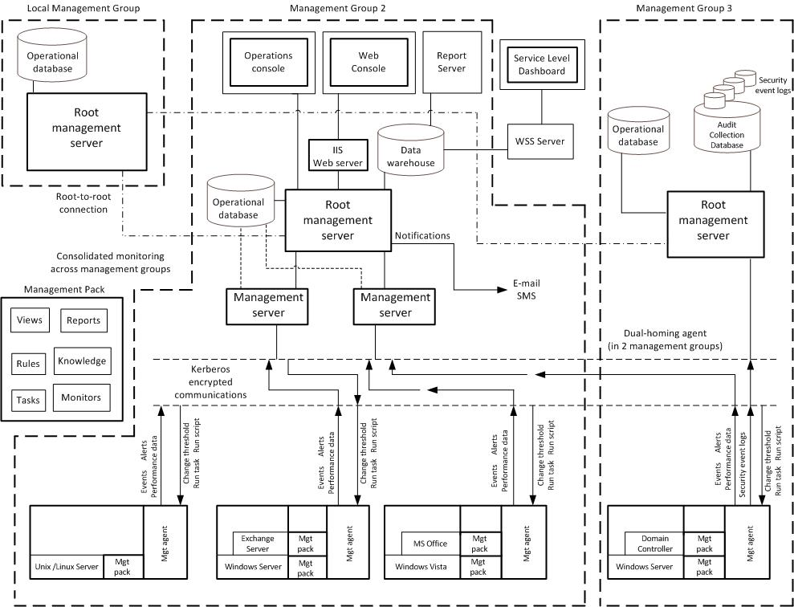
System Center Operations Manager 2007 Architecture Example
SCM
ITA
Notes:
This figure illustrates the relationship between the components that can work together to deliver a monitoring solution with Operations Manager 2007. Note that the components can be designed in many different ways; Figure 2 shows them in a particular implementation for illustrative purposes only.

Slide 7
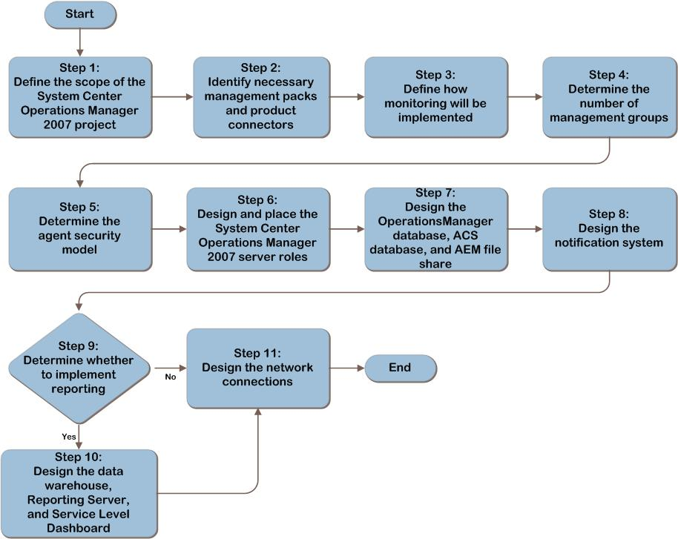
System Center Operations Manager 2007 Decision Flow
MAP w/ CAL Tracker
SCM
ITA
Notes:
Decision flow for System Center Operations Manager 2007 infrastructure planning and design.

Slide 8
Step 1: Define the Scope of the System Center Operations Manager 2007 Project
Identify business requirements
Identify business services in scope for monitoring
Identify reporting expectations
Create a component map for services identified as in scope for monitoring
Document applications, services, servers
Identify resources in scope for monitoring
Prioritize based on business impact
Identify in-place monitoring and administrative processes
Notes:
<Emphasize here that determination of what should be monitored should be driven by first identifying business services.>
The IT services that should be monitored should be identified by first understanding which services are important to the business. Then by documenting the components comprising the business services, and those upon which it depends, the applications and infrastructure that should be monitored become clear.
Reporting needs may be clear based on current reporting in place for service owners and stakeholders, but this is not always the case. Often reporting is lacking, and discussion with service owners on expectations for reporting is necessary.
By identifying administrative processes currently in place, the need for application and process integration, as well as coexistence may be necessary. For example, if an existing monitoring system automatically logs tickets in a help desk ticketing system, it would be necessary to determine if a product connector is available to duplicate that functionality with Operations Manager 2007.

Slide 9
Step 2: Identify Necessary Management Packs and Product Connectors
Determine which management packs are required
Determine how third-party devices and third-party applications will be monitored
Determine which product connectors are required
Notes:
In this step, the management packs and product connectors required to monitor the services, applications, and infrastructure identified in the previous step will be identified.
It is important to identify instances where third-party functionality is required since these management packs and product connectors come at an additional cost and will also affect the Operations Manager 2007 infrastructure sizing decisions to varying degrees.
In some cases, it may be determined that product connectors are not available, and decisions on how to work around this limitation must be made.

Slide 10
Step 3: Determine How Monitoring Will Be Implemented
Determine a synthetic transaction monitoring strategy
Where watcher nodes should be placed
Whether dedicated watcher nodes are required
The load of the synthetic transaction on watcher nodes and network
How frequently synthetic transactions should run
The number of watcher nodes for each location
Determine the client workstation sampling strategy for monitoring
Notes:
Determining the desired synthetic transaction monitoring is important because placement of watcher nodes, which requires an Operations Manager 2007 agent, must be considered in infrastructure planning and license costs. Synthetic monitoring should generally be performed from the locations where the application is used (on a per-site basis), and this will require identifying a Windows®-based computer with adequate free resources to run the desired synthetic transactions.
While client monitoring has fewer management server resource requirements than server monitoring, the number of agents reporting must be taken into consideration when sizing management servers. Agentless Exception Monitoring requires additional disk space for storing crash and hang data. Both must be considered when determining the required number and hardware sizing of management servers.

Slide 11
Step 4: Determine the Number of Management Groups
Determine the number of management groups required to meet the organization’s:
Size, location, and security requirements
Testing, auditing, and localization needs
Disaster recovery and reporting needs, and System Center Virtual Machine Manager integration
Notes:
<Emphasize that the drivers of multiple management groups can be driven not only by technical factors, but also by security requirements and organizational politics.>
The size of the infrastructure to be monitored may require multiple management groups in order to meet the scalability requirements of the organization’s infrastructure. Additionally, geographic distribution of infrastructure, such as large numbers of servers on multiple continents separated by WAN links, can also drive the need for multiple management groups. When multiple autonomous IT groups are responsible for portions of the organization’s infrastructure, multiple management groups may be required to provide the autonomy and control these groups require to manage disparate portions of the infrastructure.
Since management packs cannot be tested before they are imported into the management group, a management group for testing and staging is always recommended and could require multiple test MGs, depending on an organization’s testing and development needs. Security requirements, such as a security team requirement for an isolated Audit Collection infrastructure, may also require an additional management group(s) to provide the needed administrative isolation and data security for auditors. Since all Operations Manager servers must be installed in the same language, support for multiple languages in Operations Manager servers can drive the need for multiple management groups.
Finally, disaster recovery can entail creation of a failover management group. Consolidated views across multiple management groups (called connected management groups) may require a single local management group in a central location to facilitate the consolidated view.

Slide 12
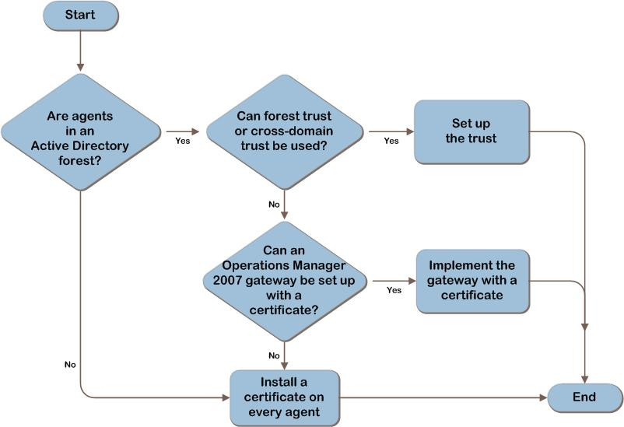
Step 5: Decision Flow: Determine the Agent Security Model
Notes:
<There is no one right way to bridge the trust boundary to facilitate mutual authentication.>
A forest trust is the type of trust required to provide Kerberos authentication between hosts in separate Active Directory (AD DS) forests.
When using certificate authentication to facilitate mutual authentication between hosts separated by trust boundaries, it is important to understand that a gateway server is never required. However, the gateway server can be employed in key scenarios to increase security and efficiency, such as:
Acting as a consolidator to decrease points of egress from a perimeter network.
Minimizing the need for certificate authentication for computers in an AD DS separate from that in which the management group is located.
Optimizing bandwidth utilization across WAN links.

Slide 13
Step 5: Determine the Agent Security Model
Are agents in an AD DS forest?
Yes: Proceed to the next decision
No: Install a certificate on each agent computer
Can a forest trust or cross-domain trust be used?
Yes: Set up the trust
No: Proceed to the next decision
Can an Operations Manager 2007 gateway be set up with a certificate?
Yes: Implement the gateway with a certificate
No: Install a certificate on each agent computer
Notes:
Walk through decision structure for determining mutual authentication strategy.

Slide 14
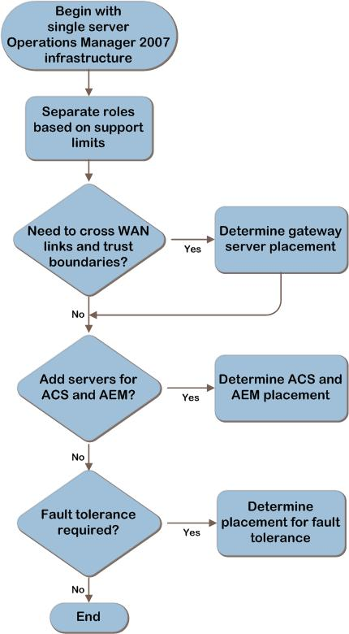
Step 6: Decision Flow: Design and Place the System Center Operations Manager 2007 Server Roles
Walk through the decision structure
Arrive at a decision
Repeat for each management group
Notes:
<Emphasize here that server sizing and Operations Manager 2007 role distribution is driven by more than just the scalability requirements of the environment.>
The number of Operations consoles in use can drive the need for separation of the RMS role and drive the need for additional hardware resources.
Geographic distribution of servers can drive the need to place gateway servers in remote locations and perimeter networks to optimize bandwidth utilization and security.
The fault-tolerance requirements of the organization can necessitate deployment of redundant gateway and management servers to facilitate agent failover in the event of server failure.
When selecting a form factor, take into consideration that server virtualization is supported for all server roles (although not recommended for some roles) and can be used to reduce infrastructure costs and ease deployment of fault-tolerant configurations.

Slide 15
Step 6: Design and Place the System Center Operations Manager 2007 Server Roles
Separate server roles based on support limits
Agent-managed computers across WAN links and trust boundaries?
Yes: Determine gateway server placement
No: Proceed to the next decision
Notes:
Walk through decision structure for designing server role placement.

Slide 16
Step 6: Design and Place the System Center Operations Manager 2007 Server Roles (continued)
Additional server capacity required for ACS and AEM?
Yes: Determine additional hardware or servers
No: Proceed to the next decision
Fault tolerance required?
Yes: Determine server placement for fault tolerance
No: End decision structure
Notes:
Walk through decision structure for designing server role placement.

Slide 17
Step 7: Design the OperationsManager Database, ACS Database, and AEM File Share
Determine resource requirements for:
OperationsManager database infrastructure
ACS database infrastructure
AEM file share infrastructure
Database roles and file share
Select a form factor for the OperationsManager database and ACS database server
Notes:
<Emphasize that database sizing requirements are generally driven more by IOps requirements than by disk space requirements. Fault tolerance is the other key driver in database infrastructure design.>
Disk IOps is going to be the primary determinant of how many disks are required in the data and log arrays.
Database infrastructure is going to be driven by a number of factors, including:
Scalability. The number of agents and management packs deployed will determine database load and, along with data retention, determine the database growth.
Fault tolerance. For example, the hardware requirements for an failover cluster will be different than requirements for supporting log shipping or database mirroring.
Security. A dedicated ACS management group, for example, can even drive the need for a separate database infrastructure.

Slide 18
Step 8: Design the Notification Strategy
Determine the required notification channels
Email
Instant message
Short Message Service (SMS)
Command
Determine the fault-tolerance strategy in notifications
Provide redundancy in the link from the RMS to the notification channel
Provide redundancy within the notification channel
Use multiple notification channels
Notes:
<For best results, use redundancy within a notification channel AND use multiple notification channels.>
To ensure consistent alert notification in the event of an outage, use not only redundancy within a notification channel, such as multiple SMTP servers for email notification, but also use multiple channels. A GSM modem can provide reliable notification via SMS when Exchange Server or other email systems are experiencing difficulties.
Out-of-band notification (one that relies on neither network or messaging system availability) is an effective method to ensure reliable notification during impact or outage conditions of network infrastructure and messaging applications.

Slide 19
Step 9: Determine Whether to Implement Reporting
Identify need for reporting
Visibility across multiple management groups?
Performance, availability, or other reports for business services?
Long-term data for capacity planning, performance tracking, or trend analysis?
Will Microsoft System Center Virtual Machine Manager be used?
Requires reporting be enabled
Notes:
<The drivers for historical reporting should be determined in the initial data collection phase of the project. There will be both business and technical drivers for reporting.>
The business may require reporting for availability and transactional performance reporting on business services, while IT consumers of reporting may rely on reporting for these reasons, but also as a resource for performance trend reporting and capacity planning.
Administrators of server virtualization within IT can use reporting to identify servers that are good candidates for virtualization. In fact, Operations Manager 2007 reporting can be integrated with System Center Virtual Machine Manager to provide Operations Manager 2007 reports in the VMM console interface.
It is important to understand that reporting is a tool that can be used to drive infrastructure planning decisions and can be leveraged by IT to demonstrate to the business the need for infrastructure improvements. Even if the business does not see a need, IT generally will have a need.

Slide 20
Step 10: Design the Data Warehouse, Reporting Server, and Service Level Dashboard
Determine each of the following:
Data consolidation strategy across management groups
Data-retention requirements
Data warehouse size requirements
Fault-tolerance requirements
Select a form factor for the server or servers
Notes:
<Drivers for data warehouse SQL Server infrastructure are largely parallel to those for OperationsManager database and ACS database sizing.>
In large environments, the reporting role is deployed to a SQL Server Reporting Services instance on a dedicated server.
Disk IOps is going to be the primary determinant of how many disks are required in the data and log arrays.
Database infrastructure is going to be driven by:
Scalability. Data warehouse database growth will be determined by the number of agents and management packs, as well as the data retention requirements of the organization.
Fault tolerance. For example, the hardware requirements for a failover cluster will be different than requirements for supporting log shipping or database mirroring.
Security. The same data isolation issues that drive the need for multiple management groups may drive the need for separate data warehouses per management group.

Slide 21
Step 11: Design the Network Connections
Determine where additional bandwidth is required
Determine network port requirements
Notes:
Monitoring needs, in conjunction with Operations Manager 2007 server placement decisions, will influence network bandwidth and port requirements.
Server sizing and placement decisions made earlier in the design process will affect the network bandwidth required to support the solution. As mentioned earlier, gateway servers can be used to optimize bandwidth utilization in WAN scenarios. Likewise, the gateway role can be used to reduce the points of egress from perimeter networks.

Slide 22
Summary and Conclusion
Carefully consider infrastructure requirements and server placement for System Center Operations Manager 2007
Planning is key
Provide feedback to satfdbk@microsoft.com
Notes:
Summary and Conclusion
This guide offers major architectural guidance. Refer to product documentation for additional details.

Slide 23
Find More Information
Download the full document and other IPD guides:
www.microsoft.com/ipd
Contact the IPD team:
satfdbk@microsoft.com
Access the Microsoft Solution Accelerators website:
http://www.microsoft.com/technet/SolutionAccelerators

Slide 24
Questions?

Slide 25
Addenda:
Benefits for Consultants or Partners
IPD in Microsoft Operations Framework 4.0
System Center Operations Manager 2007 in Microsoft Infrastructure Optimization

Slide 26
Benefits of Using the System Center Operations Manager 2007 Guide
Benefits for Business Stakeholders/Decision Makers
Most cost-effective design solution for implementation
Alignment between the business and IT from the beginning of the design process to the end
Benefits for Infrastructure Stakeholders/ Decision Makers
Authoritative guidance
Business validation questions ensuring solution meets requirements of business and infrastructure stakeholders
High integrity design criteria that includes product limitations
Fault-tolerant infrastructure
Infrastructure that’s sized appropriately for business requirements
Notes:
Benefits of Using the System Center Operations Manager 2007 Guide
Benefits for Business Stakeholders/Decision Makers:
Most cost-effective design solution for an implementation. IPD eliminates over-architecting and over-spending by precisely matching the technology solution to the business needs.
Alignment between the business and IT from the beginning of the design process to the end.
Benefits for Infrastructure Stakeholders/Decision Makers:
Authoritative guidance. Microsoft is the best source for guidance about the design of Microsoft products.
Business validation questions to ensure the solution meets the requirements of both business and infrastructure stakeholders.
High integrity design criteria that includes product limitations.
Fault-tolerant infrastructure, where necessary.
Proportionate system and network availability to meet business requirements. Infrastructure that is sized appropriately to meet business requirements.

Slide 27
Benefits of Using the System Center Operations Manager 2007 Guide (Continued)
Benefits for Consultants or Partners
Rapid readiness for consulting engagements
Planning and design template to standardize design and peer reviews
A “leave-behind” for pre- and post-sales visits to customer sites
General classroom instruction/preparation
Benefits for the Entire Organization
Using the guide should result in a design that will be sized, configured, and appropriately placed to deliver a solution for achieving stated business requirements
Notes:
Benefits of Using the System Center Operations Manager 2007 Guide (continued)
Benefits for Consultants or Partners:
Rapid readiness for consulting engagements.
Planning and design template to standardize design and peer reviews.
A “leave-behind” for pre- and post-sales visits to customer sites.
General classroom instruction/preparation.
Benefits for the Entire Organization:
Using the guide should result in a design that will be sized, configured, and appropriately placed to deliver a solution for stated business requirements, while considering the performance, capacity, manageability, and fault tolerance of the system.

Slide 28
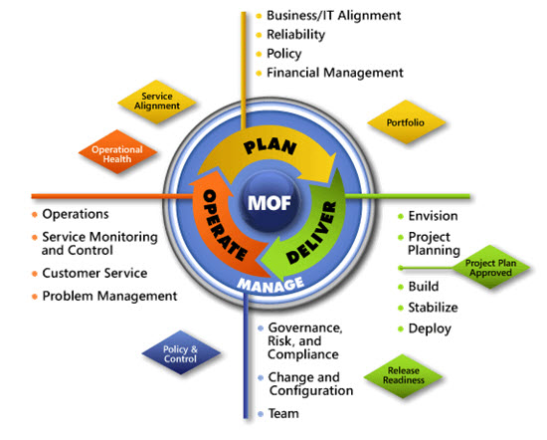
IPD in Microsoft Operations Framework 4.0
Use MOF with IPD guides to ensure that people and process considerations are addressed when changes to an organization’s IT services are being planned.
Notes:
For more information about Microsoft Operations Framework 4.0, go to www.microsoft.com/mof.

Slide 29
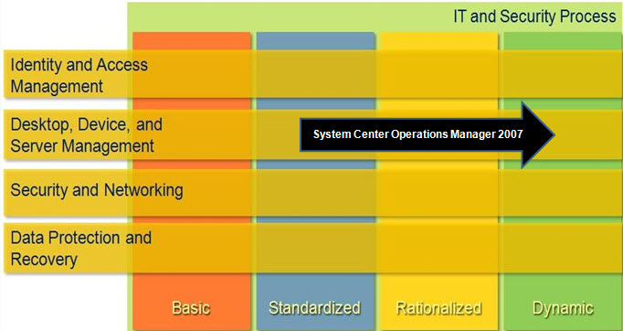
System Center Operation Manager 2007 in Microsoft Infrastructure Optimization
Notes:
<This slide shows the effect System Center Operations Manager 2007 has on infrastructure maturity as reflected in the Infrastructure Optimization Model.>
The Infrastructure Optimization (IO) Model at Microsoft groups IT processes and technologies across a continuum of organizational maturity. (For more information, see www.microsoft.com/infrastructure.) The model was developed by industry analysts, the Massachusetts Institute of Technology (MIT) Center for Information Systems Research (CISR), and Microsoft's own experiences with its enterprise customers. A key goal for Microsoft in creating the Infrastructure Optimization Model was to develop a simple way to use a maturity framework that is flexible and can easily be applied as the benchmark for technical capability and business value.
IO is structured around three information technology models: Core Infrastructure Optimization, Application Platform Optimization, and Business Productivity Infrastructure Optimization.
According to the Core IO Model, Operations Manager 2007 can be used to move an organization from a Standardized to a Dynamic level of maturity. At a Standardized level, monitoring may occur for 80 percent or more of critical servers. At the Rationalized level, service level agreement (SLA) monitoring of mission-critical servers and IT service level reporting would occur. A Dynamic level of maturity requires service level monitoring of desktops, servers, and applications.

