Slide 1
Microsoft® System Center
Configuration Manager 2007 R3
and Forefront® Endpoint Protection
Infrastructure Planning and Design
Published: October 2008
Updated: July 2011
Notes:
Copyright © 2011 Microsoft Corporation. All rights reserved. Complying with the applicable copyright laws is your responsibility. By using or providing feedback on this documentation, you agree to the license agreement below.
If you are using this documentation solely for non-commercial purposes internally within YOUR company or organization, then this documentation is licensed to you under the Creative Commons Attribution-NonCommercial License. To view a copy of this license, visit http://creativecommons.org/licenses/by-nc/2.5/ or send a letter to Creative Commons, 543 Howard Street, 5th Floor, San Francisco, California, 94105, USA.
This documentation is provided to you for informational purposes only, and is provided to you entirely "AS IS". Your use of the documentation cannot be understood as substituting for customized service and information that might be developed by Microsoft Corporation for a particular user based upon that user’s particular environment. To the extent permitted by law, MICROSOFT MAKES NO WARRANTY OF ANY KIND, DISCLAIMS ALL EXPRESS, IMPLIED AND STATUTORY WARRANTIES, AND ASSUMES NO LIABILITY TO YOU FOR ANY DAMAGES OF ANY TYPE IN CONNECTION WITH THESE MATERIALS OR ANY INTELLECTUAL PROPERTY IN THEM.
Microsoft may have patents, patent applications, trademarks, or other intellectual property rights covering subject matter within this documentation. Except as provided in a separate agreement from Microsoft, your use of this document does not give you any license to these patents, trademarks or other intellectual property.
Information in this document, including URL and other Internet Web site references, is subject to change without notice. Unless otherwise noted, the example companies, organizations, products, domain names, e-mail addresses, logos, people, places and events depicted herein are fictitious.
Microsoft, Active Directory, Forefront, SQL Server, Windows, and Windows Server are either registered trademarks or trademarks of Microsoft Corporation in the United States and/or other countries and regions.
The names of actual companies and products mentioned herein may be the trademarks of their respective owners.
You have no obligation to give Microsoft any suggestions, comments or other feedback ("Feedback") relating to the documentation. However, if you do provide any Feedback to Microsoft then you provide to Microsoft, without charge, the right to use, share and commercialize your Feedback in any way and for any purpose. You also give to third parties, without charge, any patent rights needed for their products, technologies and services to use or interface with any specific parts of a Microsoft software or service that includes the Feedback. You will not give Feedback that is subject to a license that requires Microsoft to license its software or documentation to third parties because we include your Feedback in them.

Slide 2
What Is IPD? Guidance that clarifies and streamlines the planning and design process for Microsoft infrastructure technologies
IPD:
Defines decision flow
Describes decisions to be made
Relates decisions and options for the business
Frames additional questions for business understanding
IPD guides are available at www.microsoft.com/ipd
Notes:
Infrastructure Planning and Design (IPD) is a series of planning and design guides created to clarify and streamline the planning and design process for Microsoft® infrastructure technologies.
Each guide in the series addresses a unique infrastructure technology or scenario.
These guides include the following topics:
Defining the technical decision flow (flow chart) through the planning process.
Describing the decisions to be made and the commonly available options to consider in making the decisions.
Relating the decisions and options for the business in terms of cost, complexity, and other characteristics.
Framing the decisions in terms of additional questions for the business to ensure a comprehensive understanding of the appropriate business landscape.
The guides in this series are intended to complement and augment Microsoft product documentation. It is assumed that the reader has a basic understanding of the technologies discussed in these guides. It is the intent of these guides to define business requirements, then align those business requirements to product capabilities, and design the appropriate infrastructure.

Slide 3
Getting Started
Microsoft System Center Configuration Manager 2007 R3 and Forefront Endpoint Protection
Notes:
The guide was created to enable infrastructure planners to design a Microsoft System Center Configuration Manager 2007 R3 and Forefront Endpoint Protection (FEP) infrastructure. The guide includes specific design information and activities that encourage sound planning.
Each activity includes:
Prerequisites and background on the activity.
Tasks that will be performed to complete the activity.
Reference information regarding the activity’s impact on characteristics such as the cost, complexity, and capacity of the solution.
Questions to ensure that business needs are captured and reflected in the solution.
The guide is written for information technology (IT) infrastructure specialists who are responsible for planning and designing the infrastructure for Microsoft System Center Configuration Manager 2007 R3 and Forefront Endpoint Protection.

Slide 4
Purpose and Overview
Purpose
To provide design guidance for a Microsoft System Center Configuration Manager 2007 R3 and Forefront Endpoint Protection (FEP) infrastructure
Overview
System Center Configuration Manager 2007 R3 and FEP architecture
System Center Configuration Manager 2007 R3 and FEP infrastructure design process
Notes:
Purpose and Overview
The purpose of this guide is to focus on the considerations that organizations should take into account when designing a System Center Configuration Manager 2007 R3 and FEP infrastructure.
Following the guide should result in a design that is sized, configured, and appropriately placed to deliver the stated business benefits, while considering the user experience, security, manageability, performance, capacity, and fault tolerance of the system.

Slide 5
What’s New in System Center Configuration Manager 2007 R3 and Forefront Endpoint Protection?
The guide has been revised to include these new enhancements in Configuration Manager 2007 R3 that may affect the infrastructure choices and design:
Enhanced scalability and performance
Power management
Operating system deployment improvements
Dynamic collection evaluation
Active Directory Delta Discovery
Simplified resource management
Desired configuration management
In addition, FEP uses Configuration Manager’s capabilities to perform tasks such as deploying antimalware clients, enforcing security policies on endpoints, managing devices, and alerting administrators to events related to FEP
Notes:
What’s New in System Center Configuration Manager 2007 R3 and Forefront Endpoint Protection?
This guide has been revised to include these new enhancements in Configuration Manager 2007 R3 that may affect the infrastructure choices and design:
Enhanced scalability and performance. Increased number of supported clients to 100,000 per primary site and 300,000 per entire hierarchy.
Power management. Provides a set of tools that enable the site administrator to configure standard Windows® power settings across computers.
Operating system deployment improvements. Provide pre-staging of boot images and Windows Imaging Format (.wim) files on new computers that enables the administrator to apply a task sequence to the device that can use the pre-staged media.
Dynamic collection evaluation. Enables rapid evaluation of a collection membership by adding only newly discovered resources.
Active Directory Delta Discovery. Performs an intermediate discovery cycle that adds only new resources to the Configuration Manager 2007 database.
Simplified resource management. Enables searching for and adding resources to a specified collection.
Desired configuration management. Enables creation of a collection of compliant or noncompliant computers in desired configuration management.
In addition, this guide contains new material about designing a Forefront Endpoint Protection infrastructure. FEP uses Configuration Manager’s capabilities to perform tasks such as deploying antimalware clients, enforcing security policies on endpoints, managing devices, and alerting administrators to events related to FEP.

Slide 6
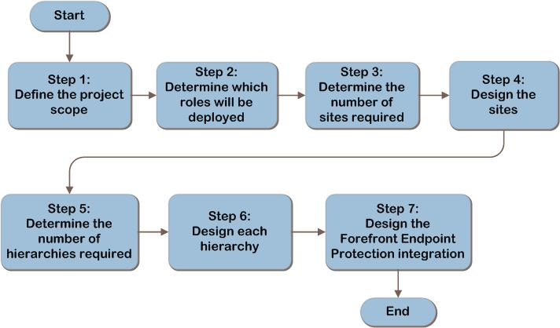
System Center Configuration Manager 2007 R3 and FEP Decision Flow
SCM
ITA
Notes:
The System Center Configuration Manager 2007 R3 and FEP design flow provides a graphical overview of the steps in designing a System Center Configuration Manager 2007 R3 and FEP infrastructure.
These steps are:
Step 1: Define the Project Scope
Step 2: Determine Which Roles Will Be Deployed
Step 3: Determine the Number of Sites Required
Step 4: Design the Sites
Step 5: Determine the Number of Hierarchies Required
Step 6: Design Each Hierarchy
Step 7: Design the Forefront Endpoint Protection Integration
Each of these steps will be described in greater detail in the following slides.

Slide 7
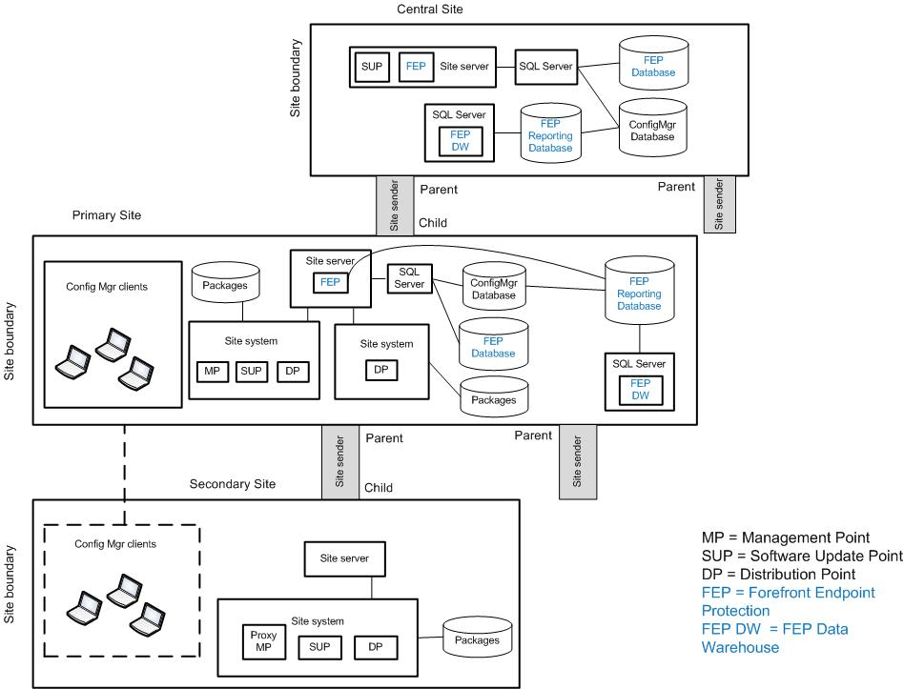
Example System Center Configuration Manager 2007 R3 and FEP Architecture
Notes:
This diagram illustrates the relationship between the components that work together to provide an architecture for System Center Configuration Manager 2007 R3 and FEP. They are shown together in one possible implementation for illustration purposes, but other configurations are possible.

Slide 8
Step 1: Define the Project Scope
Task 1: Determine Whether the Project Will Encompass the Entire Enterprise
Before beginning to plan and design a Configuration Manager and FEP infrastructure, an organization needs to determine which parts of its environment to include in the design
Task 2: Determine Which Product Capabilities This Project Will Address
Identify which product features will be used to deliver the functionality that the business requires
Notes:
Step 1: Define the Project Scope
Task 1: Determine Whether the Project Will Encompass the Entire Enterprise
Configuration Manager can be deployed across the entire enterprise—to specific hub locations (a regionalized approach), or to individual satellite offices (a decentralized approach). This will affect complexity and effort, as well as cost, risk, and return on investment.
Task 2: Determine Which Product Capabilities This Project Will Address
Determine the business motivation for implementing Configuration Manager and/or FEP, and then identify which product features will be used to deliver the functionality that the business requires.
Use the product capabilities descriptions in Table 1 in the guide, and put a check mark in the Select column for each capability needed. For example, if the business goal is to automate software installation, check the boxes for Operating System Deployment, Software Distribution, and Software Updates. Then, add the client locations for each required capability based on the output of Task 1.

Slide 9
Step 1: Define the Project Scope (Continued)
Task 3: Define the Client Population to Be Managed
Assess the client population
Task 4: Determine the Organization’s Service Expectations
Determine the service expectations of business stakeholders for the solution
Notes:
Step 1: Define the Project Scope (Continued)
Task 3: Define the Client Population to Be Managed
Assess the client population. Use Table 2 in Appendix A of the guide to record the following client population information:
Where are the client locations? How many clients are in each location? This is used to determine site server locations and server sizing and to design the site boundaries.
Are there security boundaries in the client population? If different clients are subject to different security restrictions, they may need to be placed in sites or hierarchies that are administered separately.
How are the clients connected? Are they connected via LAN, WAN, dial-up, and/or VPN? How busy are those network links? Will clients be always connected, sometimes connected, or never connected? Obtain a network infrastructure plan that shows client locations. This will be used to determine the number of sites required and to determine which site system roles to deploy.
Will clients move between locations? This helps determine if site capacity needs to be planned in more than one location for roaming clients. This will be used to determine the site design.
Which computers will require antimalware protection?
Task 4: Determine the Organization’s Service Expectations
Determine the service expectations of business stakeholders for Configuration Manager. For example, what’s the acceptable time window if critical updates need to be deployed? Validate whether the expectations are achievable; if they aren’t, engage with the stakeholders to ensure they understand what can be achieved.

Slide 10
Step 2: Determine Which Roles Will Be Deployed
Task 1: Select the Required Roles
Establishing which site roles are required and where they are located determines site design and sizing, network sizing, and whether the Configuration Manager client will be deployed
Notes:
Step 2: Determine Which Roles Will Be Deployed
Task 1: Select the Required Roles
Limit the design of the optional and function-specific roles to those necessary to deliver the necessary business requirements.
Use Table 2 in the Configuration Manager guide to list the functions and locations, and map these to the required roles. This information will be used to determine site design and sizing.

Slide 11
Step 3: Determine the Number of Sites Required
Task 1: Determine the Number of Sites
Start with one site, and then add more as required by the following:
Scale
Privacy concerns
Internet-connected clients
Active Directory® Domain System (AD DS) forests
Network location
International languages
Organization
Notes:
Step 3: Determine the Number of Sites Required
Task 1: Determine the Number of Sites
Start with one site, and then add more only if required by any of the following:
Scale. A site can include a maximum of 200,000 clients (increased to 300,000 with System Center Configuration Manager 2007 R3).
Privacy concerns. Details of files on the client that are exposed to the admin are the same for all clients site-wide. If some clients require a higher level of privacy than others, a separate site may need to be created.
Internet-connected clients. In this case, a separate site may be placed in the perimeter network (also known as DMZ) so that ports do not have to be opened into the secure zone for client-to-site connections. For a list of the ports that must be open for each of the site connections and for site-to-site connections, see http://technet.microsoft.com/en-us/library/bb632618.aspx.
AD DS forests. All the server roles within a site must be within the same AD DS forest, with the following exceptions: System Health Validator (SHV) point, server locator point (SLP), PXE service point.
Network location. Clients that are in locations separated from the site by a slow link could require a separate site that’s local to them in order to protect the network from overload.
International languages. Each localized site server supports only certain localized clients. Confirm whether the planned sites will support the localized clients by referring to the information at http://technet.microsoft.com/en-us/library/bb680663.aspx. If the sites will not support localized clients, design additional sites.
Organization. There may be reasons for separating a group of clients into a different site, such as when a newly acquired company is being integrated.

Slide 12
Step 4: Design the Sites
Task 1: Plan the Required Roles
For each role, compare the number of clients that will use it against the scale limits for the role
Task 2: Plan the Optional Roles
Add the optional roles that will be used in the site design
Task 3: Plan the Feature-Specific Roles
Use the information in Step 2 to select the relevant roles for the site
Task 4: Determine Where to Place Hierarchy Roles
Design each required role in only one site in the hierarchy
Notes:
Step 4: Design the Sites
Task 1: Plan the Required Roles
Refer to Step 2 for the site roles required. For each role, compare the number of clients that will use it against the scale limits for the role.
Task 2: Plan the Optional Roles
Add the optional roles (see Table 5 in the guide) that will be used in the site design.
Task 3: Plan the Feature-Specific Roles
The remaining site system roles are feature-specific (see Table 6 in the guide). Refer to Step 2 where it was determined which roles were relevant to the location.
Task 4: Determine Where to Place Hierarchy Roles
If any of the following roles are required, design each of them in only one site in the hierarchy:
The Asset Intelligence service point should be designed in a site that enables it to connect with the external System Center Online database.
The SHV point should be designed in a site that allows it to run on Windows Server® 2008.
The software update point (SUP) role should be designed so that it can access the Internet to synchronize with Windows Server Update Services (WSUS).

Slide 13
Step 4: Design the Sites (Continued)
Task 5: Determine Where to Place Primary and Secondary Sites and Branch Distribution Points
Sites can be primary or secondary, or a branch distribution point (BDP) could be used to represent a package distribution site
Task 6: Determine Whether Native Mode Is Required
The options are native mode and mixed mode
Task 7: Assign Clients to Sites
Decide how to implement site boundaries, and then assign the clients to their respective sites
Notes:
Step 4: Design the Sites (Continued)
Task 5: Determine Where to Place Primary and Secondary Sites and Branch Distribution Points
A primary site can include all of the available roles. It requires a site server and a site database.
A secondary site can include only a subset of the roles: distribution points, SUPs, proxy management points (PMP), and clients. Each secondary site requires a site server, but it does not have a database. A secondary site reports up to a primary site and is always a child site; it cannot have children. There can be up to 500 secondary sites per primary site. Each secondary site can have a distribution point that supports 4,000 clients; however, performance may vary depending on the size of the packages.
A branch distribution point (BDP) is a Configuration Manager site system that can be installed on a client machine in order to store package source files. It is part of a central primary or secondary site. There can be up to 2,000 BDPs per site, each supporting 100 clients. But if the BDP runs on a client operating system, only 10 clients can connect to it at any one time.
Task 6: Determine Whether Native Mode is Required
A native mode site cannot report up to a mixed mode site in a site hierarchy, so another hierarchy might need to be added to the design. Alternatively, all the sites above this one in the hierarchy must be converted to native mode.
Task 7: Assign Clients to Sites
Clients must be assigned to the primary sites. Note that clients cannot be assigned to secondary sites; secondary sites are used only to store content and (if a PMP is in place) to store policy.

Slide 14
Step 4: Design the Sites (Continued)
Task 8: Design the Boundaries of Protected Distribution Point Systems
Review the site boundaries that were designed in the previous task to determine whether a distribution point must be protected
Task 9: Design the Site Systems
See the guide for site infrastructure design recommendations from the product group
Task 10: Determine the Fault-Tolerance Approach
Use the requirements identified in Step 1 to select fault-tolerance options to be implemented
Notes:
Step 4: Design the Sites (Continued)
Task 8: Design the Boundaries of Protected Distribution Point Systems
A distribution point can be protected in order to limit the load on the server and content acquisition by clients. This is done by restricting access to that distribution point to only certain clients within a site. A special boundary is set up for the protected distribution point within the site boundary. Review the site boundaries that were designed in the previous task to determine whether a distribution point must be protected and, if so, design additional distribution points in the next task to service the site clients that will be beyond its boundaries.
Task 9: Design the Site Systems
There is no architectural guidance available for designing the site systems, so the Configuration Manager product group recommendations for site infrastructure design are provided in the guide.
Task 10: Determine the Fault-Tolerance Approach
Use the requirements that were identified in Step 1 to select which (if any) of the fault-tolerance options should be implemented.

Slide 15
Step 5: Determine the Number of Hierarchies Required
Task 1: Determine the Number of Hierarchies
Start with one hierarchy and add more only if necessary. Additional hierarchies could be required in the following scenarios:
Size
Central site is mixed mode and native mode is required
Isolated networks
Politics
Regulatory requirements
Notes:
Step 5: Determine the Number of Hierarchies Required
Task 1: Determine the Number of Hierarchies
Start with one hierarchy and add more only if necessary.
Additional hierarchies could be required in the following scenarios:
Size. The maximum size of a Configuration Manager hierarchy is 200,000 clients, or 300,000 clients with System Center Configuration Manager 2007 R3. Refer to Step 1, where the number of clients included in the scope of the project was determined. Compare the number of clients with the scale limit. Add more hierarchies if the limit is exceeded.
Central site is mixed mode and native mode is required. When the central site will be mixed mode, perhaps because a public key infrastructure (PKI) cannot easily be implemented there but one or more native mode sites are required, an additional Configuration Manager hierarchy will be required. A native mode site cannot report up to a mixed mode site. Remember that native mode is a requirement for Internet-based client management.
Isolated networks. Networks in which clients need to be managed but cannot be connected to any of the planned sites will require an additional Configuration Manager hierarchy. For example, when a client is on an isolated lab network and requires software updates, an additional hierarchy is required. Examine each location that is in scope for the project to identify any isolated networks there.
Politics. Different groups within the organization might each require their own hierarchies. For each location, record any requirement for a separate hierarchy driven by political considerations.
Regulatory requirements. Regulatory requirements can require total separation of an environment from other environments. Examine each location and record any regulatory requirements that will require the design of additional hierarchies.

Slide 16
Step 6: Design Each Hierarchy
Task 1: Determine Where to Place the Central Site
A central site requires a site server and a site database
Place the central site in the location where the best administrative skills and network connections are available
Task 2: Plan the Site Hierarchy
Try to limit the depth of the hierarchy to as few tiers as possible to reduce duplication of data in databases
Notes:
Step 6: Design Each Hierarchy
Task 1: Determine Where to Place the Central Site
If there’s only one site in the hierarchy, it is a central site. A central site requires a site server and a site database. It replicates much of the data from the primary sites that are below it. Place the central site in the location where the best administrative skills and network connections are available.
When there are more than 100,000 clients in the hierarchy, the Configuration Manager product group recommends to not assign clients to the central site. Assign them instead to primary or secondary sites so that the central site may provide better performance for centralized administration, as well as rollup and reporting of inventory, status, and compliance data.
Task 2: Plan the Site Hierarchy
All the sites have been defined, along with their locations, so the site connections must next be designed within the hierarchy. The hierarchy can be deep or wide. Try to limit the depth of the hierarchy to as few tiers as possible because each parent site will hold a replica of much of the data in the databases for all its children. In a deep hierarchy with grandchildren, or even great-grandchildren, this will create significant duplication of data in databases that are likely already under heavy load.

Slide 17
Step 7: Design the Forefront Endpoint Protection Integration
Task 1: Determine Forefront Endpoint Protection Management and Reporting Design
Each FEP instance requires that FEP management extensions be implemented into Configuration Manager site servers along with two databases
Task 2: Determine SQL Server® Requirements
Each FEP instance must have a minimum of one SQL Server instance that can host the FEP databases
Task 3: Determine the Fault-Tolerance Approach
Refer to the requirements for availability and performance in Step1 to help determine fault-tolerance approach
Notes:
Step 7: Design the Forefront Endpoint Protection Integration
Task 1: Determine Forefront Endpoint Protection Management and Reporting Design
Two distinct types of management tasks are available: policy control and administration. These can be implemented individually at the level required of the specific function.
Reporting services is independent of the management functionality and can thus also be deployed at the level that meets the business requirements on the reporting services. For example, FEP reporting can be implemented for a centralized view of all resources in the FEP instance while management tasks are distributed at a team level.
Task 2: Determine SQL Server Requirements
The Infrastructure Planning and Design Guide for Microsoft SQL Server 2008 and SQL Server 2008 R2 at http://go.microsoft.com/fwlink/?LinkId=163302 may assist in the design of the SQL Server instances.
Task 3: Determine the Fault-Tolerance Approach
Refer to the requirements for availability and performance that were determined in Step 1, and determine the correct fault-tolerance approach to take to meet the stated business requirements.

Slide 18
Summary and Conclusion
This guide has focused on summarizing the critical design decisions, activities, and tasks required to enable a successful design of Microsoft System Center Configuration Manager 2007 R3 and Forefront Endpoint Protection
See the IPD guide appendix for job aids to assist in recording decisions
Provide feedback to ipdfdbk@microsoft.com
Notes:
Summary and Conclusion
This guide has focused on summarizing the critical design decisions, activities, and tasks required to enable a successful design of Microsoft System Center Configuration Manager 2007 R3 and Forefront Endpoint Protection. It has addressed the business requirements, technical aspects, and service characteristics to complete a comprehensive review of the decision-making process. When used in conjunction with product documentation, this guide can help organizations confidently plan a Microsoft System Center Configuration Manager 2007 R3 and Forefront Endpoint Protection implementation.

Slide 19
Find More Information
Download the full document and other IPD guides:
www.microsoft.com/ipd
Contact the IPD team:
ipdfdbk@microsoft.com
Access the Microsoft Solution Accelerators website:
www.microsoft.com/technet/SolutionAccelerators

Slide 20
Questions?

Slide 21
Addenda
Benefits for consultants or partners
IPD in Microsoft Operations Framework 4.0
Microsoft System Center Configuration Manager 2007 R3 and Forefront Endpoint Protection in Microsoft Infrastructure Optimization

Slide 22
Benefits of Using the Microsoft System Center Configuration Manager 2007 R3 and Forefront Endpoint Protection Guide
Benefits for Business Stakeholders/Decision Makers
Most cost-effective design solution for implementation
Alignment between the business and IT from the beginning of the design process to the end
Benefits for Infrastructure Stakeholders/Decision Makers
Authoritative guidance
Business validation questions ensuring solution meets requirements of business and infrastructure stakeholders
High-integrity design criteria that includes product limitations
Fault-tolerant infrastructure
Infrastructure that’s sized appropriately for business requirements
Notes:
Benefits of Using the Microsoft System Center Configuration Manager 2007 R3 and Forefront Endpoint Protection Guide
Benefits for Business Stakeholders/Decision Makers:
Most cost-effective design solution for an implementation. IPD eliminates over-architecting and over-spending by precisely matching the technology solution to the business needs.
Alignment between the business and IT from the beginning of the design process to the end.
Benefits for Infrastructure Stakeholders/Decision Makers:
Authoritative guidance. Microsoft is the best source for guidance about the design of Microsoft products.
Business validation questions to ensure the solution meets the requirements of both business and infrastructure stakeholders.
High-integrity design criteria that includes product limitations.
Fault-tolerant infrastructure, where necessary.
Proportionate system and network availability to meet business requirements.
Infrastructure that is sized appropriately to meet business requirements.

Slide 23
Benefits of Using the Microsoft System Center Configuration Manager 2007 R3 and Forefront Endpoint Protection Guide (Continued)
Benefits for consultants or partners
Rapid readiness for consulting engagements
Planning and design template to standardize design and peer reviews
A “leave-behind” for pre- and post-sales visits to customer sites
General classroom instruction/preparation
Benefits for the entire organization
Using the guide should result in a design that will be sized, configured, and appropriately placed to deliver a solution for achieving stated business requirements
Notes:
Benefits of Using the Microsoft System Center Configuration Manager 2007 R3 and Forefront Endpoint Protection Guide (Continued)
Benefits for consultants or partners:
Rapid readiness for consulting engagements.
Planning and design template to standardize design and peer reviews.
A “leave-behind” for pre- and post-sales visits to customer sites.
General classroom instruction/preparation.
Benefits for the entire organization:
Using the guide should result in a design that will be sized, configured, and appropriately placed to deliver a solution for stated business requirements, while considering the performance, capacity, manageability, and fault tolerance of the system.

Slide 24
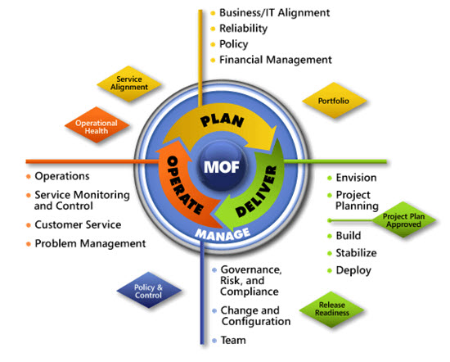
IPD in Microsoft Operations Framework 4.0
Use MOF with IPD guides to ensure that people and process considerations are addressed when changes to an organization’s IT services are being planned
Notes:
For more information about Microsoft Operations Framework 4.0, go to www.microsoft.com/mof.

Slide 25
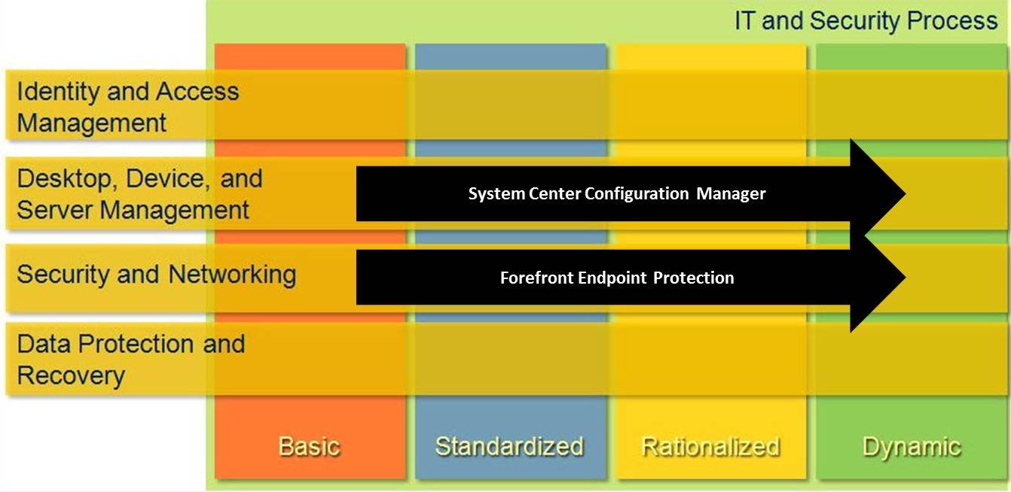
Microsoft System Center Configuration Manager 2007 R3 and Forefront Endpoint Protection in Microsoft Infrastructure Optimization
Notes:
<This slide shows the effect that Microsoft System Center Configuration Manager 2007 R3 and Forefront Endpoint Protection has on infrastructure maturity as reflected in the Core Infrastructure Optimization Model.>
The Infrastructure Optimization (IO) Model groups IT processes and technologies across a range of organizational maturity. (For more information, see www.microsoft.com/infrastructure.) The model was developed by industry analysts, the Massachusetts Institute of Technology (MIT) Center for Information Systems Research (CISR), and Microsoft’s own experiences with its enterprise customers. A key goal for Microsoft in creating the IO Model was to develop a simple way to use a maturity framework that is flexible and that can easily be applied as the benchmark for technical capability and business value.
IO is structured around three information technology models: Core Infrastructure Optimization, Application Platform Optimization, and Business Productivity Infrastructure Optimization. According to the Core IO Model, Configuration Manager can move an organization from a basic to a dynamic level of maturity. At a standardized level, the environment distributes software packages using manual processes. A rationalized level includes fully automatic software updates. A dynamic level of maturity requires asset management that includes automated compliance. This guide will assist you in planning and designing the infrastructure for a Configuration Manager and FEP implementation.

