Slide 1
Windows Server® 2008 R2 Remote Desktop Services
Infrastructure Planning and Design
Published: July 2008
Updated: February 2011
Notes:
Copyright © 2011 Microsoft Corporation. This documentation is licensed to you under the Creative Commons Attribution License. To view a copy of this license, visit http://creativecommons.org/licenses/by/3.0/us/ or send a letter to Creative Commons, 543 Howard Street, 5th Floor, San Francisco, California, 94105, USA. When using this documentation, provide the following attribution: Infrastructure Planning and Design is provided with permission from Microsoft Corporation.
This documentation is provided to you for informational purposes only, and is provided to you entirely "AS IS". Your use of the documentation cannot be understood as substituting for customized service and information that might be developed by Microsoft Corporation for a particular user based upon that user’s particular environment. To the extent permitted by law, MICROSOFT MAKES NO WARRANTY OF ANY KIND, DISCLAIMS ALL EXPRESS, IMPLIED AND STATUTORY WARRANTIES, AND ASSUMES NO LIABILITY TO YOU FOR ANY DAMAGES OF ANY TYPE IN CONNECTION WITH THESE MATERIALS OR ANY INTELLECTUAL PROPERTY IN THEM.
Microsoft may have patents, patent applications, trademarks, or other intellectual property rights covering subject matter within this documentation. Except as provided in a separate agreement from Microsoft, your use of this document does not give you any license to these patents, trademarks or other intellectual property.
Information in this document, including URL and other Internet website references, is subject to change without notice. Unless otherwise noted, the example companies, organizations, products, domain names, email addresses, logos, people, places and events depicted herein are fictitious.
Microsoft, Active Directory, Excel, Forefront, Hyper-V, Visio, Windows, and Windows Server are either registered trademarks or trademarks of Microsoft Corporation in the United States and/or other countries and regions.
The names of actual companies and products mentioned herein may be the trademarks of their respective owners.
You have no obligation to give Microsoft any suggestions, comments or other feedback ("Feedback") relating to the documentation. However, if you do provide any Feedback to Microsoft then you provide to Microsoft, without charge, the right to use, share and commercialize your Feedback in any way and for any purpose. You also give to third parties, without charge, any patent rights needed for their products, technologies and services to use or interface with any specific parts of a Microsoft software or service that includes the Feedback. You will not give Feedback that is subject to a license that requires Microsoft to license its software or documentation to third parties because we include your Feedback in them.

Slide 2
What Is IPD? Guidance that clarifies and streamlines the planning and design process for Microsoft® infrastructure technologies
IPD:
Defines decision flow
Describes decisions to be made
Relates decisions and options for the business
Frames additional questions for business understanding
IPD guides are available at www.microsoft.com/ipd
Notes:
Infrastructure Planning and Design (IPD) is a series of planning and design guides created to clarify and streamline the planning and design process for Microsoft® infrastructure technologies.
Each guide in the series addresses a unique infrastructure technology or scenario.
These guides include the following topics:
Defining the technical decision flow (flow chart) through the planning process.
Describing the decisions to be made and the commonly available options to consider in making the decisions.
Relating the decisions and options for the business in terms of cost, complexity, and other characteristics.
Framing the decisions in terms of additional questions for the business to ensure a comprehensive understanding of the appropriate business landscape.
The guides in this series are intended to complement and augment Microsoft product documentation.

Slide 3
Getting Started
Windows Server® 2008 R2 Remote Desktop Services
Notes:
The IPD guide for Windows Server 2008 R2 Remote Desktop Services was created to give infrastructure planners a step-by-step approach to designing a Windows Server 2008 R2 Remote Desktop Services infrastructure. The guide addresses the following fundamental decisions and tasks:
Identifying which applications and which desktops will be delivered by Remote Desktop Services.
Determining whether to deliver desktops by using session-based presentation virtualization or Virtual Desktop Infrastructure (VDI).
Designing the infrastructure needed to use Remote Desktop Services to serve the selected applications and desktops.
The guide is written for information technology (IT) infrastructure specialists who are responsible for planning and designing a Remote Desktop Services infrastructure.

Slide 4
Purpose and Overview
Purpose
To provide guidance for designing a Remote Desktop Services infrastructure
Overview
Remote Desktop Services features
Remote Desktop Services infrastructure design process
Notes:
This guide focuses on the elements that organizations must consider when designing a Remote Desktop Services infrastructure.
Out of Scope
Remote or multi-tenant hosting
Migration from Windows Server 2008 Terminal Services
Non-Microsoft add-ons such as Citrix MetaFrame
Planning for Windows Server 2008 Hyper-V

Slide 5
Remote Desktop Services Overview
Session-based presentation virtualization segment of Microsoft’s virtualization technologies
Enables centralized application management
Provides connection brokering for VDI
Notes:
Remote Desktop Services Overview
With presentation virtualization, processing happens on a server, while graphics and application interaction are handled remotely on the user’s computer.
Updates and upgrades can occur at the server rather than on each client computer.
Users can be local, at a branch office, at home, or anywhere there’s an Internet connection.

Slide 6
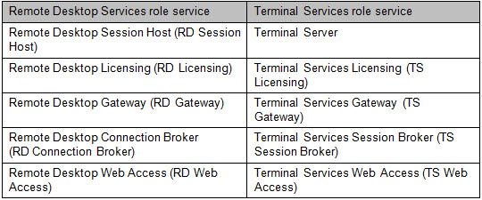
What’s New in Windows Server 2008 R2 Remote Desktop Services
In Windows Server 2008 R2, Remote Desktop Services (formerly named Terminal Services) role services have been renamed as shown in this table.
Notes:
What’s New in Windows Server 2008 R2 Remote Desktop Services
Remote Desktop Virtualization Host (RD Virtualization Host) is a new Remote Desktop Services role service included with Windows Server 2008 R2. RD Virtualization Host requires and integrates with the Hyper-V™ role to provide Virtual Desktop Infrastructure (VDI) virtual machines that can be used as personal virtual desktops or virtual desktop pools.
The IPD Guide for Windows Server 2008 Terminal Services remains available at http://go.microsoft.com/fwlink/?LinkID=160987 for use in designing a Terminal Services infrastructure.

Slide 7
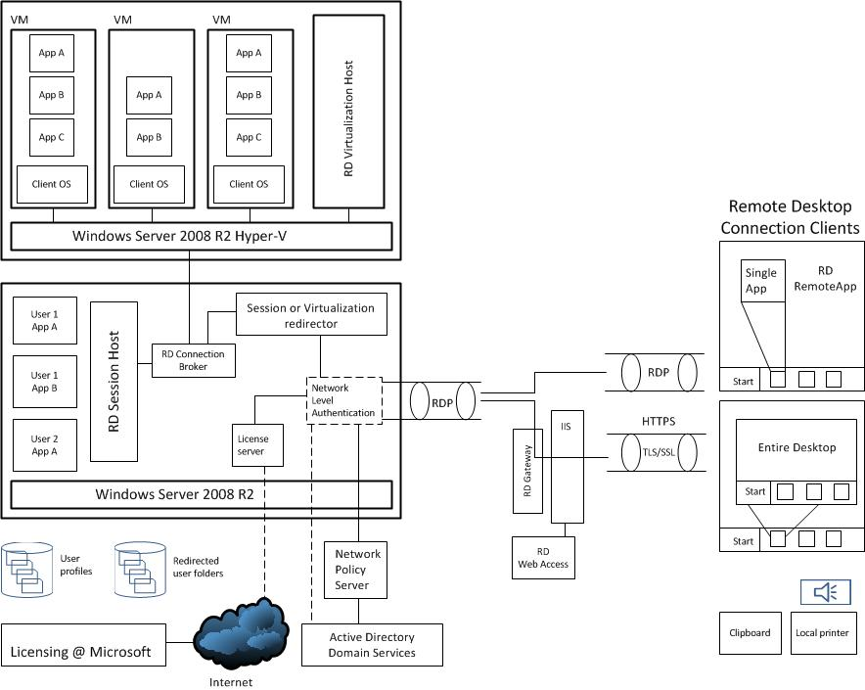
Windows Server 2008 R2 Remote Desktop Services Architecture Example
SCM
ITA
Notes:
This diagram illustrates the relationship between the components that can work together to publish applications and desktops through Remote Desktop Services. They are shown together in one possible implementation for illustrative purposes, but other configurations are possible.
Remote Desktop Services provides the following capabilities:
Delivery of virtual desktops to end users from virtual machines running on Windows Server 2008 R2 Hyper-V. This Virtual Desktop Infrastructure (VDI) is delivered by the RD Virtualization Host role service. Connections between clients and VM-based desktops are made by the Remote Desktop Connection Broker.
Centralized systems that host multiple user sessions, all running on the Windows Server 2008 R2 server operating system. All processing is done on the host systems and the user sessions are isolated from each other.
In both cases, presentation virtualization is used to deliver the desktop or applications to the end user. Only the presentation information (such as keyboard and mouse inputs and video updates) is sent between the client and the host system. The client can be a full Windows-based workstation, a Windows-based remote desktop device, or a thin client.

Slide 8
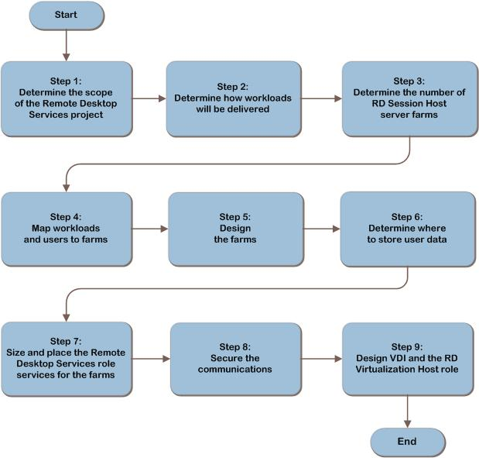
Remote Desktop Services Decision Flow
MAP w/ CAL Tracker
SCM
ITA
Notes:
These are the steps we will follow to design a Remote Desktop Services infrastructure.

Slide 9
Step 1: Determine the Scope of the Remote Desktop Services Project
Task 1: Determine organizational scope
Enterprise-wide, one or many locations, or just a single department
Notes:
Step 1: Determine the Scope of the Remote Desktop Services Project
Task 1: Determine Organizational Scope
Before the architecture can begin, the scope of the project must first be determined so that the planners know the boundaries for which they are building a solution. The scope of the project could be enterprise-wide, one or many locations, or perhaps a single department. If an organization is considering multiple implementations of Remote Desktop Services, it can iterate through this guide for each instantiation.
Validating with the Business
In order to ensure that the project stays focused on delivering the required services, ask the following questions about the business objectives for the project:
What benefits does the business expect to achieve through the use of presentation virtualization?
What is the value of those benefits and, therefore, the cost case for using Remote Desktop Services to deliver those benefits?
The business objectives should be prioritized right from the start so that they are clearly understood and agreed upon between IT and the business.

Slide 10
Step 2: Determine How Workloads Will Be Delivered
Task 1: Gather information about users and their working environment
Task 2: Determine whether the workload can be delivered using presentation virtualization
Notes:
Step 2: Determine How Workloads Will Be Delivered
Task 1: Gather Information About Users and Their Application Environment
User location and number of users. Knowing how many users are at each location assists in determining server sizing and placement.
Client operating system.
Encryption requirements. What is the required level of encryption.
Whether single sign-on to applications is provided. Is single-sign-on expected?
Applications that are used, their versions, and any special local customizations.
Service level agreement (SLA) levels.
Connection type. Are users connected through local area networks (LAN), or wide area network (WAN) links, dial-up, or an Internet service provider (ISP)?
Task 2: Determine Whether the Workload Can Be Delivered Using Presentation Virtualization
Issues That Affect Business Viability:
Can the applications be licensed for delivery using presentation virtualization, without excessive additional cost? Contact the application vendors for this information.
Are the applications supported for delivery using presentation virtualization? Contact the application suppliers for this information.
Are there legal reasons for not publishing an application?
Issues That May Prevent an Application from Being Published:
Will the end user always be connected to the network? Published workloads can only be accessed when the client is connected to the RDS infrastructure. If there are users that need to be able to run workloads in disconnected mode, for example when on an airplane, those workloads cannot be delivered by Remote Desktop Services.
Does the application require access to client-based resources that may not be available to Windows Server? Client-side devices such as scanners, specialty printers, USB devices, and floppy or hard disk drives used by the application need to be checked for compatibility in a Remote Desktop Services environment.
Is the required encryption level within the means of most of the RDP clients?
Is the application video-intensive?
Is the application audio-intensive?

Slide 11
Step 2: Determine How Workloads Will Be Delivered (Continued)
Task 3: Decide whether the workload can be delivered from an RD Session Host or using VDI
Task 4: Categorize users
Notes:
Step 2: Determine How Workloads Will Be Delivered (Continued)
Task 3: Decide Whether the Workload Can Be Delivered From an RD Session Host or Using VDI
Issues with Running on Shared Windows Server 2008 R2
Remote Desktop Services Session Host centralizes client application execution onto a Windows Server 2008 R2 platform. There may be some client applications that are unable to run effectively on the platform that Windows Server 2008 R2 provides.
Answer the following questions for each of the candidate applications:
Does the user require administrative rights on the machine? In the shared server environment, administrative rights cannot be granted to individual users.
Does the user need to be able to reboot the operating system on-demand? In the RDSH shared server environment a reboot would impact all other users.
Can the application run on Windows Server 2008? An internally developed application may be written to install and run only on earlier operating systems. Verify that the application can run on Windows Server 2008 R2.
Does an application employ code not optimized for either 32-bit or 64-bit architecture? Programs that include 16-bit code must be treated differently by the operating system, which causes the application to use a disproportionate amount of memory and CPU resources compared with programs written in 32-bit or 64-bit code..
Issues with the Application’s Behavior Cause Problems in a Multi-User Server
Does the application consume excessive resources or neglect to release them appropriately? An application cannot be allowed to monopolize the CPU, memory, or other shared server resources.
Does the application follow proper installation and uninstallation standards? Applications need to be functional for all users after installation, and uninstalls must not remove components needed by other applications on the RD Session Host.
Does the application alter shared system files and components? An application that is changing files such as fonts, dynamic link libraries (DLLs), and drivers affects other applications’ ability to function.
Is user data kept discrete from other data? If an application places user and temporary files in the same location, then other instances of the application can overwrite or alter the files, producing unpredictable results.
Is the registry accessed properly? An application must not make changes to the registry at a level where the change can affect other users or applications.
Do changes made by the user to program options affect other instances of the program? Changes made in a user’s environment should not affect other users.
Task 4: Categorize Users
Place users into one of three categories: Heavy, Normal, or Light, based on their general usage behavior in their workloads.

Slide 12
Step 3: Determine the Number of RD Session Host Server Farms
Task 1: Determine the number of RD Session Host server farms
Notes:
Step 3: Determine the Number of Remote Desktop Server Farms
Task 1: Determine the Number of RD Session Host Server Farms
Best practices suggest that a design should start with a single farm, and then add more farms only when required. Use the list below to decide whether additional RD Session Host server farms may be required:
Clients separated from the current farm by WAN speeds. If more users are accessing the RD Session Host server farm than the link to the farm can accommodate, an additional RD Session Host server farm may be placed at the remote location.
Traveling users. Determine whether additional farms or upgrades to bandwidth may be required to accommodate traveling users.
Requirements to run different versions of the same software, or to have different versions of the same files, such as DLLs. If users require access to more than one version of software or files and if the different versions cannot coexist, the different versions will have to be run on separate RD Session Host server farms.
Security limitations in some clients. Limitations in some of the clients may drive implementation of the workloads on two (or more) separate farms at different security levels.
Internal and external user populations. Where the same applications are being published both to internal and external users, the external users may be separated on a different farm.
Specific encryption requirements. There are certain levels of encryption that are legal only in certain countries or regions. RD Session Host servers can be configured to allow the client using the highest encryption it is capable of or to deny connections from clients unable to comply with a certain level of encryption.
Organizational requirements to separate business groups. For security reasons, the Accounting department may not want non-accounting personnel to be able to log on to servers containing accounting information, or Research and Development may require the higher security levels of the most recent client, which means that clients unable to comply with the security policy must connect to a different farm.
Legal considerations requiring a separate farm. National security, privacy issues, and fiduciary laws could require the separation of certain data or prevent other data from crossing national borders. If necessary, add farms to address this need.

Slide 13
Step 4: Map Workloads and Users to Farms
Task 1: Assign workloads and users to their RD Session Host server farms
Notes:
Step 4: Map Workloads and Users to Farms
Task 1: Assign Workloads and Users to Their RD Session Host Server Farms
The number of users, farms, virtual desktops and applications can all become confusing to maintain.
List the applications, associating them with the farm where they will be hosted. Be careful to place applications that have interdependencies together in the same farm.
Map which users will have access to each application or virtual desktop on each farm. Include any applications that may be unique for traveling users in each farm.
Where there are significant populations of traveling users, represent them in the job aid in all the locations to which they frequently travel.

Slide 14
Step 5: Design the Farms
Task 1: Select a form factor for the RD Session Host server
Task 2: Determine the number of RD Session Host servers required in the farm
Task 3: Determine the number of additional servers required for fault tolerance
Notes:
Step 5: Design the Farm
Task 1: Select a Form Factor for the RD Session Host Server
The goal of this task is to determine the most appropriate type of hardware on which to deploy the RD Session Host servers.
Use large memory. In the RD Session Host server, where many users are sharing the same application, large memory can significantly improve performance because it allows each user’s work to remain in memory rather than being swapped out to a physical disk. Additional memory will also reduce the disk I/O demand for this reason.
More numerous, smaller disk spindles rather than fewer, large disks. Consider using a redundant array of independent disks (RAID) configuration for disk fault tolerance. The key to performance though is in the total disk IOs per second (IOps). The disk activity generated on a typical RD Session Host affects the following three areas:
Page files
User profiles and user data
System files and application binaries
Use multi-core and multi-processor CPUs. In the multi-user environment of RD Session Host server, multiple processors and cores can help reduce CPU congestion.
Task 2: Determine the Number of RD Session Host Servers Required in the Farm
The optimal number of RD Session Host servers in an RD Session Host server farm delivers a consistent, responsive user experience while balancing system utilization, growth capacity, and cost. In order to consistently arrive at that optimal number for each farm, start with the implementation of a small farm. Use the organization’s standard server form factor, put it into production, and measure the results to determine whether the farm delivers the expected performance.
Task 3: Determine the Number of Additional Servers Required for Fault Tolerance
The number of servers per farm, determined in the previous task, does not account for fault tolerance. It’s therefore necessary to determine the number of additional servers needed to provide a fault-tolerant implementation.
RD Session Host servers cannot be placed in a Microsoft failover cluster, so fault tolerance, if desired, must be provided by additional servers with a load-balancing solution. If a server goes down, the users on that server will need to restart their sessions, which may be instantiated on one of the remaining servers. Incoming session requests will be load-balanced onto the remaining servers by RD Connection Broker. The user will experience session interruption in this case.

Slide 15
Step 6: Determine Where to Store User Data
Task 1: Design user profiles
Task 2: Design user data
Task 3: Design the storage
Notes:
Step 6: Determine Where to Store User Data
Task 1: Design User Profiles
Determine the following about user profiles:
Will users have a mandatory profile? Individual users, or user groups, can be assigned to a mandatory profile, which is very useful on multi-user computers and kiosks.
Determine how much space is required for user profiles. If mandatory profiles were chosen, measure the size of each different mandatory profile and add them together.
Determine where to store the user profiles. The storage location needs to be easily accessible by the RD Session Host servers.
Task 2: Design User Data
Determine the following about user data:
Determine how much space is required for user data. If users are allowed to store data in a My Documents folder on the storage server, then the storage space required can be significant.
Determine where to store the user data. Since the RD Session Host server, rather than the client computer, accesses the data, the storage location needs to be easily accessible by the RD Session Host servers. The data can be held on a storage area network (SAN) or any other file server.
Task 3: Design the Storage
For the user profile and the user data stores, address the following areas to ensure that the solution will meet the requirements of the users and business:
Capacity. For each user account, add together the max. size of the user profile and the max. size of the Remote Desktop Services profile. If there may be more than one pair of profiles for each user (because the user logs on to more than one farm), multiply by the number of farms. Now multiply that number by the number of user accounts. This will be the space required to hold all the user profiles. Multiply the max. data storage available for each user account by the number of user accounts. This will be the space required to hold all the user data.
Performance. The user profile files should be stored on a high speed storage device attached to a file server that has a high speed network connection.
Fault tolerance. The profile and data files should be placed in a highly available file server configuration that provides redundancy.

Slide 16
Step 7: Size and Place the Remote Desktop Services Role Services for the Farms
Task 1: Design and place the RD Connection Broker role service
Task 2: Determine the number of servers required for RD Web Access
Notes:
Step 7: Size and Place the Remote Desktop Services Role Services for the Farms
Task 1: Design and Place RD Connection Broker Role Service
Decide where RD Connection Broker services are needed and in what format, and determine which farm connects to RD Connection Broker server.
Determine whether the RD Connection Broker role service is required. For a multi-server farm, the RD Connection Broker role service will be required. The RD Connection Broker is also used to connect publish virtual desktops for VDI and to make the initial client connection to those desktops. So if Remote Desktop Services will be used to publish virtual desktops, the RD Connection Broker role service will be required.
Determine the demand on the RD Connection Broker. Since the RD Connection Broker is only used when the user connects to the farm, it can be considered a lightweight service, and its implementation can be designed as such. Start by implementing the role service in a small farm, measure the performance, analyze and learn from the results, and adjust the sizing accordingly.
Determine whether to use dedicated redirectors. To increase performance of session and/or virtualization redirection in a large RD Session Host server farm, RD Session Host servers can be dedicated as redirectors.
Determine the number of servers required. Divide the total number of users that will have sessions with the farm by the number of users that a RD Connection Broker server was able to support when tested, in order to determine the number of servers required for RD Connection Broker.
Decide whether the servers that host RD Connection Broker can be shared. Decide whether the RD Connection Broker role service can be shared. The RD Connection Broker server can be shared between farms.
Determine where to place the RD Connection Broker roles in the network. The RD Connection Broker role service needs to be able to communicate with each RD Session Host server farm whose sessions it manages.
Determine the fault tolerance requirements of the RD Connection Broker servers. RD Connection Broker role service should be protected from failure by instantiating more than one copy of the role service in a Microsoft failover cluster.
Task 2: Determine the Number of Servers Required for RD Web Access
The RD Web Access role service is installed along with the RD Connection Broker and can be used to present applications on a website that is accessed by the user with a browser. However, when the user selects an application from that website and launches it, he or she is connected directly to the RD Session Host server, and RD Web Access is no longer involved.

Slide 17
Step 7: Size and Place the Remote Desktop Services Role Services for the Farms (Continued)
Task 3: Design and Place the Remote Desktop License Servers
Task 4: Design and Place the RD Gateway Servers
Notes:
Step 7: Size and Place the Remote Desktop Services Role Services for the Farms (Continued)
Task 3: Design and Place the Remote Desktop License Servers
There are two types of Remote Desktop Services client access licenses (RDS CALs): RDS per Device CAL and RDS per User CAL.
Determine the demand on the license server. Start by implementing the role service in a small farm, measure the performance, analyze and learn from the results, and adjust the sizing of the role service in the next farm accordingly.
Determine the number of servers required. Divide the total number of users or devices that will have sessions with the farm by the number of users that a license server was able to support when tested. Complete this process for each farm, and record the value.
Decide whether the servers that host RD Licensing can be shared. This can be done in the following ways:
a. The license server can be shared between farms.
b. The license server can host other Remote Desktop Services role services.
Determine where to place the RD Licensing roles in the network. RD Session Host server farms on a high-speed LAN can share RD Licensing services. Conversely, farms separated by WAN distances will likely need to have RD Licensing services assigned at each location.
Determine the fault tolerance requirements of RD Licensing. If RD Licensing is unavailable, new clients and clients whose licenses have expired can be denied access to the remote desktop servers. To reduce the possibility of this occurring, place two license servers with half of the licenses installed on each server. Then publish both of the servers in Active Directory® Domain Services (AD DS).
Task 4: Design and Place the RD Gateway Servers
When an external client connects to the Remote Desktop Services environment through RD Gateway, RD Gateway acts as a security broker, performing client authentication by calling back-end services. It accepts the connection and authenticates the client through Remote Desktop connection authorization policies (RD CAPs) and Remote Desktop resource authorization policies (RD RAPs) that are called from AD DS. It may also call Network Address Protection to test the client’s health.

Slide 18
Step 8: Secure the Communications
Task 1: Determine the encryption level
between clients and the RD Session Host
server
Task 2: Determine whether to seal the communications
Task 3: Determine the certification authority
Task 4: Determine whether to encapsulate
with HTTPS
Notes:
Step 8: Secure the Communications
The level of security selected for each farm will depend on the security requirements of the applications that run in the farm and the capabilities and location of the clients.
Task 1: Determine the Encryption Level Between Clients and the RD Session Host Server
Remote Desktop Services sessions use native 128-bit RDP encryption by default. However, if a client seeking to connect is unable to support 128-bit encryption, the encryption strength may be reduced to 56-bit.
Task 2: Determine Whether to Seal the Communications
RDP does not provide authentication to verify the identity of an RD Session Host server, which makes it potentially vulnerable to man-in-the-middle attacks. TLS/SSL encryption can be used to enforce mutual authentication between the client and the server before communications are allowed to proceed. This authentication is effected by a certificate exchange.
Perform an assessment of the risk and potential cost of a man-in-the-middle attack. This will be used in the next step to determine the certification authority.
Task 3: Determine the Certification Authority
Certificates will be required in order to use RDP or HTTPS communications between the clients and the RD Session Host server. There are three ways to source those certificates so that they are available at the RD Session Host server and at all the clients that will need them:
Self-signed certificates
Trusted third party
Operate a certificate server
Task 4: Determine Whether to Encapsulate with HTTPS
If the clients connect using RDP, port 3389 must be open on the external firewall. Many organizations strive to limit the number of ports that are open to the Internet, often limiting it to ports 80 (HTTP) and 443 (HTTPS). Determine whether policy requires that only ports 80 and 443 can be open in the external firewall, and if that is the case, implement HTTP or HTTPS communications using the RD Gateway role service.

Slide 19
Step 9: Design VDI and the RD Virtualization Host Role
Start by deciding how VDI desktops will be provided
Determine the most appropriate type of hardware on which to deploy the RD Virtualization Host servers
Decide how many will be required
Notes:
Step 9: Design VDI and the RD Virtualization Host Role
Task 1: Design the VDI Environment
Start by deciding how VDI desktops will be provided; as personal or pooled desktops.
Task 2: Design the RDVH Role
The RD Virtualization Host role service performs the following functions:
Populates VMs into the RD Connection Broker, so that they become available for user connection.
Wakes up a suspended VM when a user initiates a connection to that VM.
Reports the status of pool VMs to the RD Connection Broker.
Once the client has established a connection to the VM, the RD Virtualization Host and the RD Connection Broker are no longer involved in the connection. So the only load on the RD Virtualization Host occurs when establishing the VDI connection. The RD Virtualization Host must be run on the same Hyper-V host as the VMs which it serves. The RD Virtualization Host can connect to only one RD Connection Broker at a time; if that RD Connection Broker is in a failover cluster, the RD Virtualization Host will discover it through DNS name resolution and populate it with the VMs that run on the Hyper-V host.
Determine the most appropriate type of hardware on which to deploy the RD Virtualization Host servers and decide how many of those machines will be required. Perform this step only if virtual machine desktops will be delivered from an RD Virtualization Host.

Slide 20
Summary and Conclusion
The Remote Desktop Services guide has addressed the fundamental decisions and tasks involved in:
Deciding what workloads are to be delivered by Remote Desktop Services and whether Remote Desktop Services is the right approach to use
Determining the resources needed to employ Remote Desktop Services to serve the selected workloads
Designing the components, layout, security, and connectivity of the Remote Desktop Services infrastructure
Provide feedback to ipdfdbk@microsoft.com
Notes:
Summary and Conclusion
This guide offers major architectural guidance. Refer to product documentation for additional details.

Slide 21
Find More Information
Download the full document and other IPD guides:
www.microsoft.com/ipd
Contact the IPD team:
ipdfdbk@microsoft.com
Access the Microsoft Solution Accelerators website:
http://www.microsoft.com/technet/SolutionAccelerators

Slide 22
Questions?

Slide 23
Addenda:
Benefits for consultants or partners
IPD in Microsoft Operations Framework 4.0
Remote Desktop Services in Microsoft Infrastructure Optimization

Slide 24
Benefits of Using the Remote Desktop Services Guide
Benefits for Business Stakeholders/Decision Makers
Most cost-effective design solution for implementation
Alignment between the business and IT from the beginning of the design process to the end
Benefits for Infrastructure Stakeholders/ Decision Makers
Authoritative guidance
Business validation questions ensuring solution meets requirements of business and infrastructure stakeholders
High integrity design criteria that includes product limitations
Fault-tolerant infrastructure
Infrastructure that’s sized appropriately for business requirements
Notes:
Benefits of Using the Remote Desktop Services guide
Benefits for Business Stakeholders/Decision Makers:
Most cost-effective design solution for an implementation. IPD eliminates over-architecting and over-spending by precisely matching the technology solution to the business needs.
Alignment between the business and IT from the beginning of the design process to the end.
Benefits for Infrastructure Stakeholders/Decision Makers:
Authoritative guidance. Microsoft is the best source for guidance about the design of Microsoft products.
Business validation questions to ensure the solution meets the requirements of both business and infrastructure stakeholders.
High integrity design criteria that includes product limitations.
Fault-tolerant infrastructure, where necessary.
Proportionate system and network availability to meet business requirements. Infrastructure that is sized appropriately to meet business requirements.

Slide 25
Benefits of Using the Remote Desktop Services Guide (Continued)
Benefits for Consultants or Partners
Rapid readiness for consulting engagements
Planning and design template to standardize design and peer reviews
A “leave-behind” for pre- and post-sales visits to customer sites
General classroom instruction/preparation
Benefits for the Entire Organization
Using the guide should result in a design that will be sized, configured, and appropriately placed to deliver a solution for achieving stated business requirements
Notes:
Benefits of Using the Remote Desktop Services guide (continued)
Benefits for Consultants or Partners:
Rapid readiness for consulting engagements.
Planning and design template to standardize design and peer reviews.
A “leave-behind” for pre- and post-sales visits to customer sites.
General classroom instruction/preparation.
Benefits for the Entire Organization:
Using the guide should result in a design that will be sized, configured, and appropriately placed to deliver a solution for achieving stated business requirements, while considering the performance, capacity, manageability, and fault tolerance of the system.

Slide 26
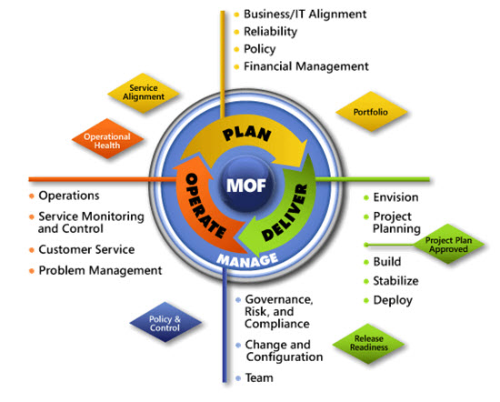
IPD in Microsoft Operations Framework 4.0
Use MOF with IPD guides to ensure that people and process considerations are addressed when changes to an organization’s IT services are being planned.
Notes:
For more information about Microsoft Operations Framework 4.0, go to www.microsoft.com/mof.

Slide 27
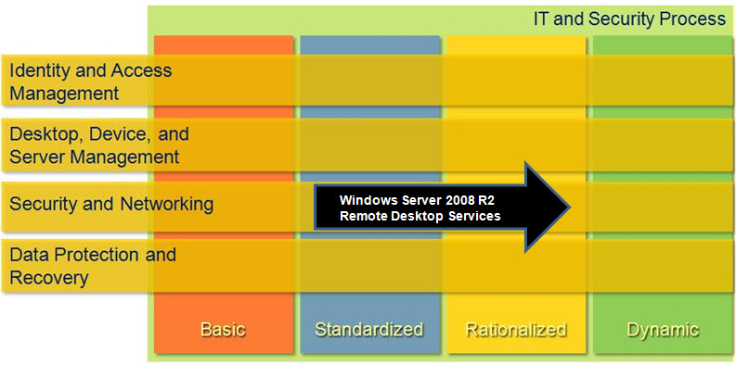
Remote Desktop Services in Microsoft Infrastructure Optimization
Notes:
<This slide shows the effect that Windows Server 2008 R2 Remote Desktop Services has on infrastructure maturity as reflected in the Core Infrastructure Optimization Model.>
The Infrastructure Optimization (IO) Model at Microsoft groups IT processes and technologies across a continuum of organizational maturity. (For more information, see http://www.microsoft.com/infrastructure.) The model was developed by industry analysts, the Massachusetts Institute of Technology (MIT) Center for Information Systems Research (CISR), and Microsoft's own experiences with its enterprise customers. A key goal for Microsoft in creating the Infrastructure Optimization Model was to develop a simple way to use a maturity framework that is flexible and can easily be applied as the benchmark for technical capability and business value.
IO is structured around three information technology models: Core Infrastructure Optimization, Application Platform Optimization, and Business Productivity Infrastructure Optimization. According to the Core Infrastructure Optimization Model, organizations that are implementing presentation virtualization for production workloads with Windows Server 2008 R2 are meeting one of the requirements to move to the Rationalized maturity level.

