Slide 1
Malware Response
Infrastructure Planning and Design
Published: February 2011
Updated: November 2011
Notes:
Copyright © 2011 Microsoft Corporation. All rights reserved. Complying with the applicable copyright laws is your responsibility. By using or providing feedback on this documentation, you agree to the license agreement below.
If you are using this documentation solely for non-commercial purposes internally within YOUR company or organization, then this documentation is licensed to you under the Creative Commons Attribution-NonCommercial License. To view a copy of this license, visit http://creativecommons.org/licenses/by-nc/2.5/ or send a letter to Creative Commons, 543 Howard Street, 5th Floor, San Francisco, California, 94105, USA.
This documentation is provided to you for informational purposes only, and is provided to you entirely "AS IS". Your use of the documentation cannot be understood as substituting for customized service and information that might be developed by Microsoft Corporation for a particular user based upon that user’s particular environment. To the extent permitted by law, MICROSOFT MAKES NO WARRANTY OF ANY KIND, DISCLAIMS ALL EXPRESS, IMPLIED AND STATUTORY WARRANTIES, AND ASSUMES NO LIABILITY TO YOU FOR ANY DAMAGES OF ANY TYPE IN CONNECTION WITH THESE MATERIALS OR ANY INTELLECTUAL PROPERTY IN THEM.
Microsoft may have patents, patent applications, trademarks, or other intellectual property rights covering subject matter within this documentation. Except as provided in a separate agreement from Microsoft, your use of this document does not give you any license to these patents, trademarks or other intellectual property.
Information in this document, including URL and other Internet Web site references, is subject to change without notice. Unless otherwise noted, the example companies, organizations, products, domain names, e-mail addresses, logos, people, places and events depicted herein are fictitious.
Microsoft, Forefront, Windows, Windows Server, and Windows Vista are either registered trademarks or trademarks of Microsoft Corporation in the United States and/or other countries and regions.
Microsoft, Active Directory, Forefront, and Windows Server are either registered trademarks or trademarks of Microsoft Corporation in the United States and/or other countries and regions.
The names of actual companies and products mentioned herein may be the trademarks of their respective owners.
You have no obligation to give Microsoft any suggestions, comments or other feedback ("Feedback") relating to the documentation. However, if you do provide any Feedback to Microsoft then you provide to Microsoft, without charge, the right to use, share and commercialize your Feedback in any way and for any purpose. You also give to third parties, without charge, any patent rights needed for their products, technologies and services to use or interface with any specific parts of a Microsoft software or service that includes the Feedback. You will not give Feedback that is subject to a license that requires Microsoft to license its software or documentation to third parties because we include your Feedback in them.

Slide 2
What Is IPD?
Guidance that clarifies and streamlines the planning and design process for Microsoft infrastructure technologies
IPD:
Defines decision flow
Describes decisions to be made
Relates decisions and options for the business
Frames additional questions for business understanding
IPD guides are available at www.microsoft.com/ipd
Notes:
Infrastructure Planning and Design (IPD) is a series of planning and design guides created to clarify and streamline the planning and design process for Microsoft® infrastructure technologies.
Each guide in the series addresses a unique infrastructure technology or scenario.
These guides include the following topics:
Defining the technical decision flow (flow chart) through the planning process.
Describing the decisions to be made and the commonly available options to consider in making the decisions.
Relating the decisions and options for the business in terms of cost, complexity, and other characteristics.
Framing the decisions in terms of additional questions for the business to ensure a comprehensive understanding of the appropriate business landscape.
The guides in this series are intended to complement and augment Microsoft product documentation. It is assumed that the reader has a basic understanding of the technologies discussed in these guides. It is the intent of these guides to define business requirements, then align those business requirements to product capabilities, and design the appropriate infrastructure.

Slide 3
Purpose and Overview
Purpose
To provide a process and tasks to help determine the nature of the malware problem, limit the spread of malware, and return the system to operation
Overview
Confirm the infection
Determine a course of action
Evaluate effectiveness
Conduct a post-attack review
Notes:
The guide describes decisions and activities to perform when responding to and recovering from a malware incident.

Slide 4
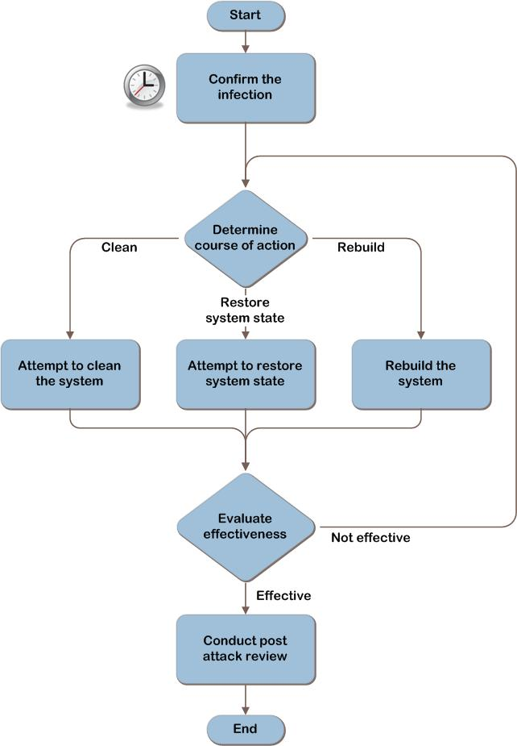
Response to a Malware Incident Decision Flow
ITA
Notes:
The steps in this process flow will be expanded in the slide deck.

Slide 5
Step 1: Confirm the Infection
  Task 1: Isolate the Threat
  Contain the immediate threat by performing one of the following:
  Power the system off
  Disconnect the system from the network
  Leave the system on and connected to the network to allow help desk personnel to remotely troubleshoot the system
  Task 2: Notify Others to Be on Alert
  Watch for an emerging malware outbreak
  Time may be an important factor
  Gather reports to help evaluate the scope and severity of
  the threat
Notes:
Step 1: Confirm the Infection
Task 1: Isolate the Threat
When a malware incident is suspected, always assume the worst. First, contain the immediate threat by performing one of the following tasks:
Power the system off.
Disconnect the system from the network.
Leave the system on, and connected to the network to allow help desk personnel to remotely troubleshoot the system.
Powering off immediately stops the malware’s actions and protects individual machines’ data not already affected by the malware. A less conservative option is to disconnect the system from the network. This action has the potential risk of allowing the malware to continue to be active, possibly destroying data. Network disconnection could be done to individual machines or a portion of the network. If the entire organization’s network is thought to be at risk, access can be severed from the internal network to all external networks.
A third option is to leave the system on and connected to the network to allow help desk personnel to remotely troubleshoot the system. Doing so presents the risk that the malware may continue to spread to other systems.
Task 2: Notify Others to Be on Alert
Decide whether to notify other support personnel to watch for an emerging malware outbreak. Time may be an important factor, so the initial responder will be making a judgment call based on the initial assessment relative to the scale of notification. For smaller IT departments, this may be as simple as verbally asking the other analysts to watch out for other users reporting unusual symptoms. Larger IT departments may have already-defined protocols and escalation procedures that the initial responder will have to weigh against the threat. If appropriate, notify other support personnel of a possible malware incident so they can be on alert for other reports. Continually gather those reports and add them to the collection of information to help evaluate the scope and severity of the threat. This will inform the response actions in later steps.

Slide 6
Step 1: Confirm the Infection (Continued)
  Task 3: Gather Information About the Threat
  Gather information from the user:
  Determine the unusual activity that prompted the report
  Gather information from the system:
  Determine whether antivirus and antimalware software were installed, running, and up to date
  Determine whether all updates and patches for the operating system and applications were current
Notes:
Step 1: Confirm the Infection (Continued)
Task 3: Gather Information About the Threat
Information to gather from the user:
Determine the unusual activity that prompted the report, such as any of the following:
Unusual or unaccountable network traffic originating from the computer.
Computer runs more slowly than normal.
Computer often stops responding to program or system commands.
Computer fails and needs to be restarted frequently.
Computer restarts on its own, and then fails to run normally.
Users cannot correctly run applications on the computer.
Users cannot access disks or disk drives on the computer.
Users cannot print correctly from the computer.
Users receive unusual error messages, pop-up windows, or advertisements.
Users see distorted menus and dialog boxes.
Users' Internet browser home pages unexpectedly change.
Users cannot access administrator shares on the computer.
Users notice an unexplained loss of disk space.
Get the details of what the user was doing just prior to the unusual activity.
Determine what may have changed.
Information to gather from the system:
Determine whether antivirus and antimalware software were installed, running, and up to date.
Determine whether all updates and patches for the operating system and applications were current.

Slide 7
Step 1: Confirm the Infection (Continued)
  Task 4: Determine the Breadth of the Problem
  Is this an isolated incident, or are multiple systems experiencing the same problems?
    Multiple systems affected may increase the alert level
  Task 5: Determine Whether Malware Is Present
  Evaluate evidence to determine whether the organization is experiencing a malware attack
Notes:
Step 1: Confirm the Infection (Continued)
Task 4: Determine the Breadth of the Problem
Determine whether this is an isolated incident or multiple systems are experiencing the same problems. Is the user who originally reported the problem aware of others having the same problem? Are there an unusual number of reports within a designated timeframe? Reports that other users are having the same problem may increase the alert level, because they might indicate an outbreak rather than just an isolated incident. Determine the scope of the suspected malware. The scope may be adjusted as new information is obtained.
Task 5: Determine Whether Malware Is Present
Evaluate the evidence to determine whether the organization is indeed experiencing a malware attack. Reasonable suspicions of malware include:
Antimalware software reporting via a message that malware was detected during either a real-time detection or a full system scan.
Unusual behavior of computers consistent with known types of malware disruption that cannot be explained by system malfunction.
Symptoms that are getting worse on a system.
Symptoms that are spreading to other systems.
Symptoms consistent with “in the wild” reports.
Before triggering an incident response plan, determine whether the incident meets the organization’s predefined thresholds, if they exist. Consider whether the characteristics or severity of the attack symptoms warrant initiating the incident response plan. After examining the data gathered from the incident report, decide whether a malware incident or outbreak is occurring. If it is likely that there is an infection, continue to Step 2.

Slide 8
Validating with the Business (Step 1)
  To help understand the organization’s priorities when responding to a malware incident, ask the business stakeholders the following questions:
  Is there an expectation for the response time required to return the systems to operation?
  Have policies and procedures been documented for isolating computers infected with malware so users and the business are prepared for the impact on productivity?
Notes:
Validating with the Business (Step 1)
To help understand the organization’s priorities when responding to a malware incident, ask the business stakeholders the following questions:
Is there an expectation for the response time required to return the systems to operation? If the business places a high priority on returning the systems to operation, IT may not be able to spend much resource time on determining the cause or source of the infection: All personnel may be needed to rebuild the systems.
Have policies and procedures been documented for isolating computers infected with malware so users and the business are prepared for the impact on productivity? Infected systems will be unavailable for use until the malware has been eradicated; in some cases, the only way to completely remove the malware is to reinstall the operating system and restore the data from a clean backup. Therefore, systems could be unavailable for a significant amount of time.

Slide 9
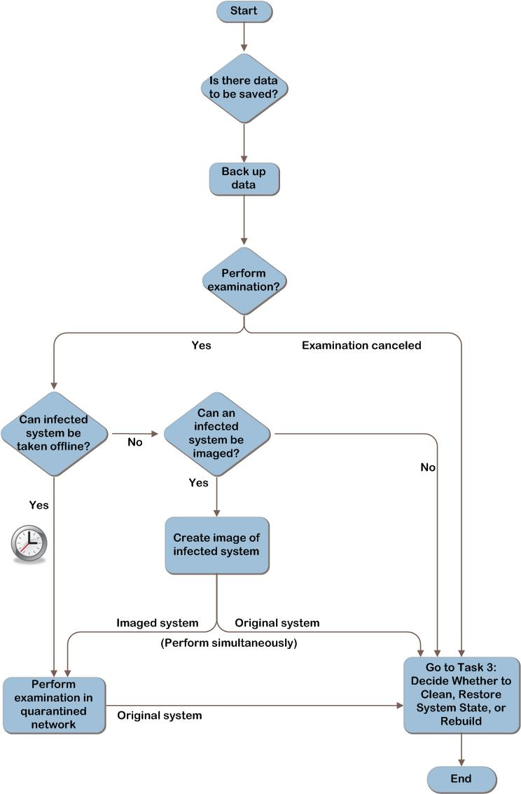
Step 2: Determine Course of Action Decision Flow
Notes:
Step 2: Determine Course of Action Decision Flow
The figure on this slide represents the steps to be performed when deciding which course of action to take.

Slide 10
Step 2: Determine Course of Action
  Task 1: Determine the Risk to Data
  Consider the risk to the data, and verify whether the data has been backed up:
    Operating system files and configuration settings
    Application installation sources, configuration settings, and data
    User data
  Task 2: Decide Whether to Examine Malware’s Effects on the System
  The primary factors when considering examination are whether the organization has the expertise needed and how urgent it is to return the system to operation
Notes:
Step 2: Determine Course of Action
Task 1: Determine the Risk to Data
The most valuable asset is most likely the data that resides on the system. So, it’s crucial to consider the risk to the data and verify whether the data has been backed up. Questions to ask are:
Is there data on the computer that is important to save? Does the computer or any devices attached to it contain mission-critical data? Consider the following:
Operating system files and the configuration settings required to restore the host operating system to its original state so all services are functioning correctly
Application installation sources, configuration settings, and data
User data, such as documents and spreadsheets, email, and user profiles
If it’s determined that data on the system needs to be backed up, back up the data now, or leave the computer powered off until it can be backed up. Consider using offline mechanisms (such as booting in to Windows® Preinstallation Environment [Windows PE] or attaching the drive as a subordinate drive in another, noninfected system) to back up the data. If backups are made with the infected operating system running, the malware may continue to infect or destroy the data. Verify that the backup is successful to ensure that the entire set of data can be restored and that it’s not infected.
Task 2: Decide Whether to Examine Malware’s Effects on the System
Decide whether the organization wants the malware’s effects on the system examined. Examination can be beneficial to the organization to determine who, what, where, how, and why the infection occurred; however, it also takes time and expertise to perform. Performing this examination is optional; the organization may decide that it’s not important to know the details about the malware infection.
The symptomatic system can be examined. The system will need to be out of service during the time that it’s being examined, so this may delay its return to service. If multiple systems are affected, a single symptomatic system can be pulled aside and used for examination, with steps performed in parallel to return the others to service.
A symptomatic system can be kept offline long enough to create a virtual image of the system for examination. Time spent imaging the system delays its return to service, but this may be quicker than examining the system on the spot.

Slide 11
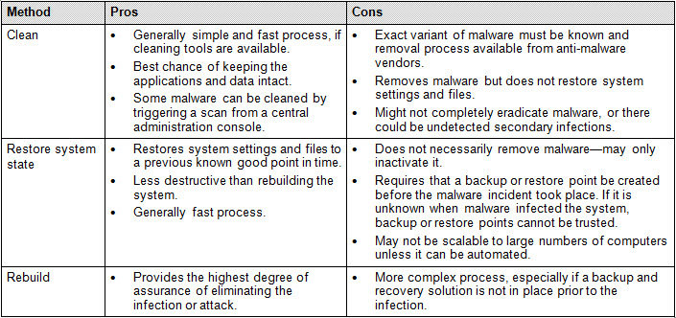
Step 2: Determine Course of Action (Continued)
  Task 3: Decide Whether to Clean, Restore System State, or Rebuild
  This table provides details on the advantages and disadvantages of each option
Notes:
Step 2: Determine Course of Action (Continued)
The table on this slide provides the pros and cons of system cleaning, restoring, and rebuilding.
Task 3: Decide Whether to Clean, Restore System State, or Rebuild
Decide whether to attempt to clean the malware, restore system state, or rebuild the system. Note that cleaning and restoring system state are not always successful, in which case rebuilding is the last resort.
Choosing which option to use should depend on the organization’s level of confidence that the option selected will reduce the malware risk to a level the organization is willing to tolerate.
Factors to consider when making this decision include:
How many systems are affected?
Is there a documented way to remove the malware? If not, does the organization have the time to wait until directions are available from antimalware vendors?
Can the recovery processes be performed with minimal or no hands-on work, or do they involve hands-on work by an onsite technician?
How long will it take to recover the affected systems? If rebuilding, are there images of the systems and are the computers’ configurations well-documented?
Is there enough confidence that the system can be cleaned or restored to a known good system state? If not, does the organization prefer that IT go straight to rebuilding the systems?
What expertise and administrative rights will be required? Do personnel performing the work have them?

Slide 12
Validating with the Business (Step 2)
  To ensure that all requirements have been identified to recover from a malware incident, ask business stakeholders the following questions:
  Does the recovery plan budget resources appropriately, depending on the scope of the outbreak and the business impact of the affected computers?
  Are there different response expectations to address different types of data and systems, such as High Impact, Medium Impact, and/or Low Impact designations for these different assets?
Notes:
Validating with the Business (Step 2)
To ensure that all requirements have been identified to recover from a malware incident, ask business stakeholders the following questions:
Does the recovery plan budget resources appropriately, depending on the scope of the outbreak and the business impact of the affected computers? In many cases, it will be quicker to rebuild systems than to try to remove complex malware; however, a system with critical business data may be worth the time and effort required for removal, especially if no current data backup is available for the affected systems.
Are there different response expectations to address different types of data and systems, such as High Impact, Medium Impact, and/or Low Impact designations for these different assets? The response speed may vary relative to the importance of the affected systems. For example, the response time would be much quicker when an email server has been infected with malware than when an informational kiosk in a building lobby has been infected.

Slide 13
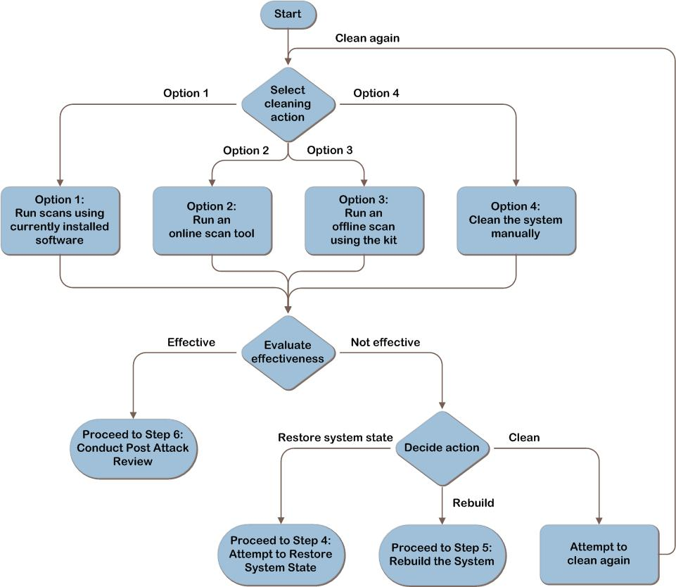
Step 3: Attempt to Clean the System Decision Flow
Notes:
Step 3: Attempt to Clean the System
The figure on this slide represents the steps to be performed when attempting to clean the system.

Slide 14
Step 3: Attempt to Clean the System
  Task 1: Clean the System
  Use scanning tools to detect and potentially automatically remove any malware from the system, or manually remove the malware
  See the table on the next two slides for the pros and cons of cleaning
Notes:
Step 3: Attempt to Clean the System
Task 1: Clean the System
Use scanning tools to detect and potentially automatically remove any malware from the system, or manually remove the malware. The options below are listed in order of ease of execution. Consider the first option, and then move progressively to more intensive attempts until the organization is confident the malware issue is resolved.
The cleaning options are:
Use locally installed antimalware software with updated signatures, with the operating system started normally and/or in safe mode.
Use online scan tools, with the operating system started normally and/or in safe mode with networking support.
Run an offline scan using the offline scan kit.
Manually clean the system.

Slide 15
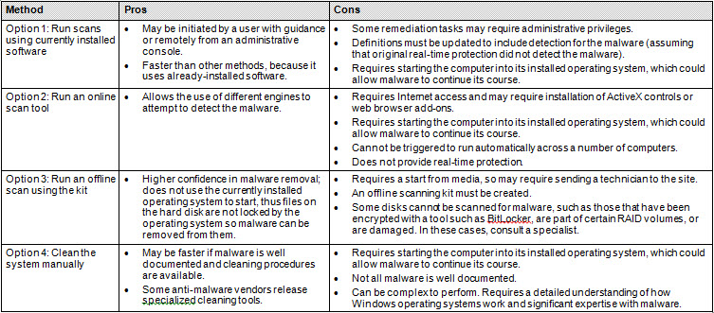
Step 3: Attempt to Clean the System (Continued)
  Task 1: Clean the System (Continued)
  This table provides details about the advantages and disadvantages of each option
Notes:
Step 3: Attempt to Clean the System (Continued)
The table on this slide provides details about the pros and cons of system cleaning.

Slide 16
Step 3: Attempt to Clean the System (Continued)
  Task 2: Evaluate Effectiveness
  At the end of each option, evaluate its effectiveness and consider whether additional measures, including rerunning scans, need to be taken to ensure that the system can be safely returned to production:
    “No malware found” does not conclusively mean cleaned
    Permissions or settings may have been changed
  If malware is still present, attempt to restore system state or rebuild the computer
Notes:
Step 3: Attempt to Clean the System (Continued)
Task 2: Evaluate Effectiveness
At the end of each option, evaluate its effectiveness and consider whether additional measures, including rerunning scans, need to be taken to ensure that the system can be safely returned to production.
Evaluate the effectiveness of the attempts to return the system to service:
Does it appear that malware is still on the system? It’s important to note that a scan returning a result of “no malware found” does not conclusively mean there is no infection. Signatures may not be available from the vendor yet to detect the malware if it’s a new strain, or the malware may be concealing itself. Because of the ever-changing nature of malware, no process can be considered 100 percent effective for cleaning malware from a computer. It may be necessary to perform more than one or even all of the options. Manual cleaning steps, described in this task, also may need to be performed in addition to the scans.
Are there any security or system settings that are not corrected? Even if the malware can no longer be detected, it might have made other modifications, such as to permissions or accounts that need to be detected and addressed. Review the malware information provided by the security vendor and determine whether additional steps need to be taken. If the malware’s effects are not well documented in terms of all changes to the system, rebuilding is the only option for returning the system to a known good state.
If malware appears still to be causing issues after attempts to clean the system, there are two options to consider:
Attempt to restore system state (see Step 4).
Rebuild the computer (see Step 5).

Slide 17
Additional Considerations (Step 3)
  Microsoft tools can help
  Windows Defender helps provide protection against spyware.
  Microsoft Security Essentials is a consumer-oriented offering that helps provide protection against spyware, viruses, and other malicious software.
  The Microsoft Safety Scanner checks for infections and helps remove infections, if one is found.
  For enterprise customers, Microsoft® Forefront® Endpoint Protection helps provide unified protection from viruses, spyware, and other current and emerging threats for business client computers, portable computers, and server operating systems.
Notes:
Additional Considerations (Step 3)
Windows Defender helps provide protection against spyware. It is included with the operating system for Windows 7 and Windows Vista® and is free to download for computers running Windows XP. To download Windows Defender or get more information on running scans, see www.microsoft.com/windows/products/winfamily/defender/support.mspx.
Microsoft Security Essentials is a consumer-oriented offering that helps provide protection against spyware, viruses, and other malicious software. It is a separate download for computers running Windows XP (with Service Pack 2 [SP2] or SP3), Windows Vista, and Windows 7. To download Microsoft Security Essentials and get more information relative to running scans, see www.microsoft.com/security_essentials.
The Microsoft Safety Scanner at www.microsoft.com/security/scanner/en-us/default.aspx is a free downloadable security tool that provides on-demand scanning and helps remove viruses, spyware, and other malicious software. It works with existing antivirus software.
For enterprise customers, Microsoft Forefront® Endpoint Protection helps provide unified protection from viruses, spyware, and other current and emerging threats for business client computers, portable computers, and server operating systems. See www.microsoft.com/forefront/clientsecurity for more information.

Slide 18
Step 4: Attempt to Restore System State
  Task 1: Restore System State
  The tools for restoring the system state vary depending on the installed operating system, but the mechanisms are similar
  Task 2: Evaluate Effectiveness
  Does it appear that malware is still on the system?
  Are any security or system settings not corrected?
  Does the system operate properly according to the user’s expectations (user acceptance–type testing)?
Notes:
Step 4: Attempt to Restore System State
Task 1: Restore System State
The following tools can be used to restore the system state:
System Restore. Applies to Windows 7, Windows Vista, and Windows XP.
Windows Recovery Environment. For computers running Windows 7, Windows Vista, Windows Server 2008, and Windows Server 2008 R2.
Last Known Good Configuration. Applies to Windows 7, Windows Vista, Windows XP, Windows Server 2003, and Windows Server 2008.
Automated System Recovery. For computers running Windows XP or Windows Server 2003.
Windows Backup. Windows Backup for Windows XP is the least automated; however, it’s flexible. Windows Backup for Windows Vista is highly automated, but it’s not as flexible as Windows Backup for Windows XP. Windows Backup for Windows 7 is both highly automated and more flexible than Windows Vista.
Task 2: Evaluate Effectiveness
Evaluate the effectiveness of the attempts to return the system to service:
Does it appear that malware is still on the system?
Are any security or system settings not corrected?
Does the system operate properly according to the user’s expectations (user acceptance-type testing)?
Evaluate whether the system meets the business risk tolerances. Go back to Step 3 if necessary. After attempting to restore the system state and/or clean the system, if malware still appears to be on the computer, the only remaining option is to rebuild the computer (see Step 5).

Slide 19
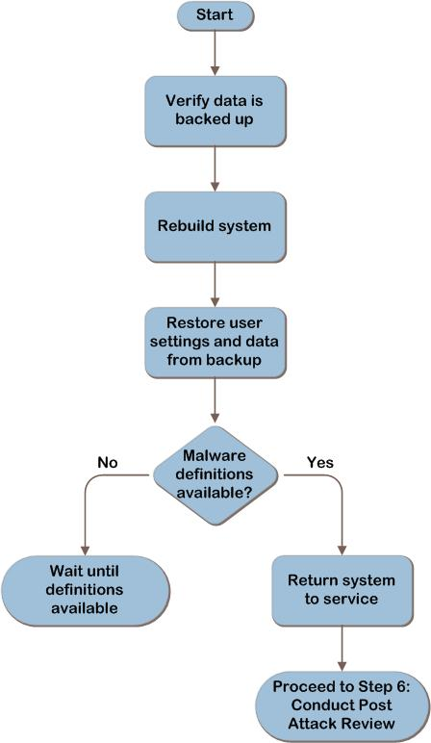
Step 5: Rebuild the System Decision Flow
Notes:
Step 5: Rebuild the System
The figure on this slide represents the steps to be performed when rebuilding the system.

Slide 20
Step 5: Rebuild the System
  Task 1: Rebuild the System
  As a reminder, any critical data on the system should be backed up, because rebuilding the system will destroy any data on the hard disk
  Task 2: Restore User Settings and Data
  Ensure that the files are clean prior to restoring them by scanning them with a malware scanner
  Task 3: Evaluate Effectiveness
  Verify that the system is clean of malware and protected against future infections
Notes:
Step 5: Rebuild the System
Task 1: Rebuild the System
As a reminder, any critical data on the system should be backed up, because rebuilding the system will destroy any data on the hard disk. See Step 2, Task 1 for more information.
After verifying that the backup data for the system is trustworthy, rebuild the system. During system rebuild, the hard disk is formatted and the operating system completely reloaded, which will delete all files currently in place.
The actual process of rebuilding the system is outside the scope of this guide and deck. For more information relative to deployment choices, see http://technet.microsoft.com/en-us/library/dd919185(WS.10).aspx.
Task 2: Restore User Settings and Data
After the system is reloaded and brought up to date, the user settings and data can be restored from backup. Ensure that the files are clean prior to restoring by scanning them with a malware scanner capable of detecting the malware variant that has infected the system.
The Security Compliance Manager tool at www.microsoft.com/scm can be used to reset security settings on the system to a baseline.
Task 3: Evaluate Effectiveness
Although rebuilding the system is the least-risky option for restoring a system to a functioning state, it’s still important to evaluate its effectiveness. If the protection measures, such as antimalware software and security updates, aren’t put in place promptly during the rebuild process, it’s possible that the machine may be reinfected. Also, restoring user data that is infected may reinfect the system.
Verify that the system is clean of malware and protected against future infections. A newly reloaded system that is found to have malware may indicate that the rebuilding process itself is contaminated.

Slide 21
Step 6: Conduct a Post-Attack Review
  This section provides suggestions for conducting a post-attack review to document the decisions made during the event to speed up the recovery process in future events
  Work with legal counsel, if necessary
  Consider estimating how much the attack may have cost the business for internal reporting purposes
  Review the antimalware defense-in-depth policy
  Add lessons learned to security policies
Notes:
Step 6: Conduct a Post-Attack Review
Consider the following specific actions after recovering from an incident:
Work with legal counsel to determine whether the organization should report the attack to the authorities if sensitive data were compromised. For example, credit card information or accidental disclosure of personally identifiable information.
Work with legal counsel to determine whether the organization should pursue legal steps against the attack perpetrators. In Step 2, Task 2, the decision was made about whether to examine the malware’s effects on the system. This section also provided links to information about creating a forensically sound image.
Consider estimating how much the attack may have cost the business for internal reporting purposes. Understanding the costs of these may help IT make a business case for resources or prioritization. This may include the following elements:
Hours spent on the recovery
Cost to repair damaged equipment
Revenue loss
Cost or damage to customer and partner relations
Amount of lost productivity from affected workers
Value of any lost data
Create or change the organization’s antimalware defense-in-depth policy.
Recommend changes to the organization’s security policy based on the lessons learned during this incident in areas such as:
Default password policies.
Audit policies.
Security updates policies.
Firewall policies.

Slide 22
Summary and Conclusion
  This guide provided recommendations for limiting the risk of malware infecting computers in organizations. It introduced a defense-in-depth approach to protecting systems against viruses, spyware, and other types of undesirable software.
  It also described approaches to investigating outbreaks and cleaning infected systems. Appendix C of the accompanying IPD Malware Response Guide presents three approaches to building a bootable CD-ROM or DVD that the organization can use to scan and clean systems while they are offline.
  Provide feedback to ipdfdbk@microsoft.com
Notes:
Summary and Conclusion
This guide provided recommendations for limiting the risk of malware infecting computers in organizations. It introduced a defense-in-depth approach to protecting systems against viruses, spyware, and other types of undesirable software. It also described approaches to investigating outbreaks and cleaning infected systems. Appendix C of the IPD Malware Response Guide presents three approaches to building a bootable CD-ROM or DVD that the organization can use to scan and clean systems while they are offline.
Because of the changing nature of malware, no single antimalware or antispyware solution can guarantee protection against all attacks. If, after following the steps in this guide, more help is needed with malware-related issues, contact Microsoft Product Support Services:
For support within the United States and Canada, call toll-free 866-727-2338 or 866-PCSAFETY.
For support outside the United States and Canada, visit the Malware Protection Center webpage at https://www.microsoft.com/security/portal/ and the “Learn more about malware: Guidance and advice” webpage at https://www.microsoft.com/security/portal/Shared/Help.aspx.

Slide 23
Find More Information
Download the full document and other IPD guides:
  www.microsoft.com/ipd
  Contact the IPD team:
  ipdfdbk@microsoft.com
    Access the Microsoft Solution Accelerators website:
  www.microsoft.com/technet/SolutionAccelerators

Slide 24
Questions?

Slide 25
Addenda
  Benefits of using the Malware Response guide
  Malware security products at a glance

Slide 26
Benefits of Using the Malware Response Guide
Benefits for Business Stakeholders/Decision-Makers
  Most cost-effective design solution for implementation
  Alignment between the business and IT from the beginning of the
  design process to the end
Benefits for Infrastructure Stakeholders/Decision-Makers
  Authoritative guidance
  Business validation questions ensuring that the solution meets the
  requirements of business and infrastructure stakeholders
  High integrity design criteria that include product limitations
  Fault-tolerant infrastructure
  Proportionate system and network availability to meet business requirements
  Infrastructure that is sized appropriately for business requirements
Notes:
Benefits of Using the Malware Response Guide
Benefits for business stakeholders/decision-makers:
Most cost-effective design solution for an implementation. IPD eliminates over-architecting and over-spending by precisely matching the technology solution to the business needs.
Alignment between the business and IT from the beginning of the design process to the end.
Benefits for infrastructure stakeholders/decision-makers:
Authoritative guidance. Microsoft is the best source for guidance about the design of Microsoft products.
Business validation questions to ensure that the solution meets the requirements of both business and infrastructure stakeholders.
High-integrity design criteria that include product limitations.
Fault-tolerant infrastructure, where necessary.
Proportionate system and network availability to meet business requirements.
Infrastructure that is sized appropriately to meet business requirements.

Slide 27
Benefits of Using the Malware Response Guide (Continued)
Benefits for Consultants or Partners
  Rapid readiness for consulting engagements
  Planning and design template to standardize design and peer reviews
  A “leave-behind” for pre- and post-sales visits to customer sites
  General classroom instruction/preparation
Benefits for the Entire Organization
  Using the guide should result in a design that will be sized, configured, and appropriately placed to deliver a solution for achieving stated business requirements
Notes:
Benefits of Using the Malware Response Guide (Continued)
Benefits for consultants or partners:
Rapid readiness for consulting engagements
Planning and design template to standardize design and peer reviews
A “leave-behind” for pre- and post-sales visits to customer sites
General classroom instruction/preparation
Benefits for the entire organization:
Using the guide should result in a design that will be sized, configured, and appropriately placed to deliver a solution for stated business requirements while considering the performance, capacity, manageability, and fault tolerance of the system.

Slide 28
Appendix A: Malware Security Products at a Glance
Microsoft offers several security products for both enterprise and home users. This table provides this information at a glance. See www.microsoft.com/security/portal/Shared/Help.aspx#security_products for up-to-date information.
Notes:
Microsoft offers several security products for both enterprise and home users. The table on this slide provides a summary of all Microsoft malware security products.

