Slide 1
Microsoft® Forefront® Unified Access Gateway
Infrastructure Planning and Design
Published: December 2009
Updated: July 2010
Notes:
Copyright © 2010 Microsoft Corporation. This documentation is licensed to you under the Creative Commons Attribution License. To view a copy of this license, visit http://creativecommons.org/licenses/by/3.0/us/ or send a letter to Creative Commons, 543 Howard Street, 5th Floor, San Francisco, California, 94105, USA. When using this documentation, provide the following attribution: Infrastructure Planning and Design is provided with permission from Microsoft Corporation.
This documentation is provided to you for informational purposes only, and is provided to you entirely "AS IS". Your use of the documentation cannot be understood as substituting for customized service and information that might be developed by Microsoft Corporation for a particular user based upon that user’s particular environment. To the extent permitted by law, MICROSOFT MAKES NO WARRANTY OF ANY KIND, DISCLAIMS ALL EXPRESS, IMPLIED AND STATUTORY WARRANTIES, AND ASSUMES NO LIABILITY TO YOU FOR ANY DAMAGES OF ANY TYPE IN CONNECTION WITH THESE MATERIALS OR ANY INTELLECTUAL PROPERTY IN THEM.
Microsoft may have patents, patent applications, trademarks, or other intellectual property rights covering subject matter within this documentation. Except as provided in a separate agreement from Microsoft, your use of this document does not give you any license to these patents, trademarks or other intellectual property.
Information in this document, including URL and other Internet website references, is subject to change without notice. Unless otherwise noted, the example companies, organizations, products, domain names, email addresses, logos, people, places and events depicted herein are fictitious.
Microsoft, ActiveSync, Active Directory, Forefront, Outlook, SharePoint, SQL Server, Windows, Windows Mobile, and Windows Server are either registered trademarks or trademarks of Microsoft Corporation in the United States and/or other countries and regions.
The names of actual companies and products mentioned herein may be the trademarks of their respective owners.
You have no obligation to give Microsoft any suggestions, comments or other feedback (“Feedback”) relating to the documentation. However, if you do provide any Feedback to Microsoft then you provide to Microsoft, without charge, the right to use, share and commercialize your Feedback in any way and for any purpose. You also give to third parties, without charge, any patent rights needed for their products, technologies and services to use or interface with any specific parts of a Microsoft software or service that includes the Feedback. You will not give Feedback that is subject to a license that requires Microsoft to license its software or documentation to third parties because we include your Feedback in them.

Slide 2
What is IPD? Guidance that clarifies and streamlines the planning and design process for Microsoft® infrastructure technologies
IPD:
Defines decision flow
Describes decisions to be made
Relates decisions and options for the business
Frames additional questions for business understanding
IPD guides are available at www.microsoft.com/ipd
Notes:
Infrastructure Planning and Design (IPD) is a series of planning and design guides created to clarify and streamline the planning and design process for Microsoft® infrastructure technologies.
Each guide in the series addresses a unique infrastructure technology or scenario.
These guides include the following topics:
Defining the technical decision flow (flow chart) through the planning process.
Describing the decisions to be made and the commonly available options to consider in making the decisions.
Relating the decisions and options for the business in terms of cost, complexity, and other characteristics.
Framing the decisions in terms of additional questions for the business to ensure a comprehensive understanding of the appropriate business landscape.
The guides in this series are intended to complement and augment Microsoft product documentation.

Slide 3
Getting Started
Microsoft Forefront
Unified Access Gateway (UAG)
Notes:
The guide leads the reader step by step through the process of planning a Forefront Unified Access Gateway (Forefront UAG) infrastructure. The guide addresses the following fundamental decisions and tasks:
Identifying the access functionality that will be provided by Forefront UAG—that is, identifying the users and client machines that will be able to access specific corporate resources including applications and servers.
Deciding how many instances of Forefront UAG will be required in order to meet the business requirements.
Designing the infrastructure needed for each instance of Forefront UAG.
The guide is written for information technology (IT) infrastructure specialists who are responsible for planning and designing a Forefront UAG infrastructure.

Slide 4
Purpose and Overview
Purpose
To provide guidance for designing a Forefront UAG infrastructure
Overview
Forefront UAG architecture
Forefront UAG infrastructure design process
Notes:
The guide focuses on the elements that organizations must consider when designing a Forefront UAG infrastructure.
Out of Scope
Migration from Microsoft Intelligent Application Gateway (IAG).
Migration from Microsoft Internet Security and Acceleration (ISA) Server.
Infrastructure design of DirectAccess or Network Access Protection (NAP).
Infrastructure design for a separate Forefront Threat Management Gateway (Forefront TMG) installation. A customized version of Forefront TMG is automatically installed by the Forefront UAG installation program.
Design of a test environment. This document is intended to be used to design the production environment; however the process could be adapted to separately design a limited scale test environment.
These are covered in the respective IPD guides, available at www.microsoft.com/ipd.

Slide 5
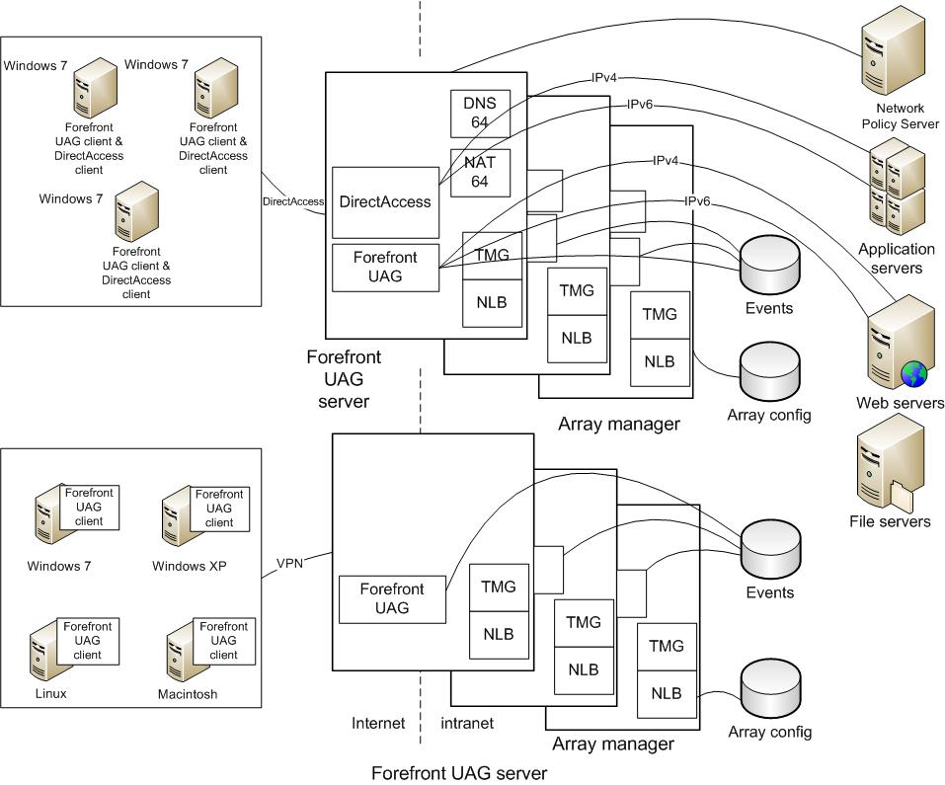
Example of Forefront UAG Architecture
MDT
SCM
ITA
Notes:
This diagram illustrates the relationship between the components that can work together to deliver an edge protection and access solution with Forefront UAG. They are shown together in one possible implementation for illustrative purposes, but other configurations are possible.

Slide 6
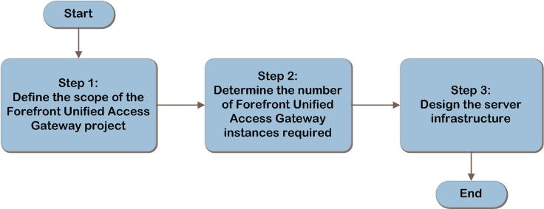
Forefront UAG Decision Flow
MDT
SCM
ITA
Notes:
These are the steps we will follow to design a Forefront UAG infrastructure.

Slide 7
Step 1: Define the Scope of the Forefront Unified Access Gateway Project
Task 1: Define the scope of the project
Define client populations
Define corporate resources client populations will access via Forefront UAG
Whether DirectAccess will be used
Task 2: Determine the client requirements
Where are the client machines located?
Will client machines travel between locations?
What client operating systems and browsers are in use?
What Forefront UAG functionality will the client workstation use?
Whether the client will use DirectAccess.
Fault-tolerance requirements.
Task 3: Determine the endpoint health approach
Forefront UAG built-in access policies
Network Access Protection (NAP) policies
Notes:
Step 1: Define the Scope of the Forefront Unified Access Gateway Project
Task 1: Define the Scope of the Project
Before designing a Forefront UAG infrastructure, an organization needs to determine which parts of its environment to include in the scope. Start by defining the populations of clients for which Forefront UAG will provide access. Next, define the corporate resources that those client populations will access through Forefront UAG. Finally, determine whether DirectAccess will be used. If so, determine whether the only role of Forefront UAG will be to provide scale out for a DirectAccess server infrastructure; in that use case, the Forefront UAG client code will not need to be deployed to the client workstations.
Task 2: Determine the Client Requirements
The following user population information should be gathered to determine the client requirements:
Where are the client machines located?
Will client machines travel between locations?
What client operating systems and browsers are in use?
What Forefront UAG functionality will the client workstation use?
Whether the client will use DirectAccess.
Fault-tolerance requirements.
Task 3: Determine the Endpoint Health Approach
If there is a requirement to evaluate client health prior to allowing access, there are two options:
The Forefront UAG built-in access policies can be used to specify prerequisites that endpoints must meet.
Network Access Protection (NAP) policies can be downloaded from a Network Policy Server (NPS).

Slide 8
Step 2: Determine the Number of Forefront Unified Access Gateway Instances Required
Task 1: Decide the number of Forefront UAG instances required
Add more instances if necessary for:
Both DirectAccess and VPN clients
Align with organization’s management model or regulatory reasons
Network isolation
Services beyond the trust boundary
Notes:
Step 2: Determine the Number of Forefront Unified Access Gateway Instances Required
Task 1: Decide the Number of Forefront UAG Instances Required
In this task, the number of Forefront UAG instances will be determined and the scope of each instance defined.
Begin with one Forefront UAG instance; then add more instances only if necessary for:
Servicing both DirectAccess clients and UAG Network Connector clients. A Forefront UAG instance cannot serve both as a DirectAccess server and as a UAG Network Connector; so if both DirectAccess and the UAG Network Connector application are required, increment the number of instances by one.
Aligning with the organization’s management model. If the organization chooses to delegate access management, decide whether additional instances of Forefront UAG may be required in each of the distributed locations and, if so, add them to the design.
Separating client populations or functionality for regulatory reasons. If regulations require that a group of clients or a set of applications use a separate infrastructure, add another Forefront UAG instance.
Isolating networks. Determine if any clients reside in networks that are isolated and therefore require a separate Forefront UAG instance. For example, organizations often isolate lab networks from production networks. Add a Forefront UAG instance to the design for each isolated network that will contain Forefront UAG clients.
Connecting to services in domains beyond the trust boundary. The Forefront UAG server can be installed in a AD DS domain or in a workgroup. The services to which it provides access must be within the trust boundary of the Forefront UAG server. Add one Forefront UAG instance to the design for each group of services that is beyond a trust boundary.

Slide 9
Step 3: Design the Server Infrastructure
Task 1: Design and place the Forefront UAG server
Task 2: Design fault tolerance and scale out
Note that if Forefront UAG is used to provide an array for DirectAccess, use of hardware load balancer is not supported
Task 3: Design the data store
Built-in Forefront UAG reporter to log events. Log files can be placed on clustered file server if fault tolerance is required.
RADIUS accounting server is in NPS and is a second option to log events.
Notes:
Step 3: Design the Server Infrastructure
Task 1: Design and Place the Forefront UAG Server
The server performs the following functions:
Receives an authentication request from each Forefront UAG client when that Forefront UAG client attempts to access a service.
Queries Active Directory Domain Services (AD DS), or other authentication services, to authenticate clients’ access permissions.
Stores access policy.
Implements access policies by filtering traffic so that only authorized services are exposed to the Forefront UAG client.
Logs events to a data store, which may be local on the same server, or remote.
Provides scale, fault tolerance, and IPv6 to IPv4 conversion for DirectAccess.
Task 2: Design Fault Tolerance and Scale Out
Load balancing of incoming requests can be performed by either of the following:
Windows Network Load Balancing (NLB). Up to eight Forefront UAG servers can be placed into an array to load balance VPN or DirectAccess traffic.
Hardware load balancer. The hardware load balancer must use IP affinity. Note that if Forefront UAG is used to provide an array for DirectAccess, use of a hardware load balancer is not supported.
Task 3: Design the Data Store
Forefront UAG can log events in the following ways:
Built-in Forefront UAG reporter. The Forefront UAG built-in reporter is enabled by default to allow events to be saved to a log file. If fault tolerance is required, the log files can instead be placed on a clustered file server.
RADIUS accounting server. Microsoft’s implementation of a RADIUS accounting server is in the NPS role in Windows Server® 2008. NPS logs data either in text format or database format, or to a stored procedure in a SQL Server database. The NPS role may be installed on the Forefront UAG server or on a remote server.
Remote syslog server. Events can be sent using the syslog protocol to a third-party server where they can be logged by the syslog daemon.
Simple Mail Transfer Protocol (SMTP) mail server. Events can be sent to one or more email addresses.
SQL Server database. Forefront UAG can log events to a SQL Server database using the Forefront TMG logging mechanism. It’s possible to specify which log fields should be written to the SQL Server log when configuring SQL Server logging in the Forefront TMG Management console. Events can be logged to a local SQL Server Express database running on the Forefront UAG server or to a remote SQL Server database. If fault tolerance is required, a remote SQL Server database can be placed in a Microsoft failover cluster.

Slide 10
Dependencies
The Forefront UAG installation program automatically installs a customized version of the Microsoft Forefront Threat Management Gateway (Forefront TMG). Forefront UAG utilizes many functions that are in Forefront TMG, including the array and the firewall. It also stores the publishing rules for the Forefront UAG portal. If Forefront TMG is uninstalled from a Forefront UAG server, this creates a configuration that Microsoft does not support.
Note that Forefront UAG does not support the stand-alone version of Forefront TMG; the only supported configuration is where Forefront UAG automatically installs its own version of Forefront TMG.
Further information about Forefront TMG’s role when used with Forefront UAG is available at http://technet.microsoft.com/en-us/library/ee522953.aspx.

Slide 11
Summary and Conclusion
The Forefront UAG guide has addressed the fundamental decisions and tasks involved in:
Defining the scope of the Forefront UAG project
Determining how many Forefront UAG instances will be required
Designing the Forefront UAG instances and the server infrastructure in them
This guide offers major architectural guidance. Refer to product documentation for additional details.
Provide feedback to satfdbk@microsoft.com
Notes:
Summary and Conclusion
This guide has summarized the critical design decisions, activities, and tasks required to enable a successful design of Microsoft Forefront Unified Access Gateway. It focused on decisions involving:
Defining the scope of the Forefront UAG project.
Determining how many Forefront UAG instances will be required.
Designing the Forefront UAG instances and the server infrastructure in them.

Slide 12
Find More Information
Download the full document and other IPD guides:
www.microsoft.com/ipd
Contact the IPD team:
satfdbk@microsoft.com
Access the Microsoft Solution Accelerators website:
http://www.microsoft.com/technet/SolutionAccelerators

Slide 13
Questions?

Slide 14
Addenda:
Benefits for Consultants or Partners
IPD in Microsoft Operations Framework 4.0
System Center Operations Manager 2007 in Microsoft Infrastructure Optimization

Slide 15
Benefits of Using the Forefront UAG Guide
Benefits for Business Stakeholders/Decision Makers
Most cost-effective design solution for implementation
Alignment between the business and IT from the beginning of the design process to the end
Benefits for Infrastructure Stakeholders/ Decision Makers
Authoritative guidance
Business validation questions ensuring solution meets requirements of business and infrastructure stakeholders
High integrity design criteria that includes product limitations
Fault-tolerant infrastructure
Infrastructure that’s sized appropriately for business requirements
Notes:
Benefits of Using the Forefront UAG Guide
Benefits for Business Stakeholders/Decision Makers:
Most cost-effective design solution for an implementation. IPD eliminates over-architecting and over-spending by precisely matching the technology solution to the business needs.
Alignment between the business and IT from the beginning of the design process to the end.
Benefits for Infrastructure Stakeholders/Decision Makers:
Authoritative guidance. Microsoft is the best source for guidance about the design of Microsoft products.
Business validation questions to ensure the solution meets the requirements of both business and infrastructure stakeholders.
High integrity design criteria that includes product limitations.
Fault-tolerant infrastructure, where necessary.
Proportionate system and network availability to meet business requirements. Infrastructure that is sized appropriately to meet business requirements.

Slide 16
Benefits of Using the Forefront UAG Guide (Continued)
Benefits for Consultants or Partners
Rapid readiness for consulting engagements
Planning and design template to standardize design and peer reviews
A “leave-behind” for pre- and post-sales visits to customer sites
General classroom instruction/preparation
Benefits for the Entire Organization
Using the guide should result in a design that will be sized, configured, and appropriately placed to deliver a solution for achieving stated business requirements
Notes:
Benefits of Using the Forefront UAG (continued)
Benefits for Consultants or Partners:
Rapid readiness for consulting engagements.
Planning and design template to standardize design and peer reviews.
A “leave-behind” for pre- and post-sales visits to customer sites.
General classroom instruction/preparation.
Benefits for the Entire Organization:
Using the guide should result in a design that will be sized, configured, and appropriately placed to deliver a solution for stated business requirements, while considering the performance, capacity, manageability, and fault tolerance of the system.

Slide 17
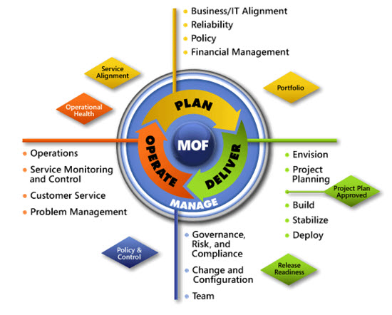
IPD in Microsoft Operations Framework 4.0
Use MOF with IPD guides to ensure that people and process considerations are addressed when changes to an organization’s IT services are being planned.
Notes:
For more information about Microsoft Operations Framework 4.0, go to www.microsoft.com/mof.

Slide 18
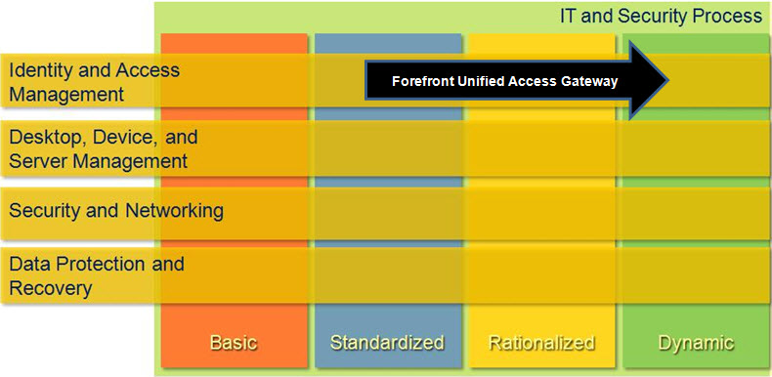
Forefront UAG in Microsoft Infrastructure Optimization
Notes:
<This slide shows the effect that Forefront UAG has on infrastructure maturity as reflected in the Core Infrastructure Optimization Model.>
The Infrastructure Optimization (IO) Model at Microsoft groups IT processes and technologies across a continuum of organizational maturity. (For more information, see http://www.microsoft.com/infrastructure.) The model was developed by industry analysts, the Massachusetts Institute of Technology (MIT) Center for Information Systems Research (CISR), and Microsoft's own experiences with its enterprise customers. A key goal for Microsoft in creating the Infrastructure Optimization Model was to develop a simple way to use a maturity framework that is flexible and can easily be applied as the benchmark for technical capability and business value.
IO is structured around three information technology models: Core Infrastructure Optimization, Application Platform Optimization, and Business Productivity Infrastructure Optimization. According to the Core Infrastructure Optimization Model, Forefront UAG can be used to move an organization from a Standardized to a Dynamic level of maturity, enabling dynamic application access and recovery for desktop applications in the process.
At a Standardized level, the enterprise may use Forefront UAG to assess client health before permitting any access to the corporate network. At the Rationalized level, providing a Virtual Private Network (VPN) is included so that users outside the corporate firewall can access different types of resources within the corporate firewall. At the Dynamic level of maturity, only the functions and content for which clients have privileges is exposed, and the client’s health and location is used to dynamically modify those privileges.

