Slide 1
Microsoft® Forefront® Identity Manager 2010
Infrastructure Planning and Design
Published: June 2010
Updated: November 2011
Notes:
Copyright © 2011 Microsoft Corporation. All rights reserved. Complying with the applicable copyright laws is your responsibility. By using or providing feedback on this documentation, you agree to the license agreement below.
If you are using this documentation solely for non-commercial purposes internally within YOUR company or organization, then this documentation is licensed to you under the Creative Commons Attribution-NonCommercial License. To view a copy of this license, visit http://creativecommons.org/licenses/by-nc/2.5/ or send a letter to Creative Commons, 543 Howard Street, 5th Floor, San Francisco, California, 94105, USA.
This documentation is provided to you for informational purposes only, and is provided to you entirely "AS IS". Your use of the documentation cannot be understood as substituting for customized service and information that might be developed by Microsoft Corporation for a particular user based upon that user’s particular environment. To the extent permitted by law, MICROSOFT MAKES NO WARRANTY OF ANY KIND, DISCLAIMS ALL EXPRESS, IMPLIED AND STATUTORY WARRANTIES, AND ASSUMES NO LIABILITY TO YOU FOR ANY DAMAGES OF ANY TYPE IN CONNECTION WITH THESE MATERIALS OR ANY INTELLECTUAL PROPERTY IN THEM.
Microsoft may have patents, patent applications, trademarks, or other intellectual property rights covering subject matter within this documentation. Except as provided in a separate agreement from Microsoft, your use of this document does not give you any license to these patents, trademarks or other intellectual property.
Information in this document, including URL and other Internet Web site references, is subject to change without notice. Unless otherwise noted, the example companies, organizations, products, domain names, e-mail addresses, logos, people, places and events depicted herein are fictitious.
Microsoft, Active Directory, Forefront, Hyper-V, Outlook, SharePoint, SQL Server, Windows, and Windows Server are either registered trademarks or trademarks of Microsoft Corporation in the United States and/or other countries and regions.
The names of actual companies and products mentioned herein may be the trademarks of their respective owners.
You have no obligation to give Microsoft any suggestions, comments or other feedback ("Feedback") relating to the documentation. However, if you do provide any Feedback to Microsoft then you provide to Microsoft, without charge, the right to use, share and commercialize your Feedback in any way and for any purpose. You also give to third parties, without charge, any patent rights needed for their products, technologies and services to use or interface with any specific parts of a Microsoft software or service that includes the Feedback. You will not give Feedback that is subject to a license that requires Microsoft to license its software or documentation to third parties because we include your Feedback in them.

Slide 2
What Is IPD? Guidance that clarifies and streamlines the planning and design process for Microsoft® infrastructure technologies
IPD:
Defines decision flow
Describes decisions to be made
Relates decisions and options for the business
Frames additional questions for business understanding
IPD guides are available at www.microsoft.com/ipd
Notes:
Infrastructure Planning and Design (IPD) is a series of planning and design guides created to clarify and streamline the planning and design process for Microsoft® infrastructure technologies.
Each guide in the series addresses a unique infrastructure technology or scenario.
These guides include the following topics:
Defining the technical decision flow (flow chart) through the planning process.
Describing the decisions to be made and the commonly available options to consider in making the decisions.
Relating the decisions and options for the business in terms of cost, complexity, and other characteristics.
Framing the decisions in terms of additional questions for the business to ensure a comprehensive understanding of the appropriate business landscape.
The guides in this series are intended to complement and augment Microsoft product documentation.

Slide 3
Getting Started
Microsoft Forefront Identity Manager 2010
Notes:
The guide was created to enable infrastructure planners to design a Microsoft Forefront Identity Manager 2010 infrastructure. The guide includes specific design information and activities that encourage sound planning.
Each activity includes:
Prerequisites and background on the activity.
Tasks that will be performed to complete the activity.
Reference information regarding the activity’s impact on characteristics such as the cost, complexity, and capacity of the solution.
Questions to ensure that business needs are captured and reflected in the solution.
The guide is written for information technology (IT) infrastructure specialists who are responsible for planning and designing the infrastructure for Forefront Identity Manager.

Slide 4
Purpose and Overview
Purpose
To provide design guidance for a Forefront Identity Manager infrastructure
Overview
Forefront Identity Manager architecture
Forefront Identity Manager infrastructure design process
Notes:
The guide focuses on the elements that organizations must consider when designing a Forefront Identity Manager infrastructure.

Slide 5
What Is Forefront Identity Manager (FIM)?
FIM provides:
An integrated and comprehensive solution for managing the entire life cycle of user identities and their associated credentials
Identity synchronization, certificate and password management, and user provisioning in a single solution that works across Windows® operating systems and other organizational systems
Notes:
Microsoft Forefront Identity Manager 2010 provides an integrated and comprehensive solution for managing the entire life cycle of user identities and their associated credentials. It provides identity synchronization, certificate and password management, and user provisioning in a single solution that works across Windows® operating systems and other organizational systems.
To develop and implement a successful Forefront Identity Manager (FIM) design, many decisions must be made and strategies determined. Considerations for performance, security, manageability, scalability, and other criteria must be addressed if the design is to be successful.
The purpose of this guide is to assist infrastructure architects in the decision-making process by providing a clear and concise path for designing the FIM infrastructure. This guide relies on best practices and real-world experience to offer considerations and alternatives at each point in the design.
This guide, when used in conjunction with product documentation, will help organizations confidently plan a FIM implementation. The Appendix includes sample job aids for recording the decisions made during the design process.

Slide 6
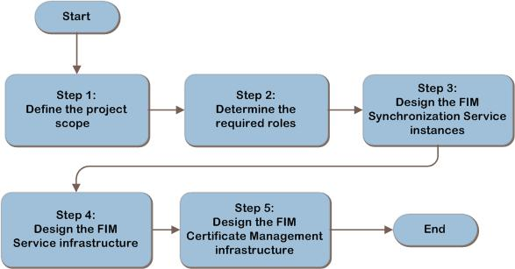
FIM Decision Flow
MAP w/ CAL Tracker
SCM
ITA
Notes:
The FIM design flow provides a graphical overview of the steps in designing a FIM infrastructure.
These steps are:
Define the Project Scope
Determine the Required Roles
Design the FIM Synchronization Service Instances
Design the FIM Service Infrastructure
Design the FIM Certificate Management Infrastructure
Each of these steps will be discussed in greater detail in the following slides.

Slide 7
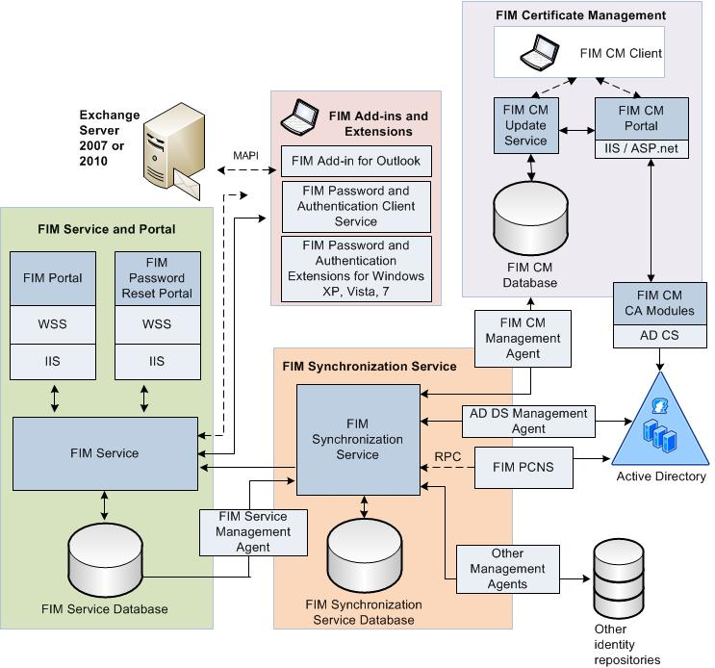
Example FIM Architecture
SCM
ITA
Notes:
This diagram illustrates the relationship between the components that work together to provide an architecture for FIM. They are shown together in one possible implementation for illustration purposes, but other configurations are possible.

Slide 8
Step 1: Define the Project Scope
Task 1: Determine the Business Reasons to Implement FIM
Decide whether the organization is implementing FIM to deliver certificate management, identity management, or both
Task 2: Determine the Connected Data Sources in Scope
A connected data source is defined as a directory, database, or other data repository that contains identity or user profile data to be integrated within FIM
Notes:
Step 1: Define the Project Scope
Task 1: Determine the Business Reasons to Implement FIM
The first decision to be made is whether the organization is implementing FIM to deliver certificate management, identity management, or both.
Certificate Management
Supplements Active Directory® Certificate Services (AD CS) by automating the provisioning, renewal, and revocation of PKI certificates for smart cards and other uses such as Encrypting File System (EFS) and web Secure Sockets Layer/Transport Layer Security (SSL/TLS). This may be implemented with or without the identity management functionality listed below.
Identity Management
The classic identity management capability of FIM provides synchronization of data and provisioning of identity information for the organization in two fundamental areas:
Synchronizes data between multiple sources. An example of this is synchronization of mobile telephone numbers from the enterprise’s Human Resource (HR) system with Active Directory Domain Services (AD DS) to make the telephone numbers available in an Exchange Server’s global address list (GAL).
Identity life-cycle management is the automated provisioning and de-provisioning of identities in the connected systems. An example is creating an Active Directory account for users when they are added to the Human Resources system. Accordingly, the account can be removed or disabled when users are no longer active in the HR system.
The FIM Service provides the following additional functionality:
Password synchronization. Requires the Password Change Notification Service to be loaded on the organization’s Active Directory domain controllers, and requires the FIM Synchronization Service.
Password self-service. Requires the FIM Service, FIM Portal, FIM Synchronization Service, and the FIM client software.
User profile management. Requires the FIM Synchronization Service, FIM Service, and FIM Portal.
Group management from portal. Requires the FIM Synchronization Service, FIM Service, and FIM Portal.
Group management from Outlook. Requires the FIM Synchronization Service, FIM Service, FIM Portal, and a FIM Service mailbox on the Exchange server.
Declarative provisioning. Requires the FIM Synchronization Service, FIM Service, and FIM Portal.
Task 2: Determine the Connected Data Sources in Scope

Slide 9
Step 1: Define the Project Scope (Continued)
Task 3: Determine User Load
Record:
Approximate number of users in each location
Expected usage
Task 4: Determine Fault-Tolerance Requirements
Determine what the business’s tolerance is for outages
Notes:
Step 1: Define the Project Scope (Continued)
Task 3: Determine User Load
It’s critical to understand the key performance characteristics that it will be subjected to and the expected response times.
Record:
Approximate number of users in each location. Assess the user population that will be served by each of the FIM functionality areas listed in Task 1, and record the physical locations, Active Directory forests, and approximate number of users. Knowing the number of users at each location will assist in determining server sizing and placement.
Expected usage. Estimate the number of times the organization expects new groups or users to be created by administrators or users, passwords to be reset, and the portal to be visited in a given time period. Note that the load may vary during the course of an hour, day, week, or year, and the implementation should be designed to support peak load.
Task 4: Determine Fault-Tolerance Requirements
For each FIM functionality area that was selected in Task 1, assess whether fault tolerance is required. Special care should be taken if password self-service, password synchronization, user profile management, or certificate management were selected in Task 1. These are end-user–facing aspects of FIM. Determine what the business’s tolerance is for outages of these features. For example, the business may determine that unavailability of password self-service is not acceptable due to the volume of users, but that user profile management functionality can be out for a day, which might be the time it requires to manually recover a single-point-of-failure server. Review the types of users gathered in Task 3, as certain categories of users may have more stringent fault-tolerance needs than others, such as a requirement that systems used by executive-level end users not experience outages.

Slide 10
Validating with the Business (Step 1)
In order to ensure that the project stays focused on delivering the required services, ask the following question about the business objectives for the project:
Do any corporate policies prevent systems from being synchronized?
Notes:
Validating with the Business (Step 1)
In order to ensure that the project stays focused on delivering the required services, ask the following question about the business objectives for the project:
Do any corporate policies prevent systems from being synchronized? For example, country or regional regulations may prevent certain identity attributes from being shared across borders.

Slide 11
Step 2: Determine the Required Roles
To determine the FIM components that will be required, refer to the feature sets that were selected in Step 1
Features selected in Step 1 will determine which of these components will be required:
FIM Synchronization Service and FIM Synchronization Service database
FIM Service, FIM Service database, and FIM Portal
FIM Certificate Management, FIM Certificate Management database, and FIM Certificate Management Portal
Password Change Notification Service (PCNS) on Active Directory® domain controllers
Notes:
Step 2: Determine the Required Roles
The functionality and feature selections that were made in Step 1 will be the basis in this step to determine the required infrastructure components to support the desired feature sets. This information will be used in later steps to design the FIM infrastructure.
A FIM 2010 deployment has two major component groups: the server-side and the client-side. The server-side components that might be implemented include:
FIM Synchronization Service and FIM Synchronization Service database.
FIM Service, FIM Service database, and FIM Portal.
FIM Certificate Management, FIM Certificate Management database, and FIM Certificate Management Portal.
Password Change Notification Service (PCNS) on Active Directory domain controllers.
The client-side FIM Add-ins and Extensions components might include:
FIM Add-in for Outlook®.
FIM Password and Authentication Client Service.
FIM Password and Authentication Extensions.
FIM Portal Authentication Extensions.
Consult Table 1 in the guide for descriptions of these FIM components.

Slide 12
Step 3: Design the FIM Synchronization Service Instances
Task 1: Decide How Many FIM Synchronization Service Instances Will Be Required
Start with one and add more if performance or business requirements dictate
Task 2: Determine FIM Synchronization Service Database Storage Requirements
Similar sizing to Microsoft Identity Integration Server (MIIS) and Identity Lifecycle Manager (ILM)
Notes:
Step 3: Design the FIM Synchronization Service Instances
Task 1: Decide How Many FIM Synchronization Service Instances Will Be Required
Most enterprises will have only one instance of the FIM Synchronization Service. A FIM Synchronization Service instance is anchored by a single SQL Server database. Separate databases define separate instances since there is no way to manage them collectively. Additionally, a FIM Synchronization Service instance can only communicate with a single FIM Service instance, which is also defined by a database (in this case, the FIM Service database). Thus a FIM Synchronization Service instance consists of the FIM Synchronization Service and its supporting database, and optionally, the FIM Service and its corresponding database.
Start with one instance of the FIM Synchronization Service, and then add more instances as required by any of the following:
Data consolidation prior to main implementation
Synchronization cycle length
Political
Regulatory requirements
Limit fault domain
Task 2: Determine FIM Synchronization Service Database Storage Requirements
Each FIM Synch Service instance has a single SQL Server database. It can be expected to be similar to its predecessors: Microsoft Identity Integration Server (MIIS) and Identity Lifecycle Manager (ILM). Factors that affected the database’s size in MIIS and ILM were:
Number of management agents in the solution.
Number of objects in each management agent.
Number of attributes being staged for each object.
Size of each attribute.
Number of multi-valued attributes and the size of their values.
The schedule at which run profiles are executed in the solution.
The frequency with which an organization clears the run history.
Number and size of attributes in the metaverse.

Slide 13
Step 3: Design the FIM Synchronization Service Instances (Continued)
Task 3: Apply Fault-Tolerance Requirements
Task 4: Determine FIM Synchronization Service Server Placement
Task 5: Determine FIM Synchronization Service Server Configuration
Notes:
Step 3: Design the FIM Synchronization Service Instances (Continued)
Task 3: Apply Fault-Tolerance Requirements
If the FIM Synchronization Service and FIM Synchronization Service database are unavailable, identity synchronizations will not take place until the systems are returned to full functionality. The database can be clustered but the FIM Sync Service can only be deployed in warm standby configuration.
Task 4: Determine FIM Synchronization Service Server Placement
FIM supports a variety of deployment topologies. Each of the main components of FIM, including the FIM Synchronization Service, FIM Service, and Certificate Management Update Service, and respective portals and databases may be installed separately, or in combination, on individual servers.
Task 5: Determine FIM Synchronization Service Server Configuration
The FIM Synchronization Service can be run in a Microsoft Hyper-V® virtual machine or in a physical server environment. If a virtual machine will be used, ensure that it has access to CPU and memory resources equivalent to those specified for a physical machine. As stated in Task 4, the FIM Synchronization Service can be co-located with other FIM components. If this is done, the server should be sized to support the sum of the peak workloads.

Slide 14
Step 4: Design the FIM Service Infrastructure
Task 1: Determine the Number of FIM Service Servers Required
Multiple servers may be implemented to provide different levels of responsiveness
Task 2: Determine the Number of FIM Portal Servers Required
Servers may be deployed in a load-balanced configuration
Task 3: Determine FIM Service Database Storage Requirements
Notes:
Step 4: Design the FIM Service Infrastructure
Task 1: Determine the Number of FIM Service Servers Required
There will only be one FIM Service database, but there can be multiple FIM Service servers that connect to that FIM Service database.
Multiple FIM Service servers may be implemented to provide different levels of responsiveness. Begin with one FIM Service server instance, and add more if needed to separate FIM Service usages.
Task 2: Determine the Number of FIM Portal Servers Required
The FIM Portal communicates with the FIM Service for each transaction and is completely dependent on the service. The FIM Portal can be scaled horizontally by adding additional servers in a load-balanced configuration. It may be installed separately or in combination with other FIM components on individual servers.
Task 3: Determine FIM Service Database Storage Requirements
Each FIM Service instance has a single SQL Server database. The database can be hosted on the same server as the FIM Service, or on a remote SQL Server-based server to support high availability or to conform to SQL Server standards for the organization. It can be co-located in the same instances of SQL Server as other databases.

Slide 15
Step 4: Design the Forefront Identity Manager Service Infrastructure (Continued)
Task 4: Apply Fault-Tolerance Requirements
Database may be clustered. FIM Service and FIM Portal may be deployed in a load-balanced configuration
Task 5: Determine the Placement of FIM Service Components
Task 6: Determine the Configuration of FIM Service Components
Notes:
Step 4: Design the FIM Service Infrastructure (Continued)
Task 4: Apply Fault-Tolerance Requirements
Fault-tolerance requirements should be considered for all services that have an impact on user-facing scenarios. Fault tolerance for the FIM Service, the FIM Service database, and the FIM Portal will be evaluated in this section.
FIM Service. The FIM Service is not cluster-aware. Multiple servers may be deployed in a hardware or software load-balanced configuration to provide fault tolerance.
FIM Service Database. SQL Server can be clustered for fault tolerance. However, the FIM Service and the FIM Service database must be installed on separate servers if SQL Server clustering is used.
FIM Portal. The FIM Portal is not cluster-aware. Multiple servers may be deployed in a hardware or software load-balancing configuration to provide fault tolerance.
Task 5: Determine the Placement of FIM Service Components
FIM supports a variety of deployment topologies. Similar to the FIM Synchronization Service, each of the main components of the FIM Service may be installed either separately or in combination on individual servers.
The FIM Portal, FIM Service, FIM Service database, and the FIM Synchronization Service servers should all be well-connected.
Task 6: Determine the Configuration of FIM Service Components
The FIM Service components can be run in a Hyper-V virtual machine or in a physical server environment. If a virtual machine will be used, ensure that it has access to CPU and memory resources equivalent to those specified for a physical machine. If it was determined that a server will host multiple FIM components, it should be sized to support the sum of the peak workloads.

Slide 16
Additional Considerations (Step 4)
The items listed below are generally outside the scope of an infrastructure design; they are included here as additional considerations that the architect may need to take into account:
Installing clients. Required for self-service password reset and group management through Outlook
Exchange integration. A FIM Service mailbox will need to be created on an Exchange 2007 or Exchange 2010 server
Notes:
Additional Considerations (Step 4)
The items listed below are generally outside the scope of an infrastructure design; however, they are included here as additional considerations that the architect may need to take into account:
Installing clients. If the design requires self-service password resets and Outlook integration for group management, then a client will need to be installed on all desktops.
Exchange integration. If the workflows will be using Exchange integration, a FIM Service mailbox will need to be created on an Exchange 2007 or Exchange 2010 server. The Exchange forest can be either mixed or native mode.

Slide 17
Step 5: Design the FIM Certificate Management Infrastructure
Task 1: Determine the Number of FIM CM Instances Required
One per forest
Task 2: Determine the Number of FIM CM Servers Required
May be load balanced
Task 3: Determine FIM CM Database Storage Requirements
Database size is not of great concern
Notes:
Step 5: Design the FIM Certificate Management Infrastructure
Task 1: Determine the Number of FIM CM Instances Required
The scope of a FIM Certificate Management (CM) installation is the Active Directory forest. If the organization has users deployed in multiple forests, then each forest will require its own CM server, certification authority (CA), and SQL Server database. Determine whether certificates or smart cards will be issued for multiple forests, and determine how many instances of FIM CM will be needed. The remainder of this step assumes a single instance and should be repeated for each instance if it is decided that multiples are needed.
Task 2: Determine the Number of FIM CM Servers Required
The FIM CM server can be scaled horizontally by adding additional servers in a load-balanced configuration. The FIM CM server may be installed separately or in combination with other FIM components on individual servers, including the FIM CM database.
Task 3: Determine FIM CM Database Storage Requirements
Each FIM CM instance has a single SQL Server database. The database can be hosted on a remote SQL Server-based server or locally with the FIM CM Update Service and Portal. It can be co-located in the same instances of SQL Server as other databases.
FIM CM uses a SQL Server database to store smart card information, audit logs, the current state of the card management workflows, and part of the configuration data.
The database size will increase in direct proportion to the number of smart cards and certificates managed by the solution and the frequency of operations performed upon them. The size of the database space should not be of great concern in FIM CM. In ILM 2007, which is the predecessor of FIM 2010, a CM installation managing 5,000 smart cards with two certificates per smart card required less than 0.4 gigabytes (GB) of hard disk space, and even larger installations didn’t increase the database to sizes that required large amounts of storage. FIM 2010 CM can be expected to perform similarly.

Slide 18
Step 5: Design the FIM Certificate Management Infrastructure (Continued)
Task 4: Apply Fault-Tolerance Requirements
Database may be clustered or mirrored, but FIM CM server is not cluster-aware
Certification authority (CA) may be clustered in Windows Server® 2008
Task 5: Decide the Placement of the FIM CM Components
Task 6: Determine the Configurations of the FIM CM Components
Task 7: Designate SMTP Relay Server
Required for one-time passwords and reminders
Notes:
Step 5: Design the FIM Certificate Management Infrastructure (Continued)
Task 4: Apply Fault-Tolerance Requirements
If the CM server or CM database is unavailable, the FIM CM system will be unavailable. AD CS will still work but without the benefit of FIM certificate management.
If the CA is unavailable but the CM system is still available, reporting operations such as querying user information and performing configuration tasks will still be available, but any operation that involves a certificate—enrollment, renewal, or revocation—will not be available.
FIM CM Server. The FIM CM server is not cluster-aware.
FIM CM Database. Fault tolerance for the SQL Server database is available via clustering or database mirroring. However, a separate server running SQL Server is necessary as the FIM CM server cannot be clustered.
Certificate Services Connection. Windows Server 2003 Certificate Services does not provide support for any clustering mechanisms other than clustering a virtual machine running the CA; the usual strategy for providing fault tolerance for Certificate Services is to deploy multiple CAs. However, FIM CM only supports designating a single CA for each certificate included in the profile template, and that profile template will be unavailable for performing certificate-based operations if the CA itself is not available. Windows Server 2008 and Windows Server 2008 R2 Certificate Services does provide support for clustering, and thus the CA would not represent a single point of failure for FIM CM.
Task 5: Decide the Placement of the FIM CM Components
The FIM CM software can be installed on the same server as the CA or on its own server. Additionally, the FIM CM database can be installed on the same server as the FIM CM Update Service, FIM CM Portal, and/or CA, or on its own server.
Task 6: Determine the Configurations of the FIM CM Components
The FIM CM Portal is an ASP.NET web application and, like most web applications, it is mostly CPU-bound. The server’s overall scalability and performance should improve with the use of higher-performance processors and with the increase in the number of processors.
Task 7: Designate SMTP Relay Server
This can be on the same computer as the FIM CM server, or authenticated relaying can be configured to an SMTP server if the relaying operation can resolve a mail exchanger (MX) record.

Slide 19
Additional Considerations (Step 5)
FIM CM client software
Only required for smart cards
Not necessary for software-based certificates
Notes:
Additional Considerations (Step 5)
The FIM CM client software is only needed to deploy smart cards, not software-based certificates. The FIM CM client assists in client-side, smart card management activities such as changing the personal identification number (PIN) on a smart card.
For details on the models of smart cards and middleware supported by FIM CM, see the FIM System Requirements page at www.microsoft.com/forefront/identitymanager/en/us/system-requirements.aspx.

Slide 20
Dependencies
A complete FIM installation requires the following:
Windows Server 2008
Active Directory Domain Services
Active Directory Certificate Services
Web server
Windows SharePoint® Services 3.0 SP1 or SP2
Microsoft SQL Server® 2008 SP1
.NET Framework 3.5:
Windows Workflow Foundation
Windows Communication Foundation
Notes:
Dependencies
A complete FIM installation requires the following infrastructure:
Windows Server 2008. All FIM services require x64 versions of Windows Server 2008 or Windows Server 2008 R2 for the base operating system. Due to the requirements for .NET Framework 3.5, Server Core is not supported for the deployment of FIM.
Active Directory Domain Services. Active Directory Domain Services (AD DS) must be present in the organization in order for the server services to communicate with each other and their respective databases, as well as to allow users to perform self-service actions within the FIM Portal. AD DS is also required to provide user access to the FIM Portal and to store permissions for FIM Certificate Management.
Active Directory Certificate Services. Required when FIM Certificate Management is used to provide Certificate Authority services.
Web server. Microsoft’s Internet Information Server (IIS) 7.0 is required to host the website and services. In the FIM architecture, a web server is not required to interact with the web services directly, but it is required if users or administrators are expected to work with the FIM Portal application. Internet Explorer 7.0 and later are supported browsers.
Windows SharePoint Services 3.0 SP1 or SP2. The FIM architecture uses Windows SharePoint Services 3.0 in conjunction with IIS 7 to host the FIM applications as native SharePoint solutions. In this manner, SharePoint provides the basic authentication and application hosting platform required.
Microsoft SQL Server 2008 SP1. All FIM services use the Microsoft SQL Server 2008 SP1 x64 database engine.
.NET Framework 3.5. FIM uses the latest features available in Windows .NET Framework 3.5, most notably:
Windows Workflow Foundation. Workflow activities can be tailored to run in the FIM policy engine, allowing for customization of the request processing.
Windows Communication Foundation. WS-* web services are the cornerstone of the FIM policy engine.

Slide 21
Summary and Conclusion
This guide has outlined the step-by-step process for planning a FIM infrastructure. In each step, major decisions relative to the FIM infrastructure were determined and described. The guide has explained how to record choices of roles needed, server resources, scaling, and fault tolerance, which can then be made available to the infrastructure planners.
Provide feedback to ipdfdbk@microsoft.com
Notes:
Summary and Conclusion
This guide has outlined the step-by-step process for planning a FIM infrastructure. In each step, major decisions relative to the FIM infrastructure were determined and described. The guide has explained how to record choices of roles needed, server resources, scaling, and fault tolerance, which can then be made available to the infrastructure planners.
Using the information recorded from the steps completed in this guide, the organization can help ensure that the business and technical requirements are met for a successful FIM deployment.
This guide was produced to assist in customer planning, but it should not be used alone to determine the appropriate servers, hardware, or topologies required for a FIM deployment. Customers are encouraged and expected to configure their own test environments to more accurately estimate capacity and performance.

Slide 22
Find More Information
Download the full document and other IPD guides:
www.microsoft.com/ipd
Contact the IPD team:
ipdfdbk@microsoft.com
Access the Microsoft Solution Accelerators website:
www.microsoft.com/technet/SolutionAccelerators

Slide 23
Questions?

Slide 24
Addenda
Benefits of using the FIM guide
IPD in Microsoft Operations Framework 4.0
FIM in Microsoft Infrastructure Optimization

Slide 25
Benefits of Using the FIM Guide
Benefits for Business Stakeholders/Decision Makers
Most cost-effective design solution for implementation
Alignment between the business and IT from the beginning of the design process to the end
Benefits for Infrastructure Stakeholders/Decision Makers
Authoritative guidance
Business validation questions ensuring solution meets requirements of business and infrastructure stakeholders
High integrity design criteria that includes product limitations
Fault-tolerant infrastructure
Proportionate system and network availability to meet business requirements
Infrastructure that’s sized appropriately for business requirements
Notes:
Benefits of Using the FIM Guide
Benefits for Business Stakeholders/Decision Makers:
Most cost-effective design solution for an implementation. IPD eliminates over-architecting and over-spending by precisely matching the technology solution to the business needs.
Alignment between the business and IT from the beginning of the design process to the end.
Benefits for Infrastructure Stakeholders/Decision Makers:
Authoritative guidance. Microsoft is the best source for guidance about the design of Microsoft products.
Business validation questions to ensure the solution meets the requirements of both business and infrastructure stakeholders.
High integrity design criteria that includes product limitations.
Fault-tolerant infrastructure, where necessary.
Proportionate system and network availability to meet business requirements.
Infrastructure that is sized appropriately to meet business requirements.

Slide 26
Benefits of Using the FIM Guide (Continued)
Benefits for Consultants or Partners
Rapid readiness for consulting engagements
Planning and design template to standardize design and peer reviews
A “leave-behind” for pre- and post-sales visits to customer sites
General classroom instruction/preparation
Benefits for the Entire Organization
Using the guide should result in a design that will be sized, configured, and appropriately placed to deliver a solution for achieving stated business requirements
Notes:
Benefits of Using the FIM Guide (Continued)
Benefits for Consultants or Partners:
Rapid readiness for consulting engagements.
Planning and design template to standardize design and peer reviews.
A “leave-behind” for pre- and post-sales visits to customer sites.
General classroom instruction/preparation.
Benefits for the Entire Organization:
Using the guide should result in a design that will be sized, configured, and appropriately placed to deliver a solution for stated business requirements, while considering the performance, capacity, manageability, and fault tolerance of the system.

Slide 27
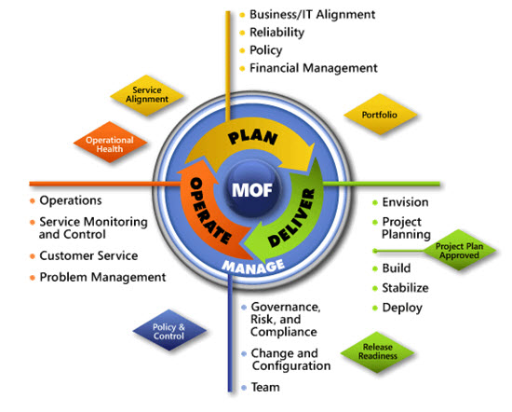
IPD in Microsoft Operations Framework 4.0
Use MOF with IPD guides to ensure that people and process considerations are addressed when changes to an organization’s IT services are being planned.
Notes:
For more information about Microsoft Operations Framework 4.0, go to www.microsoft.com/mof.

Slide 28
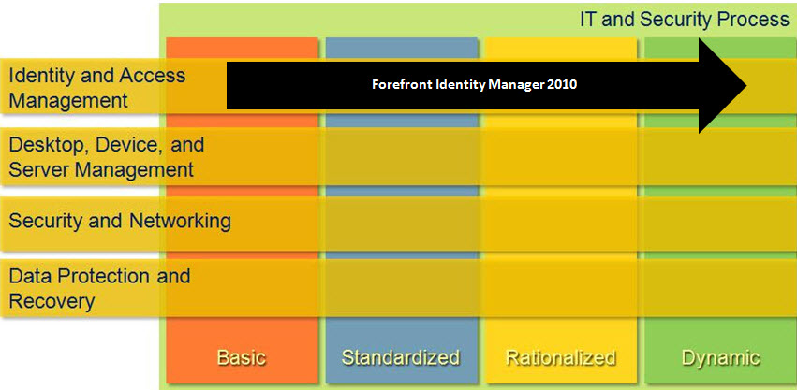
FIM in Microsoft Infrastructure Optimization
Notes:
<This slide shows the effect that FIM has on infrastructure maturity as reflected in the Core Infrastructure Optimization Model.>
The Infrastructure Optimization (IO) Model at Microsoft groups IT processes and technologies across a continuum of organizational maturity. (For more information, see www.microsoft.com/infrastructure.) The model was developed by industry analysts, the Massachusetts Institute of Technology (MIT) Center for Information Systems Research (CISR), and Microsoft's own experiences with its enterprise customers. A key goal for Microsoft in creating the Infrastructure Optimization Model was to develop a simple way to use a maturity framework that is flexible and can easily be applied as the benchmark for technical capability and business value.
IO is structured around three information technology models: Core Infrastructure Optimization, Application Platform Optimization, and Business Productivity Infrastructure Optimization. According to the Core Infrastructure Optimization Model, providing identity synchronization and automated provisioning/de-provisioning, including self-service tools for end users, will help move an organization to the Dynamic level.

