Slide 1
Windows Server® 2008
File Services
Infrastructure Planning and Design
Published: June 2010
Updated: November 2011
Notes:
Copyright © 2011 Microsoft Corporation. All rights reserved. Complying with the applicable copyright laws is your responsibility. By using or providing feedback on this documentation, you agree to the license agreement below.
If you are using this documentation solely for non-commercial purposes internally within YOUR company or organization, then this documentation is licensed to you under the Creative Commons Attribution-NonCommercial License. To view a copy of this license, visit http://creativecommons.org/licenses/by-nc/2.5/ or send a letter to Creative Commons, 543 Howard Street, 5th Floor, San Francisco, California, 94105, USA.
This documentation is provided to you for informational purposes only, and is provided to you entirely "AS IS". Your use of the documentation cannot be understood as substituting for customized service and information that might be developed by Microsoft Corporation for a particular user based upon that user’s particular environment. To the extent permitted by law, MICROSOFT MAKES NO WARRANTY OF ANY KIND, DISCLAIMS ALL EXPRESS, IMPLIED AND STATUTORY WARRANTIES, AND ASSUMES NO LIABILITY TO YOU FOR ANY DAMAGES OF ANY TYPE IN CONNECTION WITH THESE MATERIALS OR ANY INTELLECTUAL PROPERTY IN THEM.
Microsoft may have patents, patent applications, trademarks, or other intellectual property rights covering subject matter within this documentation. Except as provided in a separate agreement from Microsoft, your use of this document does not give you any license to these patents, trademarks or other intellectual property.
Information in this document, including URL and other Internet Web site references, is subject to change without notice. Unless otherwise noted, the example companies, organizations, products, domain names, e-mail addresses, logos, people, places and events depicted herein are fictitious.
Microsoft, Active Directory, BranchCache, Visio, Windows, and Windows Server are either registered trademarks or trademarks of Microsoft Corporation in the United States and/or other countries and regions.
The names of actual companies and products mentioned herein may be the trademarks of their respective owners.
You have no obligation to give Microsoft any suggestions, comments or other feedback ("Feedback") relating to the documentation. However, if you do provide any Feedback to Microsoft then you provide to Microsoft, without charge, the right to use, share and commercialize your Feedback in any way and for any purpose. You also give to third parties, without charge, any patent rights needed for their products, technologies and services to use or interface with any specific parts of a Microsoft software or service that includes the Feedback. You will not give Feedback that is subject to a license that requires Microsoft to license its software or documentation to third parties because we include your Feedback in them.

Slide 2
What Is IPD? Guidance that clarifies and streamlines the planning and design process for Microsoft® infrastructure technologies
IPD:
Defines decision flow
Describes decisions to be made
Relates decisions and options for the business
Frames additional questions for business understanding
IPD guides are available at www.microsoft.com/ipd
Notes:
Infrastructure Planning and Design (IPD) is a series of planning and design guides created to clarify and streamline the planning and design process for Microsoft® infrastructure technologies.
Each guide in the series addresses a unique infrastructure technology or scenario.
These guides include the following topics:
Defining the technical decision flow (flow chart) through the planning process.
Describing the decisions to be made and the commonly available options to consider in making the decisions.
Relating the decisions and options for the business in terms of cost, complexity, and other characteristics.
Framing the decisions in terms of additional questions for the business to ensure a comprehensive understanding of the appropriate business landscape.
The guides in this series are intended to complement and augment Microsoft product documentation.

Slide 3
Getting Started
Windows Server 2008
File Services
Notes:
File Services provides the basic building blocks upon which many other infrastructure services are based. Improperly designed File Services infrastructures have held back projects, resulted in unanticipated infrastructure expenses, and led to organizational inefficiency. Well-designed infrastructures, however, have become the quiet hero in many organizations, providing stable and secure file access and reliable data protection and disaster recovery resources. This has enabled end users and IT pros to rapidly recover from mistakenly deleted files, limiting lost time and increasing productivity.
The guide is written for those individuals who would prefer to avoid dramatic data recoveries, last-minute heroics, and close calls. Effective planning, aided by the processes described in this guide, can achieve this level of “boring” stability.

Slide 4
Purpose and Overview
Purpose
To provide design guidance for a File Services infrastructure
Overview
File Services architecture
File Services infrastructure design process
Notes:
The guide focuses on the elements that organizations must consider when designing a File Services infrastructure.

Slide 5
What’s New in Windows Server 2008 R2
Windows Server 2008 R2 introduces new functionality and enhancements to Windows® file services that provide improved performance, increased reliability, and greater flexibility for users, including the following:
BranchCache®
Support for Distributed File System (DFS) Replication in failover clusters
Read-only DFS Replication replicas
File Classification Infrastructure (FCI)
Notes:
What’s New in Windows Server 2008 R2
The guide’s design process is valid for both Windows Server® 2008 and Windows Server 2008 R2 environments.
For more details on the changes, see http://technet.microsoft.com/en-us/library/dd391932(WS.10).aspx.

Slide 6
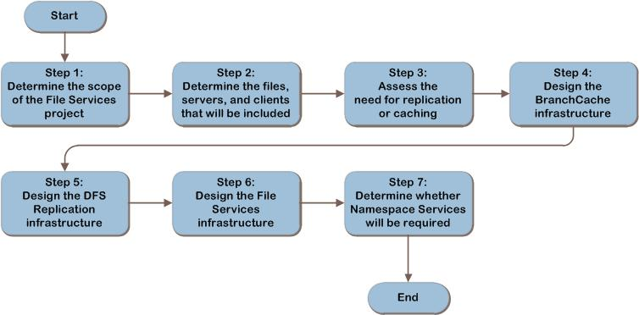
File Services Decision Flow
MAP w/ CAL Tracker
SCM
ITA
Notes:
The seven steps shown represent the most critical design elements required for achieving a well-planned Windows Server 2008 File Services design:
Step 1: Determine the Scope of the File Services Project
Step 2: Determine the Files, Servers, and Clients That Will Be Included
Step 3: Assess the Need for Replication or Caching
Step 4: Design the BranchCache® Infrastructure
Step 5: Design the DFS Replication Infrastructure
Step 6: Design the File Services Infrastructure
Step 7: Determine Whether Namespace Services Will Be Required
Some of these items represent decisions that must be made. Where this is the case, a corresponding list of common response options is presented.
Other items in this list represent tasks that must be carried out. These types of items are addressed because their presence is significant in order to complete the infrastructure design.

Slide 7
Step 1: Determine the Scope of the File Services Project
Task 1: Determine the Scope of the Project
Organizational units that will be participating in the redesign
Geographic areas that will be included
Notes:
Step 1: Determine the Scope of the File Services Project
Task 1: Determine the Scope of the Project
Determine scope of the redesign
Understanding the full extent of the work to be performed enables a designer to begin visualizing the tasks and roles that will be needed to successfully implement the infrastructure plan.
Determine goals of the redesign
Part of defining the scope of a project is to understand what the project goals are. By clearly understanding the motivation behind the File Services project, priorities can be established for the planning steps.
Create a scope document (Table A-1 job aid – Appendix A in guide)
Be sure to capture the following elements in the requirements list:
New corporate security requirements
New compliance requirements (Health Insurance Portability and Accountability Act (HIPAA), Sarbanes–Oxley (SOX), and so on)
Performance requirements
Corporate mergers or acquisitions

Slide 8
Step 2: Determine the Files, Servers, and Clients That Will Be Included
Task 1: Collect an Inventory of File Server Resources
Total storage used at location
Encryption
Replication
DFS Namespace in use
Shadow copies
Fault tolerance in use
Number of clients
Client locations
File types
Other workloads
Notes:
Step 2: Determine the Files, Servers, and Clients That Will Be Included
Task 1: Collect an Inventory of File Server Resources
Collect an inventory of the current file storage environment:
Server storage capacity (used and free). This will be used in Step 6 to determine whether additional capacity may be required.
Any use of encryption. File encryption creates additional processing overhead. Compare with encryption requirements to determine whether any existing encryption could be disabled in order to free server resources. It will also be used to check that the current level of encryption is sufficient to meet business requirements.
Whether any of the files on the server are currently being replicated. This will be used in the design of file replication in Step 5.
Whether Distributed File System (DFS) Namespace is in use. This will be used in the design of the DFS Namespace in Step 7.
Presence of shadow copies. Shadow copies allow users to restore files that they have deleted.
Implementation of fault tolerance, such as file server clustering. In Step 6, this will be compared with the requirements for fault tolerance and used to design fault tolerance into the file serving infrastructure, if necessary.
Number of clients to which files are being served at any given time. In Step 6, this will be compared with the population of concurrent clients that will be assigned to each server in order to determine whether any of the clients should be reassigned to different server resources.
Locations of clients accessing the files. A comprehensive list of where the users are that access each file would be cumbersome to build, but if there are general grouping of files, like a departmental share of files that are accessed by users in particular locations, record the locations of the users in the department that access the share.
Other workloads running on the file server, and how much of the server resources they consume. This can be used in the redesign to determine whether some of those workloads should be transferred to other resources in order to avoid impact on the file serving workload.

Slide 9
Step 3: Assess the Need for Replication or Caching
Task 1: Determine Whether Replication Is Required
In replication, copies of each file are kept on multiple servers
Task 2: Decide Whether to Use BranchCache
Caches copies of most recently used files on a local server or workstations
Notes:
Step 3: Assess the Need for Replication or Caching
Task 1: Determine Whether Replication is Required
In replication, copies of each file are kept on multiple servers. Replication may be necessary for:
Fault tolerance. As copies of each file exist on more than one server, there is a level of protection against an outage from a specific server or the WAN link going down. However, it is important to note that if a user inadvertently deletes a file, this deletion action will be repeated automatically on the replica members.
Increased performance. Local replicas of files can enhance file access responsiveness to users.
Bandwidth optimization. As users are able to access local copies of files, the bandwidth utilization of the WAN may be decreased. However, during replication, network traffic might be higher.
Task 2: Decide Whether to Use BranchCache
BranchCache may be desirable to implement to:
Increase performance in certain cases. Requests for the same file will be faster for subsequent requests as the file can be returned from the local cache, making the file access for responsive for users.
Optimize bandwidth in certain cases. As some requests may be able to be served from the local cache bandwidth, utilization may be decreased.
However, BranchCache does not guarantee file access during outages and requires the WAN line to be operational, even if requesting a previously cached file.

Slide 10
Step 4: Design the BranchCache Infrastructure
Task 1: Select BranchCache Mode
Hosted – uses a server running Windows Server 2008 R2
Distributed – cache is stored across Windows 7 PCs in branch
Task 2: Determine Placement of the Cache
If it is an existing server, complete Task 3 to allocate the disk space to the cache. If it is a new server, use Step 6 to design the BranchCache file server
Task 3: Determine Size of the Cache
5% of hard drive allocated by default, but customizable
Notes:
Step 4: Design the BranchCache Infrastructure
Task 1: Select BranchCache Mode
Choose the appropriate BranchCache mode. Depending on where the cache is located, BranchCache can operate in one of two modes:
Hosted. In hosted cache mode, cached content is maintained on a computer that is running Windows Server 2008 R2 as a host on the remote office network. Clients are configured with the fully qualified domain name of the host computer so that they can retrieve content from the Hosted Cache, when available.
Distributed. In distributed mode, local Windows 7 clients keep a copy of the content and make it available to other authorized clients that request the same data. This eliminates the need to have a server in the branch office. However, unlike Hosted Cache mode, this configuration works across a single subnet only (that is, the content has to be retrieved once per subnet in the branch office by using the WAN).
Task 2: Determine Placement of the Cache
If it was decided that hosted mode will be used, determine which server will be hosting the cache. If it is an existing server, complete Task 3 to allocate the disk space to the cache. If it is a new server, use Step 6 to design the BranchCache file server.
If it was decided that distributed mode will be used, determine the Windows 7 computers that will be hosting the cache. Other clients on the subnet use the Web Services Discovery multicast protocol to locate a cached copy of the file within the branch.
Task 3: Determine Size of the Cache
By default, 5% of the hard disk drive size will be allocated to the cache, but can be set to any size. For each branch location, determine the size of the cache that will be allocated to BranchCache.

Slide 11
Step 5: Design the DFS Replication Infrastructure
Task 1: Design Replication Groups
Design groups of servers that meet a common need for a business group or that support the same type of resource
Task 2: Design the Replication Topology
Replication topology defines how replication connections are created between members of a replication group
Task 3: Choose Folder Replication Option
DFS Replication offers flexibility in replicating folders among servers
Notes:
Step 5: Design the DFS Replication Infrastructure
Task 1: Design Replication Groups
Replication occurs between folders stored on members of replication groups. To facilitate administration, replication groups can be created based on relationships between member systems, such as department or business groups within the organization, and type of data being replicated.
Task 2: Design the Replication Topology
The replication topology defines how replication connections are created between members of a replication group. The product group does not recommend that customers set up full mesh connections for infrastructures with many servers.
Task 3: Choose Folder Replication Option
DFS replication offers flexibility in replicating folders among servers. For example, if there are three folders to replicate, it is possible to:
Create one replication group and one replicated folder, and then put the three folders to be replicated into the replicated folder.
Create one replication group and three replicated folders that correspond to each of the folders to be replicated.
Create three replication groups, each with a single replicated folder that corresponds to one of the folders to be replicated.
To choose between these options, balance the following issues:
On a LAN network, create a single replicated folder with multiple subfolders instead of creating a replicated folder for each folder to be replicated.
There can be performance benefits to spreading the replicated folders across multiple volumes. This requires the use of multiple replicated folders, not a single replicated folder.
Create multiple replication groups when a different connection topology is desired for a particular replicated folder.

Slide 12
Step 6: Design the File Services Infrastructure
Task 1: Determine File Server Placement
Place a sufficient number of servers to support expected client demand
Task 2: Determine How Many File Servers Will Be Needed
Start the design with a single server at each designated location
Task 3: Determine Content Servers for BranchCache
Review each file share and determine whether it will have users from BranchCache-enabled locations accessing the file share
Notes:
Step 6: Design the File Services Infrastructure
Task 1: Determine File Server Placement
Determine whether to plan for additional servers in the remote locations, or consider whether it may be more effective and economical to upgrade the existing network infrastructure. It may also be that the organization decides the users will have to tolerate some latency if the costs of placing a server in a location are more than the organization desires to bear. Place a sufficient number of servers to support expected client demand for each area and to ensure adequate growth in storage over the expected life of the server.
Task 2: Determine How Many File Servers Will Be Needed
Start the design with a single server at each designated location, and then add more servers if any of the following requirements apply.
Task 3: Determine Content Servers for BranchCache
File shares hosting the original content need to be identified. This may slightly decrease the number of users accessing the original content share because some requests will be served from the local cache. Depending on the complexity of the pairings of original content servers and cache, it may be useful to map this out on paper or in Visio® to verify that all shares are covered. Review each file share and determine whether it will have users from BranchCache-enabled locations accessing the file share.

Slide 13
Step 6: Design the File Services Infrastructure (Continued)
Task 4: Design Server Hardware
Determine the most appropriate hardware on which to deploy the file servers
Task 5: Design Server Fault Tolerance
Evaluate each collection of files to determine whether fault tolerance is required
Notes:
Step 6: Design the File Services Infrastructure (Continued)
Task 4: Design Server Hardware
Determine the most appropriate hardware on which to deploy the file servers. The hardware specifics that will be discussed include:
Processor architecture (32-bit versus 64-bit)
Number of CPUs and their speed
Amount of memory installed
Disk storage capacity
Disk subsystem design
Number of network card ports configured
Task 5: Design Server Fault Tolerance
Evaluate each collection of files to determine whether fault tolerance is required.
Where fault tolerance is required, it can be implemented by providing redundancy in each of the layers of the file server infrastructure:
Failover clustering
Geo clustering

Slide 14
Step 7: Determine Whether Namespace Services Will Be Required
Task 1: Determine Whether DFS Namespace Will Be Implemented
DFS Namespace can be implemented independently of DFS Replication
Task 2: Determine the Number of Namespaces
DFS Namespace can be created to allow organizations to design separate folders organized by region, business group, or administrative group
Task 3: Determine the Namespace Modes
Stand-alone or domain-based namespace
Notes:
Step 7: Determine Whether Namespace Services Will Be Required
Task 1: Determine Whether DFS Namespace Will Be Implemented
DFS Namespace can be implemented independently of DFS Replication.
Task 2: Determine the Number of Namespaces
DFS Namespace can be created to allow organizations to design separate folders organized by region, business group, or administrative group.
Task 3: Determine the Namespace Modes
When creating a namespace, choose one of the following namespace types:
Stand-alone namespace
Choose a stand-alone namespace if any of the following conditions apply to the organization’s environment:
The organization does not use Active Directory® Domain Services (AD DS).
There is a need to create a single namespace with more than 5,000 DFS Namespace folders in a domain that does not meet the requirements for a domain-based namespace (Windows Server 2008 mode).
There is a need to increase the availability of the namespace by using a failover cluster.
Domain-based namespace
Choose a domain-based namespace if any of the following conditions apply to the organization’s environment:
There is a need to ensure the availability of the namespace by using multiple namespace servers.
The organization wants to hide the name of the namespace server from users. Choosing a domain-based namespace makes it easier to replace the namespace server or migrate the namespace to another server.

Slide 15
Step 7: Determine Whether Namespace Services Will Be Required (Continued)
Task 4: Design the DFS Namespace Roots
The DFS Namespace Root is the logical “root” or top folder of the namespace tree
Task 5: Design Folder Targets
DFS folder targets are the actual physical resources that are connected to the DFS Namespace by DFS folders
Notes:
Step 7: Determine Whether Namespace Services Will Be Required (Continued)
Task 4: Design the DFS Namespace Roots
The DFS Namespace Root is the logical “root” or top folder of the namespace tree. It is a logical folder created on a DFS Namespace host server. Each root can have multiple “root targets” to provide fault tolerance. In an organization that has geographic centers separated by lower-speed WAN links, designing additional root targets for each geographical location can improve performance and reduce WAN traffic.
Task 5: Design Folder Targets
DFS folder targets are the actual physical resources that are connected to the DFS Namespace by DFS folders. Folder targets are configured by adding their UNC paths to DFS (logical) folders. Folder targets link the logical folder to a physical location defined by a UNC path. Each folder can be connected to one or more folder targets.

Slide 16
Summary and Conclusion
This guide has outlined the step-by-step process for planning a File Services infrastructure. In each step, major decisions relative to the File Services infrastructure were determined and described. The guide has explained how to define the goals and scope of the project, assess the current File Services infrastructure, and design a new File Services infrastructure, which can then be made available to the infrastructure planners.
Provide feedback to ipdfdbk@microsoft.com
Notes:
Summary and Conclusion
This guide presented the reader with decisions regarding the use of DFS for replication and namespace services, evaluating the possible decisions against characteristics such as cost and complexity. This enabled the reader to make informed decisions regarding the design of his or her own infrastructure.
By following this guidance, an organization can create a robust, fault-tolerant File Services infrastructure. This can lead to enhanced productivity through easier discovery of resources and reduced downtime and reduced costs through more effective administration and infrastructure management.

Slide 17
Find More Information
Download the full document and other IPD guides:
www.microsoft.com/ipd
Contact the IPD team:
ipdfdbk@microsoft.com
Access the Microsoft Solution Accelerators website:
www.microsoft.com/technet/SolutionAccelerators

Slide 18
Questions?

Slide 19
Addenda
Benefits of Using the File Services guide
IPD in Microsoft Operations Framework 4.0
File Services in Microsoft Infrastructure Optimization

Slide 20
Benefits of Using the File Services Guide
Benefits for Business Stakeholders/Decision Makers
Most cost-effective design solution for implementation
Alignment between the business and IT from the beginning of the design process to the end
Benefits for Infrastructure Stakeholders/Decision Makers
Authoritative guidance
Business validation questions ensuring solution meets requirements of business and infrastructure stakeholders
High integrity design criteria that includes product limitations
Fault-tolerant infrastructure
Proportionate system and network availability to meet business requirements
Infrastructure that’s sized appropriately for business requirements
Notes:
Benefits of Using the File Services Guide
Benefits for Business Stakeholders/Decision Makers:
Most cost-effective design solution for an implementation. IPD eliminates over-architecting and over-spending by precisely matching the technology solution to the business needs.
Alignment between the business and IT from the beginning of the design process to the end.
Benefits for Infrastructure Stakeholders/Decision Makers:
Authoritative guidance. Microsoft is the best source for guidance about the design of Microsoft products.
Business validation questions to ensure the solution meets the requirements of both business and infrastructure stakeholders.
High integrity design criteria that includes product limitations.
Fault-tolerant infrastructure, where necessary.
Proportionate system and network availability to meet business requirements.
Infrastructure that is sized appropriately to meet business requirements.

Slide 21
Benefits of Using the File Services Guide (Continued)
Benefits for Consultants or Partners
Rapid readiness for consulting engagements
Planning and design template to standardize design and peer reviews
A “leave-behind” for pre- and post-sales visits to customer sites
General classroom instruction/preparation
Benefits for the Entire Organization
Using the guide should result in a design that will be sized, configured, and appropriately placed to deliver a solution for achieving stated business requirements
Notes:
Benefits of Using the File Services Guide (Continued)
Benefits for Consultants or Partners:
Rapid readiness for consulting engagements.
Planning and design template to standardize design and peer reviews.
A “leave-behind” for pre- and post-sales visits to customer sites.
General classroom instruction/preparation.
Benefits for the Entire Organization:
Using the guide should result in a design that will be sized, configured, and appropriately placed to deliver a solution for stated business requirements, while considering the performance, capacity, manageability, and fault tolerance of the system.

Slide 22
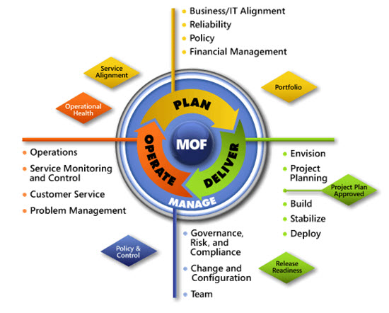
IPD in Microsoft Operations Framework 4.0
Use MOF with IPD guides to ensure that people and process considerations are addressed when changes to an organization’s IT services are being planned.
Notes:
For more information about Microsoft Operations Framework 4.0, go to www.microsoft.com/mof.

Slide 23
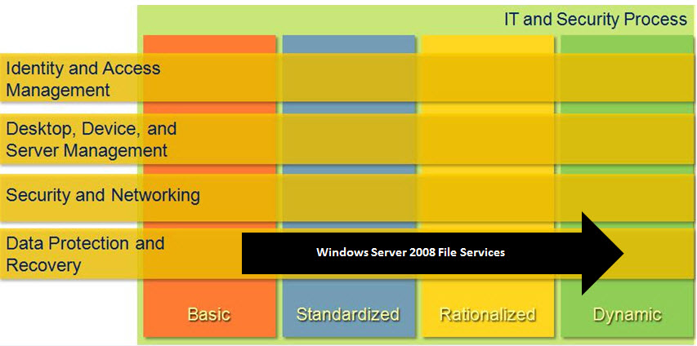
File Services in Microsoft Infrastructure Optimization
Notes:
<This slide shows the effect that File Services has on infrastructure maturity as reflected in the Core Infrastructure Optimization Model.>
The Infrastructure Optimization (IO) Model at Microsoft groups IT processes and technologies across a continuum of organizational maturity. (For more information, see www.microsoft.com/infrastructure.) The model was developed by industry analysts, the Massachusetts Institute of Technology (MIT) Center for Information Systems Research (CISR), and Microsoft’s own experiences with its enterprise customers. A key goal for Microsoft in creating the Infrastructure Optimization Model was to develop a simple way to use a maturity framework that is flexible and can easily be applied as the benchmark for technical capability and business value.
IO is structured around three information technology models: Core Infrastructure Optimization, Application Platform Optimization, and Business Productivity Infrastructure Optimization. According to the Core Infrastructure Optimization Model, providing identity synchronization and automated provisioning/de-provisioning, including self-service tools for end users, will help move an organization to the Dynamic level.

