Slide 1
Microsoft® Exchange Online— Evaluating Software-plus-Services
Infrastructure Planning and Design
Published: November 2008
Updated: December 2010
This guide was last updated in December 2010 but the basic principles still apply when planning your Exchange Online infrastructure. This guide will not continue to be updated. For the latest information, please visit the Exchange Online product group page.
Notes:
Copyright © 2010 Microsoft Corporation. This documentation is licensed to you under the Creative Commons Attribution License. To view a copy of this license, visit http://creativecommons.org/licenses/by/3.0/us/ or send a letter to Creative Commons, 543 Howard Street, 5th Floor, San Francisco, California, 94105, USA. When using this documentation, provide the following attribution: Infrastructure Planning and Design is provided with permission from Microsoft Corporation.
This documentation is provided to you for informational purposes only, and is provided to you entirely "AS IS". Your use of the documentation cannot be understood as substituting for customized service and information that might be developed by Microsoft Corporation for a particular user based upon that user’s particular environment. To the extent permitted by law, MICROSOFT MAKES NO WARRANTY OF ANY KIND, DISCLAIMS ALL EXPRESS, IMPLIED AND STATUTORY WARRANTIES, AND ASSUMES NO LIABILITY TO YOU FOR ANY DAMAGES OF ANY TYPE IN CONNECTION WITH THESE MATERIALS OR ANY INTELLECTUAL PROPERTY IN THEM.
Microsoft may have patents, patent applications, trademarks, or other intellectual property rights covering subject matter within this documentation. Except as provided in a separate agreement from Microsoft, your use of this document does not give you any license to these patents, trademarks or other intellectual property.
Information in this document, including URL and other Internet Web site references, is subject to change without notice. Unless otherwise noted, the example companies, organizations, products, domain names, email addresses, logos, people, places and events depicted herein are fictitious.
Microsoft, ActiveSync, Outlook, and Windows are either registered trademarks or trademarks of Microsoft Corporation in the United States and/or other countries and regions.
The names of actual companies and products mentioned herein may be the trademarks of their respective owners.
You have no obligation to give Microsoft any suggestions, comments or other feedback (“Feedback”) relating to the documentation. However, if you do provide any Feedback to Microsoft then you provide to Microsoft, without charge, the right to use, share and commercialize your Feedback in any way and for any purpose. You also give to third parties, without charge, any patent rights needed for their products, technologies and services to use or interface with any specific parts of a Microsoft software or service that includes the Feedback. You will not give Feedback that is subject to a license that requires Microsoft to license its software or documentation to third parties because we include your Feedback in them.

Slide 2
What Is IPD? Guidance that clarifies and streamlines the planning and design process for Microsoft infrastructure technologies
IPD:
Defines decision flow
Describes decisions to be made
Relates decisions and options for the business
Frames additional questions for business understanding
IPD guides are available at www.microsoft.com/ipd
Notes:
Infrastructure Planning and Design (IPD) is a series of planning and design guides created to clarify and streamline the planning and design process for Microsoft® infrastructure technologies.
Each guide in the series addresses a unique infrastructure technology or scenario.
These guides include the following topics:
Defining the technical decision flow (flow chart) through the planning process.
Describing the decisions to be made and the commonly available options to consider in making the decisions.
Relating the decisions and options for the business in terms of cost, complexity, and other characteristics.
Framing the decisions in terms of additional questions for the business to ensure a comprehensive understanding of the appropriate business landscape.
The guides in this series are intended to complement and augment Microsoft product documentation.

Slide 3
Getting Started
Microsoft Exchange Online—Evaluating Software-plus-Services
Notes:
The Microsoft Exchange Online—Evaluating Software-plus-Services guide evaluates Microsoft Exchange Online and on-premises solution offerings in over 30 different areas of interest to technical decision makers, including client options, mail flow changes, operational impacts, and security concerns. The organization’s needs will be rated in terms of importance, and the advantages and disadvantages of each offering will be evaluated against business requirements in order to provide a quantitative view of which offering will be best suited to serve the business’s email needs.

Slide 4
Purpose and Agenda
Purpose
To provide a technical decision maker with information about topics to consider when deciding whether to retain existing on-premises email services or to migrate to an Exchange Online solution
Agenda
Software-plus-Services
Overview of Steps – Categories/Topics
Sample Topic for Rating/Scoring
Sample Tally Sheet
Evaluate Results
Conclusion
Notes:
Purpose
The purpose of this presentation is to guide the reader through the process of deciding whether to use an on-premises email service or the Microsoft Exchange Online Standard or Dedicated offering.
Agenda
The guide contains six steps; the first five steps contain sections grouped into similar areas of functionality.
The following slides will introduce software-plus-services, and then the various topics that are covered in detail in the guide will be presented. Instructions will be given for how each topic should be rated and how to tally all of the scores at the end. A sample topic will be presented.

Slide 5
What Is Software-plus-Services?
Software-plus-services is a model of software development where an application is hosted as a service and combined with locally installed, client-based software for rich interactivity and higher performance
The software-plus-services strategy is about choice, creating freedom in functionality and delivery
Exchange Online provides:
Hosted enterprise messaging solution based on Microsoft Exchange Server
“From anywhere” access to email for users, including Outlook®, Outlook Web App, mobile devices, and others
Notes:
What is software-plus-services?
Software-plus-services combines cloud-based delivery services with the rich interactivity and high performance achieved by a locally installed client. The software-plus-services model ensures that people can access the applications and information they need even when they aren’t connected to the Internet.
The choice of a deployment option depends on several factors, including the level of in-house messaging expertise, the need for control and customization, and the overall priorities of the IT group. Because organizations have the flexibility to deploy Microsoft Exchange as a server or a service, business needs, rather than technology constraints, can drive the choice.

Slide 6
Deployment Options
On-Premises Deployment
Server and client software is installed and run on computers on the premises of the organization using the software
Exchange Online Standard Offering
Provides the core business capabilities of Microsoft Exchange Server as a hosted service from a shared server, multi-tenancy environment
Exchange Online Dedicated Offering
Provides dedicated servers at Microsoft data centers to support each organization’s Exchange architecture
Notes:
Discuss On-Premises Service Model
On-premises deployment is a model where software is installed and runs on computers on the premises of the organization using the software, rather than at a remote facility. The on-premises model provides organizations with the flexibility to perform maintenance, upgrades, and customization at their convenience. However, this model requires considerable upfront capital for such expenses as hardware, software, licenses, IT personnel for maintenance, and physical building space.
Discuss Microsoft Exchange Online
Exchange Online is a hosted enterprise messaging solution that is based on Microsoft Exchange Server 2007. It supports seamless interaction among users regardless of whether their mailboxes are hosted by Exchange Online or on-premises.
Microsoft Exchange Online provides a comprehensive message solution with a simple per-user monthly fee. It can minimize an organization’s dependency on individual IT employees and provides rapid deployment and easy scalability.
Exchange Online is available as two offerings: Standard and Dedicated. Both provide high levels of data security and redundancy, with different degrees of customization.
Exchange hosted as a partner will not be discussed.

Slide 7
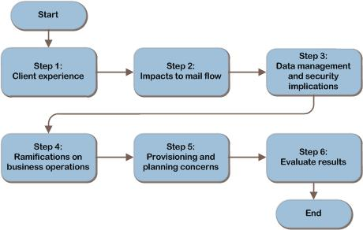
Evaluating Exchange Online Decision Flow
Notes:
This is the Exchange Online—Evaluating Software-plus-Services decision flow.
The first five steps are not sequential and can be performed in any order, but all should be completed to obtain the fullest picture of the suitability and importance of the various technologies.
Within each step, each topic is subdivided into four elements:
Definition of the topic.
A rating of the importance of the topic to the business.
A comparison of the functionality available with the Exchange Online Standard and Dedicated offerings and the on-premises technology.
A rating of how well each offering addresses the business’s requirements for the topic.
Additional context may also be included where relevant to help the decision maker evaluate the impact associated with the decision.
The sixth step will assist the reader in evaluating the results of the first five steps. The next several slides provide an overview of the categories and topics for evaluation.

Slide 8
Using This Guide to Evaluate Exchange Online
Read the introduction to the step.
Read the description for each topic.
Determine importance of each topic by reading importance rating section and record in the rating table provided.
Read the comparisons of on-premises, Standard, and Dedicated offerings in the solutions rating section and rate each solution. Record answers in the rating table provided.
Repeat for Steps 2-5.
Use the tally sheet in the appendix to tally all scores. Evaluate and make decision.
Notes:
How to use the Microsoft Exchange Online—Evaluating Software-plus-Services Guide
For the best results, technical decision makers should perform the following actions for each step:
Read the introduction to the step for a list of the topics covered within the section.
For each topic in the step, read the description of the topic and its function in the business.
In the “Importance Rating” section, determine how important the topic is to the organization by answering the provided question and recording the importance rating score for the topic in the table provided at the end of the section.
The importance rating options are 1–5:
1 = not important
2 = somewhat important
3 = important
4 = very important
5 = extremely important (must have)
In the “Solutions Rating” section, compare the functionalities of the Exchange Online Standard and Dedicated offerings and the on-premises solution. Rate each on its potential effectiveness in meeting the organization’s needs and record the scores in the table provided at the end of the section for the topic. (See Table 1 below for a sample.) Note that in some cases the Standard and Dedicated offerings have been combined to avoid redundancy in the reading, but they should still be scored individually.
The solution rating score options are 0–3:
0 = doesn’t apply/provides no benefit
1 = somewhat provides
2 = adequately provides
3 = exceeds expectations
Repeat the above process for the remainder of the steps and record the scores for each topic.
In the appendix, the “Tally Sheet” job aid lists all of the steps and their respective topics. Transfer each of the raw scores from the table in each topic section to this table and determine the weighted score for each topic. The weighted score is generated by multiplying the importance rating by each offering’s original (raw) rating score. The weighted scores provide a comprehensive view of the comparisons between the offerings, which will assist in deciding whether to stay with the on-premises solution or to migrate to either the Exchange Online Standard or Dedicated solution.

Slide 9
Exchange Online – Steps and Topics
Step 1: Client Experience
● Office Outlook Web App ● Outlook Anywhere ● MAPI
● IMAP & POP ● BlackBerry devices ● Mailbox sizes
● Macintosh clients ● Single sign-on ● Unified Messaging
● Mobile devices using Exchange ActiveSync
Step 2: Impacts to Mail Flow
● SMTP relay services ● SMTP smart hosting ● Line of bus. apps integration
● Message hygiene ● Connectors to other systems ● Transport rules
● Public folders
Step 3: Data Management and Security Implications
● Network security ● Network connectivity ● Data isolation
● Auditing ● Archiving & journaling ● Signing & encrypting messages
● Information Rights Management
Step 4: Ramifications on Business Operations
● Service continuity ● Disaster recovery testing ● Service level agreements
● Scheduled maintenance ● Adoption rates for new releases
Step 5: Provisioning and Planning Concerns
● AD DS integration ● Capacity & performance planning
Step 6: Evaluate Results
Notes:
Steps and Topics
This slide provides an overview of the areas of concern that will be discussed.
If you compare the Exchange Online Standard offering to the Exchange Online Dedicated offering, you’ll see that the Dedicated offering provides more options than the Standard offering.
The on-premises deployment is a model where software is installed and runs on computers on the premises of the organization using the software, rather than at a remote facility. The on-premises model provides organizations with the flexibility to perform maintenance, upgrades, and customization at their convenience. However, this model requires considerable upfront capital for such expenses as hardware, software, licenses, IT personnel for maintenance, and physical building space.
For more details on each topic and the capabilities available with the on-premises, Exchange Online Standard, and Exchange Online Dedicated offerings, refer to the guide.
Read through each topic in the sections and use the rating table provided at the end of each topic section to record the importance rating and scores for each offering and/or solution.

Slide 10
Example: Evaluate Signing and Encrypting Messages
Signing and Encrypting Messages description:
Secure Multipurpose Internet Mail Extensions (S/MIME) enables users to send signed and encrypted emails.
Importance Rating. Does the organization need to send signed or encrypted emails? Record the importance of this criterion in the table below.
Solutions Rating. The list below compares the specific functionalities of each solution:
Standard offering. Provides support for S/MIME certificates. Outlook will publish and store certificates in Exchange Online.
Dedicated offering. Provides support for S/MIME certificates by synchronizing certificate information from the customer’s environment to the Microsoft Online Services–managed environment as part of the Active Directory synchronization.
On-premises solution. Supports signing and encrypting emails with S/MIME.
Evaluate how well each of these offerings addresses the business’s requirements for S/MIME, and then record the ratings in the table below.
Notes:
In this example, we’ll take a look at how to rate and score a topic.
Evaluate Signing and Encrypting Messages
Read the signing and encrypting messages description.
Read and record the importance of signing and encrypting messages in the rating table.
Read the “Solutions Rating” section.
Review the information and record the score for how the Standard offering meets your needs for signing and encrypting messages in the rating table.
Review the information and record the score for how the Dedicated offering meets your needs for signing and encrypting messages in the rating table.
Review the information and record the score for how the on-premises solution meets your needs for signing and encrypting messages in the rating table.
Go to next slide to see how to use the tally sheet.

Slide 11
How to Use the Tally Sheet
Transfer the raw scores. Transfer the importance ratings and the Standard, Dedicated, and on-premises raw scores from the individual tables in each section to the tally sheet in the appendix.
Calculate weighted scores. Multiply the importance rating by each raw score to find the weighted scores. For example, multiply the importance rating for Office Outlook Web Access by the Office Outlook Web Access standard raw score (5 x 3 = 15) to get the standard weighted score for this topic. Record the standard weighted score in the appropriate box. Repeat for the Dedicated and on-premises solutions.
Total each section. After determining each of the weighted scores in a section, add the scores and record them in the Section Subtotals row. Repeat for each section.
Tally cumulative total. Finally, after using the formula to rate and score each topic throughout the “Tally Sheet” job aid, add up all of the totals from each section to obtain the cumulative scores. These cumulative totals should provide a definite picture of the solution that best fits the organization.
Notes:
Evaluate Results
In this step, the comparison ratings for each topic will be tallied so that a logical decision about which solution best fits the needs of the organization can be made. At this point, each of the topics has been rated in terms of its importance to the business. In addition, each offering has been rated in its effectiveness to meet the business’s needs.
Weighted Scoring
The “Tally Sheet” job aid in the appendix lists all of the steps and their respective topics. Transfer each of the raw scores from the table in each topic section to this table, and determine the weighted score for each topic. The weighted score is generated by multiplying the importance rating by each offering’s original (raw) rating score. The weighted scores provide a comprehensive view of the comparisons between offerings, which will assist in deciding whether to stay with the on-premises solution or to migrate to either the Exchange Online Standard or Dedicated solution. Totaling each column will reveal which offering has been rated to best meet the organization’s needs.
Analyze the Results
If one offering’s score is significantly higher than the rest, then this offering obviously best meets the needs of the organization. However, a set of similar scores may indicate that a particular offering does not necessarily better fit the needs of the organization than other offerings. In this case, it may be prudent to focus on the results of the topics that were rated to be most important to the company.
During the course of evaluation, the organization may have also realized that there was a capability that it simply must have, and either on-premises or one of the Exchange Online offerings did not provide it. This also can make the decision fairly obvious.

Slide 12
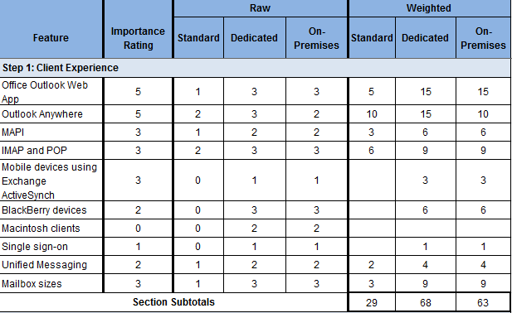
Example: Tally Sheet
Note This Tally Sheet example is for illustrative purposes only and does not include all of the steps or topics in the Exchange Online―Software-plus-Services Guide
Notes:
This is an example of a tally sheet. In this example, we see that the Standard score is significantly lower than the other offerings, indicating that perhaps there are some features important to the organization that might not be available. The Dedicated and on-premises scores are fairly close. At this point, the organization might want to review the topics rated most important to the organization to make sure critical features are available in both options, and run a cost-benefit analysis based on the organization’s personal estimates.

Slide 13
Next Steps
If, after evaluation, it is determined that Exchange Online meets the needs of the organization, consider implementing as a:
Pilot project, or
Hybrid solution (coexistence with on-premises solution)
The Microsoft Assessment and Planning (MAP) Toolkit can help assess your environment to determine its readiness for Exchange Online.
MAP is available at http://technet.microsoft.com/MAP
Notes:
Next Steps
After reviewing the different features, consider implementing a pilot project for a group of test users. Alternatively, if Exchange Online will meet the needs of some but not all of the organization’s users, a hybrid solution with some users on Exchange Online and others still hosted on premises can be implemented.
The Microsoft Assessment and Planning Toolkit is available at http://technet.microsoft.com/MAP. It provides an assessment of the client computers in the organization, as well as of the IT environment as a whole, to determine readiness for Microsoft Online Services and can be used as an aid in the provisioning process for Exchange Online. Note that it does not assess readiness for the Dedicated offering of Exchange Online.
Although outside the scope of this document, a cost-benefit analysis may also be in order to determine which offering is the best fit for the organization from a financial standpoint.

Slide 14
Summary and Conclusion
The software-plus-services strategy is about choice
The guide was designed to provide a technical decision maker with information about offerings and topics to consider when deciding whether to retain existing on-premises email services or to migrate to an Exchange Online solution
Use the guide to weigh the advantages and disadvantages of each mode of delivery against the organization’s priorities
At the conclusion of the evaluation, the organization has an individualized appraisal to assist in deciding whether to move email services to Exchange Online
Provide feedback to ipdfdbk@microsoft.com
Notes:
Summary and Conclusion
The software-plus-services strategy designed by Microsoft is about choice, creating freedom in functionality and delivery. In order for companies to choose a best fit, they need to weigh the advantages and disadvantages of each mode of delivery against their organization’s priorities. This guide was designed to provide a technical decision maker with information about offerings and topics to consider when making the decision to retain existing on-premises email services or to migrate either in full or partially to an Exchange Online solution. At the conclusion of the evaluation, the organization has an individualized appraisal to assist in making the decision whether to move email services to Exchange Online.

Slide 15
Find More Information
Download the full document and other IPD guides: www.microsoft.com/ipd
Contact the IPD team: ipdfdbk@microsoft.com
Access the Microsoft Solution Accelerators Web site: www.microsoft.com/technet/SolutionAccelerators

Slide 16
Appendix

Slide 17
Notes to presenter
The following slides contain additional details on the topics so that you can customize the presentation to your own needs.
The steps have been broken out into separate slides, and the tallying process has been described in more detail.

Slide 18
Step 1. Client Experience
The Client Experience step addresses messaging capabilities that most significantly influence the client experience
The topics covered in this step are:
Office Outlook Web App
Outlook Anywhere
MAPI
IMAP and POP
Mobile devices using Exchange ActiveSync®
BlackBerry devices
Macintosh clients
Single sign-on
Unified Messaging
Mailbox sizes
Notes:
Step 1. Client Experience
This step addresses the messaging capabilities that most significantly influence the client experience. If you compare the Exchange Online Standard offering to the Exchange Online Dedicated offering, you’ll see that the Dedicated offering provides more options than the Standard offering. The on-premises solution provides the most flexibility but could be more expensive and difficult to maintain.
The Exchange Online Standard offering is limited to: Office Outlook Web App (formerly known as Office Outlook Web Access), Outlook Anywhere, POP, Mobile Devices using Exchange ActiveSync, support for Macintosh clients, and Single Sign-On (SSO) to Microsoft Online services.
The Exchange Online Dedicated offering provides more options, including MAPI, IMAP/POP, more mobile devices using Exchange ActiveSync policies, option for BlackBerry Enterprise Server, and support for Macintosh clients, and SSO through Windows® logon.
The on-premises solution provides the most flexibility but requires more responsibility to maintain.
Read through each topic in this section and use the rating table provided at the end of each topic section to record the importance rating and scores for each offering and/or solution.

Slide 19
Step 2. Impacts to Mail Flow
The Impacts to Mail Flow step addresses some of the impacts to mail flow resulting from changing to an Exchange Online environment
The topics covered in this step are:
SMTP relay services
SMTP smart hosting
Line-of-business applications integration
Message hygiene
Connectors to other systems
Transport rules
Public folders
Notes:
Step 2. Impacts to Mail Flow
This step addresses some of the impacts to mail flow resulting from changing to an Exchange Online environment. Different features are available depending on which offering is chosen. An on-premises environment will offer the greatest level of customization, and Standard the least.
The Exchange Online Standard offering is limited to: line-of-business applications integration and message hygiene.
The Exchange Online Dedicated offering provides more options for SMTP relaying, smart hosting, connecting to other systems, transport rules, and public folders.
The on-premises solution provides the greatest level of customization and flexibility.
Read through each topic in this section and use the rating table provided at the end of each topic section to record the importance rating and scores for each offering and/or solution.

Slide 20
Step 3. Data Management and Security Implications
This step explores some of the data management and security implications of storing data either on premises or under someone else’s control
The topics covered in this step are:
Network security
Network connectivity
Data isolation
Auditing
Archiving and journaling
Signing and encrypting messages
Information Rights Management
Notes:
Step 3. Data Management and Security Implications
The need for information security in today's highly networked business environment is more important than ever. Information is arguably one of an enterprise's most valuable assets, so its protection from accidental exposure or predators from both within and outside the organization is a top IT priority.
This step explores some of the data management and security implications of storing data on an off-premises system.
Both Exchange Online systems share a high level of security. There are variations in the features available for data isolation, archiving, signing and encrypting messages, and Information Rights Management.
The on-premises solution provides the greatest level of customization and flexibility.
Read through each topic in this section and use the rating table provided at the end of each topic section to record the importance rating and scores for each offering and/or solution.

Slide 21
Step 4. Ramifications on Business Operations
Before deciding whether to use online services, existing on-premises email services, or a combination of email services, it is important to carefully examine the ramifications of this decision on business operations
The topics covered in this step are:
Service continuity
Disaster recovery testing
Service level agreements
Adoption rate for new releases
Scheduled maintenance
Notes:
Step 4. Ramifications on Business Operations
Before deciding whether to use online services, existing on-premises email services, or a combination of email services, it is important to carefully examine the ramifications of this decision on business operations. The topics in this step will be used in evaluating the business operations concerns, but they do not necessarily represent a comprehensive list. Each organization must consider its unique environment and needs.
Read through each topic in this section and use the rating table provided at the end of each topic section to record the importance rating and scores for each offering and/or solution.

Slide 22
Step 5. Provisioning and Planning Concerns
Provisioning is the creation and modification of mailboxes, distribution groups, and contacts within a system
Capacity and performance planning is a related activity that can be a challenge for IT departments as they try to balance future needs with budget limitations
The topics covered in this step are:
Active Directory Domain Services integration
Capacity and performance planning
Notes:
Step 5. Provisioning and Planning Concerns
Provisioning is the creation and modification of mailboxes, distribution groups, and contacts within a system. This can be done through automation, delegated administration portals, or manually using native tools. A related activity, capacity and performance planning can be a challenge for IT departments as they try to balance future needs with budget limitations.
Read through each topic in this section and use the rating table provided at the end of each topic section to record the importance rating and scores for each offering and/or solution.

Slide 23
Step 6. Evaluate Results
Weighted Scoring – Multiply the importance rating by each offering’s original (raw) rating score to find the weighted score. Weighted scores provide a comprehensive view of the comparisons between offerings.
Analyze Results – If one offering’s score is significantly higher than the rest, this offering will best meet the needs of the organization. However, a set of similar scores may indicate that a particular offering does not necessarily better fit the needs of the organization than other offerings.
Notes:
Evaluate Results
In this step, the comparison ratings for each topic will be tallied so that a logical decision about which solution best fits the needs of the organization can be made. At this point, each of the topics has been rated in terms of its importance to the business. Each offering has been rated in its effectiveness to meet the business’s needs.
Weighted Scoring
The “Tally Sheet” job aid in the appendix lists all of the steps and their respective topics. Transfer each of the raw scores from the table in each topic section to this table and determine the weighted score for each topic. The weighted score is generated by multiplying the importance rating by each offering’s original (raw) rating score. The weighted scores provide a comprehensive view of the comparisons between offerings, which will assist in deciding whether to stay with the on-premises solution or to migrate to either the Exchange Online Standard or Dedicated solution.
Adding up each column will reveal which offering has been rated to best meet the organization’s needs.
Analyze the Results
If one offering’s score is significantly higher than the rest, then this offering obviously best meets the needs of the organization. However, a set of similar scores may indicate that a particular offering does not necessarily better fit the needs of the organization than other offerings. In this case, it may be prudent to focus on the results of the topics that were rated to be most important to the company.
During the course of evaluation, the organization may have also realized that there was a capability that it simply must have, and either on-premises or one of the Exchange Online offerings did not provide it. This also can make the decision fairly obvious.

Slide 24
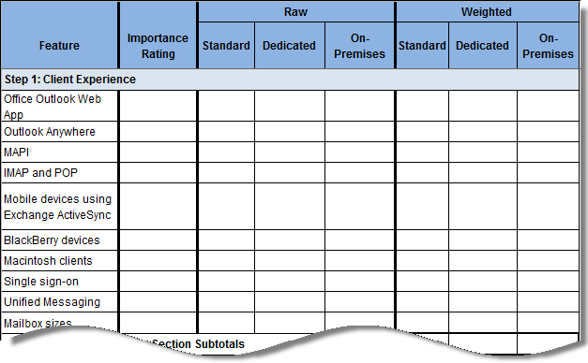
Example: Tally Sheet
Notes:
This is a sample of a tally sheet. The next slides will walk you through the process.

Slide 25
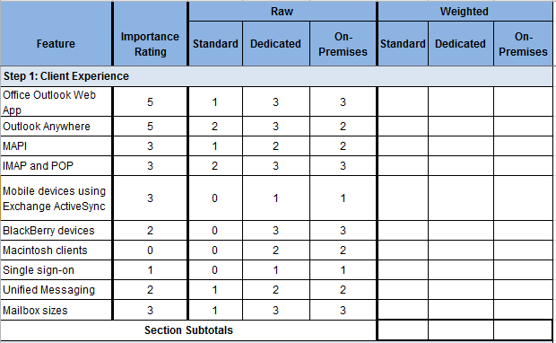
How to Use the Tally Sheet
Transfer the importance ratings and the Standard, Dedicated, and on-premises raw scores from the individual tables in each section and for each topic
Notes:
First, transfer each of the raw scores from the table in each topic section to the table in the appendix.

Slide 26
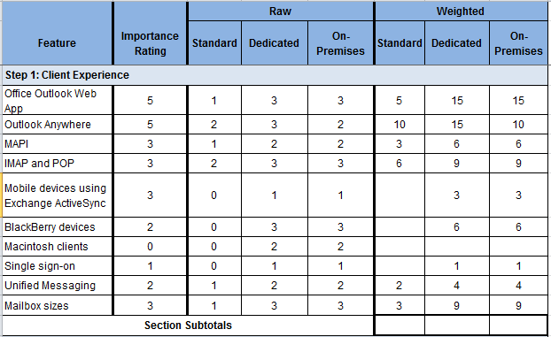
How to Use the Tally Sheet (continued)
Multiply the importance rating by each raw score to find the weighted scores. For example, multiply the Office Outlook Web Access Importance Rating by the Office Outlook Web Access Standard raw score (5 x 3 = 15) to get the Standard weighted score for the topic. Record the Standard weighted score in the appropriate box.
Notes:
Second, determine the weighted score for each topic. The weighted score is generated by multiplying the Importance Rating by each offering’s original (raw) rating score. The weighted scores provide a comprehensive view of the comparisons between offerings, with the greater emphasis given to the features the organization has deemed most important.

Slide 27
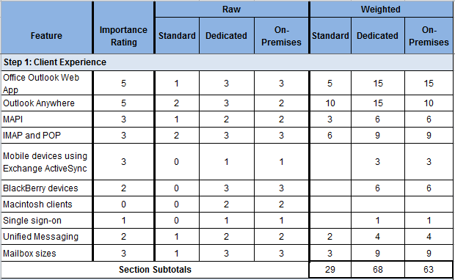
How to Use the Tally Sheet (continued)
After determining each of the weighted scores, add the scores and record in the Section Subtotals row.
Notes:
Third, add the Standard weighted score, Dedicated weighted score, and on-premises weighted score columns in each section.

Slide 28
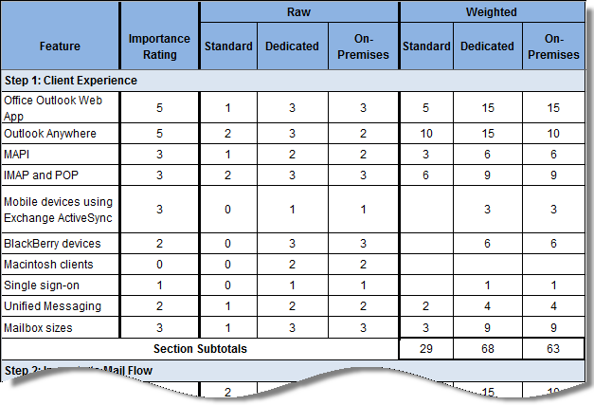
How to Use the Tally Sheet (continued)
Finally, after using the formula to rate and score each topic throughout the “Tally Sheet” job aid, add up all of the totals from each section to get the cumulative totals. These cumulative totals should provide a definite picture of the solution that best fits the organization.
Notes:
And lastly, add the subtotals in each column to reveal which offering has been rated to best meet the organization’s needs.
Analyze the Results
If one offering’s score is significantly higher than the rest, then this offering clearly best meets the needs of the organization. However, a set of similar scores may indicate that a particular offering does not necessarily better fit the needs of the organization than other offerings. In this case, it may be prudent to focus on the results of the topics that were rated to be most important to the company.
During the course of evaluation, the organization may have also realized that there was a capability that it simply must have, and either on-premises or one of the Exchange Online offerings did not provide it. This also can make the decision fairly obvious.

