Slide 1
Dynamic Datacenter
Infrastructure Planning and Design
Published: April 2010
Updated: November 2011
Notes:
Copyright © 2011 Microsoft Corporation. This documentation is licensed to you under the Creative Commons Attribution License. To view a copy of this license, visit http://creativecommons.org/licenses/by/3.0/us/ or send a letter to Creative Commons, 543 Howard Street, 5th Floor, San Francisco, California, 94105, USA. When using this documentation, provide the following attribution: Infrastructure Planning and Design is provided with permission from Microsoft Corporation.
This documentation is provided to you for informational purposes only, and is provided to you entirely "AS IS". Your use of the documentation cannot be understood as substituting for customized service and information that might be developed by Microsoft Corporation for a particular user based upon that user’s particular environment. To the extent permitted by law, MICROSOFT MAKES NO WARRANTY OF ANY KIND, DISCLAIMS ALL EXPRESS, IMPLIED AND STATUTORY WARRANTIES, AND ASSUMES NO LIABILITY TO YOU FOR ANY DAMAGES OF ANY TYPE IN CONNECTION WITH THESE MATERIALS OR ANY INTELLECTUAL PROPERTY IN THEM.
Microsoft may have patents, patent applications, trademarks, or other intellectual property rights covering subject matter within this documentation. Except as provided in a separate agreement from Microsoft, your use of this document does not give you any license to these patents, trademarks or other intellectual property.
Information in this document, including URL and other Internet website references, is subject to change without notice. Unless otherwise noted, the example companies, organizations, products, domain names, email addresses, logos, people, places and events depicted herein are fictitious.
Microsoft, Active Directory, Hyper-V, SQL Server, Windows, and Windows Server are either registered trademarks or trademarks of Microsoft Corporation in the United States and/or other countries and regions.
The names of actual companies and products mentioned herein may be the trademarks of their respective owners.
You have no obligation to give Microsoft any suggestions, comments or other feedback (“Feedback”) relating to the documentation. However, if you do provide any Feedback to Microsoft then you provide to Microsoft, without charge, the right to use share and commercialize your Feedback in any way and for any purpose. You also give to third parties, without charge, any patent rights needed for their products, technologies and services to use or interface with any specific parts of a Microsoft software or service that includes the Feedback. You will not give Feedback that is subject to a license that requires Microsoft to license its software or documentation to third parties because we include your Feedback in them.

Slide 2
What Is IPD? Guidance that clarifies and streamlines the planning and design process for Microsoft® infrastructure technologies
IPD:
Defines decision flow
Describes decisions to be made
Relates decisions and options for the business
Frames additional questions for business understanding
IPD guides are available at www.microsoft.com/ipd
Notes:
Infrastructure Planning and Design (IPD) is a series of planning and design guides created to clarify and streamline the planning and design process for Microsoft® infrastructure technologies.
Each guide in the series addresses a unique infrastructure technology or scenario.
These guides include the following topics:
Defining the technical decision flow (flow chart) through the planning process.
Describing the decisions to be made and the commonly available options to consider in making the decisions.
Relating the decisions and options for the business in terms of cost, complexity, and other characteristics.
Framing the decisions in terms of additional questions for the business to ensure a comprehensive understanding of the appropriate business landscape.
The guides in this series are intended to complement and augment Microsoft product documentation.

Slide 3
Getting Started
Dynamic Datacenter
Notes:
The guide was created to enable infrastructure planners to design a Dynamic Datacenter infrastructure.
The guide includes specific design information and activities that encourage sound planning.
Each activity includes:
Prerequisites and background on the activity.
Tasks that will be performed to complete the activity.
Reference information regarding the activity’s impact on characteristics such as the cost, complexity, and capacity of the solution.
Questions to ensure that business needs are captured and reflected in the solution.
The guide is written for information technology (IT) infrastructure specialists who are responsible for planning and designing the infrastructure for a Dynamic Datacenter.

Slide 4
Purpose and Overview
Purpose
To provide design guidance for a Dynamic Datacenter infrastructure
Overview
Dynamic Datacenter architecture
Dynamic Datacenter infrastructure design process
Notes:
The guide focuses on the elements that organizations must consider when designing a Dynamic Datacenter infrastructure.

Slide 5
What Is a Dynamic Datacenter?
A combination of automation, control, and resource management software with a well-defined topology of virtualization, servers, storage, and networking hardware
Dynamic Datacenter principles:
Adopt a service-centric approach
Enable agility
Provide utility
Minimize human involvement
Provide cost transparency
Notes:
The goal of the guide is to present common scenarios, decisions, and practices for implementing a Dynamic Datacenter infrastructure. A Dynamic Datacenter is a combination of automation, control, and resource management software with a well-defined topology of virtualization, servers, storage, and networking hardware. The flexibility that this model provides is changing the business landscape by presenting new ways to develop, deliver, deploy, and manage applications and IT infrastructures. The resulting benefits are many, such as the ability to scale as needed, be more responsive to changing market conditions, and provide an opportunity for IT to align deliverables with the organization’s business requirements.
Using the guide, IT professionals can plan and design a Dynamic Datacenter infrastructure that ensures that critical phases are not left out of the plan and that a good foundation is established for future expansion.
The primary components of a Dynamic Datacenter infrastructure are shown in the diagram on the next slide.

Slide 6
Fault Tolerance in the Dynamic Datacenter
Resiliency is a goal of the Dynamic Datacenter; however, it is not always necessary to implement redundant components in every level of the design to achieve this goal. Instead, implementation of fault-tolerant measures should be considered at the following levels:
Operating system and application measures
Component-level measures
System-level measures
Notes:
Resiliency is a goal of the Dynamic Datacenter; however, it is not always necessary to implement redundant components in every level of the design to achieve this goal. Instead, implementation of fault-tolerant measures should be considered at the following levels:
Operating system and application measures. Before implementing specific component-level and system-level fault-tolerant measures, certain operating system and application-level routes, such as clustering, should be considered.
Component-level measures. At the server level, use fault-tolerant components such as redundant power supplies, battery backup, Error Correction Code (ECC) memory, and redundant fans. At the network-level, implement fault-tolerant networking components such as redundant switches, routing, and wiring.
System-level measures. At the system level, use fault-tolerant measures such as redundant access to Active Directory® Domain Services (AD DS) and other management software and redundant storage of data. Also develop carefully planned backup and monitoring strategies.

Slide 7
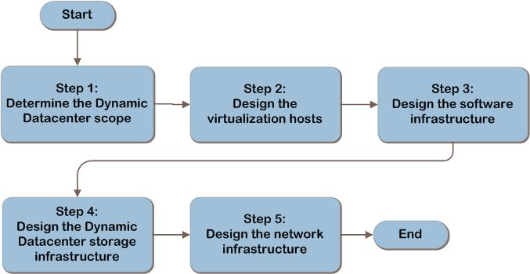
Dynamic Datacenter Decision Flow
IPD
MAP w/ CAL Tracker
SCM
ITA
Notes:
The Dynamic Datacenter design flow provides a graphical overview of the steps in designing a Dynamic Datacenter infrastructure.
These steps are:
Determine the Dynamic Datacenter scope
Design the virtualization hosts
Design the software infrastructure
Design the Dynamic Datacenter storage infrastructure
Design the network infrastructure
Each of these steps will be discussed in greater detail in the following slides.

Slide 8
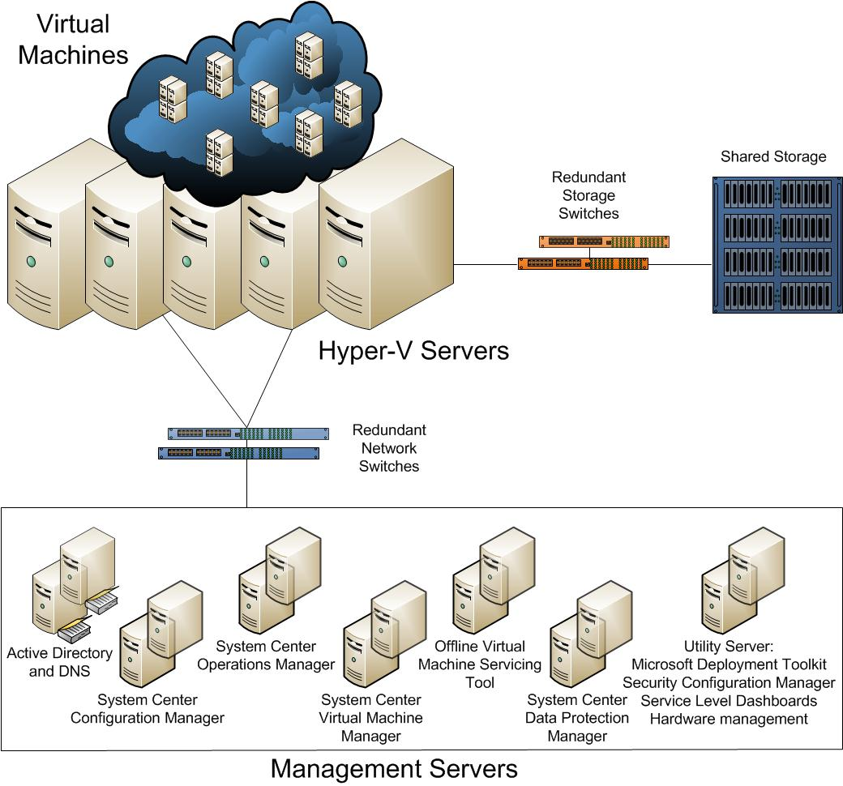
Dynamic Datacenter Architecture
IPD
MAP w/ CAL Tracker
SCM
ITA
Notes:
This diagram illustrates the relationship between the components that work together to provide an architecture for a Dynamic Datacenter. They are shown together in one possible implementation for illustration purposes, but other configurations are possible.

Slide 9
Step 1: Determine the Dynamic Datacenter Scope
Task 1: Determine the Proposed Initial Workloads for the Dynamic Datacenter
Record:
Name of application and operating systems supported by app
Memory, CPU utilization, disk space, and disk I/O
Networking requirements
Isolation requirements
Fault-tolerance requirements
Verify virtualization is supported
Use Microsoft Assessment and Planning Toolkit to help gather information from current environment
Notes:
Step 1: Determine the Dynamic Datacenter Scope
Task 1: Determine the Proposed Initial Workloads for the Dynamic Datacenter
Application. Record the name of the application used in the workload.
Operating systems supported by the application. This will be used to determine whether the workload can be run and supported in a virtual machine and whether a Remote Desktop Session Host (RD Session Host) role service can be used to deliver the workload.
Memory. Record the amount of memory needed by the workload. This will be used to determine the memory requirements for the physical host. Based on density requirements, the server could be scaled up to host a set number of workloads.
CPU utilization. This information will be used to determine the amount of CPU that each workload will utilize during peak periods.
Disk space. The disk space required by each workload will be used in the design of the storage system.
Disk I/O. This information will be used to determine the maximum disk I/O (input/output) that the storage system will need to meet the workload requirements. Disk I/O is one component of the total storage throughput.
Networking requirements. Assess the network subnets the workload needs to access and the network throughput required. This will help determine whether the physical hosts may need to have additional network adapters installed to meet network requirements.
Isolation requirements. A need for the application to be separated from other applications due to regulatory or legal reasons will drive the design of the virtualization host servers.
Fault-tolerance requirements. Determine if the workload has a requirement for fault tolerance. Workloads with similar fault-tolerance requirements may be grouped together to simplify the design.
Once the initial list is assembled, examine the compatibility of each of the candidate workloads with the Dynamic Datacenter. The Infrastructure Planning and Design Guide for Windows Server Virtualization (http://go.microsoft.com/fwlink/?LinkId=160822) provides additional guidance on this process in Step 2, Task 2, of that guide.
If the workload is not compatible with the virtualization platform for technical or business reasons, indicate that it is out of scope in Table A-1 in Appendix A. When this task is complete, a revised list of initial workloads that can be virtualized will have been defined.

Slide 10
Step 1: Determine the Dynamic Datacenter Scope (Continued)
Task 2: Select the Workload Fault-Tolerance Approach
Option 1: Load Balancing
Option 2: Virtual Machine-Level Clustering
Option 3: Host-Level Clustering
Option 4: Application-Level Fault Tolerance
Fault-tolerance selection may impact number of virtual machines or host servers required
Notes:
Step 1: Determine the Dynamic Datacenter Scope (Continued)
Task 2: Select the Workload Fault-Tolerance Approach
Workload fault-tolerance requirements may place specific technical requirements on the virtualization host server, storage, and network infrastructure. Select the most appropriate fault-tolerance approach for each workload that will be virtualized. Complete this task for each workload.
Option 1: Load Balancing
Stateless applications such as web servers can have fault-tolerance support by establishing Network Load Balancing (NLB) across multiple identical instances of the app running on separate servers. NLB technology distributes the inbound traffic headed for the app across multiple machines running the same app, which allows for one server to fail and the remaining servers to assume the load. This provides protection against hardware failure of the host server or failure of a specific virtual machine. This option requires that at least one additional virtual machine be added for each application using load balancing.
Option 2: Virtual Machine-Level Clustering
Virtual machine-level clustering provides protection against failure of the host server if the virtual machines are clustered across different hosts. This option requires that at least one additional virtual machine be added on a different host for each workload that is being clustered. Contact the application’s manufacturer or developer to verify that virtual machine-level clustering is supported.
Option 3: Host-Level Clustering
The physical virtualization hosts can be configured with Microsoft Cluster service as a failover cluster using shared storage. In this configuration, if the host server running the virtual machines fails, the virtualization host and all its virtual machines fail over to another host in the cluster. The cluster would then attempt to restart each virtual machine on the new node of the cluster, but there is no guarantee that each application will restart in the correct manner. Since this approach clusters at the host level and not the workload level, the individual workload applications are not cluster-aware and will not necessarily be managed gracefully, which could result in underlying data corruption. Contact the application’s manufacturer to verify that host-level clustering is supported.
Option 4: Application-Level Fault Tolerance
Some applications implement their own specific fault tolerance; an example is SQL Server®, which provides log shipping, database mirroring, or replication to supply multiple copies of a database for redundancy and availability. Contact the application’s manufacturer or developer to verify that application-level fault tolerance is supported. Record the fault-tolerance approach that will be used for each workload in Table A-1 in Appendix A of the guide.

Slide 11
Step 1: Determine the Dynamic Datacenter Scope (Continued)
Task 3: Determine the Initial Size of the Dynamic Datacenter
Using the job aid, tally the total requirements
Include adjustments necessary to meet requirements for growth and fault tolerance
If greenfield, make an estimate
Once the initial Dynamic Datacenter is in operation, the management and reporting capabilities can provide capacity reporting and metrics for accurate analysis
Notes:
Step 1: Determine the Dynamic Datacenter Scope (Continued)
Task 3: Determine the Initial Size of the Dynamic Datacenter
The Dynamic Datacenter will be elastic in nature and capable of growing as resources require; however, a starting point for the size of the data center infrastructure must be determined.
Consult the list of selected workload candidates, and tally the overall memory, disk storage space, and disk throughput of the initial Dynamic Datacenter in Table A-1 in Appendix A. This should include the additional infrastructure required for fault tolerance, if any.
Once the initial Dynamic Datacenter is in operation, the management and reporting capabilities can provide capacity reporting and metrics for accurate analysis.

Slide 12
Validating with the Business (Step 1)
To ensure that the list of applications and their groupings for the Dynamic Datacenter is accurate, ask business stakeholders the following questions:
Is the list of applications complete?
Are there applications on the list that should not be virtualized?
What is the timeline for moving to a Dynamic Datacenter?
What is the risk tolerance of the business for the chosen fault-tolerance approach?
Are there applications on the list that are already in virtual machines?
Are there isolation requirements for the Dynamic Datacenter?
MOF provides further discussion on business and IT alignment
Notes:
Validating with the Business
To ensure that the list of applications and their groupings for the Dynamic Datacenter is accurate, ask business stakeholders the following questions:
Is the list of applications complete? The success of the Dynamic Datacenter design depends on determining the requirements for applications that can be supported in a virtual environment. Review the proposed workload segmentation with the business for any potential issues.
Are there applications on the list that should not be virtualized? It can be difficult to recognize all the potential issues with virtualization based on technical details alone. The fact that a workload can be virtualized does not necessarily mean that it should be, or that the terms of licensing permit its use in a virtual environment. Planners should understand the basic idea behind virtualization and verify that it is a suitable solution for each workload.
What is the timeline for moving to a Dynamic Datacenter? Validate the scale and expected timeline with the business. It may be that not all workloads need to be activated from the start and that a gradual, prioritized approach to moving workloads to the Dynamic Datacenter can be taken. Such an approach allows the business to gain confidence in the Dynamic Datacenter before it moves to full production.
What is the risk tolerance of the business for the chosen fault-tolerance approach? Careful consideration should be given to the fault-tolerance approach for each workload. The business should understand the risk involved of possible data loss or interruption of business, depending on the fault-tolerance approach chosen for the workloads involved.
Are there applications on the list that are already in virtual machines? If so, confirm that they are able to be moved over to the Dynamic Datacenter.
Are there isolation requirements for the Dynamic Datacenter? Corporate policies or government regulations may require separate servers for certain types of data or for certain parts of the organization.
Refer to the MOF Business/IT Alignment Service Management Function at http://technet.microsoft.com/en-us/library/cc543303.aspx to learn more about how to better align business and IT strategy to ensure that IT services provide business value.

Slide 13
Step 2: Design the Virtualization Hosts
Task 1: Group the Workloads
Cluster similar workloads together–for example, by fault-tolerance requirements
Task 2: Design the Hosts’ Hardware Configurations
Select the hardware configuration that will be used for the servers
Redundancy not necessary at component level, might be mitigated by other measures
Task 3: Determine Host Network Connectivity Requirements
Virtual machine only and/or physical network, or no network access
Notes:
Step 2: Design the Virtualization Hosts
Task 1: Group the Workloads
Refer to the information collected in Table A-1 in Appendix A of the guide, including business and technical requirements, to determine which workloads can be run together on which virtualization hosts. Group workloads based on similarities in:
Isolation requirements. Separate workloads that must be isolated physically or administratively from each other into different groups.
Coexistence and compatibility of workloads. Add workloads to groups with which they share attributes—for example, where the workloads share fault-tolerance requirements. This may enable a single fault-tolerance solution to be applied to each group, simplifying operations. For more details, refer to Step 4 in the IPD guide for Windows Server® Virtualization (http://go.microsoft.com/fwlink/?LinkId=160822).
Task 2: Design the Hosts’ Hardware Configurations
For each workload grouping, determine:
Host-level clustering. If host-level clustering will be used, decide how many servers will be in each cluster.
Form factor. Will blade or standard rack-mount servers be used?
CPU. A combination of sufficient processors and cores should be implemented in each server to support the workload grouping’s requirements as defined in Step 2, Task 1.
Memory. An ample amount of RAM will need to be available for the virtual machines on each host as defined in Step 1, Task 1.
Power supplies. If redundant power supplies are used, each power supply should be connected to separate power sources.
Redundancy not necessary at component level, might be mitigated by other measures
Task 3: Determine Host Network Connectivity Requirements
The following options exist for defining network access settings for virtual machines:
No network connectivity. In this configuration, the virtual machine does not have network access to other virtual machines or physical servers.
Virtual machine-only (logical) networks. For security purposes, virtual machines can be configured to communicate only with other virtual machines that are on the same virtualization host computer.
Physical network access. This method allows virtual machines to access one or more physical networks to which the virtualization host is connected.

Slide 14
Validating with the Business (Step 2)
To validate design decisions, ask business stakeholders the following questions:
Does the design accommodate all the supported user-access scenarios?
Does the network infrastructure meet security and regulatory compliance requirements?
Notes:
Validating with the Business
Base the specific design of hosts and network connections on application and business requirements.
To validate design decisions, ask business stakeholders the following questions:
Does the design accommodate all the supported user access scenarios? When designing virtual network access, it is often easy to overlook some segments of the user population. Consider such factors as remote access, access from the Internet, and support for branch offices.
Does the network infrastructure meet security and regulatory compliance requirements? Organizations must ensure that communications and data remain secure in order to meet these standards. Network design should take into account methods for managing authentication, authorization, security, or data encryption requirements.

Slide 15
Step 3: Design the Software Infrastructure
Task 1: Decide Whether Existing Software Deployments Will Be Utilized
Do existing services provide required functionality efficiently?
Do existing services include the level of fault tolerance and resiliency needed?
How much external influence does the organization want on the new environment? Will Dynamic Datacenter be managed by a separate team?
Is the organization satisfied with current business processes and service management?
Is a separate environment needed for business or regulatory reasons?
Task 2: Decide Whether Guest Workloads Will Be Included
Will management infrastructure also manage guest virtual machines, or will guest virtual machines have their own Active Directory® Domain Services, Configuration Manager, Virtual Machine Manager, etc?
Does every virtual machine need all management? For example, development virtual machines might not need operations alerting
Notes:
Step 3: Design the Software Infrastructure
Task 1: Decide Whether Existing Software Deployments Will Be Utilized
Review the current deployments by asking the following questions:
Do the existing services provide all the required functionality efficiently?
Do the existing services provide the level of fault tolerance and resiliency that will be needed by the Dynamic Datacenter?
How much external influence does the organization want on this new environment? Will the Dynamic Datacenter be managed by a separate team instead of the traditional IT organization?
Is the organization satisfied with the current business processes and service management in place, or do they wish to restructure the IT systems?
Is a separate environment needed for business or regulatory reasons?
Task 2: Decide Whether Guest Workloads Will Be Included
The organization must decide whether any of the guest workloads will be included in the scope of the management software. Detailed virtual machine guest planning is not generally included in the scope of this guide, but some organizations may decide that they want to use the same management infrastructure for the guest workloads. Not all virtual machines may need the full suite of software—for example, development virtual machines may not need operations management alerting.

Slide 16
Step 3: Design the Software Infrastructure (Continued)
Task 3: Design the Directory and Authentication Services
Required for both the management of core infrastructure, operation of virtual host servers, and locating directory and authentication servers
At least two domain controllers and DNS servers for fault tolerance
Low utilization anticipated unless guests are included
The Microsoft offering that best meets these requirements is Active Directory Domain Services
Task 4: Design the Virtual Machine Management Infrastructure
Provides the library of virtual machines
Enables repetitive and consistent deployment of server and/or desktop virtual machines
Role-based permissions and rights allow fine-tuning of administrative tasks
Resource allocation
The Microsoft offering that best meets these requirements is System Center Virtual Machine Manager
Notes:
Step 3: Design the Software Infrastructure (Continued)
Task 3: Design the Directory and Authentication Services
Directory and authentication services are required for both the management of the core infrastructure and operation of the virtual host servers. In addition, name resolution services will be required to locate the directory and authentication servers.
The Dynamic Datacenter is scoped in this document to be in a single location. Using that as a premise, consult the Infrastructure Planning and Design Guide for Windows Server 2008 and Windows Server 2008 R2 Active Directory Domain Services (http://go.microsoft.com/fwlink/?LinkId=160829) to design the Active Directory infrastructure.
Task 4: Design the Virtual Machine Management Infrastructure
To design a Dynamic Datacenter for manageability, a virtual machine management solution with the following capabilities will be required:
Virtual machine library. Contains a catalog of virtual machine hardware configurations, operating system customizations, software installation media, and individual virtual machines.
Provision server and desktop workloads. The Dynamic Datacenter will need to repetitively and consistently deploy server and/or desktop virtual machines.
Security and access control. Role-based permissions and rights allow fine-tuning of administrative tasks, with support for delegated administration and self-service user roles.
Resource allocation. The CPU, memory, network, and storage resources are presented as physical components to virtual machines. Individual templates of virtual machine hardware configurations should be centrally stored in the virtual machine library to be dynamically allocated when needed.
The Microsoft offering that best meets these requirements is the Infrastructure Planning and Design Guide for System Center Virtual Machine Manager 2008 R2 (http://go.microsoft.com/fwlink/?LinkId=160869).

Slide 17
Step 3: Design the Software Infrastructure (Continued)
Task 5: Design the Configuration Management and Deployment Infrastructures
The Dynamic Datacenter will require a system to provide for the initial deployment, patching, and upgrading of the hypervisor
The following capabilities may be required:
Separate network for patch management
Ability to check the current configuration against the desired configuration
The Microsoft offering that meets these requirements is System Center Configuration Manager 2007
Microsoft Deployment Toolkit (MDT) 2010 provides technology for performing automated deployments of Windows® operating systems and applications that run on Windows
Offline Virtual Machine Servicing Tool for offline virtual machine planning
Notes:
Step 3: Design the Software Infrastructure (Continued)
Task 5: Design the Configuration Management and Deployment Infrastructures
The Dynamic Datacenter will require a system to provide for the initial deployment, patching, and upgrading of the hypervisor. The following capabilities are required and will be designed in this task:
Inventory and asset management. Provides the automatic discovery of hardware added to the Dynamic Datacenter, as well as any changes to the physical components.
Bare metal installation. This is required for the deployment of the hypervisor, as well as supporting core infrastructure and management services.
Software deployment and patch management. Deploying current security, critical operating system, and other software updates is essential to providing stability and consistency throughout the library.
Configuration monitoring. The ability to check the current configuration against the desired configuration can help ensure operational efficiency, overcome security issues, and maintain the stability of the server and network infrastructure.
Reporting. Reporting on life-cycle management status and activity allows the Dynamic Datacenter to determine whether an asset should be flagged for retirement based on rules, as well as provides some of the auditing required for compliance to regulations like Sarbanes-Oxley (SOX), the Health Insurance Portability and Accountability Act (HIPAA), Gramm-Leach-Bliley Act (GLBA), and the National Association of Securities Dealers (NASD).
The Microsoft offerings that best meet these requirements are System Center Configuration Manager, Microsoft Deployment Toolkit, and the Offline Virtual Machine Servicing Tool.

Slide 18
Step 3: Design the Software Infrastructure (Continued)
Task 6: Design the Event Monitoring and Collection Infrastructures
Provides event monitoring and collection
Enables the organization to determine the health of the system and identify potential issues
The Microsoft offering that best meets these requirements is System Center Operations Manager 2007
Task 7: Design the Hardware Management Solution
Provides a management system to monitor for faults in the server, storage, or network hardware components
Provides remote patching
Work with third-party vendors for hardware management solutions
Notes:
Step 3: Design the Software Infrastructure (Continued)
Task 6: Design the Event Monitoring and Collection Infrastructures
A monitoring system can alert the organization when components are near capacity, or when failures occur. Continuous monitoring of the network, applications, data, and hardware is essential for high availability. Software monitoring systems enable the org to determine the health of the system and identify potential issues before an error occurs. The monitoring system should have the following capabilities:
Reporting and auditing. In-depth analysis and tracking available for all events and their resulting actions.
Infrastructure monitoring via hardware vendor integration. Infrastructure components, such as power, cooling, and physical rack access, can be monitored and dynamically managed.
Remediation. Virtual workloads are monitored for resource usage.
Dynamic resource management. Services provided by the Dynamic Datacenter can have additional resources allocated dynamically, based on predefined thresholds and actions.
Chargeback (optional). Precise monitoring of resources can allow for usage-based billing.
The Microsoft offering that best meets these requirements is Infrastructure Planning and Design Guide for System Center Operations Manager 2007 (http://go.microsoft.com/fwlink/?LinkId=160985).
Task 7: Design the Hardware Management Solution
The Dynamic Datacenter will need a management system to monitor for faults in the server, storage, or network hardware components. The hardware management solution should provide the ability to:
Obtain hardware health and inventory details and provide automated discovery and identification of any new assets added to the Dynamic Datacenter.
Provide out-of-band management.
Remotely turn on or restart a device.
Receive alerts for memory faults, temperature spikes, storage array and hard drive problems, chassis intrusions, storage array faults, and network device faults.
Remotely patch the BIOS or firmware, preferably with scripts that can be used with Configuration Manager.
Provide open interfaces that can natively integrate with Operations Manager to provide monitoring data.
Provide native high availability of the hardware management software or utilize technologies such as failover clusters.

Slide 19
Additional Considerations
If Virtual Desktop Infrastructure (VDI) will be used:
Remote Desktop Services enables the brokering of hosted desktop connections via a web-based portal
The IPD guide for Remote Desktop Services can be used to assist in designing the Remote Desktop Services infrastructure to support the Dynamic Datacenter
Notes:
Additional Considerations
If it was determined in Step 1, Task 1, that virtual desktop infrastructure (VDI) workloads will be hosted in the Dynamic Datacenter, software will need to be implemented to provide the entry point for end users to the Dynamic Datacenter. Remote Desktop Services is the Microsoft offering that enables the brokering of hosted desktop connections as well as access through a web-based portal.
The Infrastructure Planning and Design Guide for Windows Server 2008 R2 Remote Desktop Services (http://go.microsoft.com/fwlink/?LinkID=177881) can be used to assist in designing the Remote Desktop Services infrastructure to support the Dynamic Datacenter. The roles that will be required to enable VDI are:
Remote Desktop Connection Broker
Remote Desktop Web Access, unless clients are running Windows® 7
Remote Desktop Virtualization Host on the machine that hosts the virtual machines
Virtualization Redirector
RD Virtualization Host requires and integrates with the Hyper-V® role to provide VDI virtual machines that can be used as personal virtual desktops or virtual desktop pools.
The required server roles can be either implemented as a server alongside the virtualization hosts and management servers or as a virtual workload within the Dynamic Datacenter.

Slide 20
Step 4: Design the Dynamic Datacenter Storage Infrastructure
Task 1: Design the Storage System
Work with storage vendor to design storage system
Consider the following to determine number of physical disks:
Throughput
Reliability
Capacity
Task 2: Design the Host Storage Connections
To provide fault tolerance, design multipath I/O
Automatic data recovery to rebuild data after replacement of failed equipment
Consider redundant fans and power supplies
Notes:
Step 4: Design the Dynamic Datacenter Storage Infrastructure
Task 1: Design the Storage System
To determine the number of physical disks that should be included in the design of the storage system, consider:
Throughput (and often response time) improves as disks are added. The disk array must be planned so that it delivers sufficient IOps for the workload.
Reliability, in terms of mean time to failure for the array, decreases as disks are added.
Usable storage capacity increases as disks are added, but so does cost.
Additionally, the Dynamic Datacenter has these requirements to ensure that it is resilient and easy to manage:
Multiple paths to the disk array for redundancy.
Automatic data recovery.
Redundant power supplies and fans.
Task 2: Design the Host Storage Connections
The physical host components necessary for communication with shared storage are the host itself, the connectors on the host that enable physical access to the storage, and the cables.
To provide fault tolerance, design for multipath I/O. Multipath I/O allows for more than one physical path between the computer and the storage devices through the buses, controllers, switches, and bridge devices connecting them. Should one of these components fail, the server and application will continue running.
If an external storage system is used, consider dedicating at least two host controller cards per physical server. The host controllers should be connected to separate ports on separate switches. The fault-tolerance guidelines also include:
If the virtualization host will boot from a Storage Area Network (SAN), a minimum of two storage host bus adapters (HBAs) should be dedicated for this use. These HBAs should not be shared with virtual workloads.
If the virtualization guest workloads will be housed on a SAN using a Fibre Channel connection, dedicate at least two HBAs per physical server.
If an iSCSI storage architecture will be used, dedicate at least two network adapters on each host server to the iSCSI network.

Slide 21
Step 4: Design the Dynamic Datacenter Storage Infrastructure (Continued)
Task 3: Design the Storage Switches
To provide redundancy and I/O optimization, dedicate a switch port on each switch for each host and storage processor connection
Consider separating iSCSI traffic from all other IP traffic ─ segregates data access from traditional network communications for host-to-host and workload operations as well as data security
Notes:
Step 4: Design the Dynamic Datacenter Storage Infrastructure (Continued)
Task 3: Design the Storage Switches
The purpose of a storage switch is to provide resilient and flexible connectivity between shared storage and physical servers. The storage switch must meet the peak storage I/O requirements for the workloads. In addition, the interconnect speeds between switches should be evaluated to determine the maximum throughput for switch-to-switch communications. This could affect the maximum number of hosts that can be placed on each switch.
While switch throughput is important, attention should also be paid to the number of available switch ports needed to support the physical virtualization hosts. Refer to the hardware vendor for each switch to ensure these requirements are met.

Slide 22
Step 4: Design the Dynamic Datacenter Storage Infrastructure (Continued)
Task 4: Select the Backup Approach
Either virtual hard disk copy or VSS snapshots
Need to plan for storage of backups
Notes:
Step 4: Design the Dynamic Datacenter Storage Infrastructure (Continued)
Task 4: Select the Backup Approach
The business should consider how much data it can afford to lose as well as how quickly it needs to recover after an event occurs.
The following two items provide additional information to consider relative to designing the backup approach:
Data loss tolerance. How much data can the business afford to lose (measured in minutes, hours, or days)? This is equivalent to the recovery point objective (RPO); frequent backups will increase the cost and complexity of the implementation.
Speed of data recovery. How quickly must the organization’s data be recovered after a problem occurs? This is one of the components of the recovery time objective (RTO), which is the time within which a business process must be restored to a serviceable state after a problem occurs. Restoring a business process to a serviceable state has many other dependencies in addition to the recovery of the application’s data. Indeed, the business service may be restored and made available to users prior to the recovery of protected data, which may occur over time as a background operation.
The Dynamic Datacenter has these requirements to ensure that it is designed with operations in mind:
Integration with enterprise reporting. Solution should provide the ability to monitor the status of backup and restore operations and to publish alerts when incidents occur.
Scalability. Solution should provide the ability to scale out horizontally based on the amount of data that will be backed up. This should include the ability to utilize multiple tape libraries.
Backup and restore of the virtual workloads. Does not imply protection of the applications residing in the virtual workloads, but merely the ability to back up and restore the entire virtual workload from a point in time.
Backup and restore of the data in the workloads. In this scenario, the guest virtual machine would be recreated and the data restored from a point in time.
The three approaches that can be taken to backing up virtual workloads are:
Virtual hard disk copy
Volume shadow copy service snapshot
Install backup agent in every virtual machine

Slide 23
Validating with the Business (Step 4)
To validate design decisions, ask business stakeholders the following question:
Has the chosen backup design been validated by the business?
A good resource with details about backup design is the IPD guide for System Center Data Protection Manager 2007
Notes:
Validating with the Business
Base the specific backup design on application and business requirements.
To validate design decisions, ask business stakeholders the following question:
Has the chosen backup design been validated by the business?
A good resource with details about backup design is the Infrastructure Planning and Design Guide for System Center Data Protection Manager 2007 with Service Pack 1 at http://go.microsoft.com/fwlink/?LinkId=160984.

Slide 24
Step 5: Design the Network Infrastructure
Task 1: Design Network Switches
Refer to Table A-3 in the guide for tally of number of ports needed on each subnet
Scaling depends on hardware
The network infrastructure should have the following characteristics:
Managed switches
Port mirroring
SNMP monitoring
IEEE 802.1Q VLANs
802.1X port authentication
Source port filtering
Link aggregation
Notes:
Step 5: Design the Network Infrastructure
Task 1: Design Network Switches
The network infrastructure used in the Dynamic Datacenter should have the following characteristics:
Managed switches. The switches must support programming instructions remotely in order to enable configuration automation.
Port mirroring. (Also known as port monitoring, spanning port, SPAN port, roving analysis port, or link mode port.) This is needed in order to provide diagnostics on the primary port’s network packets as well as debugging when fending off network attacks.
SNMP monitoring. Allows for monitoring alerts and events for the switches or network-attached devices for conditions that warrant administrative attention.
IEEE 802.1Q VLANs. VLANs address issues such as scalability, security, and network management.
802.1X port authentication. This standard specifies a way to achieve port-based network access control on an Ethernet LAN. IEEE 802.1X is used within the Dynamic Datacenter to prevent unauthorized computers from gaining access to the network.
Source port filtering. This filtering isolates Dynamic Host Configuration Protocol (DHCP) and Pre-Boot Execution Environment (PXE) traffic so that a booting computer receives traffic only from a designated port. This mitigates rogue PXE servers.
Link aggregation. (Also known as bonding, trunking, or teaming.) This is needed on the switches to provide both network scalability and connection redundancy to support scaling of the data center.

Slide 25
Step 5: Design the Network Infrastructure (Continued)
Task 2: Design the Hardware Load Balancers (Optional)
Distributes network requests across two or more workloads
Hardware load balancers should include:
SNMP monitoring
Remote configuration
Health monitoring
Traffic shaping
Task 3: Design the Firewalls (Optional)
Provides separation between Dynamic Datacenter and outside environment for security
Firewall functionality should include:
SNMP monitoring
Remote configuration
Intrusion detection capability
Interface usage (optional)
Notes:
Step 5: Design the Network Infrastructure (Continued)
Task 2: Design the Hardware Load Balancers (Optional)
The Dynamic Datacenter can use a hardware load balancer to distribute network requests evenly across two or more workloads. Because not all applications are capable of relying on a load balancer to distribute network requests, this task is optional.
Hardware load balancers deployed in the Dynamic Datacenter should include the following capabilities:
SNMP monitoring. This is required for providing both monitoring and event-based information to management systems.
Remote configuration. Remote configuration allows for the creation/deletion of load balancing policies for both infrastructure components and workloads.
Health monitoring. This is required to poll servers for application-layer health and to remove failed servers from the pool.
Traffic shaping. Traffic shaping allows for prioritization of traffic in order to optimize or guarantee performance based on the workload.
Task 3: Design the Firewalls (Optional)
A firewall provides security filtering between two networks; so depending on the sensitivity of the data residing in the Dynamic Datacenter, one or more firewalls may be required to provide separation between the Dynamic Datacenter and the outside environment, the organization’s traditional data center, or even within the Dynamic Datacenter itself. Firewalls included in the Dynamic Datacenter should include these functionalities:
SNMP monitoring. Required in order to provide both monitoring and event-based information.
Remote configuration. To allow administrators to remotely edit firewall rules.
Intrusion detection capability. Provides protection from network attacks against vulnerable services, data-driven attacks on applications, and host-based attacks such as privilege escalation, unauthorized logons, and access to sensitive files.
Interface usage (optional). Provides the ability to monitor bandwidth usage for both incoming and outgoing communications. This allows for usage-based billing and monitoring interface usage to meet service level agreements as well as capacity thresholds.

Slide 26
Validating with the Business (Step 5)
Ensure that technical decisions meet business requirements. Ask:
Are all critical areas of the application infrastructure protected?
Consider the Dynamic Datacenter holistically: Are there interdependencies between components?
Notes:
Validating with the Business
Ensure that technical decisions meet business requirements. A specific question to ask:
Are all critical areas of the application infrastructure protected?
It is easy to focus on protecting applications by themselves. However, fault tolerance requires a focus on areas such as the power infrastructure, the network, and storage devices. Applications might have dependencies on a wide array of services, all of which must remain available to support mission-critical activities.

Slide 27
Summary and Conclusion
Considerations of the Dynamic Datacenter design should include:
The scope of Dynamic Datacenter
Technical requirements and considerations
Designing a Dynamic Datacenter infrastructure to meet those requirements
Validating the overall approach
These Microsoft Solution Accelerators provide deployment, operations, and security guidance:
Microsoft Operations Framework 4.0, which provides best-practices for service management from planning through operations
Reliability workbooks, which provide best practices for operations management guidance for Microsoft products
Security guides, which provide best practices for securing Microsoft products
Provide feedback to ipdfdbk@microsoft.com
Notes:
Summary and Conclusion
This guide has outlined the step-by-step process for planning a Dynamic Datacenter infrastructure. Delivering dynamically scalable IT resources can provide dramatic benefits to nearly all aspects of an organization’s IT environment. A successful implementation depends on analyzing the business and technical requirements for the applications in scope and designing the infrastructure to meet the requirements in the traditional areas of capacity, performance, and fault tolerance, then taking the data center to a higher level by incorporating the automation and configuration management structure required to reduce the need for manual administration of the computing infrastructure.
Microsoft and its partners lower the cost of delivering data center services through integrated, end-to-end management of physical and virtual environments and support the optimization of the data center in three primary ways:
Reduction of data center costs through server and resource management automation.
Optimization of the data center infrastructure through integrated physical and virtual management.
Increased simplicity through integrated management capabilities.
These benefits are delivered through integrated tools that take advantage of a deep understanding of both the Microsoft and third-party data center environments, along with specialist partner knowledge relative to hardware, applications, virtualization, compliance, and security.
For validation of the Dynamic Datacenter, consider conferring with Microsoft Consulting Services or a qualified Microsoft Partner.

Slide 28
Find More Information
Download the full document and other IPD guides:
www.microsoft.com/ipd
Contact the IPD team:
ipdfdbk@microsoft.com
Access the Microsoft Solution Accelerators website:
www.microsoft.com/technet/SolutionAccelerators

Slide 29
Questions?

Slide 30
Addenda
Benefits for Consultants or Partners
IPD in Microsoft Operations Framework 4.0

Slide 31
Benefits of Using the Dynamic Datacenter Guide
Benefits for Business Stakeholders/Decision Makers
Most cost-effective design solution for implementation
Alignment between the business and IT from the beginning of the design process to the end
Benefits for Infrastructure Stakeholders/Decision Makers
Authoritative guidance
Business validation questions ensuring solution meets requirements of business and infrastructure stakeholders
High integrity design criteria that includes product limitations
Fault-tolerant infrastructure
Proportionate system and network availability to meet business requirements
Infrastructure that’s sized appropriately for business requirements
Notes:
Benefits of Using the Dynamic Datacenter Guide
Benefits for Business Stakeholders/Decision Makers:
Most cost-effective design solution for an implementation. IPD eliminates over-architecting and over-spending by precisely matching the technology solution to the business needs.
Alignment between the business and IT from the beginning of the design process to the end.
Benefits for Infrastructure Stakeholders/Decision Makers:
Authoritative guidance. Microsoft is the best source for guidance about the design of Microsoft products.
Business validation questions to ensure the solution meets the requirements of both business and infrastructure stakeholders.
High integrity design criteria that includes product limitations.
Fault-tolerant infrastructure, where necessary.
Proportionate system and network availability to meet business requirements.
Infrastructure that is sized appropriately to meet business requirements.

Slide 32
Benefits of Using the Dynamic Datacenter Guide (Continued)
Benefits for Consultants or Partners
Rapid readiness for consulting engagements
Planning and design template to standardize design and peer reviews
A “leave-behind” for pre- and post-sales visits to customer sites
General classroom instruction/preparation
Benefits for the Entire Organization
Using the guide should result in a design that will be sized, configured, and appropriately placed to deliver a solution for achieving stated business requirements
Notes:
Benefits of Using the Dynamic Datacenter Guide (Continued)
Benefits for Consultants or Partners:
Rapid readiness for consulting engagements.
Planning and design template to standardize design and peer reviews.
A “leave-behind” for pre- and post-sales visits to customer sites.
General classroom instruction/preparation.
Benefits for the Entire Organization:
Using the guide should result in a design that will be sized, configured, and appropriately placed to deliver a solution for stated business requirements, while considering the performance, capacity, manageability, and fault tolerance of the system.

Slide 33
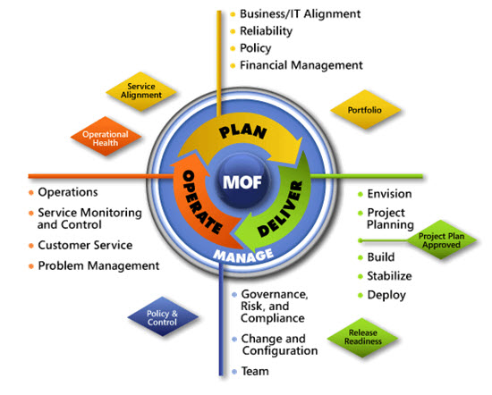
IPD in Microsoft Operations Framework 4.0
Use MOF with IPD guides to ensure that people and process considerations are addressed when changes to an organization’s IT services are being planned
Notes:
For more information about Microsoft Operations Framework 4.0, go to www.microsoft.com/mof.

