Slide 1

Getting Started With OpenStack

Slide 2
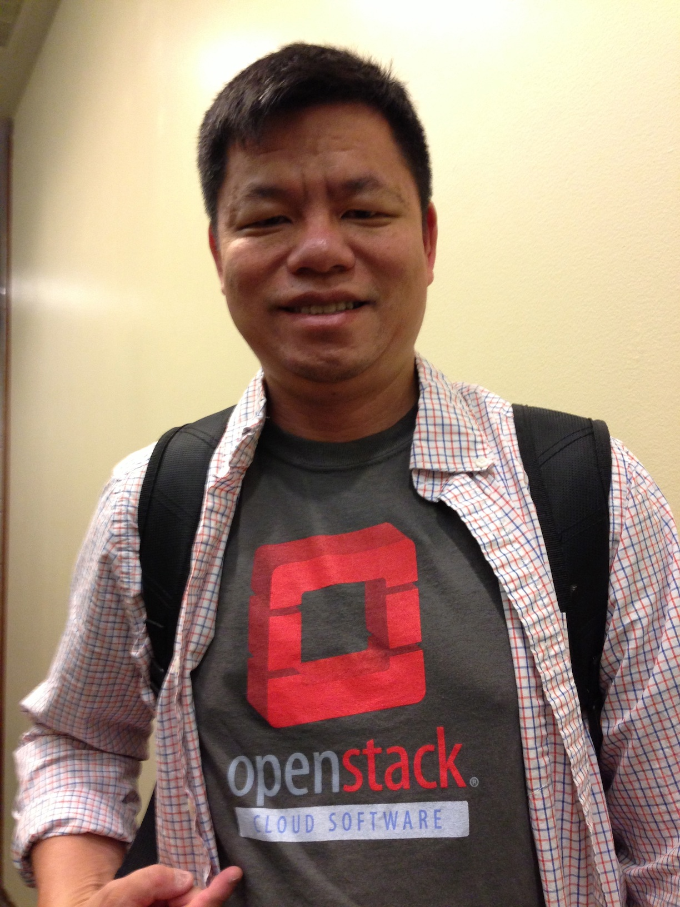

Presenters
Kenneth Hui
Technology Evangelist
Rackspace
Twitter: @hui_kenneth
Dan Radez
Sr. Software Engineer
Red Hat
IRC: radez

Slide 3
The Story of OpenStack

Slide 4
The E-mail That Started It All

Slide 5
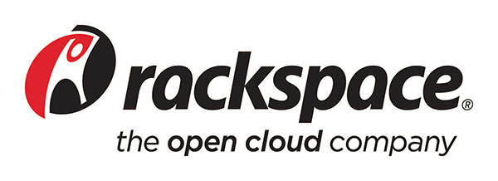
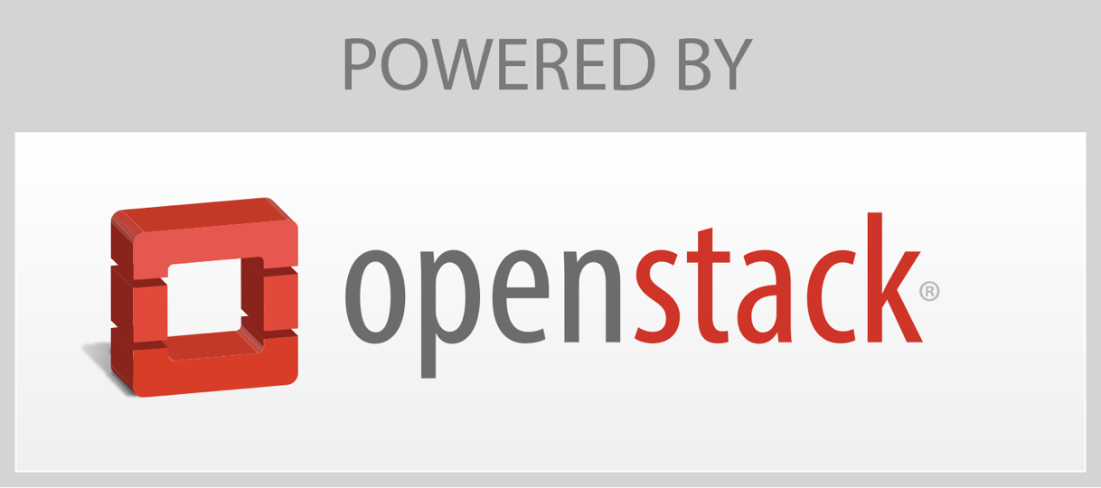

The Birth of OpenStack

Slide 6
COMPANIES
COUNTRIES
135
338
INDIVIDUAL MEMBERS
TOP 10 COUNTRIES
United States, China, India,
Great Britain, France, Russia, Australia, Canada, Japan, Germany
15,672
TOTAL DEVELOPERS
AVERAGE MONTHLY
CONTRIBUTORS
CODE CONTRIBUTIONS
2130
374
115,206

Slide 7
What is OpenStack?

Slide 8
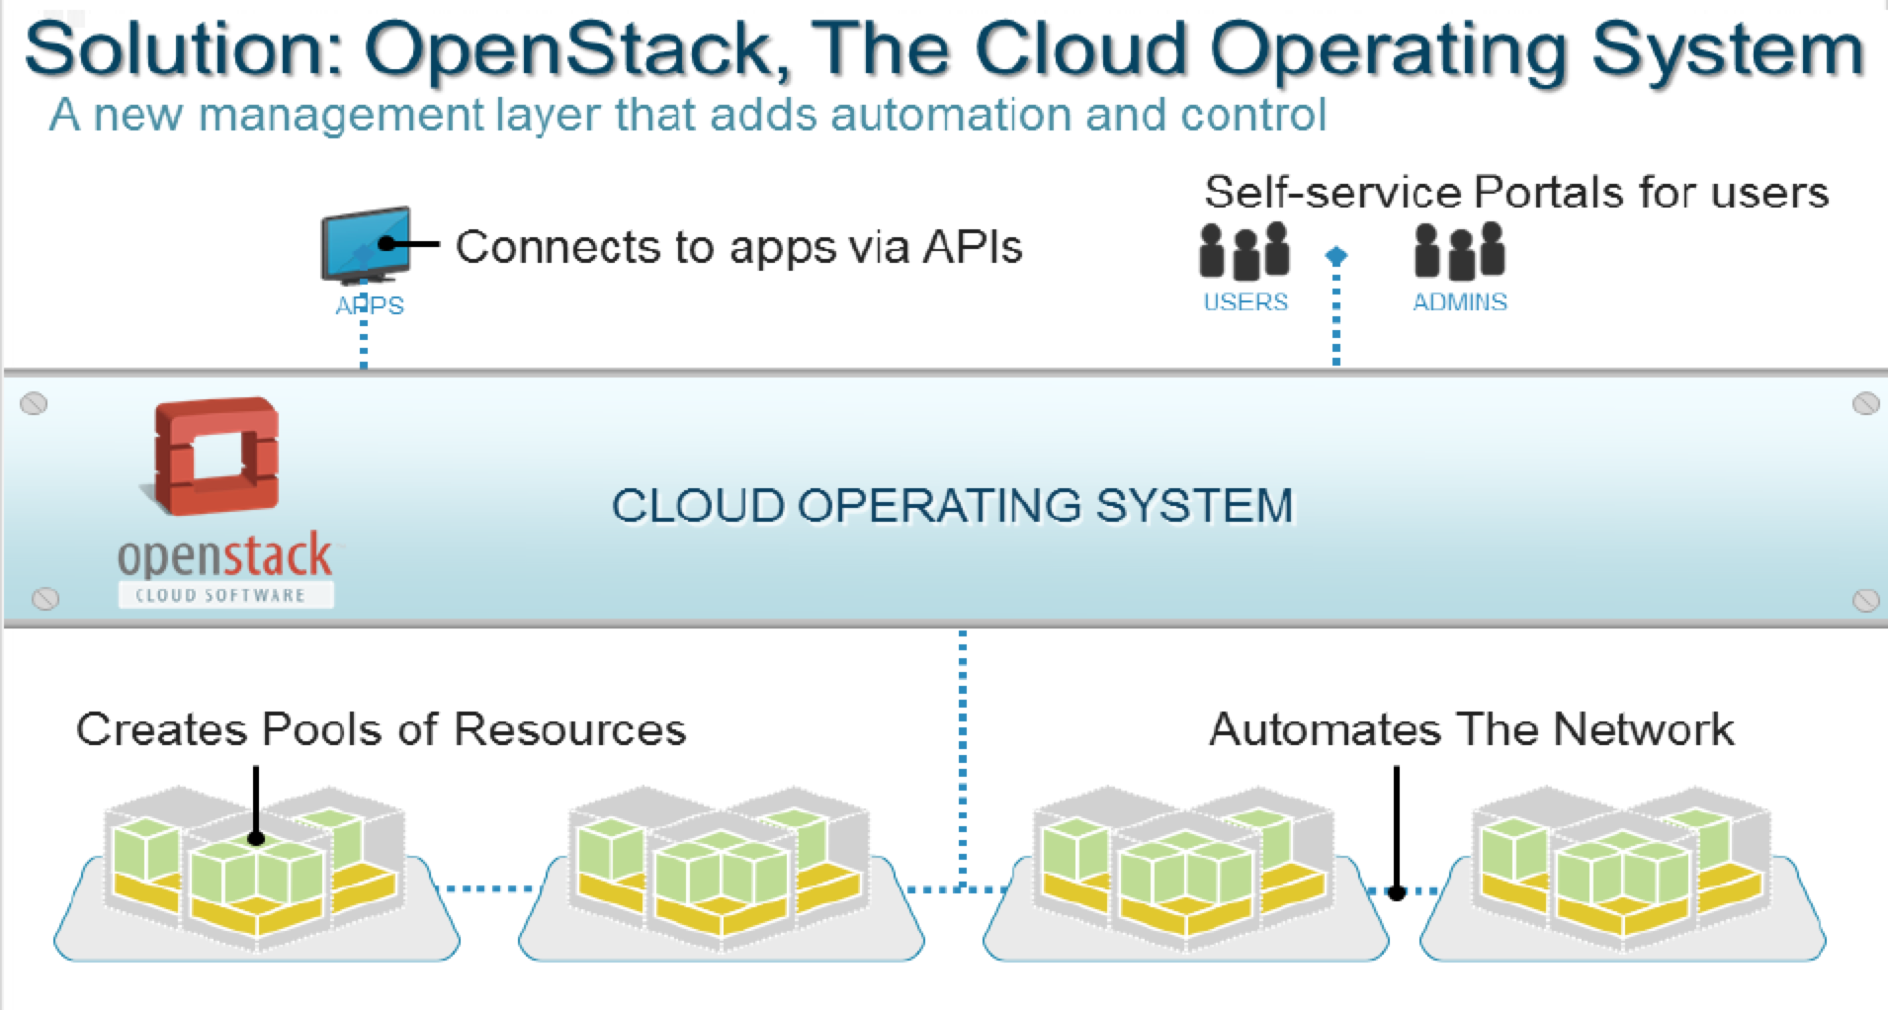
Automation and Orchestration of IT Resources
Notes:
A Cloud Computing platform sits above the virtual data center and provides both a control plane over and resource access to the virtualized data center. OpenStack, as a Cloud Computing platform, manages virtualized resources, such as virtual machines exported by a hypervisor, network overlays created by Software-Defined Network devices, and volumes exported by virtual storage arrays. OpenStack takes these data center resources and automates and orchestrates them so they can be accessed on demand and be scaled up and down as needed, turning these resources into consumable services.

Slide 9
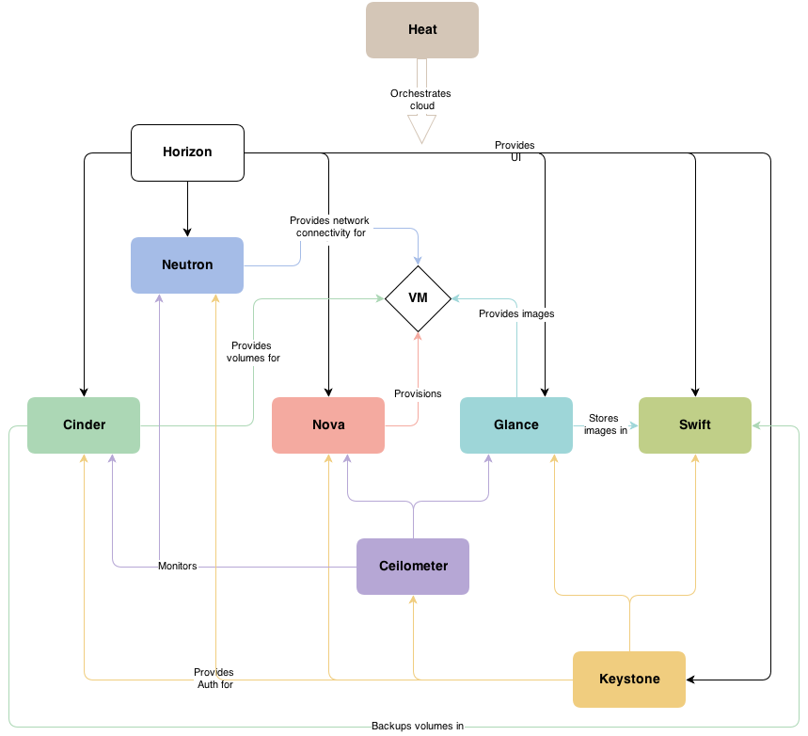
In a Loosely Coupled Architecture

Slide 10


To Deliver Self-Service IT Rapidly and At Scale

Slide 11
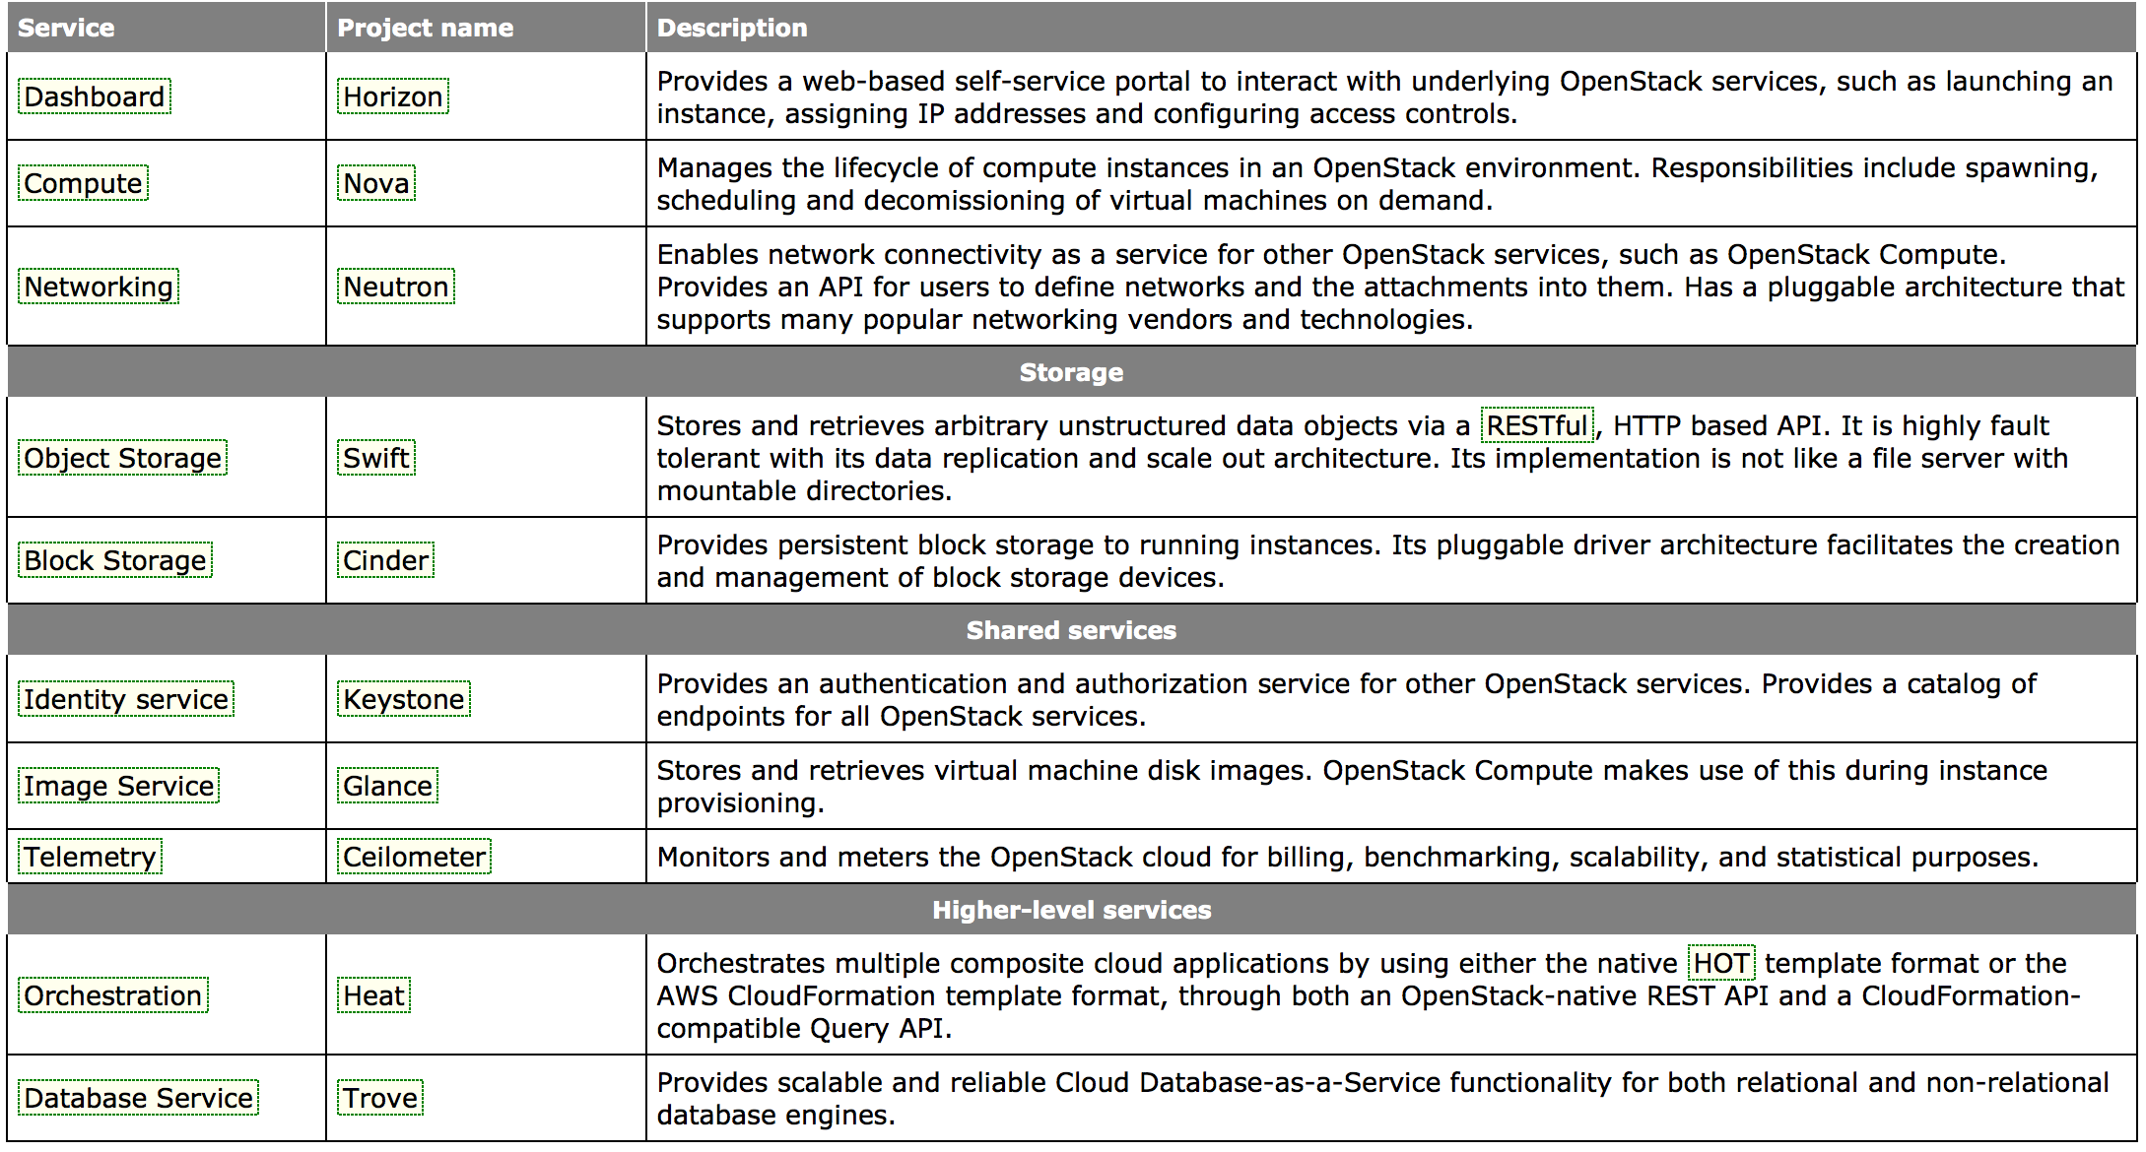
By Leveraging Various Open Source Projects
Notes:
The OpenStack platform is actually composed of multiple components, called projects. Each project is managed by a technical committee and the OpenStack Foundation decides which projects are ready to be included in the OpenStack core. These projects work together to provide the services required to deliver the Cloud.
Nova – The compute project responsible for on-demand creation and termination of compute instances. Nova leverage a number of hypervisors, including KVM, Xen, Hyper-V, and vSphere.
Glance – The OS image management project responsible for storage and management of images used to create compute instances with OSes installed, such as Windows and Linux.
Quantum – The network project that provides network access and security services to compute instances. Quantum uses plugins to leverage virtual switches and SDN-enabled devices.
Swift – The object storage project that provides a scalable repository for storing large quantities of objects such as files and media content. It can also be used as an repository for Glance images.
Cinder – The block storage project that provides a virtual storage array that can export out iSCSI volumes. A Cinder/virtual storage array server can be a server with local storage or a server using an external storage array.
Horizon – The interactive dashboard project that provides users and admins provisioning and management access to the OpenStack Cloud via a web GUI.
Keystone – The identity management project that provides authorization and access security control for all the other OpenStack projects.
New projects are being added with each release and as the OpenStack community calls for them. New projects underway include metering, application orchestration, and database-as-a-service.

Slide 12
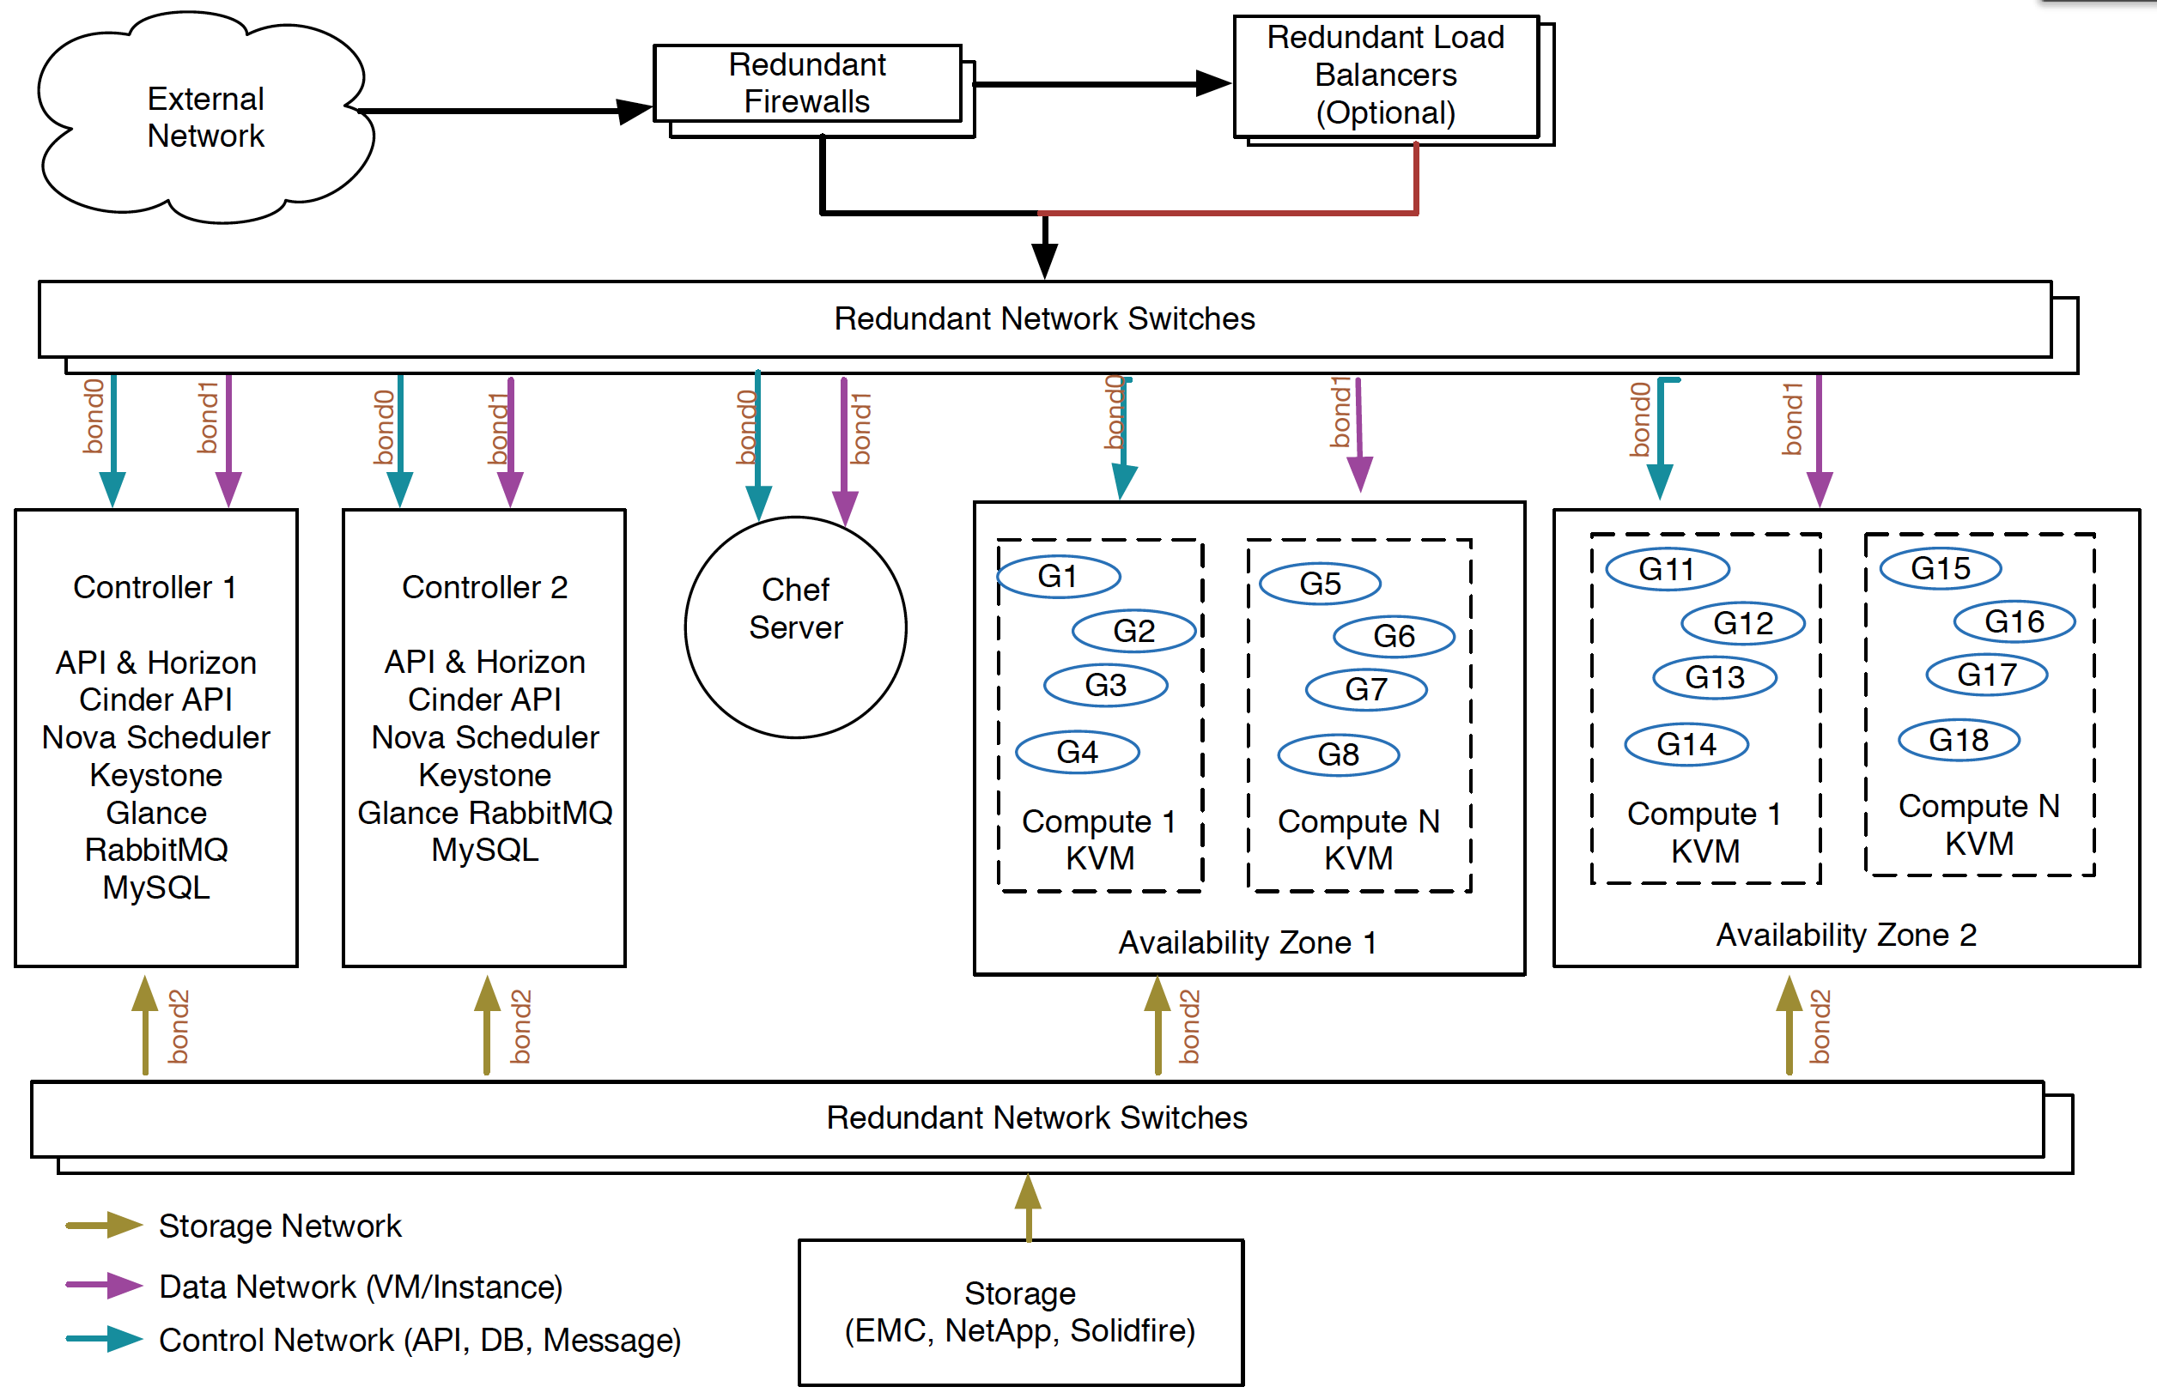
Rackspace Private Cloud Reference Architecture

Slide 13
Learning OpenStack

Slide 14
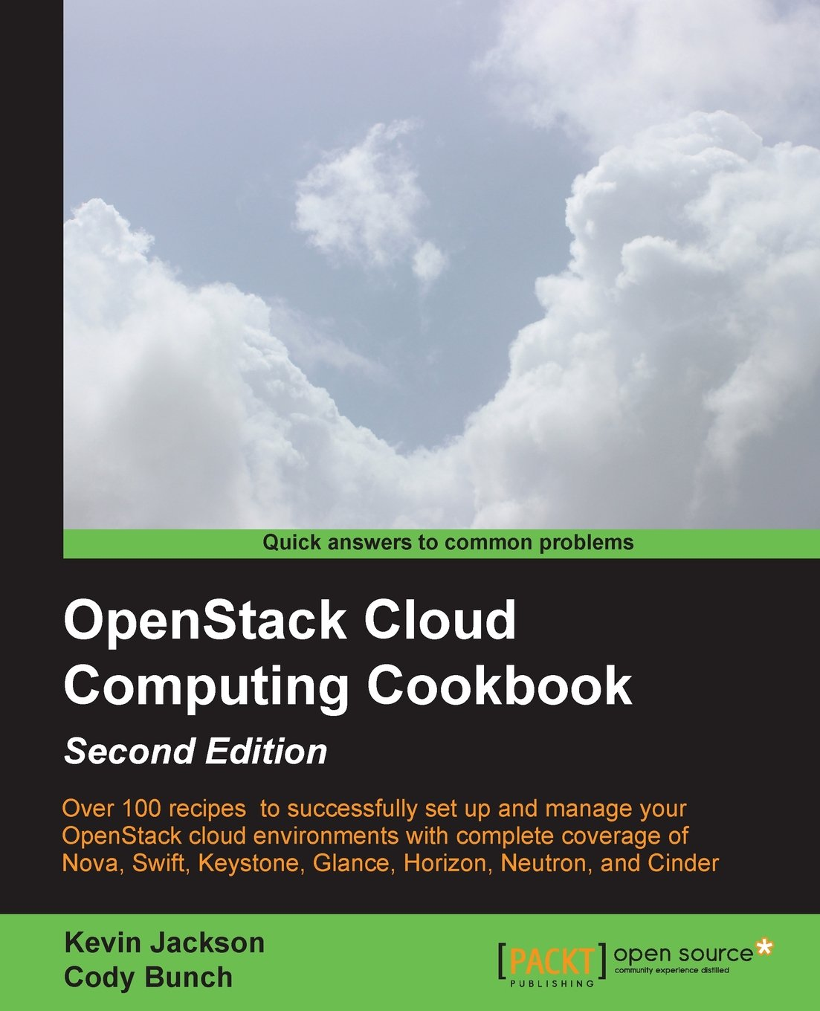
Reading About OpenStack
The OpenStack Foundation
    http://www.openstack.org/
Official OpenStack Documentation
    http://docs.openstack.org/
The OpenStack Cloud Computing Cookbook (Second Edition)
  http://www.amazon.com/OpenStack-Cloud-Computing-Cookbook-Jackson/dp/1782167587/ref=sr_1_1?s=books&ie=UTF8&qid=1382033707&sr=1-1

Slide 15
Trying Out OpenStack
TryStack (OpenStack Sandbox)
    http://trystack.org/
OpenStack-based Public Clouds
DreamHost
    http://dreamhost.com/cloud/
HP Public Cloud
    https://www.hpcloud.com/
Rackspace Public Cloud
    http://www.rackspace.com/cloud/

Slide 16
Deploying OpenStack
      OpenStack Distributions
        Red Hat - http://openstack.redhat.com/
        SUSE - https://www.suse.com/products/suse-cloud/
        Ubuntu - http://www.ubuntu.com/cloud
      Packaged Deploys For Different Linux Distros
        Mirantis - https://fuel.mirantis.com/
        Piston Cloud Computing - http://www.pistoncloud.com/openstack-cloud-software/
        Rackspace - http://www.rackspace.com/cloud/private/openstack_software/
      Configuration Management Tools
        Opscode Chef - https://github.com/opscode/openstack-chef-repo/
        Puppet Labs Puppet -http://puppetlabs.com/solutions/cloud-automation/compute/openstack

