Slide 1

Advanced Threat Protection with F5 and FireEye
Arshad Mea| Security Sales Manager F5 Networks
Gary Fisk, CISSP | Solutions Architect FireEye

Slide 2
Welcome
Security Trends from the Front Lines
F5 SSL Security Architecture
Advanced Threat Protection - FireEye
Conclusion

Slide 3


Notes:
Mandiant, a FireEye company, provides an annual report called M-Trends Report.
In last years M-Trends report we noted that cyber security had gone from a niche IT issue to a boardroom priority. This year, cyber security (or perhaps more accurately, cyber insecurity) entered the mainstream.
Mandiant consultants’ role as the first responders to critical security incidents gives us a unique vantage point into how attackers’ motives and tactics are changing.

Slide 4
M-TRENDS: INTERNAL DETECTION VS EXTERNAL NOTIFICATION
47% of organizations detected the breach on their own
Internal Discovery
47%
This percentage is growing from the previous year, where 31% of victims discovered the breach on their own.
Source Data: M-TRENDS 2016

Slide 5
M-TRENDS: INTERNAL DETECTION VS EXTERNAL NOTIFICATION
5

Slide 6
The typical incident
saw attackers present
for 4+ months
The longest time we detected attackers had been present in the victim’s environment was 2,982 days (over 8 years).
M-TRENDS 2016: MEDIAN DAYS BEFORE DISCOVERY
Notes:
Organizations made some gains, but attackers still had a free reign in breached environments far too long before being detected—a median of 146 days in 2015 vs. 205 days in 2014.
Taken together, these developments paint a threat landscape that is more complex than ever. The ability of security teams to prevent, detect, analyze, and respond to threat actors has never been harder—or more crucial.

Slide 7
The typical incident
saw attackers present
for 4+ months
The longest time we detected attackers had been present in the victim’s environment was 2,982 days (over 8 years).
M-TRENDS 2016: MEDIAN DAYS BEFORE DISCOVERY

Slide 8
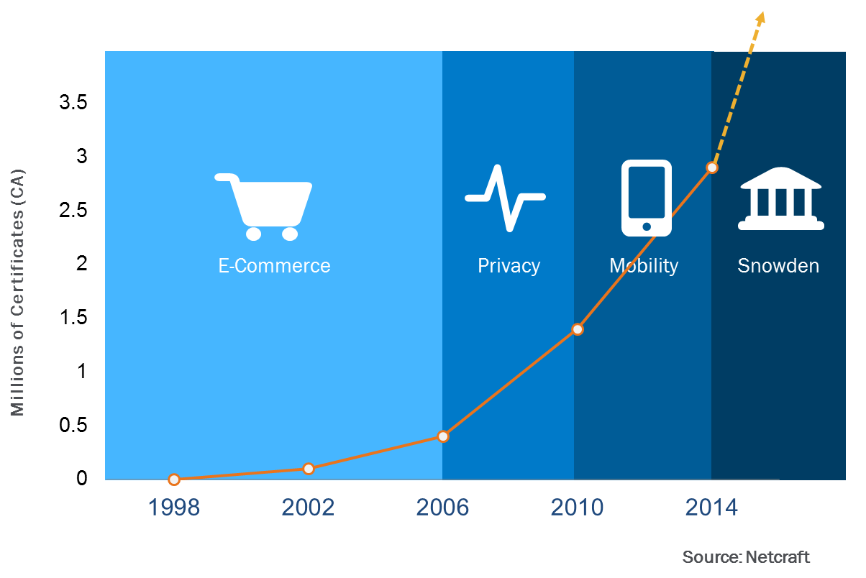
Industry Trends Driving Encrypted Traffic
An increasing share of network traffic is being encrypted
Insider threat (Snowden)
Increased customer awareness (PFS, Heartbleed)
New regulatory and compliance requirements
Evolving cryptography and new standards
Everything is connected (IoT)
    encrypted Traffic
DRIVING CHANGE
30
%
Annual Growth¹
today
2017
25%
50%
¹Netcraft

Slide 9

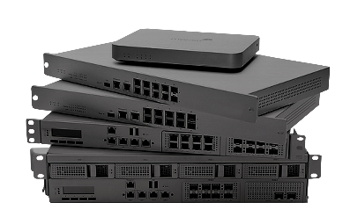





The SSL Security Challenge
Network Security Cannot Inspect Encrypted Traffic
Inbound Exploits and Malware Outbound Callbacks
Designed to Prevent ‘Man-in-the-Middle’ Interception
Encrypted Callbacks Are More Prevalent
Firewall
IPS
Exploits
Malware
https://
DLP
MVX
Callbacks
Malware Families with SSL Callbacks
Regulatory Compliance & Privacy Policies
Dyre
Shylock
KINS
Dridex
Gootkit
24+ others

Slide 10
SSL Everywhere – F5 SSL Intercept
Notes:
F5 has a comprehensive architecture to enable security

Slide 11

Applications are driving innovation and massive growth in data…
100%
4M
Total data volume doubles every
2 years
508
Apps worldwide, vs. 20,000
in 1995
3.2B
Average number
of apps per
enterprise
people can access apps via
internet
…but also creating an exponential increase in the attack surface.
Sources: Forbes, Nielsen, IDC, EMC, Statista

Slide 12
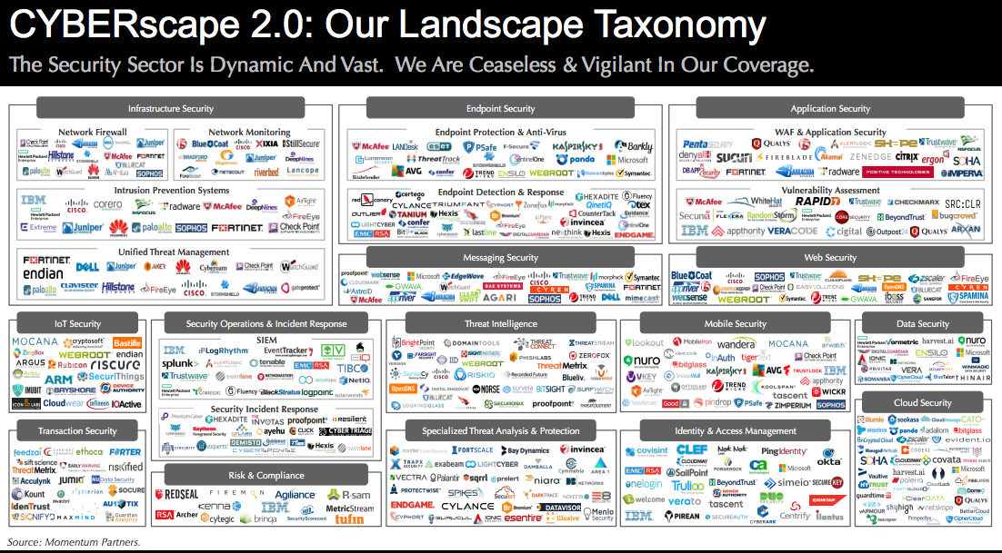

Slide 13
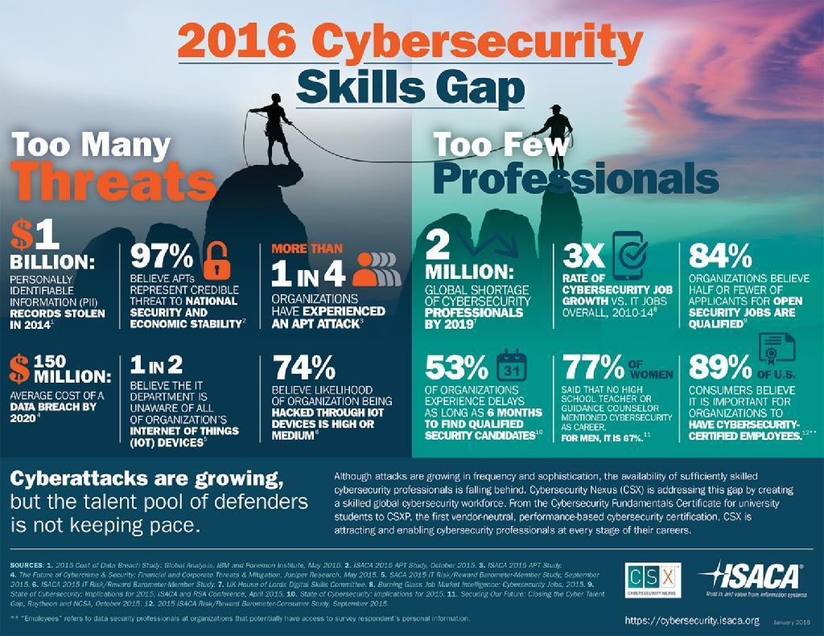
Shortage of supply to the increase in Demand

Slide 14



Current and Traditional Security investments are completely misaligned with reality
Perimeter Security
Identity & Application Security
25%
90%
72%
10%
of attacks are
focused here
of security
investment
of attacks are
focused here
of security
investment

Slide 15
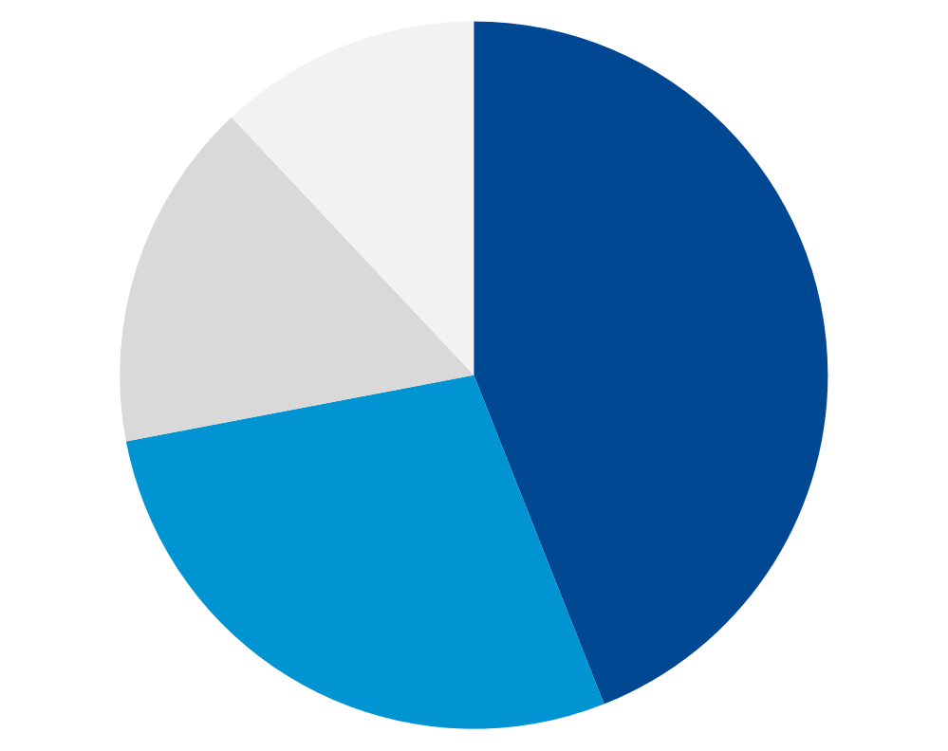

…resulting in an unprecedented increase in attacks
Source of data breaches
12%
Other
1.2B
Compromised records since 2014
$15M
Average cost of an attack
46
16%
Human Element
44%
Vulnerable
Apps
Average days to resolve an
attack
514M
$210M
28%
Compromised
Identities
Personal Profiles
Stolen
Credit Card
Fraud in
2015
Sources: Gartner, IT Business Edge, Krebson Security, Identity Theft Resource Center, CSO Online

Slide 16
Internet Trends and Challenges
SSL growth is not stopping
Impacts ability to identify behaviors or recognize exfiltration across all ports
80% performance degradation with SSL on NGFWs
New SSL protocols and ciphers can break aging security products
Organizations do not want move their certs to unknown platforms

Slide 17
Questions
Are you forced to "pass through" more and more encrypted traffic inbound and outbound? “Pass through” traffic can hide encrypted attacks avoiding detection. Current trends will continue to drive more encrypted traffic. Nearly a quarter of encrypted apps don’t use standards ports.
Is your outbound content filtering solution not able to scale with the increase in encrypted traffic? Scaling each individual security services can be difficult and costly without a scalable architecture. With legacy technology customers are forced to rip and replace with forklift upgrades
Are you decrypting and re-encrypting at multiple points in the security service chain, inducing more latency and installing certificates & keys in more places? Discuss “Select" use of defense in depth through service chaining (service chaining within the air gap) allows for greater efficiencies in both spec’ing out the scale of new security solution and in selectively utilizing 3rd party solutions when appropriate and based on policy

Slide 18
Why F5 - 2 Key Points
1. MOST Customer Network Architectures are not intercepting/inspecting encrypted traffic
- Not Built for TLS/SSL Encryption
- Customers agree on trend to 100% TLS/SSL
- HTTP 2 prefers TLS
-One large benefit of HTTP/2 is the ability to use a single TCP connection from a browser to a website.
2. New Architecture: BIG IP “out in Front” for SSL Visibility
- Why F5 is UNIQUELY qualified for this
- Growing attacks masked by encryption

Slide 19




Typical Architecture – built for little/no Encryption
0%
SSL
100%
TLS
R
R
Zero Visibility
-------
Key Mgmt Nightmare
443
FW
IPS
Pass
Thru
FW
IPS
LB
LB
SSL
Apps
Apps
Servers
Servers

Slide 20

New Architecture for SSL/TLS Visibility
Scale-Out
IPS
FW
Inspection Zones:
100% Visibility
“AIR GAP”
(Separate/Secure Network)
R
SSL/TLS
Decryption
Re-encryption
DLP
BIG-IP
FEYE
WAF
SVR

Slide 21

Why BIG-IP in Front?
Security Services with Visibility
- Firewalls: Network, WAF, DNS, DDoS
- Access Control, SSO, SAML, SSL VPN
- Forward Proxy, Web Filtering
- Anti-BOT (IPI), Anti-Fraud (Websafe)
- IPS, FireEye, DLP, etc. (external)
F5 Silverline
DDoS, WAF
iRules
TCP
LTM
TCP
SSL
SSL
TLS
TLS
1K Keys
Weak Ciphers
(SSL V3)
Servers
2K or 4K Keys
Strong Ciphers
(TLS 1x)
TMOS
FPGA
CAVIUM
DDoS Vectors in Hardware
#1 Performance/Scale
- Sessions, Connections
- Unmatched anywhere
Cipher Diversity
- HW implementation
- F5 developed drivers/ciphers
- Bulk Throughput

Slide 22
SSL/TLS Basics and why F5 is the BEST out in front
- Reduces more point products in the daisy chain
- Uses existing infrastructure smarter- i.e Investment Optimization
    - Rightsize your Firewall
    - Scale out IPS or other services
Be careful with the outbound Air Gap use case
  - Great new features in v12
- Client negotiates the Cipher so…
- Broad Cipher Diversity is Required (ideally in Hardware)
- OR software Ciphers are a new attack (DDoS) vector
- F5 writes our own drivers for our crypto cards
- F5 builds our own SSL/TLS stack (NetScaler does not)
- NetScaler and all Firewalls have LIMITED Cipher support
- SSL V3 is not secure – remove or minimize it

Slide 23
F5 SSL Interception Solution
Purpose built, all-in-one SSL Interception appliances
Provides security solutions with visibility into SSL/TLS encrypted traffic
Key Features
  SSL visibility at high performance
  Policy based service chaining of security solutions
  Load balancing of SSL traffic flows across security devices
  Centralized and simplified management of certificates, encryption keys
  Selective decrypt / encrypt of specific traffic flows
  Flexibility of deployment
Internet
Firewall
Re-encrypt
DLP (Pool)
Web Gateway (Pool)
IPS (Pool)
Decrypt and steer (based on policy, bypass options, URL categorization
F5 SSL Intercept
AV
(Pool)
NGFW (Pool)
Firewall
Users / Devices
User

Slide 24
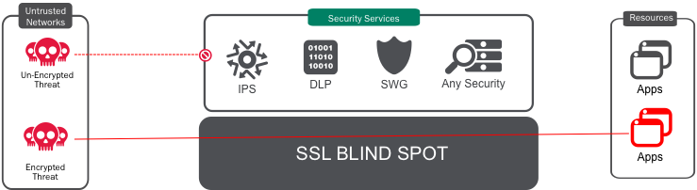
F5 – FireEye Value Proposition
In 2016, the Internet will reach an inflection point where more than half the traffic is encrypted. Typical network architectures are built for little or no encryption. A security service chain simply consists of a set of security services, such as firewalls or IPS that are intelligently connected through the BIG-IP to provided SSL visibility and to help with scalability and uptime.
Customer Scenarios
Desired Solution Capabilities
Use SSL Intercept for visibility and scale into SSL traffic with FireEye for APT threats.
Find hidden threats with SSL Visibility
Scale security services with defense-in-depth and scale-out for growth
Single point of control across security solutions for greater efficiencies
Bypass URL dynamically and statically
Dynamically detect SSL on any port

Slide 25




Solution Overview
Visibility and Control
Perimeter Services
Inspection Services
Application Services
Resources
SSL Decryption
+ Traffic Steering
SSL Visibility
SSL Encryption
+ Load Balancing
Legitimate
Users
Apps
Malicious Attackers
BIG-IP System
BIG-IP System
Scale SSL across multiple security devices that are either blind or challenged with SSL performance to defend against encrypted threats
Policy Enforcement
Security Services
Scale-Out
for Growth
IPS
DLP
SWG
Any Security
Defense-in-Depth

Slide 26
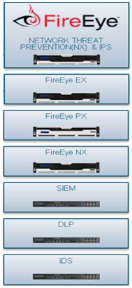

F5 and FireEye Enterprise Distributed Deployment Strategy
Gain visibility across the Enterprise
Big-IP
SSL Visibility
Load balancing
Firewall
Visibility across the Enterprise
LTM: Local Traffic Manager
AFM: Advanced Firewall Manager (Network Firewall)

Slide 27
Big-IP SSL Visibility To FireEye NX
FireEye NX Pool
Client-Side Secure Data Exchange
Unencrypted
Server-Side Secure Data Exchange
This deployment mode employs two BIG-IP creating a decryption zone in between for Inspection (Sandwich Architecture)
Ingress BIG-IP (BIG-IP 1) to decrypt the HTTPS traffic from the Client
Egress BIG-IP (BIG-IP 2) to re-encrypt the HTTPS traffic to Web Server
OUTBOUND Request
Client HTTPS traffic to server is decrypted by Ingress Big-IP and is passed through the Inline FireEye NX to inspect and uncover any threats.
Egress Big-IP aggregates and re-encrypts the client decrypted HTTPS traffic after it exits the FireEye before sending it to the server
INBOUND Response
Server HTTPS traffic to client is decrypted by Server-side Big-IP and state fully passed through the FireEye NX for Inspection.
The Client side Big-IP re-encrypts this traffic back to Client

Slide 28
FireEye Advanced Threat Protection

Slide 29





FireEye Adaptive Defense
TECHNOLOGY
Identifies known, unknown, and non-malware based threats
Integrated to protect across all major attack vectors
Patented virtual machine technology
INTELLIGENCE
Discovered 22 of the last 40 zero-days
Line intel from incident response
Millions of network and endpoint sensors
Hundreds of intel and malware experts
Hundreds of threat actor profiles
EXPERTISE
“Go-to” responders for security incidents
Hundreds of consultants and analysts
Unmatched experience with advanced attackers

Slide 30
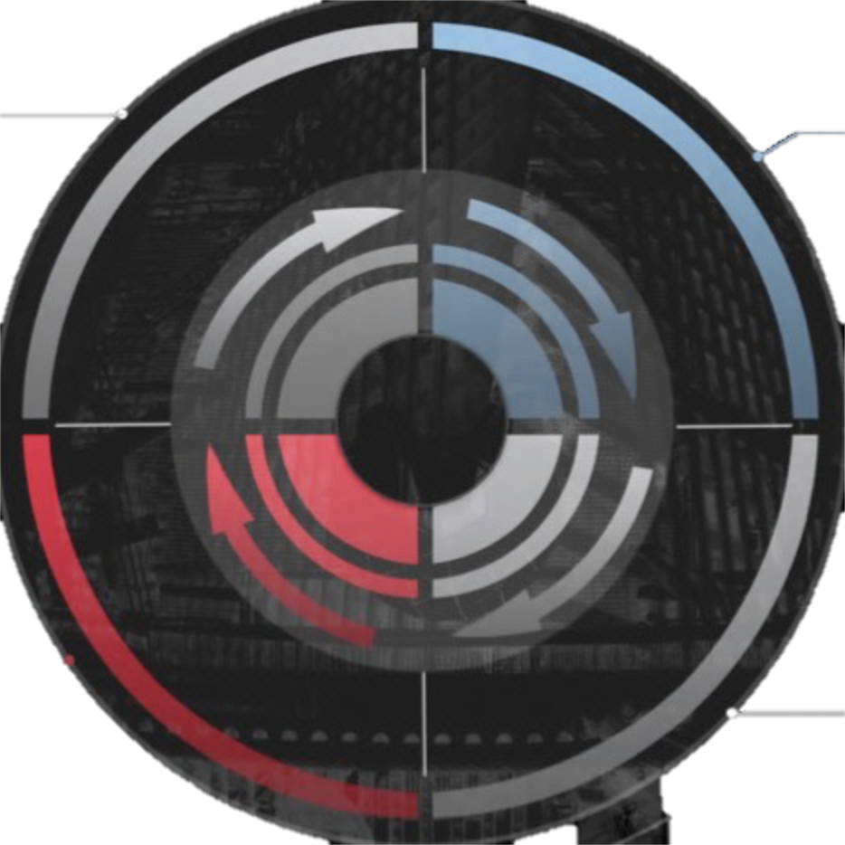
FireEye Continuous Threat Prevention Process
RESPOND ANALYSE
DETECT PREVENT
Signature-less and multi-flow virtual machine-based approach that leverages superior threat intelligence
Multi-vector inline known
and unknown threat prevention
Remediation support and threat intelligence to recover and improve risk posture
Containment, forensics investigation and kill chain reconstruction

Slide 31





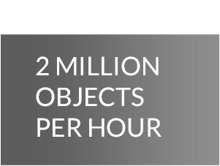




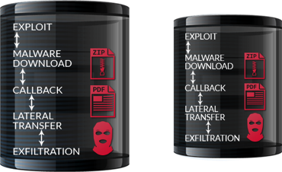
Detection And Prevention – Technology
Within VMs
Across VMs
Cross Enterprise

Slide 32











FireEye Platform: Magic of MVX
1
FireEye Hardened Hypervisor
2
Multi-modal Virtual Execution
3
Threat Protection at Scale
Custom hypervisor with built-in countermeasures
Designed for threat analysis
Multiple operating systems
Multiple service packs
Multiple applications
Multiple file-types
Over 2000 simultaneous executions
Multi-stage analysis
DTI Enterprise
DTI Cloud
Nearly 200 execution environments
Multi-modal Virtual Execution
Control Plane
v1
v2
v3
v1
v2
v3
Over 10 micro-tasks
FireEye Hardened Hypervisor
MVX
Core
Hardware

Slide 33





FireEye Intelligence — A Global Defense Community
DYNAMIC
THREAT
INTELLIGENCE
REAL-TIME
INFORMATION SHARING
RISK AND CONTEXT
TO PRIORITIZE RESPONSE
TACTICAL AND STRATEGIC INTELLIGENCE WITH ATTRIBUTION
THAT IS APPLICABLE AND ACTIONABLE TO YOUR ORGANIZATION
4,000 CUSTOMERS IN 67 COUNTRIES
10M+ VIRTUAL MACHINES
5M+ ENDPOINTS
Notes:
In addition to the MVX engine, we’ve also enabled our products with something that we call DTI, or Dynamic Threat Intelligence. And what does that do? Well, we’re interconnecting the appliances in a customer’s environment with each other. And we’re also interconnecting them with FireEye. You can enable one-way sharing, which ensures FireEye will send intelligence updates to your MVX appliances. But you can also enable two-way sharing which allows us to move some of that intelligence around the FireEye global defense community. And protect not only you, but the entire FireEye universe. And as we’re continuing to evolve the intelligence offering, we’re now going to be able to do things like give you more context about an attack. We don’t want to tell you just, “hey, I got attacked”. We want to say “Here’s who it is. Here’s the risk, and here’s how active that threat is.” That’s the power of being part of a global defense community. And with our thousands of customers and millions of virtual machines you know we can give you access to a defense community that’s, frankly, more effective than anyone else’s.

Slide 34
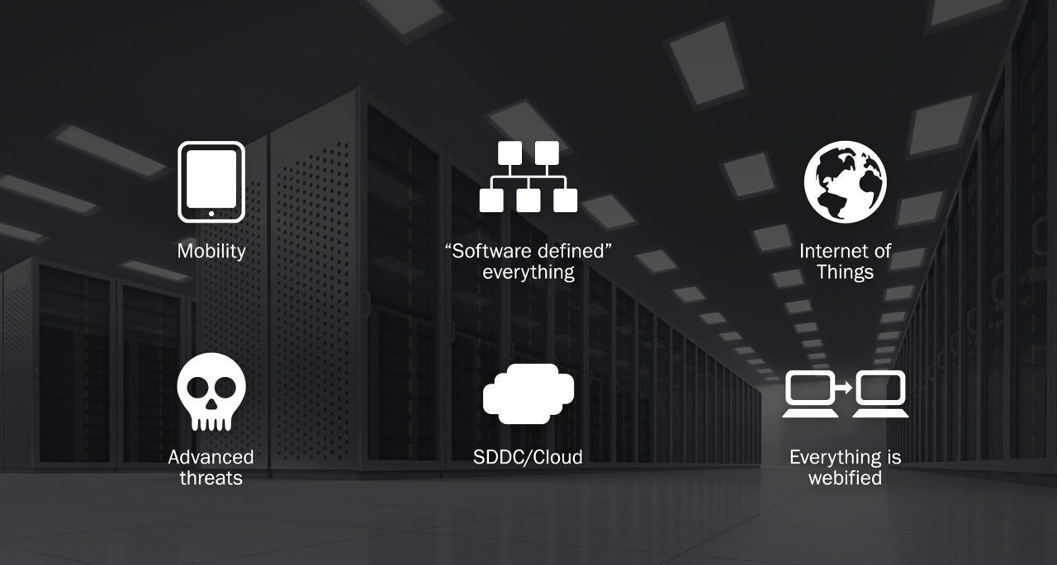
Technology trends create opportunity and complexity
Notes:
And the global IT trends that can provide revenue opportunities only add to the complexity – even refrigerators and thermostats are connected.
This means that applications have become more sophisticated and require more services to make them always available, perform faster, and stay secure.
<click>

Slide 35

Advanced Threat Protection
with F5 and FireEye
Scale FireEye
for demanding
environments
Failover protection
for service availability
Find hidden threats
in encrypted traffic
Protect keys
for data privacy
Lowest TCO
and quickest ROI
All backed by world-class support and professional services

