Slide 1

Configure Azure AD Connect like the Pros

Slide 2
Agenda
Overview
Setting up Azure AD Connect
High Availability
Advanced Configurations
PowerShell Management
Troubleshooting

Slide 3
Assumptions
Familiarity with Azure Active Directory and/or Office 365
Familiarity with Active Directory (2003+)
Familiarity with basic PowerShell usage

Slide 4
Overview

Slide 5
Azure AD & Office 365 Identity Timeline
2013
Password Hash Sync added to AAD Sync
2015
2009
DirSync introduced for identity synchronization
2012
DirSync becomes Azure AD Sync
Azure AD Sync becomes Azure AD Connect
Introduces Health engine
2017
msDS-ConsistencyGuid as source anchor
Pass Through Authentication introduced
Seamless SSO introduced

Slide 6
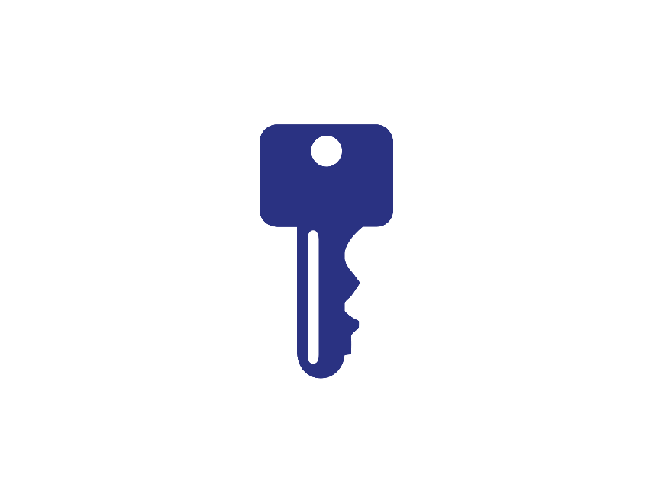
Azure AD Authentication Methods Today
Cloud Only Identity
Password Hash Synchronization
Pass-through Authentication
Federated (ADFS)
3rd Party Federated
Identities exist only in AAD
Identities synced to AAD
Identities synced to AAD
Identities synced to AAD
Authentication handled by AAD
Authentication handled by local AD
Authentication handled by local AD
Authentication handled by third-party
Identities synced to AAD
Authentication handled by AAD

Slide 7
Azure AD Authentication Methods Today
Password Hash Synchronization
Pass-through Authentication
Federated (ADFS)
Identities synced to AAD
Identities synced to AAD
Authentication handled by local AD
Authentication handled by local AD
Identities synced to AAD
Authentication handled by AAD
Notes:
All actively developed

Slide 8
Azure AD Authentication Methods Today
Password Hash Synchronization
Pass-through Authentication
Federated (ADFS)
Identities synced to AAD
Identities synced to AAD
Authentication handled by local AD
Authentication handled by local AD
Identities synced to AAD
Authentication handled by AAD
Identity Synchronization through Azure AD Connect

Slide 9

What is Azure Active Directory Connect?
Application installed on a Windows Server within your environment
Integrates local Active Directory with Azure Active Directory
Sync engine based off of Microsoft Identity Manager
Uses a local SQL server for sync database (can be separate SQL server)
Includes a monitoring component: Azure AD Connect Health
Free for all Azure AD customers

Slide 10


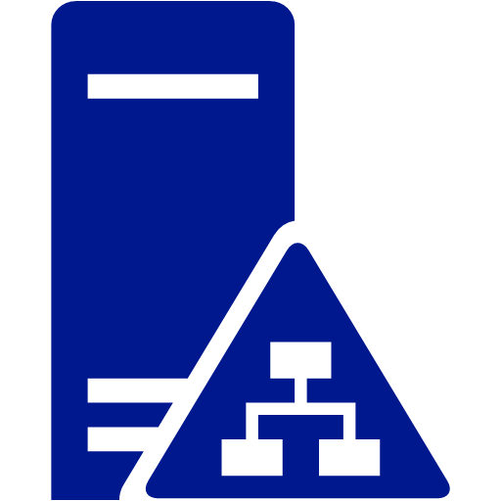
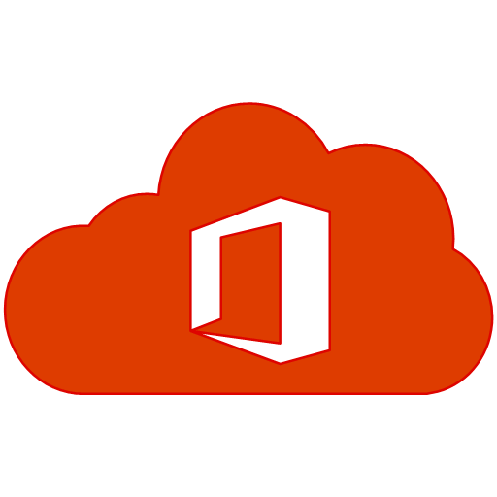



Azure Active Directory Connect Functionality
On-premises
Identity
Bridge
Azure AD Connect
Salesforce
Box
DropBox
Google
…
AD FS (optional)
Sync engine
AD DS
Health
Office 365
Your apps

Slide 11
Identity + Password (Hash) synchronization
Microsoft Azure
Active Directory
Identity + Password Hash synchronization
Azure Active Directory
authenticates user
On-
premises
Notes:
How does it work
Used to be every 30 minutes (custom). The new default synchronization frequency is 30 minutes. Can use scheduler.
Active directory can also synchronize a password hash. It will add additional hashes (every 2 minutes).
This is so that we don’t need to go back to your on-premises AD for passwords
In this model, you manage the user identity in an on-premises server and synchronize the accounts and, optionally, passwords to the cloud. The user enters the same password on-premises as he or she does in the cloud, and at sign-in, the password is verified by Azure AD. This model uses a directory synchronization tool to synchronize the on-premises identity to Office 365.
To configure the synchronized identity model, you have to have an on-premises directory to synchronize from, and you need to install a directory synchronization tool. You'll run a few consistency checks on your on-premises directory before you sync the accounts.
Advantages:
All services can use these passwords
All in sync

Slide 12

Pass-through Authentication through AADC
Overview
ON PREMISES
Microsoft Azure
Active Directory
agent
Active Directory
agent
Cloud-based authentication
Secure and compliant
Easy to administer
Same passwords for cloud-based and on-premises apps
Integrated with Smart Lockout, Identity Protection and Conditional Access
Passwords remain on-premises
        No DMZ and no inbound firewall requirements
        Agent-based deployment, can install on existing servers
        High availability out-of-the-box
        No complex on-premises deployments or network config

Slide 13
Pass-through authentication: Flow
Identity synchronization + Pass-through authentication with Seamless SSO
Azure AD completes sign-in
10
2
Microsoft Azure
Active Directory
4
Credentials encrypted and queued
Session sent to Azure AD for sign-in
3
User provides credentials
PTA picks up queued request
Identity synchronization using Azure AD Connect
Attempt to sign in to app
If sign-in is successful, access the app
5
1
11
ON-PREMISES
9
PTA responds to Azure AD
PTA decrypts uses private key to decrypt credentials
6
Azure AD completes sign-in
8
App
7
PTA validates credentials with Active Directory
Active Directory
Pass-through authentication
agent
(PTA agents can also be deployed in Azure)

Slide 14
Seamless Single Sign-on through AADC
Overview
ON PREMISES
Microsoft Azure
Active Directory
Active Directory
Easy to integrate
Easy to administer
Great user experience
Works with both Password Hash Synchronization and Pass-through Authentication
Supports Alternate Login ID
No additional on-premises infrastructure
Register non-Windows 10 devices without AD FS
        Single sign-on experience for cloud apps from Active Directory domain-joined devices within your corpnet

Slide 15

Seamless Single Sign-on through AADC
How seamless SSO works with Pass-through authentication and Password hash synchronization
Microsoft Azure
Active Directory
Office 365, SaaS, and LoB apps
Identity synchronization and managed authentication using Azure AD Connect
User signs in from Active Directory domain-joined PC or Mac
CONTOSO CORPNET
Azure AD does Kerberos Authentication against Windows Server Active Directory
Active Directory
Domain-joined

Slide 16
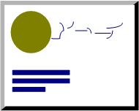

Federation at what cost?
Intranet
AD FS farm
Perimeter network
Web Application Proxy farm
Firewall &
Load Balancer
Firewall &
Load Balancer
Active Directory
Internet
Configuration
database

Slide 17
Feature summary | PTA + sSSO | PHS + sSSO | ADFS
Authentication against credentials held on-premises | Yes | No | Yes
Single-Sign-On | Yes | Yes | Yes
Passwords remain on premises | Yes | Salted hash synced | Yes
On-premises MFA solution | No | No | Yes
Azure AD MFA | Yes | Yes | Yes
On-premises password policies | Yes | Partial | Yes
On-premises account enable/disable | Yes | Delayed (30 mins) | Yes
On-premises password lockout | Yes | No | Yes
Conditional access | Yes++ | Yes++ | Yes
Credentials captured from user via Azure AD UI | Yes | Yes | No
Protection against on-premise account lockout | Smart Lockout | N/A | Extranet Lockout
Cost of implementation | Medium | Low | High
Scalability/fault tolerance | Cloud scalability | Cloud scalability | Complex
AuthN fails for remote workers if the on-premises Internet connection is down. Requires HA solution. | Yes | No | Yes
On-going maintenance for authentication | Automated | None | SSL certificate management
Azure AD Connect Health monitoring | Not integrated | Limited | Yes
Azure AD Identity Protection (requires P2 license) | Yes | Yes | No

Slide 18
Azure AD Connect

Slide 19
Prerequisites for Azure AD Connect
Verified domain in Azure AD
  Global Admin account (for installation only)
On premises Active Directory
  Schema version and forest functional level of at least Server 2003
  At least Server 2008 R2 if using password writeback
  Writeable domain controller (non RODC) accessible from the Azure AD Connect instance
  Enterprise Admin account (for installation only)

Slide 20
Prerequisites for Azure AD Connect (cont.)
Azure AD Connect Server
  Windows Server 2008 or later (not server core) with latest hotfixes
    Server 2008 R2 SP1 required for password synchronization
  .Net Framework 4.5.1 or later and PowerShell 3.0
  Must be able to connect to and resolve DNS for both local AD and internet
  Does not need to be domain joined
  1.6 GHz CPU (2 cores recommended)
  Memory 4GB+ depending on objects in AD
  Hard Drive 70 GB+ depending on objects in AD

Slide 21
Additional Recommendations
Local Active Directory
  Make sure that the domain used in Azure AD is available as UPN suffix within local AD
  Enable Active Directory Recycling Bin (easily recover from mistakes)
Azure AD Connect Server
  Install Azure AD PowerShell Commandlets (v2 recommended)
  Use a virtual machine if possible to allow for snapshots and easy recovery
  Allocate 8 GB memory and 100 GB hard drive if possible
  Consider hosting in Azure for higher availability

Slide 22


Basic Configuration Demo
FM-DC1
fritzium.com
FM-AADC1
Azure AD
fritzium.com

Slide 23
High Availability & Disaster Recovery

Slide 24
High Availability
Technically, there is no such thing as HA with Azure AD Connect
Only one Azure AD Connect instance can sync with an Azure AD tenant at a time
What can be done: Setup a second Azure AD Connect server in “Staging Mode”
  Staging mode prevents exports to local AD and Azure AD
  Server will need to be manually taken out of Staging Mode when failover is desired
    Make sure not to let both servers run in non-staging mode at the same time to avoid conflicts

Slide 25
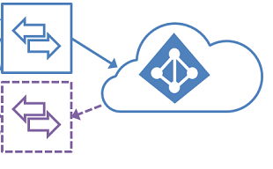
Staging Server Configuration
FM-AADC1
Azure AD
fritzium.com
FM-DC1
fritzium.com
Azure AD
fritzium.com
FM-AADC2

Slide 26
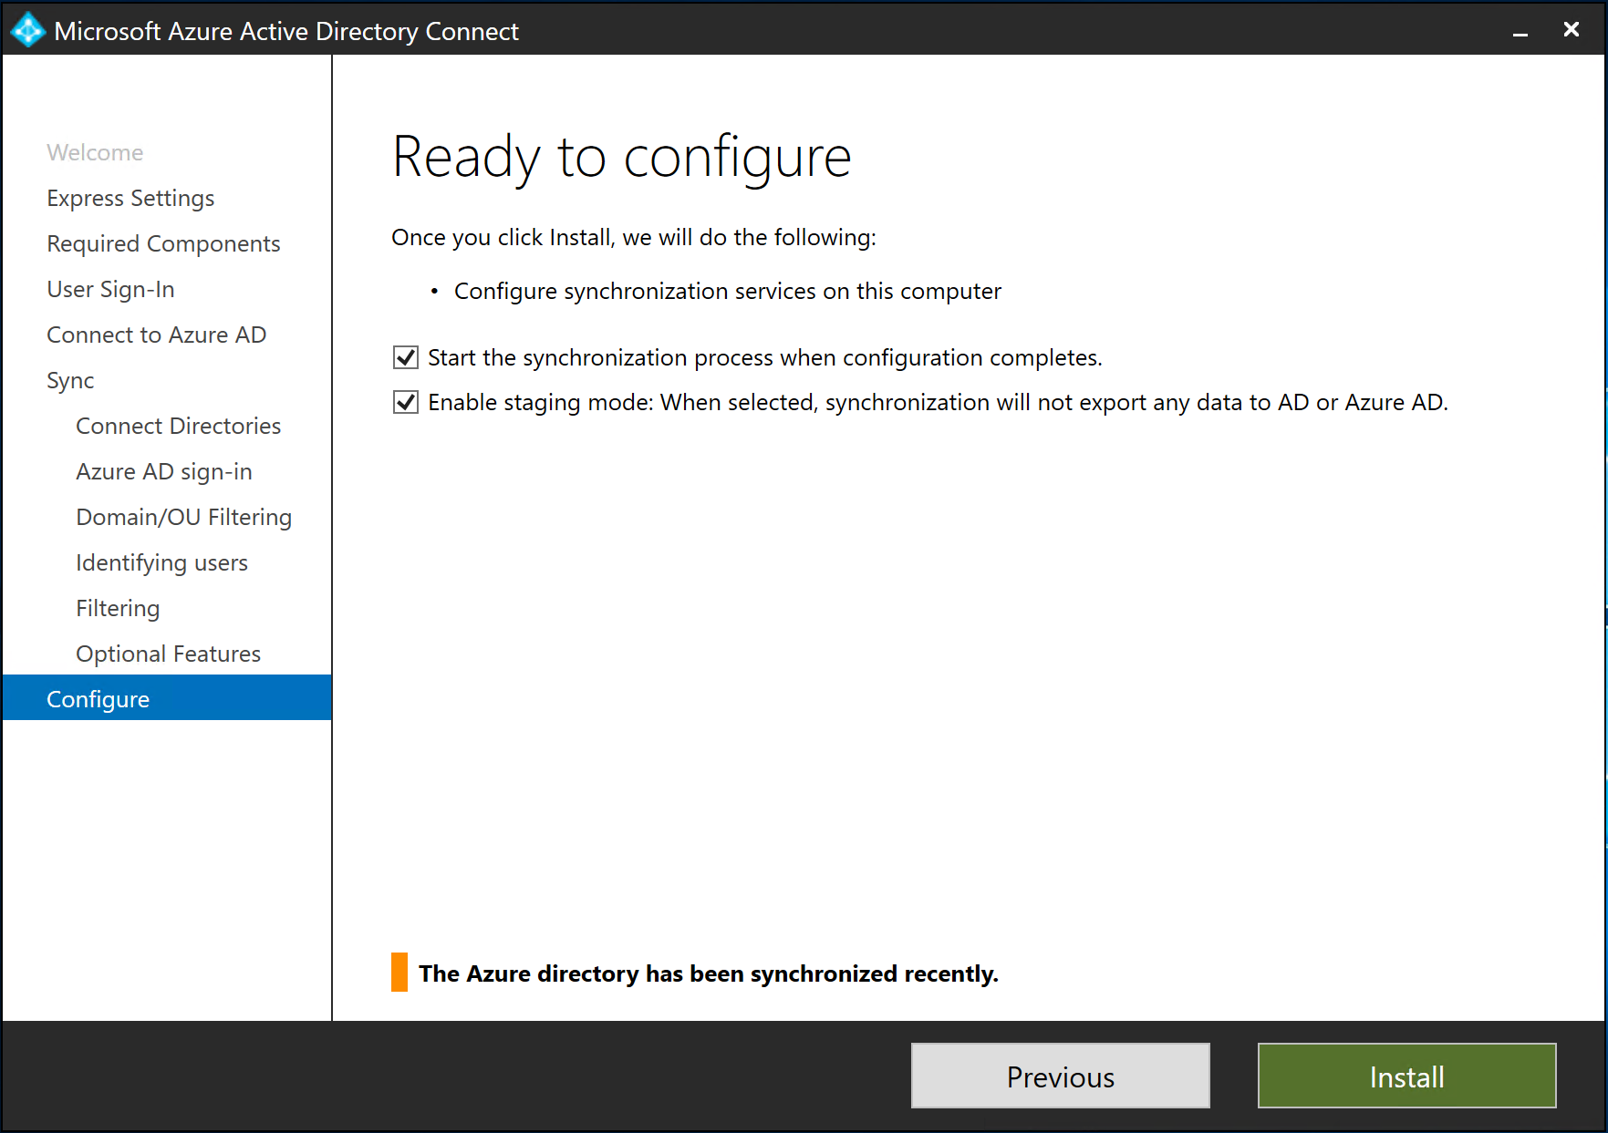
Staging Server Configuration
Make sure to setup with identical settings and configuration
One exception: Enable staging mode

Slide 27
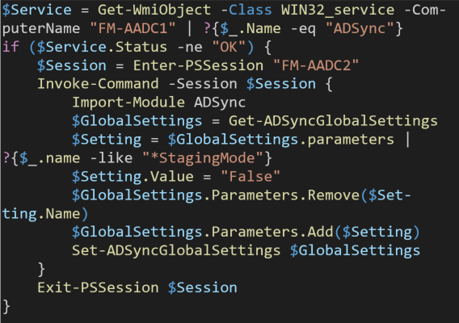
Failover Script
Setup as a scheduled task on a separate server, or in Azure Automation
Run on a frequent basis to check in on the primary Azure AD Connect server
If services aren’t running, take secondary Azure AD Connect out of staging mode

Slide 28
Multiple Forests

Slide 29
Multiple AD Forests
Multiple Active Directory Forests can sync with a single Azure AD Tenant using one Azure AD Connect server
Requirements
  Azure AD Connect server must be able to contact each forest (does not need to be domain joined)
  Users should be represented once across each forest
    If identical users are in each forest, Azure AD connect will pick one (not configurable) to use
    You can setup methods in Azure AD connect to better identify users in this scenario

Slide 30

Multiple Forests Demo
FM-DC1
fritzium.com
FM-AADC1
Azure AD
fritzium.com
Azure AD
fritzium.com
techonthefritz.com
MF-DC1
maxafritz.local
FM-AADC2

Slide 31
Multiple Tenants

Slide 32
Multiple Azure AD Tenants
A single Active Directory forest can sync with multiple Azure AD tenants by using multiple Azure AD Connect Servers
Users in AD can be synced to both tenants if desired
Sync rules and/or OU filtering need to be customized to make this work

Slide 33

PowerShell

Slide 34
Azure AD Connect PowerShell
PowerShell Module: ADSync
Many aspects of the synchronization can be managed through PowerShell
The only way to change many defaults
Best way to perform manual syncs (outside of schedule) and full syncs

Slide 35
Common PowerShell Tasks
Task | Command
Start delta sync | Start-ADSyncSyncCycle –PolicyType Delta
Start full sync | Start-ADSyncSyncCycle –PolicyType Initial
Disable default deletion threshold (500) | Disable-ADSyncExportDeletionThreshold
Enable/change deletion threshold | Enable-ADSyncExportDeletionThreshold -ObjectDeletionThreshold <Integer>
View/Change Synchronization Schedule | Get-ADSyncScheduler / Set-ADSyncScheduler
View/Change Auto Upgrade Settings | Get-ADSyncAutoUpgrade / Set-ADSyncAutoUpgrade
View detailed configuration settings | (Get-ADSyncGlobalSettings).parameters

Slide 36

Troubleshooting

Slide 37
Azure AD Connect Troubleshooting
Common steps in almost any scenario:
  Reboot the host server
  Perform a full sync
Common issues:
Clocks out of Sync
Synchronization Service will not start on server
  GPO could be overriding Log on as a service
  Password of service account could have changed
Passwords are not synchronizing
  Turn password sync on and off in the configuration settings
  Ensure proper connectivity between local server and domain controller
  Trigger manual password sync

Slide 38
Object Synchronization Issues
Synchronization Service Status Codes:
Status | Comment
stopped-* | The run could not complete. For example, if the remote system is down and cannot be contacted.
stopped-error-limit | There are more than 5,000 errors. The run was automatically stopped due to the large number of errors.
completed-*-errors | The run completed, but there are errors (fewer than 5,000) that should be investigated.
completed-*-warnings | The run completed, but some data is not in the expected state. If you have errors, then this message is usually only a symptom. Until you have addressed errors, you should not investigate warnings.
success | No issues.

Slide 39
Windows 10 and AD users
Hybrid Azure AD Join
  AD Domain Join with automatic Azure AD registration
  All the benefits of Group Policy / SCCM / Intune
When users sign-in to their device they get a
  Kerberos token for on-premises AD and Primary Refresh Token (PRT) for Azure AD access
Single sign on to all Azure AD authenticated resources
  No requirement to have access to a DC
Conditional access policies can be based on the users device
Windows Hello for Business can be used for authentication

