Slide 1
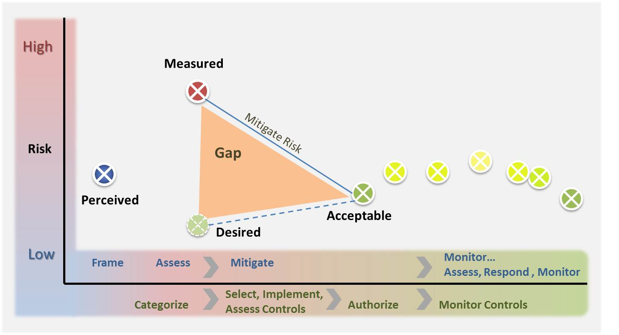
Gap Analysis
FITSP-M
Module 4
Notes:
1

Slide 2
Leadership
“…For operational plans development, the combination of threats, vulnerabilities, and impacts must be evaluated in order to identify important trends and decide where effort should be applied to eliminate or reduce threat capabilities; eliminate or reduce vulnerabilities; and assess, coordinate, and deconflict all cyberspace operations…”
The National Strategy for Cyberspace Operations
Office of the Chairman, Joint Chiefs Of Staff, U.S. Department Of Defense

Slide 3
FITSP-M Exam Objectives
Data Security
  Supervise controls that facilitate the necessary levels of confidentiality of information found within the organization’s information system
  Manage safeguards in the system that facilitate the necessary levels of integrity of information found within information systems
  Govern controls that facilitate the necessary levels of availability of information and information systems
[Security Control] Planning
  Direct security plans for organizational information systems that describe the security controls in place or planned for the information systems and the rules of behavior for individuals accessing the information systems
  Supervise processes to handle the implementation of security plans for organizational information systems that describe the security controls in place or planned for the information systems and the rules of behavior for individuals accessing the information systems

Slide 4
Gap Analysis
Module Overview
Section A: Security Categorization
  FIPS 199: Security Categorization Standards
  SP 800-60: Mapping Types to Categories
  Subsection A.1: Categorizing Privacy Information
    SP 800-122 Protecting PII
Section B: Documentation – System Security Plan
Section C: Security Control Baseline
  Subsection C1 – FIPS 200: Minimum Security Requirements
  Subsection C2 – SP 800-53: The Fundamentals
  Subsection C3 – Selecting Controls from 800-53
  Subsection C4 – Implementing Controls

Slide 5
Security Categorization
Section A

Slide 6
RMF Step 1
Categorize Information System
Security Categorization
Information System Description
Information System Registration

Slide 7
FIPS 199 – Feb. 2004
Federal Information Processing Standards
First step in Security Authorization Process
Security Standards for Categorization of Federal Information & Systems
Requires Solid Inventory of All Systems on Your Networks
Mandated by FISMA
Security Categories Based on Potential Impact

Slide 8
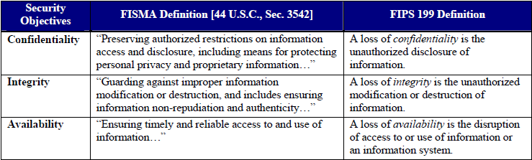
Security Objectives under FISMA

Slide 9
Levels of Potential Impact
Impact on organizations, operations, assets, or individuals
Low - Limited adverse effect
Moderate - Serious adverse effect
High - Severe or catastrophic adverse effect
Effectiveness reduced
Minor damage/loss/harm
Financial loss
Harm to individuals
Loss of life, mission capability

Slide 10
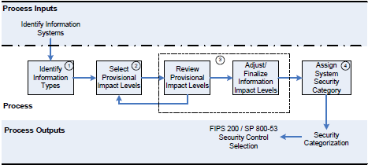
Assignment of Impact Levels and Security Categorization

Slide 11
Knowledge Check
Name the 3 tasks of the RMF Categorization step.
Security categories are to be used in conjunction with what other information in assessing the risk to an organization?
What is the first step to assigning impact levels for security categorization?
What are the key words associated with the following impact levels:
Impact | Key Word(s)
Low
Moderate
High

Slide 12
1 - Identifying
Information Types
OMB’s Business Reference Model
  Basis for Identifying Information types
  Four Business Areas/ 39 Lines of Business
Mission Based Information Types
  Service for Citizens (Purpose of Gov’t)
  Mode of Delivery (to Achieve Purpose)
Management & Support Information Types
  Support Delivery of Services (Necessary Operational Support)
  Management of Government Resources (Resource Management Functions)

Slide 13
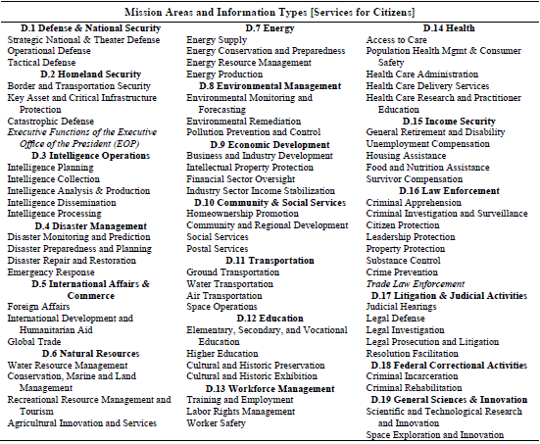

Slide 14
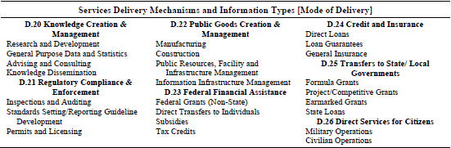

Slide 15
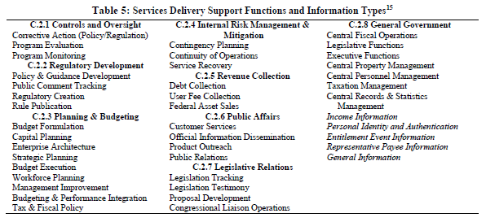
day-to-day activities necessary to provide the critical policy, programmatic, and managerial foundation that support Federal government operations

Slide 16
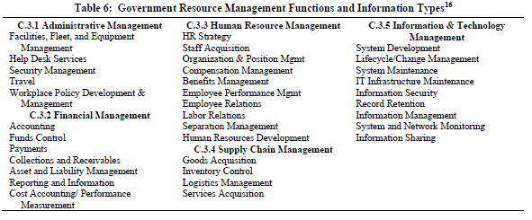
back office support activities enabling the Federal government to operate effectively

Slide 17
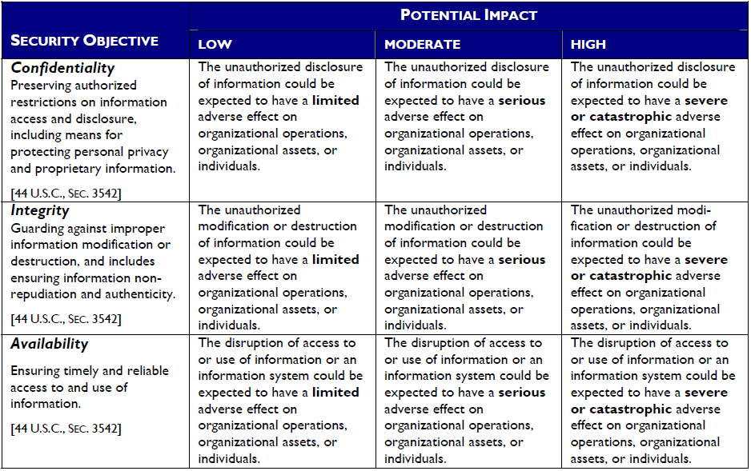
2 - Select Provisional
Impact Level

Slide 18
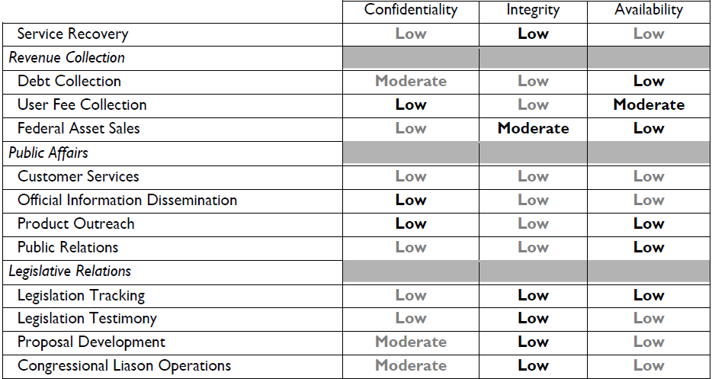
Information Types & Impact
Management & Support

Slide 19
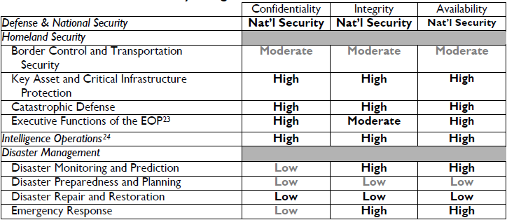
Information Types & Impact
Mission Specific

Slide 20
3 - Review Provisional Impact, Adjust/Finalize Impact Levels
Review
Adjust
(based on special guidance from 800-60)

Slide 21
Guidelines for Adjusting System Categorization
Aggregation
Critical System Functionality
Extenuating Circumstances
Public Information Integrity
Catastrophic Loss of System Availability
Large Supporting and Interconnecting Systems
Critical Infrastructures and Key Resources
Trade Secrets
Overall Information System Impact
Privacy Information

Slide 22
4 - Assign System
Security Category
Review for Aggregate Information Types
Identifying High Water Mark Based on Aggregate
Adjust High Water, as Necessary
Assign Overall Information System Impact Level
Document All Security Categorization Determinations and Decisions

Slide 23
Categorizing Privacy information
…privacy is more than security and includes, for example, the principles of transparency, notice, and choice.
Subsection A.1

Slide 24
Categorizing Privacy Information
New Guidance – SP800-122
  Organizations should identify all PII residing in their environment
  Organizations should minimize the use, collection, and retention of PII to what is strictly necessary to accomplish their business purpose and mission
  Organizations should categorize their PII by the PII confidentiality impact level
Each organization should decide which factors it will use for determining impact levels and then create and implement the appropriate policy, procedures, and controls.

Slide 25
Factors for Categorizing PII
Identifiability
Quantity of PII
Data Field Sensitivity
Context of Use
Obligations to Protect Confidentiality
Access to and Location of PII

Slide 26
Security Controls for PII
Creating Policies and Procedures
Conducting Training
De-Identifying PII
Using Access Enforcement
Implementing Access Control for Mobile Devices
Providing Transmission Confidentiality
Auditing Events

Slide 27
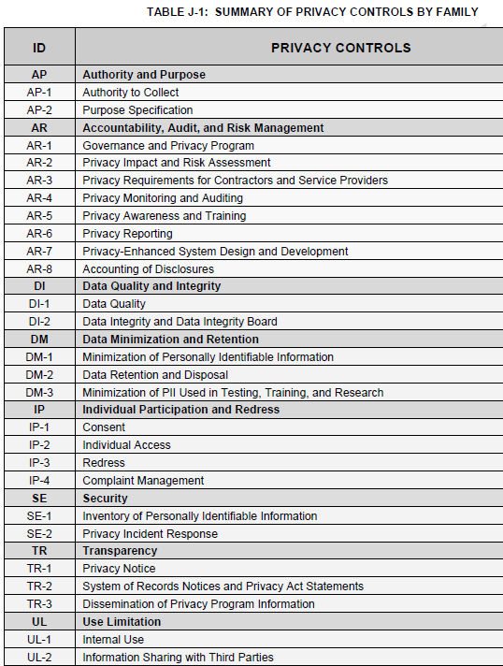

Slide 28
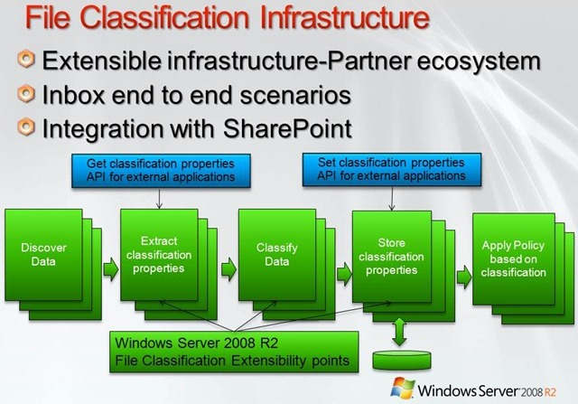
Windows Server 2008 R2

Slide 29
Knowledge Check
What is the basis for defining information types?
The BRM describes [how many] business areas containing [how many] FEA lines of business.
Which NIST document lists information types, and their associated provisional impact level?
List reasons for adjusting a system’s provisional impact level.
Which NIST Special Publication provides guidance for protecting PII.

Slide 30
Lab Activity 2 –
Categorizing Information Systems
Step 1 – Categorize Information System
Step 6 –
Monitor Controls
Step 2 –
Select Controls
Step 5 - Authorize Information System
Step 3 – Implement Controls
Step 4 –
Assess Controls

Slide 31
Logical Connection
External Network
Externally Owned System Boundaries
HGA System Boundaries
HGA’s Local Area Network – Washington, DC
Time & Attendance
Input Workstation
Financial Distribution Service Provider – Kansas City
Payroll Application
FW&A Web Portal
Financial Distribution Application
Fraud, Waste &
Abuse Reporting
Database
IRS
Tax Payments
Employee Payroll
Database
Various Banking Institutions for Employee Direct Deposits
Terremark Data Center – Culpeper, VA

Slide 32
Documentation
Section B

Slide 33
Documenting the Security Categorization Process
Categorization Determination
Research
Key Decisions
Approvals
Supporting Rationale

Slide 34
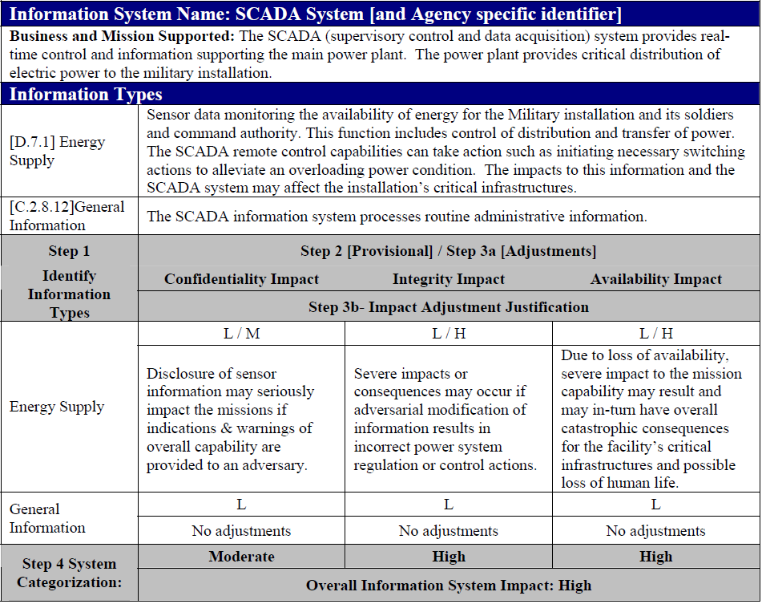

Slide 35
System Security Plan
System Name and Identifier
System Categorization
Rules of Behavior
System Boundary
Security Control Selection

Slide 36
SSP Reference Enhancements
Business Area
Legislative Mandates
Time-critical Information
Provisional Impact Review
Information Type Aggregate
Special Factors & Circumstances
Justification for Elevated Impact

Slide 37
Reuse of Categorization Information
Business Impact Analysis
Capital Planning and Investment Control
& Enterprise Architecture
System Design
Contingency and Disaster Recovery Planning
Information Sharing and System Interconnection Agreements

Slide 38
Security Control Baseline
Section C

Slide 39
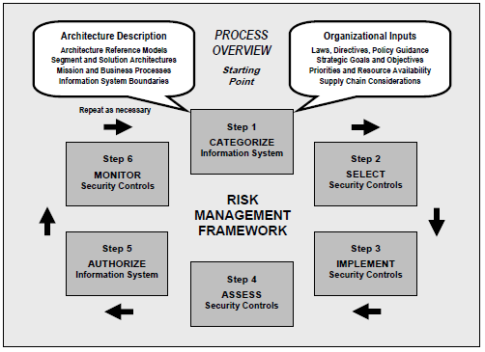
Role in the RMF Process

Slide 40
RMF STEP 2 & 3: Select & Implement Security Controls
RMF Step 2 – Select Controls
  Common Control Identification
  Security Control Selection
  Monitoring Strategy
  Security Plan Approval
RMF Step 3 – Implement Controls
  Security Control Implementation
  Security Control Documentation

Slide 41
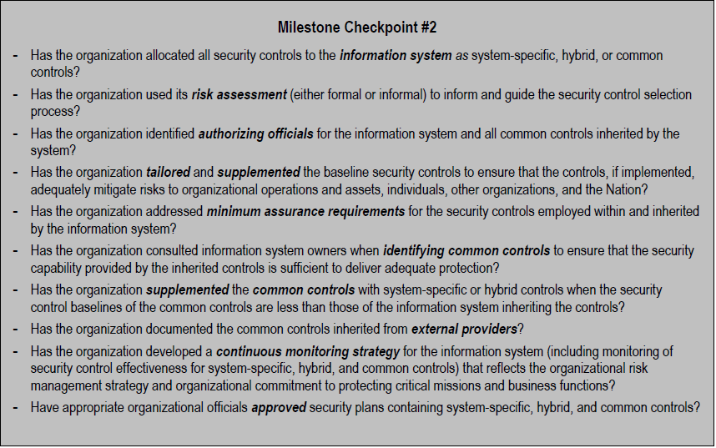

Slide 42
FIPS 200: Selecting Security Controls
Using SP 800-53
Achieve Adequate Security
Control Selection Based on FIP 199 Impact Level
  For low-impact information systems, organizations must employ appropriate controls from the low baseline of controls defined in NIST Special Publication 800-53.
  For moderate-impact information systems, …moderate baseline
  For high-impact information systems,
  …high baseline

Slide 43
Knowledge Check
What is the most significant change, regarding security control selection, in the revision of the SP 800-37?
What are the factors that drive the level of effort for the selection and implementation of security controls?
Security controls are organized by _________ and ___________.
Identify the class for the following security controls:
Control | Class
Access Control
Personnel Security
Planning

Slide 44
SP 800-53 fundamentals
Subsection C.2

Slide 45
SP 800-53r3 Control Catalog
The Fundamentals
  Security Control Organization and Structure
  Security Control Baselines
  Common Controls
  Security Controls In External Environments
  Security Control Assurance
  Revisions And Extensions
Selecting Security Controls
  Selecting
  Tailoring
  Supplementing

Slide 46
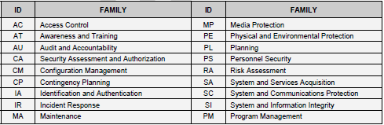
Security Control Organization and Structure

Slide 47
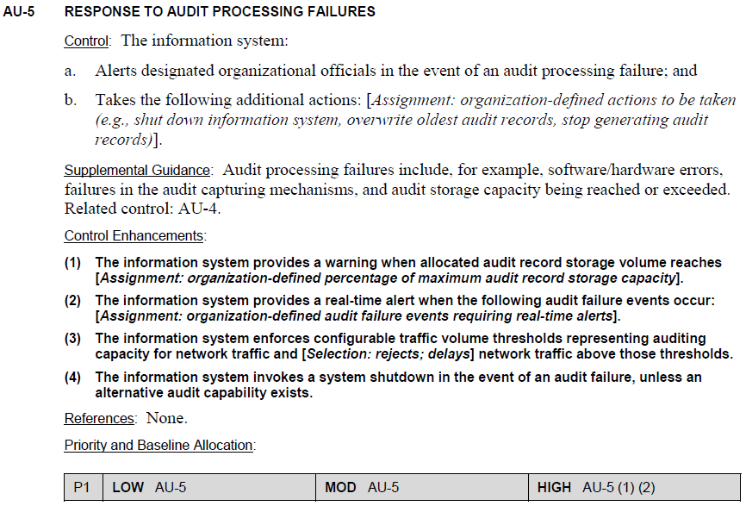

Slide 48
Security Control Baselines
Starting Point for the Security Control Selection Process
Three Sets of Baseline Controls Based on Information Impact
  Low
  Moderate
  High
Supplements to the Tailored Baseline will Likely be Necessary

Slide 49
Common Controls
Inheritable
Organization-wide Exercise
Common Control Candidates
  Contingency Planning
  Incident Response
  Security Training And Awareness
  Personnel Security
  Physical And Environmental Protection
  Intrusion Detection
System-specific Controls
Hybrid Controls

Slide 50

Security Controls In External Environments
Used by, but Not Part of, Organizational Information Systems
May Completely Replace Functionality of Internal Information Systems
Information System Security Challenges
  Defining Services
  Securing Services
  Obtaining Assurances of Acceptable Risk
Trust Relationships & Chain of Trust
Applying Gap Analyses to External Service Providers

Slide 51
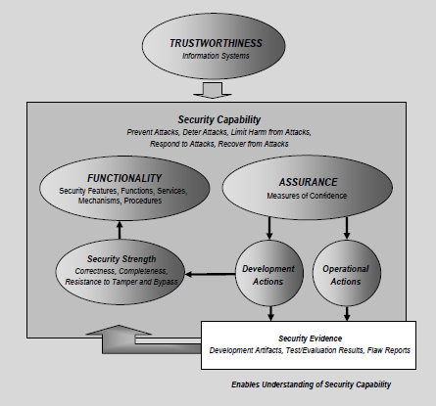
Security Control Assurance

Slide 52
Revisions And Extensions of the Control Catalog
Experience Gained from Using Controls
Changing Security Requirements
Emerging Threats, Vulnerabilities, and Attack Methods
Availability of New Technologies

Slide 53
SP 800-53 Selecting Security Controls
Subsection C.3

Slide 54
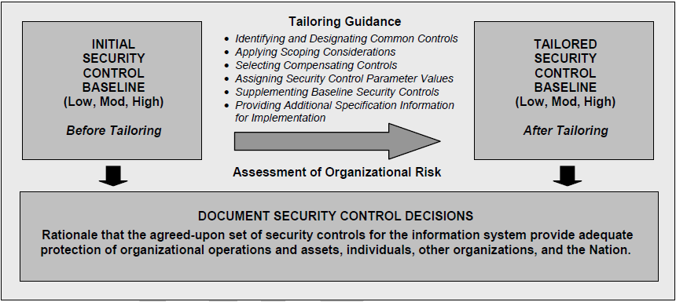
Selecting Security Controls
Selecting the Initial Set Of Baseline Security Controls
Tailoring the Baseline Security Controls
Supplementing the Tailored Baseline

Slide 55
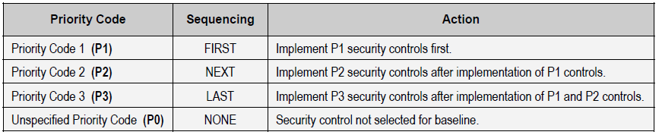
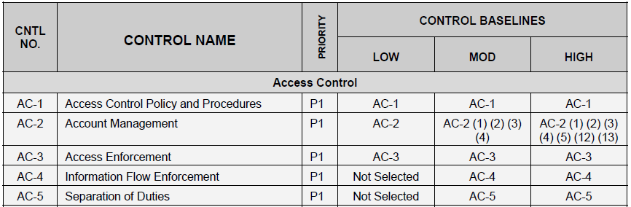
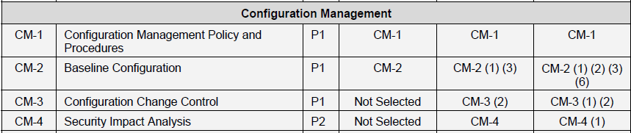

Slide 56
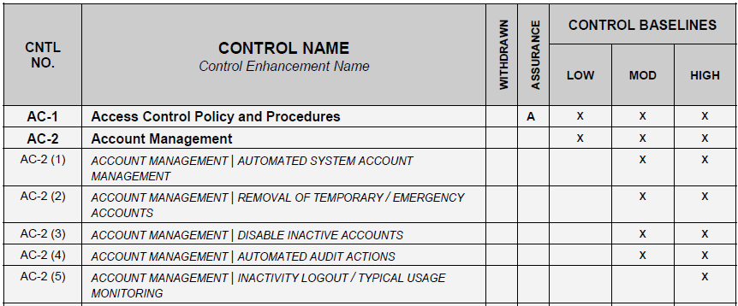
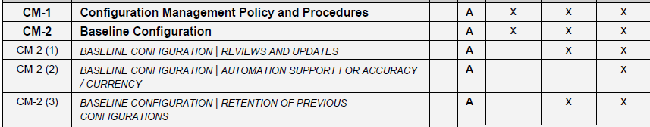

Slide 57
Tailoring Security Controls
Scoping Guidance
Compensating Security Controls
Organization-defined Parameters

Slide 58
Scoping Guidance Considerations
Common Control-related
Security Objective-related
Technology-related
Physical Infrastructure-related
Policy/Regulatory-related
Operational/Environmental-related
Scalability-related
Public Access-related
Implementing only those controls that are essential to providing the appropriate level of protection.

Slide 59
Compensating Security Controls
Used in Lieu of Recommended Control
Control Not Available
Provides Supporting Rationale
Risk Accepted with Compensating Control

Slide 60


Slide 61
Supplementing Security Controls
Advanced Persistent Threat
Cross-domain Services
Mobility
Highly Sensitive Information and Information Sharing
Application-layer Security

Slide 62
Knowledge Check
There are three levels of baseline controls that are defined by the _____________ of the information system.
What are security controls that are inheritable by one or more organizational information systems?
What are the Two key components of information security affecting the trustworthiness of information systems ?
What kind of security control is a management, operational, or technical control is employed by an organization in lieu of a recommended security control.?

Slide 63
Implementing Controls
Subsection C.4

Slide 64
Implementing Controls
NO | CNTL NAME | CC Provider | CNTL_Implementation | Platforms | Monitoring Strategy
SI-3 | Malicious Code Protection | Systems Integrity Division | Symnantec Endpoint Protection v.11 - The AntiVirus Program provides anti-virus software support to Domestic Bureaus, Consular and Executive Offices, IRM Systems Managers, Overseas Posts and Tenant Organizations Department-wide. | The contract with the Symantec Corporation for Symantec Endpoint Protection (SEP) supports the following operating system platforms: Windows File and Exchange Servers, and client workstations, Current Operating Systems (Windows NT, 2000, XP, 2003, Vista) | Anti-Virus signature file age detection is provided by SMS. The date on the signature file is compared to the current date. There is no score until a grace period of 6 days has elapsed. Beginning on day 7, a score of 6.0 is assigned for each day since the last update of the signature file. In particular, on day 7 the score is 42.0.
SI-3 | Malicious Code Protection | Systems Integrity Division | Fortinet FortiMail, FortiGate, Micro ScanMail. To protect the network backbone infrastructure, i.e., e-mail gateways and Windows Exchange Servers from penetration by hostile hacker software tools, the Department implemented network "on the fly" anti-virus software support. | Implemented network anti-virus software support using: Fortinet FortiMail - SMTP, Spam, Phishing,Fortinet FortiGate - SMTP, FTP and HTTP Scanning, Trend Micro ScanMail for Microsoft Exchange Servers - SMTP, Spam, Content Filtering.

Slide 65
Gap Analysis
Key Concepts & Vocabulary
Security Categorization
  FIPS 199: Security Categorization Standards
  SP 800-60: Mapping Types to Categories
  Categorizing Privacy Information
  SP 800-122 Protecting PII
Documentation – System Security Plan
Security Control Baseline
  FIPS 200: Minimum Security Requirements
  SP 800-53: The Fundamentals
  Selecting Controls from 800-53
  Implementing Controls

Slide 66
Lab Activity 3 – Selecting and Implementing Baseline Controls
Step 1 – Categorize Information System
Step 6 –
Monitor Controls
Step 2 –
Select Controls
Step 5 - Authorize Information System
Step 3 – Implement Controls
Step 4 –
Assess Controls

Slide 67

Questions?
Next Module: Control Assessment

